Slide 1
Pen-testers tool box series part-1: Burpsuite
A walkthrough of what is burpsuite and why it is a valuable addition to pen-testers arsenal

Slide 2
Who am I??
This one is known as “Dhina”
Likes to break things and get to know how those things work
Currently a Software Developer in Test
Security learner-Preparing for CEH, MSc Cybersecurity and OSCP simultaneously..
Loves to add more knowledge and share it
Wanna be a threat researcher/responder

Slide 3
Web app pen-testing
Process =
Scoping -> Initial site recon, determine how large the application is, how dynamic, try to assess platform, etc.
Pricing/Tooling -> Use your scope to fit your assessment into a pricing model. Usually by days of analysis.
Analysis/Hacking -> Get your hack on. Usually good to have a methodology.
Reporting -> /sigh … I mean, SUPER IMPORTANT, convey business risk, etc.

Slide 4
Why Burpsuite
Most commonly used interception proxy for web hackery.
Pay tool with Free Version that performs automatic security scan
Can also manipulate HTTP and HTTPS requests
Contains Crawler and spider
Comprised of several parts:
Proxy – Intercept and Log Requests
Spider – Discover Content
Scanner – App Vuln Scanner
Intruder – Attack Tool
Repeater – Attack Tool
Sequencer – Token Assessment
Decoder & Comparer – Auxiliary Tools

Slide 5
Burp suite and the process
Scoping: Defining the range of the test. Leads to pricing.
Spidering gives us a site map. We want to determine application complexity by how much dynamic content there is.
Right click on your domain -> Engagement tools -> Analyse Target & Find Scripts. (Spider 1st).
This gives us a better idea (sometimes only pre-authentication) how to budget/price the assessment. Spidering is not illegal. Throttle if necessary.

Slide 6
Common Hacking methodology
Open Source Intelligence Gathering
Mapping the target *
Vulnerability Assessment & Fuzzing *
Exploitation *
Session Testing *
Authentication Testing *
Logic Testing
Server Tests *
Auxiliary tests (Flash, Java, ActiveX, Web Services)
+ more… many people do different things or do their tests in different orders.
https://portswigger.net/burp/documentation/desktop/penetration-testing

Slide 7
Installation and configuration
Downloading Burp Software and your License Key
Activating your Burp License Key
Launching Burp Suite from your Desktop
Burp Suite Display Settings
Configuring your Browser to work with Burp

Slide 8
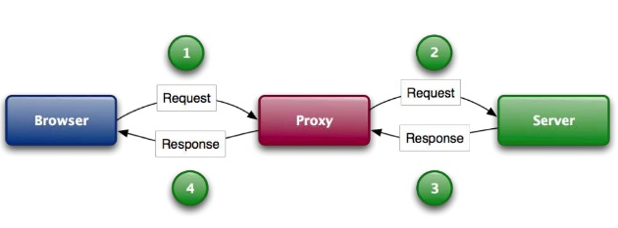
Burp suite Proxy
Man in the middle

Slide 9
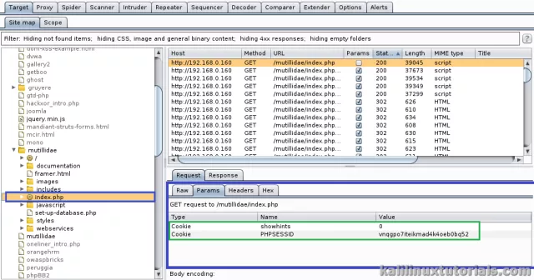
Burp Suite Sitemap
The site map aggregates all of the information that Burp has gathered about applications.
You can filter and annotate this information to help manage it, and also use the site map to drive your testing workflow.

Slide 10
Scanner
Scanners! Save time and money.
Good first step in application security.
Have lots of vetted code, attack strings, detection regex’s, auxiliary tools, teams to support and update etc…
Commercial:-Acunetix-Appscan-WebInspect-Netsparker-Burp Scanner-Nessus-CORE-Cenzic-many more…
Open-Source:-w3af-Wapiti-GrendelScan-Nikto-Websecurify-Skipfish-MetasploitWmap-Wfuzz-CAT-many more…
Predominantly this is what most scanners do… The kitchen sink approach.

Slide 11
Burp Suite Scanner
Only in professional/Enterprise edition(Pay to get stuff)
Crawling for content - This involves navigating around the application, following links, submitting forms, and logging in where necessary, to catalog the content of the application and the navigational paths within it.
Auditing for vulnerabilities - This involves analysing the application's traffic and behaviour to identify security vulnerabilities and other issues. Depending on the scan configuration, it may involve sending a large number of requests to the application.

Slide 12
Burp Suite Repeater
Manually amend and play back a message to the server.

Slide 13
Burp Suite Intruder
tool for automating customized attacks against web applications
extremely powerful and configurable, and can be used to perform a huge range of tasks, from simple brute-force guessing of web directories through to active exploitation of complex blind SQL injection vulnerabilities.
Typical uses
Enumerating identifiers
Harvesting useful data
Fuzzing for vulnerabilities

Slide 14
Burp Suite Intruder- Payload types
Sniper–sends a single payload to each of the selected parameters; i.e. each parameter is sequentially tested with the same set of variables
Battering ram –sends a single payload to all of the selected parameters at once; i.e. all parameters will be passed the first variable, followed by all Parameters being passed the second variable, and so on until the payload is completed.
Pitchfork –sends a specific payload to each of the selected parameters; i.e. all parameters need to be passed its own payload, and the variables of each payload are passed to its designated parameter in sequence.
Cluster bomb –starts with a specific payload to each parameter, and when all variables have been tested, will start testing with the payload from the next variable, such that all parameters get tested with all variables
For big lists use “runtime file” Payload set...

Slide 15
Burp Suite Decoder
encoded data into its canonical form and vice versa
Different transformations that can be used
URL
HTML
Base64
ASCII hex
Hex
Octal
Binary
GZIP
Even capable of recognising encoding formats automatically –Smart Decoding

Slide 16

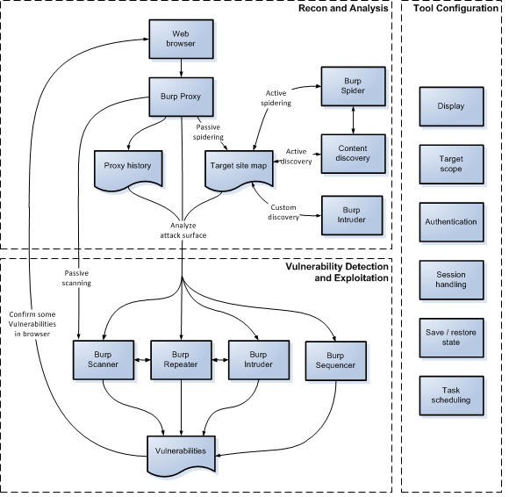

Slide 17


Verdict
Be your own scanner
Don’t be a tool, really use your tools.
Humans > machines
Sharing is caring-> If you know share it with fellow Learners

