Slide 1
Let‘s get sassy (SASE)
Kalli Schlauch, CEH, GCIH, TCSM, VC{I|P}, CCNA
Cloud and Security Architect at Trend Micro
no – this is not a sales presentation

Slide 2
SDWAN as a solution to replace MPLS
Gartner:
SASE combines network security functions (such as SWG, CASB, FWaaS and ZTNA), with WAN capabilities (i.e., SDWAN) to support the dynamic secure access needs of organizations. These capabilities are delivered primarily aaS and based upon the identity of the entity, real time context and security/compliance policies.

Slide 3
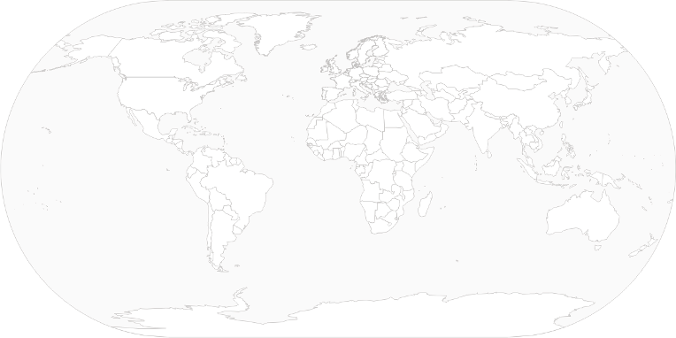
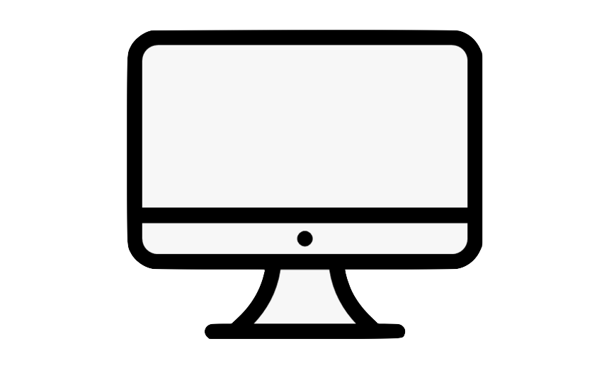


Legacy Datacenter Network Design Workforce in office connecting to services in DC

Slide 4

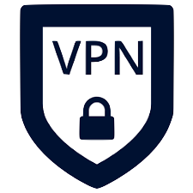
Mobile Workforce Roaming users connecting via VPN

Slide 5


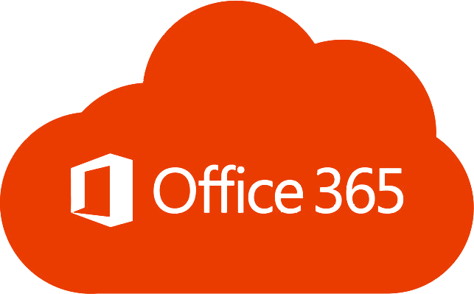


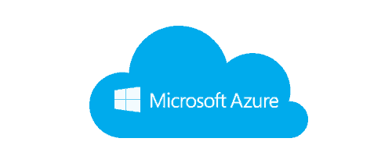

BYOD, IaaS and SaaS movement Enterprise network architectures have not kept up with the way that IT has changed
SaaS
FEDERATION
IaaS
The legacy “data center as the center of the universe” network and network security architecture is obsolete and has become an inhibitor to the needs of digital business. ​

Slide 6

Security problem to solve How to protect users, if the security estate is in Datacenter
Redirect all user traffic through Office/DC?

Slide 7
SDWAN as a solution to replace MPLS
Expensive MPLS (up to 50:1 cost leased line)
Quality of Service (bandwidth allocation VOIP)

Slide 8
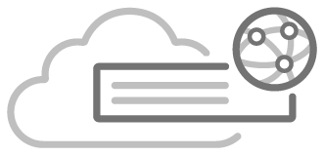
SDWAN
Controller
Key Points
HW is provided from SD-WAN Vendor
Placed on multiple cheaper Internet circuits: Leased lines, 4G/5G and or MPLS
HW is auto-configured and policies are determined centrally
SD-WAN auto establishes the mesh, routing and failover settings
Makes efficient use all circuits
Performs path selection on traffic mgmt. policy
Regain full visibility over all traffic in Enterprise Backbone
ISP C
DC2
DC1
ISP A
ISP D
ISP B
Control
DATA
ISP E
ISP F
DC3

Slide 9
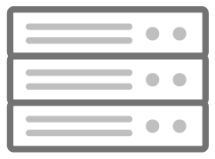









SDWAN On Premise to Managed Service
On premise SD-WAN
SD-WAN as a Service
Data Center
Internet
Regional Offices
Regional Offices
POP 1
POP N
Regional Offices
Global Private Network
Data Center
Regional Offices
Data Center
Data Center
MPLS
Optimises site to site traffic on EBB
Requires capital investment and operational overhead
Helps manage out MPLS and reduces complexity
Doesn’t optimise cloud-based applications
Optimises site to site and cloud-based application traffic
OPEX vs CAPEX model
Reduced latency vs EBB/On Premise model via Global POP's
Cost effective as Vendors using Internet Circuits vs MPLS

Slide 10
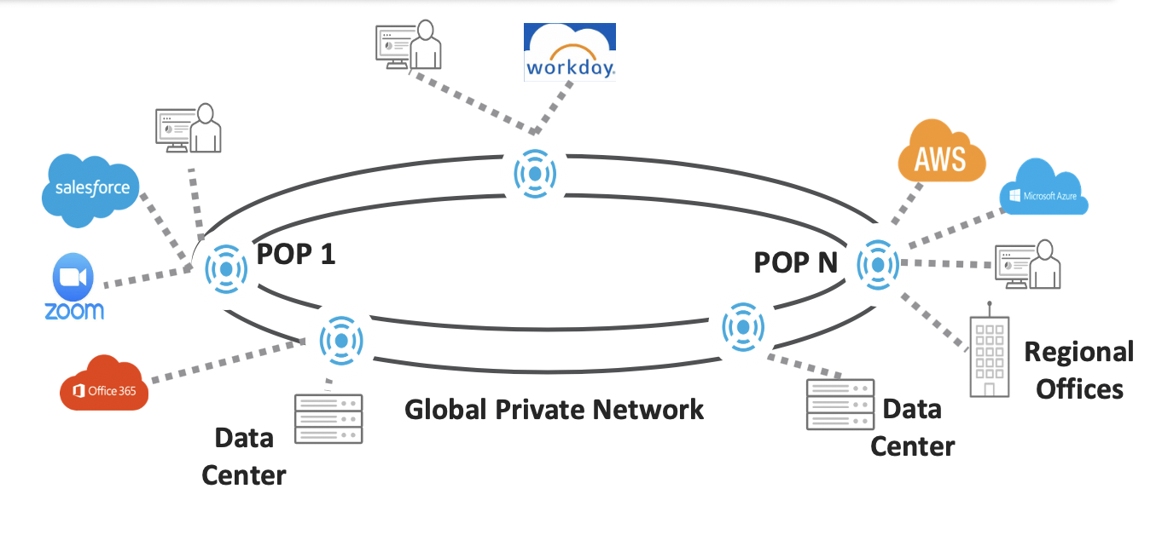
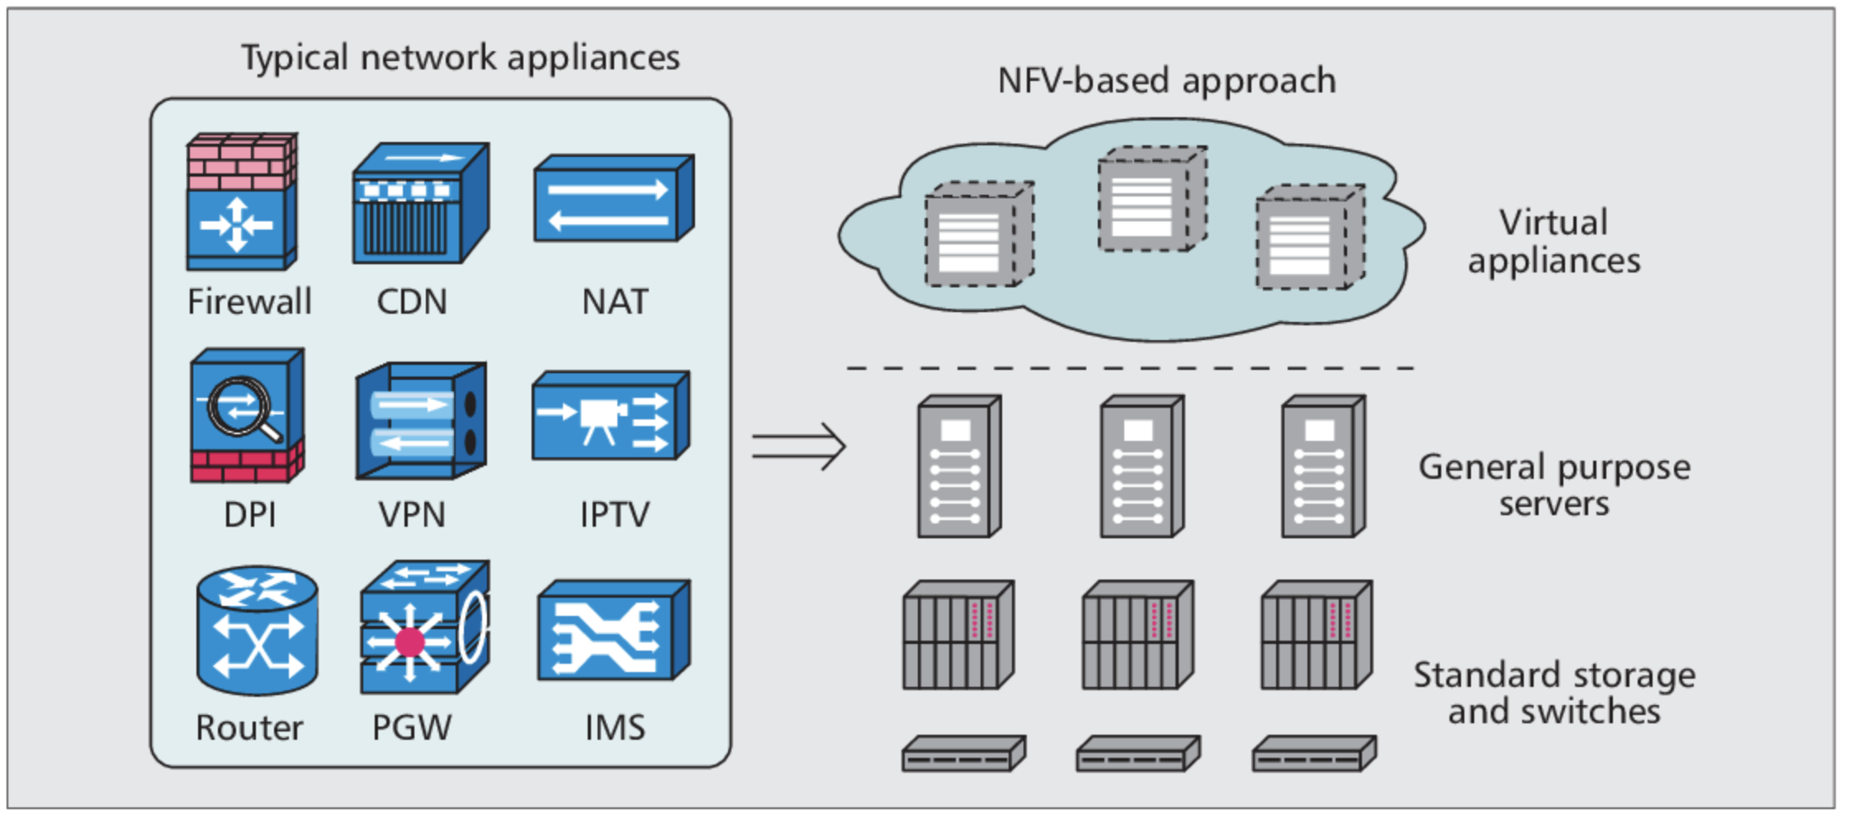
SDWAN POPs -> Network Function Virtualization
Notes:
https://www.semanticscholar.org/paper/Network-function-virtualization%3A-Challenges-and-for-Han-Gopalakrishnan/e27557e1508563701f6c04ebecff0ee49269addd

Slide 11
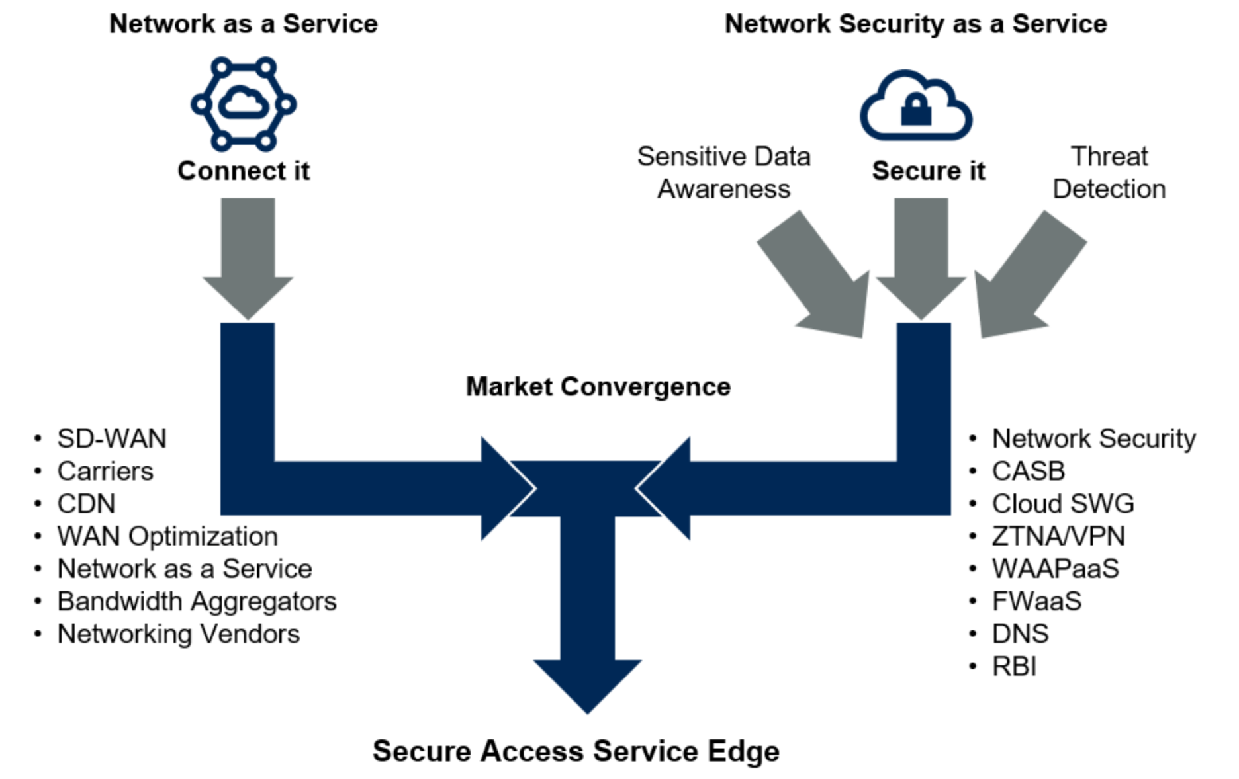
SASE Convergence
Notes:
From Gartner

Slide 12









Securing and simplifying User Access Based on zero trust
Use Cases
Known exit points - Lock down cloud service
Exit point close to service (speed)
Entry point close to user (bring your security)
Multiple entry points close to user (autoconnect, availability ->UX)
Simple definition of policy based on user, device and state
User cannot ‘see’ out of policy: Attacker wont get a response (Security, mitigate DDoS, MITM, PTH,…)
Customer can rely on SDWAN vendor to do security (offload, see next slide)
SASE
Access points entry and exit

Slide 13
Appendix

Slide 14
Terms
CARTA = Continuous Adaptive Risk and Trust Assessment
CASB = Cloud Access Security Broker
DLP = Data Loss Prevention
SASE = Secure Access Service Edge
SWG = secure web gateway
UEBA = User and Entity Behavior Analytics
VNF = Virtual Network Function
ZTNA = zero trust network access
WAAPaaS = Web Application and API Protection as a Service
RBI = Remote Browser Isolation

Slide 15
DNS Security Adaptive DNS service with security protection
Definition:
Flexible and adaptive DNS service that can deliver DNS service at edge ( branch office) to support security policy and route traffic inline as major building block of SASE framework.
In service level, offers DNS security protection to block malicious domains with algorithm-based malware, phishing, signals of C&C.
Benefits: stop the attacks earlier in the kill chain

Slide 16
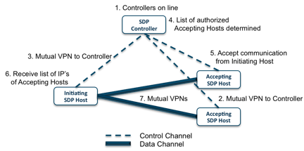
ZTNA – Zero Trust Network Access also known as SDP – Software Defined Perimeter
Technical Background:
'Server/Gateway' connects to SDP controller
Receives policy set (who can connect) rejects any communication from anyone else
'Client' connects to SDP controller
Receives list of 'Servers/accepting Hosts' and builds mutual VPN with those systems, effectively leaving other systems unscannable.

Slide 17
RBI Remote Browser Isolation
Definition:
Creates an airgap between web browser and the rest of the Internet by moving the fetch and execute functions of web browsing away from client network to cloud-based platform. Only sanitized, nonexecutable content is rendered safely in users’ devices—providing a safe yet seamless experience. Some vendor also offering seamless integration to SWG, SEG, and FWaaS.
Benefits:
Safety via isolation
It can integrate with SWG, SEG, and FWaaS to enhance overall security.

Slide 18
WAAPaaS Web Application and API Protection as a Service
Definition:
Cloud-based web application and API protection services, usually offers the following features: DDoS protection, bot mitigation, API protection and web application firewalls (WAFs).
Benefits:
globally distributed cloud service to defense outside of your perimeters.
Scale with your business.

