Slide 1
The world of pfsense
Paul Horgan @pauliehorgan
Who am I ?
My name is Paul Horgan and I work as an IT Manager for an MSP based in Cork
For those who care about such things, I currently hold CISSP and PMP certifications
Previously I have held Microsoft and Cisco accreditations
Information Security is not my full time job, yet.
I do this as a hobby, which should tell you all you need to know about my personality.
I am active on THM, HTB and Offensive Security’s proving grounds platforms
I like CTF’s and I am on twitter: @pauliehorgan

Slide 2
The world of pfsense
Paul Horgan @pauliehorgan
What is pfsense ?
Pfsense is probably best described as a Linux distribution geared to replace your internet provider router
But that’s underselling it massively.
Pfsense is also :
A router far better in quality than you’ll get from your ISP
A Firewall that far surpasses what you need for home
Its an IDS/IPS (Intrusion Detection/ Prevention System)
It’s a Pi-Hole
It’s a VPN Server (natively uses OpenVPN)
It can do High Availability (active/active failover)
It can be set to manage your VPN Certs (self signed and also Let’s Encrypt) and auto renew them
It can do packet capture (constant and triggered)
It can do captive portal for guests
It can do WAN failover, so if your primary goes down, it can kick in a secondary (including a USB stick)
It’ll do traffic shaping, to manage the available bandwidth

Slide 3
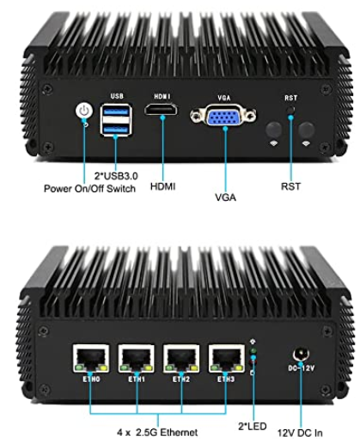
The world of pfsense
Paul Horgan @pauliehorgan
So what do you need for this :
As I said, it’s a pretty basic FreeBSD system. It can be a VM configured on your network
It can be installed on a custom PC.
Here’s my setup :
I bought the box bare, no HDD, no RAM
Its an i3-7130U, so a pretty old proc
I put a 256GB SSD in it for log retention
And 16GB of laptop RAM I had lying around

Slide 4
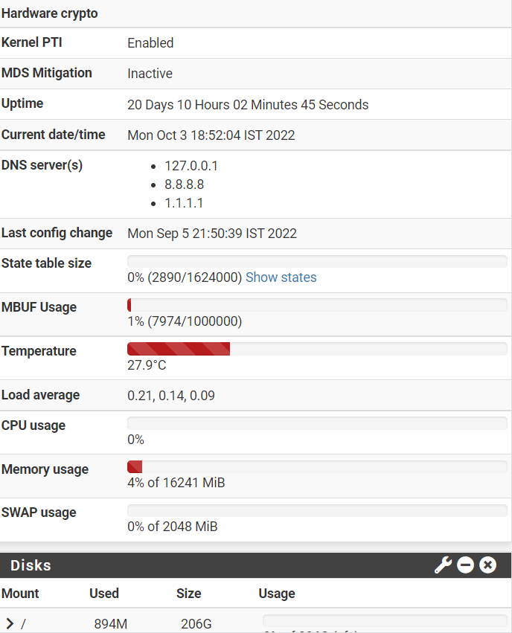
The world of pfsense
Paul Horgan @pauliehorgan
So that’s a pretty basic config.
I have a fair amount of packages configured (more on this later)
And this is what the system looks like :
As you can see, it uses next to no resources
Its happily monitoring my 1GB connection
without noticeable slow down

Slide 5
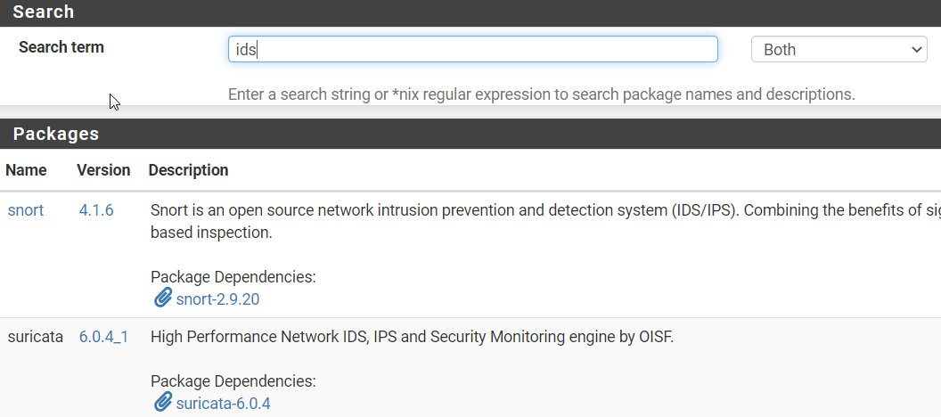
The world of pfsense
Paul Horgan @pauliehorgan
So the packages :
As you’d expect, there’s a pretty good package manager that has almost anything you’d want.
The documentation on line is better than most manufacturers give you (looking at you Cisco)
And almost everything has a Youtube tutorial to get you up and going

Slide 6
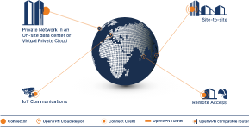
The world of pfsense
Paul Horgan @pauliehorgan
OpenVPN config
Supports point to site and site to site configurations
Supports authenticator based MFA authentication
Very easy cert based authentication and cert management
The system can be time based (only available outside office hours)
The reporting is integrated with the rest of the system logs
Because its package based, its very easy to update the server software

Slide 7
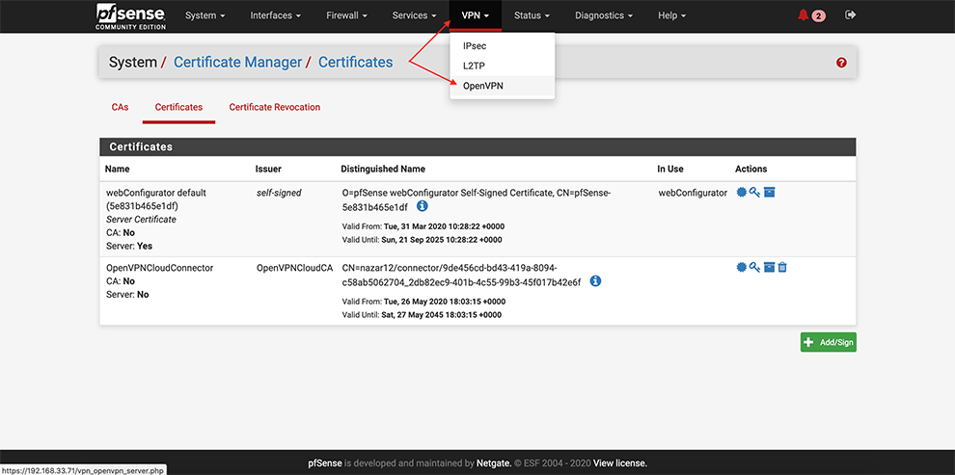
The world of pfsense
Paul Horgan @pauliehorgan

Slide 8
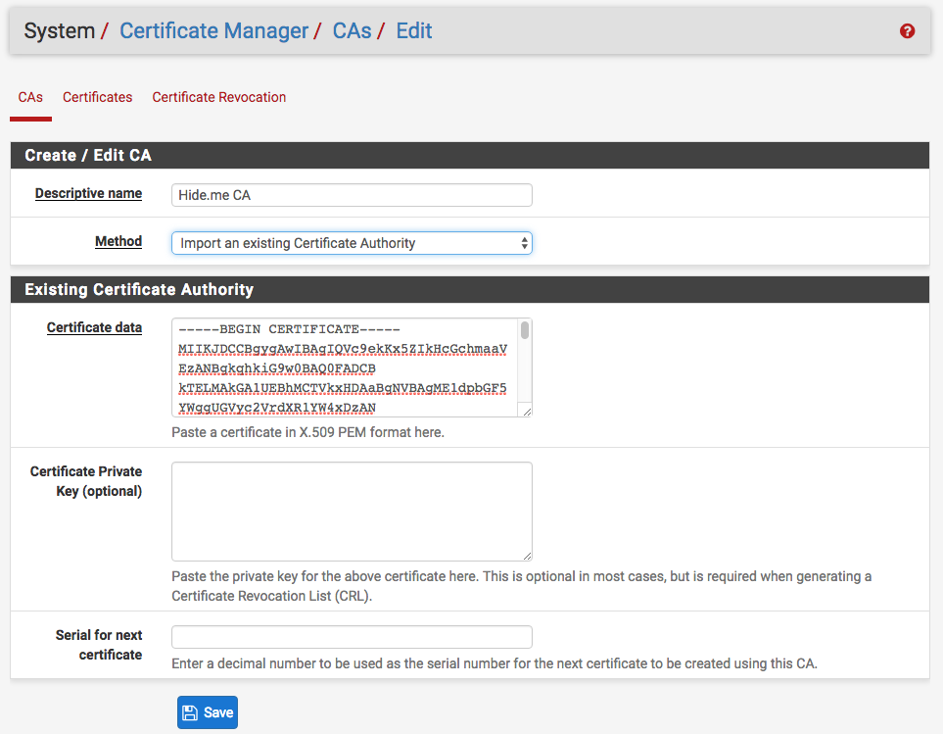
The world of pfsense
Paul Horgan @pauliehorgan

Slide 9
The world of pfsense
Paul Horgan @pauliehorgan
Ad blocking
One of the most used features is the ad blocking packages.
I’m using pfblocker, which I have set to update its domain list every hour, which runs as a Cron job
I’m also using a plugin called MaxMind, which does my GEO-IP blocking, Maxmind also gets updated hourly with domain names of known and emerging compromised IP addresses, so if I do somehow get Ransomware’d, the software can’t phone home for the key to encrypt my files. That’s the theory anyway.
See the example below for an idea of the level of reporting you can generate.

Slide 10
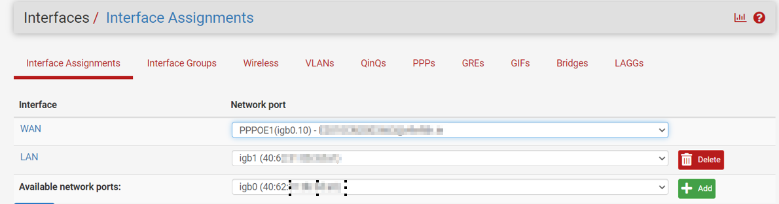
The world of pfsense
Paul Horgan @pauliehorgan
Routing:
This is as you’d imagine a fully featured router. You can assign VLANs, have specific ports follow specific Firewall rules, run multiple VPN endpoints (or instances of OpenVPN) , from the one single box.
I would recommend breaking out your network into segments and putting them on separate interfaces, but then I’m weird that way.

Slide 11
The world of pfsense
Paul Horgan @pauliehorgan
IDS/IPS
IPS and IDS are delivered by Snort or Suricata. There are pros and cons for each of these packages and the online discussions can get heated about it.
Snort is an intrusion detection and prevention system. It can be configured to simply log detected network events to both log and block them. Thanks to OpenAppID detectors and rules, Snort package enables application detection and filtering. The package is available to install in the pfSense® software GUI from System > Package Manager. Snort operates using detection signatures called rules. Snort rules can be custom created by the user, or any of several pre-packaged rule sets can be enabled and downloaded.
Important note on IDS/IPS – everything is in the ruleset(s). IDS is not a set it up and walk away exercise. There is an awful lot of false positives and rule tuning to get this working right.
One painful lesson I learned is that you don’t want to monitor the WAN port, you want the LAN port. Otherwise you wind up with a lot of noise and logs to dig through.
The Snort package currently offers support for these pre-packaged rules:
Snort VRT (Vulnerability Research Team) rules
Snort GPLv2 Community Rules
Emerging Threats Open Rules
Emerging Threats Pro Rules
OpenAppID Open detectors and rules for application detection

Slide 12
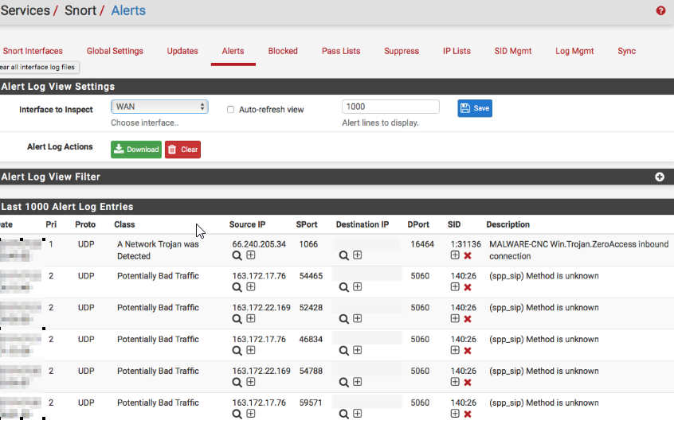
The world of pfsense
Paul Horgan @pauliehorgan
Again, the level of logging is far beyond what you’d expect from a free product, and if you aren’t careful can get out of hand fast. See below for why you don’t monitor the WAN port.
You can apply rulesets per interface so if you have a sensitive network you can add more rules, and maybe not monitor your guest network for example.

Slide 13
The world of pfsense
Paul Horgan @pauliehorgan
Traffic Shaping
Pfsense will allow you to allocate a set amount of bandwidth per device.
So it will attempt to reign in applications like Netflix from hogging all the bandwidth.
It can also be set to allow a “Daily data allowance”, again per device, so it will for instance stop your kids downloading more than 5 GB per day/week/month
You can break this out into per device, per IP, per VLAN, per subnet or per Interface

Slide 14
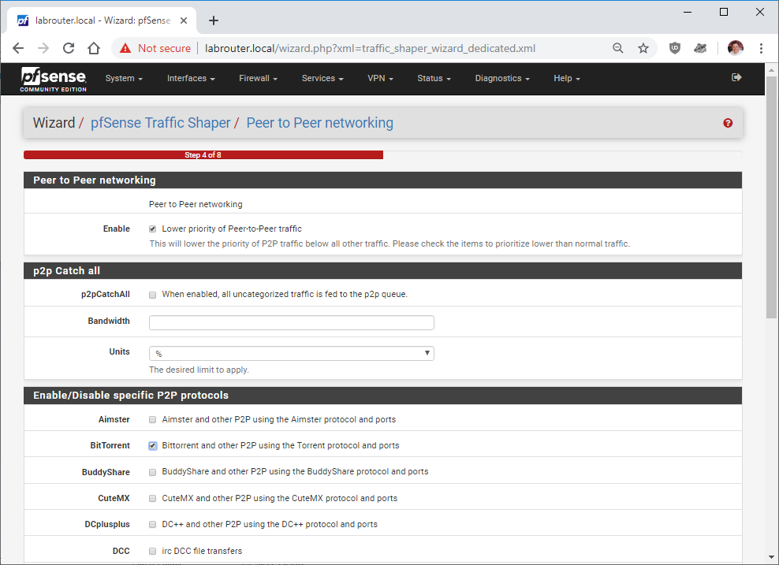
The world of pfsense
Paul Horgan @pauliehorgan

Slide 15
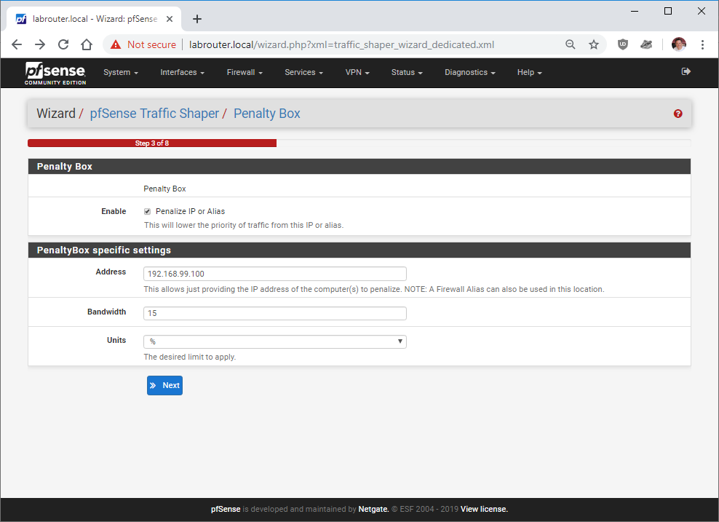
The world of pfsense
Paul Horgan @pauliehorgan

Slide 16
The world of pfsense
Paul Horgan @pauliehorgan
Packet Capture
One of the nice extras that Pfsense will do is packet capture
You can specify the capture based on:
Interface
Address family – IP V4 or V6
Protocol
Host
MAC Address
IP Address
Port
You can also specify the length of packet captured (for example if you only want the header)
You can also set it to automatically do a reverse DNS on destination or source IP from outside

Slide 17
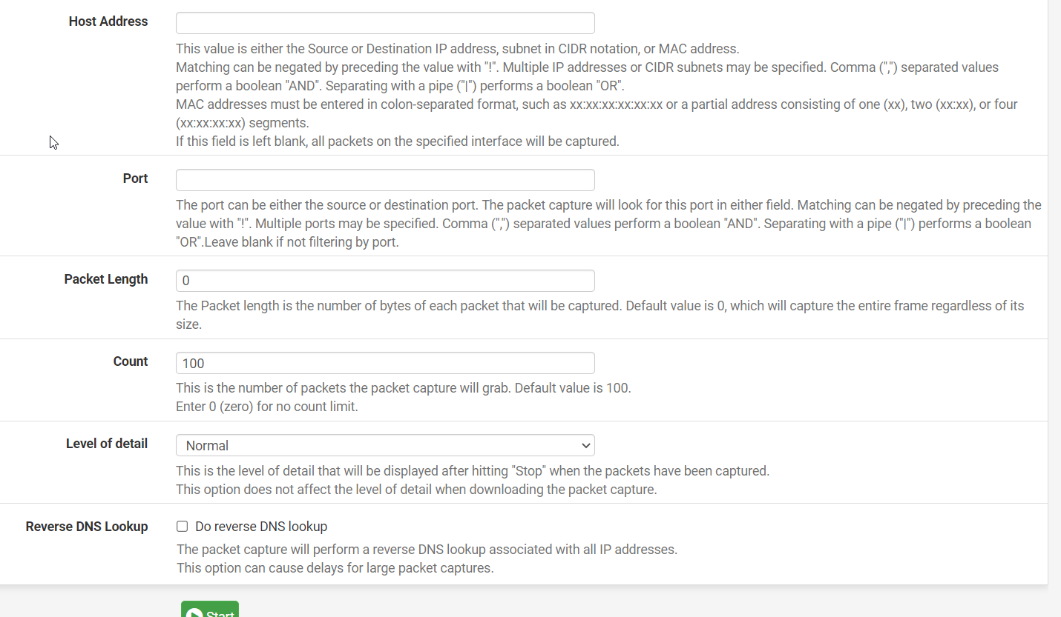
The world of pfsense
Paul Horgan @pauliehorgan

Slide 18
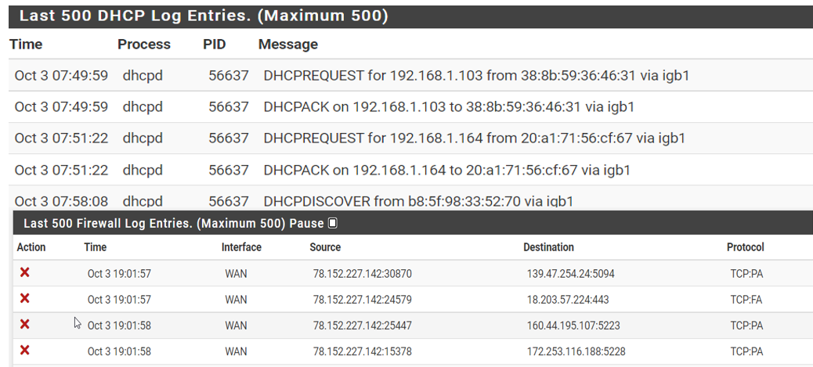
The world of pfsense
Paul Horgan @pauliehorgan
Reporting
If you are a stats junkie, this system is heaven.
It’ll monitor everything and anything that can be measured. By default it keeps the last 500 events in each log current and archives the logs weekly/monthly whatever you want

Slide 19
The world of pfsense
Paul Horgan @pauliehorgan
Alerting
As you’d expect, this system can alert via Email using SMTP, but it can also send you alerts via :
Telegram
Slack
WebSMS
SNMP
IRC
All the logs are stored in /var/logs so easy to run a cron job to automatically back them up
Pfsense also plays nice with other network monitoring software like Manage Engine
And you can of course configure the alerts to be as in depth and informative as you like

Slide 20
The world of pfsense
Paul Horgan @pauliehorgan
So That’s Pfsense.
The community edition is free
The plugins are in the main free (some require registration for API keys)
Its based on FreeBSD
You can run it as a VM on your network and route traffic through it
The VPN config is really easy, and the cert manager is good
The traffic shaping is great if you have kids
The IDS/IPS is great to have integrated with the Firewall
It updates really quickly, it can use multiple rulesets and the community reacts fast to emerging threats

Slide 21
The world of pfsense
Paul Horgan @pauliehorgan

Slide 22
The world of pfsense
Paul Horgan @pauliehorgan

