Slide 1
AUTOMATING PENETRATION TESTING USING A PYTHON-BASED TOOL

Slide 2
INTRODUCTION
Penetration testing is a process in which a cybersecurity professional tries to uncover exploits and weaknesses in an application or a network.
With the increase in number of cyber attacks there is a need of automating the penetration testing process.
The manual Penetration testing process is time-consuming and requires a lot of analysis along with user interaction.
The main objective of this research is to automate the penetration testing process and gather information that can be useful from a penetration tester’s perspective.
It will also eliminate the need to research through various tools and run them one by one and reduces the time taken for the analysis.

Slide 3
MOTIVATION
There is a need of developing a tool which can automate the entire process of penetration testing as there are very less tool developed in the past that can effectively automate the entire process.
Existing approaches of automating the penetration testing process involve mapping different tools together and extracting relevant information with no or very less intelligence involved.
The tools developed in the past focuses on automating a single or few phases of the penetration testing process and not the entire process. Also, none of the tools have implemented automation for the exploitation as it is complex to automate the exploitation phase in penetration testing.
It is much harder to implement later phases like exploitation and post-exploitation rather than initial phases scanning, information gathering, and enumeration.

Slide 4
CONTRIBUTION
The designed tool improves the performance significantly and is capable of extracting data in a report file easing the penetration testing process.
It also integrates and automates various open-source penetration testing tools to improve the process by removing manual work.
The designed tool is capable in identifying different situation automatically and require less user interaction.
The designed tool is 2 to 3 times faster than manual approaches of penetration testing.
The tool provides flexibility In terms of usage as it can be run for both an IP address and URL also it allows an individual to add different Metasploit modules based on the requirement.
The designed tool is capable of detecting even the tiniest flaws in enterprise systems.

Slide 5
RESEARCH QUESTIONS
How can we automate the existing process of penetration testing and how effective will it be when compared with the manual way?
What are the existing tools which can be used in automating the process of penetration testing and will the designed tool will be capable of generating a report which can be used in the future as well?
How different tools will be integrated such that they work in executing the entire penetration testing process?
How flexible the tool will be in terms of user input and modification when it comes to automating the process?

Slide 6
KEY LITERATURE
Papers Published | Authors | Findings
Automation of cyber-reconnaissance: A java-based open source tool for information gathering | A. Roy, L. Mejia, P. Helling, and A. Olmsted | The implementation of this tool is mainly focused on the reconnaissance phase of penetration testing.
Knowledge extraction and integration for information gathering in penetration testing | A. Kothia, B. Swar, and F. Jaafar | It identifies method for integrating and automating the tools like sublist3r used for subdomain enumeration, enumall, and masscan etc.
Improving the efficiency and effectiveness of penetration test automation | K. Haubris and J. Pauli | This script is written in python and automates different tools like TheHarvester , Metagoofil, ZAP, NMAP, Nessus, shodanhq’s API, and Metasploit.
Automation of post-exploitation | M. T. Irani and E. R. Weippl | The paper builds a prototype based on existing frameworks like Metasploit and Meterpreter and utilizes it to automate common post-exploitation tasks.

Slide 7
PROBLEM DEFINATION
Manual penetration testing has a limited scope in terms of testing the number of systems and a lengthy process.
It is also highly dependent on the tester’s abilities.
It is even more costly and requires more time in getting the final deliverables.
Manual penetration testing requires more knowledge and research about different tools and methodologies.
An inexperienced tester, or one with no prior knowledge in the organization’s industry or technology stack, may sometimes overlook critical flaws and insights

Slide 8
PROPOSED SOLUTION
Automating penetration tests can simulate the actions of a tester or a user by creating a tool, depending on the needs of the test.
Many tests can be conducted at the same time using an automated test tool.
Automated technologies allow a test to be reproduced as many times as needed, even several times per day
Testers and developers are less stressed as a result of automated testing, and they can devote their time and energy to other initiatives and activities that require human attention, such as monitoring for more sophisticated infiltration.

Slide 9
PROJECT DESIGN (i)
The tool designed uses python as a programming language to automate the entire penetration testing process.
The automation is based on the user input which can be either a URL or an IP Address.
The tool checks if the target is valid or not by performing an ICMP Scan (Ping).
If the input is a URL the script will automatically gather as much information as possible about the target by running tools like WhatWeb, dig, Nikto, dirb, sublist3r,nslookup and TheHarvester.

Slide 10
PROJECT DESIGN (ii)
Next, a Nmap scan is performed on the target for both an IP Address and a URL to identify the open ports, services, MAC address, protocol, version, operating system, and script information about the target
Based on the list of open ports and operating system information “metasploit_enum_exp.csv” file is iterated containing a list of auxiliary and exploit modules which is used in exploitation of the target.
The tool then automatically execute each and every payload until a session is created or the target is exploited.
Once a session is created the tool will perform the post-exploitation step and execute commands in order to further enumerate the target.
This tool compiles all the information at once in a report file “report.txt”.

Slide 11
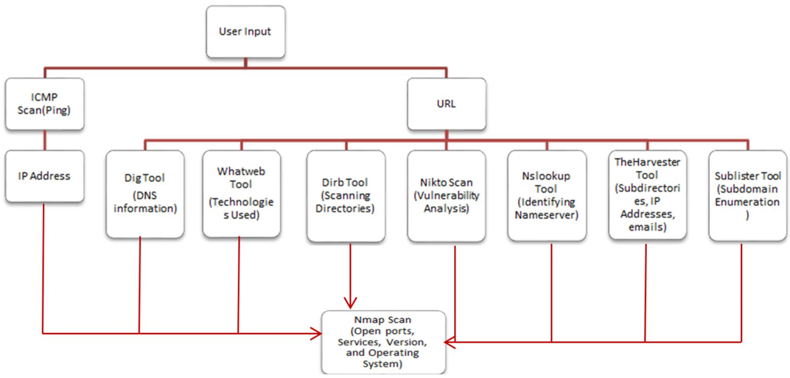
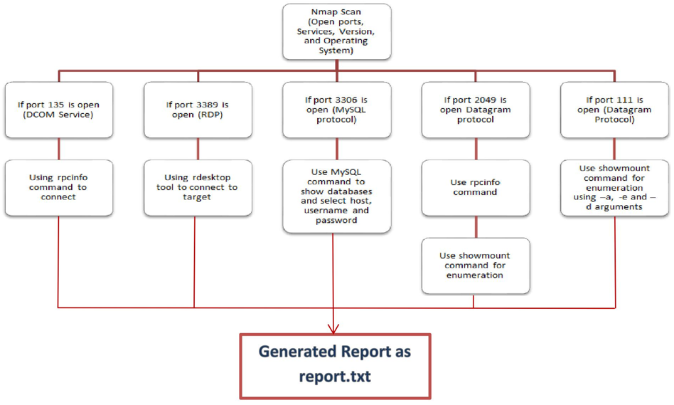
FLOW DIAGRAM (i)

Slide 12
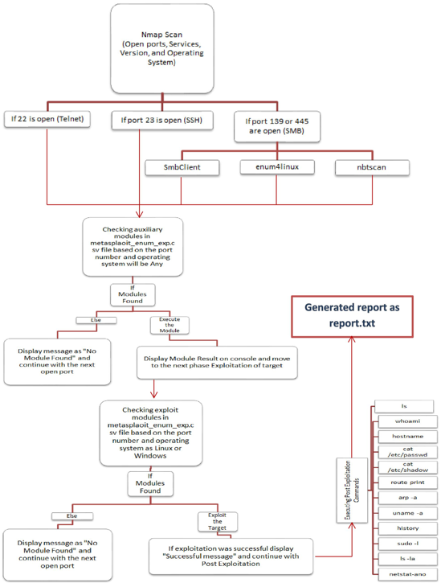
FLOW DIAGRAM (ii)

Slide 13
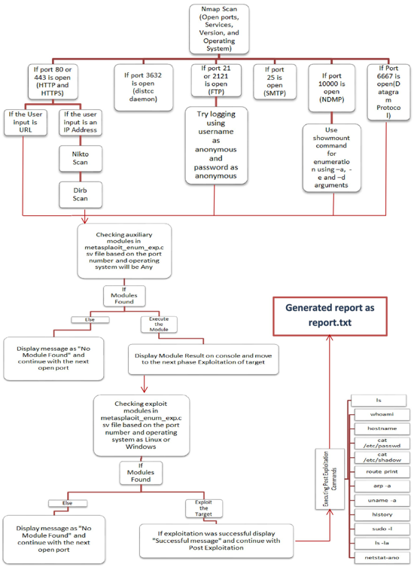
FLOW DIAGRAM (iii)

Slide 14
IMPLEMENTATION (i)
The designed tool automates the entire penetration testing process starting to check if the host is up or not, information gathering, scanning and enumeration, exploitation, post-exploitation, and reporting phase of penetration testing.
Tools like dig, whatweb, sublist3r, dirb, nikto, and harvester will collect information like DNS information, technologies used, subdirectories, vulnerability analysis, directory bursting, name servers, etc.
Every port is iterated one by one to check if there are any possible exploits or auxiliary modules present for the open ports.

Slide 15
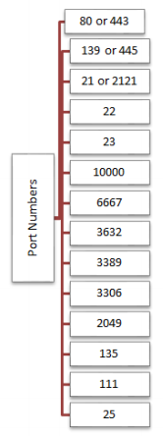
IMPLEMENTATION (ii)
The flow in which port numbers are evaluated

Slide 16
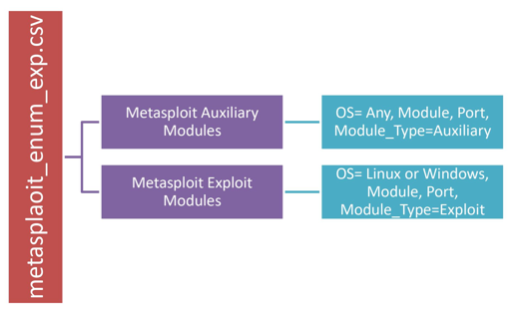
IMPLEMENTATION (iii)
Challenges Faced:
Finding a way to iterate Metasploit modules based on user flexibility.
Solution:
Automating the penetration testing process
Solution:
To overcome this problem different python libraries like nmap and pymetasploit3 are used. These libraries are specifically built for implementing Nmap and Metasploit related functionality.
Reporting
Solution:
A report directory is created using the python os library if it already doesn’t exist. Once the directory is created “report.txt” report file is created.

Slide 17
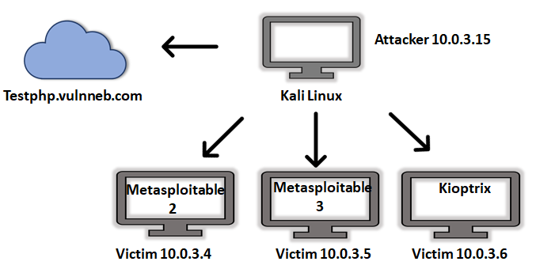
TESTING AND EVALUATION (i)

Slide 18
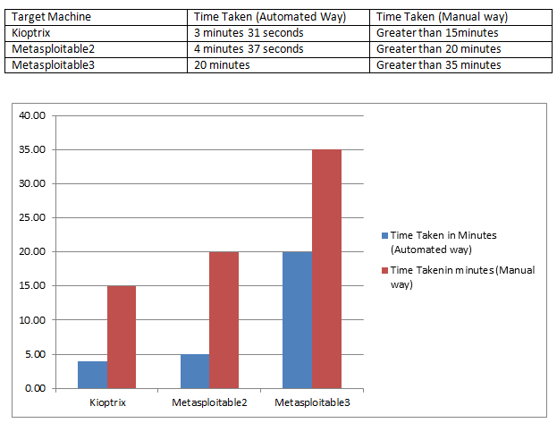
TESTING AND EVALUATION (ii)
Saves Time

Slide 19
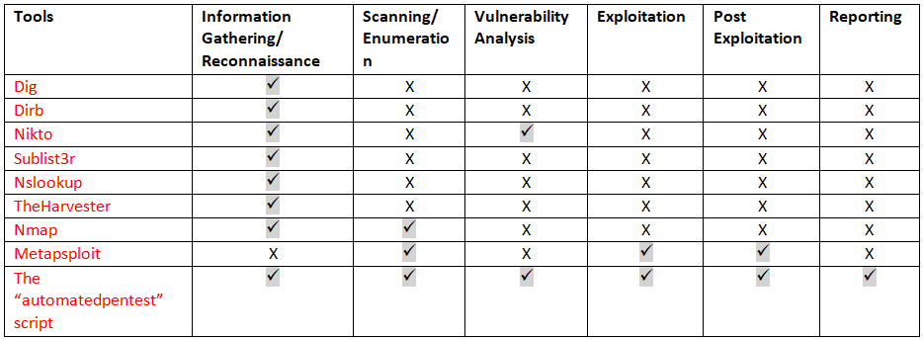
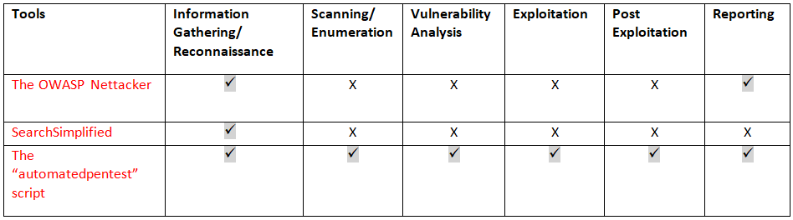
TESTING AND EVALUATION (iii)
Reliability
Comparison

Slide 20
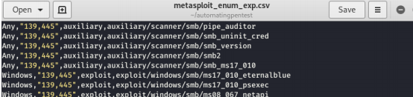
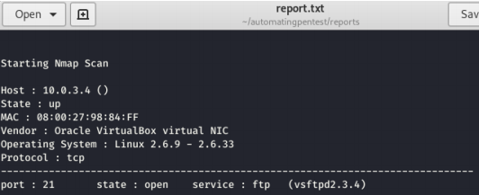
TESTING AND EVALUATION (iv)
Flexibility
The “metasploit_enum_exp.csv” file allows the user to add different modules based on port numbers and operating system
Reporting
The tool created will automatically compile all the information in a file “report.txt” thus eliminating the need to go through the output of every tool and extracting the result

Slide 21
ACHIEVED RESULT
Metasploitable 2
Successfully able to exploit the target Metasploitable 2 target using ”php_cgi_arg_injection” module and “bind_perl” payload for port 80.
Kioptrix
Successfully able to exploit the target Kioptrix target using ”trans2open” module and “bind_nonx _tcp” payload for port 80.
Metasploitable 3
Successfully able to exploit the target Metasploitable 3 target using ”ms17_010_psexec” module and VNC payload for port 139.
Testphp.vulnweb.com
Unable to exploit the target as it is not vulnerable

Slide 22
CONCLUSION
The tool successfully automates the entire penetration testing process for both a URL and an IP address as an input.
It also integrates various tools like Dig, Dirb, Sublist3r, Nikto, TheHarvester, nslookup, Nmap, and Metasploit to automate the process.
The tool is successfully able to record all the information in a report file.
It provides user flexibility to iterate through different Metasploit modules from a .csv file by using the port number, module type, module name, and operating system.
The tool is capable of iterating and executing each and every payload present for the Metasploit exploit modules until a session is created.

Slide 23
FUTURE WORK
Pivoting the Target after compromising the target
Implementing pivoting could have benefited the penetration tester as it is a complex process to be implemented even when done manually.
Integrating complex vulnerability scanners
There are various python libraries like pynessus and python-zap which can be used in automating the vulnerability scanner like Nessus and ZAP with the script.
Implementing different scan types for Nmap
It is recommended to have different types of scans like XMAS, ACK, FIN, NULL, RPC, etc. performed on the target when the target is blocking the request packets.
Implementing manual ways for exploitation
It is much efficient to automate manual ways in which the target can be exploited along with the Metasploit exploit methods.

