Slide 1


Data Loss Prevention
Protect your information and reputation
010
Rahul Krishna

Slide 2

Goal of Security is to protect assets

Slide 3
Intentional
Internal
Unintentional
Threats to data
External

Slide 4
First, why protect data?
Data breaches
Financial loss
Competitive advantage
Regulatory Compliances
Reputational Damage

Slide 5
Data Loss Prevention program:
Data discovery
Data classification
Define rules and policies
Enforce using DLP tool
Monitor and fine-tune

Slide 6




Data Discovery
Where is your data?
Manual and automated process
Who access data and how?

Slide 7

Data Classification
Identify the data to be protected
Categorize data based on criteria
Efficient management and protection
Data tagging

Slide 8
Classification
Content based
Context based

Slide 9
Data Classification
Public
Internal
Private
Confidential
Restricted

Slide 10
Described Content Matching
Exact Data Matching
Indexed Data Matching
Machine Learning
Data Classification techniques

Slide 11
Described Content Matching - DCM
Example: Detect credit cards
\d{4}(-|\s)\d{4}(-|\s)\d{4}(-|\s)\d{4}\D
Regular expressions
Keywords
File properties
PCI, PHI, PII

Slide 12
Social Security Number detection:
"^(?!666|000|9\\d{2})\\d{3}-(?!00)\\d{2}-(?!0{4})\\d{4}$"
^ represents the starting of the string.
(?!666|000|9\\d{2})\\d{3} represents the first 3 digits should not start with 000, 666, or between 900 and 999.
– represents the string followed by a hyphen (-).
(?!00)\\d{2} represents the next 2 digits should not start with 00 and it should be any from 01-99.
– represents the string followed by a hyphen (-).
(?!0{4})\\d{4} represents the next 4 digits can’t 0000 and it should be any from 0001-9999.
$ represents the ending of the string.

Slide 13
Exact Data Matching - EDM
Detect structured data transfer
Structured data fed to DLP solution to create fingerprints
Most accurate detection

Slide 14

Indexed Data Matching - IDM
Detect unstructured data
Creates document fingerprints
Generates index with multiple hashes for partial and derivate matches

Slide 15
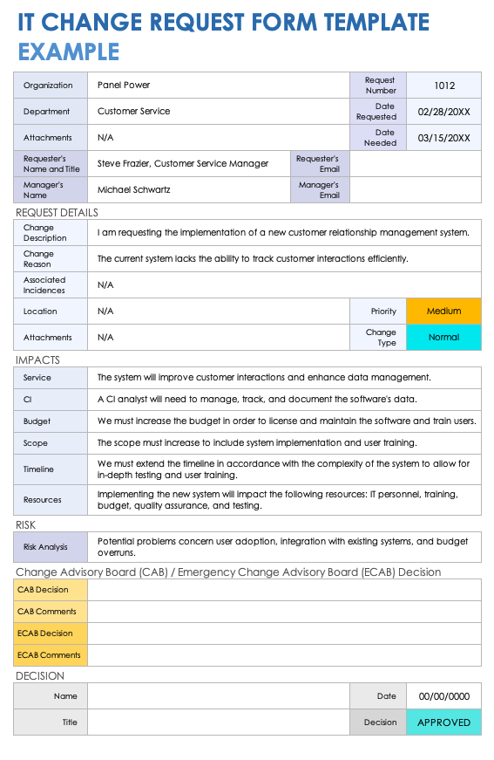
Hash 1
Hash 2
Hash 3
Hash 4

Slide 16
Stages of Data
Data in rest
Data in motion
Data in use

Slide 17
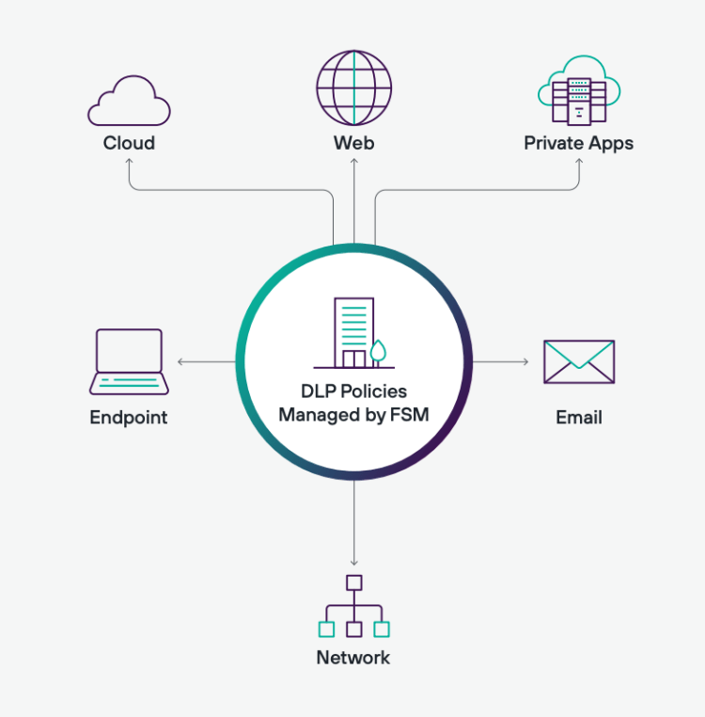
Data Loss Prevention
Enforce DLP policies and rules
Deep integration with organization infrastructure
On-prem or SaaS
Forcepoint, Trellix, Symantec, Proofpoint, Microsoft Purview

Slide 18

Endpoint DLP
Agent based detection
USB, Print, Email, Clipboard and Web uploads
On and Off the network detection

Slide 19

Network DLP
Monitor network traffic
Webmail, web apps, HTTP(S), FTP

Slide 20

Email DLP
Monitors emails for sensitive information
Allow, Quarantine or Block
Inline API Integration
Passive API Integration

Slide 21

Cloud DLP
Protect sensitive data in Cloud solutions
Integrates with Cloud providers to scan, identify and respond to sensitive data
Whitelist applications for sensitive data access

Slide 22

CASB
Cloud Access Security Broker
Enforces policies between end users and cloud environments
Monitor cloud activities – Shadow IT, Risk scores
Contextualize user and enforce rules

Slide 23
Validators, Thresholds and Keywords
Example: Detect credit cards
\d{4}(-|\s)\d{4}(-|\s)\d{4}(-|\s)\d{4}\D
Luhn checksum validator (Remainder 0)
CVV, CVC, Account, Payment, Card, Number
Threshold 10, 50-100, 100+

Slide 24
DLP Response Actions
Monitor
Quarantine
Delete
Block
Encrypt

Slide 25






Mail server
DLP Engine

Slide 26


Mail server
Quarantine/Block
DLP Engine

Slide 27


Username: Alice
Password: Pwd@2024
IP: 192.168.61.8
SSN - 489-36-8350
Notify
Quarantine
Encrypt
Delete

Slide 28
Challenges
6-12 months of monitoring
Active fine-tuning

Slide 29
Thank You

