Slide 1
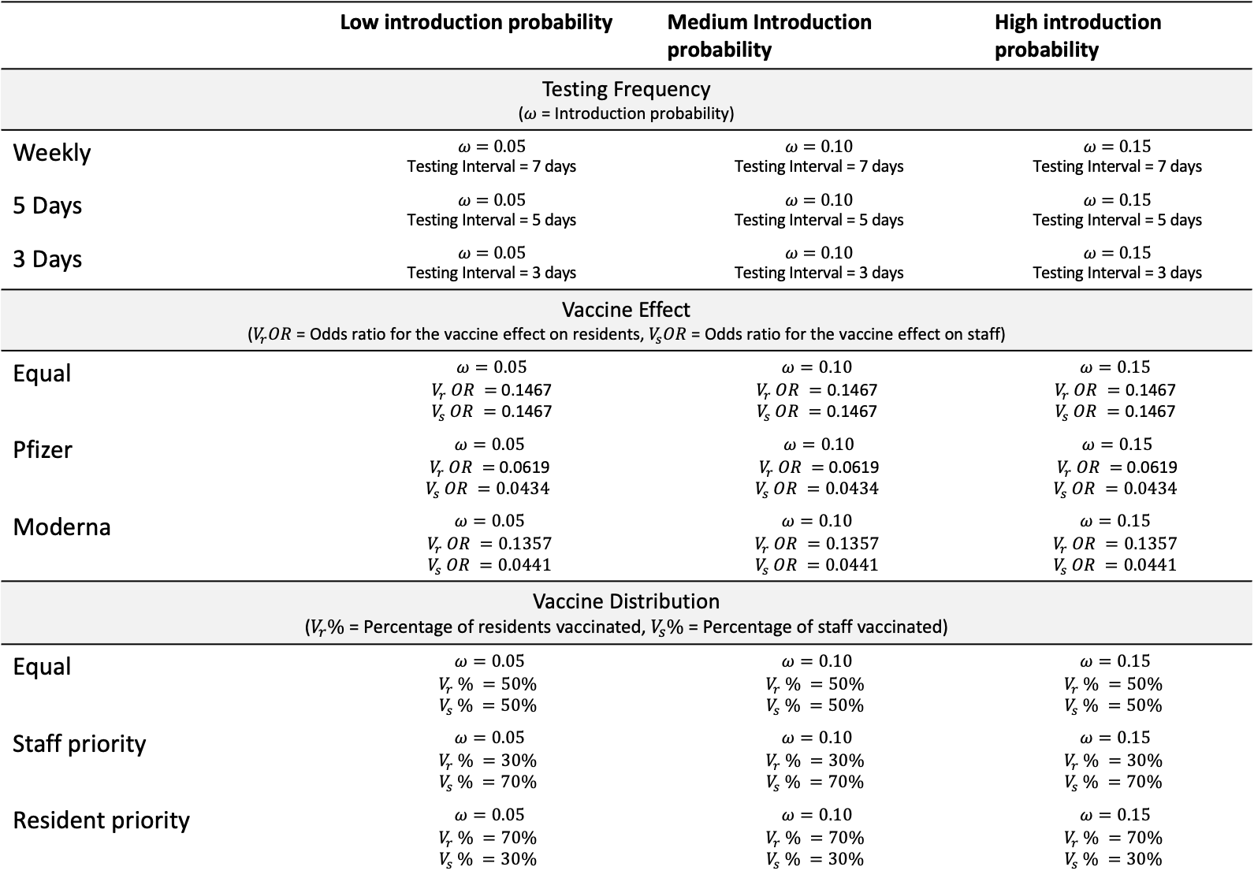
 | Low introduction probability | Medium Introduction probability | High introduction probability
Testing Frequency ($ω$ = Introduction probability)
Weekly | $$ω=0.05$$ Testing Interval = 7 days | $$ω=0.10$$ Testing Interval = 7 days | $$ω=0.15$$ Testing Interval = 7 days
5 Days | $$ω=0.05$$ Testing Interval = 5 days | $$ω=0.10$$ Testing Interval = 5 days | $$ω=0.15$$ Testing Interval = 5 days
3 Days | $$ω=0.05$$ Testing Interval = 3 days | $$ω=0.10$$ Testing Interval = 3 days | $$ω=0.15$$ Testing Interval = 3 days
Vaccine Effect ($V_{r}OR$ = Odds ratio for the vaccine effect on residents, $V_{s}OR$ = Odds ratio for the vaccine effect on staff)
Equal | $$ω=0.05$$ $V_{r} OR =$0.1467 $$V_{s} OR =\text{0.1467}$$ | $$ω=0.10$$ $$V_{r} OR =\text{0.1467}$$ $$V_{s} OR =\text{0.1467}$$ | $$ω=0.15$$ $$V_{r} OR =\text{0.1467}$$ $$V_{s} OR =\text{0.1467}$$
Pfizer | $$ω=0.05$$ $V_{r} OR =$0.0619 $$V_{s} OR =0.0434$$ | $$ω=0.10$$ $V_{r} OR =$0.0619 $$V_{s} OR =0.0434$$ | $$ω=0.15$$ $V_{r} OR =$0.0619 $$V_{s} OR =0.0434$$
Moderna | $$ω=0.05$$ $$V_{r} OR =0.1357$$ $$V_{s} OR =0.0441$$ | $$ω=0.10$$ $$V_{r} OR =0.1357$$ $$V_{s} OR =0.0441$$ | $$ω=0.15$$ $$V_{r} OR =0.1357$$ $$V_{s} OR =0.0441$$
Vaccine Distribution ($V_{r}\%$ = Percentage of residents vaccinated, $V_{s}\%$ = Percentage of staff vaccinated)
Equal | $$ω=0.05$$ $$V_{r} \% =50\%$$ $$V_{s} \% =50\%$$ | $$ω=0.10$$ $$V_{r} \% =50\%$$ $$V_{s} \% =50\%$$ | $$ω=0.15$$ $$V_{r} \% =50\%$$ $$V_{s} \% =50\%$$
Staff priority | $$ω=0.05$$ $$V_{r} \% =30\%$$ $$V_{s} \% =70\%$$ | $$ω=0.10$$ $$V_{r} \% =30\%$$ $$V_{s} \% =70\%$$ | $$ω=0.15$$ $$V_{r} \% =30\%$$ $$V_{s} \% =70\%$$
Resident priority | $$ω=0.05$$ $$V_{r} \% =70\%$$ $$V_{s} \% =30\%$$ | $$ω=0.10$$ $$V_{r} \% =70\%$$ $$V_{s} \% =30\%$$ | $$ω=0.15$$ $$V_{r} \% =70\%$$ $$V_{s} \% =30\%$$

Slide 2
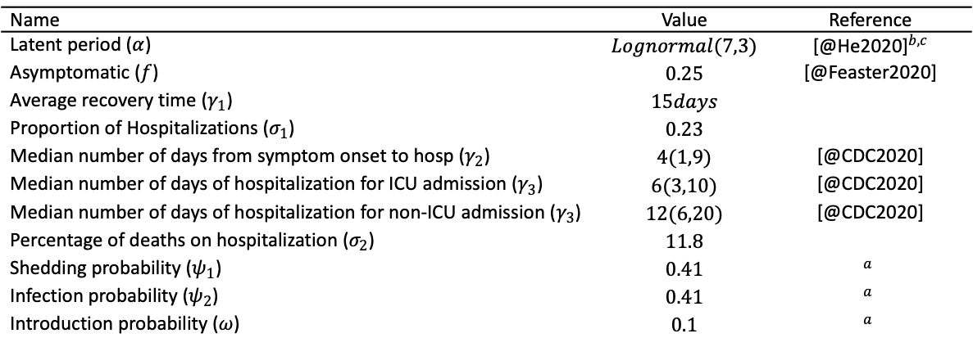
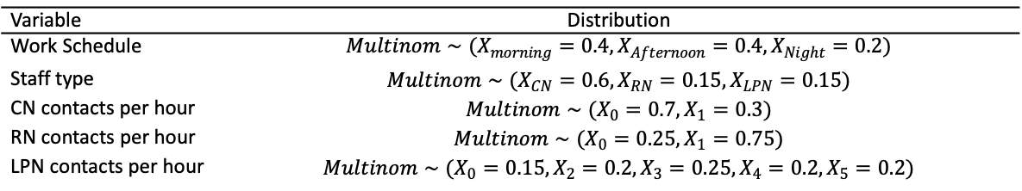
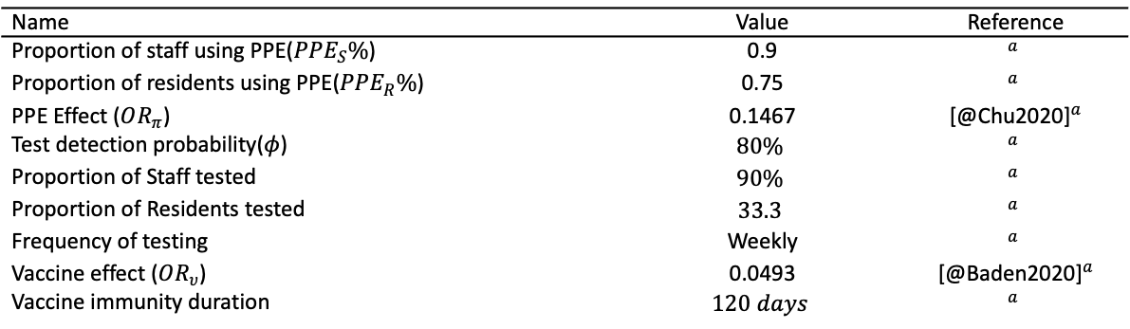
Name | Value | Reference
Latent period ($α$) | $$Lognormal(7,3)$$ | [@He2020]$​^{b,c}$
Asymptomatic ($f$) | $$0.25$$ | [@Feaster2020]
Average recovery time ($γ_{1}$) | $$15days$$
Proportion of Hospitalizations ($σ_{1}$) | $$0.23$$
Median number of days from symptom onset to hosp ($γ_{2}$) | $$4(1,9)$$ | [@CDC2020]
Median number of days of hospitalization for ICU admission ($γ_{3}$) | $$6(3,10)$$ | [@CDC2020]
Median number of days of hospitalization for non-ICU admission ($γ_{3}$) | $$12(6,20)$$ | [@CDC2020]
Percentage of deaths on hospitalization ($σ_{2}$) | $$11.8$$
Shedding probability ($ψ_{1}$) | $$0.41$$ | $$​^{a}$$
Infection probability ($ψ_{2}$) | $$0.41$$ | $$​^{a}$$
Introduction probability ($ω$) | $$0.1$$ | $$​^{a}$$
Name | Value | Reference
Proportion of staff using PPE($PPE_{S}\%$) | 0.9 | $$​^{a}$$
Proportion of residents using PPE($PPE_{R}\%$) | 0.75 | $$​^{a}$$
PPE Effect ($OR_{π}$) | 0.1467 | [@Chu2020]$​^{a}$
Test detection probability($φ$) | $$80\%$$ | $$​^{a}$$
Proportion of Staff tested | $$90\%$$ | $$​^{a}$$
Proportion of Residents tested | $$33.3$$ | $$​^{a}$$
Frequency of testing | Weekly | $$​^{a}$$
Vaccine effect ($OR_{υ}$) | 0.0493 | [@Baden2020]$​^{a}$
Vaccine immunity duration | $$120 days$$ | $$​^{a}$$
Variable | Distribution
Work Schedule | $$Multinom∼(X_{morning}=0.4,X_{Afternoon}=0.4,X_{Night}=0.2)$$
Staff type | $$Multinom∼(X_{CN}=0.6,X_{RN}=0.15,X_{LPN}=0.15)$$
CN contacts per hour | $$Multinom∼(X_{0}=0.7,X_{1}=0.3)$$
RN contacts per hour | $$Multinom∼(X_{0}=0.25,X_{1}=0.75)$$
LPN contacts per hour | $$Multinom∼(X_{0}=0.15,X_{2}=0.2,X_{3}=0.25,X_{4}=0.2,X_{5}=0.2)$$

Slide 3
Scenario | Value used
Disease Transmission
Low transmission | 0.38
High transmission | 0.45
Introduction Probability
Low Introduction Probability | 0.05
High Introduction Probability | 0.15
Detection Probability
Low Detection Probability | 0.7
High Detection Probability | 0.90
PPE effect
High effect PPE | 0.0722
Low effect PPE | 0.3408
Testing Frequency
Every 5 days | every 5 days
Every 3 days | every 3 days

Slide 4
Scenario | Epidemic Length | Infection Rate | Total Infected | Infected residents | Infected staff | Hospitalizations | Deaths
Baseline | 24.5 (7,49) | 0.22 (0,0.49) | 75.5 (1.45,168.05) | 40.5 (0,106.65) | 29 (1,64) | 5 (0,17) | 0 (0,2)
Low transmission | 21 (7,59.85) | 0.08 (0,0.35) | 29 (1.45,119.65) | 16.5 (0,79.55) | 15 (1,48.3) | 2.5 (0,17.1) | 0 (0,2.55)
High transmission | 21 (7,42) | 0.37 (0.01,0.52) | 127 (5,180.55) | 82.5 (1.45,112) | 49.5 (3,68.55) | 13 (0,22.2) | 1 (0,3.55)
Low Introduction Probability | 20 (7,42) | 0.03 (0,0.51) | 11.5 (1,176.45) | 7 (0,115.65) | 5.5 (0,58.05) | 1 (0,19.75) | 0 (0,2)
High Introduction Probability | 28 (14,74.1) | 0.28 (0.02,0.49) | 97.5 (7.9,169.25) | 52 (2,106.1) | 38 (6.45,65) | 8.5 (0.45,18.55) | 0.5 (0,2)
Low Detection Probability | 28 (7,61) | 0.28 (0,0.56) | 97 (1.45,193.75) | 60.5 (0,118.7) | 38.5 (1,74.5) | 9 (0,20.75) | 0 (0,3)
High Detection Probability | 26.5 (7,42) | 0.16 (0,0.4) | 54 (1.45,139.2) | 34.5 (0,93.45) | 20.5 (1,48) | 5 (0,15.1) | 0 (0,3)
High effect PPE | 14 (7,60) | 0.02 (0,0.26) | 6 (1,88.55) | 2 (0,54.5) | 5 (1,39.65) | 1 (0,9.55) | 0 (0,1)
Low effect PPE | 20.5 (14,31.3) | 0.79 (0.59,0.94) | 271.5 (201.95,324.7) | 168 (116.95,203.75) | 103 (74.9,125) | 21 (9.9,33.1) | 1 (0,4)
Every 5 days | 20 (5,52.4) | 0.07 (0.01,0.45) | 25 (2.2,153.4) | 13 (0,87.4) | 12 (2,60.4) | 3 (0,18.6) | 0 (0,2)
Every 3 days | 12 (3,39.6) | 0.03 (0,0.17) | 9 (1,59) | 1 (0,36.4) | 5 (1,24.4) | 1 (0,5.8) | 0 (0,0.8)
Same vaccine effect | 11.5 (7,30.75) | 0.01 (0,0.1) | 4 (1,33.3) | 0.5 (0,19) | 3 (1,15.65) | 0 (0,3) | 0 (0,0.55)
Pfizer | 10 (7,35) | 0.01 (0,0.09) | 4 (1,30.75) | 0 (0,17) | 3 (1,16) | 0 (0,4) | 0 (0,1)
Moderna | 14 (7,34.55) | 0.01 (0,0.12) | 4.5 (1,41.5) | 1 (0,23.3) | 3.5 (1,14.55) | 0.5 (0,4) | 0 (0,0.55)

Slide 5
Scenario | Epidemic Length | Infection Rate | Total Infected | Infected residents | Infected staff | Hospitalizations | Deaths
Testing Frequency
High introduction probability, 7-day testing interval (HI_7) | 14 (7,66.85) | 0.04 (0.01,0.17) | 15 (3,60.1) | 5 (0,32.2) | 8 (2,28.55) | 1 (0,7.1) | 0 (0,1)
High introduction probability, 5-day testing interval (HI_5) | 15 (5,40) | 0.02 (0,0.08) | 8 (1,28.75) | 2 (0,15.85) | 6 (1,15) | 0.5 (0,3.55) | 0 (0,1)
High introduction probability, 3-day testing interval (HI_3) | 11 (3,24) | 0.01 (0,0.05) | 5 (1,15.65) | 1 (0,6.55) | 4 (1,12.1) | 0 (0,2) | 0 (0,0)
Medium introduction probability, 7-day testing interval (MI_7) | 10.5 (7,35) | 0.01 (0,0.16) | 4 (1,53.65) | 1 (0,33.1) | 4 (1,21.65) | 0 (0,6.55) | 0 (0,1)
Medium introduction probability, 5-day testing interval (MI_5) | 15 (5,35) | 0.02 (0,0.1) | 6.5 (1,34.15) | 1.5 (0,16.65) | 5 (1,14.2) | 0.5 (0,3.1) | 0 (0,1)
Medium introduction probability, 3-day testing interval (MI_3) | 9 (3,24.55) | 0.01 (0,0.05) | 3 (0.45,17.4) | 0 (0,8.1) | 2 (0.45,10) | 0 (0,2) | 0 (0,0)
Low introduction probability, 7-day testing interval (LI_7) | 12.5 (7,34.1) | 0.01 (0,0.09) | 3.5 (0,31.4) | 0.5 (0,18.4) | 2 (0,13) | 1 (0,3.1) | 0 (0,0.55)
Low introduction probability, 5-day testing interval (LI_5) | 10 (5,26.1) | 0.01 (0,0.05) | 2 (0,17.55) | 1 (0,9.55) | 1 (0,8.55) | 0 (0,2.55) | 0 (0,0.55)
Low introduction probability, 3-day testing interval (LI_3) | 9 (3,17.55) | 0.01 (0,0.03) | 2 (0,10.2) | 0 (0,4.55) | 1 (0,4) | 0 (0,1.55) | 0 (0,0)
Vaccine Distribution
High introduction probability, Equal distribution (HI_E) | 14 (7,59.85) | 0.04 (0.01,0.2) | 12.5 (3,67.2) | 4.5 (0,41.85) | 9 (2,29.65) | 1 (0,7.55) | 0 (0,1)
High introduction probability, Resident priority (HI_R) | 21 (7,51.95) | 0.04 (0.01,0.13) | 14.5 (2.45,45.1) | 4 (0,19.55) | 9 (2,32.3) | 1 (0,5) | 0 (0,1)
High introduction probability, Staff priority (HI_S) | 20.5 (7,49) | 0.03 (0,0.17) | 10 (1,60) | 2 (0,37) | 7 (1,23) | 1 (0,10.65) | 0 (0,1)
Medium introduction probability, Equal distribution (MI_E) | 14 (7,41.6) | 0.02 (0,0.14) | 6 (1,47.2) | 1 (0,29.3) | 4 (1,18.2) | 0.5 (0,5.65) | 0 (0,1)
Medium introduction probability, Resident priority (MI_R) | 14 (7,45.85) | 0.01 (0,0.16) | 5 (1,54.55) | 1.5 (0,29.3) | 4 (1,28) | 1 (0,7.65) | 0 (0,0.55)
Medium introduction probability, Staff priority (MI_S) | 13.5 (7,56) | 0.01 (0,0.13) | 4.5 (1,45.65) | 1 (0,24.3) | 3 (1,20) | 0.5 (0,6) | 0 (0,1)
Low introduction probability, Equal distribution (LI_E) | 11.5 (7,35) | 0.01 (0,0.1) | 3 (0,32.75) | 0.5 (0,20.55) | 2 (0,14.55) | 1 (0,2) | 0 (0,1)
Low introduction probability, Resident priority (LI_R) | 14 (7,42) | 0.02 (0,0.14) | 6.5 (1,48.85) | 2 (0,28.1) | 4 (1,22.65) | 1 (0,5.1) | 0 (0,1)
Low introduction probability, Staff priority (LI_S) | 11.5 (7,41.1) | 0.01 (0,0.11) | 4 (1,38.2) | 1 (0,21) | 3 (1,17.1) | 0 (0,5.55) | 0 (0,1)
Vaccine Effect
High introduction probability, Equal effect (HI_E) | 21 (7,59.85) | 0.04 (0.01,0.13) | 14 (3,44.75) | 4.5 (0,23) | 9.5 (3,26) | 1 (0,4) | 0 (0,1)
High introduction probability, Pfizer OR (HI_P) | 21 (7,58.75) | 0.05 (0.01,0.12) | 17.5 (3,42.3) | 5 (0,20.55) | 10.5 (2.45,26.1) | 1 (0,5) | 0 (0,1)
High introduction probability, Moderna OR (HI_M) | 14 (7,63) | 0.05 (0.01,0.13) | 16.5 (3,46.1) | 5 (0,23.75) | 9.5 (2,29.55) | 1 (0,6.65) | 0 (0,1)
Medium introduction probability, Equal effect (MI_E) | 11.5 (7,30.75) | 0.01 (0,0.1) | 4 (1,33.3) | 0.5 (0,19) | 3 (1,15.65) | 0 (0,3) | 0 (0,0.55)
Medium introduction probability, Pfizer OR (MI_P) | 10 (7,35) | 0.01 (0,0.09) | 4 (1,30.75) | 0 (0,17) | 3 (1,16) | 0 (0,4) | 0 (0,1)
Medium introduction probability, Moderna OR (MI_M) | 14 (7,34.55) | 0.01 (0,0.12) | 4.5 (1,41.5) | 1 (0,23.3) | 3.5 (1,14.55) | 0.5 (0,4) | 0 (0,0.55)
Low introduction probability, Equal effect (LI_E) | 9 (7,28) | 0.01 (0,0.07) | 2 (0,23.05) | 0 (0,14.7) | 1 (0,8.65) | 0 (0,2.55) | 0 (0,0)
Low introduction probability, Pfizer OR (LI_P) | 10 (7,28) | 0.01 (0,0.09) | 2 (0,32.55) | 0 (0,22.8) | 1 (0,10.65) | 0 (0,3.65) | 0 (0,0)
Low introduction probability, Moderna OR (LI_M) | 11.5 (7,34.1) | 0.01 (0,0.07) | 2.5 (0,23.2) | 0 (0,13.1) | 2 (0,11.2) | 0.5 (0,2.55) | 0 (0,0.55)

