Slide 1
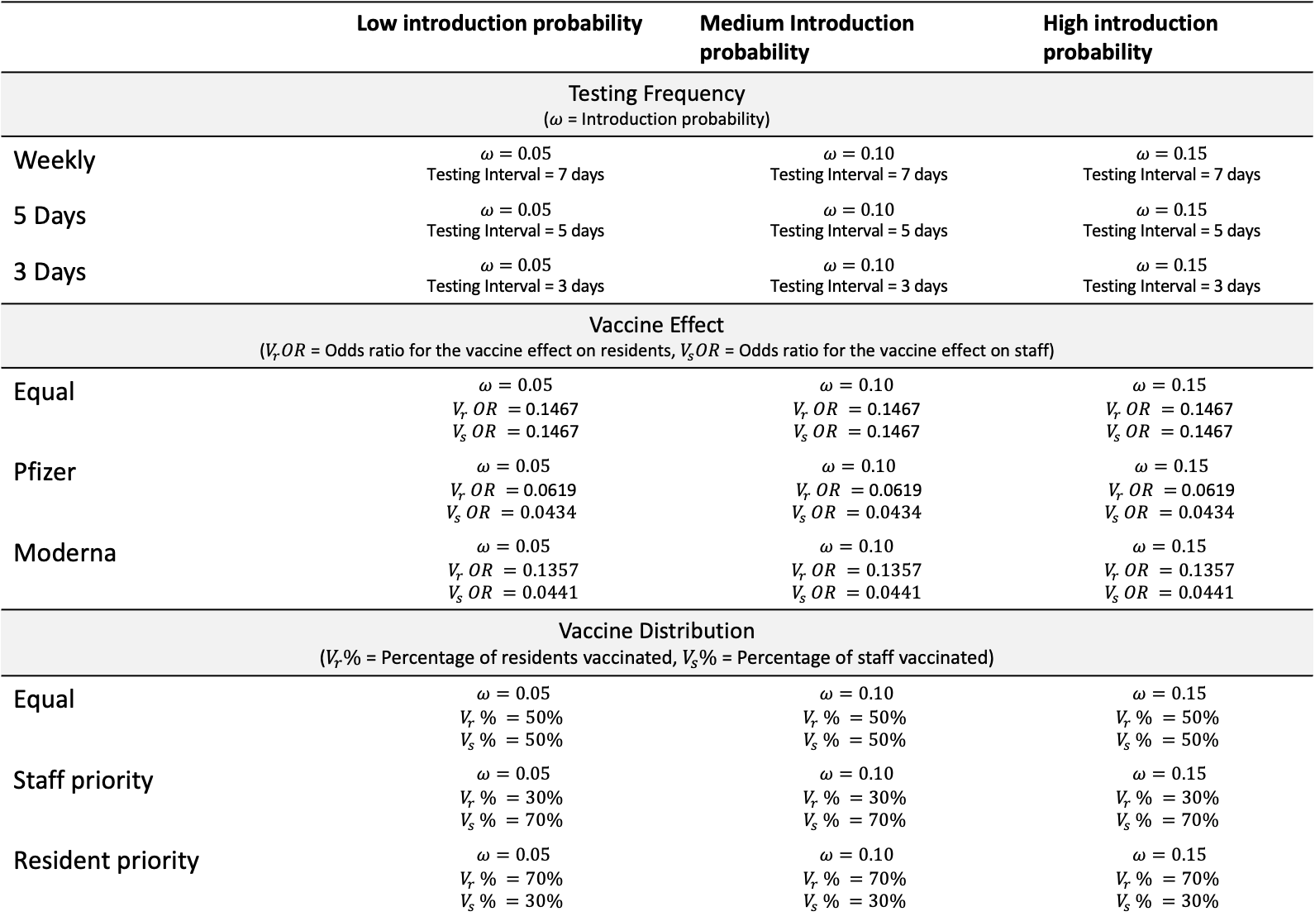
 | Low introduction probability | Medium Introduction probability | High introduction probability
Testing Frequency ($ω$ = Introduction probability)
Weekly | $$ω=0.05$$ Testing Interval = 7 days | $$ω=0.10$$ Testing Interval = 7 days | $$ω=0.15$$ Testing Interval = 7 days
5 Days | $$ω=0.05$$ Testing Interval = 5 days | $$ω=0.10$$ Testing Interval = 5 days | $$ω=0.15$$ Testing Interval = 5 days
3 Days | $$ω=0.05$$ Testing Interval = 3 days | $$ω=0.10$$ Testing Interval = 3 days | $$ω=0.15$$ Testing Interval = 3 days
Vaccine Effect ($V_{r}OR$ = Odds ratio for the vaccine effect on residents, $V_{s}OR$ = Odds ratio for the vaccine effect on staff)
Equal | $$ω=0.05$$ $V_{r} OR =$0.1467 $$V_{s} OR =\text{0.1467}$$ | $$ω=0.10$$ $$V_{r} OR =\text{0.1467}$$ $$V_{s} OR =\text{0.1467}$$ | $$ω=0.15$$ $$V_{r} OR =\text{0.1467}$$ $$V_{s} OR =\text{0.1467}$$
Pfizer | $$ω=0.05$$ $V_{r} OR =$0.0619 $$V_{s} OR =0.0434$$ | $$ω=0.10$$ $V_{r} OR =$0.0619 $$V_{s} OR =0.0434$$ | $$ω=0.15$$ $V_{r} OR =$0.0619 $$V_{s} OR =0.0434$$
Moderna | $$ω=0.05$$ $$V_{r} OR =0.1357$$ $$V_{s} OR =0.0441$$ | $$ω=0.10$$ $$V_{r} OR =0.1357$$ $$V_{s} OR =0.0441$$ | $$ω=0.15$$ $$V_{r} OR =0.1357$$ $$V_{s} OR =0.0441$$
Vaccine Distribution ($V_{r}\%$ = Percentage of residents vaccinated, $V_{s}\%$ = Percentage of staff vaccinated)
Equal | $$ω=0.05$$ $$V_{r} \% =50\%$$ $$V_{s} \% =50\%$$ | $$ω=0.10$$ $$V_{r} \% =50\%$$ $$V_{s} \% =50\%$$ | $$ω=0.15$$ $$V_{r} \% =50\%$$ $$V_{s} \% =50\%$$
Staff priority | $$ω=0.05$$ $$V_{r} \% =30\%$$ $$V_{s} \% =70\%$$ | $$ω=0.10$$ $$V_{r} \% =30\%$$ $$V_{s} \% =70\%$$ | $$ω=0.15$$ $$V_{r} \% =30\%$$ $$V_{s} \% =70\%$$
Resident priority | $$ω=0.05$$ $$V_{r} \% =70\%$$ $$V_{s} \% =30\%$$ | $$ω=0.10$$ $$V_{r} \% =70\%$$ $$V_{s} \% =30\%$$ | $$ω=0.15$$ $$V_{r} \% =70\%$$ $$V_{s} \% =30\%$$

Slide 2
Scenario | Epidemic Length | InfectionRate | Total Infected | Infected residents | Infected staff | Hospitalizations | Deaths
Testing Frequency
High introduction probability, 7-day testing interval (HI_7) | 14 (7,66.85) | 0.04 (0.01,0.17) | 15 (3,60.1) | 5 (0,32.2) | 8 (2,28.55) | 1 (0,7.1) | 0 (0,1)
High introduction probability, 5-day testing interval (HI_5) | 15 (5,40) | 0.02 (0,0.08) | 8 (1,28.75) | 2 (0,15.85) | 6 (1,15) | 0.5 (0,3.55) | 0 (0,1)
High introduction probability, 3-day testing interval (HI_3) | 11 (3,24) | 0.01 (0,0.05) | 5 (1,15.65) | 1 (0,6.55) | 4 (1,12.1) | 0 (0,2) | 0 (0,0)
Medium introduction probability, 7-day testing interval (MI_7) | 10.5 (7,35) | 0.01 (0,0.16) | 4 (1,53.65) | 1 (0,33.1) | 4 (1,21.65) | 0 (0,6.55) | 0 (0,1)
Medium introduction probability, 5-day testing interval (MI_5) | 15 (5,35) | 0.02 (0,0.1) | 6.5 (1,34.15) | 1.5 (0,16.65) | 5 (1,14.2) | 0.5 (0,3.1) | 0 (0,1)
Medium introduction probability, 3-day testing interval (MI_3) | 9 (3,24.55) | 0.01 (0,0.05) | 3 (0.45,17.4) | 0 (0,8.1) | 2 (0.45,10) | 0 (0,2) | 0 (0,0)
Low introduction probability, 7-day testing interval (LI_7) | 12.5 (7,34.1) | 0.01 (0,0.09) | 3.5 (0,31.4) | 0.5 (0,18.4) | 2 (0,13) | 1 (0,3.1) | 0 (0,0.55)
Low introduction probability, 5-day testing interval (LI_5) | 10 (5,26.1) | 0.01 (0,0.05) | 2 (0,17.55) | 1 (0,9.55) | 1 (0,8.55) | 0 (0,2.55) | 0 (0,0.55)
Low introduction probability, 3-day testing interval (LI_3) | 9 (3,17.55) | 0.01 (0,0.03) | 2 (0,10.2) | 0 (0,4.55) | 1 (0,4) | 0 (0,1.55) | 0 (0,0)
Vaccine Distribution
High introduction probability, Equal distribution (HI_E) | 14 (7,59.85) | 0.04 (0.01,0.2) | 12.5 (3,67.2) | 4.5 (0,41.85) | 9 (2,29.65) | 1 (0,7.55) | 0 (0,1)
High introduction probability, Resident priority (HI_R) | 21 (7,51.95) | 0.04 (0.01,0.13) | 14.5 (2.45,45.1) | 4 (0,19.55) | 9 (2,32.3) | 1 (0,5) | 0 (0,1)
High introduction probability, Staff priority (HI_S) | 20.5 (7,49) | 0.03 (0,0.17) | 10 (1,60) | 2 (0,37) | 7 (1,23) | 1 (0,10.65) | 0 (0,1)
Medium introduction probability, Equal distribution (MI_E) | 14 (7,41.6) | 0.02 (0,0.14) | 6 (1,47.2) | 1 (0,29.3) | 4 (1,18.2) | 0.5 (0,5.65) | 0 (0,1)
Medium introduction probability, Resident priority (MI_R) | 14 (7,45.85) | 0.01 (0,0.16) | 5 (1,54.55) | 1.5 (0,29.3) | 4 (1,28) | 1 (0,7.65) | 0 (0,0.55)
Medium introduction probability, Staff priority (MI_S) | 13.5 (7,56) | 0.01 (0,0.13) | 4.5 (1,45.65) | 1 (0,24.3) | 3 (1,20) | 0.5 (0,6) | 0 (0,1)
Low introduction probability, Equal distribution (LI_E) | 11.5 (7,35) | 0.01 (0,0.1) | 3 (0,32.75) | 0.5 (0,20.55) | 2 (0,14.55) | 1 (0,2) | 0 (0,1)
Low introduction probability, Resident priority (LI_R) | 14 (7,42) | 0.02 (0,0.14) | 6.5 (1,48.85) | 2 (0,28.1) | 4 (1,22.65) | 1 (0,5.1) | 0 (0,1)
Low introduction probability, Staff priority (LI_S) | 11.5 (7,41.1) | 0.01 (0,0.11) | 4 (1,38.2) | 1 (0,21) | 3 (1,17.1) | 0 (0,5.55) | 0 (0,1)
Vaccine Effect
High introduction probability, Equal effect (HI_E) | 21 (7,59.85) | 0.04 (0.01,0.13) | 14 (3,44.75) | 4.5 (0,23) | 9.5 (3,26) | 1 (0,4) | 0 (0,1)
High introduction probability, Pfizer OR (HI_P) | 21 (7,58.75) | 0.05 (0.01,0.12) | 17.5 (3,42.3) | 5 (0,20.55) | 10.5 (2.45,26.1) | 1 (0,5) | 0 (0,1)
High introduction probability, Moderna OR (HI_M) | 14 (7,63) | 0.05 (0.01,0.13) | 16.5 (3,46.1) | 5 (0,23.75) | 9.5 (2,29.55) | 1 (0,6.65) | 0 (0,1)
Medium introduction probability, Equal effect (MI_E) | 11.5 (7,30.75) | 0.01 (0,0.1) | 4 (1,33.3) | 0.5 (0,19) | 3 (1,15.65) | 0 (0,3) | 0 (0,0.55)
Medium introduction probability, Pfizer OR (MI_P) | 10 (7,35) | 0.01 (0,0.09) | 4 (1,30.75) | 0 (0,17) | 3 (1,16) | 0 (0,4) | 0 (0,1)
Medium introduction probability, Moderna OR (MI_M) | 14 (7,34.55) | 0.01 (0,0.12) | 4.5 (1,41.5) | 1 (0,23.3) | 3.5 (1,14.55) | 0.5 (0,4) | 0 (0,0.55)
Low introduction probability, Equal effect (LI_E) | 9 (7,28) | 0.01 (0,0.07) | 2 (0,23.05) | 0 (0,14.7) | 1 (0,8.65) | 0 (0,2.55) | 0 (0,0)
Low introduction probability, Pfizer OR (LI_P) | 10 (7,28) | 0.01 (0,0.09) | 2 (0,32.55) | 0 (0,22.8) | 1 (0,10.65) | 0 (0,3.65) | 0 (0,0)
Low introduction probability, Moderna OR (LI_M) | 11.5 (7,34.1) | 0.01 (0,0.07) | 2.5 (0,23.2) | 0 (0,13.1) | 2 (0,11.2) | 0.5 (0,2.55) | 0 (0,0.55)

