Slide 1
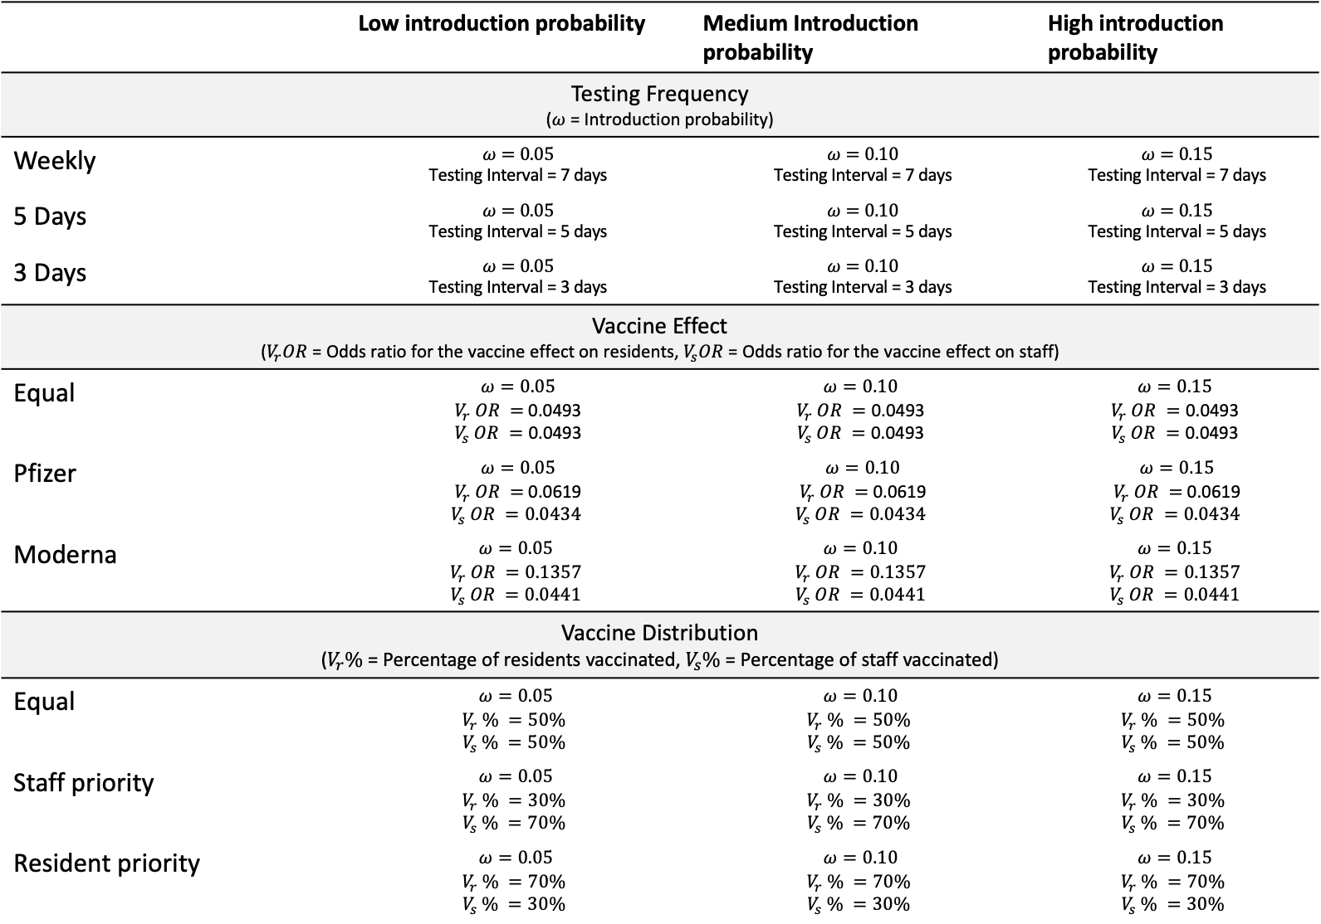
 | Low introduction probability | Medium Introduction probability | High introduction probability
Testing Frequency ($ω$ = Introduction probability)
Weekly | $$ω=0.05$$ Testing Interval = 7 days | $$ω=0.10$$ Testing Interval = 7 days | $$ω=0.15$$ Testing Interval = 7 days
5 Days | $$ω=0.05$$ Testing Interval = 5 days | $$ω=0.10$$ Testing Interval = 5 days | $$ω=0.15$$ Testing Interval = 5 days
3 Days | $$ω=0.05$$ Testing Interval = 3 days | $$ω=0.10$$ Testing Interval = 3 days | $$ω=0.15$$ Testing Interval = 3 days
Vaccine Effect ($V_{r}OR$ = Odds ratio for the vaccine effect on residents, $V_{s}OR$ = Odds ratio for the vaccine effect on staff)
Equal | $$ω=0.05$$ $V_{r} OR =$0.0493 $$V_{s} OR =\text{0.0493}$$ | $$ω=0.10$$ $$V_{r} OR =\text{0.0493}$$ $$V_{s} OR =\text{0.0493}$$ | $$ω=0.15$$ $$V_{r} OR =\text{0.0493}$$ $$V_{s} OR =\text{0.0493}$$
Pfizer | $$ω=0.05$$ $V_{r} OR =$0.0619 $$V_{s} OR =0.0434$$ | $$ω=0.10$$ $V_{r} OR =$0.0619 $$V_{s} OR =0.0434$$ | $$ω=0.15$$ $V_{r} OR =$0.0619 $$V_{s} OR =0.0434$$
Moderna | $$ω=0.05$$ $$V_{r} OR =0.1357$$ $$V_{s} OR =0.0441$$ | $$ω=0.10$$ $$V_{r} OR =0.1357$$ $$V_{s} OR =0.0441$$ | $$ω=0.15$$ $$V_{r} OR =0.1357$$ $$V_{s} OR =0.0441$$
Vaccine Distribution ($V_{r}\%$ = Percentage of residents vaccinated, $V_{s}\%$ = Percentage of staff vaccinated)
Equal | $$ω=0.05$$ $$V_{r} \% =50\%$$ $$V_{s} \% =50\%$$ | $$ω=0.10$$ $$V_{r} \% =50\%$$ $$V_{s} \% =50\%$$ | $$ω=0.15$$ $$V_{r} \% =50\%$$ $$V_{s} \% =50\%$$
Staff priority | $$ω=0.05$$ $$V_{r} \% =30\%$$ $$V_{s} \% =70\%$$ | $$ω=0.10$$ $$V_{r} \% =30\%$$ $$V_{s} \% =70\%$$ | $$ω=0.15$$ $$V_{r} \% =30\%$$ $$V_{s} \% =70\%$$
Resident priority | $$ω=0.05$$ $$V_{r} \% =70\%$$ $$V_{s} \% =30\%$$ | $$ω=0.10$$ $$V_{r} \% =70\%$$ $$V_{s} \% =30\%$$ | $$ω=0.15$$ $$V_{r} \% =70\%$$ $$V_{s} \% =30\%$$

Slide 2
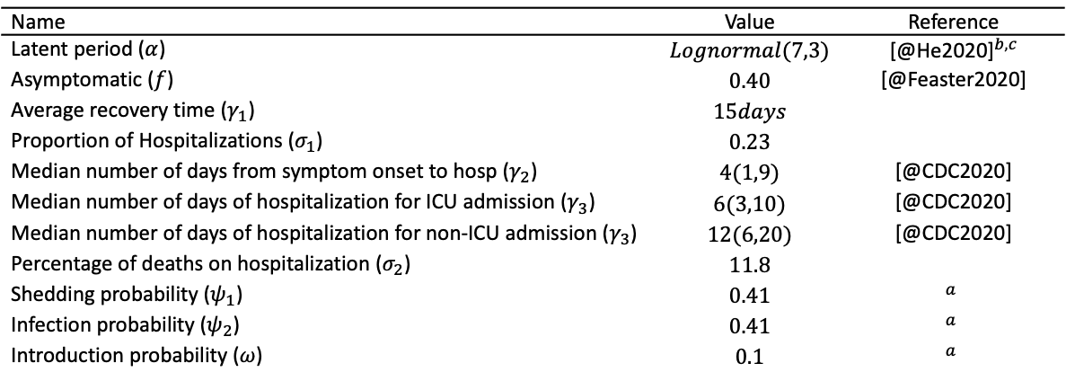
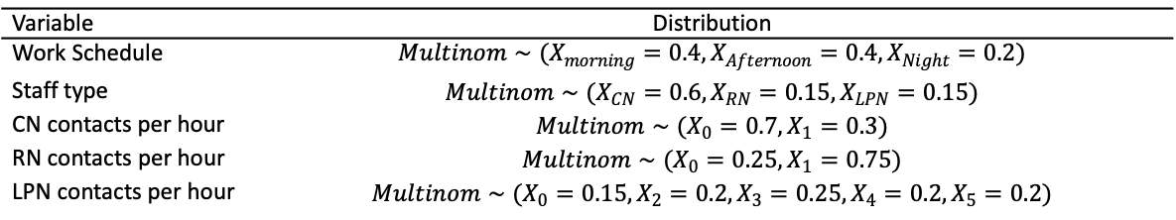
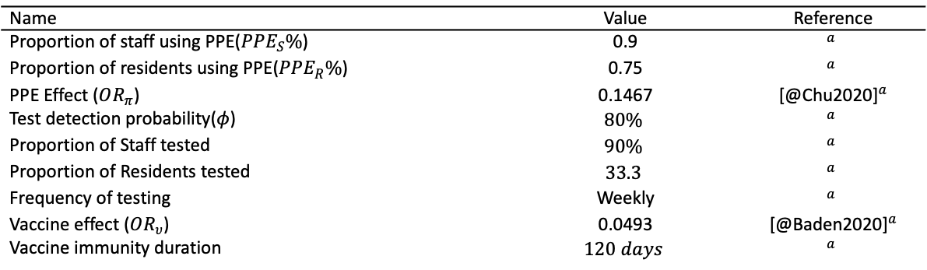
Name | Value | Reference
Latent period ($α$) | $$Lognormal(7,3)$$ | [@He2020]$​^{b,c}$
Asymptomatic ($f$) | $$0.40$$ | [@Feaster2020]
Average recovery time ($γ_{1}$) | $$15days$$
Proportion of Hospitalizations ($σ_{1}$) | $$0.23$$
Median number of days from symptom onset to hosp ($γ_{2}$) | $$4(1,9)$$ | [@CDC2020]
Median number of days of hospitalization for ICU admission ($γ_{3}$) | $$6(3,10)$$ | [@CDC2020]
Median number of days of hospitalization for non-ICU admission ($γ_{3}$) | $$12(6,20)$$ | [@CDC2020]
Percentage of deaths on hospitalization ($σ_{2}$) | $$11.8$$
Shedding probability ($ψ_{1}$) | $$0.41$$ | $$​^{a}$$
Infection probability ($ψ_{2}$) | $$0.41$$ | $$​^{a}$$
Introduction probability ($ω$) | $$0.1$$ | $$​^{a}$$
Name | Value | Reference
Proportion of staff using PPE($PPE_{S}\%$) | 0.9 | $$​^{a}$$
Proportion of residents using PPE($PPE_{R}\%$) | 0.75 | $$​^{a}$$
PPE Effect ($OR_{π}$) | 0.1467 | [@Chu2020]$​^{a}$
Test detection probability($φ$) | $$80\%$$ | $$​^{a}$$
Proportion of Staff tested | $$90\%$$ | $$​^{a}$$
Proportion of Residents tested | $$33.3$$ | $$​^{a}$$
Frequency of testing | Weekly | $$​^{a}$$
Vaccine effect ($OR_{υ}$) | 0.0493 | [@Baden2020]$​^{a}$
Vaccine immunity duration | $$120 days$$ | $$​^{a}$$
Variable | Distribution
Work Schedule | $$Multinom∼(X_{morning}=0.4,X_{Afternoon}=0.4,X_{Night}=0.2)$$
Staff type | $$Multinom∼(X_{CN}=0.6,X_{RN}=0.15,X_{LPN}=0.15)$$
CN contacts per hour | $$Multinom∼(X_{0}=0.7,X_{1}=0.3)$$
RN contacts per hour | $$Multinom∼(X_{0}=0.25,X_{1}=0.75)$$
LPN contacts per hour | $$Multinom∼(X_{0}=0.15,X_{2}=0.2,X_{3}=0.25,X_{4}=0.2,X_{5}=0.2)$$

Slide 4
Sensitivity Analysis results
Scenario | Value used | Epidemic Length | Infection Rate | Total Infected | Infected residents | Infected staff | Hospitalizations | Deaths
Baselineª |  | 21 (7,49.35) | 0.14 (0.01,0.38) | 47.5 (2,130.05) | 28 (0,80.1) | 18 (1,47.1) | 4 (0,14.2) | 0 (0,2)
Disease transmission
Low | 0.34 | 14 (7,51.2) | 0.03 (0,0.19) | 11.5 (1,65.3) | 2.5 (0,38.1) | 6.5 (1,31) | 1 (0,9) | 0 (0,1)
High | 0.42 | 28 (7,49) | 0.39 (0.01,0.58) | 133.5 (3.45,199.75) | 83.5 (1,127.55) | 53 (2,76) | 13 (0,22.55) | 1 (0,4)
Introduction probability
Low | 0.05 | 15.5 (7,38.85) | 0.02 (0,0.32) | 6.5 (1,108.55) | 3 (0,70.1) | 4.5 (1,39.1) | 1 (0,14.55) | 0 (0,1)
High | 0.15 | 31 (9.7,85.4) | 0.18 (0.01,0.41) | 62 (3.45,141.4) | 32 (1,86.3) | 26.5 (2.45,62.55) | 6 (0,18.55) | 0 (0,2.55)
Detection probability
Low | 0.7 | 21 (7,76.55) | 0.14 (0.01,0.38) | 49.5 (2.45,132.1) | 27 (1,82.55) | 22 (1,53) | 4.5 (0,16.1) | 0 (0,2)
High | 0.9 | 21 (7,49) | 0.08 (0.01,0.34) | 26.5 (1.95,117.3) | 15 (0,77.05) | 12 (1,45.15) | 2 (0,14.05) | 0 (0,2)
PPE effect
High | 0.07 | 14 (7,42) | 0.01 (0,0.22) | 5 (1,76.1) | 1.5 (0,46) | 4 (1,29) | 0.5 (0,9) | 0 (0,2)
Low | 0.34 | 21 (13.45,42) | 0.62 (0.33,0.82) | 214 (115.15,281.2) | 133.5 (67.35,177.55) | 78 (47.8,108) | 18 (7.45,28) | 1 (0,3)
Testing interval
Every 5 days | 5 days | 11 (5,37.75) | 0.02 (0,0.18) | 8 (1,62.75) | 2 (0,33.65) | 5 (1,27.55) | 1 (0,9) | 0 (0,0.55)
Every 3 days | 3 days | 10.5 (3,39.3) | 0.02 (0,0.13) | 6 (1,43.85) | 2 (0,24.2) | 4.5 (1,23.1) | 1 (0,4) | 0 (0,0.55)
Vaccine effect
Similar age-specific vaccine efficacy | 0.0493 | 14 (7,38.85) | 0.01 (0,0.06) | 4 (1,21.55) | 0 (0,7.55) | 4 (1,11.65) | 0 (0,1.55) | 0 (0,0)
Similar age-specific vaccine efficacy [Pfizer] | 0.0619^{b}, 0.0434^{c} | 14 (7,35) | 0.01 (0,0.06) | 5 (0.45,21.55) | 0 (0,10.2) | 4 (0.45,13) | 0 (0,2.55) | 0 (0,1)
Similar age-specific vaccine efficacy [Moderna] | 0.1357^{b}, 0.0441^{c} | 14 (7,22.1) | 0.01 (0,0.05) | 4.5 (1,18.55) | 0 (0,11) | 3.5 (0.45,10) | 0 (0,2) | 0 (0,0)
Table 2:Results from the sensitivity analysis summarized by the median and 95% confidence intervals for the various simulations considered. ª Assumed values in table 1, ^{b} value assumed for resident agents, ^{c} value assumed for staff agents

Slide 5
Scenario modeling results
Scenario | Epidemic Length | Infection Rate | Total Infected | Infected residents | Infected staff | Hospitalizations | Deaths
Testing Frequency
High introduction probability, 7-day testing interval (HI_7) | 21 (7,51.2) | 0.03 (0.01,0.09) | 12 (2.45,31.55) | 2 (0,14.55) | 8 (2,22) | 1 (0,3) | 0 (0,0.55)
High introduction probability, 5-day testing interval (HI_5) | 15 (5,44.55) | 0.02 (0,0.08) | 7 (1.45,26.55) | 1 (0,8.55) | 5.5 (1,14.75) | 0 (0,3) | 0 (0,0)
High introduction probability, 3-day testing interval (HI_3) | 10 (3,21) | 0.01 (0.01,0.04) | 4 (2,12.55) | 0.5 (0,5.55) | 4 (1,9.55) | 0 (0,2) | 0 (0,0)
Medium introduction probability, 7-day testing interval (MI_7) | 14 (7,22.1) | 0.01 (0,0.05) | 4 (1,17.65) | 0 (0,9.65) | 3 (0.45,9.55) | 0 (0,2.55) | 0 (0,0.55)
Medium introduction probability, 5-day testing interval (MI_5) | 9 (5,25) | 0.01 (0,0.03) | 3 (1,11.75) | 0 (0,4.55) | 3 (0.45,8.1) | 0 (0,1) | 0 (0,0)
Medium introduction probability, 3-day testing interval (MI_3) | 9 (3,20.55) | 0.01 (0,0.03) | 3 (0.45,11.1) | 0 (0,6.1) | 2 (0.45,7.65) | 0 (0,1) | 0 (0,0)
Low introduction probability, 7-day testing interval (LI_7) | 9 (7,27.55) | 0.01 (0,0.02) | 2 (0,7) | 0 (0,3) | 1 (0,5.55) | 0 (0,1) | 0 (0,0)
Low introduction probability, 5-day testing interval (LI_5) | 9 (5,22.2) | 0.01 (0,0.03) | 2 (0,9) | 0 (0,4) | 1 (0,5) | 0 (0,1.55) | 0 (0,0)
Low introduction probability, 3-day testing interval (LI_3) | 9 (3,21) | 0.01 (0,0.02) | 2 (0,8.1) | 0.5 (0,3) | 1 (0,4.55) | 0 (0,1) | 0 (0,0)
Vaccine Distribution
High introduction probability, Equal distribution (HI_E) | 21 (7,59.85) | 0.03 (0.01,0.11) | 12 (2,38.6) | 2 (0,18.5) | 8 (2,22) | 1 (0,4.75) | 0 (0,1)
High introduction probability, Resident priority (HI_R) | 21 (7,42) | 0.04 (0.01,0.08) | 14 (3,28.55) | 2 (0,12.55) | 9 (3,19) | 1 (0,3) | 0 (0,1)
High introduction probability, Staff priority (HI_S) | 14 (7,38.85) | 0.02 (0,0.1) | 7.5 (1.45,34.3) | 2 (0,19.65) | 6 (1.45,14.1) | 0.5 (0,3) | 0 (0,1)
Medium introduction probability, Equal distribution (MI_E) | 14 (7,42) | 0.01 (0,0.06) | 5 (1,20) | 0 (0,10.55) | 4 (0.45,12.2) | 0 (0,2) | 0 (0,0.55)
Medium introduction probability, Resident priority (MI_R) | 14 (7,38.4) | 0.01 (0,0.06) | 5 (1,22) | 0.5 (0,9.55) | 4.5 (1,13.55) | 0 (0,2.55) | 0 (0,0.55)
Medium introduction probability, Staff priority (MI_S) | 9 (7,23.75) | 0.01 (0,0.04) | 3.5 (1,12.75) | 1 (0,7) | 2.5 (0.45,8.55) | 0 (0,2) | 0 (0,1)
Low introduction probability, Equal distribution (LI_E) | 9 (7,27.55) | 0.01 (0,0.02) | 2 (0,8.1) | 0 (0,3) | 1 (0,5.1) | 0 (0,1) | 0 (0,0)
Low introduction probability, Resident priority (LI_R) | 14 (7,28) | 0.01 (0,0.04) | 5 (1,15.1) | 1 (0,6) | 4 (1,10) | 0 (0,2.55) | 0 (0,0)
Low introduction probability, Staff priority (LI_S) | 9 (7,24.85) | 0.01 (0,0.06) | 3.5 (1,19.9) | 1 (0,12.5) | 2.5 (0.45,8.55) | 0 (0,2) | 0 (0,0)
Vaccine Effect
High introduction probability, Equal effect (HI_E) | 14 (7,42) | 0.02 (0.01,0.08) | 7 (2,29.2) | 1 (0,10.55) | 5.5 (2,20.1) | 1 (0,2.55) | 0 (0,1)
High introduction probability, Pfizer OR (HI_P) | 14 (7,54.2) | 0.02 (0.01,0.09) | 7.5 (2,31.5) | 1 (0,15.1) | 6 (2,22.55) | 0 (0,2.55) | 0 (0,0.55)
High introduction probability, Moderna OR (HI_M) | 21 (7,54.65) | 0.03 (0.01,0.09) | 12 (2.45,31.1) | 2 (0,16.55) | 8 (2.45,21.55) | 1 (0,3) | 0 (0,1)
Medium introduction probability, Equal effect (MI_E) | 14 (7,42) | 0.01 (0,0.06) | 4 (1,19.3) | 0 (0,8.55) | 3.5 (1,13) | 0 (0,2) | 0 (0,1)
Medium introduction probability, Pfizer OR (MI_P) | 14 (7,41.55) | 0.01 (0,0.07) | 4 (1,23.95) | 0 (0,9.65) | 3 (1,15.2) | 0 (0,1.55) | 0 (0,0.55)
Medium introduction probability, Moderna OR (MI_M) | 14 (7,41.55) | 0.01 (0,0.05) | 4 (1,16.1) | 0 (0,7.55) | 3 (1,11.65) | 0 (0,2) | 0 (0,0.55)
Low introduction probability, Equal effect (LI_E) | 9 (7,30.2) | 0 (0,0.04) | 1 (0,13.55) | 0 (0,9.1) | 1 (0,8.65) | 0 (0,2) | 0 (0,0)
Low introduction probability, Pfizer OR (LI_P) | 9 (7,21) | 0 (0,0.04) | 1 (0,13.55) | 0 (0,7.1) | 1 (0,6) | 0 (0,1.55) | 0 (0,0)
Low introduction probability, Moderna OR (LI_M) | 9 (7,28) | 0.01 (0,0.03) | 2 (0,10) | 0 (0,3.55) | 1 (0,8.2) | 0 (0,1.55) | 0 (0,0)

