Slide 1
Commuter Parking at UT Monday, September 22
Team Members:
Patrick Elam
Nathan Peck
David Lu
Jacob Lambert
Ben Mills
Project Description: UT Commuter Parking Availability System

Slide 2
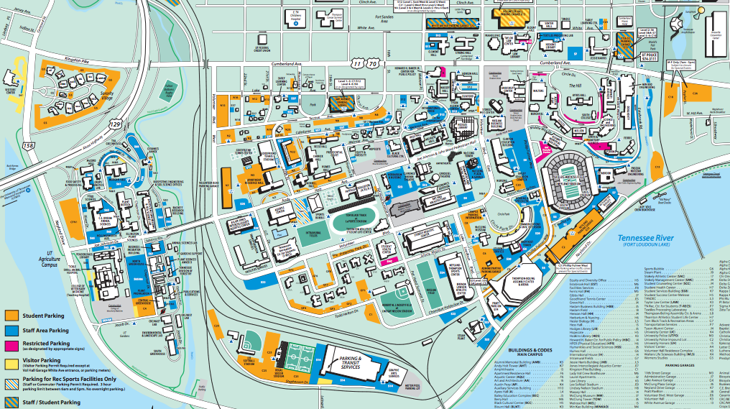
Need
~16,000 Spaces on Campus, ~30,000 cars come to Campus each day
Commuter Parking Permits to Space Ratio: 1.85
UT Makes 1.2 Million each year from parking tickets

Slide 3
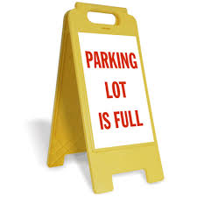

Concept
System monitors real-time parking space availability for UT parking lots and decks.
Data can be quickly and easily accessed on mobile or computer
Mobile app
Website
Daily parking analytics
- When do lots tend to be full?

Slide 4
Market
Main Market
Commuter Students
> 10,000 Commuter Passes
Possible Market
Non-Commuter Students
Staff/Faculty
Guests & Visitor

Slide 5
Competition
Ticketing-based systems
Numerous Garages
Sensor-based systems
San Francisco's SF park
Image-processing systems
Minnesota DoT

Slide 6
[Slide unintentionally left blank]

Slide 7
Thank You!

