Slide 1
AI6 Workshop 6W
Making Things Better with Model Tuning
Unit 6 — Optimisation (maths made practical)

Slide 2
Before we start
Safeguarding: if you have concerns about a colleague or learner during today's session, please speak to your coach straightaway — they are here to help and will know how to take it forward. If you are unsure about your organisation's reporting process, ask your coach now.
Wellbeing check-in: take 30 seconds and turn to the person next to you — how are you doing today, honestly?
And one for yourself: what is one kind thing you have done for yourself this month?
There is no right answer. You do not have to share with the room. We ask because this work takes energy, and noticing how you are arriving matters.

Slide 3
What you will learn today
What fine‑tuning is (and isn’t): optimisation from a strong starting point
What happens inside trainer.train(): loss → gradients → weight updates
How to diagnose learning rate issues from curves and metrics
How to spot and explain the generalisation gap (train vs validation)

Slide 4
Workshop Structure — Activities at a Glance
Activity 1 Warm-Up: Curve Diagnosis — Catch up; read curves; discuss what feels familiar (B3, K18)
Activity 2 Environment Setup and Baseline — Record your 'before' measurement
Activity 3 Group Learning Rate Experiment — Run your preset, log the results
Activity 4 Share and Compare — Whole-group synthesis and engineering conclusion
Activity 5 Convergence Check — Maths to compute cost (K18)
Activity 6 Data Quality and Uncertainty — Stakeholder caveats (B5)
Activity 7 Reflection and Horizon Scan — Task 6 materials (K18, S31, B1)
Activity 8 Going Further (optional) — Extensions: schedule, freeze, error analysis

Slide 5
Unit 6 “maths” without the pain
We won’t derive calculus on a whiteboard…
…but we will use the real words: loss, gradient (partial derivative), SGD, learning rate, generalisation
Why: tools and papers use this vocabulary — engineers need to speak it

Slide 6
Fine‑tuning vs retraining vs optimisation
Optimisation (the “mechanism”)
Reduce a loss function by adjusting weights
Uses gradients (slopes / partial derivatives)
Runs in tiny steps, thousands of times
Fine‑tuning vs retraining (the context)
Fine‑tuning: start from a pretrained model
Retraining: run optimisation again because data changed
Training from scratch: rare + expensive in business

Slide 7
What trainer.train() does
Reads a mini‑batch of labelled examples
Predicts labels
Scores wrongness (loss)
Computes gradients (how to reduce loss)
Updates weights using an optimiser (e.g. AdamW — in the SGD family)
…and the loop runs thousands of times until loss stops improving

Slide 8
Metrics: what to watch
Loss = altitude (are we going downhill mathematically?)
Validation accuracy/F1 = road test (does it work on unseen examples?)
Generalisation gap = train performance − validation performance
Gap widening = likely overfitting (memorising)

Slide 9
You’ve seen this before
Iterative adjustment against a target is not unique to machine learning.
Too cautious (too low): a new team member given only tiny tasks — they technically improve, but so slowly it barely registers. A medication dose raised by a fraction each month when a bolder step is needed.
Too aggressive (too high): an interest rate raised 5% in one step — overshoots, causes recession. A diet changed by cutting 1,000 calories overnight — unsustainable, collapses.
Just right: a physio programme that stretches but does not injure — steady measurable gains, consistent across sessions.
Generalisation gap: a revision technique that works perfectly on past papers but fails in the actual exam. The student memorised the questions, not the subject.
Today you will watch these same patterns happen live inside a training loop — with numbers you can measure.

Slide 10
Activity 1 — Warm-Up: Curve Diagnosis
15 minutes total — this is a warm-up, not a lab
Task 1 (5 min): catch up — what have you been working on since last workshop?
Task 2 (5 min): match each curve to its cause — TOO_LOW / JUST_RIGHT / TOO_HIGH
Task 3 (3 min): which of the examples on the previous slide felt familiar? Share briefly.
Task 4 (2 min): explain one unhealthy curve to a non-technical colleague — in plain language, no jargon
KSBs: K18 (reading optimisation signals) | B3 (communicating across technical and non-technical backgrounds)

Slide 11
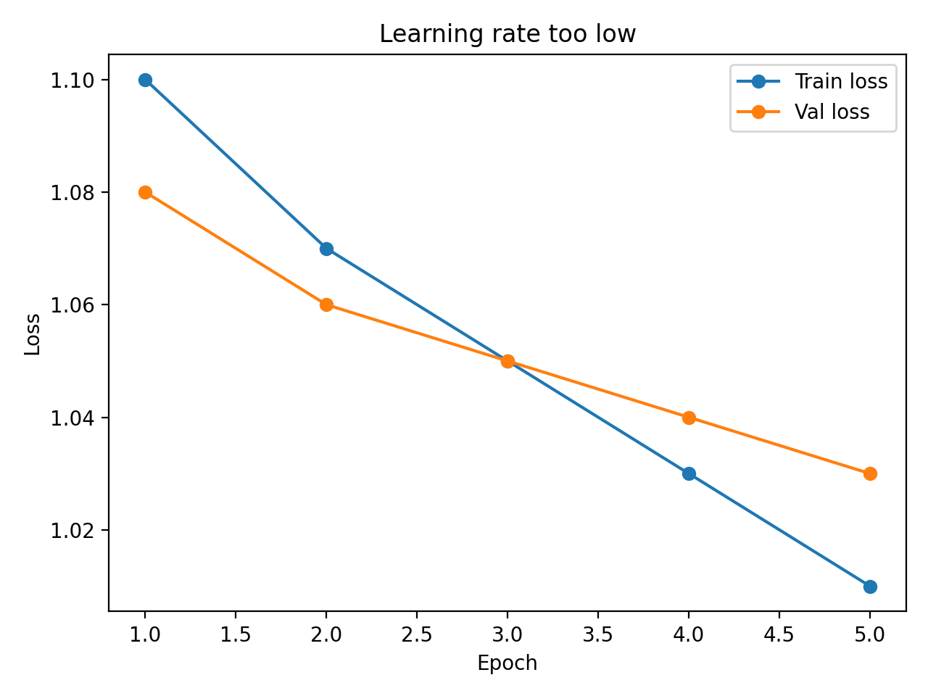
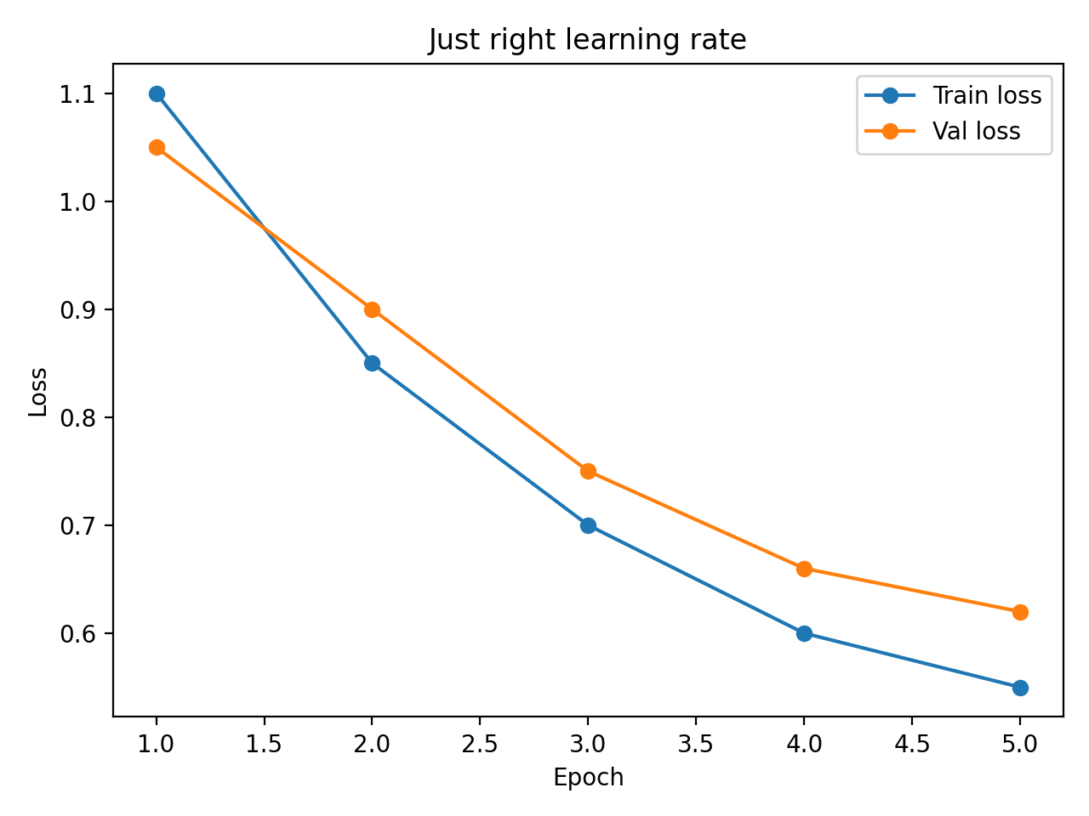
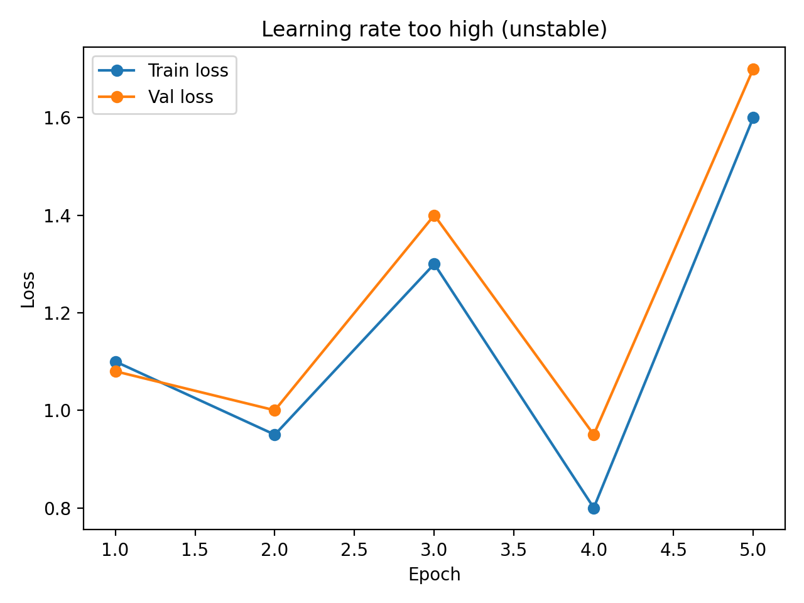
Activity 1 — Warm-Up: The Three Patterns (Task 2)
Too low LR
(slow learning)
Just right
(steady improvement)
Too high LR
(unstable)
Task 3: which of the examples from the previous slide feels familiar from your work? Share briefly — 2 minutes. | Task 4 — B3: explain one of these patterns to someone non-technical, no jargon.

Slide 12
Activity 2 — Environment Setup and Baseline
Clone repo, create virtual environment, install requirements (35 minutes)
Launch Jupyter Lab and open the main notebook
Run baseline evaluation cells — record metrics BEFORE any training
Locate and understand the speed dials (TRAIN_SUBSET, MAX_LENGTH, EPOCHS)
Checkpoint: baseline accuracy and F1-macro recorded in your experiment log
KSB: S9 (before-and-after comparison — this is your 'before')

Slide 13
Activity 3 — Group Learning Rate Experiment
Groups of 3–4, each running ONE preset: TOO_LOW, JUST_RIGHT, or TOO_HIGH
Before you run: write your prediction. Assign roles — driver, logger, observer.
0–25 min: run training, record metrics each epoch as they appear
25 min — midpoint pulse: each group calls one word across the room: “moving”, “stalled”, or “crashed”
25–50 min: inspect curve, complete experiment log, run extension if time allows
Your coach(es) will be circulating throughout — flag them if you are stuck or if training is very slow
KSBs: K18 (loss and gradients in action) | S9 (logging for reproducibility)

Slide 14
Activity 3 — Group Learning Rate Experiment
What you run
Each group picks one preset:
TOO_LOW, JUST_RIGHT, or TOO_HIGH
Run 1–2 epochs and record metrics
What you expect
TOO_LOW: curve barely moves
JUST_RIGHT: steady improvement
TOO_HIGH: unstable / oscillation / may error

Slide 15
Activity 4 — Share and Compare
Each group reports results into the shared slide (30 minutes)
Compare curves across TOO_LOW / JUST_RIGHT / TOO_HIGH
Engineering conclusion: which preset would you recommend for production — and why?
Task 4 (3 min): share any patterns from today that felt familiar from your own work — the whole group benefits from hearing different sectors
Stakeholder framing (B3): draft a one-paragraph update for a non-technical colleague — translate the result, do not just report the numbers
KSBs: K18 (generalisation gap) | B3 (communicating across technical and non-technical backgrounds)

Slide 16
Activity 5 — Convergence Check
Convergence = the point where further training is no longer producing meaningful improvement.
Like a kettle approaching boiling point: the temperature is still rising, but each second adds less than the last. At some point, waiting longer gives you nothing more.
We measure it with loss delta: how much did loss change between the last two epochs? If the answer is very small (e.g. < 0.01), the model has converged within our threshold.
Why it matters: reliability (a model still moving is not stable for deployment) + cost (training past convergence burns compute for no gain).
Run the convergence check cells (6b), record your delta, and answer: would more epochs be worth the cost for this task?
KSB: K18 — connecting mathematical principles (loss, gradients) to a practical engineering decision (when to stop)

Slide 17
Activity 6 — Data Quality and Uncertainty
Whole-group facilitated discussion (15 minutes)
financial_phrasebank (allagree subset): only the unambiguous cases — not representative of real text
synth_financial_sentiment.csv: synthetic — generated, not collected
Small subsets (300-800 examples): 2% accuracy difference may be noise
Deployment question: what caveats would you give a project manager?
KSBs: B5 (data quality and uncertainty), S14 (statistical analysis — margins)

Slide 18
Activity 7 — Reflection and Horizon Scan
Part C: write reflections individually in silence (10 minutes)
Use the vocabulary from today: loss, gradient, generalisation gap, convergence
Part E: find ONE credible horizon scan source relevant to today (15 minutes)
Suggested searches: LoRA fine-tuning, learning rate schedules, training carbon footprint
Shareback: 2-3 volunteers share what they found and why
KSBs: K18, B1 (self-directed learning), S31/K28 (horizon scanning for Task 6)

Slide 19
Practical tuning rules (so you don’t waste time)
Always take a baseline
Change ONE dial at a time (start with learning rate)
Time‑box experiments (compute is money)
Write a short decision log (what you tried, what happened, what you’ll do next)

Slide 20
Activity 8 (Going Further) — Extensions
Schedule: constant vs linear learning rate schedule
Freeze encoder: train only the classification head
Error analysis: confusion matrix + inspect misclassifications
Experiment tracking (optional): W&B if policy allows

Slide 21
Wrap‑up
You can now explain fine‑tuning using the optimisation loop
You can diagnose learning rate issues from curves
You can describe generalisation gap and why it matters
Next: connect this to Unit 6 evidence (Task 6 / CPD q’s)

