Slide 1
AI6 Workshop 6W
Making Things Better with Model Tuning
Unit 6 — Optimisation (maths made practical)

Slide 2
What you will learn today
What fine‑tuning is (and isn’t): optimisation from a strong starting point
What happens inside trainer.train(): loss → gradients → weight updates
How to diagnose learning rate issues from curves and metrics
How to spot and explain the generalisation gap (train vs validation)

Slide 3
Unit 6 “maths” without the pain
We won’t derive calculus on a whiteboard…
…but we will use the real words: loss, gradient (partial derivative), SGD, learning rate, generalisation
Why: tools and papers use this vocabulary — engineers need to speak it

Slide 4
Fine‑tuning vs retraining vs optimisation
Optimisation (the “mechanism”)
Reduce a loss function by adjusting weights
Uses gradients (slopes / partial derivatives)
Runs in tiny steps, thousands of times
Fine‑tuning vs retraining (the context)
Fine‑tuning: start from a pretrained model
Retraining: run optimisation again because data changed
Training from scratch: rare + expensive in business

Slide 5
What trainer.train() does
Reads a mini‑batch of labelled examples
Predicts labels
Scores wrongness (loss)
Computes gradients (how to reduce loss)
Updates weights using an optimiser (e.g. AdamW — in the SGD family)
Repeats

Slide 6
Metrics: what to watch
Loss = altitude (are we going downhill mathematically?)
Validation accuracy/F1 = road test (does it work on unseen examples?)
Generalisation gap = train performance − validation performance
Gap widening = likely overfitting (memorising)

Slide 7
Activity: learning rate presets
What you run
Each group picks one preset:
TOO_LOW, JUST_RIGHT, or TOO_HIGH
Run 1–2 epochs and record metrics
What you expect
TOO_LOW: curve barely moves
JUST_RIGHT: steady improvement
TOO_HIGH: unstable / oscillation / may error

Slide 8
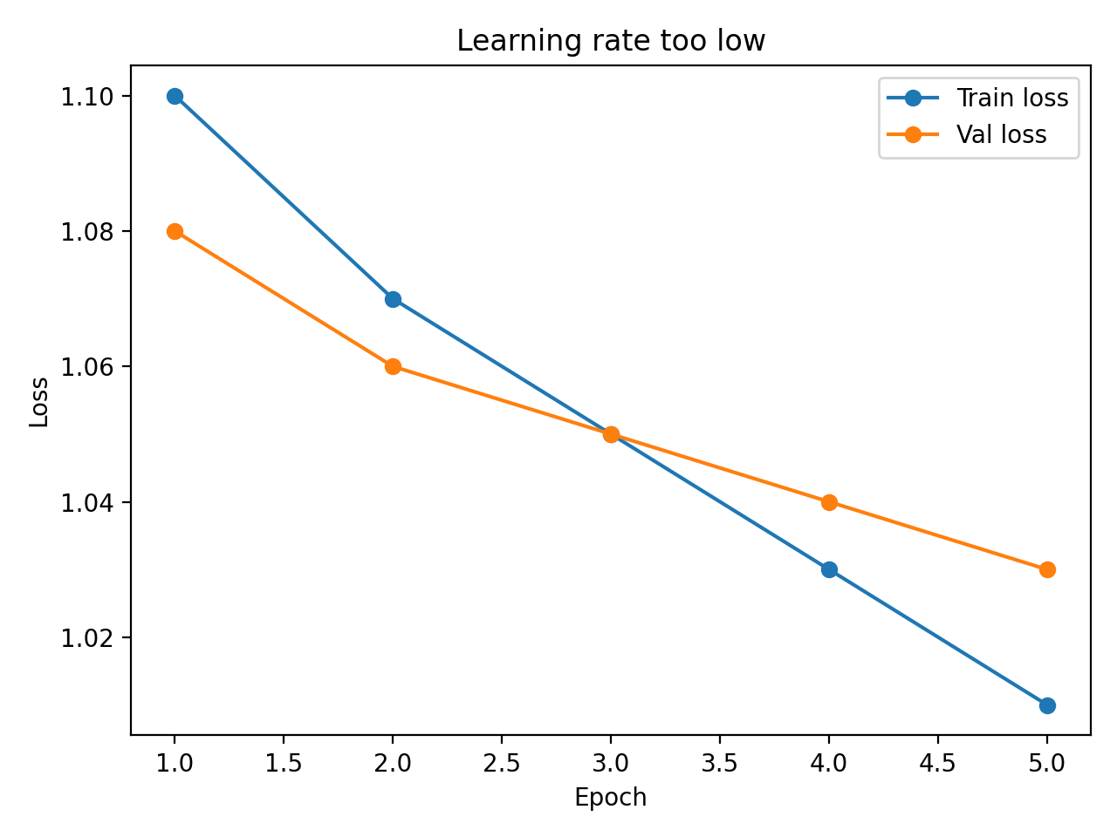
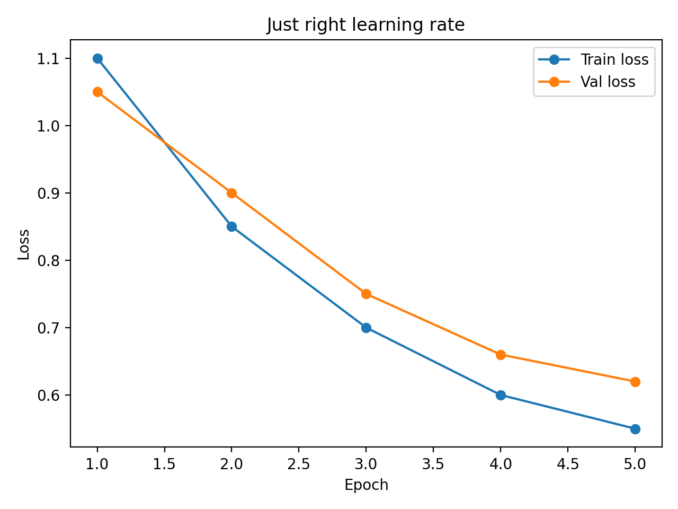
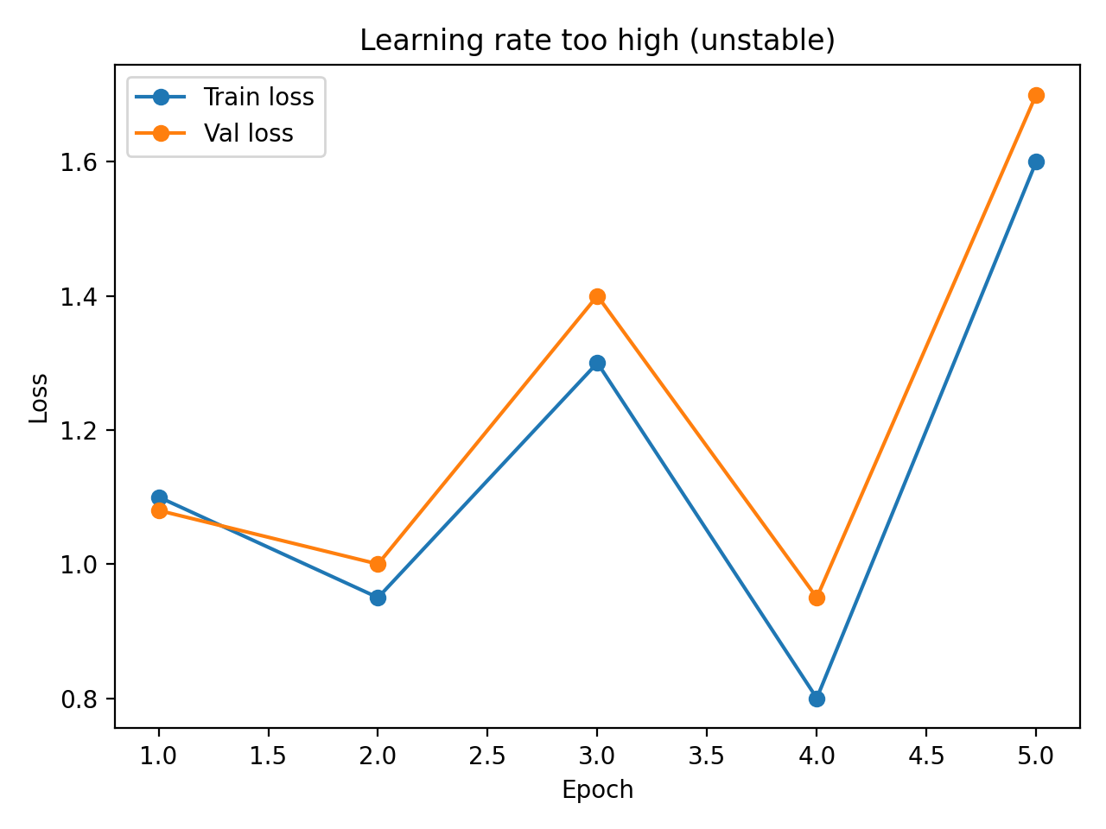
Reading curves (diagnostics)
Too low LR
(slow learning)
Just right
(steady improvement)
Too high LR
(unstable)

Slide 9
Going further (optional)
Schedule: constant vs linear learning rate schedule
Freeze encoder: train only the classification head
Error analysis: confusion matrix + inspect misclassifications
Experiment tracking (optional): W&B if policy allows

Slide 10
Practical tuning rules (so you don’t waste time)
Always take a baseline
Change ONE dial at a time (start with learning rate)
Time‑box experiments (compute is money)
Write a short decision log (what you tried, what happened, what you’ll do next)

Slide 11
Wrap‑up
You can now explain fine‑tuning using the optimisation loop
You can diagnose learning rate issues from curves
You can describe generalisation gap and why it matters
Next: connect this to Unit 6 evidence (Task 6 / CPD q’s)

