Slide 1
Progress Report: V2X BSM Malicious Threat Detection
By: Aidan Lochbihler, Adam ALi Husseinat, Josimar Kouam
SYSC 5804
March 8th, 2023

Slide 2
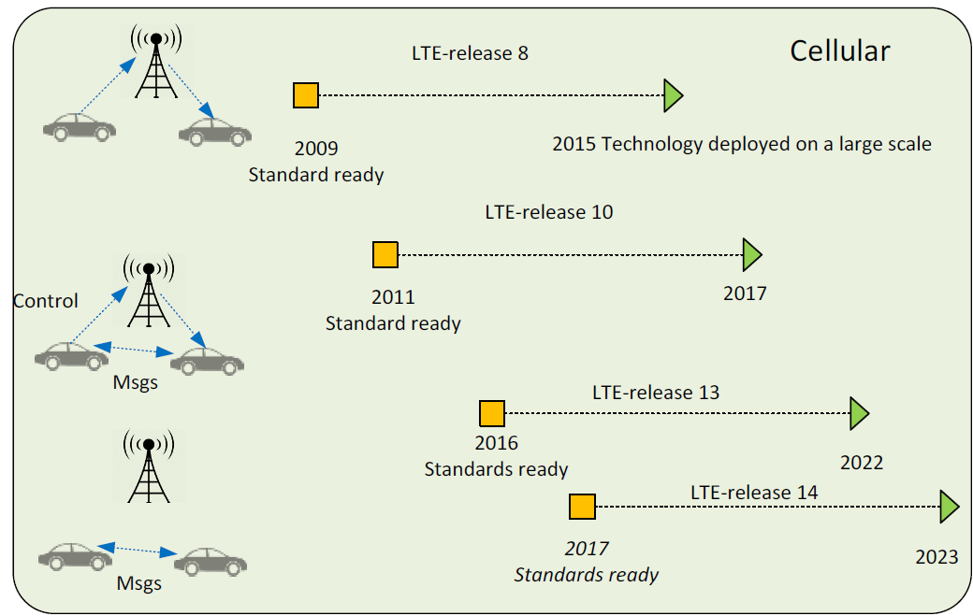
CAVs, VANETS & V2X
Connected Autonomous vehicles, Vehicular Ad Hoc Networks, and Vehicle to everything
Dedicated short range communication for vehicle to vehicle
5G Network for vehicle to Base Station
For communication vehicles broadcast Basic Safety Message (BSMs)

Slide 3
Introduction
Cooperative Intelligent Transport Systems (C-ITS) is an ongoing technology that will change our driving experience in the near future, vehicles and Road–Side Unit (RSU) cooperate by broadcasting V2X messages over the vehicular network. Safety applications use these data to detect and avoid dangerous situations on time.
MisBehavior Detection (MBD) in Cooperative Intelligent Transport Systems (C-ITS) is an active research topic which consists of monitoring data semantics of the exchanged Vehicle-to-X communication (V2X) messages to detect and identify potential misbehaving entities.
The detection process consists of performing plausibility and consistency checks on the Received V2X messages. If an anomaly is detected, the entity may report it by sending a Misbehavior Report (MBR) to the Misbehavior Authority (MA). TheMA will then investigate the event and decide to revoke the sender or not [1].

Slide 4
Abbreviations
BSM: Basic Safety Message
C-ITS: Cooperative Intelligent Transport Systems
DDOS: Distributed Denial of Service attack
VeReMi: Dataset
SMOTE: Synthetic Minority Oversampling TEchnique
DSRC: Dedicated Short-Range Communications
OBU: ON-Board Unit

Slide 5
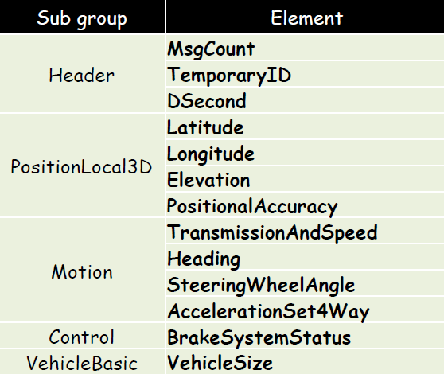
Importance of BSM

Slide 6
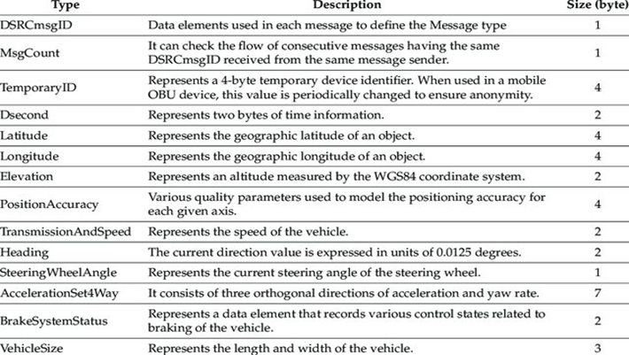
Importance of BSM

Slide 7
How Attackers can Exploit BSMs
Can exploit systems by either:
Overloading the BSM network (Like a DDOS attack)
Can be solved with conventional solutions (I.e. messaging thresholds, message identifiers)
Mimicking a real vehicle and sending ghost vehicle positions and speed
Much more difficult to fix with conventional methods (Which we will aim to solve)

Slide 8
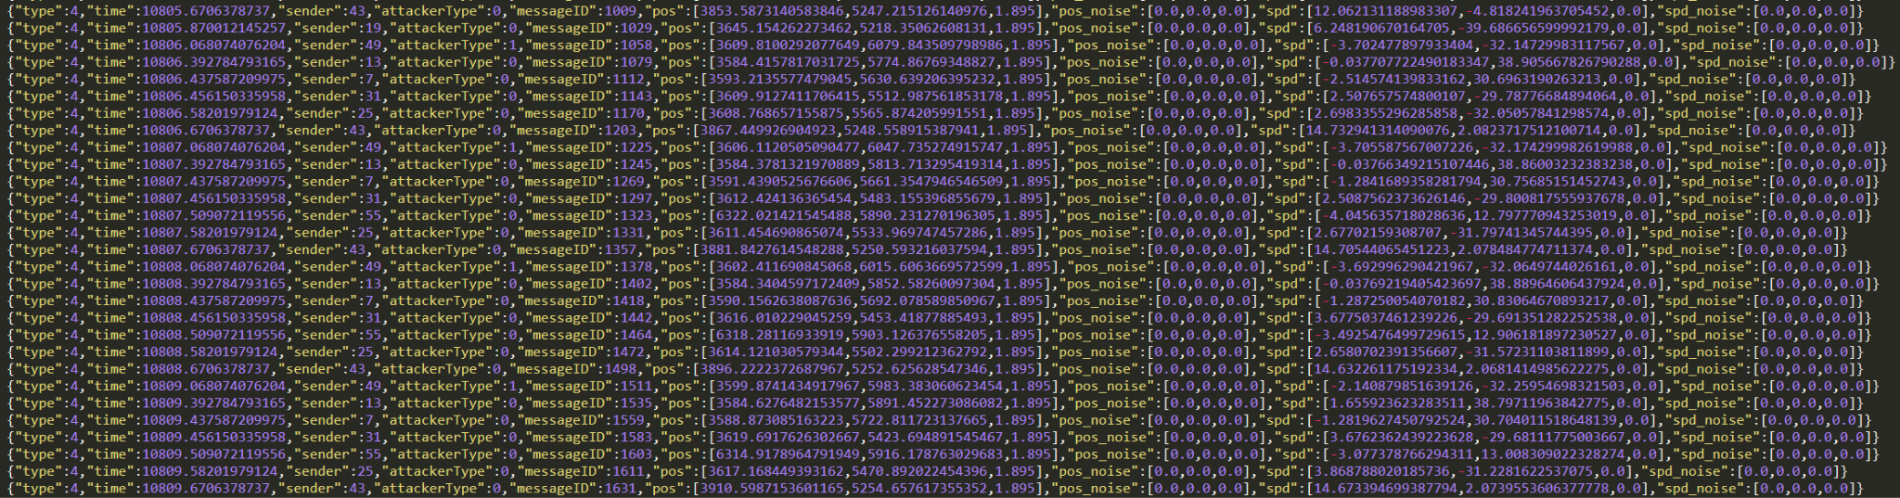
Methods: The Dataset
Vehicular Reference Misbehavior (VeReMi) dataset, a simulated simplified dataset for the evaluation of misbehavior detection mechanisms for VANETs using BSMs
Includes malicious messages intended to trigger incorrect application behavior, which is what misbehavior detection mechanisms aim to prevent
Time snippet of VeReMii Dataset

Slide 9
Methods: The Dataset
Single BSM

Slide 10
Method: Organizing the Data
Inter-Threat Detection: Analyzing the BSM messages of a car within itself
*(Promising for high density scenarios)
Intra-Threat Detection: Analyzing a BSM message from a car within the context of many BSM messages before it from all cars
*(Can detect threats faster)

Slide 11
Method: Machine Learning and Deep Learning
Speed vs Accuracy:
In most deep learning problems high classification accuracy is all that matters
But in this case speed can be equally as important (Inference time & number of BSMs needed*)
Speed:
XGBoost, Neural Network
Accuracy:
LSTM, Transformer
Notes:
Inference time as well as how many messages does it take before a threat can be detected

Slide 12
Challenges & Next Steps
Current LSTM models achieve about 80% accuracy
BUT is over predicting the majority class
In the dataset and in the real world application attackers will be much more infrequent than normal cars
Therefore there will be a significant class imbalance
Currently the model is having trouble with this imbalance
However methods such as SMOTE (Synthetic Minority Oversampling TEchnique) and weighted loss functions are being used to correct this
Another challenge is deciding the way in which different car density scenarios will be handled
Notes:
Depending on how the model works it may be promising at finding attackers agnostic of density

Slide 13
Method: BSM Densities
In all cases vehicles are sending BSMs at ~10Hz. Percent of cars that are attackers remains similar
Low Density:
35-39 vehicles
Medium Density:
97-108 vehicles
High Density:
491-519 vehicles

Slide 14
5G Vision
As in PMI (Precoding Matrix Information) of CSI (Channel-State-Information) message in 5G eMBB network, BSM provide information about the vehicular position that system use to control and coordinate the other vehicles and overall traffic safety.
An attacker may manipulate this information and cause a traffic congestion or blocking, more dangerous, false BSM information may lead to a sudden actions from other vehicles as a response for these false information and lead to serious dangers like sudden breaking or speeding behaviour while a vehicle is in front and close in reality so an accident happened.

Slide 15
5G Network Security Potential Solutions
1 - BSM contents Verification using gNB.
2 - BSM contents Verification using other Vehicles.
3 - BSM contents Verification using RSUs.
4 - BSM contents Verification optional fields in the BSM.
5 - Other 5G features and aspects.
All above are a prospective solutions to achieve an accurate and effective MDS using AI.

Slide 16
References
[1] Kamel, Joseph & Ansari, Mohammad & Petit, Jonathan & Kaiser, Arnaud & Ben
Jemaa, Ines & Urien, Pascal. (2020). Simulation Framework for Misbehavior
Detection in Vehicular Networks. IEEE Transactions on Vehicular Technology. PP.
10.1109/TVT.2020.2984878.
[2] Kim, Jae-Wan & Jeon, Dong-Keun. (2018). A Cooperative Communication Protocol for
QoS Provisioning in IEEE 802.11p/Wave Vehicular Networks. Sensors. 18. 3622.
10.3390/s18113622.

