Slide 1
ThermalSight v1.8.0
Foot Thermal Image Processing & Diagnostic Workflow
A Simple & Clear Guide: From FLIR Thermal Camera Capture to Ready-to-Publish Medical Analysis
Designed for high clarity, large legibility, and straightforward understanding for senior audiences, physicians, and professors.

Slide 2
STEP 1 Input Data: What Goes Into the System?
The types of thermal images accepted by ThermalSight
1. FLIR Thermal Images
• Uses genuine radiometric images from FLIR cameras (.jpg, .png, or .tiff).
• These are not ordinary photos: every single pixel carries true, calibrated physical temperature values in degrees Celsius.
• Works with handheld FLIR E-series, ONE, and clinical station cameras.
2. Flexible Input Modes
• Single Image Mode: Select 1 photo for immediate clinical inspection.
• Sequence Folder Mode: Select an entire folder of 10–50 consecutive patient walking or cooling frames.
• Or simply Drag & Drop image files directly into the software window.
3. Smart Root Filter
• If the patient folder contains previous result subfolders (_Result or _analysis), the app automatically skips them.
• Only primary patient photos in the root directory are processed, avoiding any duplicate or corrupted data.

Slide 3
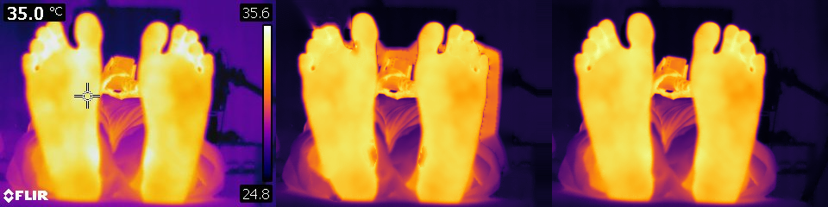
STEP 2 FLIR Image Cleaning (Pure Radiometric Sensor)
How the system extracts clean, natural foot images without artificial blur
Why 'Pristine Mode' (Mode Mula-mula)?
• FLIR cameras burn logos, temperature tags ('35°C'), and colorbars directly over the images.
• Old Method (Inpainting/Blur): Erased stamps but blurred skin margins and distorted temperature values.
• ThermalSight v1.8.0 Solution: Direct 16-bit radiometric byte decoding via Planck equations.
✓ All overlays vanish naturally at the byte level.
✓ Zero artificial blurring or pixel interpolation.
✓ 100% true physical temperature accuracy preserved.
Visual Comparison: Mode Mula-mula vs Inpainting

Slide 4
STEP 3 Application Workflow (4 Practical Stages)
The simple step-by-step user journey from start to finish
STAGE 1
Upload Images
Open 1 single photo or an entire sequence folder.
The system safely reads and validates all files with a clear progress bar.
STAGE 2
Calibrate Scale
Draw a line or box over a known reference ruler (e.g., 10 cm).
Matches computer screen pixels exactly to real human anatomy (px to cm).
STAGE 3
Mark Foot Points
Single-click on clinical landmarks (big toe, ball of foot, heel).
A standardized 9×9 circle forms instantly with radial heat spread vectors.
STAGE 4
Save & Export
Click 'Save & Export'.
The app automatically compiles journal-quality figures, numeric CSV spreadsheets, and a ZIP archive.

Slide 5
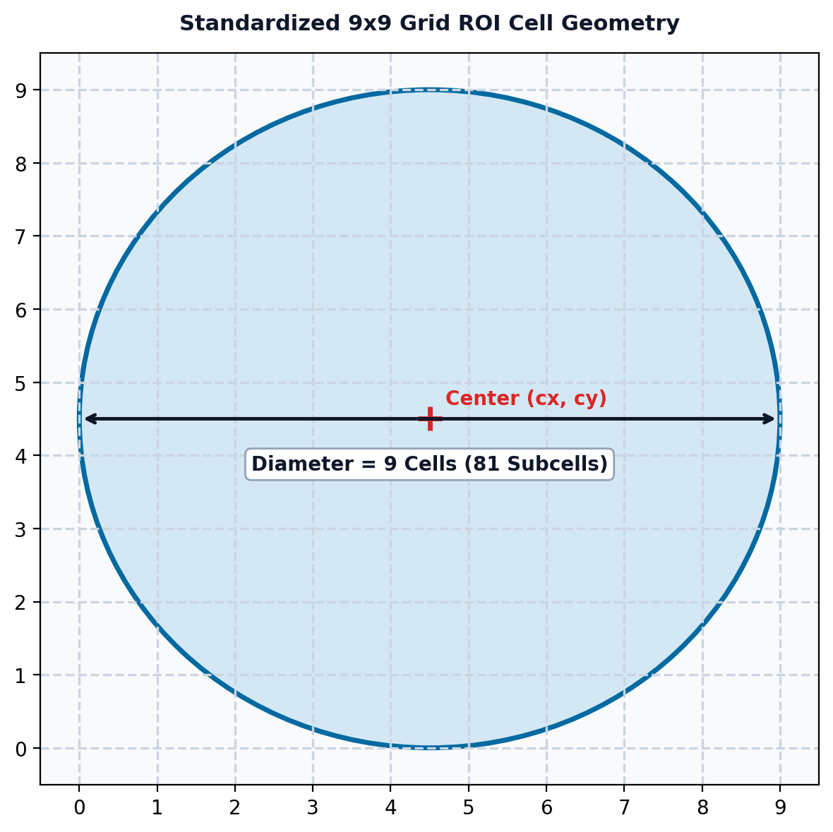
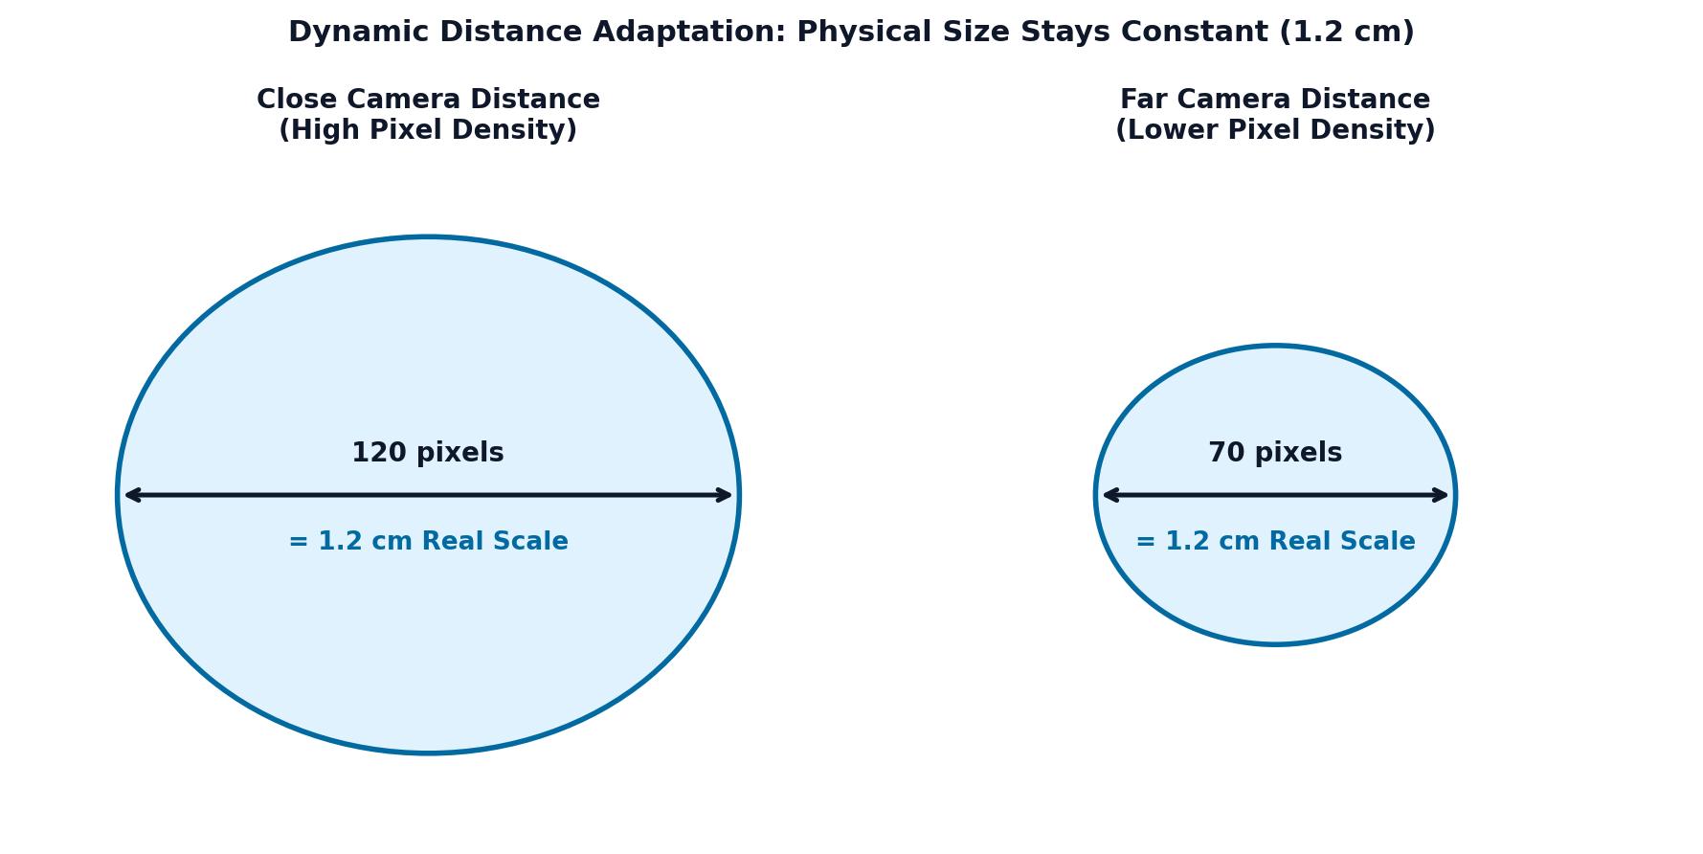
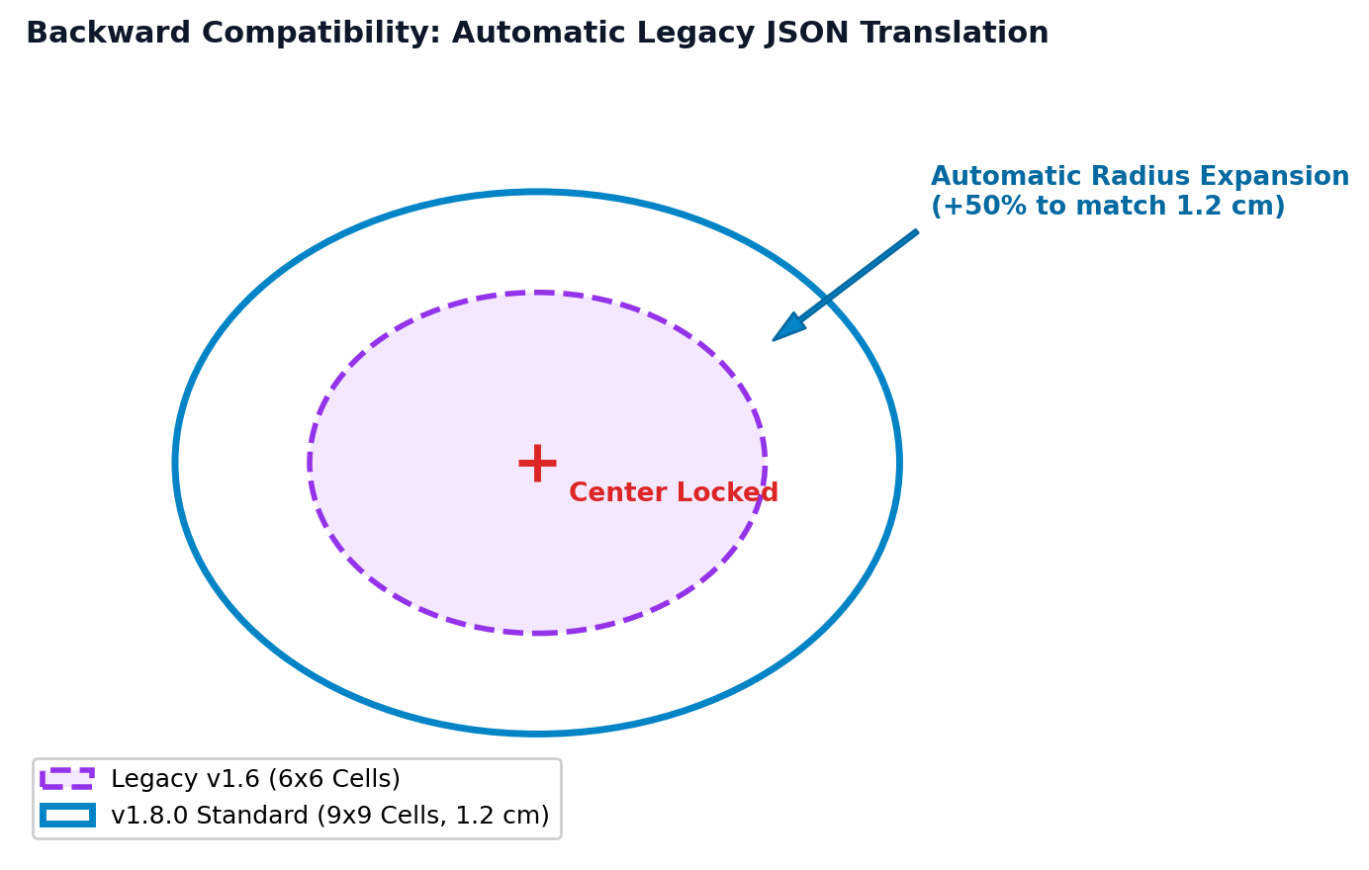
STEP 4 9×9 Grid Standardization System
Physical calibration, 81 sub-cell matrix, and seamless legacy session auto-upgrade
1. Exact 9×9 Cell Dimension
2. Dynamic Distance Sync
3. Seamless Auto-Upgrade
• Standardizes each landmark circle to exactly 9 grid cells in diameter (radius = 4.5 cells).
• Contains 81 subcells for micro-gradient tracking across the plantar sole.
• Camera distances vary across clinical sessions (closer vs farther).
• The software dynamically scales on-screen pixels so the physical skin footprint stays constant: exactly 1.2 cm.
• When loading older sessions (v1.6 / v1.7 with 6×6 circles), the app auto-enlarges the radius to standard 9×9.
• Center points stay locked in place: historical annotations are instantly modernized.

Slide 6
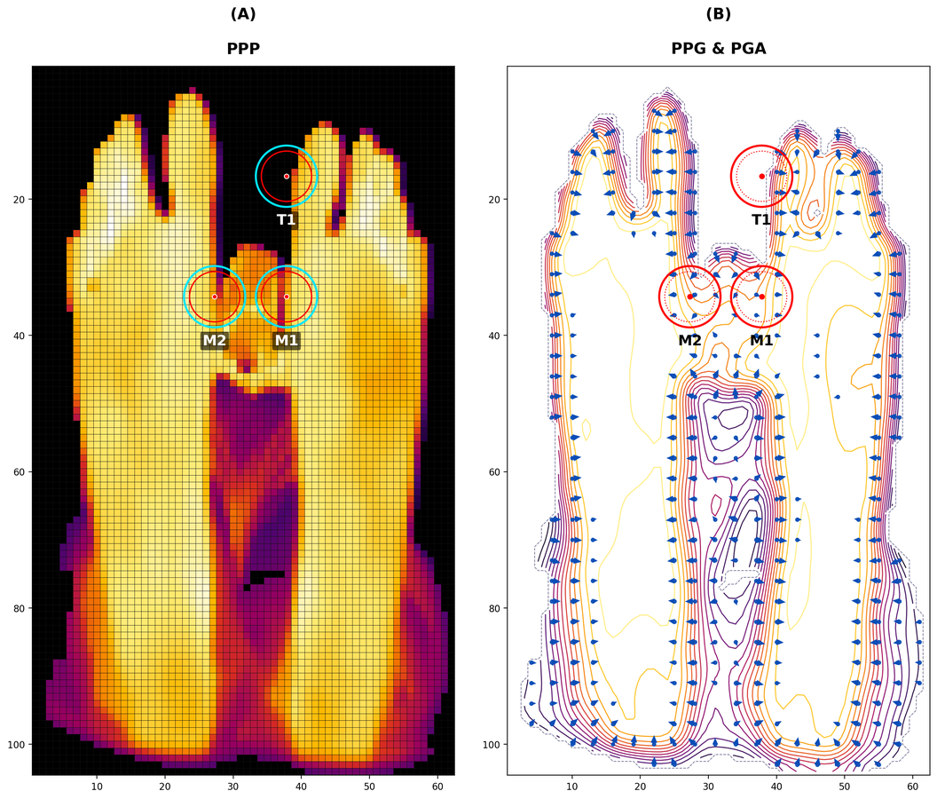
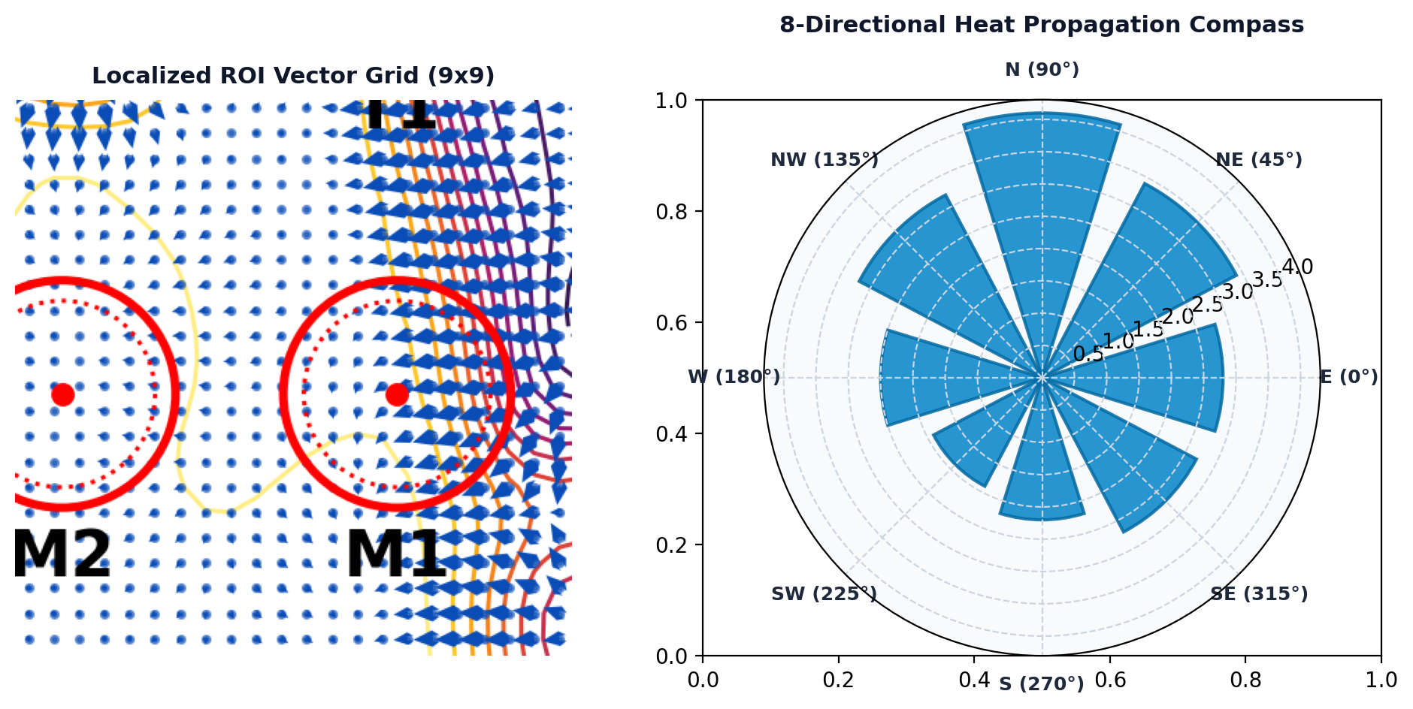
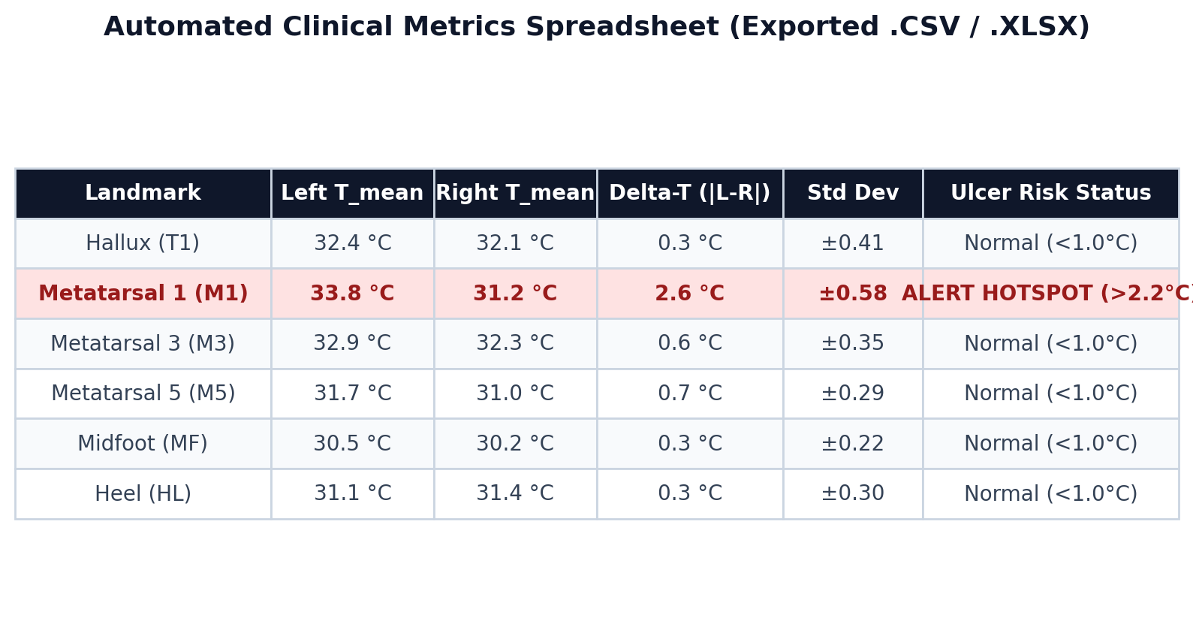
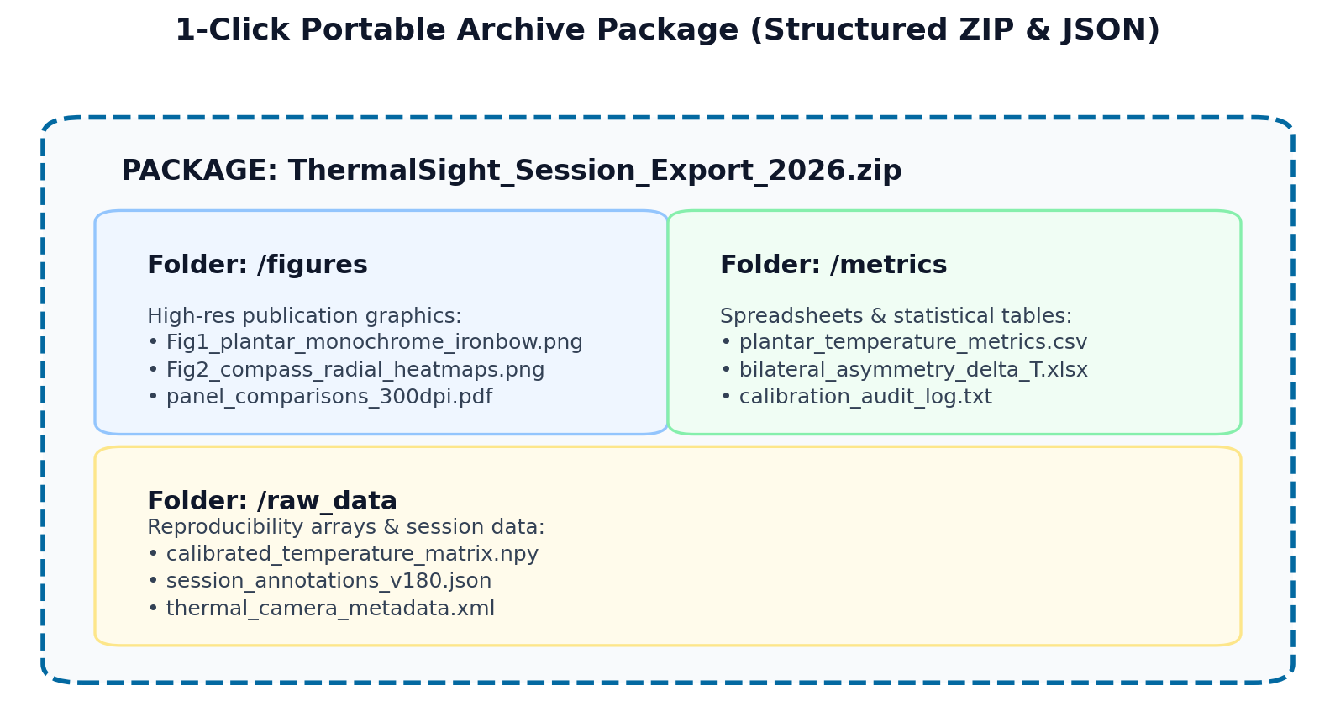
STEP 5 Final Deliverables & Results (Output Package)
Comprehensive visual overview: 4 standardized publication and clinical outputs
1. Journal Publication Figure 1
• High-contrast monochrome foot with false-color ROIs.
• Precision hairline grids ready for journal submission.
2. Directional Heat Spread (Compass)
• Samples thermal propagation in 8 compass directions.
• Localized 9×9 vector grid reveals inflammation flow.
3. Automated Metrics (CSV / Excel)
• Min, max, mean temps per landmark with asymmetry.
• Flags hotspots exceeding clinical ulcer risk threshold.
4. 1-Click Portable Archive (ZIP)
• Bundles figures, matrices (.npy), and metadata (.json).
• Portable package for complete research reproducibility.

Slide 7
STEP 5 — DELIVERABLE 1 Plantar Overview Figure 1 (Publication Grade)
Bilateral comparison: Visible-light anatomy vs calibrated thermal map
Key Scientific Features
• Panel A (PPP): Visible grayscale foot contour with locked aspect ratio and millimeter scale bar.
• Panel B (Thermal): Calibrated temperature map with 9×9 ROI circles rendered in high-contrast Ironbow palette.
• Dynamic Colorbar: Embedded temperature scale (°C) with calibrated min/max limits.
• Journal Compliance: Exported at 300 DPI, ready for direct submission to medical journals (IEEE, Elsevier, Springer).

Slide 8
STEP 5 — DELIVERABLE 2 8-Directional Heat Spread Maps (Compass)
Quantifying radial heat propagation vectors across plantar tissue
Directional Inflammation Analysis
• 8 Compass Vectors: Evaluates temperature flow in cardinal directions (N, NE, E, SE, S, SW, W, NW).
• Gradient Magnitudes: Detects whether heat is escaping toward the toes or radiating into the midfoot arch.
• Early Ulcer Warning: Identifies asymmetric heat plumes before physical skin breakdown occurs.
• Polar Radar Rose: Provides an intuitive visual summary for rapid clinical consultation.

Slide 9
STEP 5 — DELIVERABLE 3 Automated Tabular Metrics (CSV / Excel)
Numeric temperature statistics and bilateral asymmetry screening
Clinical Screening Rules
• Bilateral Comparison: Calculates Delta-T (|Left - Right|) for corresponding foot landmarks.
• International Rule: Temperature asymmetry > 2.2 °C indicates high risk of acute inflammation or impending ulceration.
• Automated Flagging: Highlights high-risk zones in red for immediate clinical attention.
• Audit Trail: Exports pixel-to-cm calibration metrics alongside temperature statistics.

Slide 10
STEP 5 — DELIVERABLE 4 1-Click Portable Archive (Structured ZIP & JSON)
Complete research package: Figures, spreadsheets, and reproducible raw data
Complete Data Reproducibility
• Self-Contained Package: Everything needed for audits, presentations, and peer-reviewed journals in 1 archive.
• Raw Arrays (.npy): Preserves original 16-bit thermal matrices for secondary algorithm verification.
• JSON Session Backup: Allows reopening the session in ThermalSight anytime without re-annotating.
• Medical Record Friendly: Easy to attach to hospital Electronic Health Records (EHR).

