Slide 1





FemSafe
Data for Justice:
Mapping and Predicting Femicide in Kenya
A Data-Driven Approach to proactive intervention

Slide 2


MEMBERS
CORNELIUS NGATIA
EDWIN CHELIMO
BLAISE MWANGI
MICHELLE USAGI

Slide 3


PROBLEM STATEMENT
Femicide in Kenya , the gender-based killing of women , is a growing crisis.
Often underreported or misrepresented as domestic violence.
Media reports exist but are scattered and unstructured.
Current interventions are reactive, not data-driven

Slide 4


PROJECT OVERVIEW
“History of Woman Suffrage”
This project aims to analyze, map, and predict femicide cases in Kenya using data science:
• Clean and analyze publicly available femicide data
• Identify temporal, geographic, and demographic patterns
•Build machine learning models to predict risk
• Use NLP to extract insights from narrative case reports
• Deploy an interactive dashboard for stakeholder use
“Why We Picket”

Slide 5


PROJECT OBJECTIVES
To develop an AI-powered system that analyzes user-reported messages and behavior patterns to detect early signs of gender-based violence and potential femicide risk.
To provide real-time safety features such as a panic button, emergency contact alerts, and access to support services including counseling, shelters, and legal aid
To prevent femicide in Kenya by identifying early warning signs, empowering at-risk individuals, and enabling timely intervention through technology, data, and community support
To raise awareness and educate users on recognizing abuse, understanding their rights, and building safety plans through localized, culturally relevant content

Slide 6
KEY STAKEHOLDERS
who is involved ?
NGOs & Civil Society: Provide support, use risk tools, offer shelters.
Law Enforcement: Use predictive tools to prioritize protective action.
Healthcare Providers: Flag recurring injuries or delayed reporting patterns.
Judiciary & Legal: Incorporate risk indicators into legal rulings and protection
Government: Allocate resources and design GBV prevention policies.

Slide 7
PROJECT WORKFLOW OVERVIEW
1
3
2
EDA
Class, fake/real, and age distribution plot
Sentiment Analysis:
- Calculate sentiment score using TextBlob
- Plot sentiment score distribution by risk level
Feature Correlation:
- Plot correlation heatmap between sentiment score and meta-features
Data Loading and Initial Exploration
Data Cleaning
4
FEATURE ENGINEERING
Add sentiment_score and risk_keyword_count to features
TF-IDF + meta-features
5
Dimensionality Reduction
Apply PCA for visualizing feature space
7
6
MODEL EVALUATION
Classification reports & confusion matrices
SHAP Explainability:
- Local & global feature importance for ML models
- SHAP applied to BERT outputs
MODEL BUILDING
Logistic Regression
BERT Transformer Model:
- Fine-tune DistilBERT for classification
- Save and load model
8
Conclusion

Slide 8




DATA AND METHODOLOGY
•A dataset of femicide cases in Kenya from 2016 to 2023.
•Includes columns like title, text, location, suspect relationship, Type of femicide, Mode of killing, and circumstance
METHODOLOGY
•Data preprocessing : Cleaning and preparing raw data
•Text Analysis : Using TF-IDF Vectorization and sentiment analysis
•Machine learning : Trained models like Logistic regression, RandomForest, DistilBert.

Slide 9
FINDINGS
•Geographic Patterns: Cases are disproportionately concentrated in major urban centers and their surrounding areas.
•Relationship Dynamics: A significant majority of victims were killed by a current or former intimate partner.
•Common Killing Modes: The most frequent methods identified were stabbings and strangulation.
Missing Data: A notable number of cases lacked information for key fields like label, femicide_type, and circumstance, highlighting a challenge in data collection
Your paragraph text

Slide 10
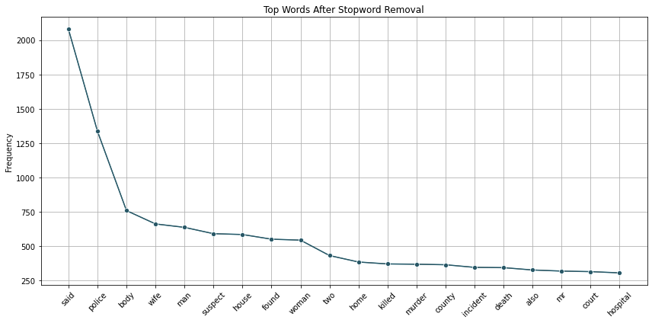
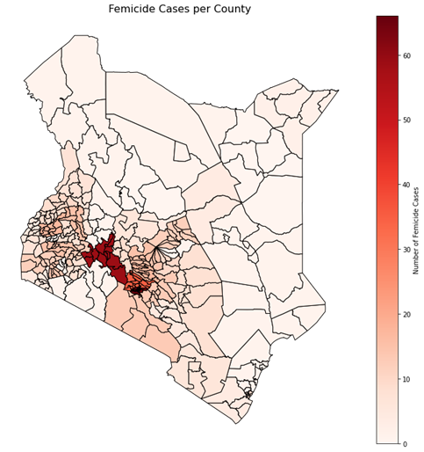
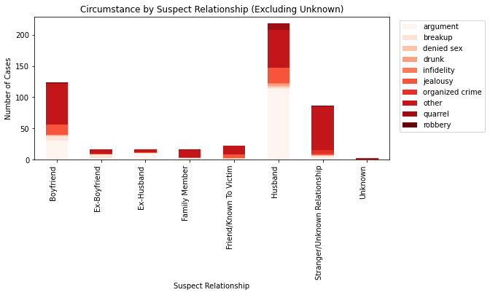
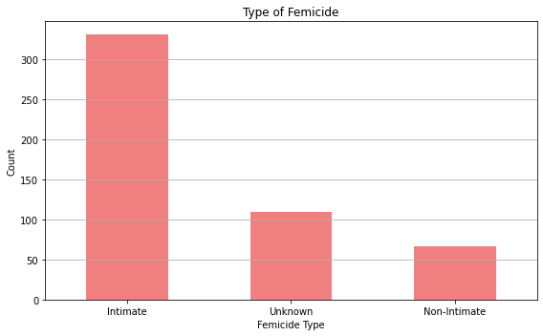
TOP words
Femicide by county
Type of femicide
Circunstance by suspect relationship
Your paragraph text

Slide 11
Advanced Model - DistilBERT
MODELING
Why BERT?
Transformer-based model that understands context in text better than traditional methods
Pre-trained on large text corpus → fine-tuned for our data
What we did:
Used DistilBERT (lightweight BERT) for efficiency
Fine-tuned with our dataset
Used Hugging Face Transformers library
Baseline Model - Logistic Rgression
How we used it:
TF-IDF vectorization for text
Train-test split
Measured metrics: Accuracy, Precision, Recall, F1
Results Example:
Accuracy: 78%
F1: 0.76

Slide 12
MODEL EVALUATION
•
MODEL | ACCURACY | PRECISION | RECALL | F1-SCORE
LOGISTIC REGRESSION | 97 | 100 | 91 | 95
DISTILBERT | 97 | 97 | 97 | 97
Your paragraph text

Slide 13
DEPLOYMENT
The model was deployed to make it usable for others
How it was deployed:
Saved model with save_pretrained()
Streamlit app for predictions
Allows users to input a text narrative and get risk prediction instantly
•
LIMITATIONS
Limited dataset size
Model overfitting risk
Ethical concerns around misclassification

Slide 14
Translating Data Into Action
RECOMMENDATIONS
•Create Integrated Platforms: Develop a central platform where NGOs, police, and healthcare providers can securely share and access risk-assessment data.
Develop Training Programs: Educate law enforcement and social workers on how to use the predictive tools and dashboards effectively.
Implement a Pilot Program: Launch the risk detection system in a specific, high-risk region to test its efficacy and gather feedback for improvements..
.

Slide 15

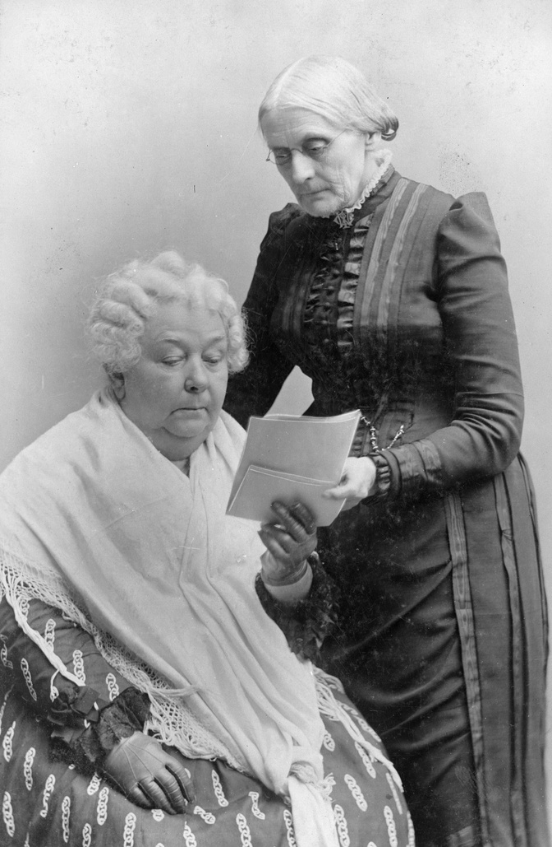

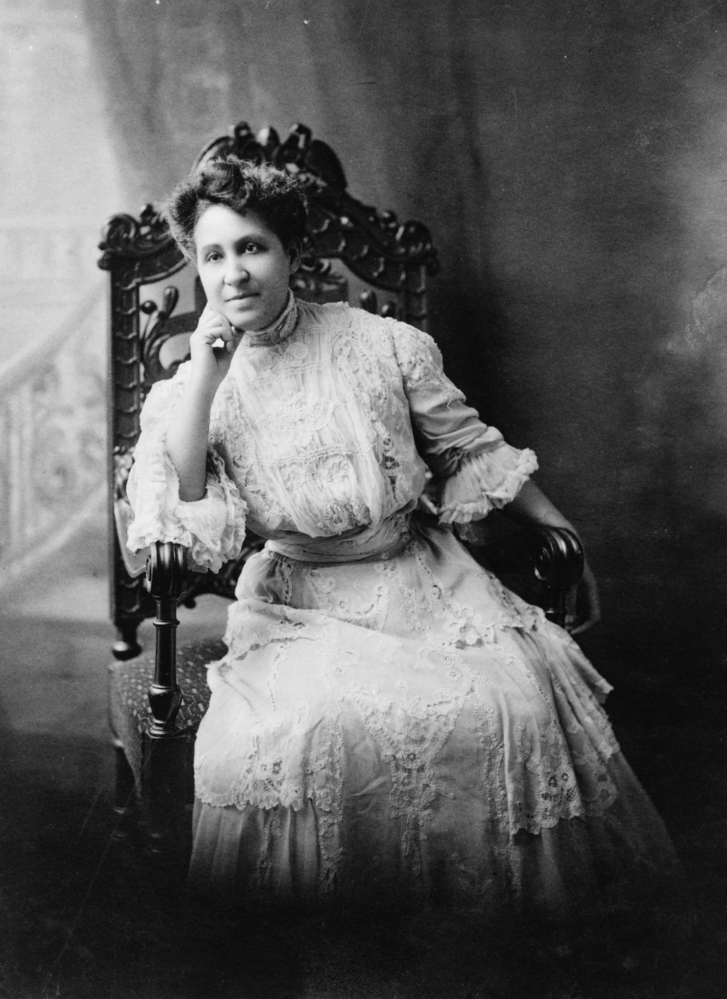
NEXT STEPS
The Road Ahead
•Model Refinement: Continuously update and retrain the model with more diverse and real-time data to improve accuracy.
•Ethical Oversight: Establish a dedicated ethics committee to oversee the deployment and use of the predictive system.
•Expand Data Sources: Integrate additional data, such as call center logs, social media data (with consent), and court records to enhance the model's predictive power.
•Public Awareness: Launch public campaigns to inform communities about the new system and how they can report potential cases of GBV.

Slide 16


CONCLUSION
A shift from Reactive to Proactive
Data reveals clear temporal, demographic, and relationship-based risk patterns.
Logistic Regression, Random Forest, and DistilBERT effectively identified high-risk cases.
SHAP provided transparency and interpretability.
Shifts response from reactive crisis management to proactive prevention and protection.
Emphasizes privacy, bias mitigation, and human oversight.

