Slide 1
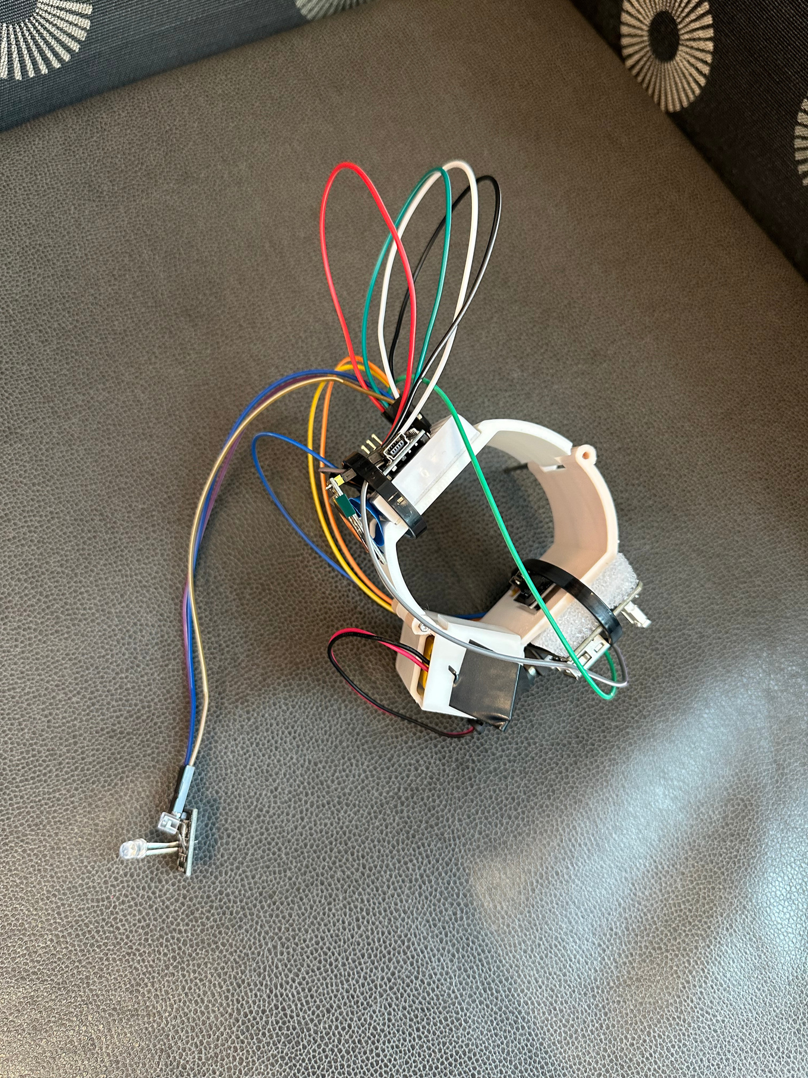

HypoAlert
A low-cost, kid-friendly warning system for hypoglycemia
Caleb Takiguchi
Ethan Hau
Keisuke Kwong
Nicholas Biega
Notes:
Hi, my name is Caleb
I'm Ethan
I'm Keisuke
and I'm Nick
And we are the creators of HypoAlert, a low-cost, kid-friendly warning system for hypoglycemia.

Slide 2
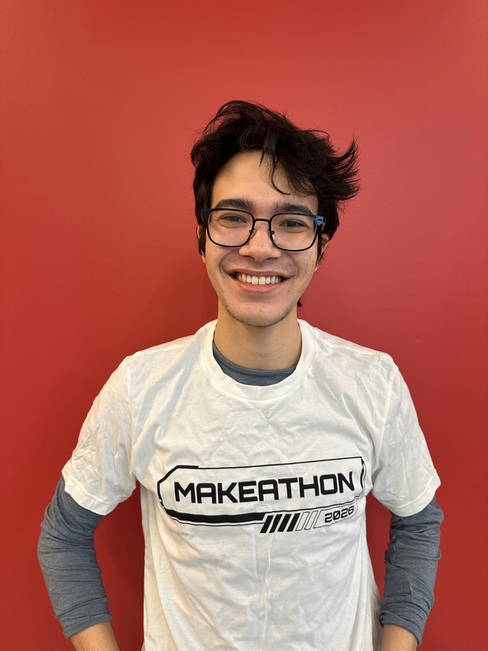
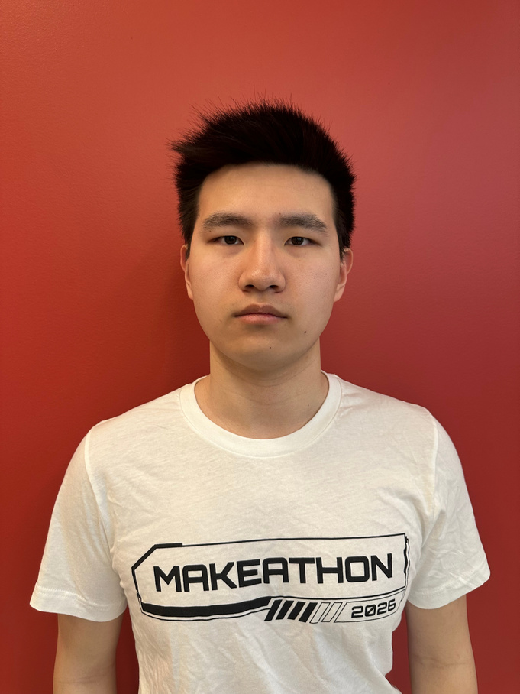
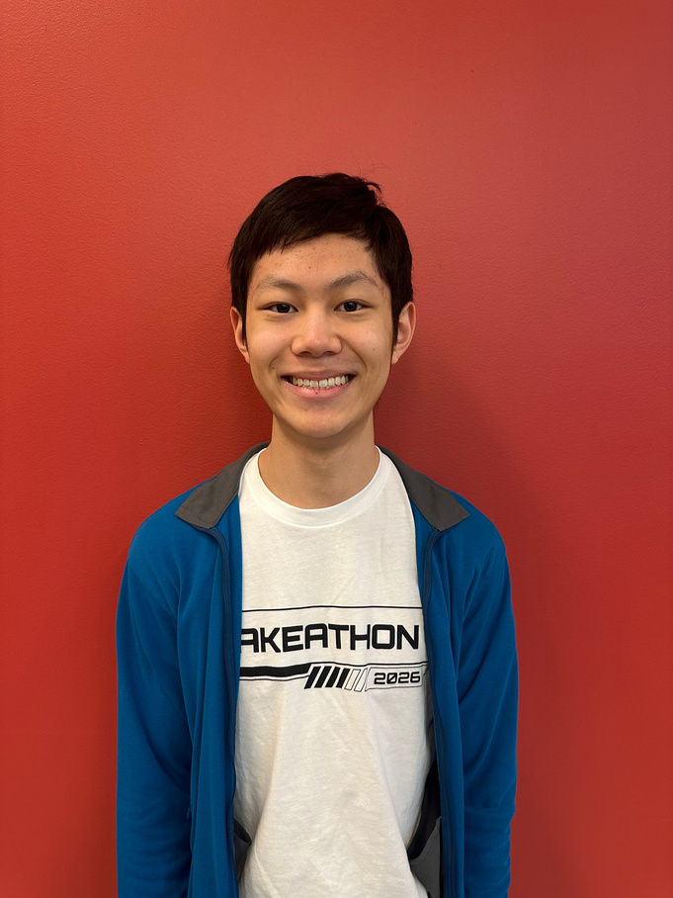

Our Team
Nick Biega
ECE
Ethan Hau
ECE
Keisuke Kwong
MechE
Caleb Takiguchi
BME
Notes:
A little about our team.
Nick - I'm a freshman ECE major, and I worked on desgining the
Ethan - I'm a freshman ECE major, and I worked on designing the
Keisuke - I'm a freshman MechE major, and I worked on desgining the cuff and
Caleb - I'm a freshman BME major, and I worked on the initial idea and it's impacts.

Slide 3
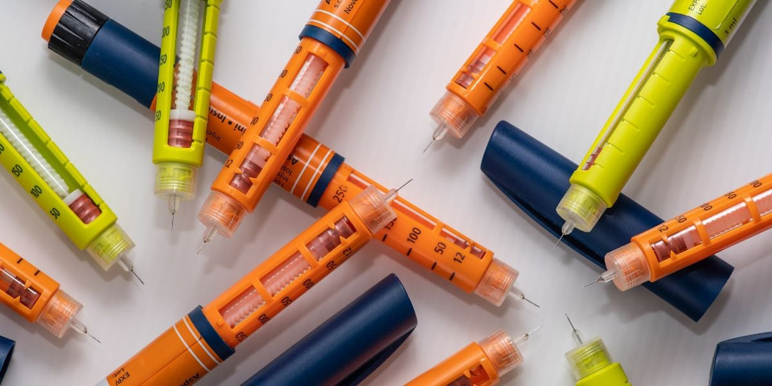

The Problem
Current methods for detecting hypoglycemia are inconsistent, expensive, and invasive.
Prevalence of diabeties
https://www.diabetes.co.uk/insulin/diabetes-and-insulin-pens.html
Insulin treatments are not perfect
Accessibility for young kids
Notes:
Diabetes is a growing issue, especially with kids, where it is on the rise.
One of the most common treatments is insulin injections, which are available but often come with side effects.
In particular, younger kids who are on insulin can be ask risk for hypoglycemia, when their injected insulin drops their blood sugar dangerously low.
Current methods for detecting hypoglycemia are inconsistent, expensive, and invasive.

Slide 4
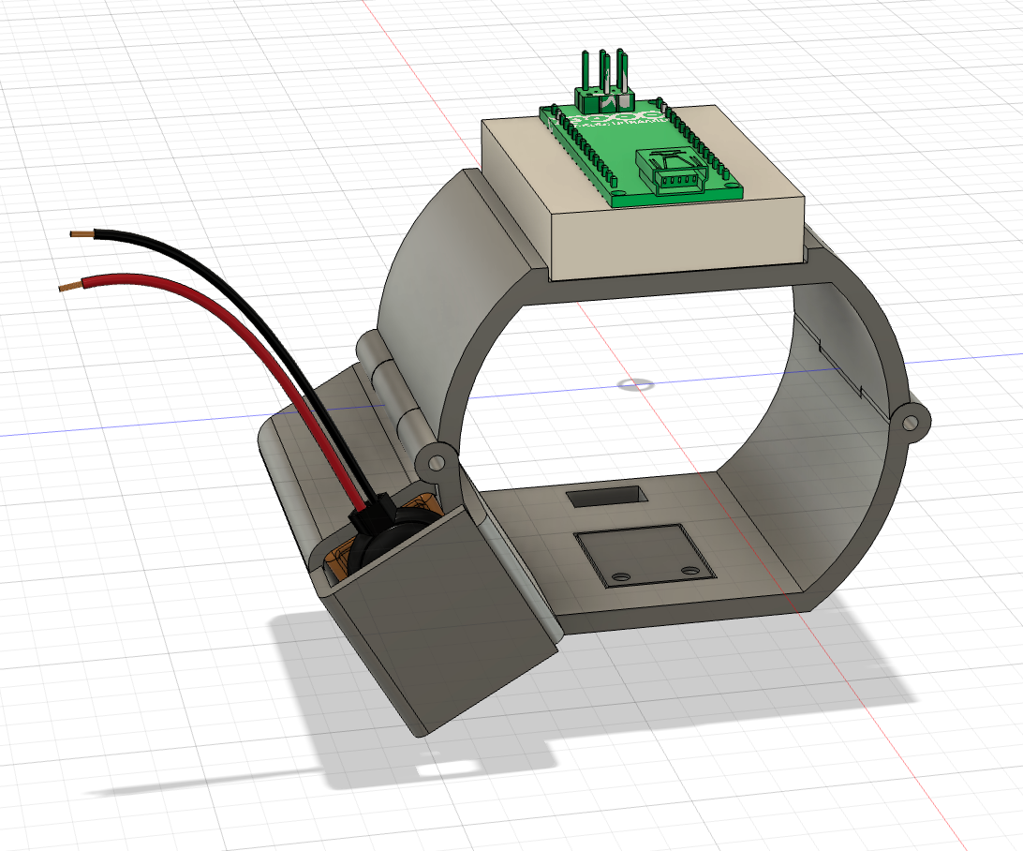
Our Solution
HypoAlert
Features:
  Integrated sensors
    Heartbeat
    Temperature
    Sweat
    Tremors
  Light, non-invasive design
    Easy-wear, lightweight cuff
    Child-friendly clasp
  Real, constant data and feedback
    Monitors 24/7
    Gives alerts when changes are detected
Notes:
To solve this issue, we developed a bracelet that senses symptoms of hypoglycemia due to insulin treatments.
It tracks heartbeat and skin temperature, getting a baseline of the individual’s normal levels and altering them when those factors indicate their blood sugar is dangerously low.
This is a non-invasive indicator specifically for kids, particularly in low-income communities where more expensive treatments like continuous glucose monitors are unattainable.

Slide 5
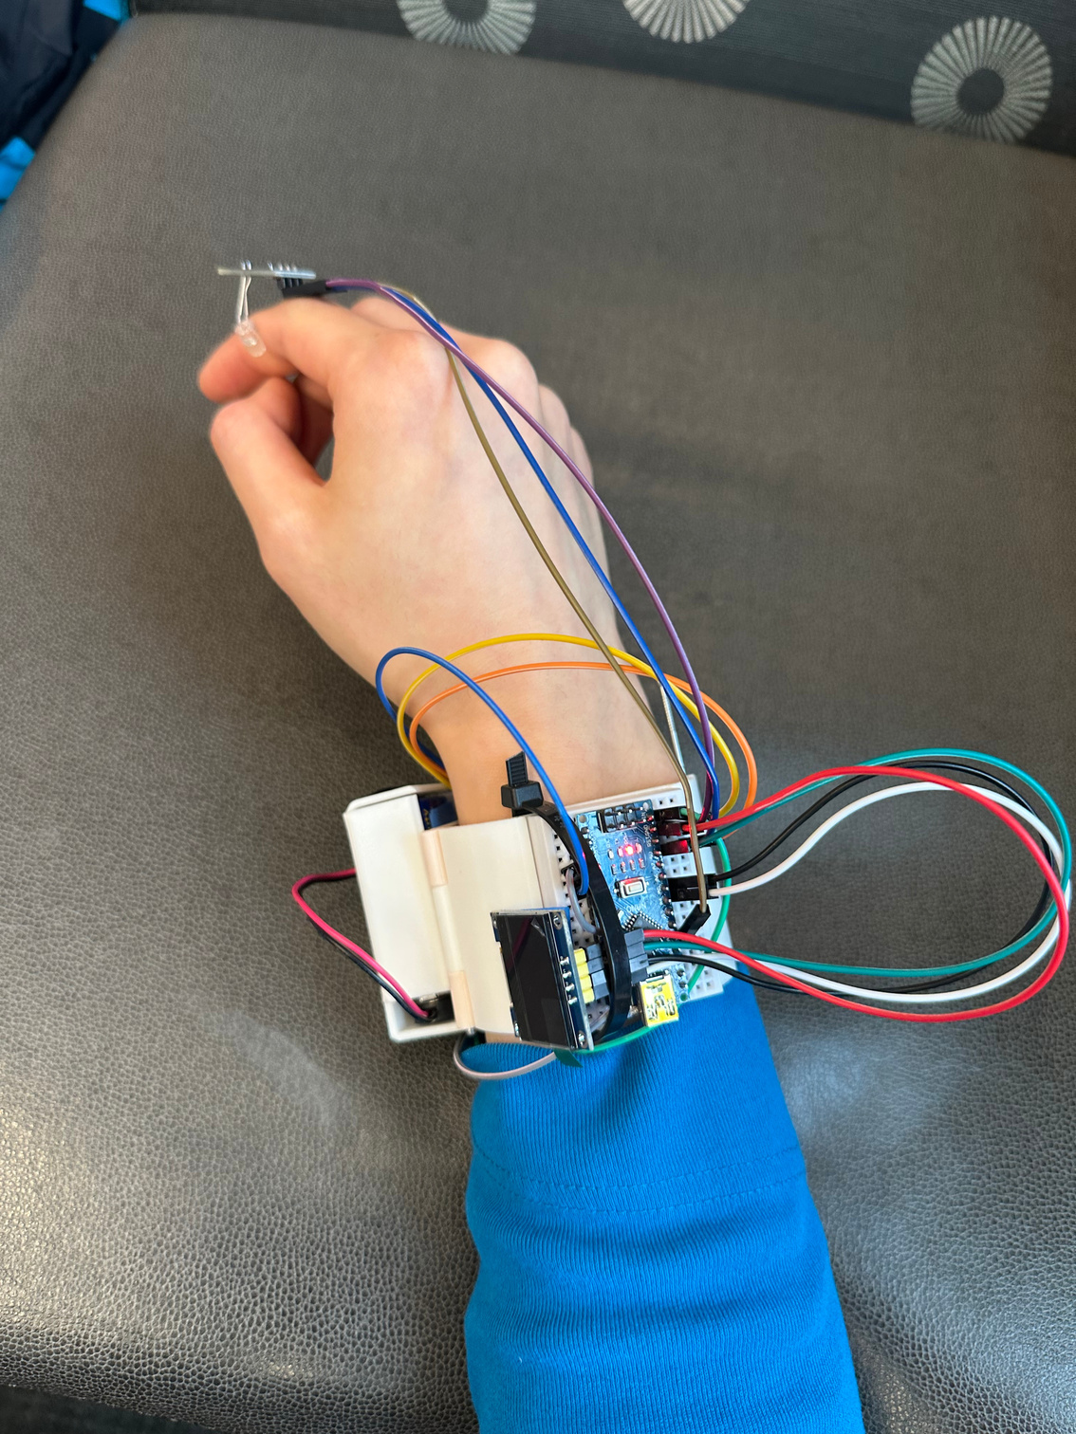

Our MVP
HypoAlert
Easy-wear cuff with hinge and latch
Heart rate and skin temperature sensors
3D-printed wristband with OLED display
Notes:
Given the constraints of this competition, we created this minimum viable product, which uses a few of the features we planned out in our solution.

Slide 6
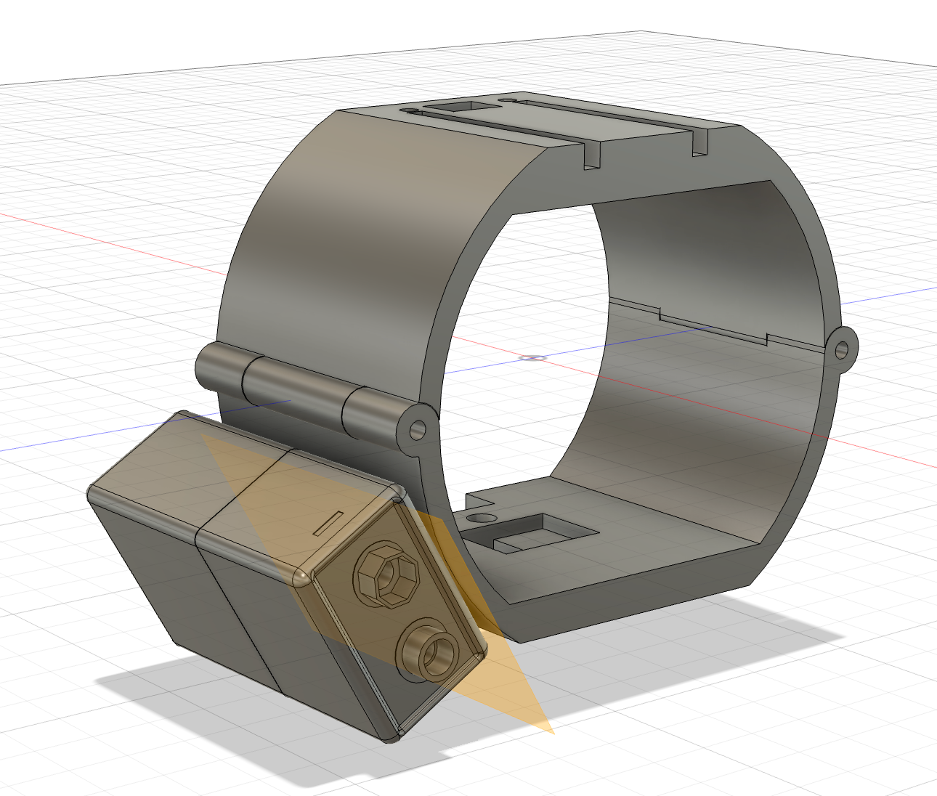

Initial Prototype
Easy-wear cuff with hinge and pin latch
Low-cost and
non-invasive
Dettachable battery holder
Iterations
Revised Design

Slide 7
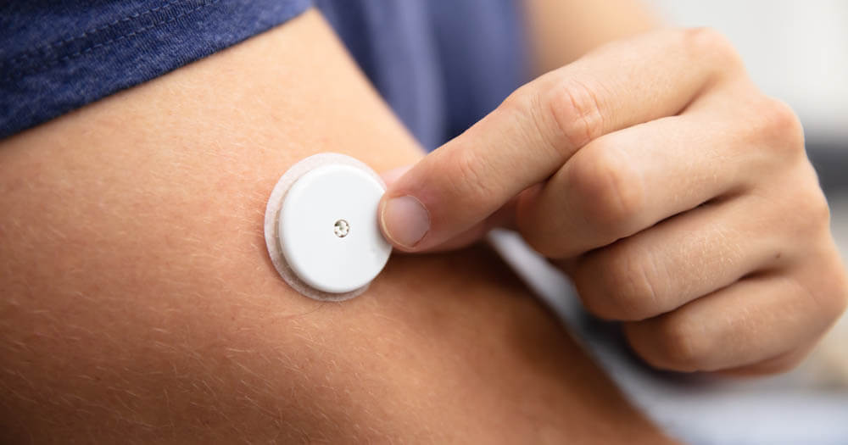
https://diabetesonthenet.com/journal-diabetes-nursing/skin-assessment/
Increased warning capabilites
Reduce false positives
Future Improvements
Affordability and accessibility
Notes:
There are a few constraints we acknowledge with our device.
One, we are limited in our warnings to the user when they are experiencing hypoglycemia, as messages can be ignored or missed depending on the activity.
Two, the device can be fooled by high-intensity activity, which can produce similar effects to hypoglycemia, including sweat and elevated heartbeat levels. However, by monitoring the body's temperature, which drops with hypoglycemia, we can avoid false positives with greater accuracy.
Finally, we are in a similar niche to continuous glucose monitors, as we track of the symptoms of hypoglycemia and they track the glucose levels themselves, but we are better suited to low-income families and those who are adverse to attaching a monitor directly in their arm.

Slide 8
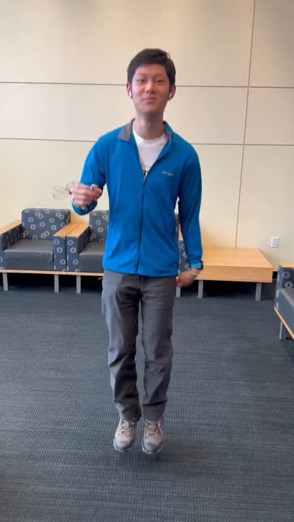

Slide 9
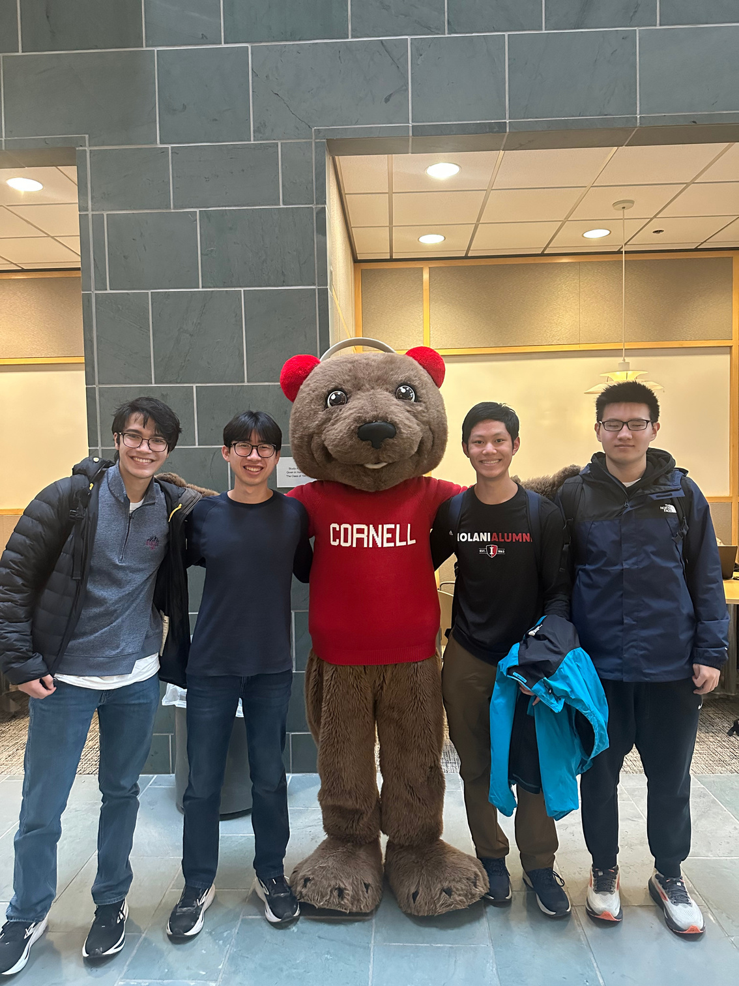
Thank you!
Any questions?
Notes:
HypoAlert is working to make hypoglycemia detection more kid-friendly, more consistent, and more accessible.
Thank you for your time!

