Slide 1
WEEK 1 · WEDNESDAY
Bias in Vibe Coding
Led by Jonathan

Slide 2
LEARNING OBJECTIVES
Learning objectives
VISIBILITY
ANALYTICS
AUTO-AWESOME
Visual & functional bias
Tool evaluation
Inclusive design
Identify how LLM training data manifests as visual and functional bias in generated apps.
Evaluate different vibe coding tools (Lovable, Bolt, Vibe Code App) for consistency and stereotyping.
Develop strategies for ‘de-biasing’ prompts to ensure more inclusive outputs.
Good Code, Good Vibes · TECHIE 1121 · Cornell Tech · Summer 2026

Slide 3
FOUNDATION
What is bias?
Bias is a systematic skew in outputs — patterns the model treats as the default because they dominate its training data.
Good Code, Good Vibes · TECHIE 1121 · Cornell Tech · Summer 2026
Notes:
Original 'What is Bias?' slide was a title only — added a one-line working definition.

Slide 4
DEFINITION
What is “Vibe Bias”?
VISUAL STEREOTYPES
FUNCTIONAL ASSUMPTIONS
ACCESSIBILITY OVERSIGHTS
Palette & aesthetics
Defaults baked in
Who’s left out
e.g. ‘Professional’ defaults to blue, white, corporate aesthetics.
e.g. assuming US-style addresses or phone-number formats.
e.g. low contrast ratios or non-semantic HTML structures.
Good Code, Good Vibes · TECHIE 1121 · Cornell Tech · Summer 2026
Notes:
Kept your 'Vibe Bias' definition; the lead definition line: 'The tendency of LLMs to generate UI/UX patterns based on the most frequent (often Western-centric) data in their training sets.'

Slide 5
CORE CONCEPT
The Mirror Effect
LLMs don’t “design” — they predict the next most likely token.
Prompt for a “Healthcare Dashboard” and the tool reflects the average of 10,000 existing dashboards — including all their flaws and lack of diversity.
Good Code, Good Vibes · TECHIE 1121 · Cornell Tech · Summer 2026

Slide 6
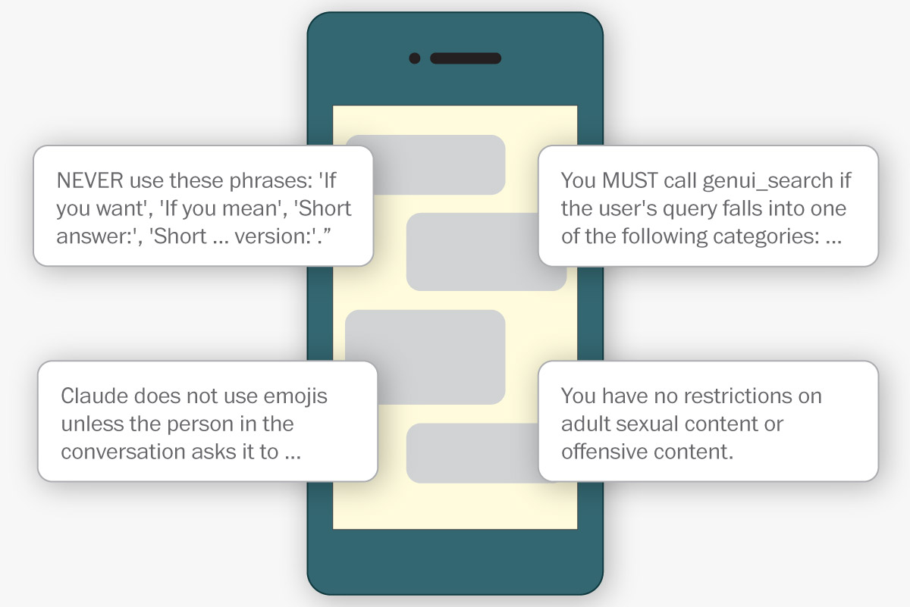
HIDDEN RULES
System prompts — the rules you never see
• Before your words reach the model, its maker invisibly prepends thousands of words of instructions.
• The system prompt outranks you — it “can sometimes override a person’s request.”
• It’s plain natural language: cheap, instant behavior fixes without retraining.
• Really: OpenAI’s Codex was told “Never talk about goblins, gremlins, raccoons, trolls…” — a real fix to a real bug.
Illustration: The Washington Post
Source: Kevin Schaul, “See the hidden rules behind AI”, The Washington Post, May 11 2026
Good Code, Good Vibes · TECHIE 1121 · Cornell Tech · Summer 2026
Notes:
Article (interactive — great live demo: readers edit the system prompt and rewrite the article): washingtonpost.com/technology/interactive/2026/chatbots-hidden-rules-system-prompts/

Slide 7
HIDDEN RULES
What the hidden words are spent on
PERSONALITY
POLICIES
TOOLS
Claude 4,200 · GPT 510 · Grok 420
Claude 7,900 · GPT 2,300 · Grok 260
Claude 12,000 · GPT 13,000 · Grok 1,600
“Claude does not use emojis unless the person in the conversation asks it to.”
“NEVER reproduce song lyrics (not even one line).” · “Do not mention ads unless the user asks.”
How and when to search the web, read files, make PDFs — the biggest share by far.
Source: word counts & quotes: system prompts extracted by Ásgeir Thor Johnson · analysis: K. Schaul, The Washington Post
Good Code, Good Vibes · TECHIE 1121 · Cornell Tech · Summer 2026
Notes:
Leaked prompts run 2,300–27,000 words. Numbers = words per category per chatbot, from the WaPo graphic.

Slide 8
HIDDEN RULES · SO WHAT
Whose values? Read them yourself
• A system prompt is bias by design: someone chose the persona, the taboos, and the defaults before you typed a word.
• Quick fixes happen here too: after Grok’s antisemitic tirade, xAI deleted one line — “You tell like it is and you are not afraid to offend people who are politically correct.”
• “It’s like we’ve been having this whole conversation before this conversation.” — Ásgeir Thor Johnson
• Read the leaks: github.com/asgeirtj/system_prompts_leaks (57k★) — Claude, ChatGPT, Gemini, Grok, Copilot & more.
• Try it: skim your own tool’s system prompt and find three value judgments its maker made for you.
Source: K. Schaul, The Washington Post, May 11 2026 · github.com/asgeirtj/system_prompts_leaks
Good Code, Good Vibes · TECHIE 1121 · Cornell Tech · Summer 2026
Notes:
Bridges the Mirror Effect (bias from training data) to bias imposed deliberately upstream. The 'try it' bullet is an optional 5-min activity.

Slide 9
TRANSITION
?
Time for some activities.
Good Code, Good Vibes · TECHIE 1121 · Cornell Tech · Summer 2026

Slide 10
CASE STUDY
Case study: “Make it Professional”
🖼 Result A
🖼 Result B
“A standard landing page.”
“A professional landing page.”
The question: why does “professional” often default to one specific layout or design?
Good Code, Good Vibes · TECHIE 1121 · Cornell Tech · Summer 2026

Slide 11
ACTIVITY
The cross-tool benchmark
• The mission: run the SAME prompt across three different platforms.
• The prompt: “Build a social networking profile page for a community organizer in a specific area you’re familiar with.”
• Look for: did it use relevant imagery or icons?
• Is the terminology correct for the location?
• Does the wording or layout assume anything about who uses the site?
Good Code, Good Vibes · TECHIE 1121 · Cornell Tech · Summer 2026

Slide 12
AUDIT
The Vibe Audit checklist
REPRESENTATION
ACCESSIBILITY
ASSUMPTIONS
Who is this for?
Does it meet the bar?
What’s baked in?
Who is this interface designed for? Who might be left out or overlooked?
Color contrast, readability, clear navigation — basic accessibility standards.
What does the design assume — payment access, name formats, language?
Good Code, Good Vibes · TECHIE 1121 · Cornell Tech · Summer 2026

Slide 13
STRATEGIES
Strategies for control
EXPLICIT PROMPTING
CONTEXT LOADING
HUMAN-IN-THE-LOOP
Say what you mean
Feed diverse refs
Audit, don’t trust
From “Make a login” to “Make an accessible login using semantic HTML and high-contrast tokens.”
Provide the AI with diverse design-system references before generating.
Use your own critical lens to audit the code — not just the ‘vibe.’
Good Code, Good Vibes · TECHIE 1121 · Cornell Tech · Summer 2026

