Slide 1
WEEK 3 - TUESDAY
Values at Play: The Whole Framework
Discovery -> Implementation -> Verification -> then verify your own

Slide 2
TODAY
From "can people use it?" to "what values did we build in - and did they land?"
Monday asked whether people can use your Project 2. Today we go all the way around the Values at Play loop - the method behind everything you have been doing - and then you verify your own value.
Three parts, with breaks: Discovery (what values?) -> Implementation (build them in) -> Verification (did they land?). Then the canvas, real projects, and your activity.
Good Code, Good Vibes · TECHIE 1121 · Cornell Tech · Summer 2026

Slide 3
FINAL PROJECT STARTS TODAY
Commit to your value - then join your team
Your team name IS your value. We suggest carrying your Project 2 value through the final - but you can switch, or add a secondary value.
One person accepts on GitHub Classroom and creates the team with that exact name; everyone else JOINS it - no duplicates.
Good Code, Good Vibes · TECHIE 1121 · Cornell Tech · Summer 2026

Slide 4
JOIN YOUR TEAM
Six teams - named for the value you carry
01 Security Isa . Om . Jason
02 Safety & Autonomy John . Ajin
03 Sustainability & Trust Emily . Kylie . Aria
04 Care & Wellbeing Elaine . Winnie . Vienna
05 Productivity Liam . Justin . Sebastien
06 Sustainability & Transparency Evan . Derin . Magnes . Oliver
Good Code, Good Vibes · TECHIE 1121 · Cornell Tech · Summer 2026
Notes:
Two 'Sustainability' teams - check the second word (Trust vs Transparency). Accept + join: classroom.github.com/a/VTWqWkXg. Final Project page (per-team showcase): cornell-tech-vibe-coding-summer-2026.github.io/cornell-tech-vibe-coding-summer-2026-final-project-template/

Slide 5
PART 1 - FOUNDATIONS
Do artifacts have politics?
Before you design values IN, see that they are already there

Slide 6
WINNER, 1980
?
Do artifacts
have politics?
Good Code, Good Vibes · TECHIE 1121 · Cornell Tech · Summer 2026

Slide 7
CASE - ROBERT MOSES
Overpasses that sorted who reached the beach
[ Robert Moses / Long Island parkway overpass - add image ]
The low overpasses kept buses - and the people who rode them - off the parkway. A design choice, carrying a politics.
Good Code, Good Vibes · TECHIE 1121 · Cornell Tech · Summer 2026

Slide 8
VALUES LIVE IN THE THING
A $2.90 rule, cast in steel
A subway turnstile does not argue about fare policy - it enforces it. The value (pay to ride) is built into the hardware.
Winner: an artifact can settle a political question, or require a political arrangement just to work at all.
Good Code, Good Vibes · TECHIE 1121 · Cornell Tech · Summer 2026

Slide 9
CASE - FACEBOOK ALT-TEXT
"Image may contain: 1 person, sky, crowd"
[ Facebook automatic alt-text example - add image ]
What should an AI label - gender? race? Facebook set an 80% confidence bar, higher for sensitive tags. Every one of those is a value choice.
Good Code, Good Vibes · TECHIE 1121 · Cornell Tech · Summer 2026

Slide 10
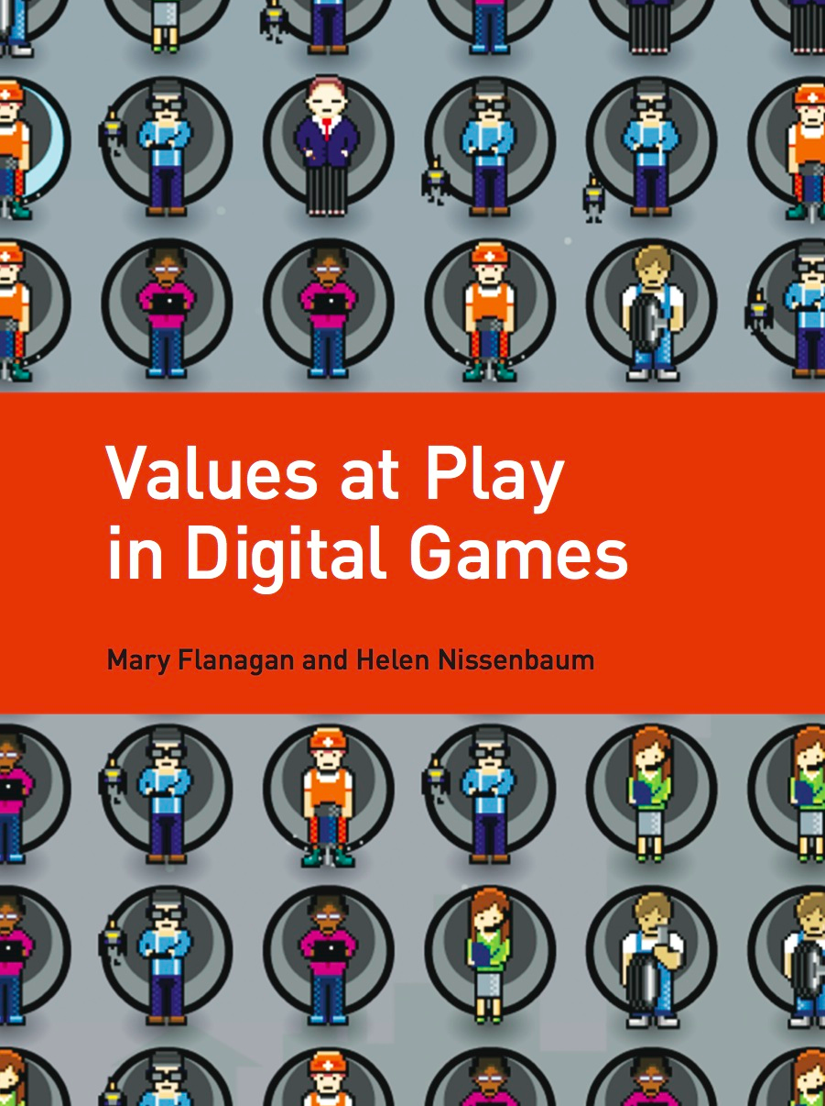
THE PRACTICAL TURN
The conscientious designer
Once values are always in the thing, the question flips: not "are there values?" but "which ones - and did I choose them on purpose?"
Values at Play is the method for doing that deliberately.
Good Code, Good Vibes · TECHIE 1121 · Cornell Tech · Summer 2026
Flanagan & Nissenbaum, Values at Play (MIT Press) - VAP course, Engelmann & Nissenbaum, Cornell Tech

Slide 11
THE HEURISTIC
Discovery -> Implementation -> Verification
One loop, three moves - and it is cyclical

Slide 12
BREAK
~10 minutes
Stretch, water. We pick up with Discovery: what values are even in play?
Good Code, Good Vibes · TECHIE 1121 · Cornell Tech · Summer 2026

Slide 13
PART 2 - DISCOVERY
What values? And what do they actually mean?

Slide 14
DISCOVERY I - CONSIDER THE SOURCES
Where the values hide
FUNCTIONAL DESCRIPTION
KEY ACTORS
CONTEXT + CONSTRAINTS
What does it do?
Who is involved?
Where does it live?
The core function already implies values - a secure messenger implies privacy; a feed implies attention.
Designers, funders, users, bystanders. Whose interests are in the room - and whose are not?
Societal norms, laws, and technical limits (screen size, bandwidth, model context) all carry values.
Good Code, Good Vibes · TECHIE 1121 · Cornell Tech · Summer 2026
Notes:
Discovery I heuristic (VAP, Engelmann & Nissenbaum). The upshot is a LIST OF VALUES - including 'collateral' values you didn't set out to touch.

Slide 15
DISCOVERY II - OPERATIONALIZE
A value is not one thing
An abstract value has to be defined before you can build it or test it:
Privacy = control? secrecy? contextual integrity?
Fairness = equal shares? or proportional to merit / need?
Your operational definition decides your design AND your test. (That is yesterday's move - and today's.)
Good Code, Good Vibes · TECHIE 1121 · Cornell Tech · Summer 2026

Slide 16
CASE - WHAT'S FAIR?
One value, incompatible definitions
THE SETUP
THE OPTIONS
THE POINT
Split a limited loan
All to A? Or share?
No free lunch
Person A repays 100%, Person B repays 20%. Identical otherwise. How do you split the money?
All to A maximizes repayment - and leaves B nothing. Proportional shares the pot but funds a worse bet.
A single algorithm can't satisfy every definition of fairness. Someone chooses - make it conscious.
Good Code, Good Vibes · TECHIE 1121 · Cornell Tech · Summer 2026

Slide 17
BREAK
~10 minutes
Back soon - next we turn values into features, and handle the clashes.
Good Code, Good Vibes · TECHIE 1121 · Cornell Tech · Summer 2026

Slide 18
PART 3 - IMPLEMENTATION
Translate values into features - and resolve the clashes

Slide 19
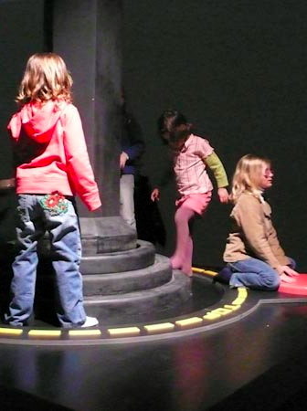
TRANSLATE
From a value to a spec
Implementation turns an ethical or political value into concrete requirements, features, and architecture.
Mary Flanagan's Giant Joystick makes "play" physical - one value, rebuilt into the hardware itself.
Good Code, Good Vibes · TECHIE 1121 · Cornell Tech · Summer 2026
Mary Flanagan, 'Giant Joystick' - Values at Play (educational use)

Slide 20
DESIGN CHOICES CARRY VALUES
The same feed, two values
Design a social-media feed for engagement, and you get autoplay, streaks, and notifications - "push people's buttons."
Design it for autonomy, and you add friction, stopping points, and real user control.
Same product. The values show up in the defaults.
Good Code, Good Vibes · TECHIE 1121 · Cornell Tech · Summer 2026

Slide 21
WHEN VALUES CLASH
Name the resolution - out loud
DISSOLVE
COMPROMISE
TRADE-OFF
Redesign around it
Each in part
Sacrifice one
Find a design where BOTH values hold. (Vacuum: on-device maps, nothing to the cloud.)
Promote each value in less than full measure. (Vacuum: cloud data, but anonymized + opt-out.)
Give one up for another - and say so out loud. (Vacuum: full collection for max automation.)
Good Code, Good Vibes · TECHIE 1121 · Cornell Tech · Summer 2026

Slide 22
BREAK
~10 minutes
Last stretch. Then: did any of it actually work?
Good Code, Good Vibes · TECHIE 1121 · Cornell Tech · Summer 2026

Slide 23
PART 4 - VERIFICATION
Did the values actually land?

Slide 24
VERIFICATION
Assessing whether the values made it in
"Verification involves assessing whether efforts to integrate values have succeeded." Cyclical - ask at every step.
Three ways to ask - and your operationalization decides which one fits.
Good Code, Good Vibes · TECHIE 1121 · Cornell Tech · Summer 2026

Slide 25
THE THREE LENSES
Behavior - Understanding - Affect
BEHAVIOR
UNDERSTANDING
AFFECT
Do they ACT differently?
Do they GRASP it?
Do they FEEL differently?
Observation, A/B, before/after, task completion.
Survey, interview, think-aloud, scenario.
Attitude survey, diary, interview, choice under pressure.
Verification lenses: Values at Play - VAP course, Engelmann & Nissenbaum (Cornell Tech)
Good Code, Good Vibes · TECHIE 1121 · Cornell Tech · Summer 2026

Slide 26
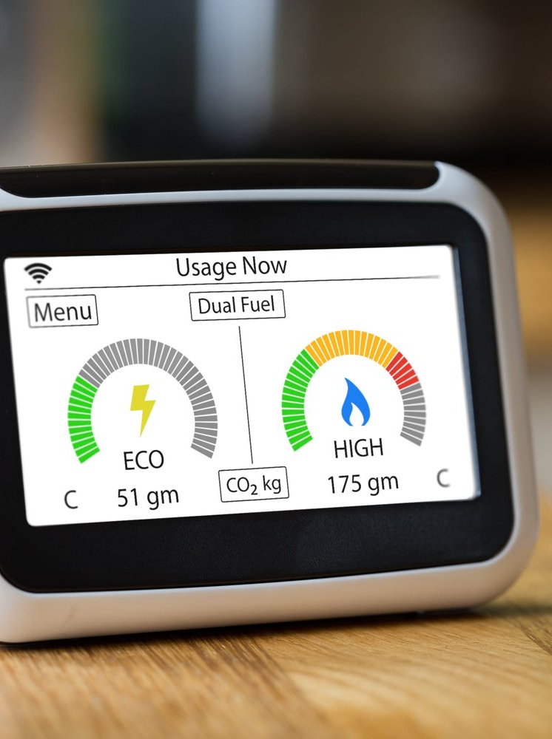
EXAMPLE - BEHAVIOR
Does the design change what people DO?
A smart meter only "works" for sustainability if people actually use less. Behavior is the sharpest test.
Verify how: prototype - A/B - before/after - task completion.
Good Code, Good Vibes · TECHIE 1121 · Cornell Tech · Summer 2026
Behavior verification (Values at Play) - smart-meter image, educational use

Slide 27
PICK THE INSTRUMENT THAT FITS YOUR VALUE
Examples - tie the tool to the value you are analyzing
• Beauty / craft / originality -> the Vibed Slop Detector (is it generic AI slop?), or UEQ attractiveness.
• Autonomy / competence / wellbeing -> METUX + Self-Determination scales.
• Trust / warmth / safety -> a validated scale from the HRI Scale Database.
• Overall UX beyond usability -> UEQ. The instrument has to match the value - don't default to UEQ.
Good Code, Good Vibes · TECHIE 1121 · Cornell Tech · Summer 2026

Slide 28
FROM OUR RESEARCH
“
Persuasion-focused evaluation nearly DOUBLED how often professional designers rejected dark-pattern designs - and shifted their reasoning from business justifications toward user autonomy and well-being.
— Sandhaus, Rhomberg & Nissenbaum, CHIWORK 2026 - a study of 141 UX professionals
Measuring a value doesn't just describe it - it changes what gets built. That is why verification is not optional.
Good Code, Good Vibes · TECHIE 1121 · Cornell Tech · Summer 2026

Slide 29
PART 5 - IN PRACTICE
The VAP canvas + real projects

Slide 30
THE FIGJAM CANVAS
One board, the whole loop
[ walk the 'Vibing Values' canvas live ]
figma.com/board/.../Vibing-Values - each tab is one move (Discovery / Implementation / Verification). We walk them as connected case studies.
Good Code, Good Vibes · TECHIE 1121 · Cornell Tech · Summer 2026

Slide 31
PITECH PROJECTS
Fellows who ran the whole framework
[ show the PiTech projects + website - add screenshots ]
Real value-driven projects, and what worked - and what was hard - when teams used VAP end to end.
Good Code, Good Vibes · TECHIE 1121 · Cornell Tech · Summer 2026

Slide 32
NOW YOU (TEAM)
Verify the value your Project 2 claims.
→ State how you operationalize your value - that definition decides the method.
→ No time to run tests: RESEARCH how each lens could be verified (behavior especially) + what design interventions have worked.
→ Does it deliver the value - for whom, and who's left out? Then: what would you change?
▶ A value-centered user RESEARCH deck + a reflection on FigJam - each person owns a slide + a lane - due today
Good Code, Good Vibes · TECHIE 1121 · Cornell Tech · Summer 2026
Notes:
Hand back to the activity. Language note: no 'verdict' - just 'does it deliver the value, and for whom?'

Slide 33
FIND YOUR PAPER - EACH PERSON
Section 04 is individual: real evidence, found with AI search
For your named slide, find ONE real paper on a design intervention that tried to move your value:
Claude / ChatGPT (ask for real, citable papers - then open + check them), Elicit, Semantic Scholar, Google Scholar - and its new Scholar Labs.
Never invent a citation. Open the actual paper and confirm it says what you think.
Good Code, Good Vibes · TECHIE 1121 · Cornell Tech · Summer 2026

Slide 34
QUIET READING
15 minutes - read the paper YOU found
Phones away. Individual. This is the discovery reading - it fills your section-04 slide (FigJam: 04 Outlook).

Slide 35
WHILE YOU READ
Pull out what your slide needs
From the paper you found, mark:
1. the design intervention they tried - what exactly did they change?
2. the result - did it move the value? worked / mixed / failed
3. whether it supports OUR design direction
Then put it on your named slide (section 04), with the citation.
Good Code, Good Vibes · TECHIE 1121 · Cornell Tech · Summer 2026
Notes:
Protected, individual reading of the paper each person found via AI academic search (Claude / ChatGPT / Elicit / Semantic Scholar / Google Scholar Labs). This is the discovery reading the timer is built around - keep it silent.

Slide 36
SOURCES
Read + cite
Flanagan & Nissenbaum - Values at Play in Digital Games (MIT Press, 2014) — mitpress.mit.edu
Winner - Do Artifacts Have Politics? (Daedalus, 1980) — the Robert Moses + turnstile cases
van de Poel - Translating Values into Design Requirements (2013) — implementation
VAP course - S. Engelmann & H. Nissenbaum — Cornell Tech - INFO 5010 (PiTech Ethics)
Sandhaus, Rhomberg & Nissenbaum 2026 - User Testing Promotes Ethical Sensibility (CHIWORK) — osf.io/nw2tj
UEQ - ueq-online.org | HRI Scale DB | METUX / SDT scales — verification instruments
Vibed Slop Detector + impeccable.style slop rules — github.com/HaukeCornell/Vibed-Slop-Detector
Good Code, Good Vibes · TECHIE 1121 · Cornell Tech · Summer 2026

