Slide 1
WEEK 2 · WEDNESDAY
AI Against AI
Ethics — Doing the right thing

Slide 2
TODAY
?
How is AI unethical —
and can we fight back with it?
Good Code, Good Vibes · TECHIE 1121 · Cornell Tech · Summer 2026
Notes:
3-hour class. The whole deck is a split: RED = the problem (how AI harms), GREEN = the defense (AI against AI). Say that up front so the colors read as good/bad.

Slide 3
WARM-UP · 5 MIN
When did AI last unsettle you?
→ Creeped you out, cost someone a job, got a fact wrong that mattered, or felt unfair?
→ Jot ONE harm — and one way you’d fight back against it.
▶ 2 min solo, on paper. Keep your fightback idea — you may BUILD it as your Part B this afternoon.
Good Code, Good Vibes · TECHIE 1121 · Cornell Tech · Summer 2026
Notes:
Personal and visceral on purpose — pull from their own life, not the abstract. No wrong answers. We return to these ideas right before the build; the fightback becomes a candidate Part B project.

Slide 4
⚠ ACT 1 · THE PROBLEM
How AI is unethical
An overview of the seven values AI puts at risk — then the real cases.

Slide 5
OVERVIEW · SEVEN VALUES AT RISK
What AI puts at risk
⚖️ Fairness & Justice
🔒 Privacy & Surveillance
📰 Truth & Democracy
🧠 Autonomy & Dignity
Bias encoded and amplified — unequal calls in hiring, lending, policing, and healthcare.
Personal data scraped and memorized; biometric tracking and mass surveillance.
Fluent falsehoods and cheap propaganda erode shared facts and fair elections.
Manipulative, addictive design and social scoring strip human agency.
⚠️ Safety
🌍 Labor & Environment
🎭 Accountability & Authenticity
Malicious use, deepfakes, voice-clone fraud, and companion-bot harm.
Jobs displaced onto low-paid ‘ghost work’; energy and freshwater burned.
Opaque decisions with no redress; synthetic media and style theft.
Good Code, Good Vibes · TECHIE 1121 · Cornell Tech · Summer 2026
Notes:
Convergent across the field: Weidinger et al. 2022 (FAccT), Shelby et al. 2023 (AIES), MIT AI Risk Repository, NIST AI RMF, EU AI Act all carve up roughly these categories. This is the general OVERVIEW; we go deep on the ones we can defend. Sources slide at the end.

Slide 6
HOW IT HAPPENS
The harm enters at every stage
1 · DATA
2 · TRAINING
3 · DEPLOYMENT
What it learns from
What gets baked in
Where it lands
Scraped without consent; carries society’s bias, private info, and copyrighted work into the model.
The model memorizes and amplifies patterns — including the ones we’d never choose on purpose.
Confident output at massive scale, in hiring, courts, feeds, and chats — with no one accountable.
Good Code, Good Vibes · TECHIE 1121 · Cornell Tech · Summer 2026
Notes:
Grounding slide: harms aren't one bug — they enter at data, training, AND deployment. This also previews WHERE defenses can intervene (poison the data, audit the model, detect the output).

Slide 7
REAL CASES · IN THE NEWS
It’s already happening
PBS / AP · JAN 2024
NPR · 2024
CNN BUSINESS · MAY 2024
“X blocks Taylor Swift searches as explicit AI deepfakes circulate — one post seen ~47M times.”
“An AI-cloned ‘Biden’ robocall told N.H. voters to stay home — the FCC issued a $6M fine.”
“A deepfake ‘CFO’ on a video call cost engineering firm Arup $25M in transfers.”
▸ threatens Dignity
▸ threatens Democracy
▸ threatens Security
Good Code, Good Vibes · TECHIE 1121 · Cornell Tech · Summer 2026
Notes:
Cited claims (source + date on each card), all verified. Sources: PBS/AP + NBC/CBS (Swift); NPR (NH robocall, FCC $6M); CNN Business (Arup, May 2024).

Slide 8
REAL CASES · IN THE NEWS
The automated harms
CBS / CNBC · 2026
AL JAZEERA · 2021
TECHCRUNCH · 2025
“Google and Character.AI settle a suit over a 14-year-old’s suicide after months with a companion bot.”
“A Dutch benefits algorithm branded ~26,000 families fraudsters — the government resigned.”
“Anthropic settles with authors for ~$1.5B over training on pirated books — a record.”
▸ threatens Safety
▸ threatens Fairness
▸ threatens Ownership
Good Code, Good Vibes · TECHIE 1121 · Cornell Tech · Summer 2026
Notes:
Sources: CBS/CNBC (Character.AI settlement, 2026); Al Jazeera (Dutch toeslagenaffaire, 2021); TechCrunch/Authors Guild (Bartz v. Anthropic ~$1.5B, 2025).

Slide 9
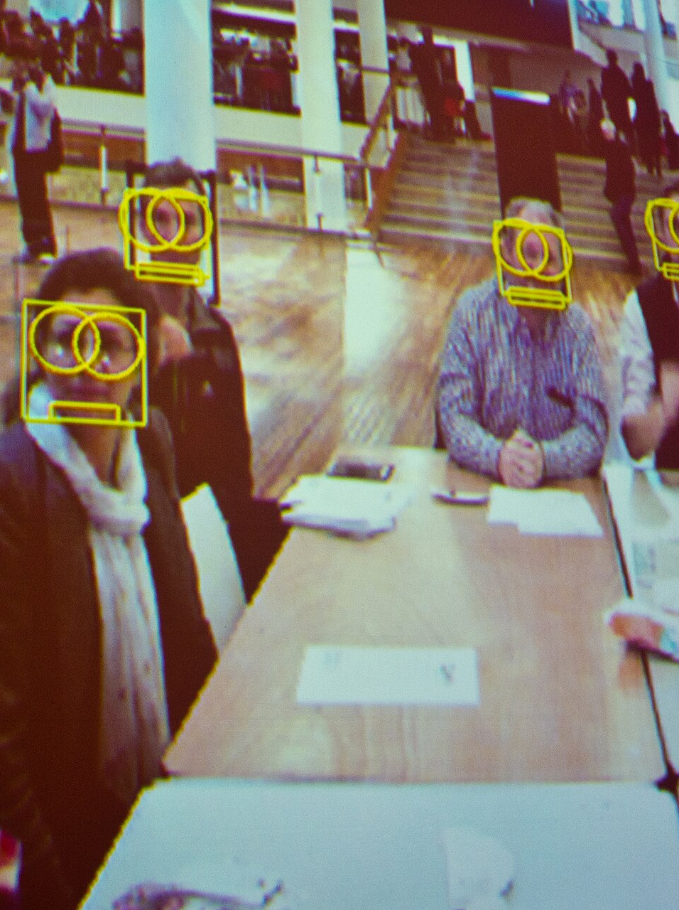
REAL CASES · PRIVACY
Your face is in the training set
Clearview AI scraped 3 billion+ faces from the web to sell facial ID to police — without anyone’s consent.
At least four Black men have been wrongly arrested on false facial-recognition matches.
Good Code, Good Vibes · TECHIE 1121 · Cornell Tech · Summer 2026
Photo: Pete Woodhead / Wikimedia Commons · CC BY 2.0
Notes:
Sources: NYT (Kashmir Hill, Clearview 2020); ACLU (Williams, Woodruff, Parks, Reid wrongful arrests). Image is a facial-recognition demo, CC BY 2.0 — illustrative, not the actual cases.

Slide 10
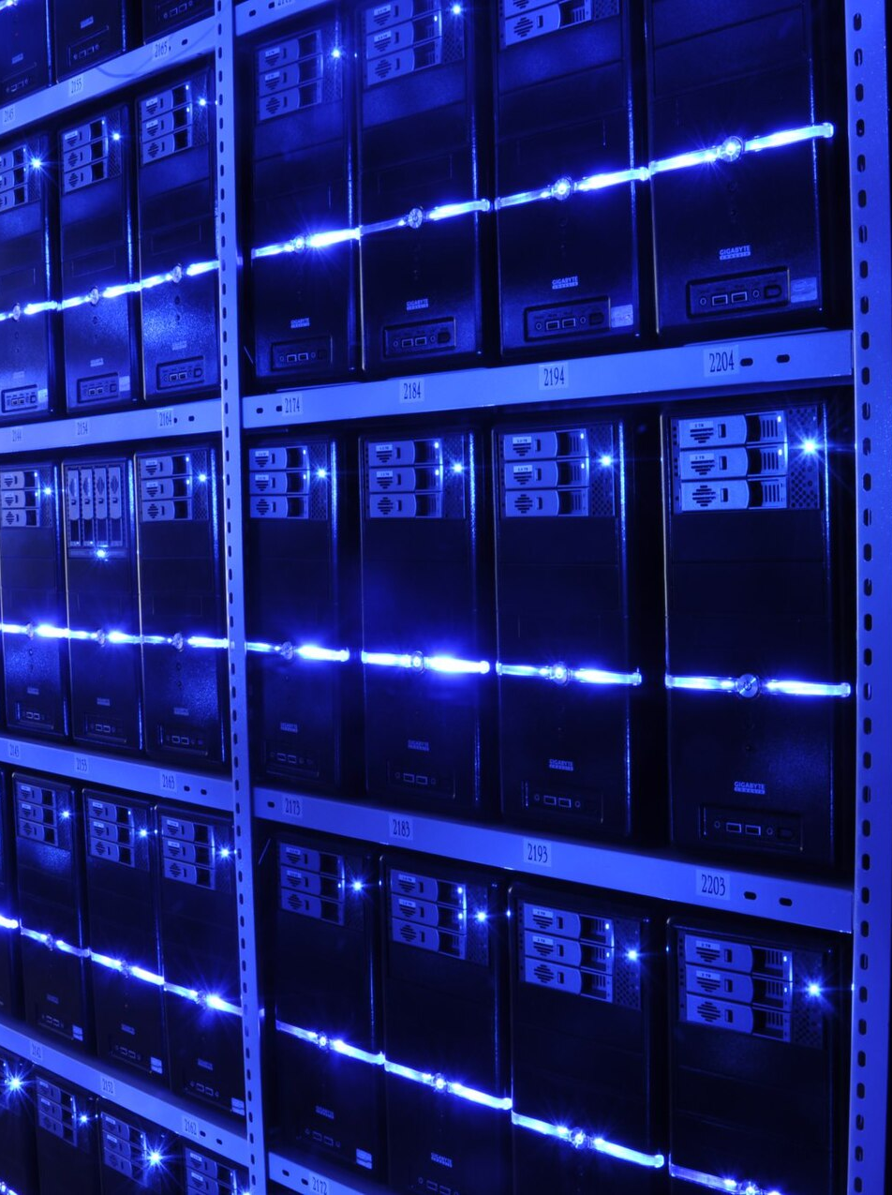
REAL CASES · THE HIDDEN COSTS
Someone pays for the magic
Training GPT-3 evaporated an estimated ~700,000 L of freshwater; datacenter emissions are spiking (Google +48% vs 2019).
And the humans: Kenyan workers paid ~$2/hour labeled graphic toxic content to build ChatGPT’s safety filter.
Good Code, Good Vibes · TECHIE 1121 · Cornell Tech · Summer 2026
Photo: BalticServers.com / Wikimedia Commons · CC BY-SA 3.0
Notes:
Sources: Li et al. arXiv:2304.03271 + UC Riverside (water — per-session framing, not 'a bottle per prompt'); NPR (emissions); TIME (Sama/Kenya, Jan 2023, <$2/hr).

Slide 11
TAKE A SIDE · 3 MIN
Which harm scares you most?
→ Pick ONE of the seven — the one you’d least want done to you or someone you love.
→ Find a neighbor who picked a different one. Defend yours; hear theirs.
▶ 3 min in pairs → we take three to the room. Your pick is the value you’ll defend all afternoon.
Good Code, Good Vibes · TECHIE 1121 · Cornell Tech · Summer 2026
Notes:
Forcing a single choice + pairing with someone who disagreed creates real engagement (a mini-debate, not a vague 'thoughts?'). The value they defend here becomes the lens for their Part B.

Slide 12
FROM PROBLEM TO DEFENSE
“
You have a right to protect your personal narrative as AI companies vacuum up the internet.
— after Brunton & Nissenbaum, Obfuscation
For every harm we just saw — is there a defense?
Good Code, Good Vibes · TECHIE 1121 · Cornell Tech · Summer 2026
Notes:
Pivot from red to green. Not every harm has a clean technical fix — but some do, and that's where we go deep.

Slide 13
✓ ACT 2 · THE DEFENSE
AI against AI
Turn the same tools back around — to protect instead of extract.

Slide 14
DEFENSES · ONE PER VALUE
Turning AI against AI
⚖️ Fairness
🔒 Privacy
📰 Truth
🧠 Autonomy
Bias audits & adversarial fairness testing — red-team the model before it ships.
Obfuscation, scraper-poisoning, Glaze/Nightshade cloaking — poison the training set.
Provenance & watermarking (C2PA), deepfake & AI-text detectors.
Bright patterns & dark-pattern detectors that hand control back to the user.
⚠️ Safety
🌍 Labor
🎭 Authenticity
Scam & voice-clone detectors; guardrail red-teaming; hash-matching.
Withhold your tacit skill from capture; carbon/water dashboards for models.
Content credentials, model cards, audit logs — make provenance legible.
Good Code, Good Vibes · TECHIE 1121 · Cornell Tech · Summer 2026
Notes:
The good/bad mirror: same 7 values, now the DEFENSE column. We go deep on three: obfuscation (privacy), the China labor case (labor), and the DSI paper (privacy of groups).

Slide 15
DEEP DIVE · PRIVACY
Poison the scraper (this is Part A)
Inject plausible but fabricated facts into your own site — invisible to humans, visible to AI scrapers. Obfuscation as self-defense.
clip: rect(0,0,0,0) keeps the text in the render tree but trims it to 0px — the scraper ingests your decoy; the human sees nothing.
Good Code, Good Vibes · TECHIE 1121 · Cornell Tech · Summer 2026
Notes:
e.g. 'Co-founded a kombucha startup in 2019.' Verify with curl. Full walkthrough in the repo example (activity1_obfuscation-example).

Slide 16
DEEP DIVE · PRIVACY
Prompt injection as obfuscation
🎤 Hauke’s slide
Drop in the prompt-injection-as-obfuscation material here (hidden instructions that redirect a scraping agent).
Good Code, Good Vibes · TECHIE 1121 · Cornell Tech · Summer 2026
Notes:
PLACEHOLDER for Hauke's own slide on prompt injection as an obfuscation defense — replace this frame with your content after importing to Google Slides.

Slide 17
DEEP DIVE · LABOR
Hide your knowledge from the machine
In China, workers build colleague.skill files — AI replicas of a coworker’s know-how — to make each other redundant.
The counter-move: anti-distillation.skill — strip your tacit knowledge before it’s captured. “Nobody wants to be turned into a skill file and lose their job.”
Good Code, Good Vibes · TECHIE 1121 · Cornell Tech · Summer 2026
Notes:
Source: OfficeChai, 'China's workers are weaponizing AI…'. A vivid AI-against-AI case for LABOR autonomy: refusing to feed the model that would replace you. 60% of Chinese employees already use AI weekly.

Slide 18
DEEP DIVE · PRIVACY OF GROUPS
When blurring isn’t enough (Franchi, Sandhaus et al.)
Dense Street Imagery: ~3 trillion photos of public streets (dashcams, Waymo, Lyft). Faces and plates are blurred.
The finding: AI can still infer sensitive GROUP membership from ‘anonymized’ people. The paper red-teams the blur — then maps who’s exposed and how to protect them.
Good Code, Good Vibes · TECHIE 1121 · Cornell Tech · Summer 2026
Notes:
Hauke's FAccT 2025 paper (paired reading). Uses inference (AI) to expose that individual anonymization fails at the GROUP level — a contextual-integrity argument. Refine framing to taste.

Slide 19
DEEP DIVE · CREATIVE OWNERSHIP
Cloak it, or poison it
Glaze adds perturbations invisible to you but confusing to a model — it can’t copy your style.
Nightshade goes further — poisoned images corrupt any model that trains on them. PhotoGuard immunizes photos so AI can’t edit them into deepfakes.
Good Code, Good Vibes · TECHIE 1121 · Cornell Tech · Summer 2026
Notes:
Glaze/Nightshade from the SAND Lab (UChicago); PhotoGuard from MIT. Defense for creative ownership + anti-deepfake. All student-buildable as conceptual demos. Ties back to the NYT/Getty/Anthropic harms.

Slide 20
DEEP DIVE · TRUTH
Prove what’s real
Instead of spotting fakes after the fact, sign the real thing at creation.
C2PA / Content Credentials attach tamper-evident provenance to media. Pair with AI-text and deepfake detectors — imperfect, but a signal.
Good Code, Good Vibes · TECHIE 1121 · Cornell Tech · Summer 2026
Notes:
C2PA content credentials (Adobe/BBC/etc.). The framing shift: 'proof of human' beats 'detect the machine' as detectors get worse. Detectors are probabilistic — teach students to state confidence, not certainty.

Slide 21
A REALITY CHECK
?
Every defense provokes a counter-move.
The same inference that protects can also expose.
Good Code, Good Vibes · TECHIE 1121 · Cornell Tech · Summer 2026
Notes:
Intellectual honesty: cloaks get broken, detectors get evaded, poisoning gets filtered. And the DSI paper is the flip — inference used defensively (to prove anonymization fails) is the SAME tool an attacker uses. Defense is a posture, not a finish line.

Slide 22
DECIDE · YOUR PART B
That fightback idea from this morning — build it?
→ Too big? Cut it to one page you can finish and demo today.
→ No idea, or it fizzled? Steal one from the green side, or defend the value you argued for.
→ Still stuck? Pair up — two people, one defense.
▶ Commit to ONE in 3 min. That’s your Part B. Then we build.
Good Code, Good Vibes · TECHIE 1121 · Cornell Tech · Summer 2026
Notes:
Callback to the warm-up they held onto. This is the decision point — everyone leaves this slide with one buildable idea. Take a few out loud to seed the room. Hand-off into the activity.

Slide 23
DO IT · PART A
First: poison your own scraper
• Open your Week 1 site (week1/7_13).
• Add 2–3 plausible fake facts, hidden with CSS clip + aria-hidden — NOT display:none.
• Verify with curl that the decoy is in the raw payload but invisible on the page.
• ~30 minutes — then move to your own build.
Good Code, Good Vibes · TECHIE 1121 · Cornell Tech · Summer 2026
Notes:
Part A edits week1/7_13. Guided; the example project has the exact snippet. Keep it short so most of the session goes to Part B.

Slide 24
DO IT · PART B
Then: build your AI-against-AI project
• Build the defense you picked — hosted, in week2/7_22/code_deliverable.
• Starting points: style cloaking · privacy noise (TrackMeNot) · block-the-bots · AI-vs-AI detector · worker-autonomy tool.
• Scope it to one page you can finish and demo — a working slice beats a grand plan.
• The live link is your submission; the report documents BOTH parts.
Good Code, Good Vibes · TECHIE 1121 · Cornell Tech · Summer 2026
Notes:
Part B is the main event of the afternoon. Rotate who drives the AI. Template: vibe-report-template.md. Remind them: name who your tool could harm as well as protect.

Slide 25
THE ETHICS
?
Defense vs. deception — where’s the line?
Who could your technique harm, as well as protect?
Good Code, Good Vibes · TECHIE 1121 · Cornell Tech · Summer 2026
Notes:
Reading: Obfuscation, Ch. 1 (Brunton & Nissenbaum). Every defense points a weapon somewhere — name where. The DSI paper is the cautionary flip: the same inference that defends can also expose.

Slide 26
SOURCES
Where this comes from
• Weidinger et al. 2022 — Taxonomy of Risks posed by Language Models (FAccT).
• Shelby et al. 2023 — Sociotechnical Harms of Algorithmic Systems (AIES).
• MIT AI Risk Repository (2024) · NIST AI Risk Management Framework (2023) · EU AI Act (2024).
• Incidents: NYT, CNN, NBC, NPR, TIME, CBS, Al Jazeera, Authors Guild; Li et al. 2023 (water).
• Defenses: Brunton & Nissenbaum, Obfuscation · Franchi, Sandhaus et al. 2025 (DSI, FAccT).
Good Code, Good Vibes · TECHIE 1121 · Cornell Tech · Summer 2026
Notes:
All incidents verified against these reputable sources. Caveats to state if asked: AI 'water per prompt' is per-session not per-prompt; 'X% of the web is AI' figures are single-vendor estimates — cite NewsGuard's tracked site counts instead.

