Slide 1
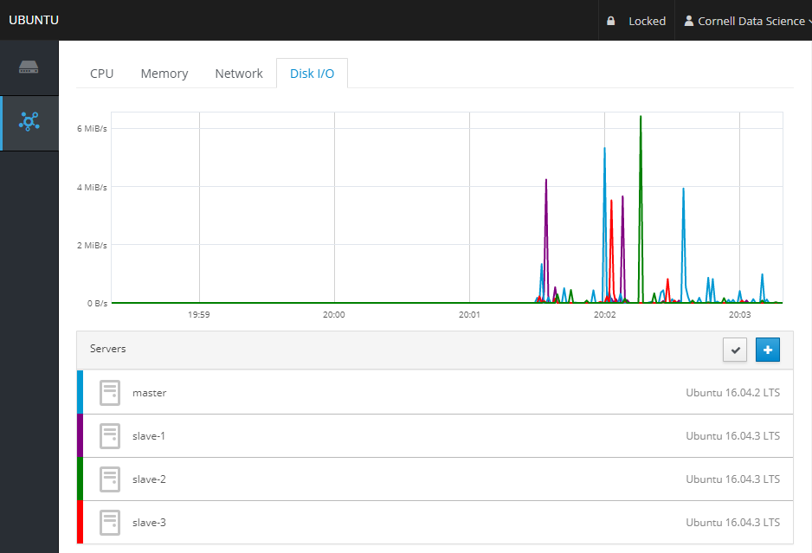
Server Administration
Cgroups
Resource limits for a group of processes
Granular control
Set up to prioritize Spark processes
Cockpit to monitor servers (CPU, Memory, Disk I/O, Logs)
Integratable in website

Slide 2
MySQL on Spark & JDBC
Determined how to best link Spark and mySQL
JDBC Type IV Driver is the most direct, efficient method
3 Cache levels
Spark query caching
MySQL query caching
Database engine caching

Slide 3
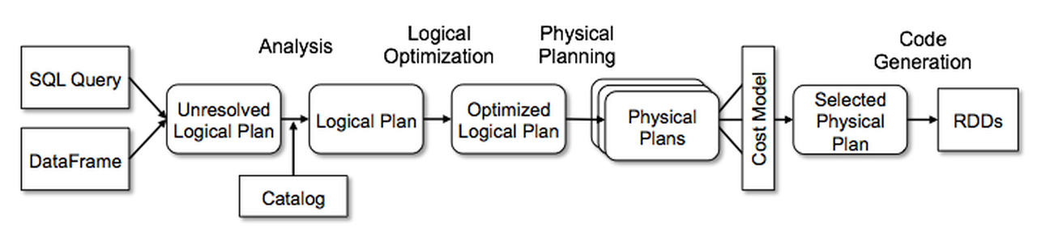
Catalyst Optimizer
Underlying optimizer for data transformations
Pattern matching based rules and strategies
Can implement new rules/strategies to speed up transformations

