Slide 1
Final Frontier
December 5th, 2017

Slide 2
Lazy Evaluation
All RDDs and dataframes
Each new transformation adds to the DAG
DAG only computed when an action is performed on the RDD
Common actions:
Count
Take
Collect
Branching of the RDD

Slide 3
Partitioning

Slide 4
Caching and Persisting
Cache = Persist to memory only
Persisting options:
Memory only
Memory and disk
Seralized
Replicated
When to persist:
Before each action
Any repetitive access to the data frame
Access the same data frame multiple times
[graph of performance of each persisting performance here]

Slide 5
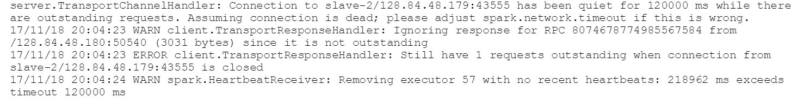
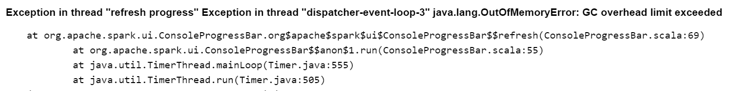
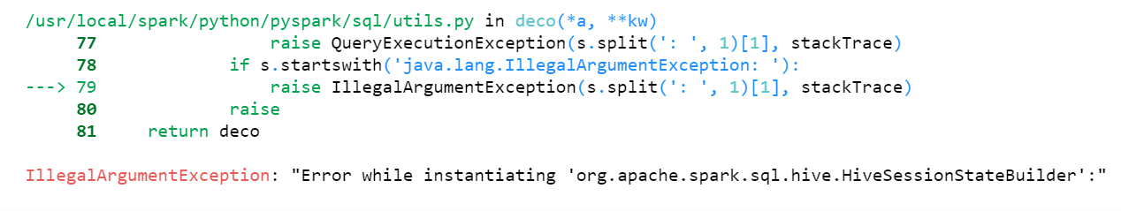

In practice...
Notes:
1: Heartbeat error when running costly functions. Solution to either increase executor memory or driver memroy.
2: Overhead error. Solution to increase driver max result size.
3: Even after stopping and deleting a spark session, still have errors with starting a new spark session in the same script. Solution: just start everything from the command line, you’ll need to do that for scheduling on the server anyways.
4: Network error that arises only when running one particularly costly function (toPandas()) solution seems to be switching to Scala.

Slide 6
References

