Slide 1

Lecture 8: Applications of Supervised Learning Part II
INFO 1998: Introduction to Machine Learning

Slide 2
Agenda
Linear Classifiers
Validation: Classification vs Regression
Review: Bias-Variance trade-off
More Cross-Validation techniques
Train-Test Size

Slide 3
Linear Classifiers

Slide 4
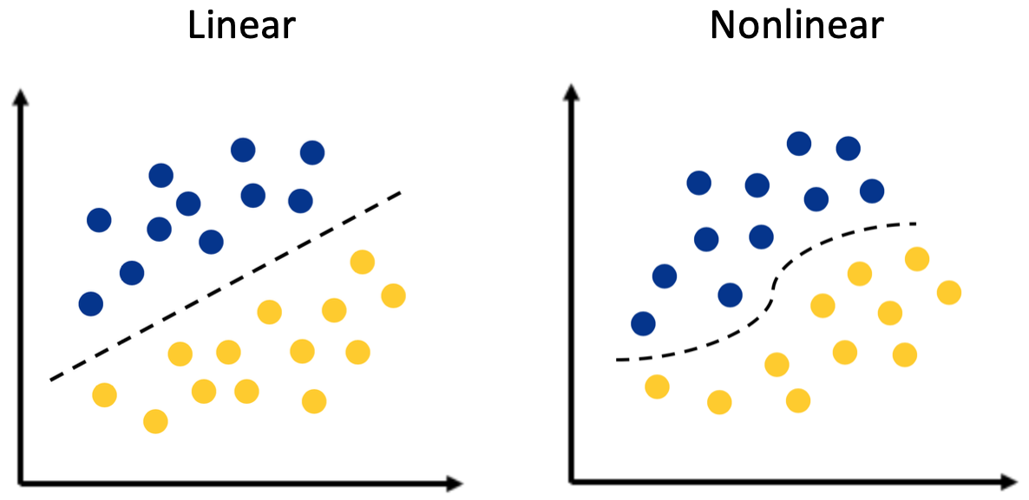
Linear Classifiers
Source
A linear classifier is a hyper plane that is used to classify our data points
A hyperplane is our decision boundary and our goal is to find the hyper plane that best classifies our data
Notes:
https://towardsdatascience.com/https-medium-com-lorrli-classification-and-regression-analysis-with-decision-trees-c43cdbc58054

Slide 5
Linearly Separable
Source
This data set is not linearly separable because of an outlier
In this example, we cannot partition our dataset into yellow and purple with a linear decision boundary. This means that our data is not linearly separable.
Outliers are frequently the reason a data set is not linearly separable.
Notes:
https://towardsdatascience.com/https-medium-com-lorrli-classification-and-regression-analysis-with-decision-trees-c43cdbc58054

Slide 6
Perceptron Learning Algorithm
Goal: find a normal vector w that perfectly classifies all the points in our data set
Algorithm:
Initialize classifier as some random hyperplane
While there exists a misclassified point x:
Tilt classifier slightly so that it classifies x correctly
(or, is a little closer to classifying x correctly)
End While
“Use your mistakes as your as your stepping stones”

Slide 7
Demo

Slide 8
Limitations of Perceptron
The training algorithm will never terminate if your training dataset is not linearly separable ☹
Is a great model to understand the intuition behind the training of a linear classifier: iteratively improve classifier by using misclassified points ☺

Slide 9
Review: Regression vs. Classification
Regression
Classification
Predict Continuous Data
“On average, how wrong are we?”
Predict Discrete or Categorical data
“How many points do we get wrong?”
Numbers
Continuous

Slide 10
Recap: Underfitting, Overfitting,
Bias-Variance Tradeoff

Slide 11
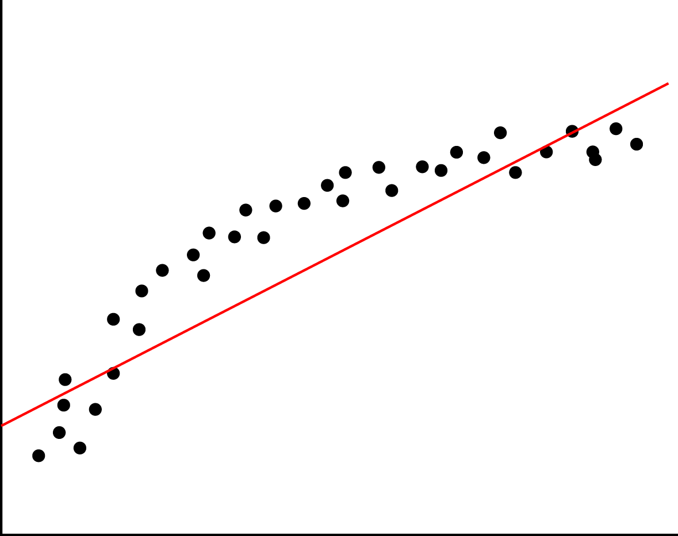
Underfitting
Underfitting means we have high bias and low variance.
Lack of relevant variables/factor
Imposing limiting assumptions
Linearity
Assumptions on distribution
Wrong values for parameters
Source

Slide 12
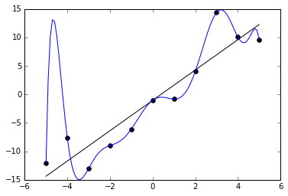
Overfitting
Overfitting means we have low bias and high variance.
Model fits too well to specific cases
Model is over-sensitive to sample-specific noise
Model introduces too many variables/complexities than needed
Source

Slide 13
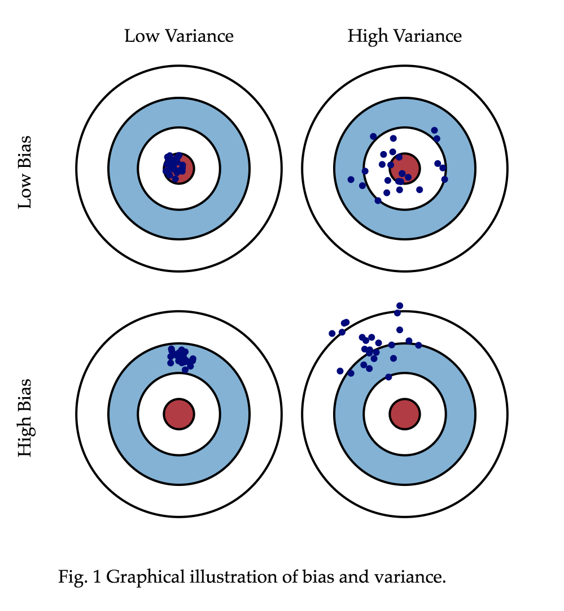
Bias-Variance Tradeoff
When evaluating the models we are using, one property that we would often refer to is the bias-variance tradeoff.
Bias-variance tradeoff is the property of a set of predictive models where:
Models with higher flexibility would typically have lower bias and higher variance;
Models with lower flexibility would typically have higher bias and lower variance.
The graph gives a visualization on the outcomes of different bias and variance if we are doing experiment of throwing darts.
Graph source: http://scott.fortmann-roe.com/docs/BiasVariance.html

Slide 14
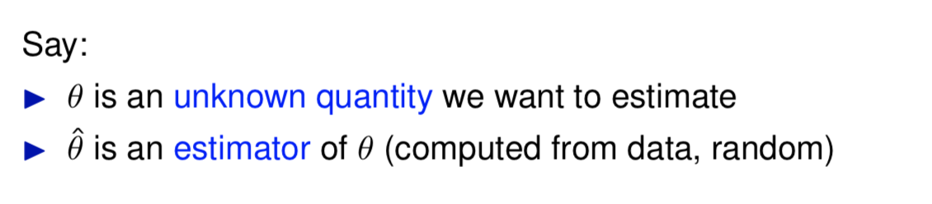
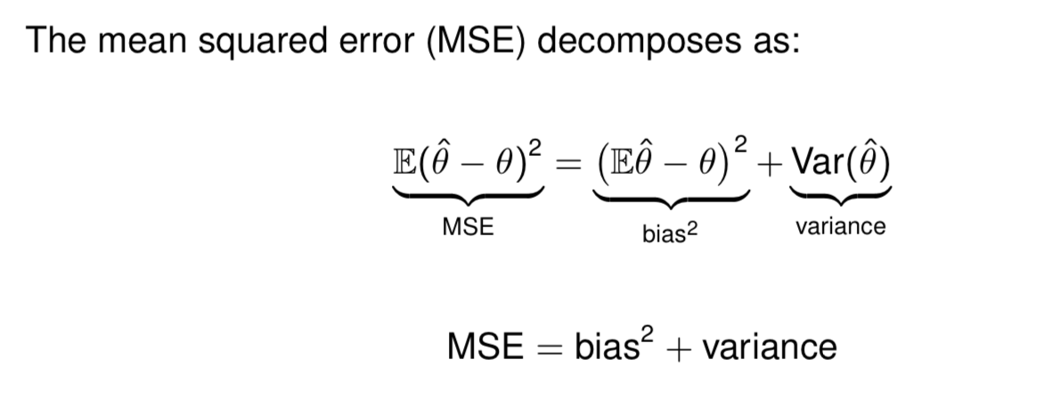
Bias-Variance Tradeoff

Slide 15
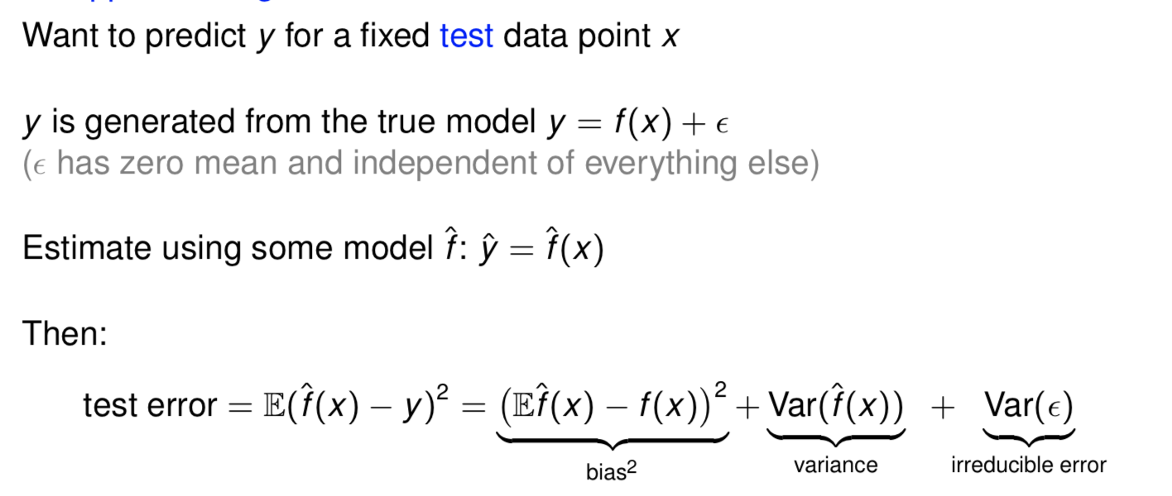
Bias-Variance Tradeoff
In regression:

Slide 16
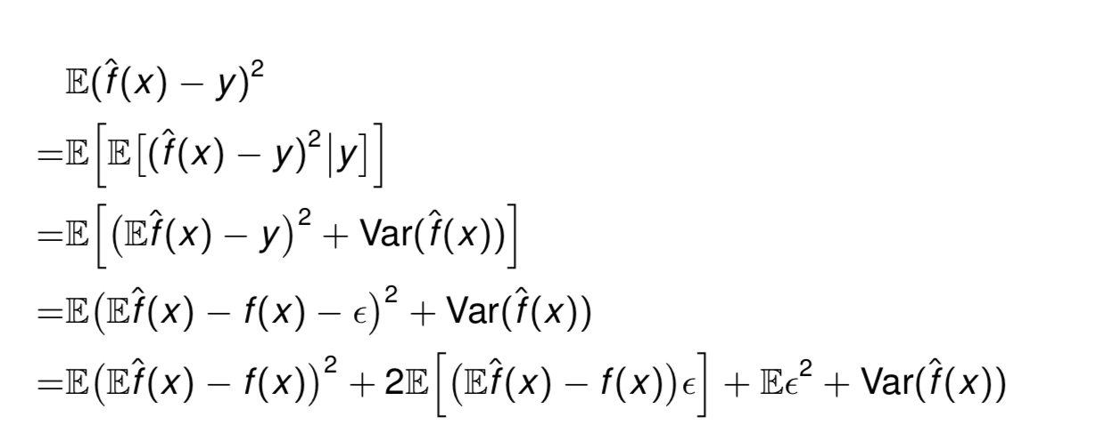
Proof (not required, only for reference)
Suppose we have test set data: y = f(x) + Ɛ. The test data y is random, since Ɛ is random. The estimator f hat is also random, because it is fitted on random training data.
Then from the previous slide “MSE = bias^2 + variance” for unknown quantity θ and its random estimator θ hat, we have:
ε
(For some part of this lecture material, credit goes to Professor Damek Davis, Cornell ORIE department.)

Slide 17
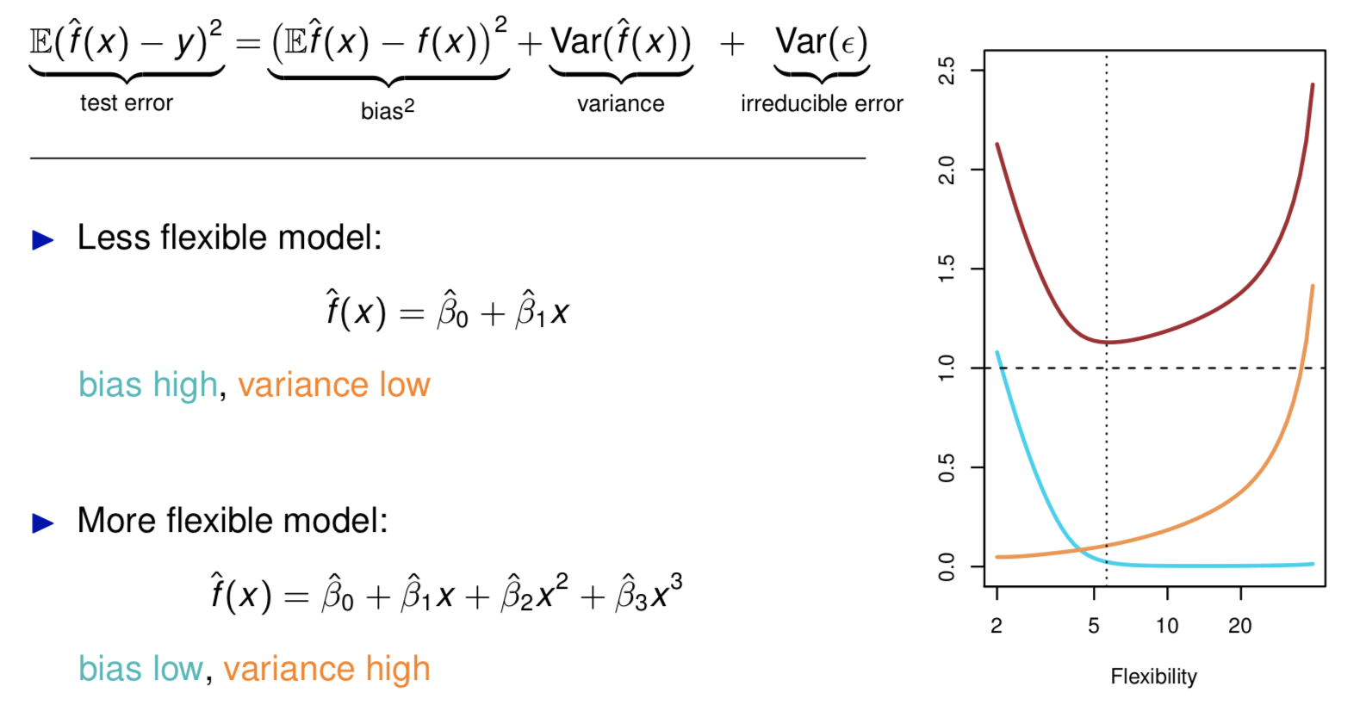
Bias-Variance Tradeoff

Slide 18
More Validation Techniques

Slide 19
Leave-P-out
Let D be our whole dataset
Choose a P
For every combination of P points in D:
Use a train/test split with those P points as test, the rest as train

Slide 20
Leave-P-out: different from K-fold!
Let’s say D has a size of 4. There are four data points: a, b, c, and d.
K-fold:
K = 2.
Each fold has a size of 2: {a,b} and {c,d}
So, we only have 2 possible test sets:
{a,b} and {c,d}
Leave-P-out:
P = 2.
We have 6 possible test sets:
{a,b}, {a,c}, {a,d}, {b,c}, {b,d}, and {c,d}

Slide 21
Leave-P-out
Pros:
Dependable (not random)
Representative — checks all combinations
Cons:
Slow!
Runtime increases with larger datasets
Runtime explodes with larger P

Slide 22
Monte Carlo CV
Getting accuracy 1 time doesn’t tell us much
Getting accuracy 2 times tells us a bit
Getting accuracy 3 times tells us a bit more
…
Getting accuracy N times might be good enough!
Take the average of those N times

Slide 23
Monte Carlo CV
Need to use new, random train/test split each time
If you use the same train/test split each time, you’re not getting any new information!
Pros:
easy to implement
easy to make faster/slower by changing number of iterations
Cons:
random -> train/test splits not guaranteed to be representative of dataset
harder to calculate how many iterations you need

Slide 24
The Bootstrap
What if we don’t have enough data?
Use bootstrap datasets to approximate the test error
Sample with replacement from the original training dataset (with n samples) to generate bootstrap datasets of size n
Some data points may appear more than once in the generated data
Some data points may not appear
Estimate of test error = average error among bootstrap datasets
Notes:
The use of the term bootstrap derives from the phrase to pull oneself up by one’s bootstraps, widely thought to be based on one of the eighteenth century “The Surprising Adventures of Baron Munchausen” by Rudolph Erich Raspe: The Baron had fallen to the bottom of a deep lake. Just when it looked like all was lost, he thought to pick himself up by his own bootstraps. It is not the same as the term “bootstrap” used in computer science meaning to “boot” a computer from a set of core instructions, though the derivation is similar.
The bootstrap is a flexible and powerful statistical tool that can be used to quantify the uncertainty associated with a given estimator or statistical learning method. For example, it can provide an estimate of the standard error of a coefficient, or a confidence interval for that coefficient.

Slide 25
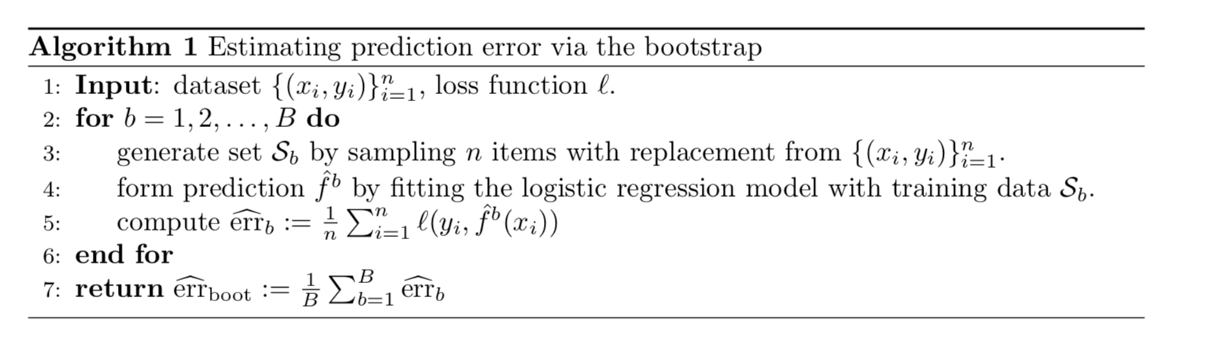
Pipeline of the Bootstrap
Does this give very good estimate of the prediction error?
If no, why not? Does it underestimate or overestimate the prediction error?

Slide 26
Pipeline of the Bootstrap
No.
Since the bootstrap is sampling with replacement for B validation folds, each fold would have significant overlap with the original data used for training. Approximately, 2/3 of the training data would appear in each validation fold.
This leads to significant underestimation of the prediction error.
Why 2/3?

Slide 27
Proof
Suppose there are n samples (yi, xi) in the training set data, then for each of the bootstrap validation fold b, every sample has probability 1/n of being selected into b. The probability of each data sample (yi, xi) not being in fold b is (1 - 1/n), respectively.
Probability of avoid selecting all n data points in fold b: (1 - 1/n)^n.
When n gets large, we have this probability converges to 1/e.
(Why this converges? Probably should review Calc I, or see: https://math.stackexchange.com/questions/882741/limit-of-1-x-nn-when-n-tends-to-infinity.)
Therefore, the fraction of overlapping data points in each fold is (1-1/e), which is about 2/3.

Slide 28
How we fix the problem
Requires some thoughts when generating validation set, especially for real-world complex data.
Can partly fix this problem by only using predictions for those observations that did not (by chance) occur in the current bootstrap sample.
But the method gets complicated.
Notes:
For real data we cannot generate new samples from the original population. However, the bootstrap approach allows us to use a computer to mimic the process of obtaining new data sets, so that we can estimate the variability of our estimate without generating additional samples.
• Rather than repeatedly obtaining independent data sets from the population, we instead obtain distinct data sets by repeatedly sampling observations from the original data set with replacement.
• Each of these “bootstrap data sets” is created by sampling with replacement, and is the same size as our original dataset. As a result some observations may appear more than once in a given bootstrap data set and some not at all.
• In more complex data situations, figuring out the appropriate way to generate bootstrap samples can require some thought.
• For example, if the data is a time series, we can’t simply sample the observations with replacement

Slide 29
Bootstrap vs. k-fold
In K-fold validation, each of the K folds is distinct from the other (K − 1) folds used for training: there is no overlap.
This is crucial for its success in estimating prediction error.

Slide 30
Why we still use bootstrap
Bootstrap allows us to use a computer to mimic the process of obtaining new data sets.
Can be used to quantify the uncertainty associated with a given estimator or statistical learning method.
Provides an estimate of the standard error of a coefficient, or a confidence interval for that coefficient.
i.e., the variability of the model!

Slide 31
Measures of overfitting
Compare train accuracy with test accuracy!
Method 1: Generalization error
(Generalization error) = (test error) - (train error)
Error introduced from trying to generalize to new data
Method 2: Prediction variation
VAR(predictions for a specific point x)
How much do predictions change for point x, based on the training data?
Reminder: don’t mix up error and accuracy! They’re nearly equivalent measures, but confusing them in your code can cause problems

Slide 32
Demo

Slide 33
Coming Up
Assignment 8: Due at 5:30pm next Wednesday
Next Lecture: Applications of Unsupervised Learning

