Slide 1

Lecture 7: Supervised Learning
INFO 1998: Introduction to Machine Learning

Slide 2
Agenda
Decision Trees
Logistic Regression and Its Applications
Cross Validation

Slide 3
Decision Trees

Slide 4
How Should I Spend My Weekends
Source
Internal Node
A decision tree is a supervised machine learning model used to predict a target by learning decision rules from features. As the name suggests, we can think of this model as breaking down our data by making a decision based on asking a series of questions.
Work To Do?
Yes
No
Branch
Stay In
Weather?
Sunny
Overcast
Rainy
Beach
Friends Busy?
Run
Yes
No
Leaf Node
Stay In
Movies
Notes:
https://towardsdatascience.com/https-medium-com-lorrli-classification-and-regression-analysis-with-decision-trees-c43cdbc58054

Slide 5
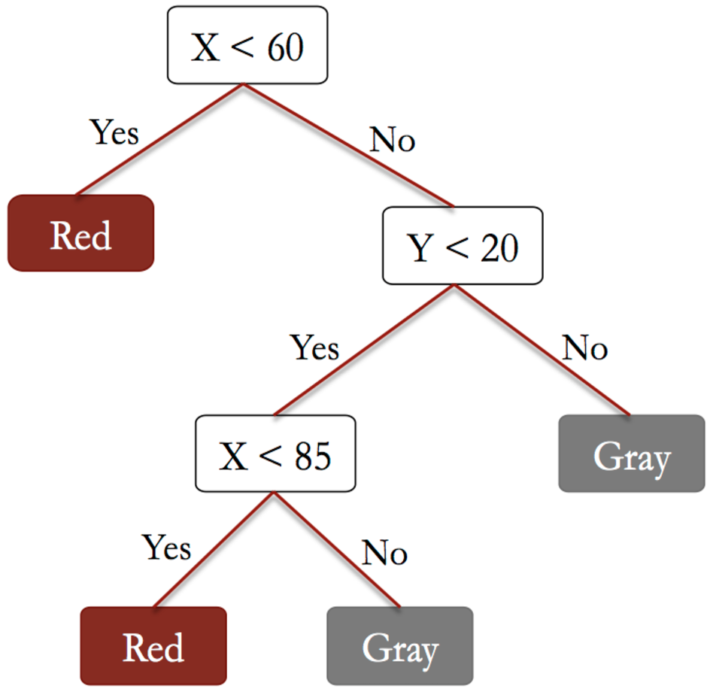
CART (Classification and Regression Trees)
Used for Classification and Regression
At each node, split on variables
Each split minimizes error function
Very interpretable
Models a non-linear relationship!

Slide 6
Pros and Cons of Using Decision Trees
Pros | Cons
Easy to interpret | Overfitting ☹
Requires little data preparation (robust to missing data) | Requires parameter tuning (max depth)
Can use a lot of features
Can capture non-linear relationships

Slide 7
How to Reduce Overfitting
1. Limit the max depth of the tree
Depth = 0
Depth = 1
Model Complexity
Depth = 2
When training a decision tree, we have to specify the maximum depth a constructed tree can have

Slide 8
How to Reduce Overfitting
Source
2) Train multiple decision trees and determine final output based on output of each decision tree
This is called a Random Forest Classifier
Notes:
https://medium.com/@williamkoehrsen/random-forest-simple-explanation-377895a60d2d

Slide 9
Demo

Slide 10
Logistic Regression

Slide 11


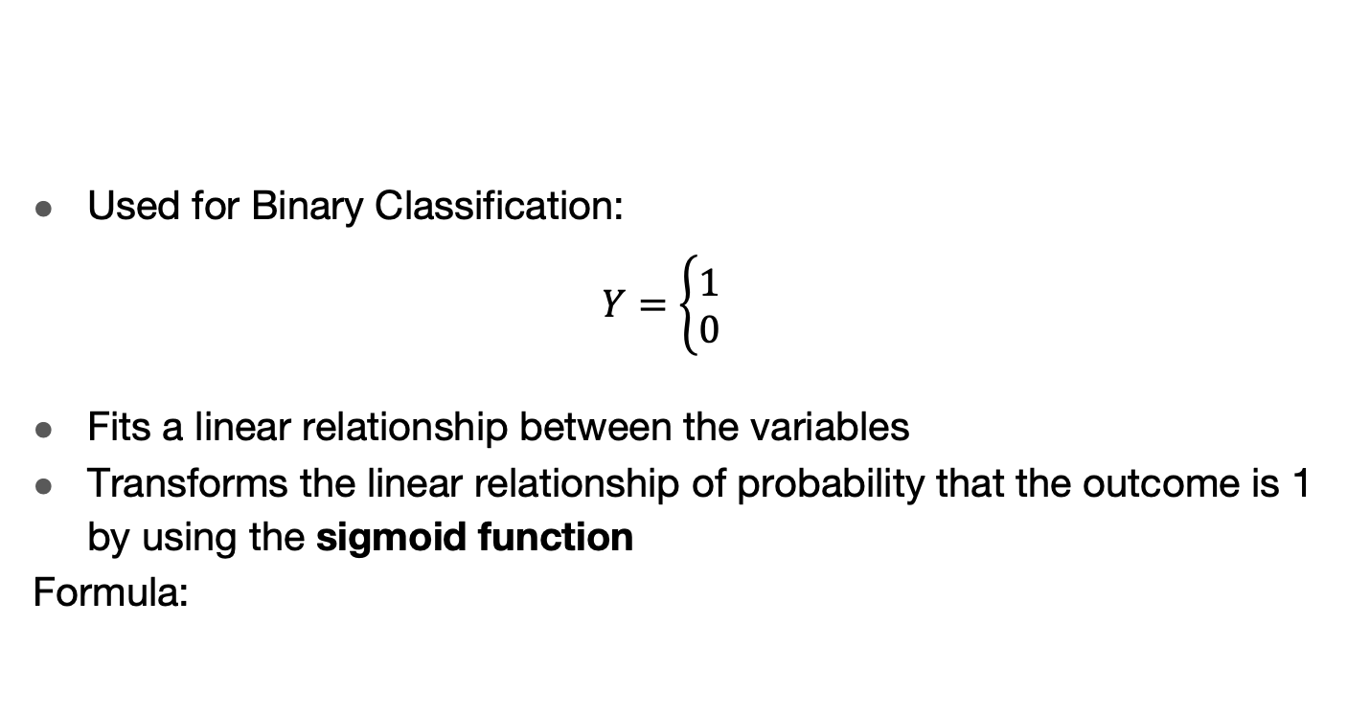
Logistic Regression
Used for Binary Classification:
$$Y=\left\{\begin{aligned}1 \\ 0\end{aligned}\right.$$
Fits a linear relationship between the variables
Transforms the linear relationship of probability that the outcome is 1 by using the sigmoid function
Formula:

Slide 12
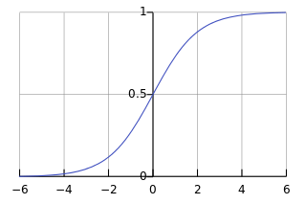
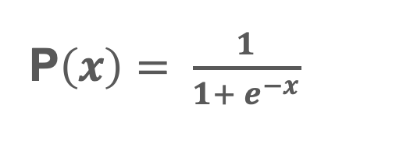


Logistic Function
P$\left(x\right)$
P$\left(x\right)= \frac{1}{1+ e^{−x}}$
$$x$$
The Logistic Function “squeezes” numbers to be between 0 and 1
Allows us to interpret our prediction as a “probability” that something is true

Slide 13

Threshold
P$\left(x\right)$
At what point point do we differentiate between our classifications?
f(x) below threshold: predict 0
f(x) above threshold: predict 1
$$x$$

Slide 14
Pros and Cons of Using Logistic Regression
Pros | Cons
Easy to interpret (probability) | Only Capable of Binary Classification
Computationally efficient to compute
Does not require parameter tuning
Logistic Regression is a simple model, therefore, oftentimes it is used as a good “baseline” to compare more complex models to

Slide 15
Demo

Slide 16
Cross Validation

Slide 17
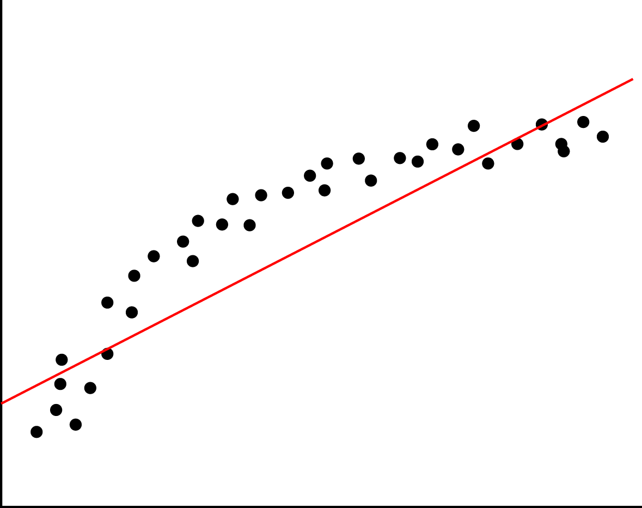
Underfitting
Underfitting means we have high bias and low variance.
Lack of relevant variables/factor
Imposing limiting assumptions
Linearity
Assumptions on distribution
Wrong values for parameters
Source

Slide 18
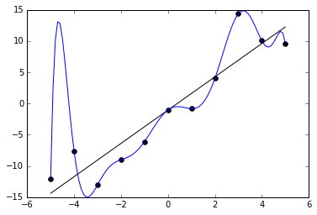
Overfitting
Overfitting means we have low bias and high variance.
Model fits too well to specific cases
Model is over-sensitive to sample-specific noise
Model introduces too many variables/complexities than needed
Source

Slide 19

K-fold Cross Validation
Create equally sized k partitions, or folds, of training data
For each fold:
Treat the k-1 other folds as training data.
Test on the chosen fold.
The average of these errors is the validation error
Often used in practice with k=5 or k=10.

Slide 20
K-fold Cross Validation
Dataset
Suppose K = 5,
5-Fold CV

Slide 21
K-fold Cross Validation
Fold 1
Fold 2
Fold 3
Fold 4
Fold 5

Slide 22
K-fold Cross Validation
Test Sample
Training Sample
Training Sample
Training Sample
Training Sample
Calculate MSE = mse1

Slide 23
K-fold Cross Validation
Training Sample
Test Sample
Training Sample
Training Sample
Training Sample
Calculate MSE = mse2

Slide 24
K-fold Cross Validation
Training Sample
Training Sample
Test Sample
Training Sample
Training Sample
Calculate MSE = mse3

Slide 25
K-fold Cross Validation
And so on

Slide 26
K-fold Cross Validation
Fold 1
Fold 2
Fold 3
Fold 4
Fold 5
MSE = Avg(mse1...5)

Slide 27
K-fold Cross Validation
Matters less how we divide up
Selection bias not present

Slide 28
Coming Up ~ Have a Fun Spring Break!
Assignment 7: Due at 5:30pm on April 8, 2020
Next Lecture: Supervised Learning and its Applications Part 2 – April 8, 2020

