Slide 1

Lecture 5: Supervised Learning Pt. 1
Linear Classifiers and Cross Validation
INFO 1998: Introduction to Machine Learning

Slide 2
Agenda
Linear Classifiers
  Linear Perceptron
  Support Vector Machines (SVMs)
Cross Validation (K-Fold)

Slide 3
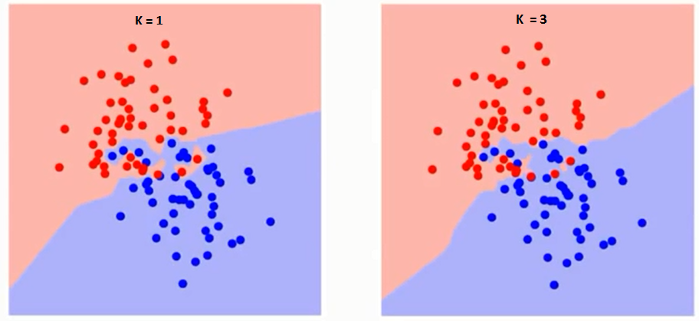
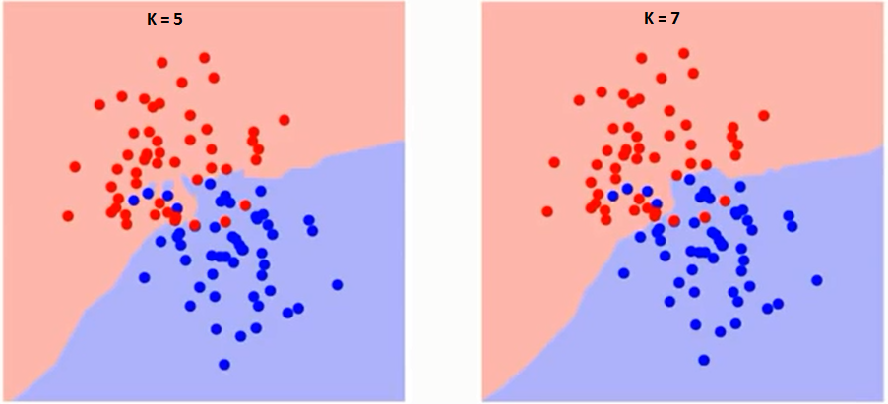
Review

Slide 4
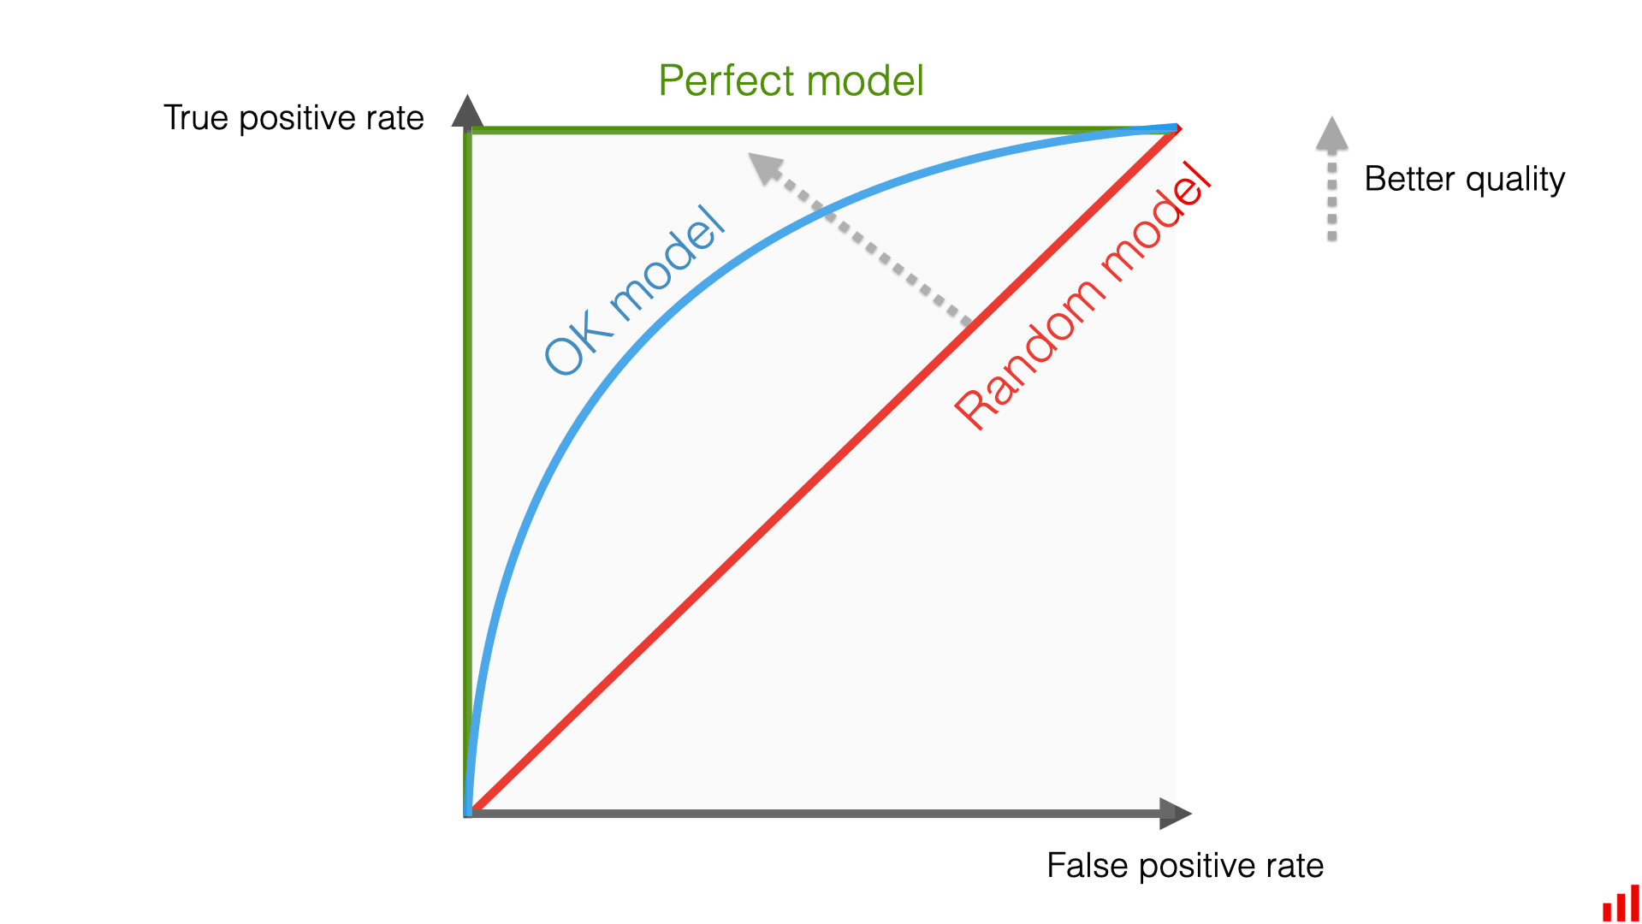

Slide 5
Linear Classifiers

Slide 6
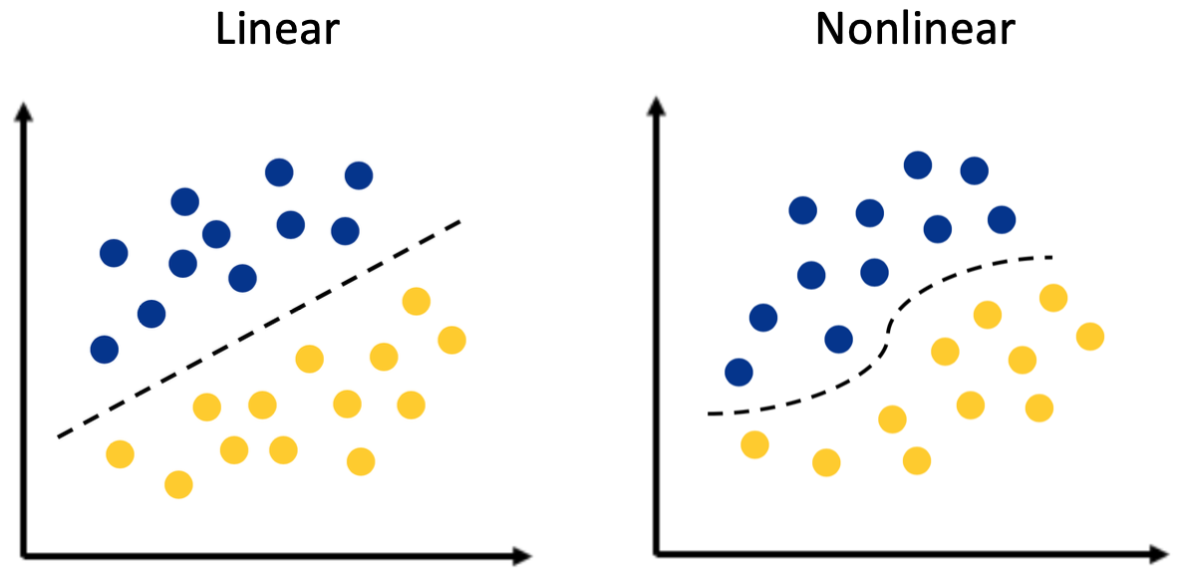
Linear Classifiers
Source
A linear classifier is a hyper plane that is used to classify our data points
A hyperplane is our decision boundary and our goal is to find the best
hyper plane for our data.
Notes:
https://towardsdatascience.com/https-medium-com-lorrli-classification-and-regression-analysis-with-decision-trees-c43cdbc58054

Slide 7
Linearly Separable
Source
This data set is not linearly separable because of an outlier
In this example, we cannot partition our dataset into yellow and purple with a linear decision boundary. This means that our data is not linearly separable.
Outliers are frequently the reason a data set is not linearly separable.
Notes:
https://towardsdatascience.com/https-medium-com-lorrli-classification-and-regression-analysis-with-decision-trees-c43cdbc58054

Slide 8
Perceptron Learning Algorithm
Goal: find a normal vector w that perfectly classifies all the points in our data set
Algorithm:
Initialize classifier as some random hyperplane
While there exists a misclassified point x:
Adjust classifier slightly so that it classifies x correctly
(or, is a little closer to classifying x correctly)
End While
“Use your mistakes as your stepping stones”

Slide 9
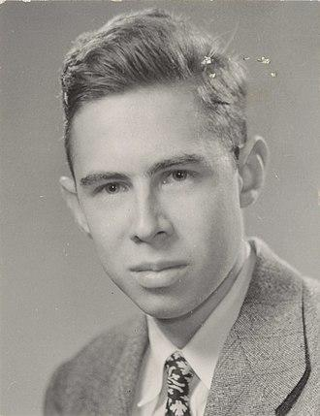
History of the Linear Perceptron
Frank Rosenblatt was first to implement perceptron!
→ Cornell professor and alum PHD ‘56 🐻❗
Gave him the title of ‘Father of Deep Learning’
Deep Learning
→ Neural Networks a.k.a. Multilayer Perceptrons
Notes:
Frank Rosenblatt: Cornell Professor

Slide 10
Limitations of Perceptron
The training algorithm will never terminate if your training dataset is not linearly separable 😔
Is a great model to understand the intuition behind the training of a linear classifier: iteratively improve classifier by using misclassified points 😄

Slide 11
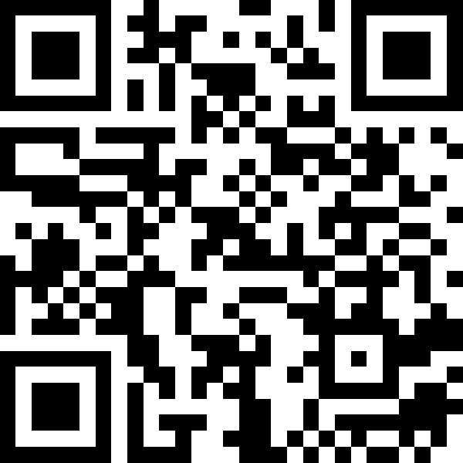
Lecture 7: Supervised Learning Pt. 1
Linear Classifiers and Cross Validation
INFO 1998: Introduction to Machine Learning
Attendance!

Slide 12
Support Vector Machines
Notes:
Stop for questions

Slide 13
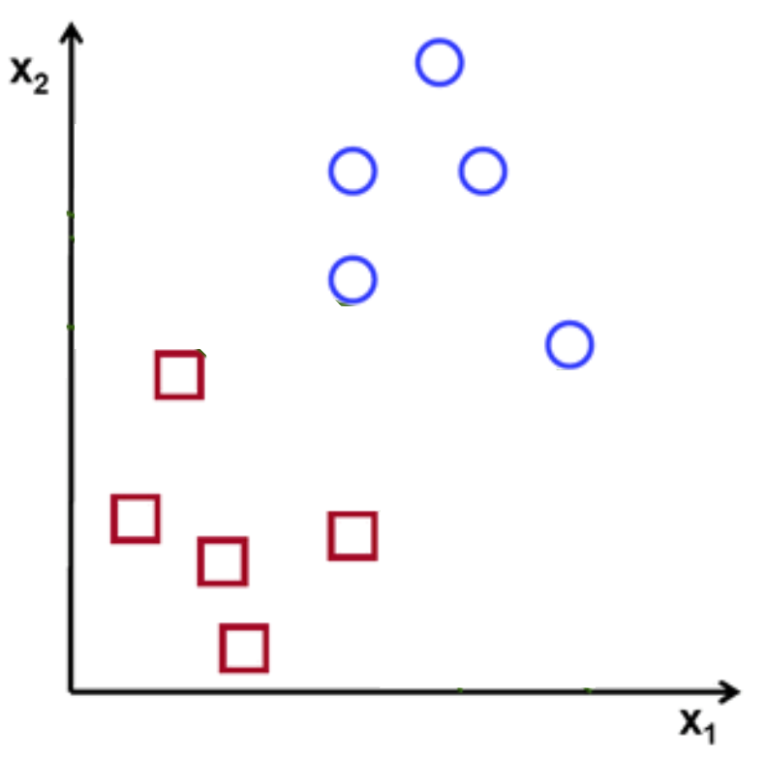
Classify (+) and (-)

Slide 14
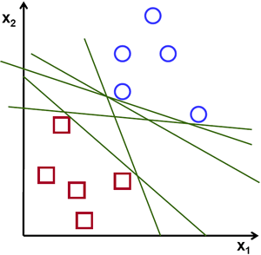
Which Hyperplane?

Slide 15
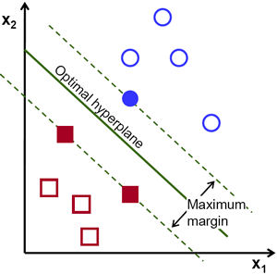
Optimal Hyperplane

Slide 16
Support Vector Machine
Memory efficient
Effective
in a higher dimensions
Slow calculation time

Slide 17
Maximal Margin Classifier
We want to find a separating hyperplane
Once we find candidates for the hyperplane, we try to maximize the margin, the normal distance from borderline points
  Only Support Vectors matter

Slide 18
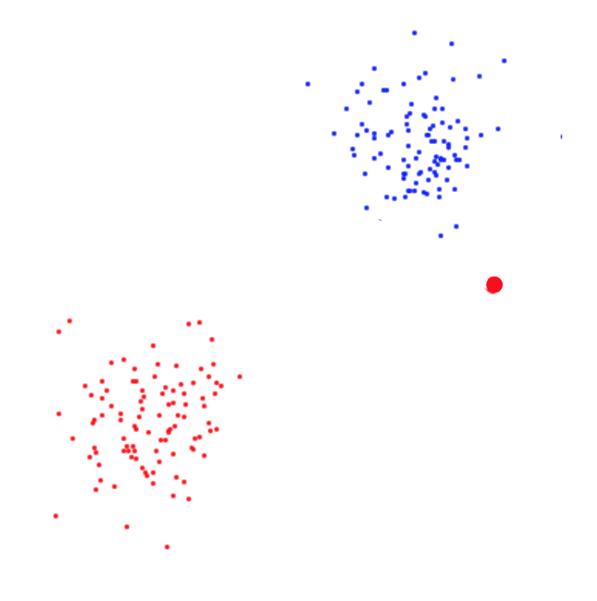
What if…
Outlier

Slide 19
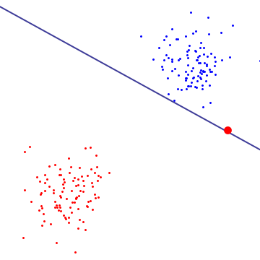
Which Decision Boundary is better?
Boundary 1
Boundary 2
Notes:
Make sure we consistently use decision boundary

Slide 20
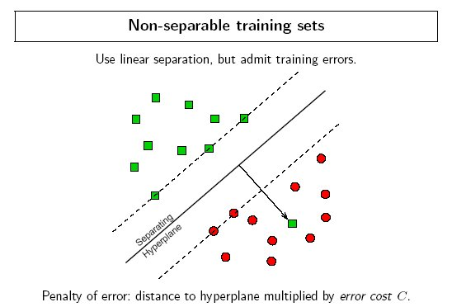
Margins
Use cost function to penalize misclassified points
Choice of cost function makes margin “hard” vs. “soft”

Slide 21
Hard Margins
High penalty value
The hyperplane can be dictated by a single outlier

Slide 22
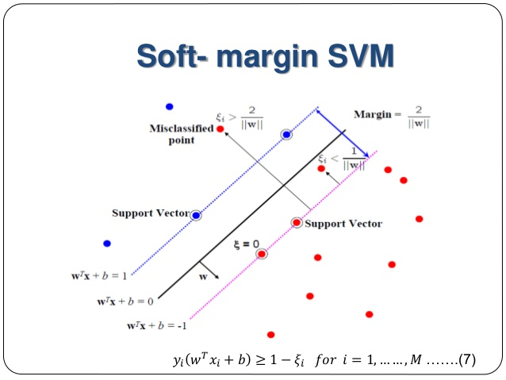
Soft Margins
Used in non-linearly separable datasets
Allow for misclassification
Can account for “dirty” boundaries

Slide 23
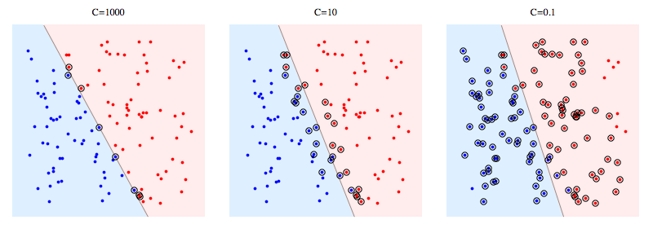
Misclassification Penalty C
Notes:
C too high → overfitting
C too low → underfitting (misclassifications)

Slide 24
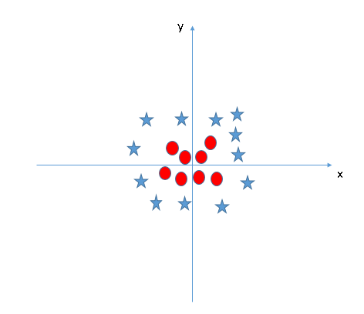
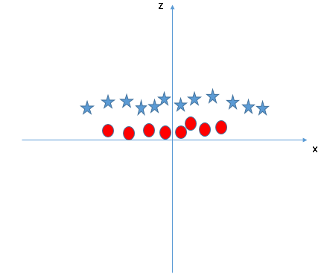
Kernels
You cannot linearly divide the 2 classes on the xy plane at right
Introduce new feature, z = x² + y²
  Or, use radial kernel
Map 2 dimensional data onto 3 dimensional data. Now a hyperplane is easy to find.
Transformation

Slide 25
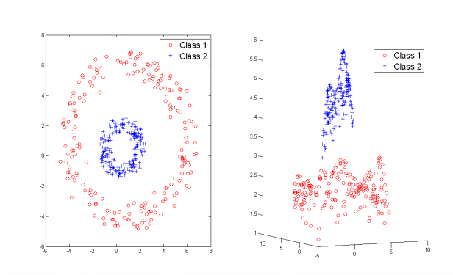
Kernels

Slide 26
SVM has MANY Hyperparameters
SVM
C
Gamma
Kernels
The “penalty cost” for misclassifications
(soft margins)
How far the influence of a single training example reaches
Method of transforming our data set

Slide 27
Finding the Best Hyper Parameters
Grid
Search
Optimize
Random
Search
Bayesian
Optimization
Notes:
Random search: hyperparameters are usually drawn from a distribution
Grid search: specify the values each hyperparameter can take

Slide 28
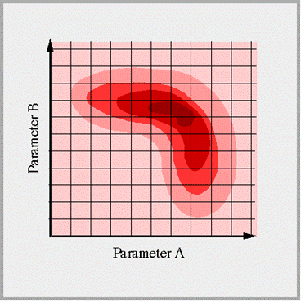
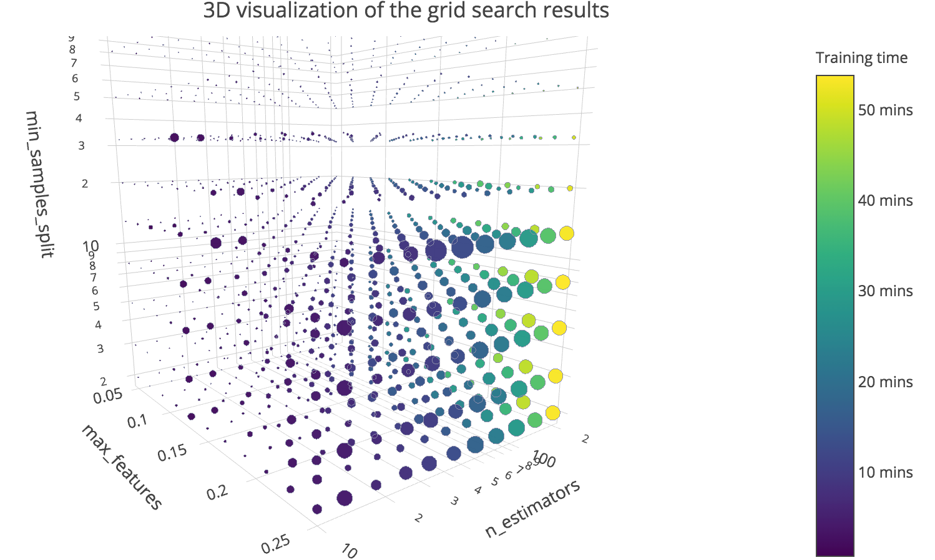
Curse of Dimensionality
source
Our search space for the optimal hyper-parameters increases exponentially as the number of hyper parameters we are considering increases
Add dimension
Notes:
Question: have students implement a grid search over three parameters of SVM (how long does it take? How accurate?)

Slide 29
Overview
Perceptron | SVM
A very simple model Will perform poorly if data is not linearly separable | More complex model because we have to choose the “penalty cost” associated with misclassifications Can transform feature space by choosing a Kernel
Notes:
The perceptron has become extinct due to its revolutionary younger brother

Slide 30
Demo

Slide 31
Cross Validation

Slide 32

K-fold Cross Validation
Create equally sized k partitions, or folds, of training data
For each fold:
Treat the k-1 other folds as training data.
Test on the chosen fold.
The average of these errors is the validation error
Often used in practice with k=5 or k=10.

Slide 33
K-fold Cross Validation
Dataset
Suppose K = 5,
5-Fold CV

Slide 34
K-fold Cross Validation
Fold 1
Fold 2
Fold 3
Fold 4
Fold 5

Slide 35
K-fold Cross Validation
Test Sample
Training Sample
Training Sample
Training Sample
Training Sample
Calculate MSE = mse1

Slide 36
K-fold Cross Validation
Training Sample
Test Sample
Training Sample
Training Sample
Training Sample
Calculate MSE = mse2

Slide 37
K-fold Cross Validation
Training Sample
Training Sample
Test Sample
Training Sample
Training Sample
Calculate MSE = mse3

Slide 38
K-fold Cross Validation
And so on

Slide 39
K-fold Cross Validation
Fold 1
Fold 2
Fold 3
Fold 4
Fold 5
MSE = Avg(mse1...5)

Slide 40
K-fold Cross Validation
Matters less how we divide up
Selection bias not present

Slide 41
Leave-1-Out Cross Validation
For each sample:
Treat all other data as training data.
Test on that one sample
The average of these errors is the validation error
Pro: Better on small datasets
Pro: More realistic (trained on most of the data)
Con: Takes longer to run
Notes:
Special case of k-fold cross validation where k is set to the # of samples in the full dataset

Slide 42
Coming Up
Assignment 3: Releasing Friday night, due next Friday

