Slide 1

Lecture 8: Supervised Learning Pt. 2
More Models, Bootstrapping, and Bagging
INFO 1998: Introduction to Machine Learning

Slide 2

Attendance Form!

Slide 3
Agenda
Decision Trees
Logistic Regression
Validation Techniques
  Bootstrapping & Bagging

Slide 4
Decision Trees

Slide 5
How Should I Spend My Weekends
Source
Internal Node
Decision Tree
supervised machine learning model
breaking down our data by making a decision based on asking a series of questions based on features
Work To Do?
Yes
No
Branch
Stay In
Weather?
Sunny
Overcast
Rainy
Beach
Friends Busy?
Run
Yes
No
Leaf Node
Stay In
Movies
Notes:
https://towardsdatascience.com/https-medium-com-lorrli-classification-and-regression-analysis-with-decision-trees-c43cdbc58054

Slide 6
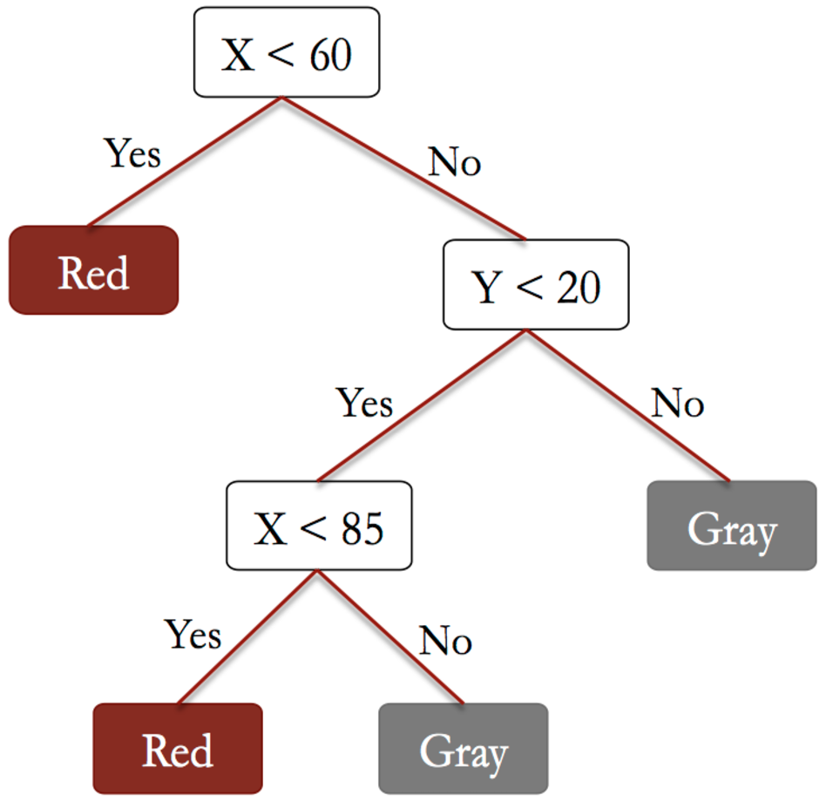
CART (Classification and Regression Trees)
Used for Classification and Regression
At each node, split on variables
Each split minimizes error/impurity function
Very interpretable
Models a non-linear relationship!

Slide 7
Pros and Cons of Using Decision Trees
Pros | Cons
Easy to interpret | Overfitting ☹
Requires little data preparation (robust to missing data) | Requires parameter tuning (max depth)
Can use a lot of features | Can only make horizontal/vertical splits (solvable with feat. eng. / ensembling)
Can capture non-linear relationships

Slide 8
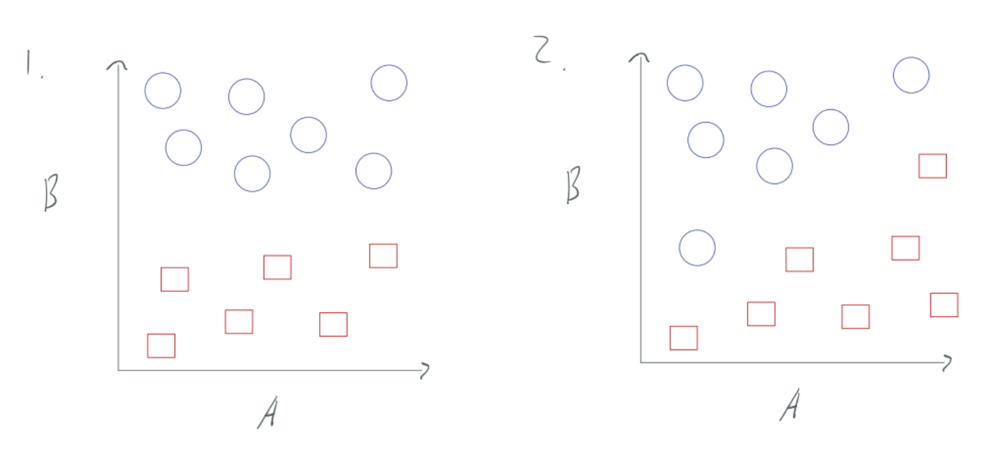
What would these decision boundaries look like?

Slide 9
What would these decision boundaries look like?
“If B less than this value, it’s a red square. Otherwise, it’s a blue circle.”

Slide 10
What would these decision boundaries look like?
Decision trees only make horizontal/vertical splits!
“If B less than this value, it’s a red square. Otherwise, it’s a blue circle.”
Uhhh…

Slide 11
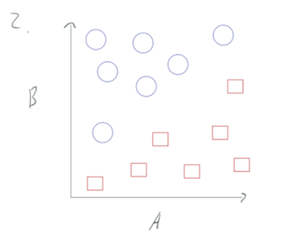
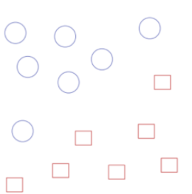
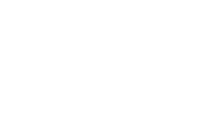
But…
Rotate!

Slide 12
How to Reduce Overfitting
1. Limit the max depth of the tree
Depth = 0
Depth = 1
Model Complexity
Depth = 2
When training a decision tree, we have to specify the maximum depth a constructed tree can have

Slide 13
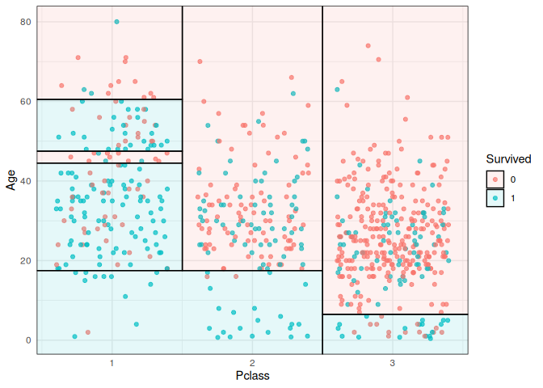
How to Reduce Overfitting
Source
There are no “curves” for each decision tree boundary line
Limiting the depth of the tree limits the number of lines you are splitting on

Slide 14
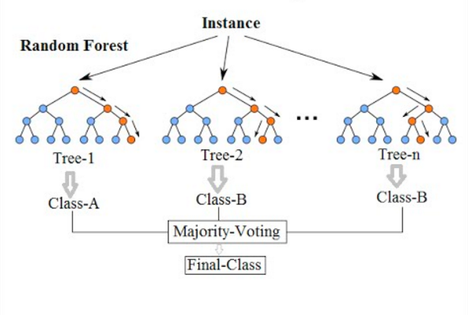
How to Reduce Overfitting
Source
2) Train multiple decision trees and determine final output based on output of each decision tree
This is called a
Random Forest Classifier
Notes:
https://medium.com/@williamkoehrsen/random-forest-simple-explanation-377895a60d2d

Slide 15
Demo

Slide 16
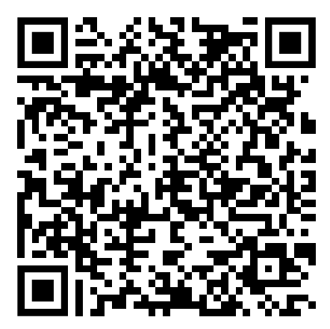
Lecture 8: Supervised Learning Pt. 2
INFO 1998: Introduction to Machine Learning
Attendance!

Slide 17
Logistic Regression

Slide 18
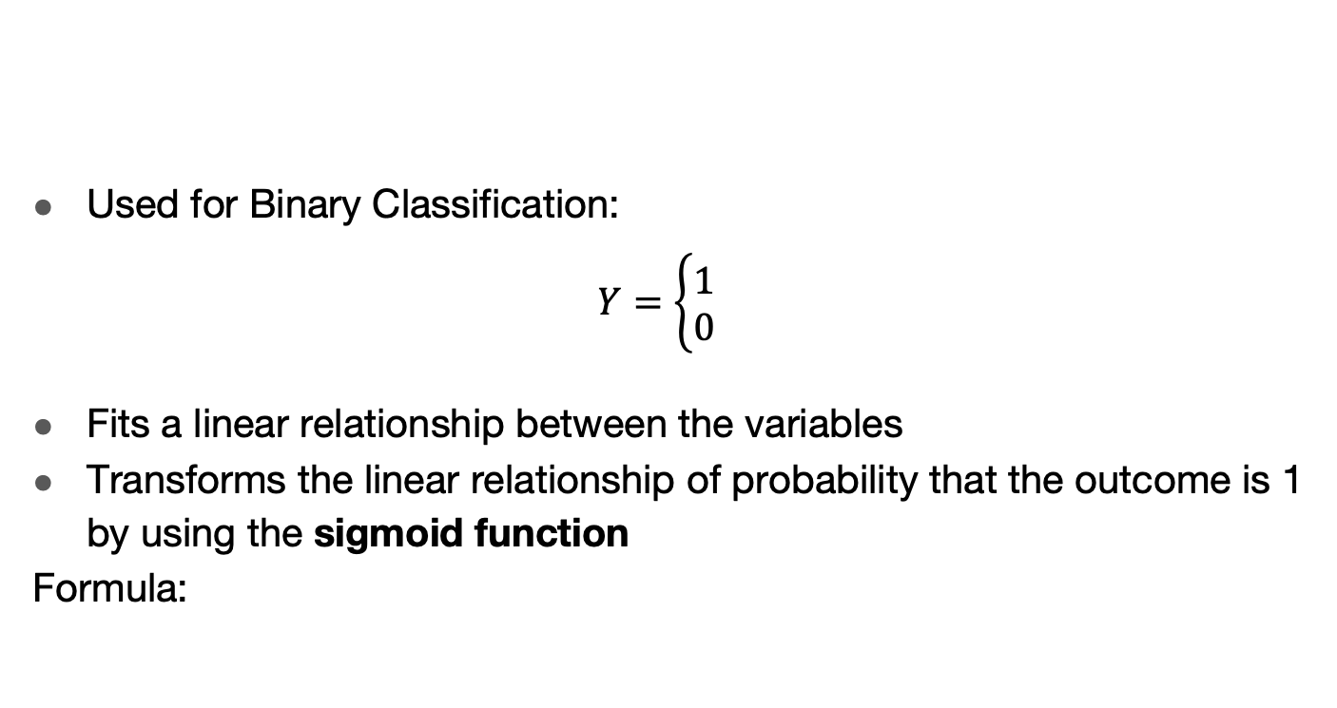


Logistic Regression

Slide 19

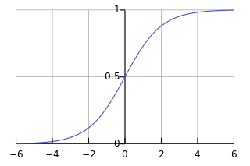
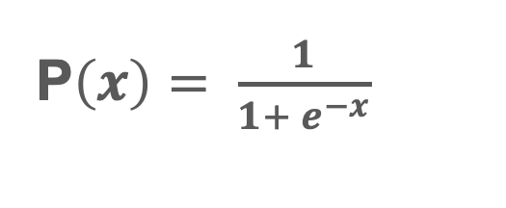

Logistic Function
The Logistic Function “squeezes” numbers to be between 0 and 1
Allows us to interpret our prediction as a “probability” that something is true

Slide 20

Threshold
At what point do we differentiate between our classifications?
f(x) below threshold: predict 0
f(x) above threshold: predict 1

Slide 21
Pros and Cons of Using Logistic Regression
Pros | Cons
Easy to interpret (probability) | Only Capable of Binary Classification
Computationally efficient to compute | No closed form solution (requires use of optimization algorithms)
Does not require parameter tuning
Logistic Regression is a simple model, therefore, oftentimes it is used as a good “baseline” to compare more complex models to

Slide 22
Validation Techniques
Notes:
terminology: train, validation, test

Slide 23
Review: Regression vs. Classification
Regression
Classification
Predict Continuous Data
“On average, how wrong are we?”
Predict Discrete or Categorical data
“How many points do we get wrong?”
Numbers
Continuous

Slide 24
Leave-P-out
Let D be our whole dataset
Choose a P
For every combination of P points in D:
Use a train/test split with those P points as test, the rest as train

Slide 25
Leave-P-out: different from K-fold!
Let’s say D has a size of 4. There are four data points: a, b, c, and d.
K-fold:
K = 2.
Each fold has a size of 2: {a,b} and {c,d}
So, we only have 2 possible test sets:
{a,b} and {c,d}
Leave-P-out:
P = 2.
We have 6 possible test sets:
{a,b}, {a,c}, {a,d}, {b,c}, {b,d}, and {c,d}
Notes:
K-Fold you create k partitions, and then pick each of k partitions to be test set exactly once
Leave-P-Out: you use all possible test sets based on size P, much slower

Slide 26
Leave-P-out
Pros:
Dependable (not random)
Representative — checks all combinations
Cons:
Slow!
  Runtime increases with larger datasets
  Runtime explodes with larger P
Notes:
Runtime explodes when P ~ N/2

Slide 27
Monte Carlo Cross Validation
Getting accuracy 1 time doesn’t tell us much
Getting accuracy 2 times tells us a bit
Getting accuracy 3 times tells us a bit more
…
Getting accuracy N times might be good enough!
Take the average of those N times

Slide 28
Monte Carlo CV
Need to use new, random train/test split each time
  If you use the same train/test split each time, you’re not getting any new information!
Pros:
  easy to implement
  easy to make faster/slower by changing number of iterations
Cons:
  random -> train/test splits not guaranteed to be representative of dataset (might overlap, or miss some data)
  harder to calculate how many iterations you need

Slide 29
The Bootstrap
What if we don’t have enough data?
Use bootstrap datasets to approximate the test error
Sample with replacement from the original training dataset (with n samples) to generate bootstrap datasets of size n
  Some data points may appear more than once in the generated data
  Some data points may not appear
Estimate of test error = average error among bootstrap datasets
Notes:
The use of the term bootstrap derives from the phrase to pull oneself up by one’s bootstraps, widely thought to be based on one of the eighteenth century “The Surprising Adventures of Baron Munchausen” by Rudolph Erich Raspe: The Baron had fallen to the bottom of a deep lake. Just when it looked like all was lost, he thought to pick himself up by his own bootstraps. It is not the same as the term “bootstrap” used in computer science meaning to “boot” a computer from a set of core instructions, though the derivation is similar.
The bootstrap is a flexible and powerful statistical tool that can be used to quantify the uncertainty associated with a given estimator or statistical learning method. For example, it can provide an estimate of the standard error of a coefficient, or a confidence interval for that coefficient.
Bootstrap → sample from training data
Monte Carlo → train test splits of training data

Slide 30
Demo

Slide 31
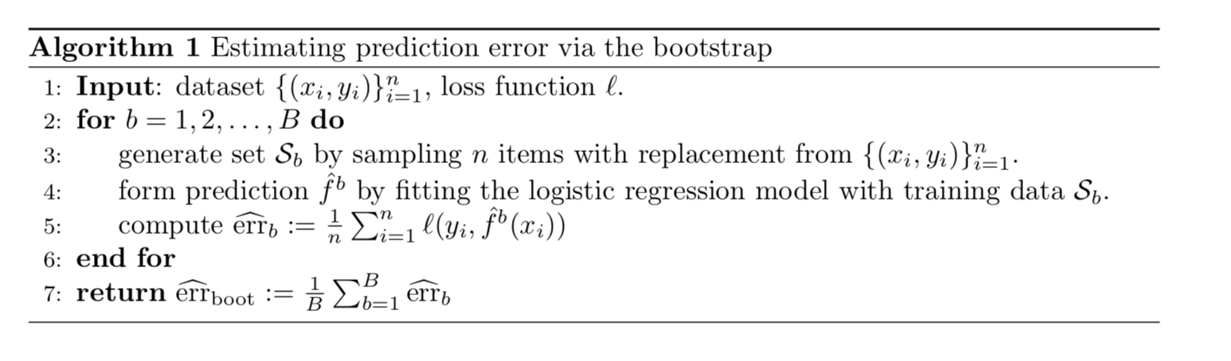
Pipeline of the Bootstrap
Does this give very good estimate of the prediction error?
If no, why not? Does it underestimate or overestimate the prediction error?

Slide 32
Pipeline of the Bootstrap
No.
Since the bootstrap is sampling with replacement for B validation folds, each fold would have significant overlap with the original data used for training. Approximately, 2/3 of the training data would appear in each validation fold.
This leads to significant underestimation of the prediction error.
Why 2/3?

Slide 33
Proof
Suppose there are n samples (yi, xi) in the training set data, then for each of the bootstrap validation fold b, every sample has probability 1/n of being selected into b. The probability of each data sample (yi, xi) not being in fold b is (1 - 1/n), respectively.
Probability of avoid selecting all n data points in fold b: (1 - 1/n)^n.
When n gets large, we have this probability converges to 1/e.
(Why this converges? Probably should review Calc I, or see: https://math.stackexchange.com/questions/882741/limit-of-1-x-nn-when-n-tends-to-infinity.)
Therefore, the fraction of overlapping data points in each fold is (1-1/e), which is about 2/3.

Slide 34
How we fix the problem
Requires some thoughts when generating validation set, especially for real-world complex data.
Can partly fix this problem by only using predictions for those observations that did not (by chance) occur in the current bootstrap sample.
But the method gets complicated.
Notes:
For real data we cannot generate new samples from the original population. However, the bootstrap approach allows us to use a computer to mimic the process of obtaining new data sets, so that we can estimate the variability of our estimate without generating additional samples.
• Rather than repeatedly obtaining independent data sets from the population, we instead obtain distinct data sets by repeatedly sampling observations from the original data set with replacement.
• Each of these “bootstrap data sets” is created by sampling with replacement, and is the same size as our original dataset. As a result some observations may appear more than once in a given bootstrap data set and some not at all.
• In more complex data situations, figuring out the appropriate way to generate bootstrap samples can require some thought.
• For example, if the data is a time series, we can’t simply sample the observations with replacement

Slide 35
Bootstrap vs. k-fold
In K-fold validation, each of the K folds is distinct from the other (K − 1) folds used for training: there is no overlap.
This is crucial for its success in estimating prediction error.

Slide 36
Why do we still use Bootstrap?
Bootstrap allows us to use a computer to mimic the process of obtaining new data sets.
Can be used to quantify the uncertainty associated with a given estimator or statistical learning method.
Provides an estimate of the standard error of a coefficient, or a confidence interval for that coefficient.
  i.e. the variability of the model!

Slide 37
Bagging (Bootstrap Aggregating)
What if we don’t have enough data?
Bagging is a common technique that builds on Bootstrapping
Main Idea: Do Bootstrapping a bunch and make a classifier for each bootstrap, then choose majority prediction.
Many weak learners aggregated typically outperform a single learner over the entire set, and overfits less.
  Principle behind Random Forests (“forest” of decision trees)

Slide 38
Coming Up
Assignment 7: Due tonight at 11:59pm
Assignment 8: Due April 15th, 2026
Final Project: Due April 29th, 2026
Next Lecture: Applications of Unsupervised Learning

