Slide 1

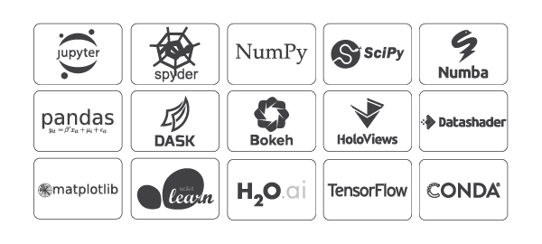
Welcome to INFO 1998!
First Step: Get the required software
1.
Anaconda
https://www.anaconda.com/distribution/
2.
Open Terminal (MacOS) / Command Prompt (Windows),
Type and enter: jupyter notebook
Notes:
Interactive questions while people are still downloading:
Who here has prior ds experience
Who here’s a freshman? So forth
Who here is undecided as to whether or not they will take this class?

Slide 2

Lecture 1: Introduction
INFO 1998: Introduction to Machine Learning

Slide 3
Agenda
Meet CDS: Who are we?
Course Syllabus: What will we learn?
Introduction: What is Data Science / Machine Learning?
Course Logistics: How will we learn?
Getting Started: Software

Slide 4
Who are we?
Cornell Data Science
Project Team
Community Outreach
Data Science
INFO 1998
Machine Learning Engineering
Tech Talks
Data Engineering
Quantitative Finance

Slide 5
Nice to meet you!
Who you have to deal with
You can talk to me any time about:
Cooking
Research
Multi-turn interactions in {human,LLM} x {human,LLM} communication
This course!!!
Laerdon Kim
CS ‘28
lyk25@cornell.edu
DS Subteam

Slide 6
Course Staff
Backbone of INFO 1998
Ethan Li (QF ‘29)
Joy Wang (DE ‘29)
Sophia Lu (QF ‘29)
Vivian Kahm (QF ‘29)
Weiyun Hsu (QF ‘29)
Rohan Anne (DS ‘29)
Mihir Kulshreshtha (DS ‘28)
Bryan Chung (DS ‘28)
Naijei Jiang (Tech Chair)

Slide 7
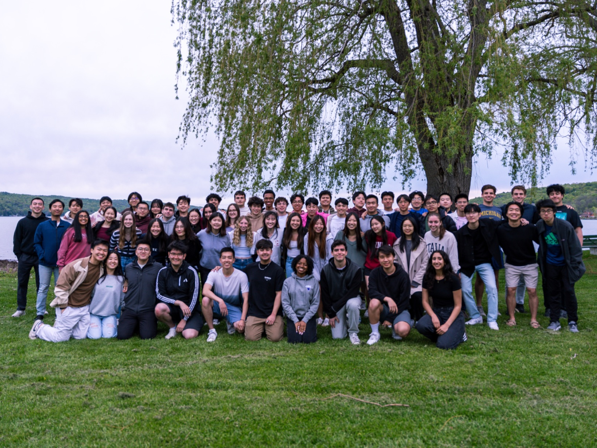
Getting to know your classmates
Spend 5 minutes going over the following:
Name
Major
Why you are taking this course
If you were a baseball player/UFC fighter, what would your walk up song be?
  Alternatively, something funny that happened to you recently
Project Team Website: cornelldata.science
Course Website: cornelldatascience.github.io/info1998/

Slide 8
What Do You Get Out of This?
What you will have accomplished by the end of this?
An excuse to learn the stuff you said you wanted to learn
Friends
Notes:
Make friends while doing your project!
You’ll get the knowledge of basic Machine Learning
MOST IMPORTANTLY - You’ll learn how to get started with your own data science projects in your free time. We’ll teach you the basics so you can go out there and learn on your own and do your own projects!

Slide 9
What is machine learning?
Why is it interesting, and why is it important?
Notes:
My goal is to prove to you that, AI, machine learning, and data science—there is so, so much to it

Slide 10
Traditional Computer Science
Data
Output
Computer
Program
(Function)

Slide 11
Machine Learning
Data
Program
(Function)
Computer
Output

Slide 12




AI is taking over the world—
A non exhaustive list of frontier labs
(ish!)

Slide 13
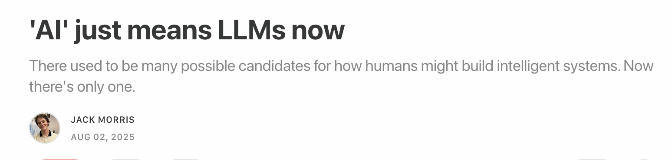
As a result, there’s a big spotlight on AI, and a big spotlight on language models
Notes:
From Jack Morris…

Slide 14
Computational social science
Deep learning
Natural language
processing
Machine learning
Computer
vision
Reinforcement learning
Robotics
ML theory
Notes:
But there is a long and rich history
Are you confused? Great, I am too.
This complexity is something which begins as really confusing. But if you are interested, broadly, in machine learning, this is absolutely a place to start.

Slide 15
Computational social science
Deep learning
Natural language
processing
Machine learning
Computer
vision
Reinforcement learning
Robotics
YOU ARE HERE
ML theory
Notes:
Machine learning makes up the backbone of this wonderful and rich field.

Slide 16
AI is more than:

Slide 17
AI is more than:
ChatGPT

Slide 18
AI is more than:
ChatGPT wrappers

Slide 19
AI is more than:
ChatGPT wrappers
Transformers (the architecture of large language models)

Slide 20
AI is more than:
ChatGPT wrappers
Transformers
Neural networks

Slide 21
AI is more than:
ChatGPT wrappers
Transformers
Neural networks
Machine learning (symbolic AI!)

Slide 22
What makes someone broadly successful in machine learning? In my opinion:
Understanding of how to manage a lot of + messy data
Mathematical diligence
Most importantly: genuine interest

Slide 23
Course Objectives and Syllabus
What you should aim to understand by the end of the course
OBJECTIVES
SYLLABUS
Manipulating Data
Data Manipulation / Visualization
Lectures 1-3
Communicating Data
Understanding of ML as a concept
Fundamentals of Machine Learning
Lectures 4-5
Intuitive understanding of ML models
Implementation of ML models
Supervised Learning
Lectures 6-8
Comfort Using Python
Applications in Industry
Unsupervised Learning
Lecture 9
Project Experience
Syllabus is posted on our website.

Slide 24
What is Data Science?
“By "Data Science", we mean almost everything that has something to do with data: Collecting, analyzing, modeling...... yet the most important part is its applications --- all sorts of applications.”
Journal of Data Science
Notes:
Social media collecting your data to recommend advertisements
Lot of information that can be gained from data and analysis
How do you express the information you found? How can you communicate your results. (Final Project).

Slide 25
What is Data Science?
Conway’s Data Science Venn Diagram
Statistical Research
Domain Expertise
Mathematics
Data
Science
Danger
Zone
Machine Learning
Computer Science

Slide 26
What is Data Science?
Conway’s Data Science Venn Diagram
Mathematics / Statistics
Statistical Research
Domain Expertise
Mathematics
How do we scale?
Data
Science
Computer Science
Danger
Zone
Machine Learning
How do we ask the right questions / apply insights?
Computer Science
Domain Expertise

Slide 27
Data Science ≠ Machine Learning

Slide 28
Applications of Data Science
We’ll be back to this slide!
Stock Prices
Predictive
Netflix Recommendations
Medical Diagnosis
Preventive
Social Impact Analytics
Digital Advertising
Real-Time
Autonomous Vehicles

Slide 29
Course Objectives and Syllabus
What you should aim to understand by the end of the course
OBJECTIVES
SYLLABUS
Manipulating Data
Data Manipulation / Visualization
Lectures 1-3
Communicating Data
Understanding of ML as a concept
Fundamentals of Machine Learning
Lectures 4-5
Intuitive understanding of ML models
Implementation of ML models
Supervised Learning
Lectures 6-8
Comfort Using Python
Applications in Industry
Unsupervised Learning
Lecture 9
Project Experience
Syllabus is posted on our website.

Slide 30
FAQs
Is this class a good fit for you?
1) Will I become a Data Scientist / Machine Learning Engineer?
No, you will not. The course covers a breadth of concepts, helps build intuitive understanding of some models, but does not dive too deep into the mathematical complexities (since this is a 1000-level course). However, feel free to come to office hours if you’re interested in learning more.
2) How much time commitment is this course?
Completely up to you. It’s not hard to pass the class if all you want is basic street-fighting machine learning skills, which is fine too – that’ll require less than 1 hour per week. If you want to put some more time in and come up with a creative and cool data science project that you can be proud of, that will take more time but is very rewarding!
3) I have no background in CS / Stats – am I underprepared?
Not at all! We’ll teach you everything you need to know, but you may have to spend a little more time getting comfortable with Python. A number of non-STEM graduate students have taken this class in the past to understand basics that they could apply to their research. A large number of freshmen also take the course because they’re excited to learn more about the field. TL;DR: If you’re interested, give it a shot!

Slide 31
Course Logistics
How is the class structured (and graded)?
9 assignments (~1 assignment per lecture)
55%
We drop your lowest score!
Project
40%
2-3 students
Attendance
5%
What you are doing right now ☺
Passing Grade: 70%

Slide 32
Project Details
More details to come on the final project rubric and our website
Pre-Processing and Manipulation
Any necessary cleaning and manipulation of the dataset
Visualizations
At least two different visualizations. Visualizations are clearly visible, clean, well-labeled, and serve a clear purpose for your question(s).
Models
Machine learning models that are chosen wisely, implemented correctly, and give meaningful results. For example, you won’t get points if you run a linear regression for a classification problem. If applicable, the results of the models are compared.
Feel free to stay after class or post on Ed to form groups!

Slide 33
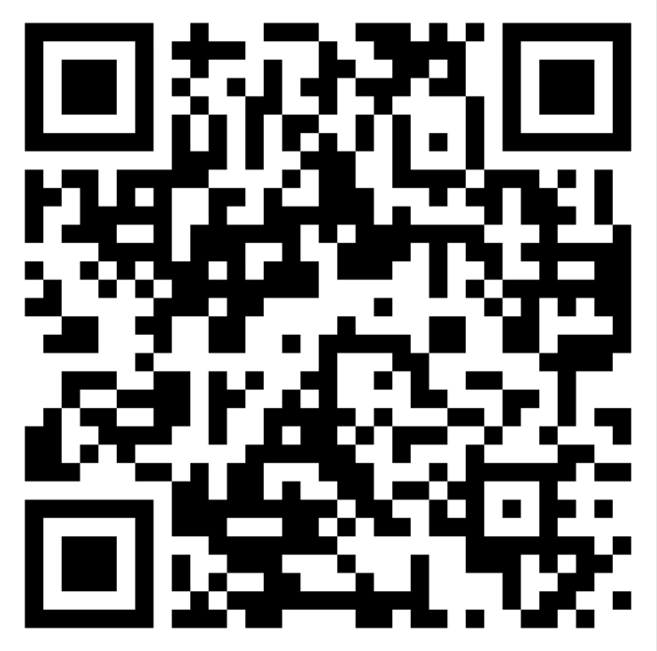
Enrollment
Let’s get this credit
Fill out by Friday to get a pin.
Also counts for today’s attendance!
Notes:
Emphasize to only fill this out if you truly intend to take the class for credit

Slide 34
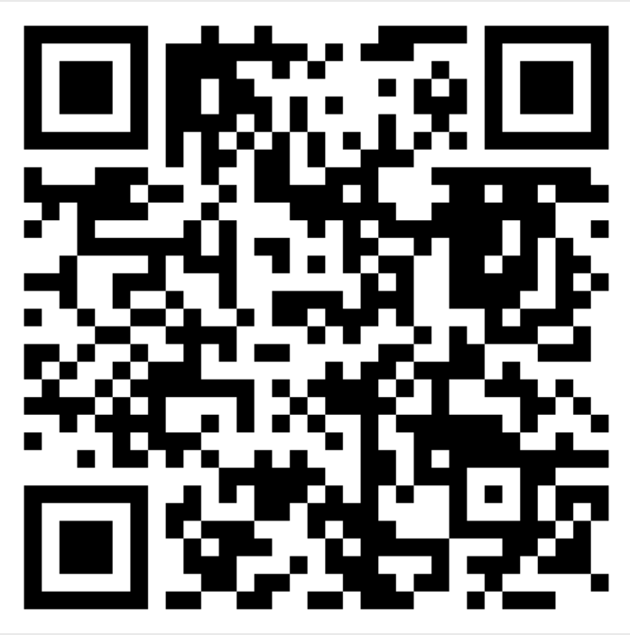
Enrollment
Let’s get this credit
1
Enroll in Ed Discussion
https://edstem.org/us/join/aet3sj
You will be added to CMS over the weekend (after enrollment)
Fill out by Friday to get a pin.
https://forms.gle/CbrxY1eBWHBiw4dv9

Slide 35
Enrollment
Let’s get this credit
3
1
2
Fill out by Friday to get a pin.
https://forms.gle/CbrxY1eBWHBiw4dv9
Enroll in Ed Discussion
https://edstem.org/us/join/aet3sj
You will be added to CMS over the weekend
Enroll through Student Center after obtaining pins

Slide 36
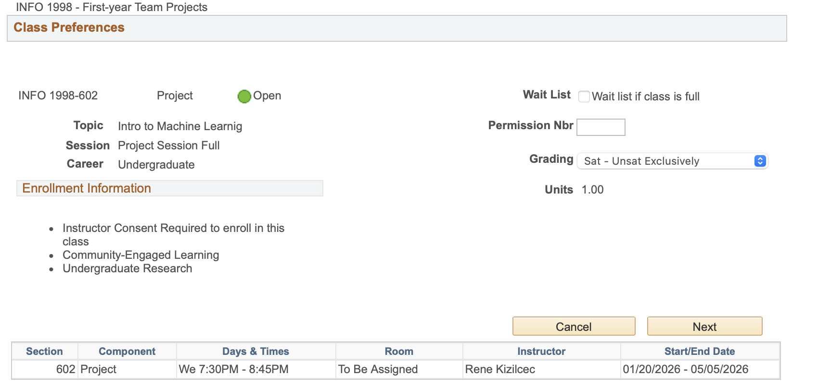
Enrollment on Student Center
Let’s get this credit
Get enrollment pin via email (sometime next week)
Add INFO 1998 Section 602 (class # …) under Rene Kizilcec
Please try to enroll as soon as possible when you receive your pin
pin
1 credit pass/fail

Slide 37
Where can I find course information?
Asking Questions and Course Announcements: Ed Discussion (avoid email if possible)
https://edstem.org/us/join/aet3sj
Assignment File & Submitting Assignments: CMS
https://cmsx.cs.cornell.edu/
Office Hours Schedule & Assignment Files: Course Website
https://cornelldatascience.github.io/info1998/

Slide 38
Jupyter Notebook Demo
Feel free to follow along in Jupyter Notebook (linked on website)

Slide 39
Next Steps
Installation: Reach out over Ed!
Assignment 1: Due date forthcoming
Enroll on Student Center: Will receive a pin via Cornell email sometime this upcoming week
Next Lecture: Data Manipulation

