Slide 1
INFO 1998: Introduction to Machine Learning
Download lecture2data.csv and demo from the website – make sure they are in the same directory!

Slide 2

Lecture 2: Data Manipulation
INFO 1998: Introduction to Machine Learning
Notes:
Hi. Welcome to the second lecture of introduction to machine learning. The lecture today is about Data Manipulation.

Slide 3
Logistics
Enroll using the PINs!
Ask yourself:
Can you access the Ed Discussion?
Can you access the course website?
A1 to be released soon! A diagnostic.

Slide 4
Agenda
Define Good Question + Get Raw Data
Data Manipulation Techniques
Data Imputation
Other Techniques
Demo + Summary
Notes:
This is our agenda for today. We will talk about how to define a good question and get raw data, how to manipulate data, how to impute data, and some other techniques. Then we will see a demo. You can go to the course page to download this slide, but it’d be better if you just follow along.

Slide 5
Define Good Question + Get Raw Data
Notes:
This is our agenda for today. We will talk about how to define a good question and get raw data, how to manipulate data, how to impute data, and some other techniques. Then we will see a demo. You can go to the course page to download this slide, but it’d be better if you just follow along.

Slide 6
Creating A Good Question
Good Examples:
What work and lifestyle conditions greatly impact mental health, and in what way?
Based on this data, what factors can be used to predict a candidate’s success within a Canadian election?
What features best predict the amount of solar radiation the Earth gets based on data collected by NASA?
Poor Examples:
What can the data tell me about mental health?
Is there a relationship between the data and a candidate’s success in a Canadian election?
Can we predict amount of solar radiation the earth gets?
Notes:
Before everything, first we need to have a question. Here’s a list of good examples as well as some poor examples.
Let’s take a look at the first good example on the left. it‘s asking a quantitative question. It’s looking for features (such as when you go to sleep) that will produce some target, which here is mental health. we will see how they are dealt with in future lessons.
If you ask, what can the data tell me about mental health, then it’s too broad and general. We want our question to be specific, not too broad, nor a simple Y/N question,
This is very important to think about when creating a question for your final project.
Mental health: quantitative vs. general question
Canadian election: avoid Y/N
Solar radiation: again, avoid Y/N but also specificity

Slide 7
The Data Pipeline
Problem Statement
Summary and visualization
Statistical and predictive results
Raw data
Usable data
Meaningful output
Data cleaning, imputation, normalization
Data analysis, predictive modeling, etc.
Solution
Debugging, improving models and analysis
We are here!
https://towardsdatascience.com/5-steps-of-a-data-science-project-lifecycle-26c50372b492
Notes:
(Good link for getting a rough idea of the data science project cycle; includes links for further review including)
So now we have a problem, and we want to get the solution. What do we do next? So first we obtain raw data, then we scrub the data by data cleaning, imputation and normalization, so that it becomes usable data. Then we explore the data by analyzing, applying predictive models etc. When we get statistical and predictive results, we can continue debugging and improving models and analysis, or move on to summarize and visualize the results. And then we interpret the results and get our solution.
You will see this data pipeline throughout this semester, and today we will focus on the first step, here!

Slide 8

Acquiring data
Option 1: Web scraping directly from web with tools like BeautifulSoup
Option 2: Querying from databases
Option 3: Downloading data directly (ex. from Kaggle/Inter-governmental organizations/Govt./Corporate websites)
…and more!
Notes:
So, how do we acquire data? There are several options…
A quick note here,
We will have a web-scraping workshop in a few weeks
The time isn’t set yet but it will be after feb break

Slide 9
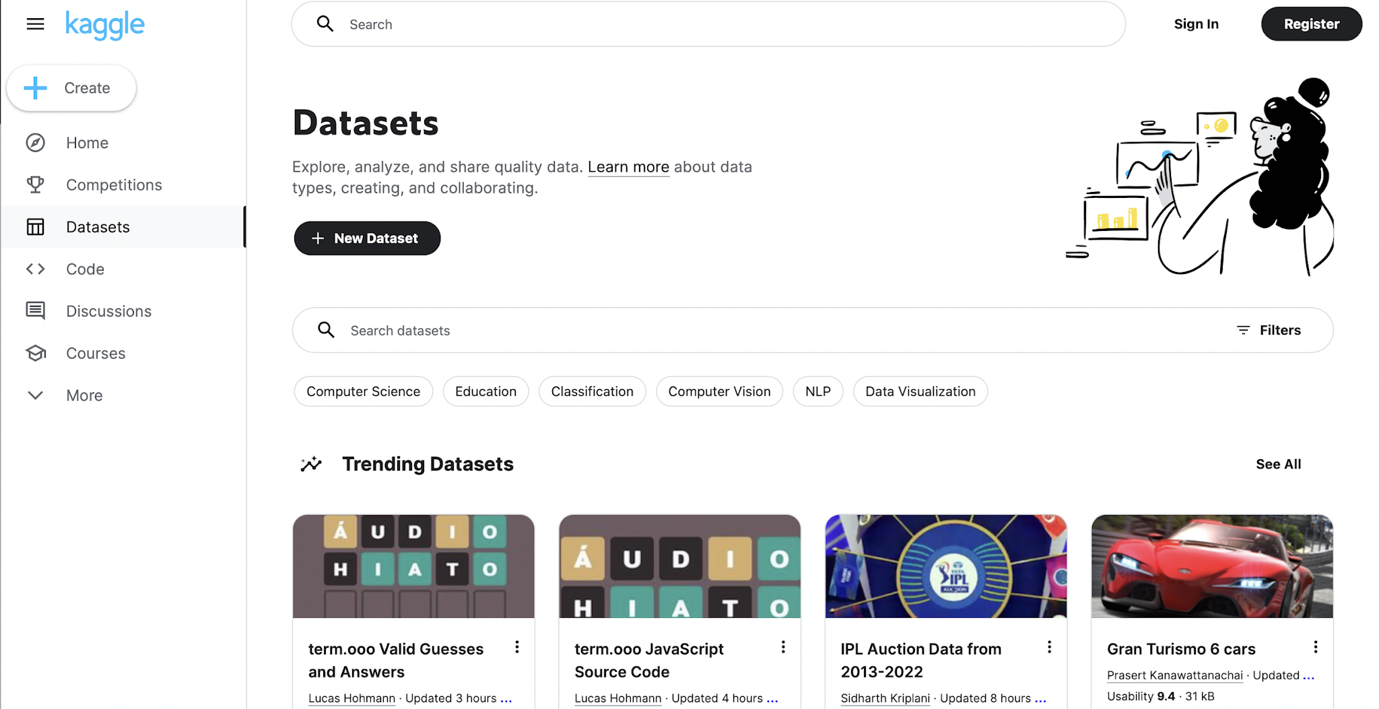
Finding a Relevant Dataset
Questions to Ask Yourself…
Does the data measure what you care about?
Is your data connected/related?
Do you have a lot of data?
https://www.kaggle.com/datasets
Notes:
Xxx
Xxx
These are all very important when you are finding dataset for your final project. You wouldn’t want to start with a data set with very few data and later realize that it doesn’t work well or doesn’t work at all.
We strongly suggest that you find a dataset on Kaggle. Check it out afterclass.

Slide 10
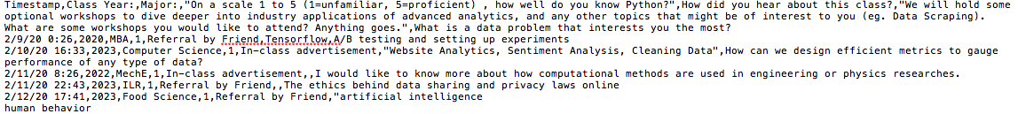
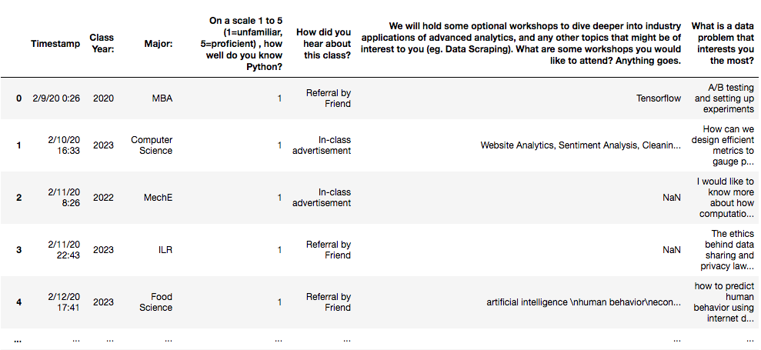
How does input data usually look?
Notes:
When you download a dataset from Kaggle, it’s usually a csv or tsv file. It means comma or tab separated files. They are known as flat test files, and requires parsers to load into code. If you just click it open, it looks like this, and we want them to look like this.

Slide 11
However…
Most datasets are messy.
Datasets can be huge.
Datasets may not make sense.

Slide 12
Question
What are some ways in which data can be “messy”?
Notes:
Do poll everywhere (or at the begining)
https://www.polleverywhere.com/free_text_polls/9oxoRWdgR0dMEYVfkHiFA

Slide 13

ATTENDANCE

Slide 14
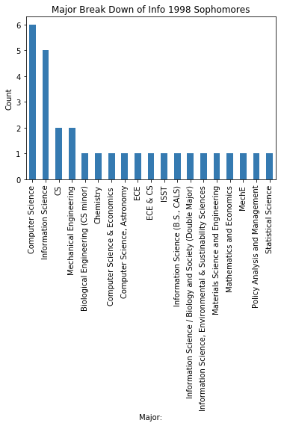
Examples of Weird Data
From the onboarding form!
Example 1: Let’s find CS majors in INFO 1998.
Example 2: From INFO 1998
Different cases:
Example answers for ‘What Year Are You?’
Computer Science
CS
Cs
computer science
CS and Math
OR/CS
…goes on
2002
1st
Junor
INFO SCI 2028
…goes on

Slide 15
Data Manipulation Techniques
Notes:
So why do we manipulate data? Increase clarity and usability

Slide 16
Why should we manipulate data?
Ease of Use
Prevent calculation errors
Capture True Intentions
Notes:
So why do we manipulate data? Increase clarity and usability

Slide 17

DataFrames
Pandas (a Python library) offers DataFrame objects to help manage data in an orderly way
Similar to Excel spreadsheets or SQL tables
DataFrames provides functions for selecting & manipulating data
import pandas as pd
Notes:
what is "as" and why we do "pd"?
pandas is an open-source data analysis library built on top of the Python programming language.
The as pd portion of the code then tells Python to give pandas the alias of pd. This allows you to use the pandas functions by simply typing pd.function_name rather than pandas.function_name.

Slide 18
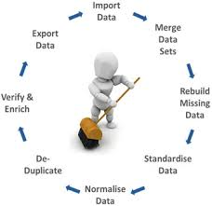
Data Manipulation Techniques (with Pandas)
Filtering & Subsetting
Concatenating
Joining
Bonus: Summarizing

Slide 19
Filtering vs. Subsetting
Filters rows
Focusing on data entries
Subsets columns
Focusing on characteristics
Name | Year | Major
Mericel | 2025 | CS
Deniz | 2026 | CS
Mahi | 2025 | ORIE
Sri | 2025 | CS
Name | Year | Major
Mericel | 2025 | CS
Deniz | 2026 | CS
Mahi | 2025 | ORIE
Eric | 2024 | Math
Filtering
Subsetting
Notes:
Filtering and subsetting can decrease the size of the data set so we can examine sub groups closer.
Filtering means looking at only certain rows, based on the values in columns. Here in this example, we only want to look at upperclassman members, so we filter through year focus on certain entries.
Subsetting means getting rid of unnecessary columns and focus on certain characteristics. For example, we don’t need the names and just want the year and major, so we took a subset here.
So just remember you filter rows and subsets columns. Don’t mix them up!

Slide 20
Joining
Joins together two data frames on any specified key (fills in NaN = Not a Number otherwise). The index is the key here.
 | Name | Age | Major
0 | Sri | 20 | CS
1 | Mahi | 21 | CS
3 | Deniz | 21 | CS
 | Name | Age | Major
0 | Mericel | NaN | NaN
1 | Deniz | 21 | CS
2 | Mahi | 21 | CS
3 | Eric | Nan | NaN
4 | Sri | 20 | CS
 | Name
0 | Mericel
1 | Deniz
2 | Mahi
3 | Eric
4 | Sri
Notes:
Joining is combining the columns of two data frames on some specified keys. In this example, the index is the key, and the missing entries are represented as NaN, which means not a number.
Explain why it’s good to know this in practice: e.g. student enrollments in courses (all data won’t be in one giant table) — makes sense to keep table about students separate from table about courses

Slide 21
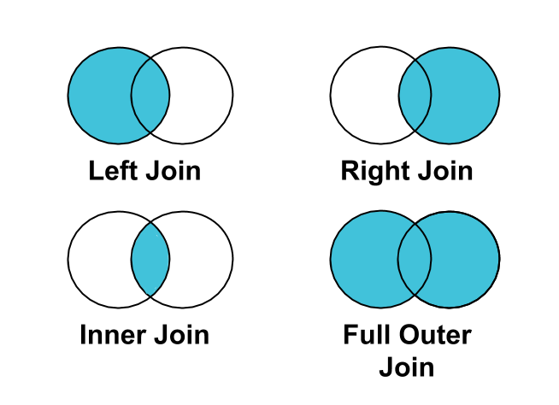
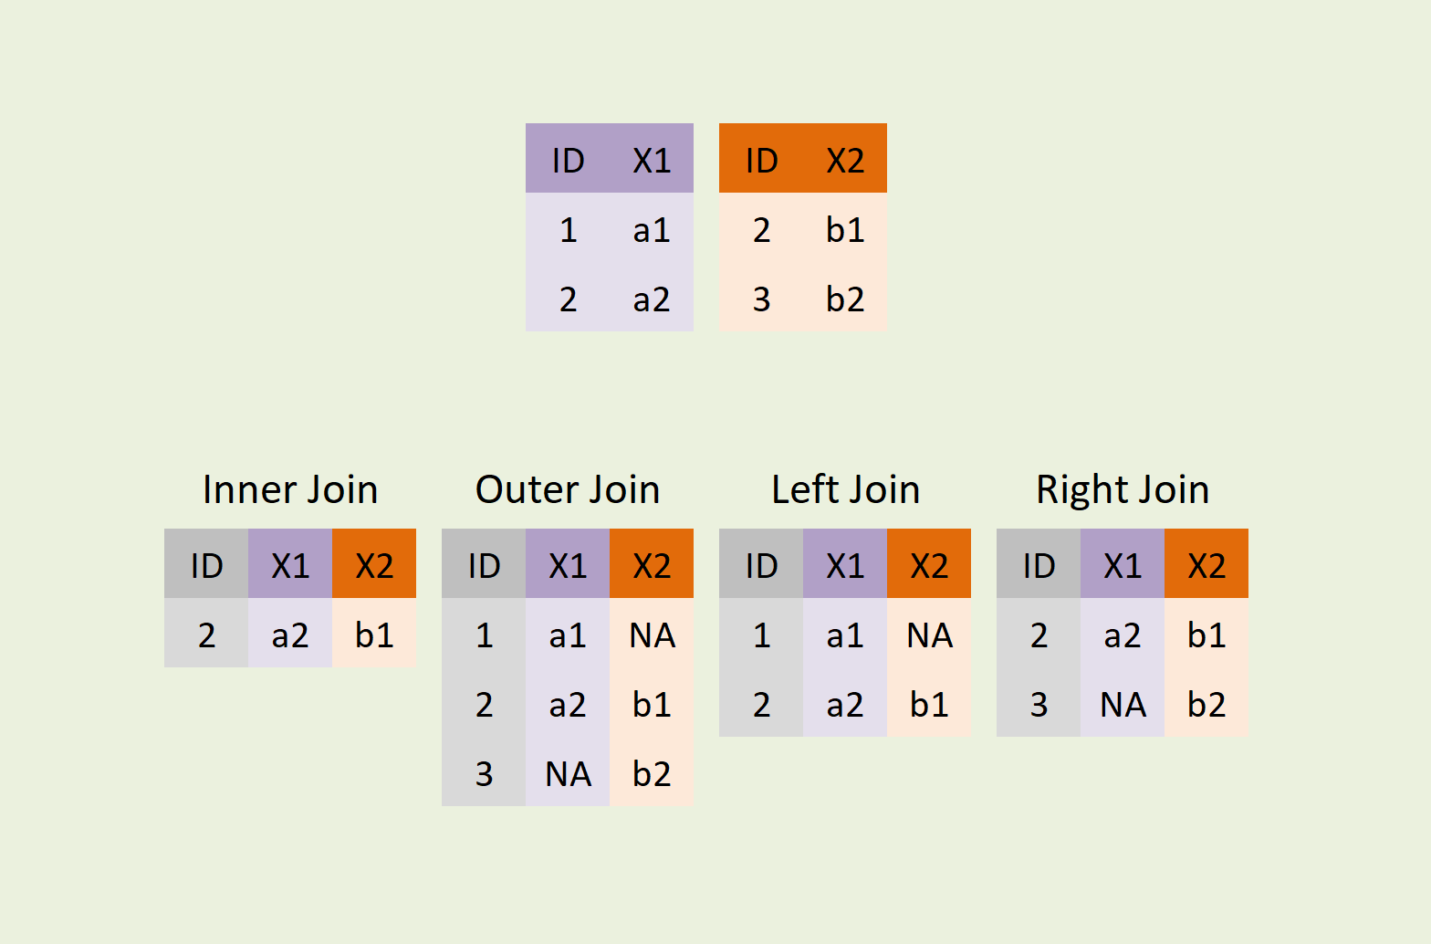
Types of Joins
https://statisticsglobe.com/wp-content/uploads/2021/12/join-types-python-merge-programming.png
Notes:
Here are four types of joins. Be careful of what data you want to keep when joining two data frames.

Slide 22
Concatenating
Combines together two data frames, either row-wise or column-wise
Name | Sex | Major
Varun | M | CS
Eric | M | Math
Name | Sex | Major
Varun | M | CS
Eric | M | Math
Mahi | F | ORIE
Deniz | F | CS
Name | Sex | Major
Mahi | F | ORIE
Deniz | F | CS
concat!
Notes:
Concatenating is also combining two data frames, but while join offers a low level of control, concat has a lot more options. You don’t need to memorize them, just look them up if you need to use them.

Slide 23
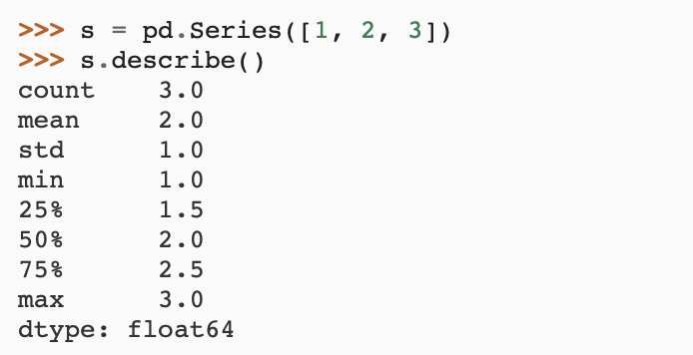
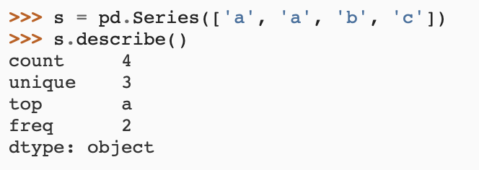
Bonus: Summarizing
Gives a quantitative overview of the dataset
Useful for understanding and exploring the dataset!
Above: stats made easy
Notes:
Summarizing is very useful as it gives us a quantitative overview of the dataset. Besides count, for numerical datasets, it gives us mean, standard deviation, minimum maximum and quartile numbers. For non-numerical datasets, it gives other useful overall statistics.
BEFORE we move on to data imputation, does anyone have any questions? (Compensate for Missing Values In a Dataset )

Slide 24
Data Imputation
Notes:
explain the algorithm
give a high level explanation of clustering and KNN

Slide 25

Dealing with missing data
Datasets are usually incomplete. We can solve this by:
Leaving out samples with missing data
Data imputation
Randomly Replacing NaNs
Using summary statistics
Using predictive models

Slide 26
1: Leaving out samples with missing values
Option: Remove NaN values by removing specific samples or features
Beware not to remove too many samples or features!
  Information about the dataset is lost each time you do this
Notes:
You can remove NaN values by removing specific samples or entire features
Could lead to biased model

Slide 27
2: Data Imputation
3 main techniques to impute data:
Randomly replacing NaNs
Using summary statistics
Using regression, clustering, and other advanced techniques
Notes:
Compensate for Missing Values In a Dataset

Slide 28
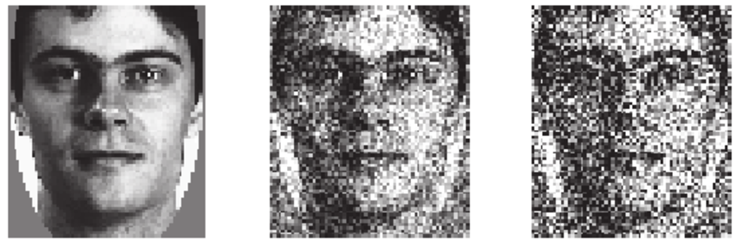
2.1: Randomly replacing NaNs
This is not good - don’t do it
Replacing NaNs with random values adds unwanted and unstructured noise
Notes:
(not good technique -- actually making it distorbant)

Slide 29
2.2: Using summary statistics
non-categorical data
Works well with small datasets
Fast and simple
Does not account for correlations & uncertainties
e.g. mean vs. median, average
categorical data
Using mode works with categorical data (only theoretical)
But it introduces bias in the dataset
>> an_array.mean(axis=1) # computes means for each row
>> an_array.median() # default is axis=0
Notes:
Categorical data means data in which individuals are placed into groups or categories — for example gender, region, or type of movie. Summarizing categorical data involves boiling down all the information into just a few numbers that tell its basic story.
The mode is the category with the greatest number of cases.

Slide 30
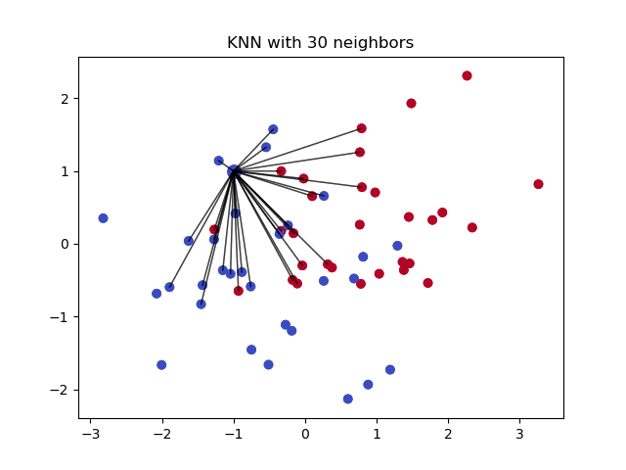
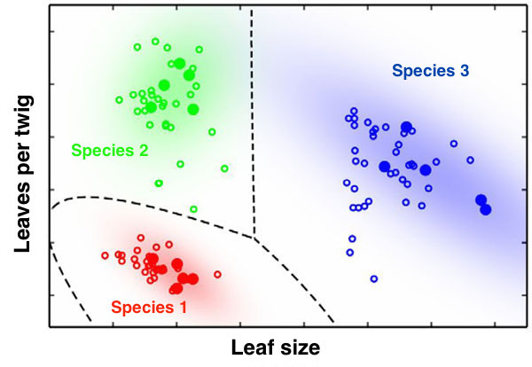
2.3: Using Regression / Clustering
Use other variables to predict the missing values
  Through regression, clustering, KNN…
Doesn't include an error term, so it's not clear how confident the prediction is
Notes:
explain the algorithm
give a high level explanation of clustering and KNN

Slide 31
Other Techniques
Notes:
buckets analogy: can control number and size of buckets. dropping balls into buckets. smaller buckets = more buckets
bucket is a range

Slide 32
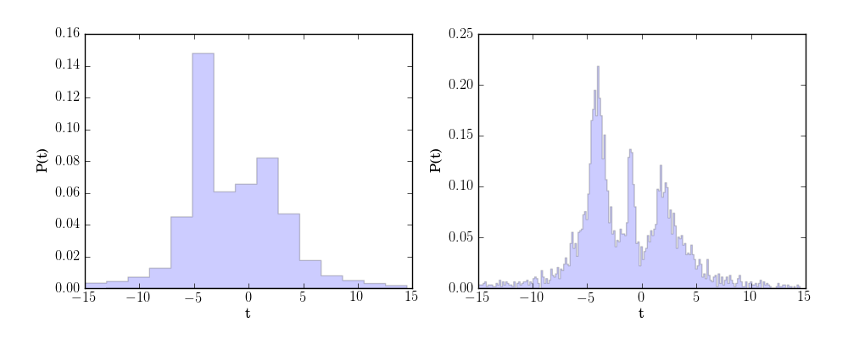
Technique 1: Binning
What?
Makes continuous data categorical by lumping ranges of data into discrete “levels”
Why?
Applicable to problems like (third-degree) price discrimination
Notes:
buckets analogy: can control number and size of buckets. dropping balls into buckets. smaller buckets = more buckets
bucket is a range

Slide 33
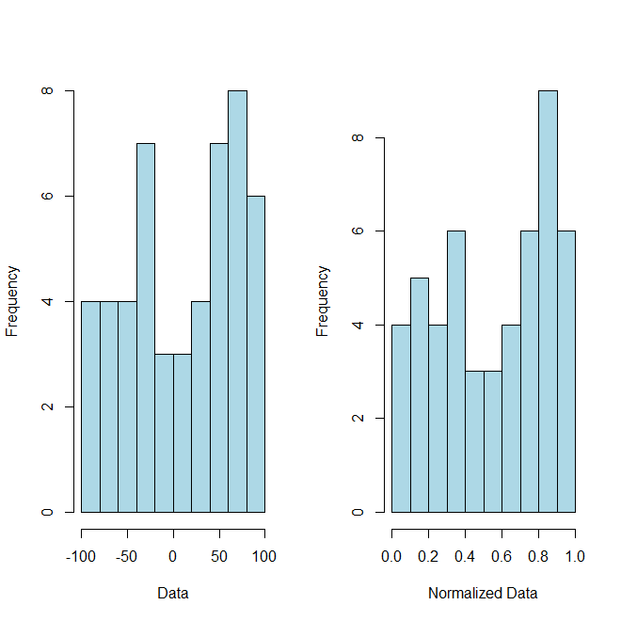
Technique 2: Normalizing
What?
Turns the data into values between 0 and 1
Why?
Easy comparison between different features that may have different scales. Necessary for models with distance metrics.

Slide 34
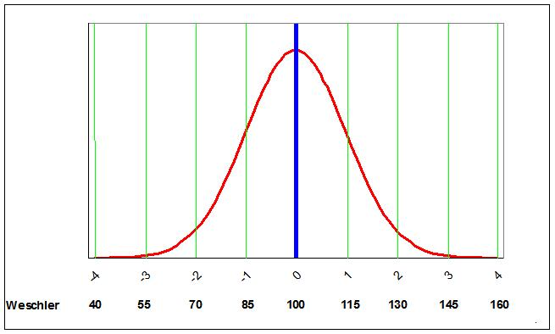
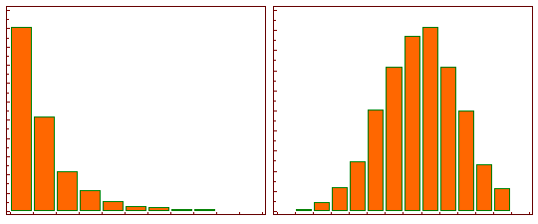
Technique 3: Standardizing
What?
Turns the data into a normal distribution with mean = 0 and SD = 1
Why?
Meet model assumptions of normal data; act as a benchmark since the majority of data is normal; curving grades.
Standardizing
Log transformation
Others include square root, cubic root, reciprocal, square, cube...
Notes:
90% got curved down to a B
grade deflation
Data is not always normal! E.g. Income (normality is usually a safe assumption though)

Slide 35
Technique 4: Ordering
What?
Why?
Example
Converts categorical data that is inherently ordered into a numerical scale
Numerical inputs often facilitate analysis
January → 1
February → 2
March → 3
…

Slide 36
Technique 5: Dummy Variables
What?
Creates a binary variable for each category in a categorical variable
plant | is a tree
aspen | 1
poison ivy | 0
grass | 0
oak | 1
corn | 0

Slide 37
Technique 6: Feature Engineering
What?
Generates new features which may provide additional information to the user and to the model
Why?
You may add new columns/dimensions of your own design to derive more meaningful relationships in your analysis!
ID | Num
0001 | 2
0002 | 4
0003 | 6
ID | Num | Half | SQ
0001 | 2 | 1 | 4
0002 | 4 | 2 | 16
0003 | 6 | 3 | 36
Notes:
example: real data is the squared column
but want to apply linear regression
convert sq -> num col
dont need non linear

Slide 38
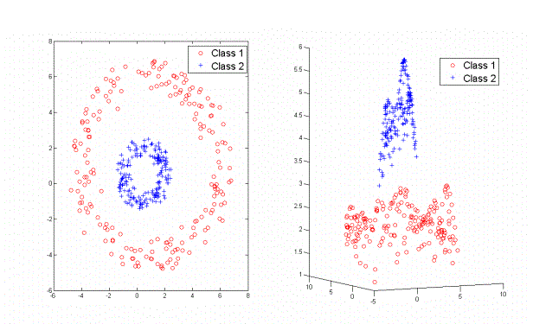
Example: Feature Engineering
Notes:
How can we separate these two rings?

Slide 39
Example: Feature Engineering
Notes:
example: real data is the squared column
but want to apply linear regression
convert sq -> num col
dont need non linear
Add a feature! Take distance from the center of the rings

Slide 40
Summary
Today
Organizing and “tidying up” data
Set a standard across all data collected
Remove unnecessary overlaps
Next Week!
Replace missing values

Slide 41
Demo

Slide 42
Coming Up
Assignment 1: Releasing this week.
Next Lecture: Data Visualization

