Slide 1

Lecture 3: Fundamentals of Machine Learning Pt. 1
INFO 1998: Introduction to Machine Learning

Slide 2
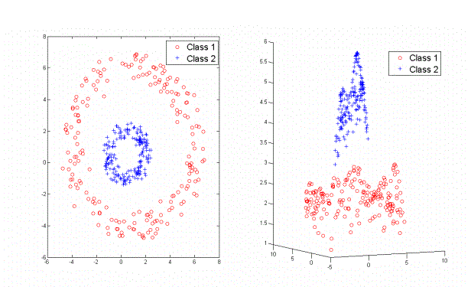
Last class: How do we separate these two classes of data?
Notes:
example: real data is the squared column
but want to apply linear regression
convert sq -> num col
dont need non linear
Add a feature! Take distance from the center of the rings

Slide 3
Course Logistics
Assignment A2 releasing today, due next Wed (10/7). Submit via CMSX
Notes:
Mention its for a grade, 2 weeks before spring break
5 points of project grade

Slide 4
Poll: who knows Python/Numpy?
Assignment A2 releasing today, due next Wed (10/7)
Notes:
Mention its for a grade, 2 weeks before spring break
5 points of project grade

Slide 5
Agenda
Today’s Goal: be able to write code to do some kind of ML (to some extent)
Define Machine Learning: or like, 5 definitions
Start learning the language of ML: There’s a lot of terminology!
Try Linear Regression (via ScikitLearn): Our first ML algorithm!
Introduce our Workflow: An outline for developing an ML model
Discuss Some Important Considerations: What should we be thinking about as we’re MLing?

Slide 6

What’s Machine Learning? Part 1: what does an ML engineer do
Notes:
AUDIENCE QUESTION

Slide 7
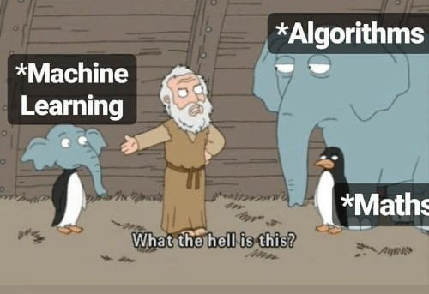
Some Definitions of ML
Give computers the ability to learn without being explicitly programmed
Build a useful mathematical model, based on sample data, to make inferences
Take in data and make predictions or decisions
Help your computer learn patterns
Notes:
1st is pretty bad and vague
2nd is pretty accurate but too technical
3rd is a pretty simplified definition
4th is oversimplified but still true

Slide 8
Machine Learning can involve:
Preprocessing data
Splitting and selecting pieces of data
Doing mathematical analysis on the data
Deciding what data structures are needed to efficiently implement algorithms
Implementing accuracy metrics
...and a lot more
Notes:
Manipulating those data structures as the algorithm indicates
Optimizing for hardware infrastructure

Slide 9
What we’re gonna do:
Our main tasks:
Formulate a problem
Find and understand data for that problem
Choose a specific algorithm class to solve the problem
Choose different parts of the data to best solve the problem
Find which pandas, numpy, and scikit-learn functions do what we want
Interpret the results and fine-tune our model
Write as little code as possible!
Use pandas to deal with data
Use numpy to do math
Use scikit-learn (“sklearn”) to make & analyze ML models

Slide 10

Quick analogy: studying
Setup
  Goal: Be able to solve the test problems well
  Resources: Practice problems + answers
Method
  You study those practice problems and answers. Given a problem, how do you get the answer?
Result:
  On the real test, the problems aren’t the exact same as the practice problems. But they’re similar!
  Since you learned generally how to solve the practice problems, you can solve the similar test problems too :)
*Note: this analogy describes supervised learning

Slide 11
What’s Machine Learning? Part 2: like seriously what is it
Notes:
AUDIENCE QUESTION

Slide 12
Traditional Computer Science
Data
Output
Computer
Program
(Function)

Slide 13
Machine Learning
Data
Program
(Function)
Computer
Output

Slide 14
Using Machine Learning
Traditional CS
Machine Learning
New Data
Data
Output
Program
Known
Output
Computer
Computer
Notes:
we want to learn the relationship between inputs and outputs by imposing some assumptions on the data. then, using this relationship, we can predict outputs for data the model has not seen (not been "trained on")

Slide 15
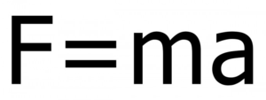
Physics: A White-Box View of the World
We have studied the world and crafted models by ourselves to represent it
Our models are interpretable
White-box algorithms: The inner workings of the algorithm are transparent
Notes:
1st is pretty bad and vague
2nd is pretty accurate but too technical
3rd is a pretty simplified definition
4th is oversimplified but still true

Slide 16
Black Box Models
Perhaps we can derive a process to solve the problem
  Determine what a function would roughly look like
  Think of relevant inputs
  Allow the function to build itself
Black Box Model: Results may not be interpretable!
Notes:
1st is pretty bad and vague
2nd is pretty accurate but too technical
3rd is a pretty simplified definition
4th is oversimplified but still true

Slide 17
What’s Machine Learning? Part 3: what’s a model?
Notes:
AUDIENCE QUESTION

Slide 18
What’s a model?
The output of a machine learning algorithm
A procedure to produce some outputs when given some inputs
A relationship between inputs and outputs
A guess at how inputs and outputs are related
A set of assumptions we’re imposing on the dataset
A parametrized function we can configure

Slide 19
Review: Dataset Structure
Rows are data points
  AKA samples
Columns are features
  A sample is made
of lots of features,
including the goal
 | Name | Age | Major
0 | Ann | 19 | Computer Science
1 | Chris | 20 | Sociology
2 | Dylan | 19 | Computer Science
3 | Camilo | NaN | NaN
4 | Tanmay | NaN | NaN

Slide 20
A Sample (Regression) Task
name | city | state | adm_rate | undergrads | cost | compl_4 | median_hh_inc | median_earnings
Cornell University | Ithaca | NY | 0.1507 | 14226 | 63596 | 0.8639 | 80346.48 | 73600
Washington University in St Louis | Saint Louis | MO | 0.1674 | 7032 | 65887 | 0.8643 | 79298.58 | 66300
Lafayette College | Easton | PA | 0.3025 | 2505 | 61905 | 0.8653 | 85923.51 | 67500
Johns Hopkins University | Baltimore | MD | 0.1412 | 5862 | 63509 | 0.869 | 81539.46 | 69800
Vanderbilt University | Nashville | TN | 0.1168 | 6857 | 62320 | 0.8697 | 76279.78 | 64500

Slide 21
What are some things we can do?
name | city | state | adm_rate | undergrads | cost | compl_4 | median_hh_inc | median_earnings
Cornell University | Ithaca | NY | 0.1507 | 14226 | 63596 | 0.8639 | 80346.48 | 73600
Washington University in St Louis | Saint Louis | MO | 0.1674 | 7032 | 65887 | 0.8643 | 79298.58 | 66300
Lafayette College | Easton | PA | 0.3025 | 2505 | 61905 | 0.8653 | 85923.51 | 67500
Johns Hopkins University | Baltimore | MD | 0.1412 | 5862 | 63509 | 0.869 | 81539.46 | 69800
Vanderbilt University | Nashville | TN | 0.1168 | 6857 | 62320 | 0.8697 | 76279.78 | 64500

Slide 22
Predict Median Graduate Earnings
name | city | state | adm_rate | undergrads | cost | compl_4 | median_hh_inc | median_earnings
Cornell University | Ithaca | NY | 0.1507 | 14226 | 63596 | 0.8639 | 80346.48 | 73600
Washington University in St Louis | Saint Louis | MO | 0.1674 | 7032 | 65887 | 0.8643 | 79298.58 | 66300
Lafayette College | Easton | PA | 0.3025 | 2505 | 61905 | 0.8653 | 85923.51 | 67500
Johns Hopkins University | Baltimore | MD | 0.1412 | 5862 | 63509 | 0.869 | 81539.46 | 69800
Vanderbilt University | Nashville | TN | 0.1168 | 6857 | 62320 | 0.8697 | 76279.78 | 64500

Slide 23
Pick Some Features
name | city | state | adm_rate | undergrads | cost | compl_4 | median_hh_inc | median_earnings
Cornell University | Ithaca | NY | 0.1507 | 14226 | 63596 | 0.8639 | 80346.48 | 73600
Washington University in St Louis | Saint Louis | MO | 0.1674 | 7032 | 65887 | 0.8643 | 79298.58 | 66300
Lafayette College | Easton | PA | 0.3025 | 2505 | 61905 | 0.8653 | 85923.51 | 67500
Johns Hopkins University | Baltimore | MD | 0.1412 | 5862 | 63509 | 0.869 | 81539.46 | 69800
Vanderbilt University | Nashville | TN | 0.1168 | 6857 | 62320 | 0.8697 | 76279.78 | 64500

Slide 24
Our Goal?
name | city | state | adm_rate | undergrads | cost | compl_4 | median_hh_inc | median_earnings
Cornell University | Ithaca | NY | 0.1507 | 14226 | 63596 | 0.8639 | 80346.48 | 73600
Washington University in St Louis | Saint Louis | MO | 0.1674 | 7032 | 65887 | 0.8643 | 79298.58 | 66300
Lafayette College | Easton | PA | 0.3025 | 2505 | 61905 | 0.8653 | 85923.51 | 67500
Johns Hopkins University | Baltimore | MD | 0.1412 | 5862 | 63509 | 0.869 | 81539.46 | 69800
Vanderbilt University | Nashville | TN | 0.1168 | 6857 | 62320 | 0.8697 | 76279.78 | 64500
Rutgers University | New Brunswick | NJ | 0.5845 | 35102 | 29076 | 0.5838 | 82669.68 | ?
Case Western Reserve University | Cleveland | OH | 0.3627 | 5039 | 59467 | 0.6311 | 69873.4 | ?

Slide 25
ML Algorithms
We pick different kinds of algorithms to accomplish different tasks
Classification
  Group Data Into Distinct Classes
Regression
  Based on an input, provide a continuous-value output
“All Models Make Assumptions”

Slide 26
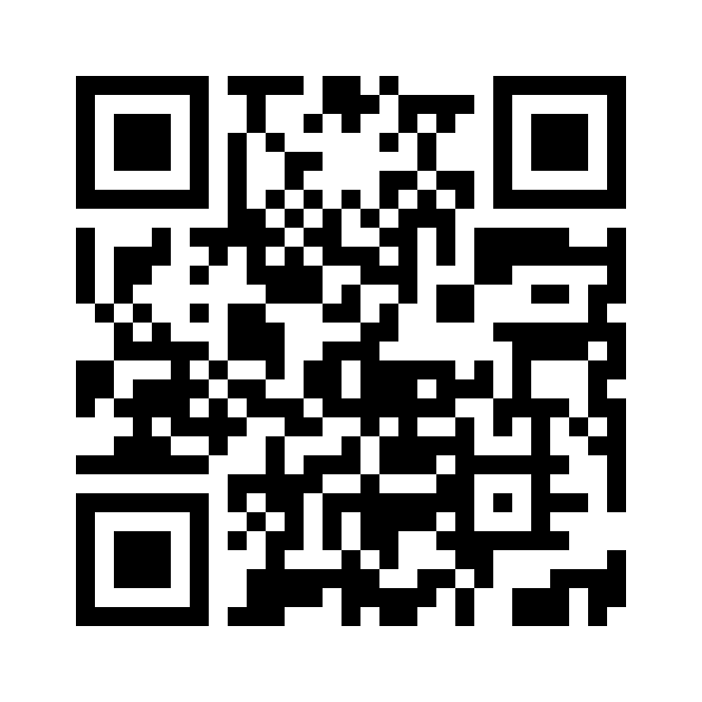
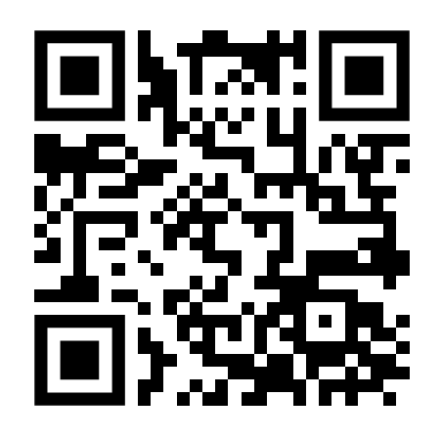
Lecture 4: Fundamentals of Machine Learning Pt. 1
INFO 1998: Introduction to Machine Learning
Attendance!

Slide 27
Linear Regression
Our first ML model!

Slide 28
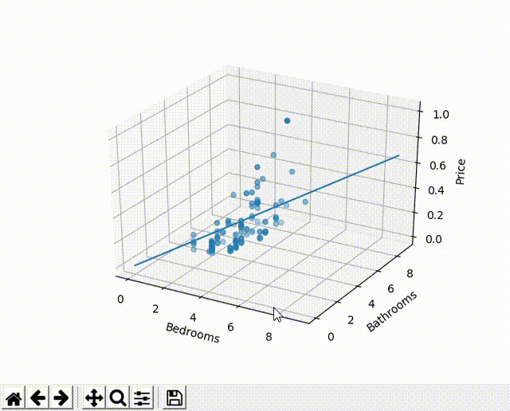
Linear Regression
y = B₀ + B₁x₁ + … + B_{p}x_{p}+ ε
x is an input; x₁, x₂ , …, x_{p} are the features of x
y is an output (usually a single value)
B’s are “weights”
  a linear regression equation is defined by its B’s
  “program” produced by ML
Given a set of x’s and y’s, find the “B”-s that “most closely” satisfies the equation above for training points
Plug in new values to of x to predict respective y
Notes:
next three slides repeat lots of info
Visual for multidimensional (changing the slope in one dimension, other dimension), multiple features
Goal is to learn what the B values are
Less words on other slides!

Slide 29
y = B₀ + B₁x₁+ ... is a model
A relationship between inputs and outputs
y = B₀ + B₁x₁ + … relates inputs to outputs
A guess at how inputs and outputs are related
but y = B₀ + B₁x₁ + … is just a guess/estimate; it’s not exactly true
A set of assumptions we’re imposing on the dataset
We’re assuming output is linearly related to input features
A configurable thing (hyperparameters)
Sorry, we don’t cover very much linear regression configuration here 😅
y
x
y = B₀ + B₁x
Notes:
Make some changes to this

Slide 30
y = B₀ + B₁x₁+ ... is a model
Use algorithm to “learn” parameters that give us this line of best fit
A relationship between inputs and outputs
y = B₀ + B₁x₁ + … relates inputs to outputs
A guess at how inputs and outputs are related
but y = B₀ + B₁x₁ + … is just a guess/estimate; it’s not exactly true
A set of assumptions we’re imposing on the dataset
We’re assuming output is linearly related to input features
A configurable thing (hyperparameters)
Sorry, we don’t cover very much linear regression configuration here 😅
y
x
y = B₀ + B₁x
Notes:
Hyperparameters: control the learning process for a ML model. E.g. learning rate and batch size

Slide 31
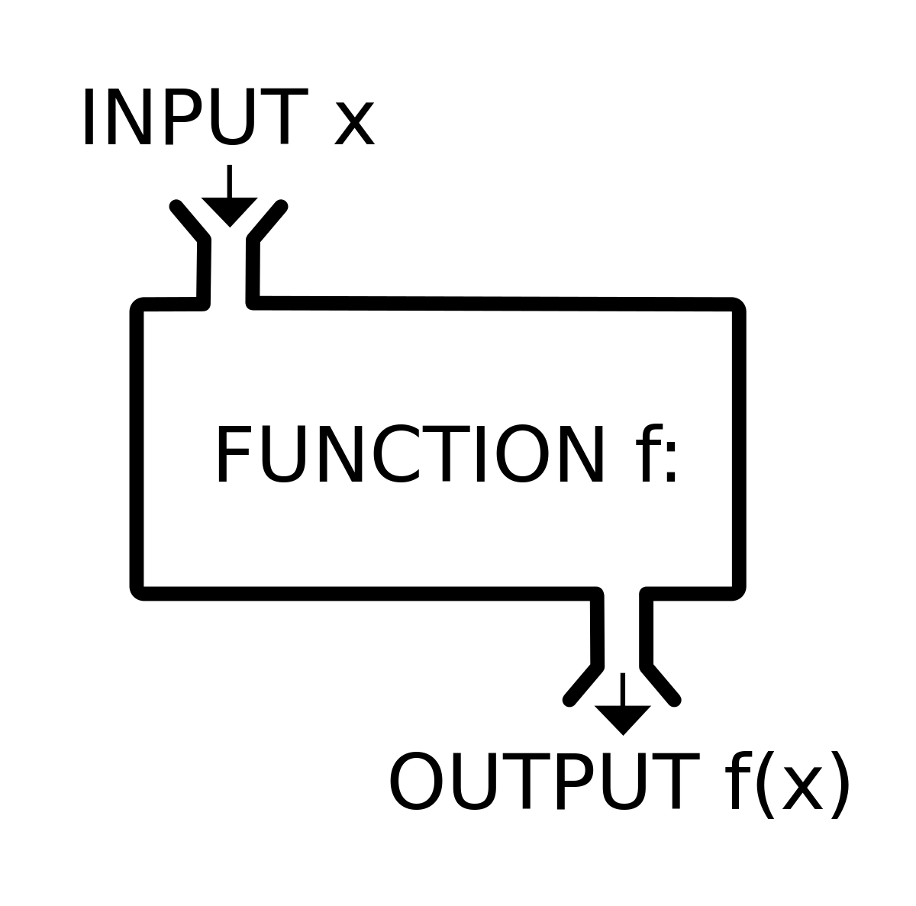
Linear Regression
Function
x₁ … x_{p}
y = B₀ + B₁x₁ + … + B_{p}x_{p}
y
Notes:
stress: B’s are different based on the training data

Slide 32
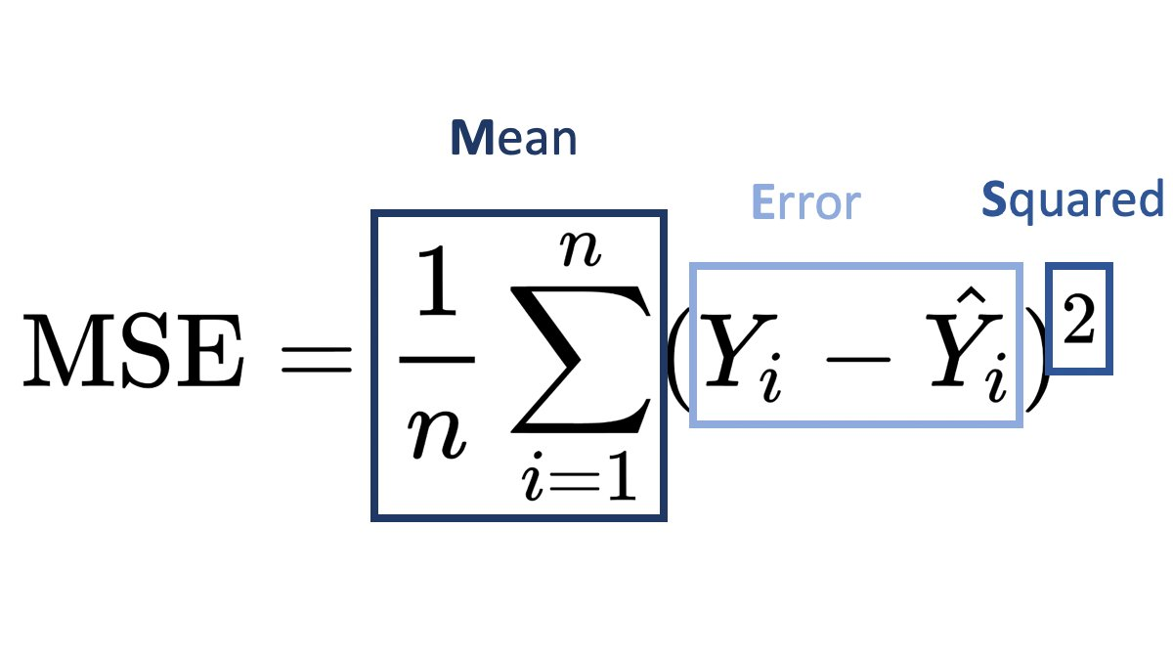
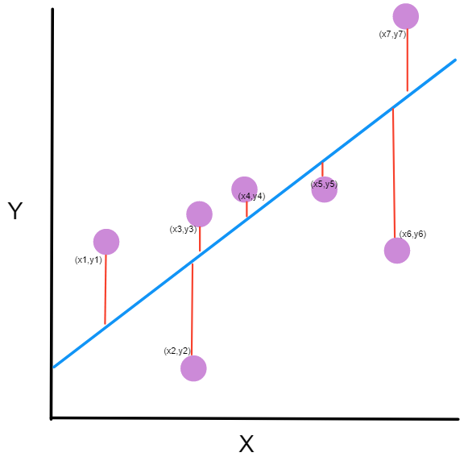
Linear Regression: Ordinary Least Squares
Ordinary least squares method of linear regression calculates the weight vector B by minimizing the mean-squared error of the predicted y-values
Other types of linear regression (i.e. ridge regression) use different loss functions to calculate the weights
Notes:
Other types vary the loss functions and regularization types
Lasso: takes magnitude of coefficients, ridge takes square

Slide 33
“Training” a Model
Dataset of n training points
Datapoints: (𝚇,𝚈_{i}) -> (input, output)
Objective: Minimize MSE
Use the 𝑥 values in our dataset to make a prediction
  Note: 𝑥 is a vector
Compare our prediction to the real 𝚈_{i}
Update B to get a better prediction
  Special Algorithm: Gradient Descent
Repeat until MSE is as small as possible
Ŷ_{i}= B₀ + B₁x₁ + … + B_{p}x_{p}+ ε
Notes:
Other types vary the loss functions and regularization types
Lasso: takes magnitude of coefficients, ridge takes square

Slide 34
What’s Machine Learning? Part 4: What makes a good model?

Slide 35
Terminology: Training and Validating
Split data into two sets
Train model on one, validate on the other
“Model training” = learn a relationship/program
  e.g. give the linear regression data so it can define the B’s
“Model validation” = see if the learned relationship is accurate on other data
Notes:
Validating: if parameters good on general
Want a final performance that isn’t biased or specific to some data

Slide 36
Our ML Workflow
Validation
Training
Validation Data
Training Data & Output
Computed
Output
VS
Validation
Output
Function
(Model)
Computer
Computer
ML Algorithm

Slide 37
Adjust Algorithm Parameters
Validation
Training
Validation Data
Train Data & Output
Computer
Computed
Output
VS
Validation
Output
Function (Model)
Computer
ML Algorithm
1. Select data
2. Assess model accuracy
3. Adjust Model
Notes:
if your validation output is very different to the computed output, you can adjust algorithm parameters or even change the model if you feel that's necessary (lin reg doesn't work on everything and tends to underfit, but it's a good baseline - a model shouldn't be doing worse than linear regression)

Slide 38
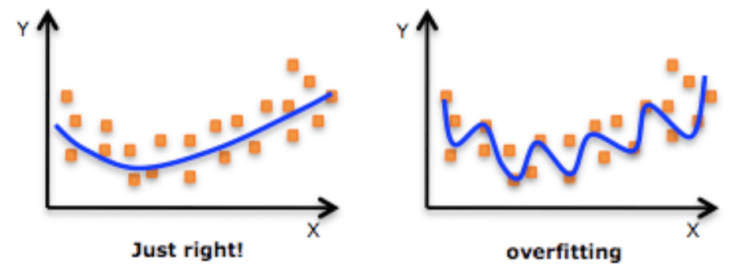
Pitfall of Training: Overfitting
Model is accurate for train data
Model can accurately predict new data
We learned the specific mapping from train input to train outputs…
But, we didn’t learn the data’s general patterns 🥲🥲🥲🥲🥲🥲
Solution: train on part of data, and check accuracy on a separate part of data (validation set)

Slide 39
Pitfall of Validation: Overfitting
Predicting well on validation set
Predicting well on new data
We used the validation set to make our adjustments.
  ⇒ Our model is biased to the validation set. 🥲🥲
Solution: keep a separate, rarely-used test set

Slide 40
Validation
Training
Testing
Validation Data
Training Data
Computed
Output
Validation
Output
VS
Function
Training Output
Supervised Learning
Supervised Learning
Testing Data
Predicted Output
Supervised Learning
Notes:
Training: Usually the biggest set, used to fit the model, “learns” the parameters
Validation: used to find optimal hyper parameter values
Testing: evaluates model performance and ensures no overfitting
Usually 75-25 split training to testing, you will see this in your assignemnts
testing is like your "final model performance" - once you're done with training and validation loop, you then use the test set as your final performance.

Slide 41
Model Goals
When training a model we want our models to:
The first two are especially difficult to do simultaneously!
The more sensitive the model, the less generalizable and vice versa.
Capture the trends of the training data
Generalize well to other samples of the population
Be moderately interpretable
Notes:
Sensitive Definition
Sensitivity is a measure of how well a machine learning model can detect true positive instances

Slide 42
Things to Keep In Mind
Linear Regression is just one algorithm — we’ll cover many more! 🤠
The “model” produced by an algorithm is not always a simple equation like in linear regression.
Validation is really important.
  Overfitting is a huge problem!
  We’ll delve deeper in the next few lectures…

