Slide 1
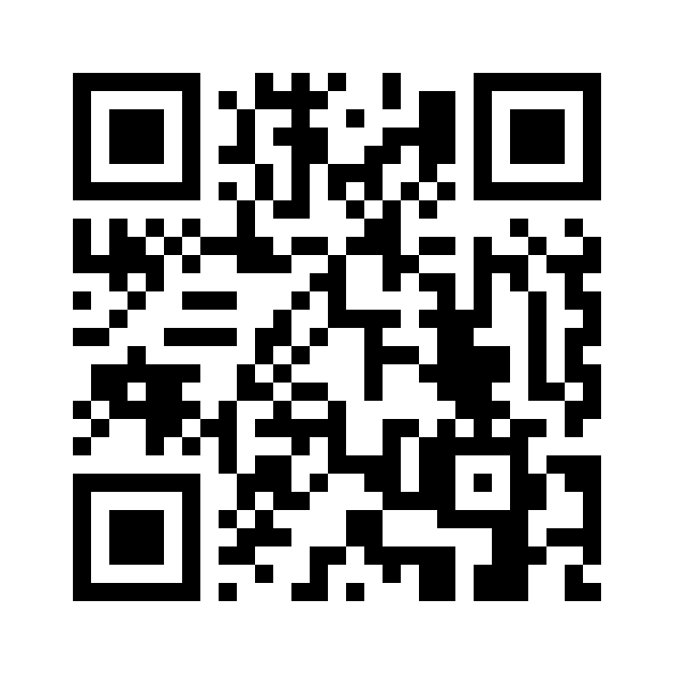

Lecture 6: Intro to Classifiers
INFO 1998: Introduction to Machine Learning
Notes:
SLOW DOWN!!!!!!!!!!!!!!!

Slide 2
Lecture 6: Intro to Classifiers
INFO 1998: Introduction to Machine Learning

Slide 3
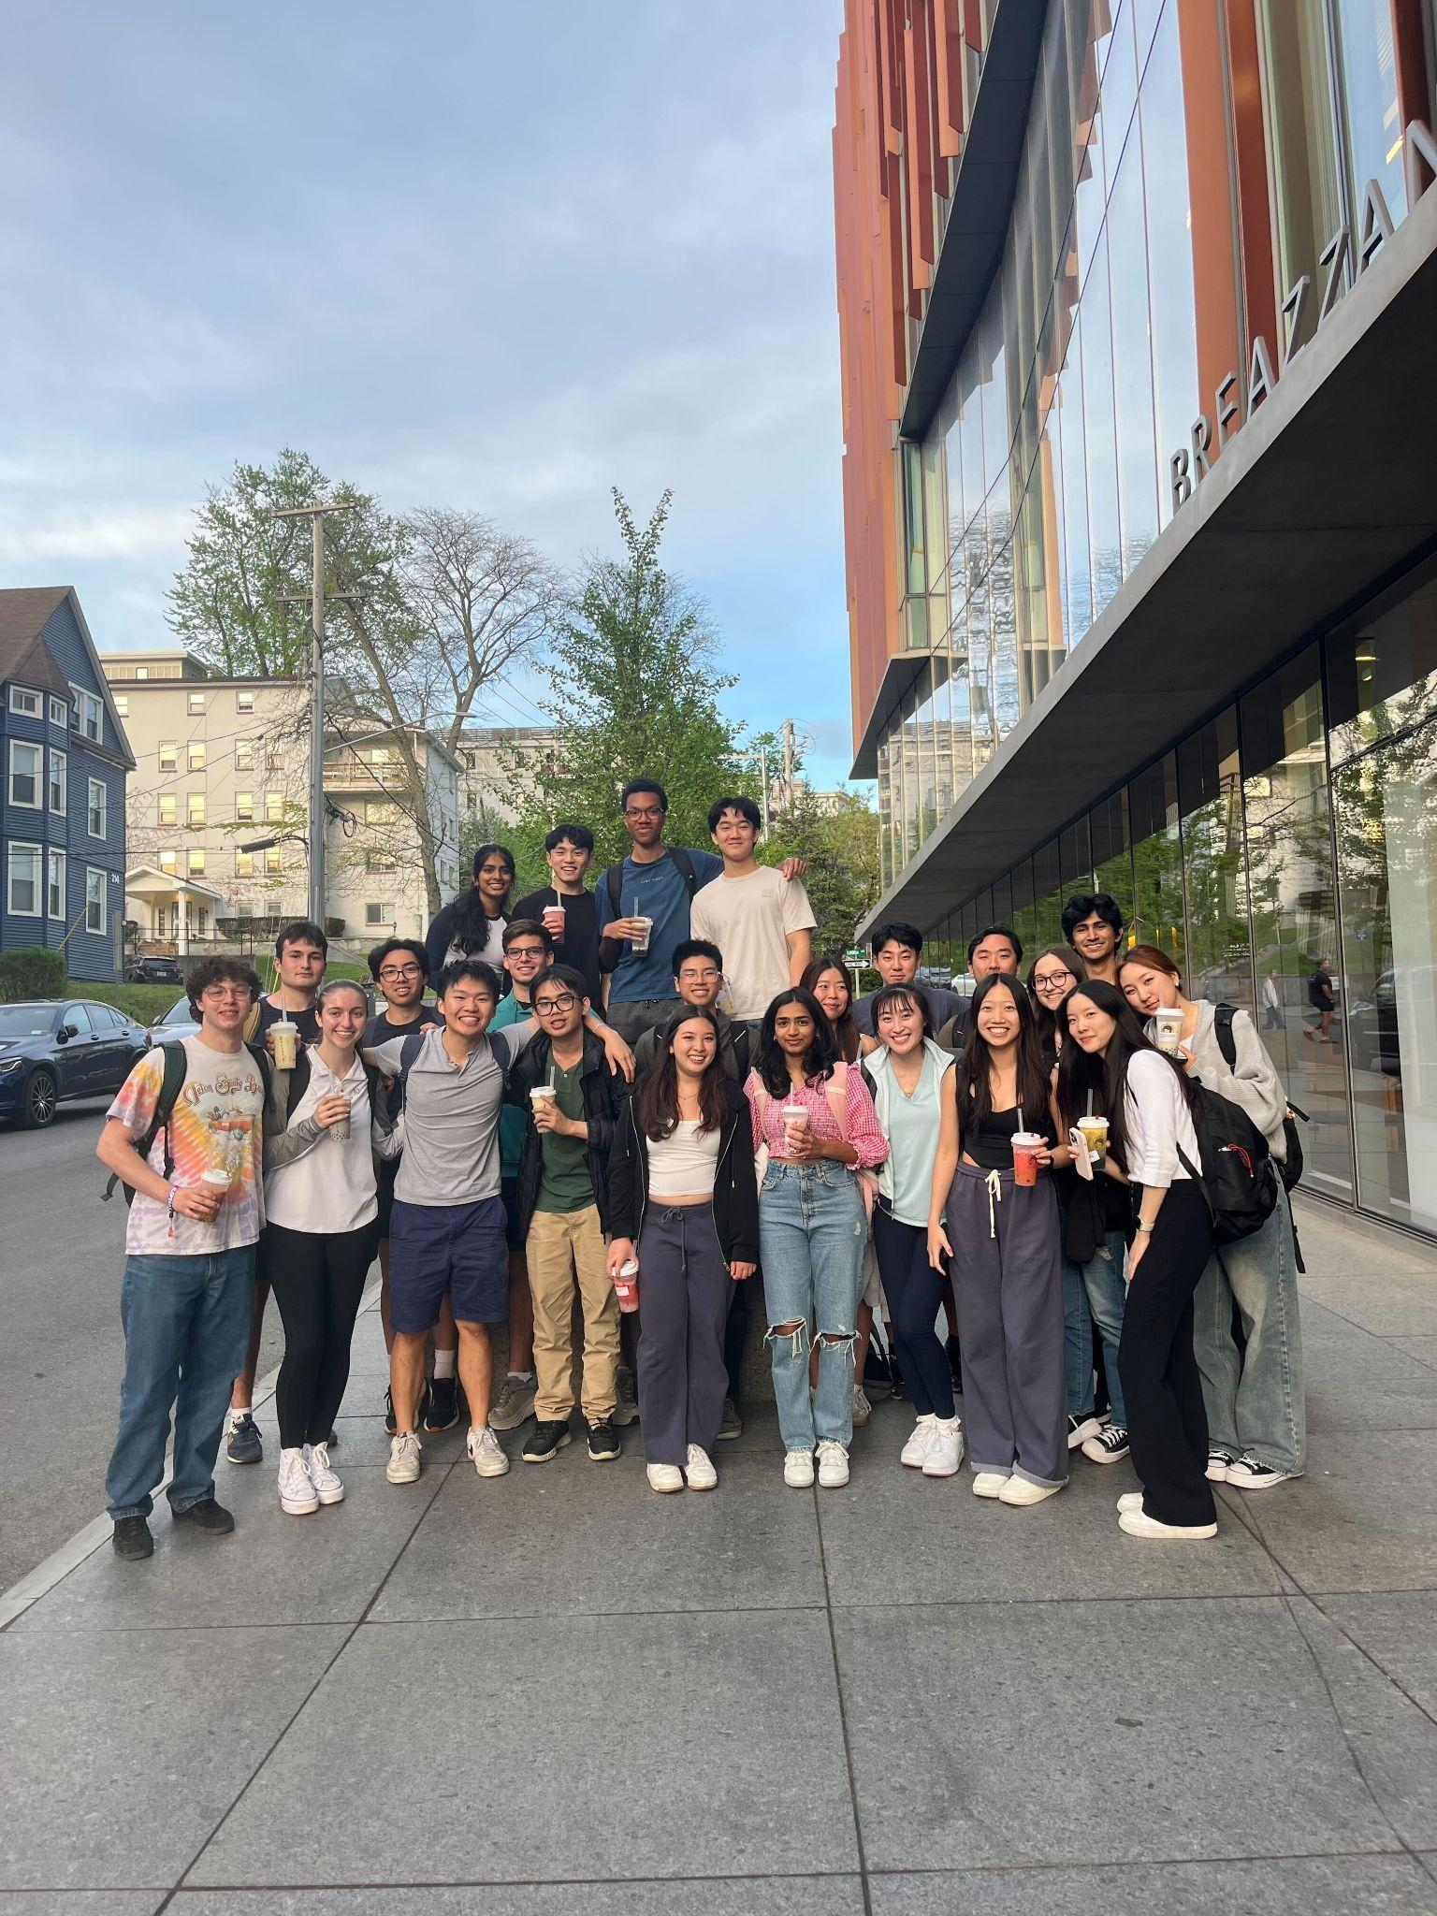
Apply to Cornell Data Science! 📣
All subteams are recruiting freshmen this semester!
  Deadline: October 15th, 11:59pm
  Don’t forget to also submit the College of Engineering application.
Application Link: https://cornelldata.science/recruitment
If you’re enjoying this class…
  you’ll LOVE being on CDS 👀
Subteam UTea trip!

Slide 4
Agenda
What is a Classifier?
K-Nearest Neighbors Classifier
Review of Underfitting v. Overfitting
Confusion Matrices

Slide 5
What are Classifiers?
Notes:
A classifier in machine learning is an algorithm that automatically orders or categorizes data into one or more of a set of “classes.”
Some examples of classification include spam detection, churn prediction, sentiment analysis, dog breed detection and so on.

Slide 6
What are Classifiers?
Classifiers are able to help answer questions like…
“What species is this?”
“What major is a student in based on their classes?”
“Which Hogwarts House do I belong to?”
“Am I going to pass this class?”
Notes:
Distinct categories

Slide 7
What are Classifiers?
Classifiers predict the class/category of a set of data points. This class/category is based off of the target variable we are looking at.
Difference between linear regression and classifiers
  Linear regression is used to predict the value of a continuous variable
  Classifiers are used to predict categorical or binary variables
Notes:
regression helps predict a continuous quantity, classification predicts discrete class labels.
Example: regression is what will the temperature be tomorrow? Classification is will it rain or not tmrw?

Slide 8
K-Nearest Neighbors Classifier
Notes:
Lazy learners, also known as instance-based learners, store the training data and make predictions by comparing new instances directly to the training examples, which can be computationally intensive.
In contrast, eager learners, such as decision trees and neural networks, build a model during training and use that model to make predictions, making them faster at inference but potentially less adaptable to changes in the data.

Slide 9
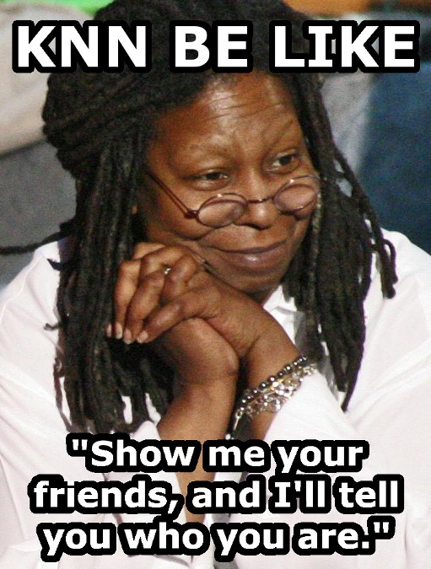
What is the KNN Classifier?
Lazy learner classifier
Easy to interpret
Fast to calculate
Good for coarse analysis
Notes:
A k-Nearest Neighbors (KNN) classifier is a type of lazy learner or instance-based learner used in machine learning for classification tasks. It classifies a new data point by finding the k training examples (data points) in its vicinity that are closest to it in terms of a chosen distance metric (e.g., Euclidean distance). The majority class among these k neighbors is assigned as the predicted class for the new data point. KNN is a simple and intuitive algorithm, but it can be computationally expensive for large datasets and may require careful selection of the value for k.

Slide 10
How Does It Work?
Uses the k (a user specified value) nearest data points to predict the unknown one
A simple assumption: the values nearest to a data point are similar to it
k is a hyperparameter of the KNN model
  a parameter which affects the training process
Notes:
Feature Relevance: It assumes that all features used in the dataset are relevant to the classification task. If irrelevant or noisy features are included, they can negatively impact the algorithm's performance.
Local Smoothness: KNN assumes that data points of the same class are often found near each other in the feature space, meaning that regions with similar feature values tend to have the same class labels.
Stationarity: KNN assumes that the distribution of data does not change significantly over the local neighborhoods defined by the value of k. In other words, it assumes a certain level of stationarity in the data, meaning that the relationships between features and classes don't change abruptly over short distances.
Distance Metric Choice: The algorithm assumes that the choice of distance metric (e.g., Euclidean distance, Manhattan distance, etc.) is appropriate for the problem at hand. Selecting the right distance metric is crucial for the algorithm's performance.
K Value Selection: The choice of the value of k (the number of nearest neighbors to consider) is important. KNN assumes that an appropriate k can be chosen that balances bias and variance, leading to good generalization to new, unseen data.
Class Distribution: KNN assumes that the class distribution in the dataset is relatively balanced. In cases of imbalanced datasets, it might favor the majority class in predictions.
Normalization of Features: It is often assumed that the features have been properly scaled or normalized to

Slide 11
How Does It Work?
C
Most around me got an A, maybe I got an A as well then.
B
C
A
?
B
A
C
A
A
A
B
B
A
A
A
C

Slide 12
How Does It Work? (Step-By-Step Example)
Define a k value (in this case k = 3)
Notes:
The "k" in the k-Nearest Neighbors (KNN) algorithm refers to the number of nearest neighbors that are considered when making a prediction for a new data point. In other words, it is the parameter that determines how many data points from the training dataset are taken into account when classifying a new data point.
Choosing the right value for k is a crucial aspect of using KNN effectively. A small value of k, like 1 or 3, means that the algorithm will consider only the nearest neighbors, which can make the classification sensitive to noise in the data. On the other hand, a large value of k, like 10 or 20, can make the algorithm more robust to noise but might cause it to miss fine-grained patterns in the data.
The choice of k depends on the specific dataset and problem you are working on. It often involves a trade-off between bias and variance. Smaller values of k lead to lower bias but higher variance, while larger values of k lead to higher bias but lower variance. Cross-validation and hyperparameter tuning techniques can help in selecting an appropriate value for k that optimizes the model's performance on the given task.

Slide 13
How Does It Work? (Step-By-Step Example)
Define a k value (in this case k = 3)
Pick a point to predict (blue diamond)
Notes:
Here we want to predict the classification of what the blue diamond will be

Slide 14
How Does It Work? (Step-By-Step Example)
Define a k value (in this case k = 3)
Pick a point to predict (blue diamond)
Count the number of closest points
3
3
Notes:
As you can see, there are 3 circles and 3 triangles near the blue diamond

Slide 15
How Does It Work? (Step-By-Step Example)
Define a k value (in this case k = 3)
Pick a point to predict
(blue diamond)
Count the number of closest points
Increase the radius until the number of points in circle adds up to 3
3/3
0/3
Notes:
We choose a radius here

Slide 16
How Does It Work? (Step-By-Step Example)
Define a k value (in this case k = 3)
Pick a point to predict (blue diamond)
Count the number of closest points
Increase the radius until the number of points within the radius adds up to 3
Predict the blue diamond to be a blue circle!
3/3
0/3

Slide 17
Demo
Demo

Slide 18
Underfitting v. Overfitting

Slide 19
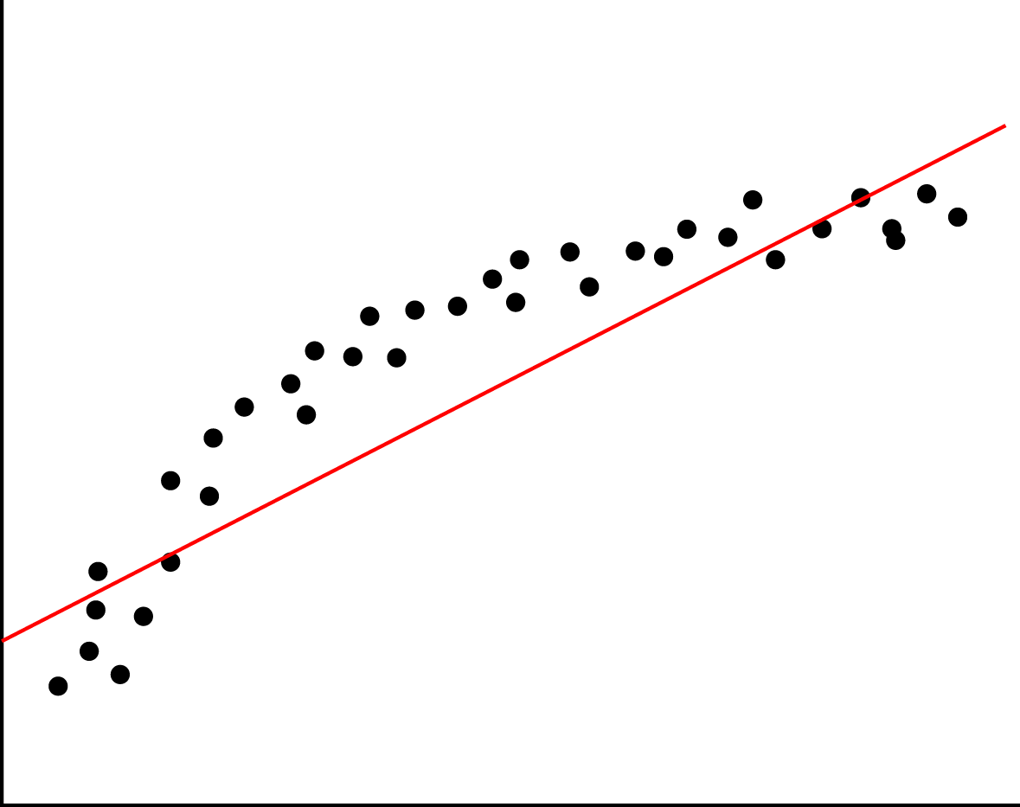
Underfitting
Underfitting means we have high bias and low variance.
Lack of relevant variables/factor
Imposing limiting assumptions
  Linearity
  Assumptions on distribution
  Wrong values for parameters
Source

Slide 20
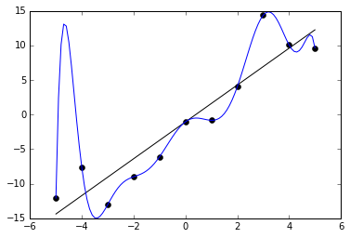
Overfitting
Overfitting means we have low bias and high variance.
Model fits too well to specific cases
Model is over-sensitive to sample-specific noise
Model introduces too many variables/complexities than needed
Source

Slide 21
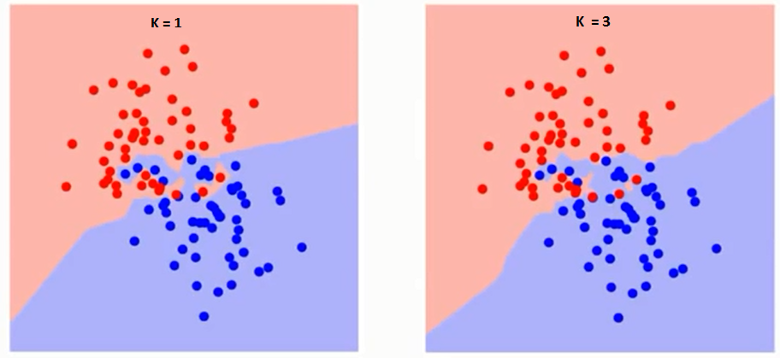
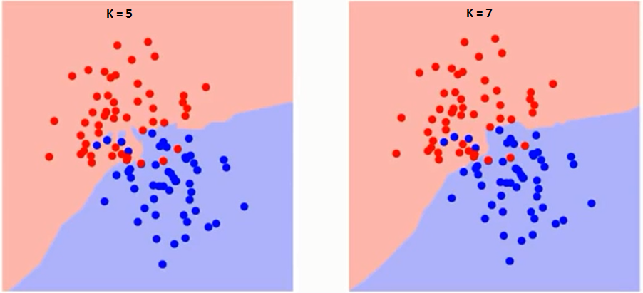
Relationship
Between k and Fit
k=3
k=1
The k value you use has a relationship to the fit of the model
A higher k gives a smoother line, but too large of a k and it is the average of all the data (or the label that is most common/likely)
k=5
k=7
Notes:
High k = smooth line
This is because the model considers more neighbors when predicting
If you choose an extremely large k-value, it can effectively turn the model into a "majority vote" or "average" predictor. This means that the model's prediction becomes dominated by the most common or likely class in the entire dataset.
Again, need to find the proper balance

Slide 22
Confusion Matrix

Slide 23
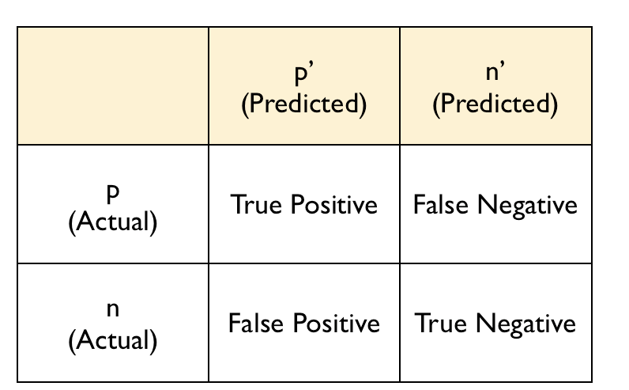
What is a Confusion Matrix?
Table used to describe the performance of a classifier on a set of binary test data for which the true values are known

Slide 24
Sensitivity
Called the true positive rate
Tells us how many positives are correctly identified as positives
Optimize for: Initial diagnosis of fatal disease
Sensitivity = True Positive/
(True Positive + False Negative)
Notes:
“If you have the disease when you take the test, what is the chance it comes back positive?”

Slide 25
Specificity
Called the true negative rate
Tells us how many negatives are correctly identified as negatives
Optimize for: Exclusion of legit emails from spam classification
Sensitivity = True Negative/
(True Negative + False Positive)
Notes:
“If you have the disease when you take the test, what is the chance it comes back positive?”

Slide 26
Question
Which is an example of when you would want higher specificity?
DNA tests for a death penalty case
Deciding which iPhone to buy
Airport security
Notes:
Answer the question in the attendance form!

Slide 27
Overall Accuracy
Proportion of correct predictions
Accuracy =
(True Positive + True Negative) / Total
Sensitivity = True Negative/
(True Negative + False Positive)

Slide 28
Overall Error Rate
Proportion of incorrect predictions
Error = (False Positive + False Negative) / Total
Sensitivity = True Negative/
(True Negative + False Positive)

Slide 29
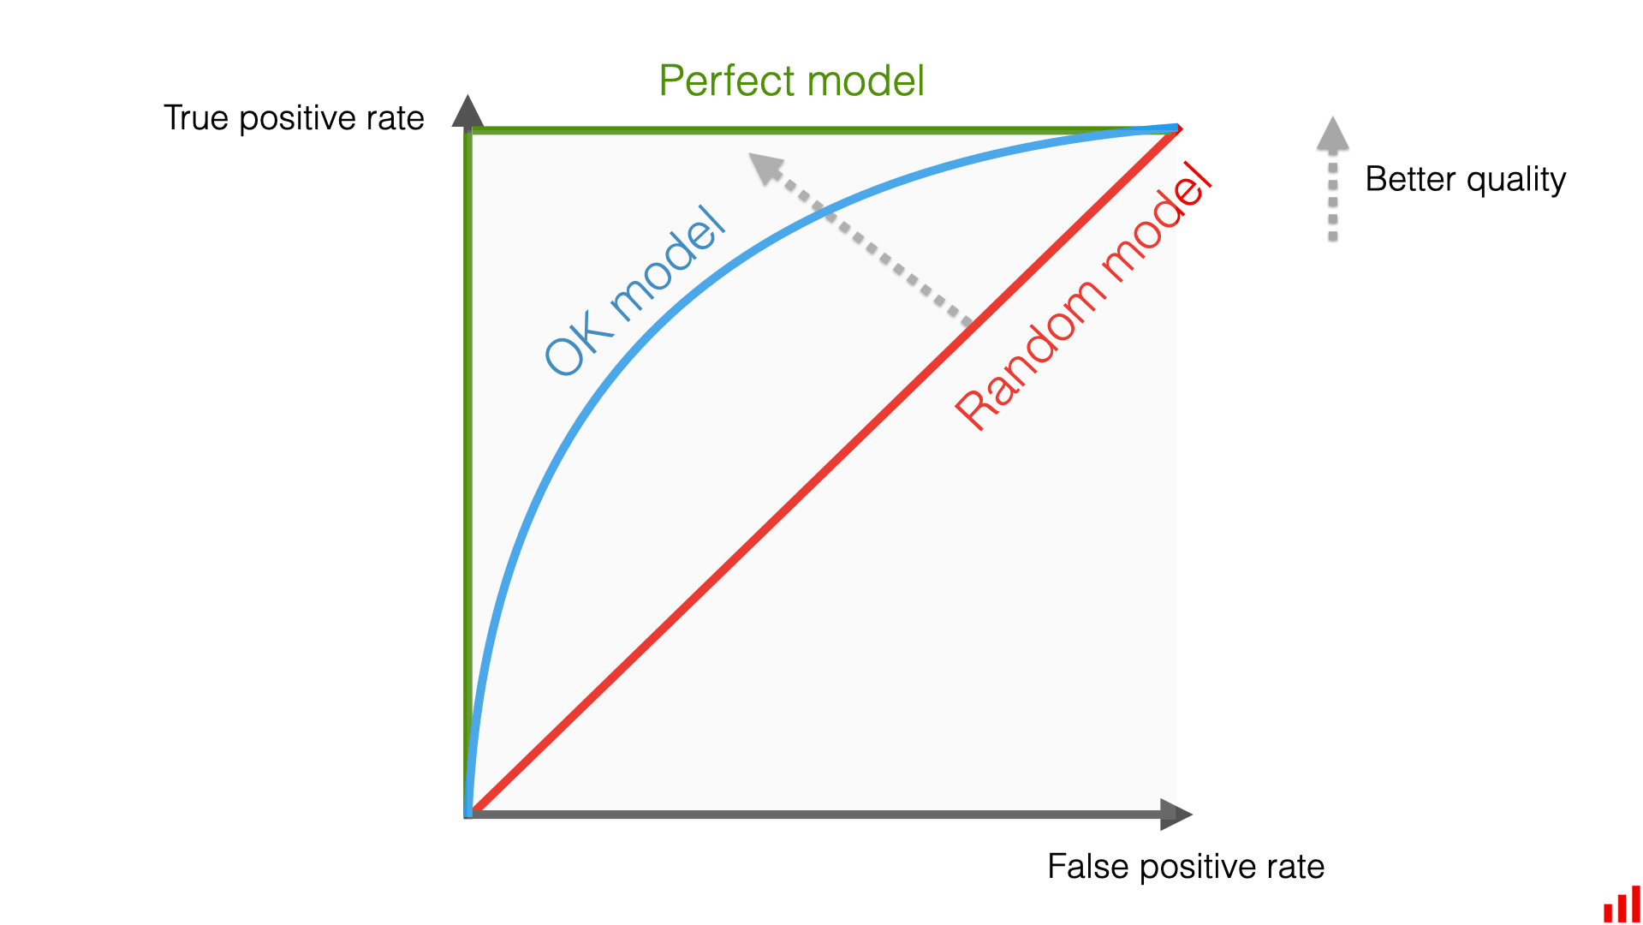
ROC Curves!
ROC (Receiver Operating Characteristic) curve plots True Positive Rate (TPR) vs. False Positive Rate (FPR) across all classification thresholds
Particularly powerful for imbalanced datasets where accuracy is misleading—ROC reveals what accuracy hides
Helps you choose optimal threshold for your specific problem: prioritize recall for medical screening (catch all cases), prioritize precision for spam filters (minimize false alarms)

Slide 30
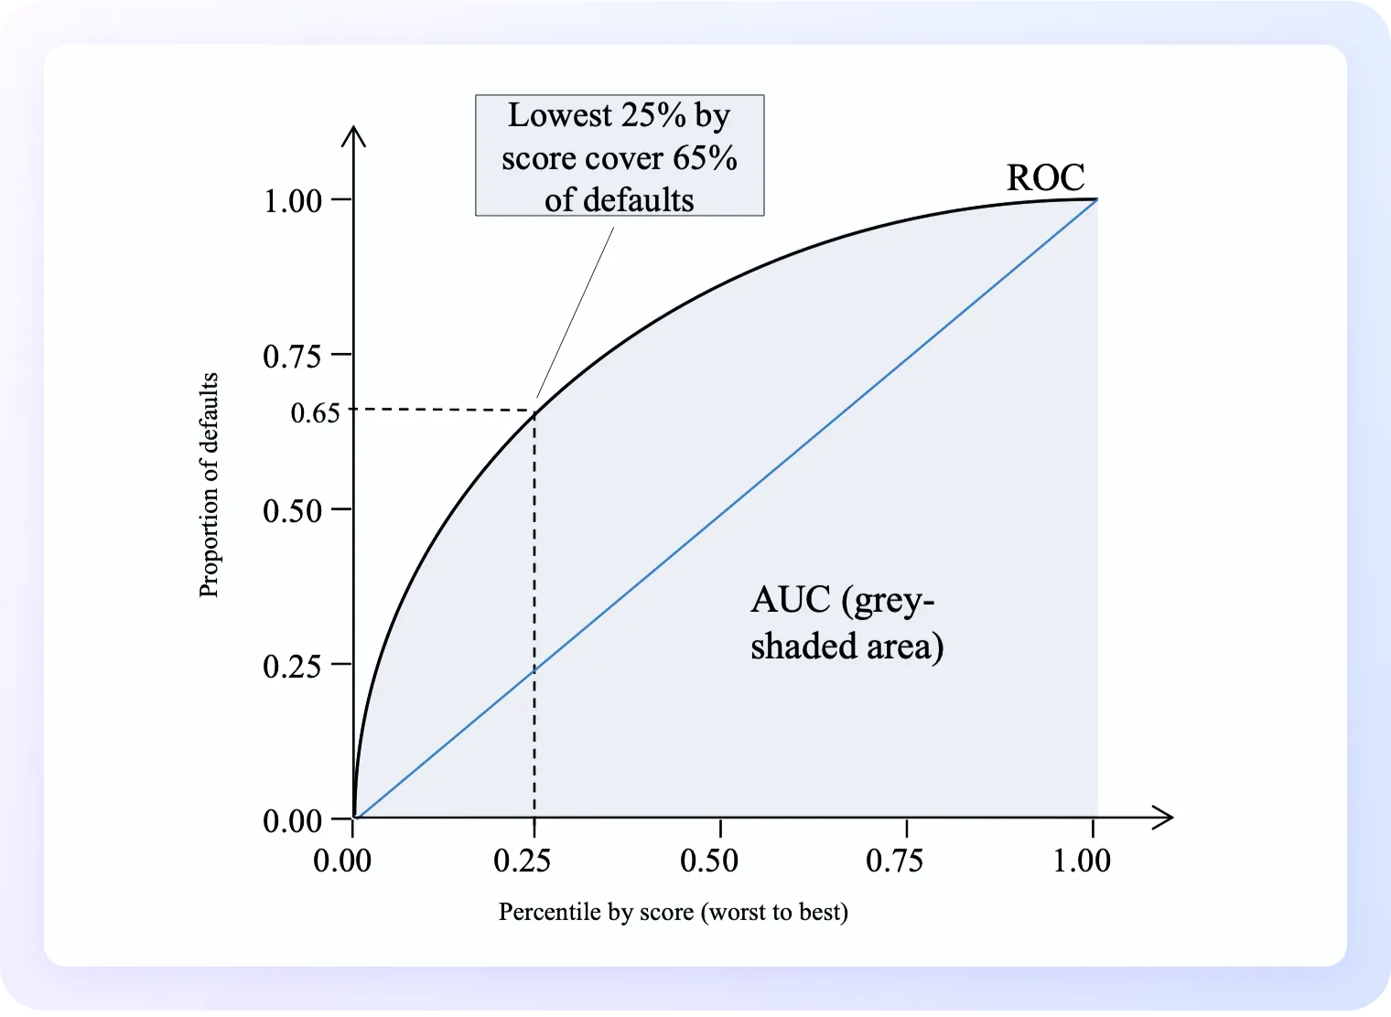
AUC (Area Under Curve)
AUC (Area Under the Curve) is a single number summarizing the entire ROC curve, ranging from 0 to 1
Interpretation scale: AUC = 0.5 (random guessing), 0.6–0.7 (fair), 0.7–0.8 (good), 0.8–0.9 (very good), 0.9+ (excellent)
Unlike accuracy, AUC is threshold-independent and handles class imbalance naturally—it doesn't punish you for having more negatives than positives

Slide 31
Coming Up
Assignment 5: Due tonight at 11:59pm!
Assignment 6: Due next Wednesday 10/29
Mid-Semester Check-In: Details on ED! Complete by Wednesday 10/29.
Please check Ed regularly (cuz why do my posts get 5 unique views)
Please turn in your assignments, especially if you’re enrolled (because i care about your transcript)
Next Lecture: Supervised Learning Pt. 1

