Slide 1
Why does averaging work?
Yoav Freund AT&T Labs

Slide 2
Plan of talk
Generative vs. non-generative modeling
Boosting
Boosting and over-fitting
Bagging and over-fitting
Applications

Slide 3


Toy Example
Computer receives telephone call
Measures Pitch of voice
Decides gender of caller
Male
Human
Voice
Female

Slide 4


Generative modeling
mean1
mean2
Probability
var1
var2
Voice Pitch

Slide 5
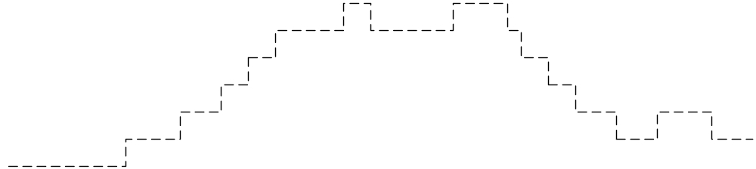
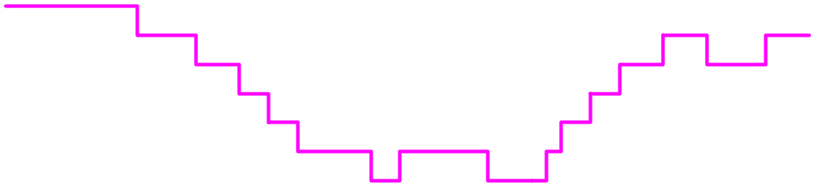
Discriminative approach
No. of mistakes
Voice Pitch

Slide 6
Ill-behaved data
mean1
mean2
Probability
No. of mistakes
Voice Pitch

Slide 7
Traditional Statistics vs.
Machine Learning
Machine Learning
Data
Predictions
Actions
Estimated
world state
Decision
Theory
Statistics

Slide 8
Another example
Two dimensional data (example: pitch, volume)
Generative model: logistic regression
Discriminative model: separating line ( “perceptron” )

Slide 9
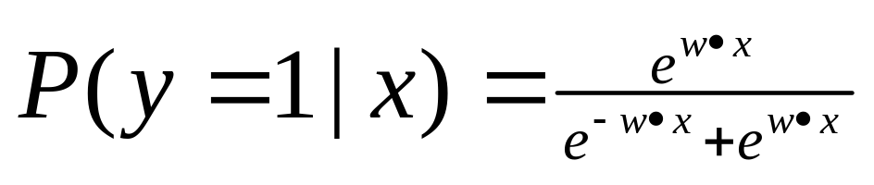
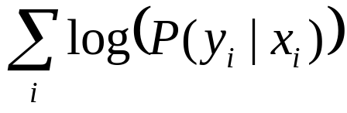
Model:
Find W to maximize
w

Slide 10
Model:
Find W to maximize
w

Slide 11
Comparison of methodologies
Model | Generative | Discriminative
Goal | Probability estimates | Classification rule
Performance measure | Likelihood | Misclassification rate
Mismatch problems | Outliers | Misclassifications

Slide 12

Boosting

Slide 13
Adaboost as gradient descent
Discriminator class: a linear discriminator in the space of “weak hypotheses”
Original goal: find hyper plane with smallest number of mistakes
  Known to be an NP-hard problem (no algorithm that runs in time polynomial in d, where d is the dimension of the space)
Computational method: Use exponential loss as a surrogate, perform gradient descent.
Unforeseen benefit: Out-of-sample error improves even after in-sample error reaches zero.

Slide 14


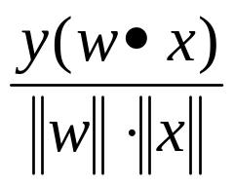
Margins view
Prediction =
Margin =
-
w
Cumulative # examples
-
+
+
+
-
Mistakes
Correct
+
-
+
+
-
-
Project
-
-
+
Correct
Mistakes
Margin

Slide 15
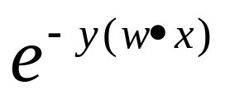
Adaboost et al.
Adaboost =
Logitboost
Loss
Brownboost
0-1 loss
Margin
Mistakes
Correct

Slide 16
One coordinate at a time
Adaboost performs gradient descent on exponential loss
Adds one coordinate (“weak learner”) at each iteration.
Weak learning in binary classification = slightly better than random guessing.
Weak learning in regression – unclear.
Uses example-weights to communicate the gradient direction to the weak learner
Solves a computational problem

Slide 17

Boosting and over-fitting

Slide 18
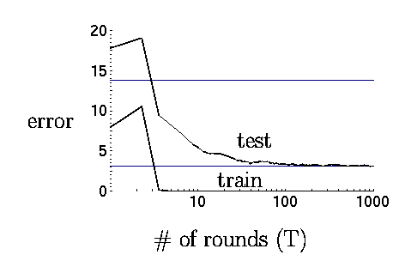
Curious phenomenon
Boosting decision trees
Using <10,000 training examples we fit >2,000,000 parameters

Slide 19
Explanation using margins
0-1 loss
Margin

Slide 20

Explanation using margins
0-1 loss
No examples with small margins!!
Margin

Slide 21
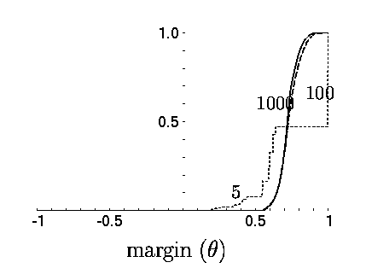
Experimental Evidence

Slide 22




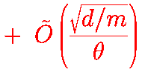
Theorem
Schapire, Freund, Bartlett & Lee
Annals of stat. 98
For any convex combination and any threshold
Fraction of training example
with small margin
Probability of mistake
Size of training sample
No dependence on number
of weak rules
that are combined!!!
VC dimension of weak rules

Slide 23
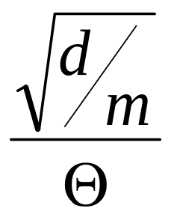
Suggested optimization problem
Margin

Slide 24
Idea of Proof

Slide 25
Bagging and over-fitting

Slide 26
A metric space of classifiers
Classifier space
Example Space
d
f
g
d(f,g) = P( f(x) = g(x) )
Neighboring models make similar predictions

Slide 27
Confidence zones
Certainly
Bagged variants
Certainly
No. of mistakes
Majority vote
Voice Pitch

Slide 28
Bagging
Averaging over all good models increases stability (decreases dependence on particular sample)
If clear majority the prediction is very reliable (unlike Florida)
Bagging is a randomized algorithm for sampling the best model’s neighborhood
Ignoring computation, averaging of best models can be done deterministically, and yield provable bounds.

Slide 29
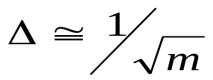

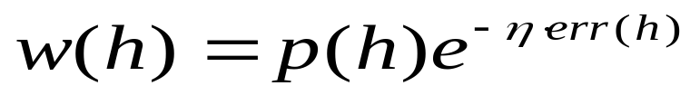
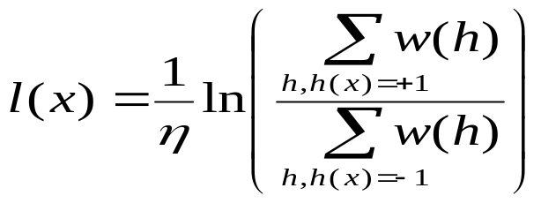

A pseudo-Bayesian method
Freund, Mansour, Schapire 2000
Define a prior distribution over rules p(h)
Get m training examples,
set
;
For each h : err(h) = (no. of mistakes h makes)/m
Weights:
Log odds:
l(x)>+
+1
Prediction(x) =
else
0
Insufficient data
l(x)< -
-1

Slide 30
Applications

Slide 31
Applications of Boosting
Academic research
Applied research
Commercial deployment

Slide 32
Academic research
% test error rates
Database | Other | Boosting | Error reduction
Cleveland | 27.2 (DT) | 16.5 | 39%
Promoters | 22.0 (DT) | 11.8 | 46%
Letter | 13.8 (DT) | 3.5 | 74%
Reuters 4 | 5.8, 6.0, 9.8 | 2.95 | ~60%
Reuters 8 | 11.3, 12.1, 13.4 | 7.4 | ~40%
Notes:
Cleveland: Heart disease, features: blood pressure, etc.
Promoters: DNA, indicates that intron is coming
Letter: standard b&w OCR benchmark, Frey & Slate 1991, Roman alphabet, 20 distorted fonts,
16 given attributes: # pixels, moments etc.
Reuters-21450, 12,902 documents, standard benchmark,
Reuters 4: first table A9, A10. Naïve bayes CMU, Rocchio,

Slide 33
Applied research
Schapire, Singer, Gorin 98
“AT&T, How may I help you?”
Classify voice requests
Voice -> text -> category
Fourteen categories
  Area code, AT&T service, billing credit, calling card, collect, competitor, dial assistance, directory, how to dial, person to person, rate, third party, time charge ,time
Notes:
AT&T service – sign up or drop

Slide 34
Examples
Yes I’d like to place a collect call long distance please
Operator I need to make a call but I need to bill it to my office
Yes I’d like to place a call on my master card please
I just called a number in Sioux city and I musta rang the wrong number because I got the wrong party and I would like to have that taken off my bill
collect
third party
calling card
billing credit

Slide 35
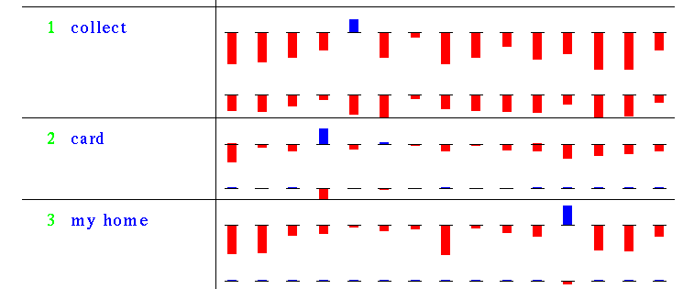
Weak rules generated by “boostexter”
Third party
Calling card
Collect call
Category
Weak Rule
Word occurs
Word does
not occur

Slide 36
Results
7844 training examples
  hand transcribed
1000 test examples
  hand / machine transcribed
Accuracy with 20% rejected
  Machine transcribed: 75%
  Hand transcribed: 90%

Slide 37
Commercial deployment
Freund, Mason, Rogers, Pregibon, Cortes 2000
Distinguish business/residence customers
Using statistics from call-detail records
Alternating decision trees
  Similar to boosting decision trees, more flexible
  Combines very simple rules
  Can over-fit, cross validation used to stop
Notes:
3 years for fraud

Slide 38
Massive datasets
260M calls / day
230M telephone numbers
Label unknown for ~30%
Hancock: software for computing statistical signatures.
100K randomly selected training examples,
~10K is enough
Training takes about 2 hours.
Generated classifier has to be both accurate and efficient
Notes:
Call detail: originating, called, terminated (e.g, for 800, forwarding) #,
start, end time, quality, termination code (e.g., for wireless), quality, no rate information
Statistics: #calls, Distribution within day, week, # #’s called, type (800, toll, etc.), incoming vs. outgoing

Slide 39
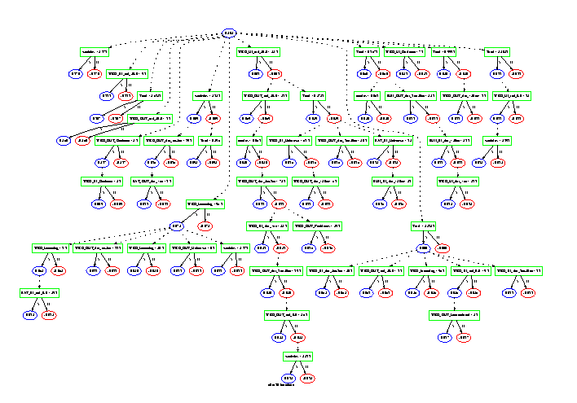
Alternating tree for “buizocity”

Slide 40
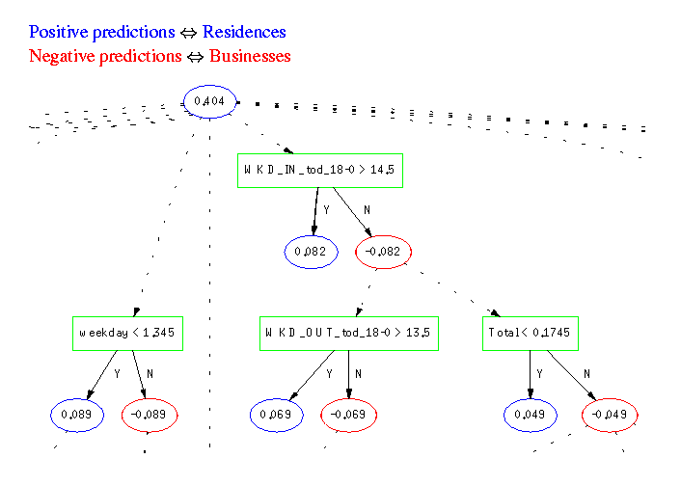
Alternating Tree (Detail)

Slide 41
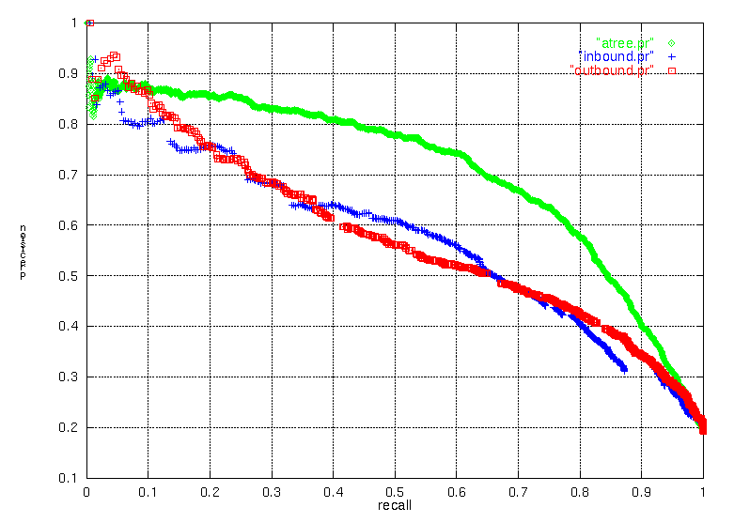
Precision/recall graphs
Accuracy
Score

Slide 42
Business impact
Increased coverage from 44% to 56%
Accuracy ~94%
Saved AT&T 15M$ in the year 2000 in operations costs and missed opportunities.

Slide 43
Summary
Boosting is a computational method for learning accurate classifiers
Resistance to over-fit explained by margins
Underlying explanation – large “neighborhoods” of good classifiers
Boosting has been applied successfully to a variety of classification problems

Slide 44
Please come talk with me
Questions welcome!
Data, even better!!
Potential collaborations, yes!!!
Yoav@research.att.com
www.predictiontools.com

Slide 45
