Slide 1

Data Cleaning by Gio
Data
Notes:
https://colab.research.google.com/drive/1_fTsD8SywpmZygXnsBNJ0R4_WfulcaHm?usp=sharing
https://colab.research.google.com/drive/144xME_fK6moao220A5MWpjSYI7mwouse?usp=sharing

Slide 2
Basic Principle: Garbage in Garbage Out
Garbage in Garbage out (GIGO) is the prevailing principle that flawed components of a data set can invalidates the practical use that data set in data science or machine learning
Data Cleaning is the act of removing all flawed or irrelevant parts of data so that what remains is more suited to a particular goal; typically, data science or machine learning

Slide 3
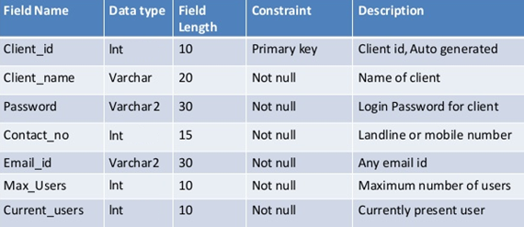
NYC Taxi Data Set
Data dictionary
CSV and Data Frames
Resources & Links

Slide 4
Preliminary Inspection
Statistical breakdown
NaN counts
Visual inspection
Notice: Non-Linear & Geographic columns

Slide 5
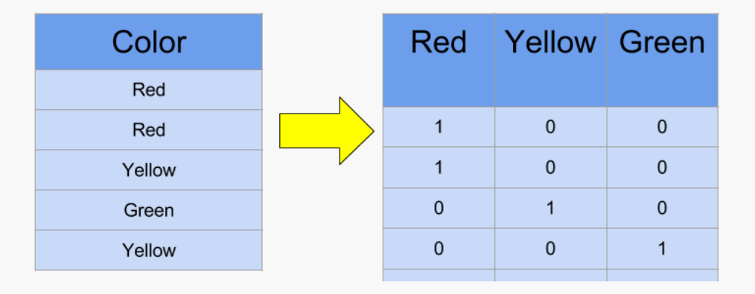
Non-Linear Column Value Engineering
Categorical columns
Binary and One-Hot Encoding
Timestamping dates

Slide 6
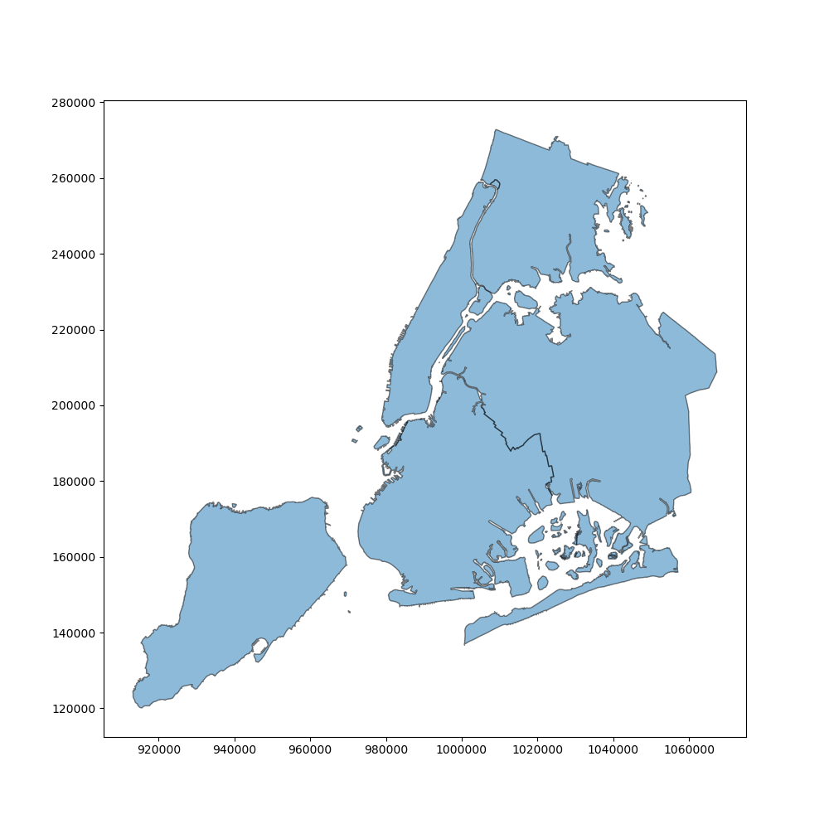
Geographic Value Engineering
Geo-Encoding API and GeoPandas
Shape files
European Petroleum Survey Group(EPSG)
Frequency measurements

Slide 7
Middle Data Inspection
Statistical breakdown
NaN counts
Random visual inspection
Notice: NaN & total number of columns

Slide 8
Replace Not-a-Number(NaN) Values
Approaches: drop rows, statistical replacement, etc.
NaN distribution and random value generation

Slide 9
Feature Scaling, PCA & Correlations
Feature Scaling is the process of normalizing a range of a variable to add context to the values within the data
Principal Component Analysis is the process of utilizing the principal components of a data set to reduce the dimensionality(# of columns) of that data set
Correlations are the statistical relationships between variables that can imply dependencies between those variables

Slide 10


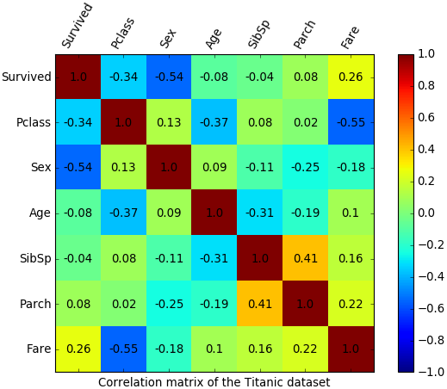
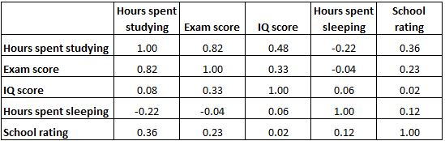
Feature Scaling, PCA & Correlations
Rescaling(Min-Max Normalization)
Standardization
Correlation Matrices, Tables and Lists

Slide 11
Final Data Inspection
Compare with original data set
Statistical breakdown
Random visual inspection

Slide 12
Thank you!

