Slide 1
Introduction to Data Science Lecture 4 Data Cleaning
CS 194 Spring 2014
Michael Franklin
Dan Bruckner, Evan Sparks,
Shivaram Venkataraman

Slide 2
Outline for this Evening
Lecture – Data Cleaning
Perspectives on “Dirty Data”
Perspectives on Data Quality
Some problems and solutions
Exercise – Data Surveying and Cleaning with Open Refine
(Evan: Tutorial and Lab)
Review of exercise
About the course
Overview of Assignments and Final Project
Instant Office Hours with Dan regarding HW1

Slide 3
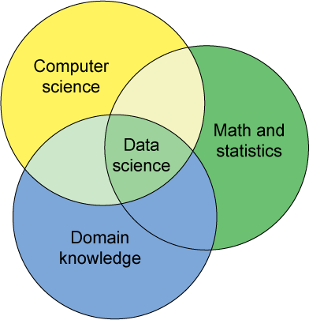
Data Science – One Definition

Slide 4

DB-hard Queries
Company_Name | Address | Market Cap
Google | Googleplex, Mtn. View, CA | $210Bn
Intl. Business Machines | Armonk, NY | $200Bn
Microsoft | Redmond, WA | $250Bn
SELECT Market_Cap
From Companies
Where Company_Name = “Apple”
Number of Rows: 0
Problem:
Missing Data

Slide 5
DB-hard Queries
Company_Name | Address | Market Cap
Google | Googleplex, Mtn. View, CA | $210Bn
Intl. Business Machines | Armonk, NY | $200Bn
Microsoft | Redmond, WA | $250Bn
SELECT Market_Cap
From Companies
Where Company_Name = “IBM”
Number of Rows: 0
Problem:
Entity Resolution
Notes:
For the database administrator it is the correct answer, but for the CEO it is not really understandable

Slide 6
DB-hard Queries
Company_Name | Address | Market Cap
Google | Googleplex, Mtn. View | $210
Intl. Business Machines | Armonk, NY | $200
Microsoft | Redmond, WA | $250
Sally’s Lemonade Stand | Alameda,CA | $260
SELECT MAX(Market_Cap)
From Companies
Number of Rows: 1
Problem:
Unit Mismatch
Notes:
For the database administrator it is the correct answer, but for the CEO it is not really understandable

Slide 7
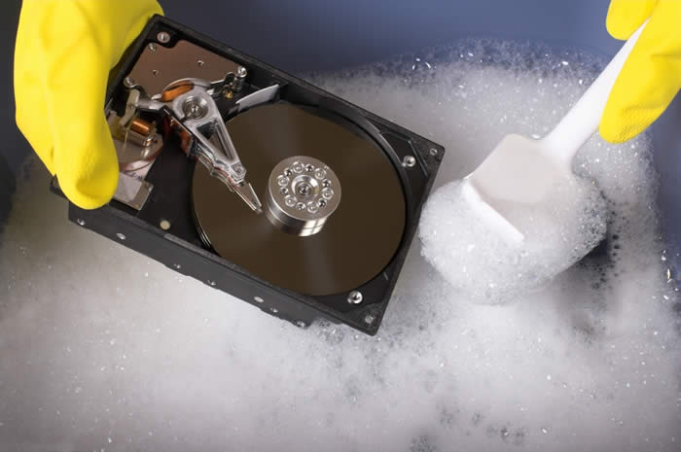
Who’s Calling Who’S Data Dirty?

Slide 8
Dirty Data
The Statistics View:
There is a process that produces data
Any dataset is a sample of the output of that process
Results are probabilistic
You can correct bias in your sample

Slide 9
Dirty Data
The Database View:
I got my hands on this data set
Some of the values are missing, corrupted, wrong, duplicated
Results are absolute (relational model)
You get a better answer by improving the quality of the values in your dataset

Slide 10
Dirty Data
The Domain Expert’s View:
This Data Doesn’t look right
This Answer Doesn’t look right
What happened?

Slide 11
Dirty Data
The Data Scientist’s View:
Some Combination of all of the above

Slide 12
Data Quality Problems
Data is dirty on its own
Data sets are clean but integration (i.e., combining them) screws them up
Data sets are clean but suffer “bit rot”
Old data loses its value over time
Any combination of the above

Slide 13
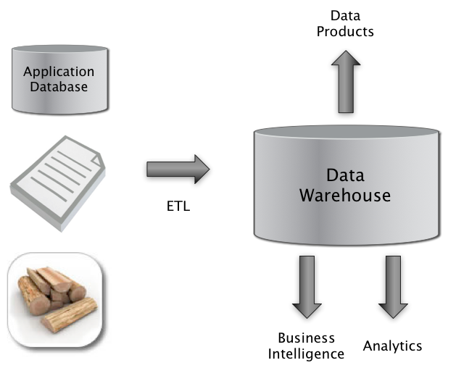

Big Picture: Where can Dirty Data Arise?
Integrate
Clean
Extract
Transform
Load

Slide 14
Example Data Quality Problems
T.Das|97336o8327|24.95|Y|-|0.0|1000
Ted J.|973-360-8779|2000|N|M|NY|1000
Can we interpret the data?
What do the fields mean?
What is the key? The measures?
Data glitches
Typos, multiple formats, missing / default values
Metadata and domain expertise
Field three is Revenue. In dollars or cents?
Field seven is Usage. Is it censored?
Field 4 is a censored flag. How to handle censored data?
Adapted from Ted Johnson’s SIGMOD 2003 Tutorial

Slide 15
Data Glitches (a telco view)
Systemic changes to data which are external to the recorded process.
Changes in data layout / data types
Integer becomes string, fields swap positions, etc.
Changes in scale / format
Dollars vs. euros
Temporary reversion to defaults
Failure of a processing step
Missing and default values
Application programs do not handle NULL values well …
Gaps in time series
Especially when records represent incremental changes.
Adapted from Ted Johnson’s SIGMOD 2003 Tutorial

Slide 16
Dirty Data Problems
From Stanford Data Integration Course:
parsing text into fields (separator issues)
Naming conventions: ER: NYC vs New York
Missing required field (e.g. key field)
Different representations (2 vs Two)
Fields too long (get truncated)
Primary key violation (from un to structured or during integation
Redundant Records (exact match or other)
Formating issues – esp dates
Licensing issues/Privacy/ keep you from using the data as you would like?

Slide 17

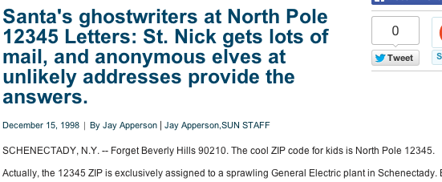
Typical problems
Why are so many of our customers in Beverly Hills, CA and Schenectady, NY?

Slide 18
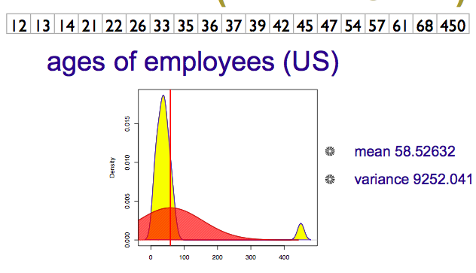

Numeric Outliers
Adapted from Joe Hellerstein’s 2012 CS 194 Guest Lecture

Slide 19
Schema and Data Integration
Which problems does Integration exacerbate?
Which problems does schema on write help?
Mediated Schema
Semantic mappings
wrapper
wrapper
wrapper
wrapper
wrapper
Courtesy of Alon Halevy

Slide 20
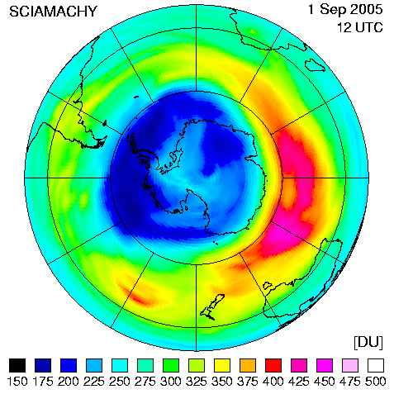
Data Cleaning Makes Everything Okay?
The appearance of a hole in the earth's ozone layer over Antarctica, first detected in 1976, was so unexpected that scientists didn't pay attention to what their instruments were telling them; they thought their instruments were malfunctioning.
National Center for Atmospheric Research
In fact, the data were rejected as unreasonable by data quality control algorithms

Slide 21
How Clean is “clean-enough”?
How much cleaning is too much?
Answers are likely to be:
domain-specific
data source-specific
application-specific
user-specific
all of the above?
How to split between shared and application-specific cleaning?

Slide 22
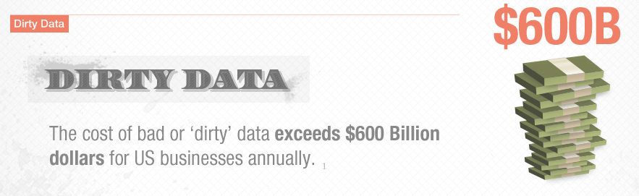
Data Quality
from http://www-new.insightsquared.com/wp-content/uploads/2012/01/insightsquared_dq_infographic-2.png

Slide 23
Meaning of Data Quality (1)
Generally, you have a problem if the data doesn’t mean what you think it does, or should
Data not up to spec : garbage in, glitches, etc.
You don’t understand the spec : complexity, lack of metadata.
Many sources and manifestations
As we have discussed
Data quality problems are expensive and pervasive
DQ problems cost hundreds of billion $$$ each year.
Resolving data quality problems is often the biggest effort in a data mining study.
Adapted from Ted Johnson’s SIGMOD 2003 Tutorial
Notes:
Many sources and manifestations make definitions difficult.
But it is necessary to get a grip on the problem because … expensive and pervasive.

Slide 24
Conventional Definition of Data Quality
Accuracy
The data was recorded correctly.
Completeness
All relevant data was recorded.
Uniqueness
Entities are recorded once.
Timeliness
The data is kept up to date.
Special problems in federated data: time consistency.
Consistency
The data agrees with itself.
Adapted from Ted Johnson’s SIGMOD 2003 Tutorial

Slide 25
Problems …
Unmeasurable
Accuracy and completeness are extremely difficult, perhaps impossible to measure.
Context independent
No accounting for what is important. E.g., if you are computing aggregates, you can tolerate a lot of inaccuracy.
Incomplete
What about interpretability, accessibility, metadata, analysis, etc.
Vague
The conventional definitions provide no guidance towards practical improvements of the data.
Adapted from Ted Johnson’s SIGMOD 2003 Tutorial

Slide 26
Finding a modern definition
We need a definition of data quality which
Reflects the use of the data
Leads to improvements in processes
Is measurable (we can define metrics)
First, we need a better understanding of how and where data quality problems occur
The data quality continuum
Adapted from Ted Johnson’s SIGMOD 2003 Tutorial

Slide 27
Meaning of Data Quality (2)
There are many types of data, which have different uses and typical quality problems
Federated data
High dimensional data
Descriptive data
Longitudinal data
Streaming data
Web (scraped) data
Numeric vs. categorical vs. text data
Adapted from Ted Johnson’s SIGMOD 2003 Tutorial

Slide 28
Meaning of Data Quality (2)
There are many uses of data
Operations
Aggregate analysis
Customer relations …
Data Interpretation : the data is useless if we don’t know all of the rules behind the data.
Data Suitability : Can you get the answer from the available data
Use of proxy data
Relevant data is missing
Adapted from Ted Johnson’s SIGMOD 2003 Tutorial
Notes:
Challenge in operations : many handoffs. Some processes more important than others.
Challenge in aggregate analysis: can tolerate errors, but you’re summing up over a lot of data, therefore likely to add in glitched data.
Customer relations : the fields must be accurate, but errors don’t spread.

Slide 29
The Data Quality Continuum
Data and information is not static, it flows in a data collection and usage process
Data gathering
Data delivery
Data storage
Data integration
Data retrieval
Data mining/analysis
Adapted from Ted Johnson’s SIGMOD 2003 Tutorial

Slide 30
Data Gathering
How does the data enter the system?
Sources of problems:
Manual entry
No uniform standards for content and formats
Parallel data entry (duplicates)
Approximations, surrogates – SW/HW constraints
Measurement errors.
Adapted from Ted Johnson’s SIGMOD 2003 Tutorial
Notes:
MPDS workshop, John Bates

Slide 31
Solutions
Potential Solutions:
Preemptive:
Process architecture (build in integrity checks)
Process management (reward accurate data entry, data sharing, data stewards)
Retrospective:
Cleaning focus (duplicate removal, merge/purge, name & address matching, field value standardization)
Diagnostic focus (automated detection of glitches).
Adapted from Ted Johnson’s SIGMOD 2003 Tutorial

Slide 32
Internet of Things has Special Problems
RFID data has many dropped readings
Typically, use a smoothing filter to interpolate
SELECT distinct tag_id
FROM RFID_stream [RANGE ‘5 sec’]
GROUP BY tag_id
Smoothed output
Smoothing Filter
Raw readings
Time

Slide 33
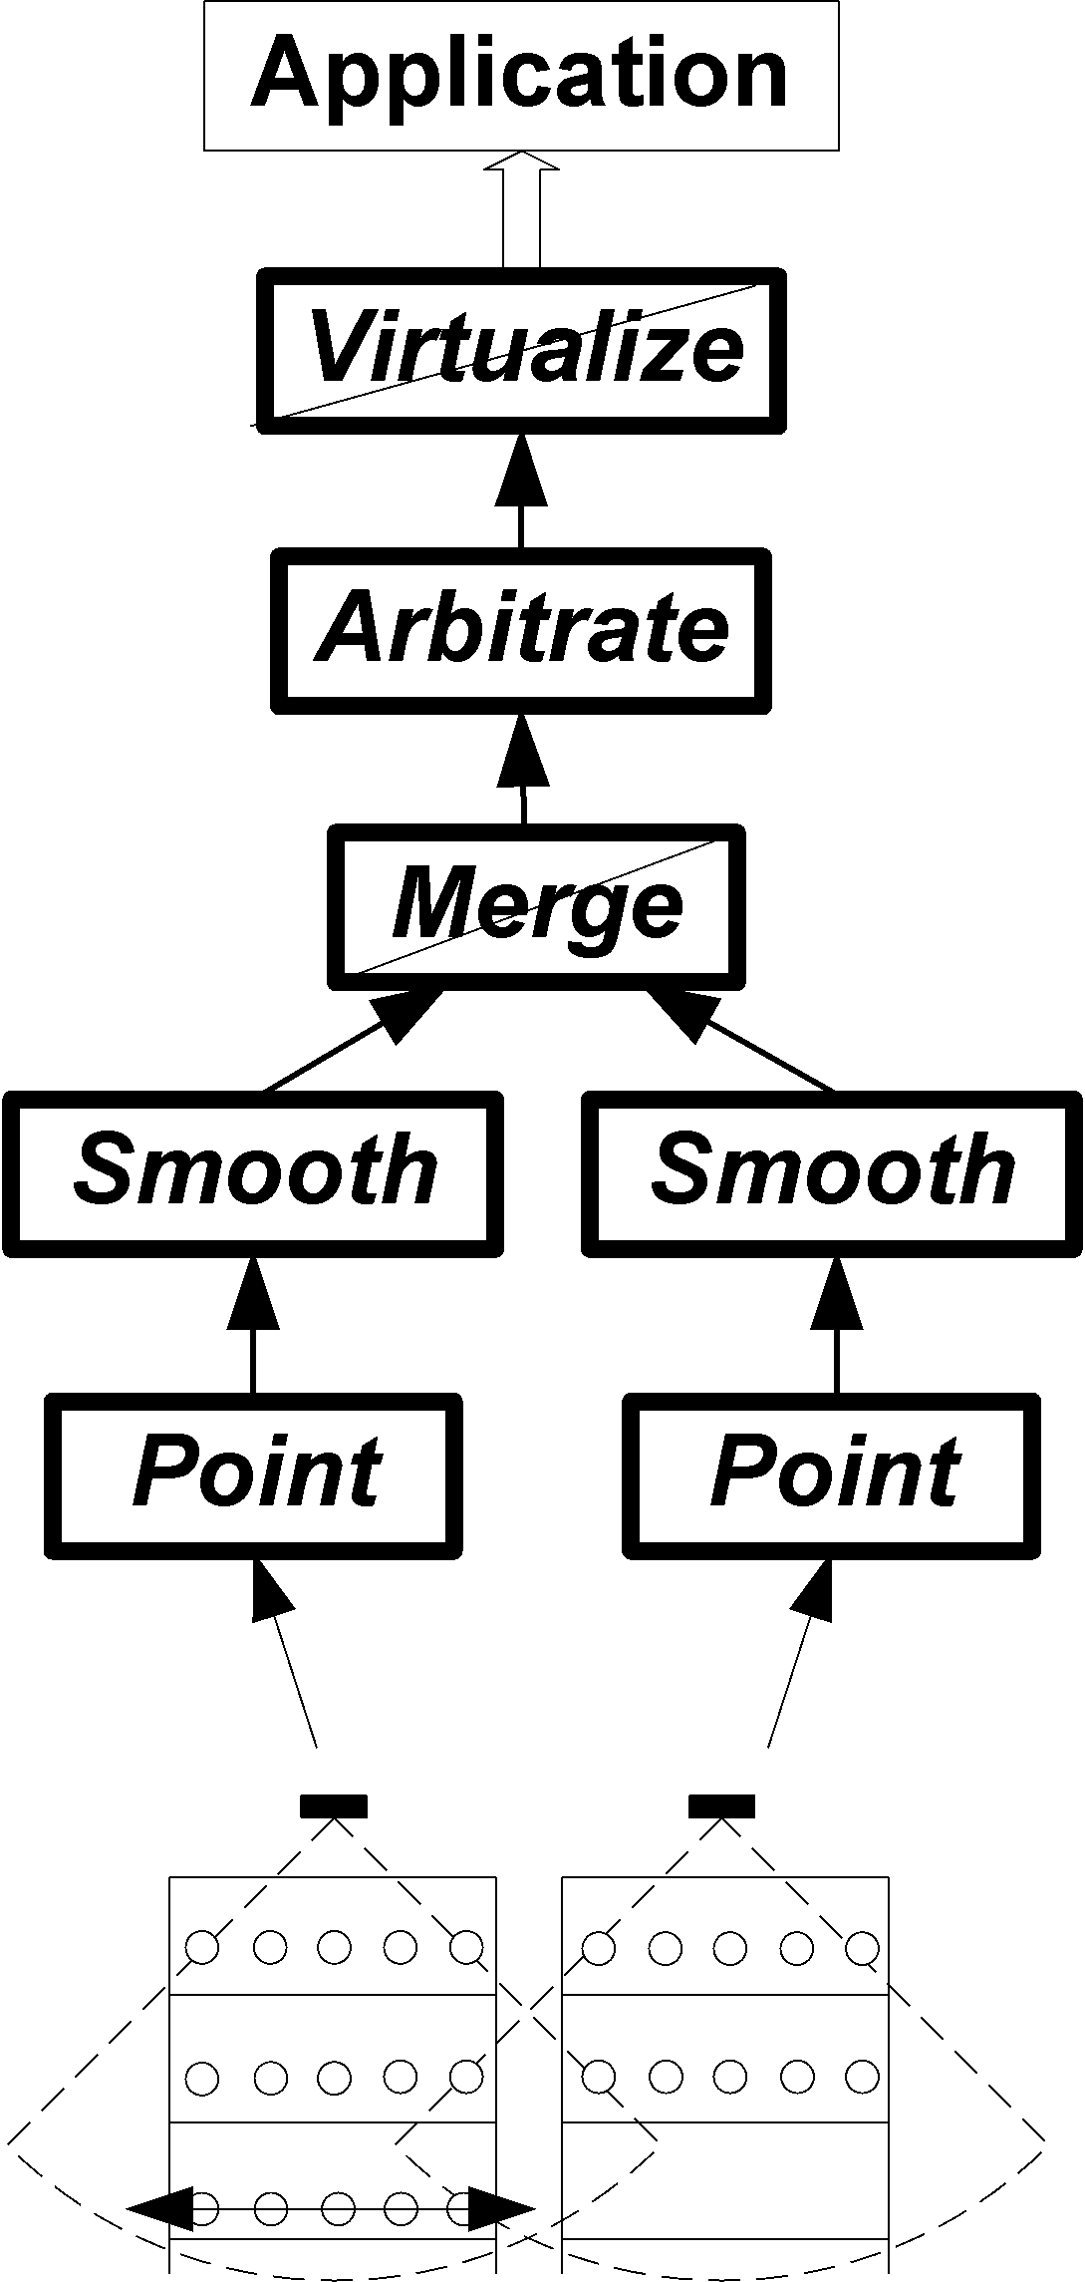
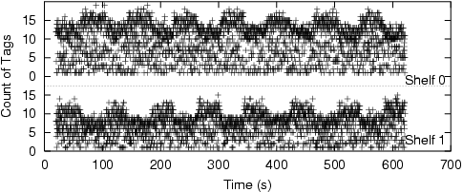
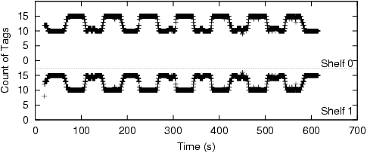
Physical Data Cleaning
“Restock every time inventory goes below 5”

Slide 34
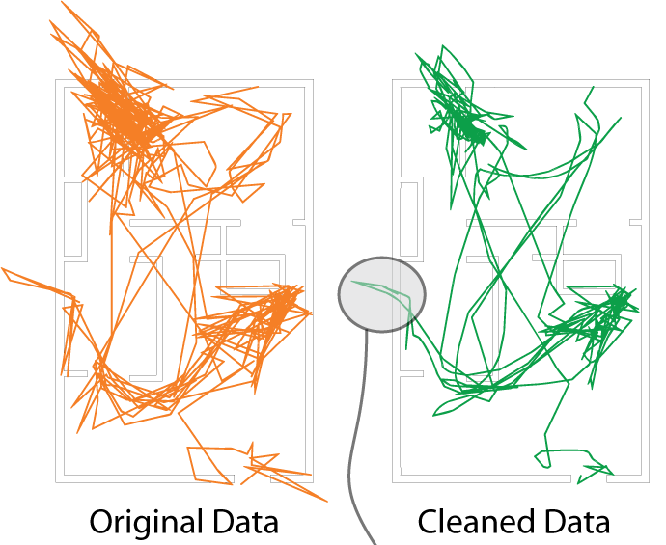
Tracking Superman @ home?
Ubisense tracking data from Ryan Appierspach
He walks through walls;
He flies across the room…
Too much
cleaning
and you
lose detail.

Slide 35
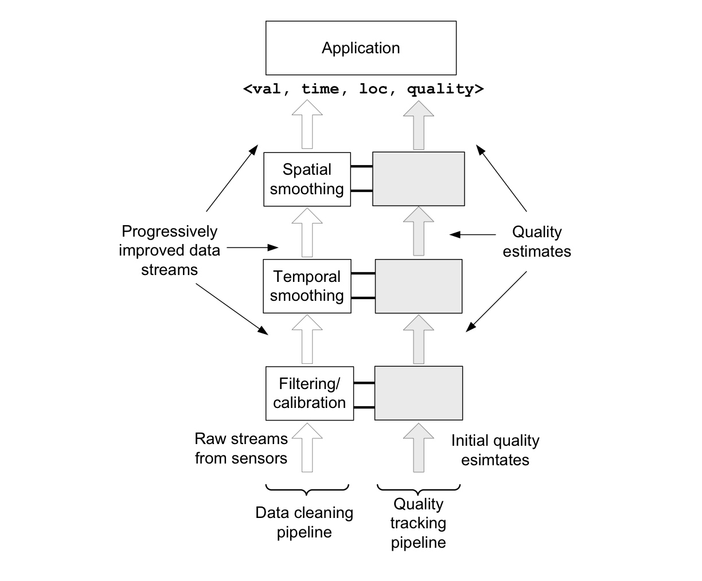
Adding Quality Assessment

Slide 36
Data Delivery
Destroying or mutilating information by inappropriate pre-processing
Inappropriate aggregation
Nulls converted to default values
Loss of data:
Buffer overflows
Transmission problems
No checks
Adapted from Ted Johnson’s SIGMOD 2003 Tutorial

Slide 37
Solutions
Build reliable transmission protocols
Use a relay server
Verification
Checksums, verification parser
Do the uploaded files fit an expected pattern?
Relationships
Are there dependencies between data streams and processing steps
Interface agreements
Data quality commitment from the data stream supplier.
Adapted from Ted Johnson’s SIGMOD 2003 Tutorial

Slide 38
Data Storage
You get a data set. What do you do with it?
Problems in physical storage
Can be an issue, but terabytes are cheap.
Problems in logical storage
Poor metadata.
Data feeds are often derived from application programs or legacy data sources. What does it mean?
Inappropriate data models.
Missing timestamps, incorrect normalization, etc.
Ad-hoc modifications.
Structure the data to fit the GUI.
Hardware / software constraints.
Data transmission via Excel spreadsheets, Y2K
Adapted from Ted Johnson’s SIGMOD 2003 Tutorial

Slide 39
Solutions
Metadata
Document and publish data specifications.
Planning
Assume that everything bad will happen.
Can be very difficult.
Data exploration
Use data browsing and data mining tools to examine the data.
Does it meet the specifications you assumed?
Has something changed?
Adapted from Ted Johnson’s SIGMOD 2003 Tutorial

Slide 40
Data Integration
Combine data sets (acquisitions, across departments).
Common source of problems
Heterogenous data : no common key, different field formats
Approximate matching
Different definitions
What is a customer: an account, an individual, a family, …
Time synchronization
Does the data relate to the same time periods? Are the time windows compatible?
Legacy data
IMS, spreadsheets, ad-hoc structures
Sociological factors
Reluctance to share – loss of power.
Adapted from Ted Johnson’s SIGMOD 2003 Tutorial

Slide 41
Solutions
Commercial Tools
Significant body of research in data integration
Many tools for address matching, schema mapping are available.
Data browsing and exploration
Many hidden problems and meanings : must extract metadata.
View before and after results : did the integration go the way you thought?
Adapted from Ted Johnson’s SIGMOD 2003 Tutorial

Slide 42
Data Retrieval
Exported data sets are often a view of the actual data. Problems occur because:
Source data not properly understood.
Need for derived data not understood.
Just plain mistakes.
Inner join vs. outer join
Understanding NULL values
Computational constraints
E.g., too expensive to give a full history, we’ll supply a snapshot.
Incompatibility
Ebcdic? Unicode?
Adapted from Ted Johnson’s SIGMOD 2003 Tutorial

Slide 43
Data Mining and Analysis
What are you doing with all this data anyway?
Problems in the analysis.
Scale and performance
Confidence bounds?
Black boxes and dart boards
Attachment to models
Insufficient domain expertise
Casual empiricism
Adapted from Ted Johnson’s SIGMOD 2003 Tutorial
Notes:
Casual empiricism : use an arbitrary number to support a pre-conception.

Slide 44
Solutions
Data exploration
Determine which models and techniques are appropriate, find data bugs, develop domain expertise.
Continuous analysis
Are the results stable? How do they change?
Accountability
Make the analysis part of the feedback loop.
Adapted from Ted Johnson’s SIGMOD 2003 Tutorial

Slide 45
Data Quality Constraints
Many data quality problems can be captured by static constraints based on the schema.
Nulls not allowed, field domains, foreign key constraints, etc.
Many others are due to problems in workflow, and can be captured by dynamic constraints
E.g., orders above $200 are processed by Biller 2
The constraints follow an 80-20 rule
A few constraints capture most cases, thousands of constraints to capture the last few cases.
Constraints are measurable. Data Quality Metrics?
Adapted from Ted Johnson’s SIGMOD 2003 Tutorial
Notes:
Dynamic constraints often come from operational databases. But analysis data sets, CRM databases are often derived from operational data.

Slide 46
Data Quality Metrics
We want a measurable quantity
Indicates what is wrong and how to improve
Realize that DQ is a messy problem, no set of numbers will be perfect
Types of metrics
Static vs. dynamic constraints
Operational vs. diagnostic
Metrics should be directionally correct with an improvement in use of the data.
A very large number metrics are possible
Choose the most important ones.
Adapted from Ted Johnson’s SIGMOD 2003 Tutorial
Notes:
Metrics can give incentives for bad behavior : throw away data that doesn’t join.

Slide 47
Examples of Data Quality Metrics
Conformance to schema
Evaluate constraints on a snapshot.
Conformance to business rules
Evaluate constraints on changes in the database.
Accuracy
Perform inventory (expensive), or use proxy (track complaints). Audit samples?
Accessibility
Interpretability
Glitches in analysis
Successful completion of end-to-end process
Adapted from Ted Johnson’s SIGMOD 2003 Tutorial

Slide 48
Technical Approaches
We need a multi-disciplinary approach to attack data quality problems
No one approach solves all problem
Process management
Ensure proper procedures
Statistics
Focus on analysis: find and repair anomalies in data.
Database
Focus on relationships: ensure consistency.
Metadata / domain expertise
What does it mean? Interpretation
Adapted from Ted Johnson’s SIGMOD 2003 Tutorial

Slide 49
Next Time
Data Cleaning and Integration Techniques
But now – hands on Data Cleaning with Open Refine (a.k.a. Google Refine)

Slide 50
Some Notes on the Class
3/3: Data Integration Techniques
FINAL PROJECTS – guidelines out by 2/25(!)
Group size = 3
What’s expected – find data, build a COOL Data Product, integration & viz or good reason why not
Schedule:
Form your groups now. GROUP LISTS DUE 3/3 Midnight
1-2page proposal GROUP LISTS DUE 3/10 Midnight
Midway review meeting with Prof or GSIs following 1-2 weeks
Final Presentation (Posters and/or Lightning talks)
Final Report

