Slide 1
Trying out PowerPoint Automation
With python-pptx and GitHub action!

Slide 2
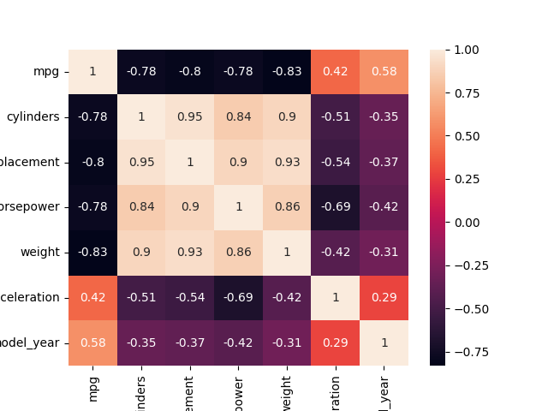
Add Image with Python

