Slide 1
Exercise: Programming

Slide 2
Session Outline
Introduce where to find the code and how to open it
Exercise: program the set partitioning and max cut QUBOs
Review the solution (tomorrow)
Session Goals
Practice programming a QUBO onto Advantage

Slide 3
Material

Slide 4
Exercises – Leap Access
If you have access to Leap
Log in to Leap
In a new tab open up https://github.com/CornerstonesQC/Annealing_Challenges
The instructions are in the ReadMe and the exercises are in the Day 2 folder. Note that both the set partitioning and max cut exercises are here.
To open up the code in the Leap IDE, type https://ide.dwavesys.io/# in front of the github URL.
Alternatively open https://ide.dwavesys.io/#https:// github.com/CornerstonesQC/Annealing_Challenges
You may complete the exercise in the Leap IDE

Slide 5
Exercises – No Leap Access
If you DO NOT have access to Leap
Install Ocean locally if you haven’t already https://docs.ocean.dwavesys.com/en/latest/overview/install.html
Open and clone or copy the code in the Day 2 folder here: https://github.com/CornerstonesQC/Annealing_Challenges
The instructions are in the ReadMe and the exercises are in the Day 2 folder. Note that both the set partitioning and max cut exercises are here
Instead of using the DWaveSampler and EmbeddingComposite, use SimulatedAnnealing instead. Replace the sampling code in the files with this:
from neal import SimulatedAnnealingSampler
sampler = SimulatedAnnealingSampler()
Sampleset = sampler.sample(bqm)
SimulatedAnnealingSampler documentation:
https://docs.ocean.dwavesys.com/en/latest/docs_neal/sdk_index.html

Slide 6
Reminders

Slide 7
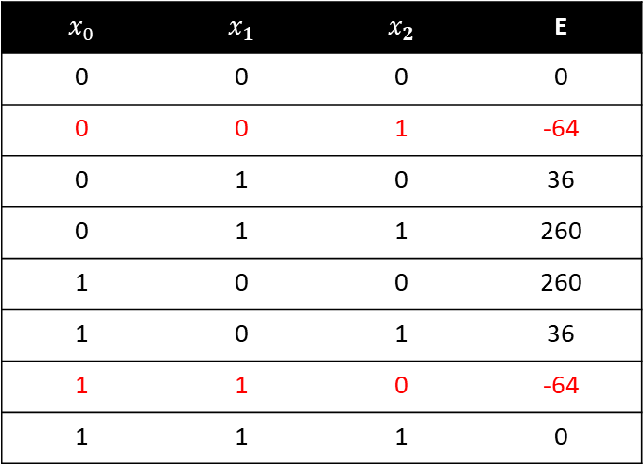
Example: Set Partitioning
Problem
Partition the numbers in [-5, 9, 4] into two sets such that the sum of each set is equal
$E_{qubo}=260x_{0}$ + 36 $x_{1}−64x_{2}−360x_{0}$ $x_{1}+ 288x_{1}x_{2}−160x_{0}$ $x_{2}$
$$x_{0}$$ | $$x_{1}$$ | $$x_{2}$$ | E
0 | 0 | 0 | 0
0 | 0 | 1 | -64
0 | 1 | 0 | 36
0 | 1 | 1 | 260
1 | 0 | 0 | 260
1 | 0 | 1 | 36
1 | 1 | 0 | -64
1 | 1 | 1 | 0

Slide 8
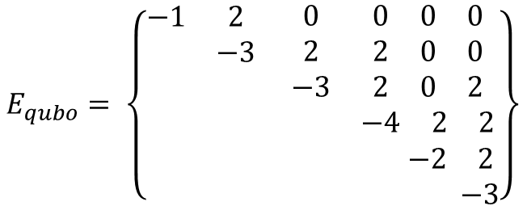
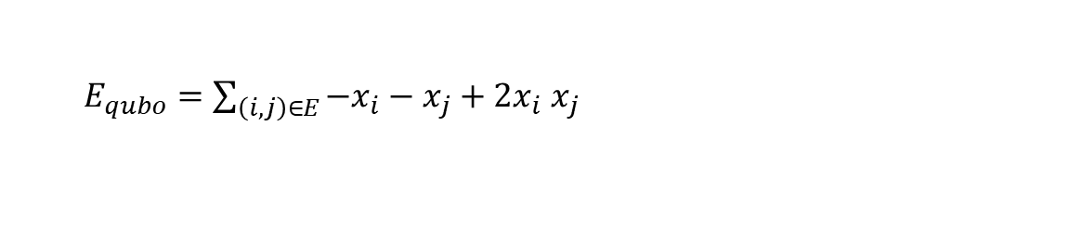
Example: Maximum Cut
Problem
Partition the set so that the partition cuts through a maximum number of edges
Step 5. Combine objectives and constraints
c
d
$E_{qubo}=\sum_{\left(i, j\right)∈E}{{−x}_{i}−x_{j}}+2x_{i}$ $x_{j}$
e
Let’s expand this for our problem:
b
f
a b c d e f
a b c d e f
a
$$E_{qubo}= \left\{\begin{matrix}\begin{matrix}\begin{matrix}−1 \\ \\ \end{matrix} & \begin{matrix}2 \\ −3 \\ \end{matrix} \\ & \end{matrix} & \begin{matrix}\begin{matrix}0 \\ 2 \\ −3\end{matrix} & \begin{matrix}\begin{matrix}0 & 0 & 0\end{matrix} \\ \begin{matrix}2 & 0 & 0\end{matrix} \\ \begin{matrix}2 & 0 & 2\end{matrix}\end{matrix} \\ & \begin{matrix}−4 & 2 & 2\end{matrix}\end{matrix} \\ \begin{matrix} & \\ & \end{matrix} & \begin{matrix} & \begin{matrix} & −2 & 2\end{matrix} \\ & \begin{matrix} & & −3\end{matrix}\end{matrix}\end{matrix}\right\}$$

Slide 9
Challenge
How would you rewrite the maximum cut code so that it can run on any graph (like what we did with the antennas example).
The QUBO for the maximum cut problem is:
$E_{qubo}=\sum_{\left(i, j\right)∈E}{{−x}_{i}−x_{j}}+2x_{i}$ $x_{j}$

