Slide 1
Exercise: Maximum Cut

Slide 2
Session Outline
Introduce the maximum cut example
Exercise: develop a QUBO for the maximum cut problem
Review the solution
Session Goals
Practice formulating a QUBO

Slide 3
Problem: Maximum Cut

Slide 4
Example: Maximum Cut Problem
Problem
The maximum cut problem seeks to cut through the maximum amount of edges in a graph.
Another way of saying this is:
A maximum cut is a subset of a graph’s vertices such that the number of edges between this subset and the remaining vertices is as large as possible
c
d
e
b
f
a

Slide 5
Example: Maximum Cut Problem
Problem
The maximum cut problem seeks to cut through the maximum amount of edges in a graph.
Another way of saying this is:
A maximum cut is a subset of a graph’s vertices such that the number of edges between this subset and the remaining vertices is as large as possible
c
d
c
d
e
e
b
f
b
f
a
a

Slide 6
Example: Maximum Cut Problem
Problem
The maximum cut problem seeks to cut through the maximum amount of edges in a graph.
Exercise
Follow the QUBO formulation steps to write a QUBO that finds the subset of the graph below that cuts through a maximum amount of edges.
c
d
c
d
e
e
b
f
b
f
a
a

Slide 7
Example: Maximum Cut Problem
Problem
Partition the set so that the partition cuts through a maximum number of edges
QUBO Writing Process
Write out the objective and constraints in your problem domain
Define the binary variables
Write out objective in QUBO form
Write out constraints in QUBO form
Combine objectives and constraints
Solve and interpret results
Tune your QUBO to get better results

Slide 8
Example: Maximum Cut Problem
Problem
The maximum cut problem seeks to cut through the maximum amount of edges in a graph.
Exercise
Follow the QUBO formulation steps to write a QUBO that finds the subset of the graph below that cuts through a maximum amount of edges.
Hint
In this domain you’re working with the graph’s edges (whereas in the number partitioning problem you were thinking about the sums of numbers). You want edges in the same set to increase the QUBO’s energy.
c
d
c
d
e
e
b
f
b
f
a
a

Slide 9
Maximum Cut Example

Slide 10
Example: Maximum Cut Problem
Problem
Partition the set so that the partition cuts through a maximum number of edges
Step 1. Write out the objective and constraints in your problem domain
Objective:
Maximize the number of cut edges
Constraints:
No constraints this time

Slide 11
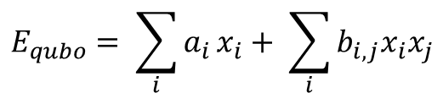
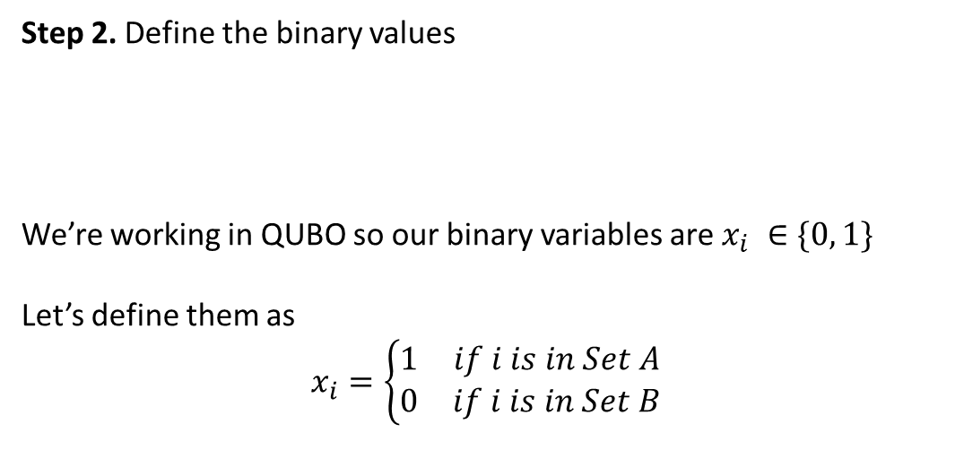
Example: Maximum Cut Problem
Problem
Partition the set so that the partition cuts through a maximum number of edges
Step 2. Define the binary values
We’re working in QUBO so our binary variables are $x_{i} ∈\{0, 1\}$
Let’s define them as
$$x_{i}=\left\{\begin{matrix}1 & if i is in Set A \\ 0 & if i is in Set B\end{matrix}\right.$$
$$E_{qubo}= \sum_{i}{a_{i}}x_{i}+ \sum_{i}{b_{i,j}x_{i}x_{j}}$$

Slide 12
Example: Maximum Cut Problem
Problem
Partition the set so that the partition cuts through a maximum number of edges
Step 3. Write out the objective in QUBO form
If we cut an edge, the nodes it was connecting will be in opposite sets.
Since we want to maximize cut edges we want to favor edges between nodes with opposite values.
a | b | Cut Edge(a, b)
0 | 0 | 0
0 | 1 | 1
1 | 0 | 1
1 | 1 | 0
a
b

Slide 13
Example: Maximum Cut Problem
Problem
Partition the set so that the partition cuts through a maximum number of edges
Step 3. Write out the objective in QUBO form
X_{i} | X_{j} | edge(i, j)
0 | 0 | 0
0 | 1 | 1
1 | 0 | 1
1 | 1 | 0
c
d
e
b
f
a

Slide 14
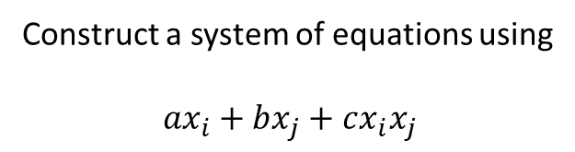
Example: Maximum Cut Problem
Problem
Partition the set so that the partition cuts through a maximum number of edges
Step 3. Write out the objective in QUBO form
Construct a system of equations using
$${ax}_{i}+bx_{j}+cx_{i}x_{j}$$
Truth table
Eqn | X_{i} | X_{j} | Cut Edge (i, j)
① | 0 | 0 | 0
② | 0 | 1 | 1
③ | 1 | 0 | 1
④ | 1 | 1 | 0

Slide 15
Example: Maximum Cut Problem
Problem
Partition the set so that the partition cuts through a maximum number of edges
Step 3. Write out the objective in QUBO form
Construct a system of equations using
$${ax}_{i}+bx_{j}+cx_{i}x_{j}$$
Truth table
Eqn | X_{i} | X_{j} | Cut Edge (i, j)
① | 0 | 0 | 0
② | 0 | 1 | 1
③ | 1 | 0 | 1
④ | 1 | 1 | 0
① | 0 + 0 + 0 = 0
② | 0 + b + 0 = 1 | → b = 1
③ | a + 0 + 0 = 1 | → a = 1
④ | a + b + c = 0 | → c = -2

Slide 16
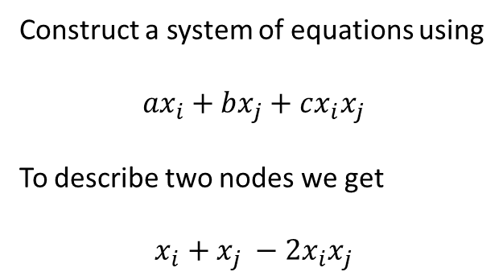
Example: Maximum Cut Problem
Problem
Partition the set so that the partition cuts through a maximum number of edges
Step 3. Write out the objective in QUBO form
Construct a system of equations using
$${ax}_{i}+bx_{j}+cx_{i}x_{j}$$
To describe two nodes we get
$$x_{i}+x_{j} −2x_{i}x_{j}$$
a
b

Slide 17
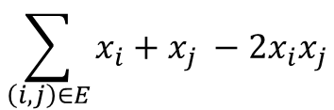
Example: Maximum Cut Problem
Problem
Partition the set so that the partition cuts through a maximum number of edges
Step 3. Write out the objective in QUBO form
To describe our entire graph we can sum up our relationship over every node and edge
$$\sum_{\left(i, j\right)∈E}{x_{i}+x_{j} −2x_{i}x_{j}}$$
c
d
e
b
f
where
E = {(a,b), (b,c), (b,d), (c,d), (c,f), (d,e), (d,f), (e,f)}
a

Slide 18
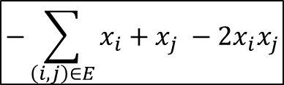
Example: Maximum Cut Problem
Problem
Partition the set so that the partition cuts through a maximum number of edges
Step 3. Write out the objective in QUBO form
Since the QPU naturally finds the minimum of a landscape, we change our objective function to minimize instead of maximize
$$−\sum_{\left(i, j\right)∈E}{x_{i}+x_{j} −2x_{i}x_{j}}$$
c
d
e
b
f
where
E = {(a,b), (b,c), (b,d), (c,d), (c,f), (d,e), (d,f), (e,f)}
a

Slide 19
Example: Maximum Cut Problem
Problem
Partition the set so that the partition cuts through a maximum number of edges
Step 4. Write out the constraints in QUBO form
There aren’t any constraints in this problem so we skip this step
Notes:
Constraints are rules that define what solutions are acceptable and which are not.

Slide 20
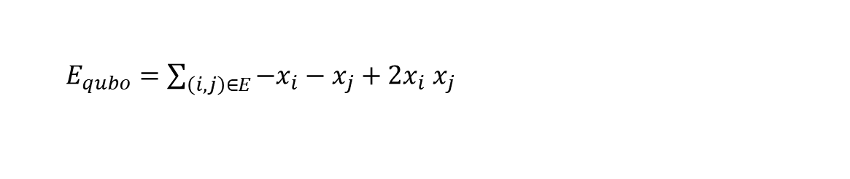
Example: Maximum Cut Problem
Problem
Partition the set so that the partition cuts through a maximum number of edges
Step 5. Combine objectives and constraints
$$E_{qubo}=\min\left(objective\right)+ γ(constraints)$$
$E_{qubo}=\sum_{\left(i, j\right)∈E}{{−x}_{i}−x_{j}}+2x_{i}$ $x_{j}$

Slide 21
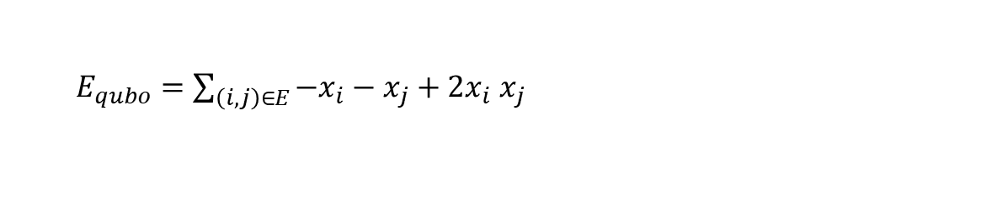
Example: Maximum Cut Problem
Problem
Partition the set so that the partition cuts through a maximum number of edges
Step 5. Combine objectives and constraints
c
d
e
$E_{qubo}=\sum_{\left(i, j\right)∈E}{{−x}_{i}−x_{j}}+2x_{i}$ $x_{j}$
b
f
where
E = {(a,b), (b,c), (b,d), (c,d), (c,f), (d,e), (d,f), (e,f)}
a
Need to expand this for our problem

Slide 22
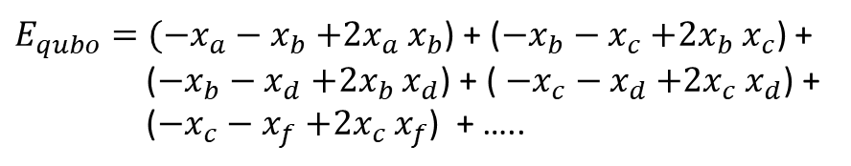
Example: Maximum Cut Problem
Problem
Partition the set so that the partition cuts through a maximum number of edges
Step 5. Combine objectives and constraints
c
d
e
$E_{qubo}=\sum_{\left(i, j\right)∈E}{{−x}_{i}−x_{j}}+2x_{i}$ $x_{j}$
b
f
Let’s expand this for our problem:
a
$E_{qubo}=({−x}_{a}−x_{b}$ $+2x_{a}$ $x_{b}$) + (${−x}_{b}−x_{c}$ $+2x_{b}$ $x_{c}$) +
(${−x}_{b}−x_{d}$ $+2x_{b}$ $x_{d}$) + ( ${−x}_{c}−x_{d}$ $+2x_{c}$ $x_{d}$) +
(${−x}_{c}−x_{f}$ $+2x_{c}$ $x_{f}$) + …..

Slide 23
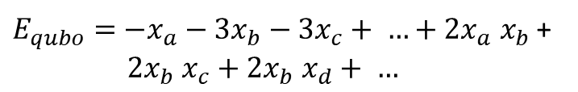
Example: Maximum Cut Problem
Problem
Partition the set so that the partition cuts through a maximum number of edges
Step 5. Combine objectives and constraints
c
d
e
$E_{qubo}=\sum_{\left(i, j\right)∈E}{{−x}_{i}−x_{j}}+2x_{i}$ $x_{j}$
b
f
Let’s expand this for our problem:
a
$E_{qubo}=({−x}_{a}−x_{b}$ $+2x_{a}$ $x_{b}$) + (${−x}_{b}−x_{c}$ $+2x_{b}$ $x_{c}$) +
(${−x}_{b}−x_{d}$ $+2x_{b}$ $x_{d}$) + ( ${−x}_{c}−x_{d}$ $+2x_{c}$ $x_{d}$) +
(${−x}_{c}−x_{f}$ $+2x_{c}$ $x_{f}$) + …..
$E_{qubo}=$ ${−x}_{a}−3x_{b}−3x_{c}+ …+2x_{a} x_{b}$ +
$2x_{b}$ $x_{c}+2x_{b} x_{d}+ …$

Slide 24
Example: Maximum Cut Problem
Problem
Partition the set so that the partition cuts through a maximum number of edges
Step 5. Combine objectives and constraints
c
d
e
$E_{qubo}=\sum_{\left(i, j\right)∈E}{{−x}_{i}−x_{j}}+2x_{i}$ $x_{j}$
b
f
Let’s expand this for our problem:
a
$E_{qubo}=({−x}_{a}−x_{b}$ $+2x_{a}$ $x_{b}$) + (${−x}_{b}−x_{c}$ $+2x_{b}$ $x_{c}$) +
(${−x}_{b}−x_{d}$ $+2x_{b}$ $x_{d}$) + ( ${−x}_{c}−x_{d}$ $+2x_{c}$ $x_{d}$) +
(${−x}_{c}−x_{f}$ $+2x_{c}$ $x_{f}$) + …..
The coefficients =
- (the number of edges connected to the node)
$E_{qubo}=$ ${−x}_{a}−3x_{b}−3x_{c}+ …+2x_{a} x_{b}$ +
$2x_{b}$ $x_{c}+2x_{b} x_{d}+ …$
Quadratic biases are always 2

Slide 25
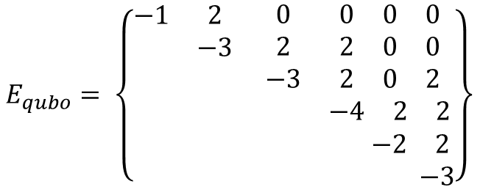
Example: Maximum Cut Problem
Problem
Partition the set so that the partition cuts through a maximum number of edges
Step 5. Combine objectives and constraints
c
d
$E_{qubo}=\sum_{\left(i, j\right)∈E}{{−x}_{i}−x_{j}}+2x_{i}$ $x_{j}$
e
Let’s expand this for our problem:
b
f
a b c d e f
a b c d e f
a
$$E_{qubo}= \left\{\begin{matrix}\begin{matrix}\begin{matrix}−1 \\ \\ \end{matrix} & \begin{matrix}2 \\ −3 \\ \end{matrix} \\ & \end{matrix} & \begin{matrix}\begin{matrix}0 \\ 2 \\ −3\end{matrix} & \begin{matrix}\begin{matrix}0 & 0 & 0\end{matrix} \\ \begin{matrix}2 & 0 & 0\end{matrix} \\ \begin{matrix}2 & 0 & 2\end{matrix}\end{matrix} \\ & \begin{matrix}−4 & 2 & 2\end{matrix}\end{matrix} \\ \begin{matrix} & \\ & \end{matrix} & \begin{matrix} & \begin{matrix} & −2 & 2\end{matrix} \\ & \begin{matrix} & & −3\end{matrix}\end{matrix}\end{matrix}\right\}$$

Slide 26
Example: Maximum Cut Problem
Problem
Partition the set so that the partition cuts through a maximum number of edges
Step 6. Solve and interpret results
You’ve got this (later today)!

