Slide 1
Exercise: Maximum Cut

Slide 2
Session Outline
Introduce the maximum cut example
Exercise: develop a QUBO for the maximum cut problem
Review the solution
Session Goals
Practice formulating a QUBO

Slide 3
Problem: Maximum Cut

Slide 4
Example: Maximum Cut Problem
Problem
The maximum cut problem seeks to cut through the maximum amount of edges in a graph.
Another way of saying this is:
A maximum cut is a subset of a graph’s vertices such that the number of edges between this subset and the remaining vertices is as large as possible
c
d
e
b
f
a

Slide 5
Example: Maximum Cut Problem
Problem
The maximum cut problem seeks to cut through the maximum amount of edges in a graph.
Another way of saying this is:
A maximum cut is a subset of a graph’s vertices such that the number of edges between this subset and the remaining vertices is as large as possible
c
d
c
d
e
e
b
f
b
f
a
a

Slide 6
Example: Maximum Cut Problem
Problem
The maximum cut problem seeks to cut through the maximum amount of edges in a graph.
Exercise
Follow the QUBO formulation steps to write a QUBO that finds the subset of the graph below that cuts through a maximum amount of edges.
c
d
c
d
e
e
b
f
b
f
a
a

Slide 7
Example: Maximum Cut Problem
Problem
Partition the set so that the partition cuts through a maximum number of edges
QUBO Writing Process
Write out the objective and constraints in your problem domain
Define the binary variables
Write out objective in QUBO form
Write out constraints in QUBO form
Combine objectives and constraints
Solve and interpret results
Tune your QUBO to get better results

Slide 8
Example: Maximum Cut Problem
Problem
The maximum cut problem seeks to cut through the maximum amount of edges in a graph.
Exercise
Follow the QUBO formulation steps to write a QUBO that finds the subset of the graph below that cuts through a maximum amount of edges.
Hint
In this domain you’re working with the graph’s edges (whereas in the set partitioning problem you were thinking about the sums of numbers). You want edges in the same set to increase the QUBO’s energy.
c
d
c
d
e
e
b
f
b
f
a
a

Slide 9
Exercise: Maximum Cut

Slide 10
Building blocks of QUBOs
To construct a QUBO for a particular problem you need to define a few things about that problem
Binary Variables
Each state of the binary variables must be assigned a meaning
Objective
The overall goal of the problem – what we’re trying to minimize or maximize
Constraints
Rules that define what solutions are acceptable and which are not

Slide 11
Example: Maximum Cut Problem
Problem
Partition the set so that the partition cuts through a maximum number of edges
Step 1. Write out the objective and constraints in your problem domain
Objective:
Constraints:

Slide 12
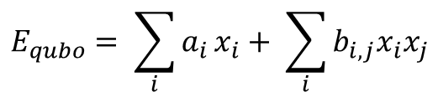
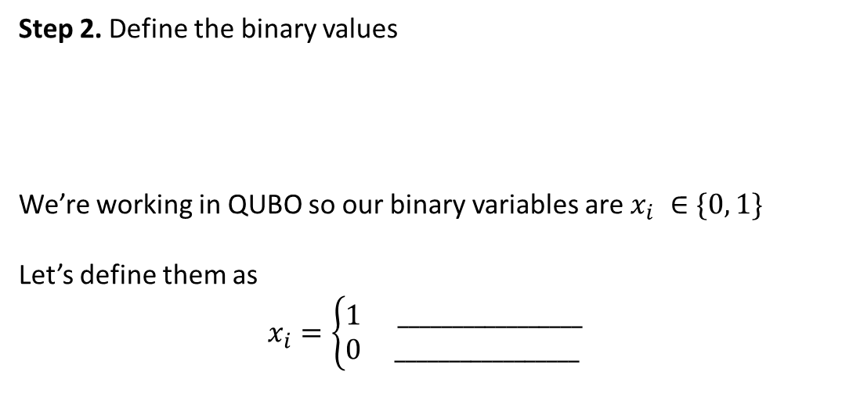
Example: Maximum Cut Problem
Problem
Partition the set so that the partition cuts through a maximum number of edges
Step 2. Define the binary values
We’re working in QUBO so our binary variables are $x_{i} ∈\{0, 1\}$
Let’s define them as
$$x_{i}=\left\{\begin{matrix}1 & _________________ \\ 0 & _________________\end{matrix}\right.$$
$$E_{qubo}= \sum_{i}{a_{i}}x_{i}+ \sum_{i}{b_{i,j}x_{i}x_{j}}$$
Assign meaning to binary values

Slide 13
Example: Maximum Cut Problem
Problem
Partition the set so that the partition cuts through a maximum number of edges
Step 3. Write out the objective in QUBO form
Hint:
Think about cutting through one edge first. How would you write this out mathematically?
a
b

Slide 14
Example: Maximum Cut Problem
Problem
Partition the set so that the partition cuts through a maximum number of edges
Step 3. Write out the objective in QUBO form
X_{i} | X_{j} | edge(i, j)
Hint:
Can a truth table help?

Slide 15
Example: Maximum Cut Problem
Problem
Partition the set so that the partition cuts through a maximum number of edges
Step 3. Write out the objective in QUBO form
Hint:
How can you apply an expression for one edge to an entire graph?
c
d
e
b
f
a

Slide 16
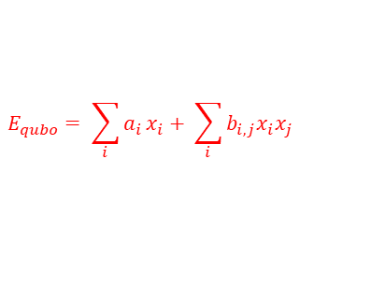
Example: Maximum Cut Problem
Problem
Partition the set so that the partition cuts through a maximum number of edges
Step 3. Write out the objective in QUBO form
Hint:
$$E_{qubo}= \sum_{i}{a_{i}}x_{i}+ \sum_{i}{b_{i,j}x_{i}x_{j}}$$
c
d
e
b
f
a

Slide 17
Example: Maximum Cut Problem
Problem
Partition the set so that the partition cuts through a maximum number of edges
Step 4. Write out the constraints in QUBO form
Hint:
Remember that constraints are rules about which solutions are feasible and which aren’t.
Notes:
Constraints are rules that define what solutions are acceptable and which are not.

Slide 18
Example: Maximum Cut Problem
Problem
Partition the set so that the partition cuts through a maximum number of edges
Step 5. Combine objectives and constraints
c
d
e
$$E_{qubo}=\min\left(objective\right)+ γ(constraints)$$
b
f
a

