Slide 1

Final Project: Prediction of Patient’s Treatment Category
Notes:
Hospitals are pretty busy nowadays Doctors are carrying a lot of responsibilities along with nurse nurses they are deciding how to treat patients how to better serve patience and how to manage their time
Let's think of a doctor, whose patient came to have some examination or to have some one-day quick surgery. Such a patient shouldn't necessarily stay at the hospital overnight. The decision whether to leave the hospital or to stay often can be tricky to make.
Such decision is usually based on multiple different factors ranging from general health of the patient objective test results and some third circumstances like the amount of free space at the hospital and business of the personnel for example during the coronavirus pandemic
Therefore, this case present problems on different levels.

Slide 2

PROBLEM STATEMENT
Healthcare professionals’ point of view:
Timewise efficiency of interaction with patient
Reasonable decision-making
Hospital management’s point of view:
Cost efficiency
Management of places free for hospitalization
Staff management
Notes:
Tell about the problems

Slide 3
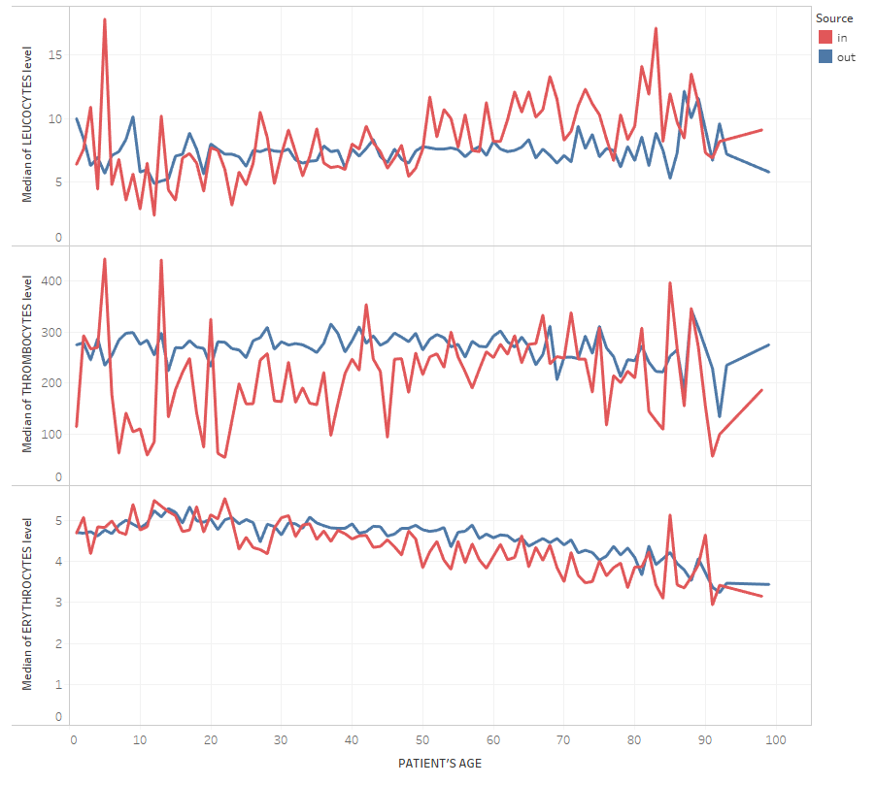
POSSIBLE SOLUTION
Approach: training a classification Machine Learning model (Random Forest)
Dataset: CBC (complete blood count) test results of ~ 4.5K patients
Data source: Sadikin, Mujiono (2020), “EHR Dataset for Patient Treatment Classification”, Mendeley Data, V1, doi: 10.17632/7kv3rctx7m.1
Notes:
– description of data, insights, approach(ML), importance of precisely predicting inpatient category and lowering the false negatives. Error metric – recall (?)
The system I designed is trying solve this problem. I build a machine learning model which is supposed to predict whether the patient needs Supervision and will stay in the hospital or the patient can safely go home and come back the next day to have the further testing or a procedure. A model is trained on the data set of patients’ blood test results. Here you can see the plots of median values of three blood cell types against the age of patients with differentiation on inpatient and outpatient category. In all of the three cases it is clear that inpatient group data is more variable while outpatient category stays relatively constant. Clearly that if a patient has a drastically high or drastically low level some factor, then most probably he has a serious health condition which needs hospitalization. For this case the machine learning is not even needed. But as we see there are points where for that particular blood cell the levels are the same , and yet the category of a patient is different. That is where we need the machine learning algorithm to train on all the blood parameters and figure out if there is a risk of having patients’ health problems in the nearest future.
A complete blood count (CBC) is a blood test used to evaluate your overall health and detect a wide range of disorders, including anemia, infection and leukemia.

Slide 4

DEMO TIME!
Notes:
DEMO – find two good understandable examlpes – in and out (normal test and change something in normal)

Slide 5

CHALLENGES AND NEXT STEPS
Main challenge: an accurate prediction of inpatient group
Reason of inaccuracy: lack of data
Ways to improve:
Including more training data (more patient records)
Introducing additional input features (blood pressure, blood sugar etc.)
Notes:
Next steps how to improve the results – what is the future of the system

Slide 6
Thanks. Stay safe!

