Slide 1
Behold Bootstrap!
Day 6
April 8, 2016

Slide 2
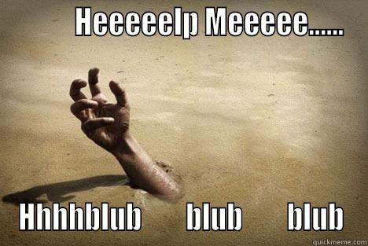

Slide 3


Slide 4


Slide 5


Slide 6
Today’s Class

Slide 7
Objectives
Students will use the Bootstrap CSS Framework to create layouts
Students will learn to use media queries for mobile responsive websites
Students will learn to use the meta tag to make sure all devices are displaying web pages optimally for their viewport.

Slide 8

Focus!
This stuff is important…

Slide 9
Recap Bootstrap

Slide 10
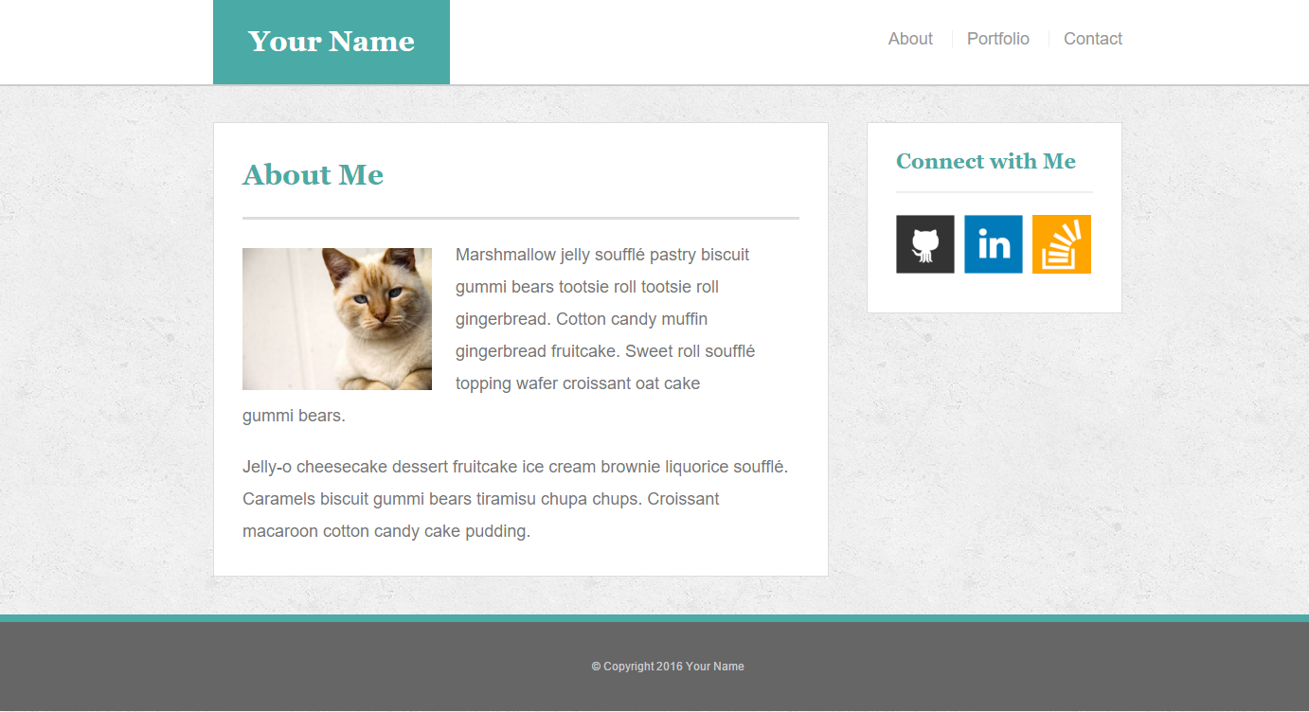
The Pains of HW 1
Plain HTML + CSS makes layout building challenging

Slide 11
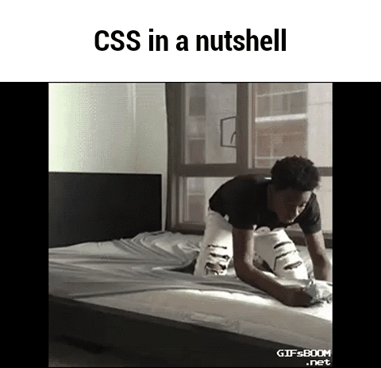
How You (Probably) Feel About CSS

Slide 12
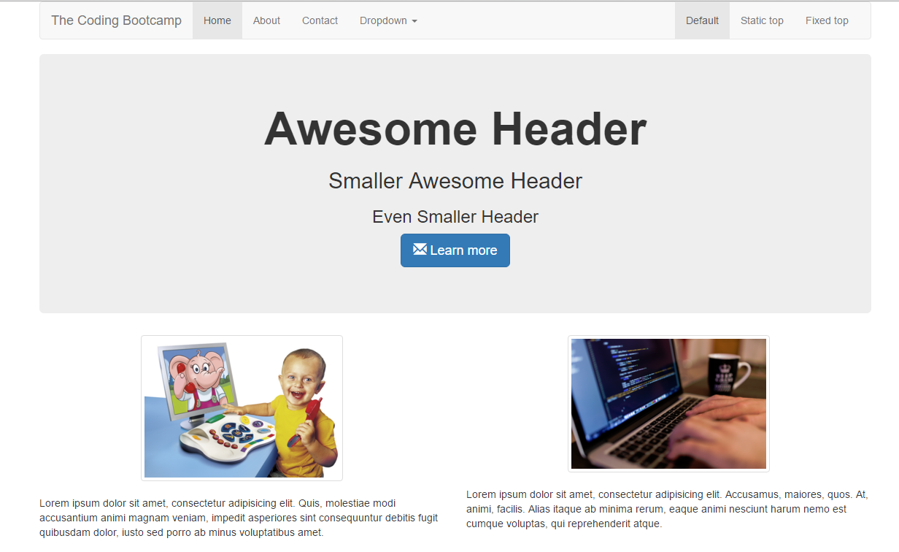
But Then Came Bootstrap…

Slide 13
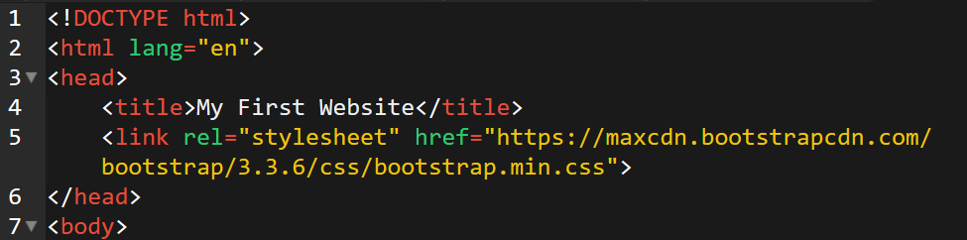
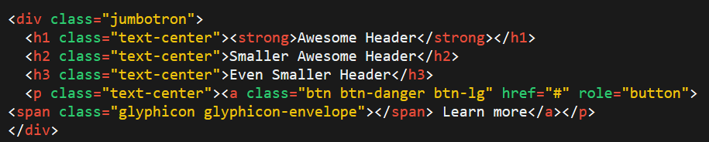
Powered by Bootstrap
External CSS Link
Pre-Defined CSS Class (ex: “Jumbotron”)

Slide 14
Powered by Bootstrap
class=“jumbotron”

Slide 15

Big Deal!!!
Using Bootstrap,
we have PRE-DEFINED CSS Styles.

Slide 16
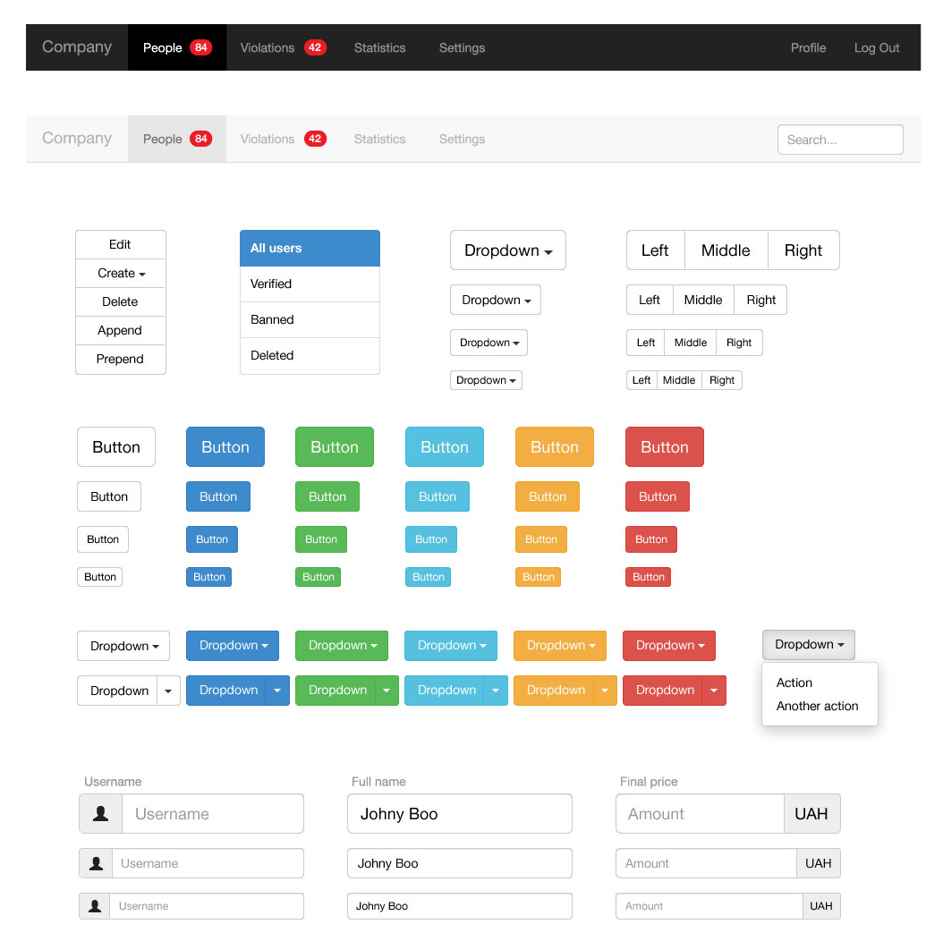
Why Use Bootstrap?
Reason #1: UI Kit
Familiarize yourself with the UI features it offers via the documentation.
Once Bootstrap is active, you can simply copy snippets from the documentation to save yourself major time of creating elements yourself.

Slide 17
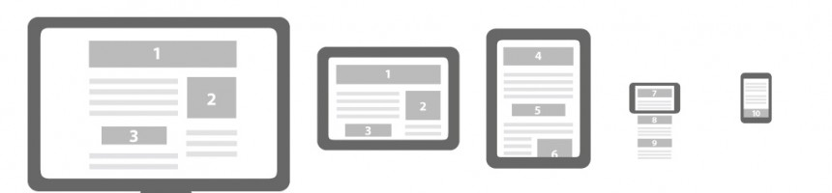
Why Use Bootstrap?
Reason #2: Mobile Responsiveness
One of the most compelling reasons to use Bootstrap is the default mobile-responsive quality it provides.
This means that your website will look “good” automatically when viewed on screens ranging from monitors to tablets to phones.

Slide 18
> YOUR TURN!!
Warmup Activity:
As a repeat of last class, quickly create an HTML webpage.
Then add in a Bootstrap component of your choosing.
Hint: Copy the Bootstrap CSS link. Then copy the code from any Bootstrap element or CSS.

Slide 19
Next Phase Bootstrap
Last class, we focused on Bootstrap Components (like buttons and tables).
Today we’ll be focused on using Bootstrap to build layouts.

Slide 20
Sketching / Grid Layouts

Slide 21

Take a Huge Breath…

Slide 22

FOCUS!
Because in our opinion, these next two sections are some of the
MOST IMPORTANT ONES
in the ENTIRE program.
Facebook surf at your own peril (and to the peril of the galaxy)

Slide 23
FOCUS!
Relax. That doesn’t mean its hard.

Slide 24
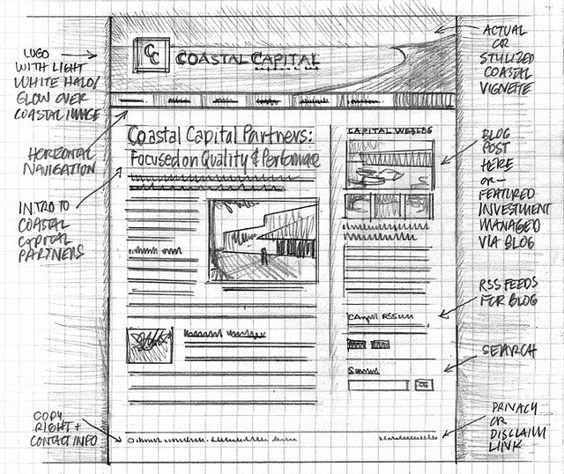
Importance of Sketches
Because every aspect of a site’s “look” is defined by HTML/CSS – it is crucial to have a detailed sketch going in.
Pay particular attention to the location of navigation bars, titles, headers, content, images, footers etc.
When imagining alignments, in particular, be mindful of the grid

Slide 25
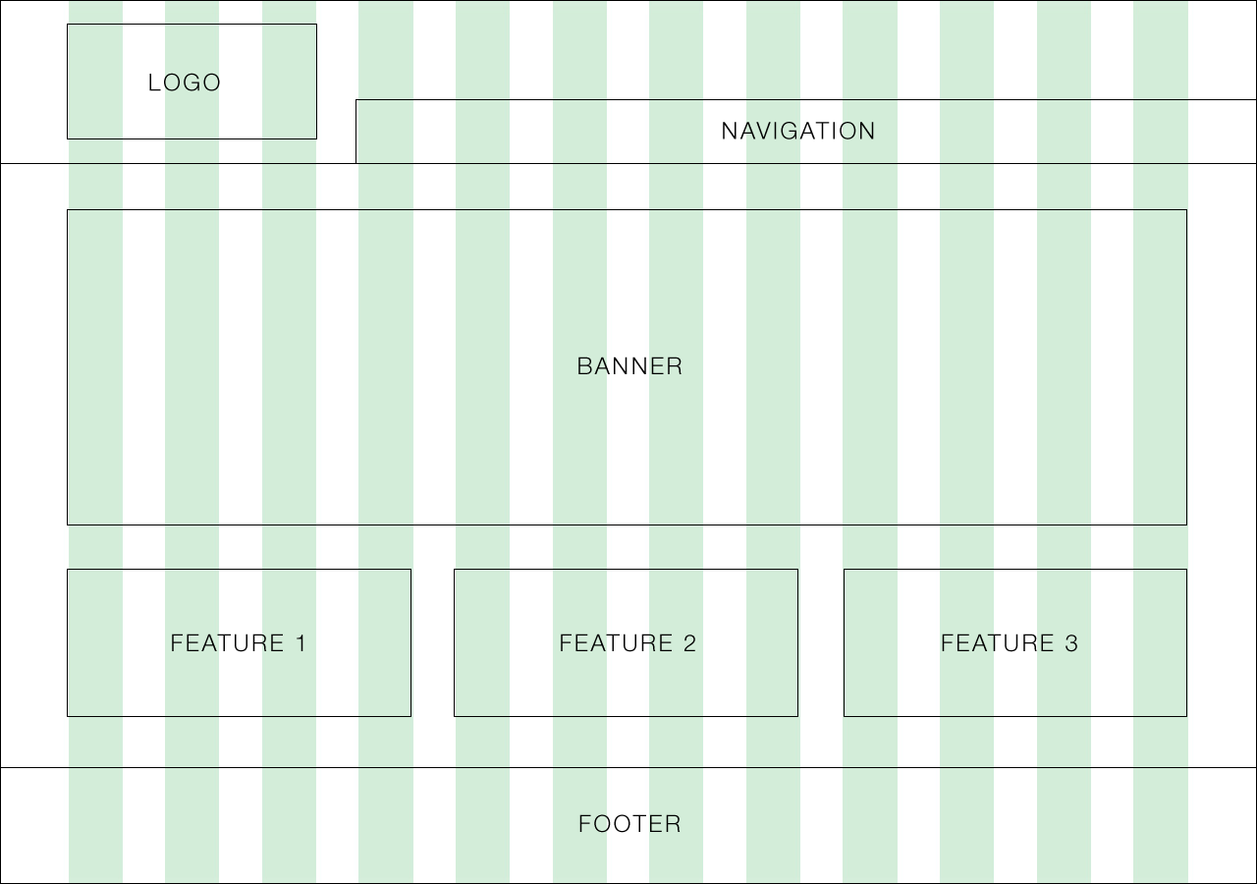
Designing with a Grid in Mind
Grids serve to align elements aesthetically.

Slide 26
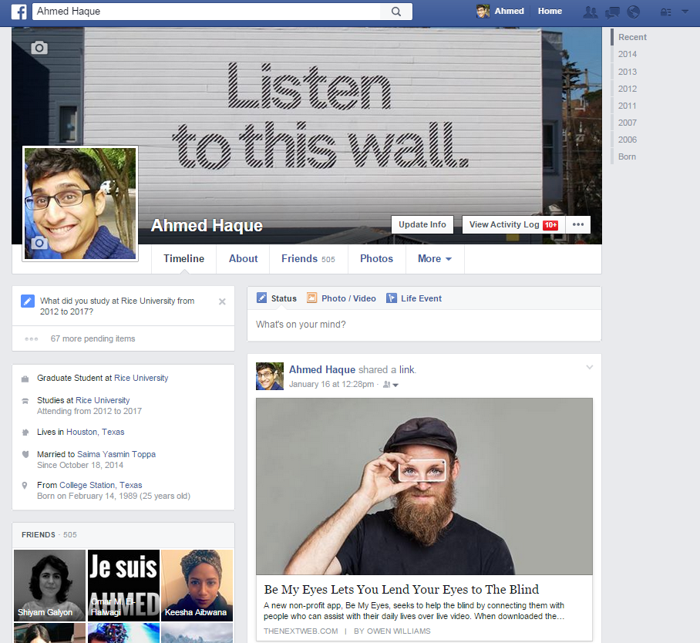
Facebook’s Grid
Facebook is a perfect example of a website where the “grid-layout” is obvious.
Grids make it easy to have content (text, images, and regions) align aesthetically.

Slide 27
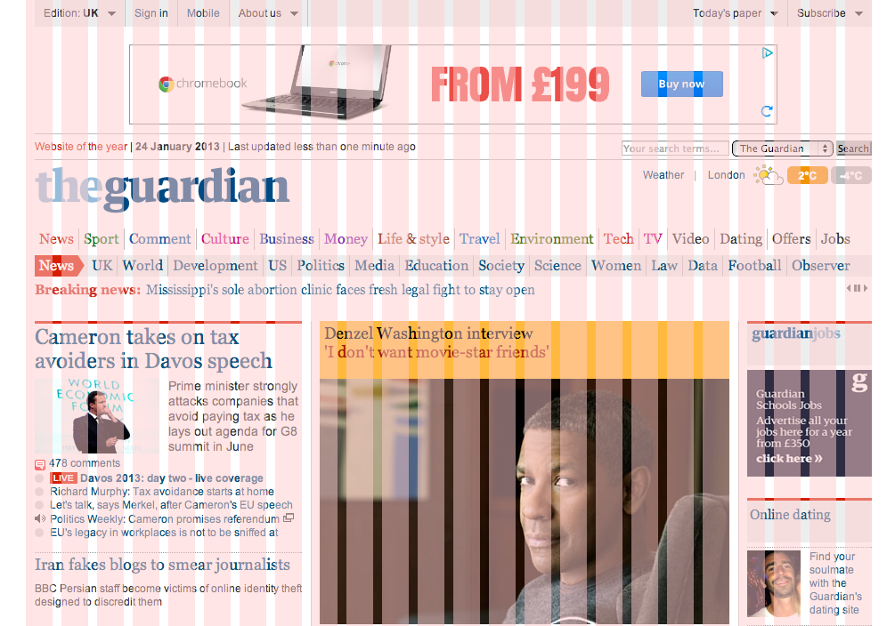
A More Complex Grid…

Slide 28
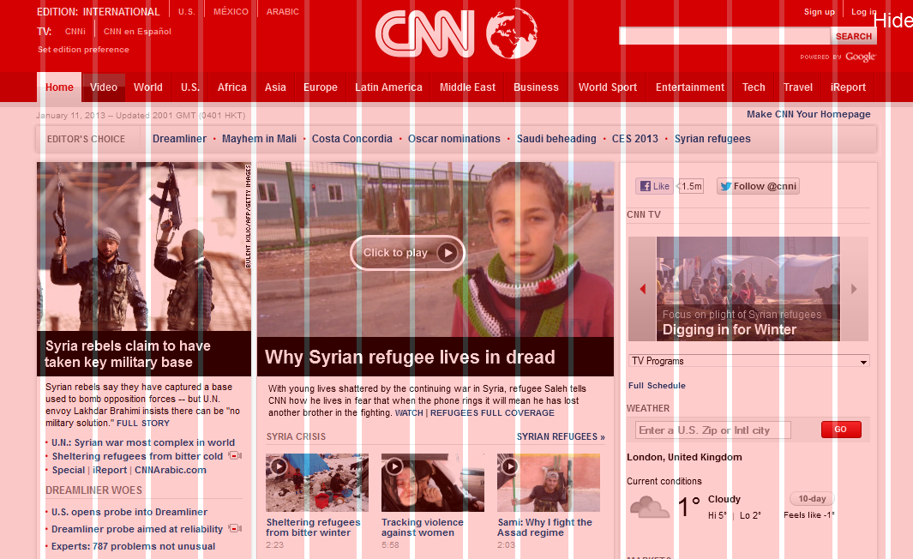
A More Complex Grid…

Slide 29
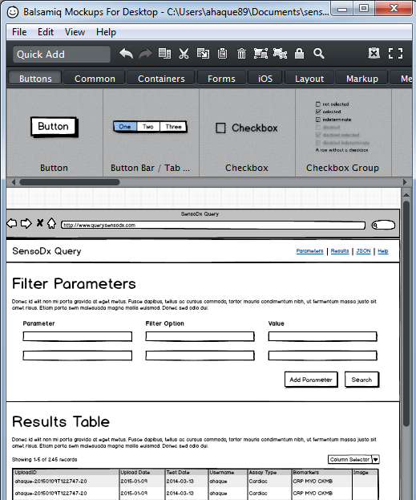
Tools for Sketch / Grid Creation
Wireframing Tools:
Balsamiq***: https://balsamiq.com/
Framebox: http://framebox.org/
Pen and Paper: Your notebook
Grids for Photoshop / Illustrator:
960 GS: http://960.gs/
GuideGuide: http://framebox.org/
Designing with Grids Guides:
960 Grid System Made Easy: http://bit.ly/1sjYaFC
Design by Grid: http://www.designbygrid.com/
Designing with Grid-Based Approach: http://bit.ly/1CM4Hzo

Slide 30
Rows and Columns
Workshop

Slide 31
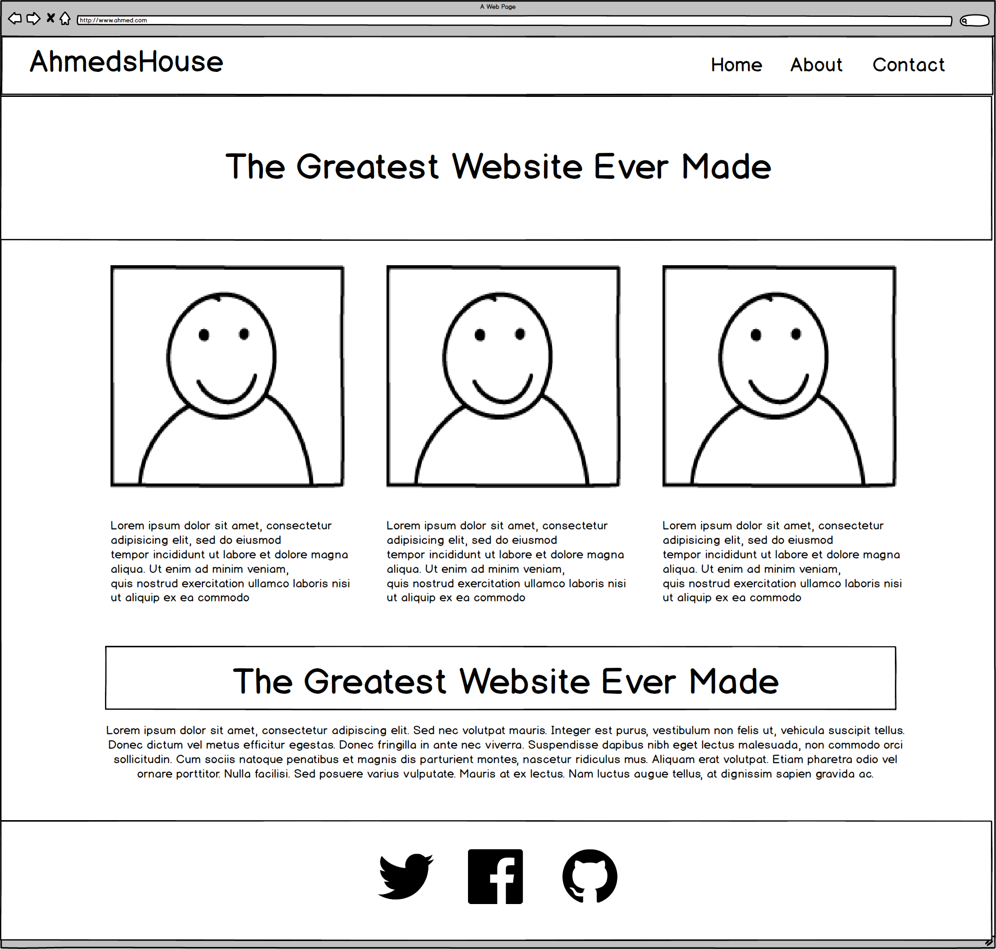
Web Design Fundamentally = Wireframes

Slide 32
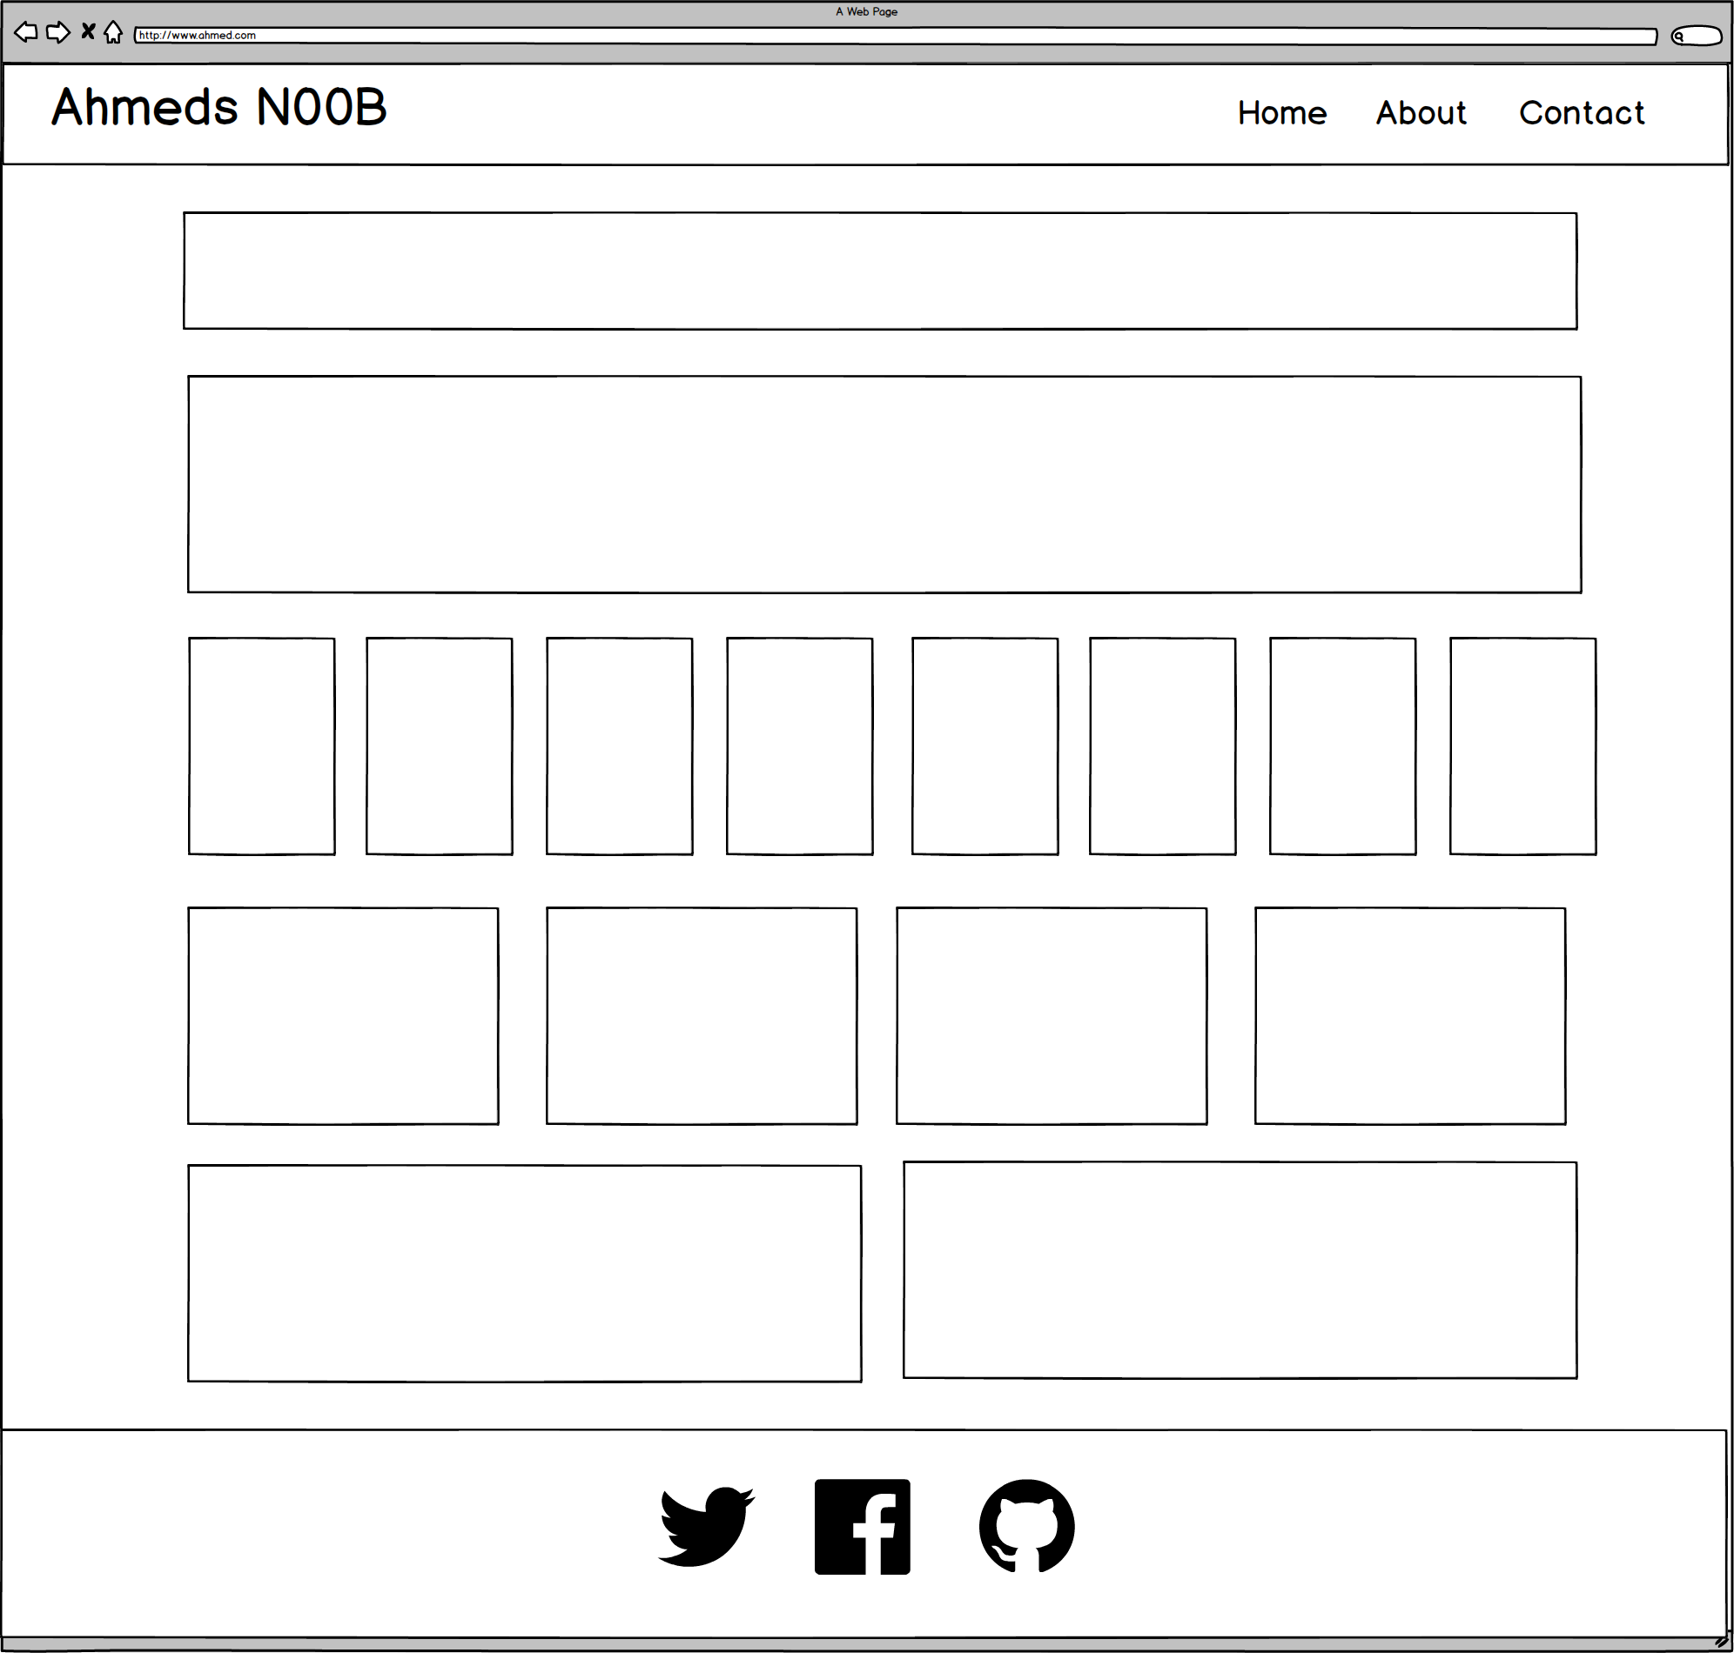
Notes:
7:00 – 7:05

Slide 33
ROWS
1
1
1
1
1
6 Total
1
Notes:
7:00 – 7:05

Slide 34
COLUMNS
1
1
8
4
2
1
Total Not relevant
Notes:
7:00 – 7:05

Slide 35
You Try!
Notes:
7:00 – 7:05

Slide 36
Level Up!
Now, let’s make it more challenging…

Slide 37
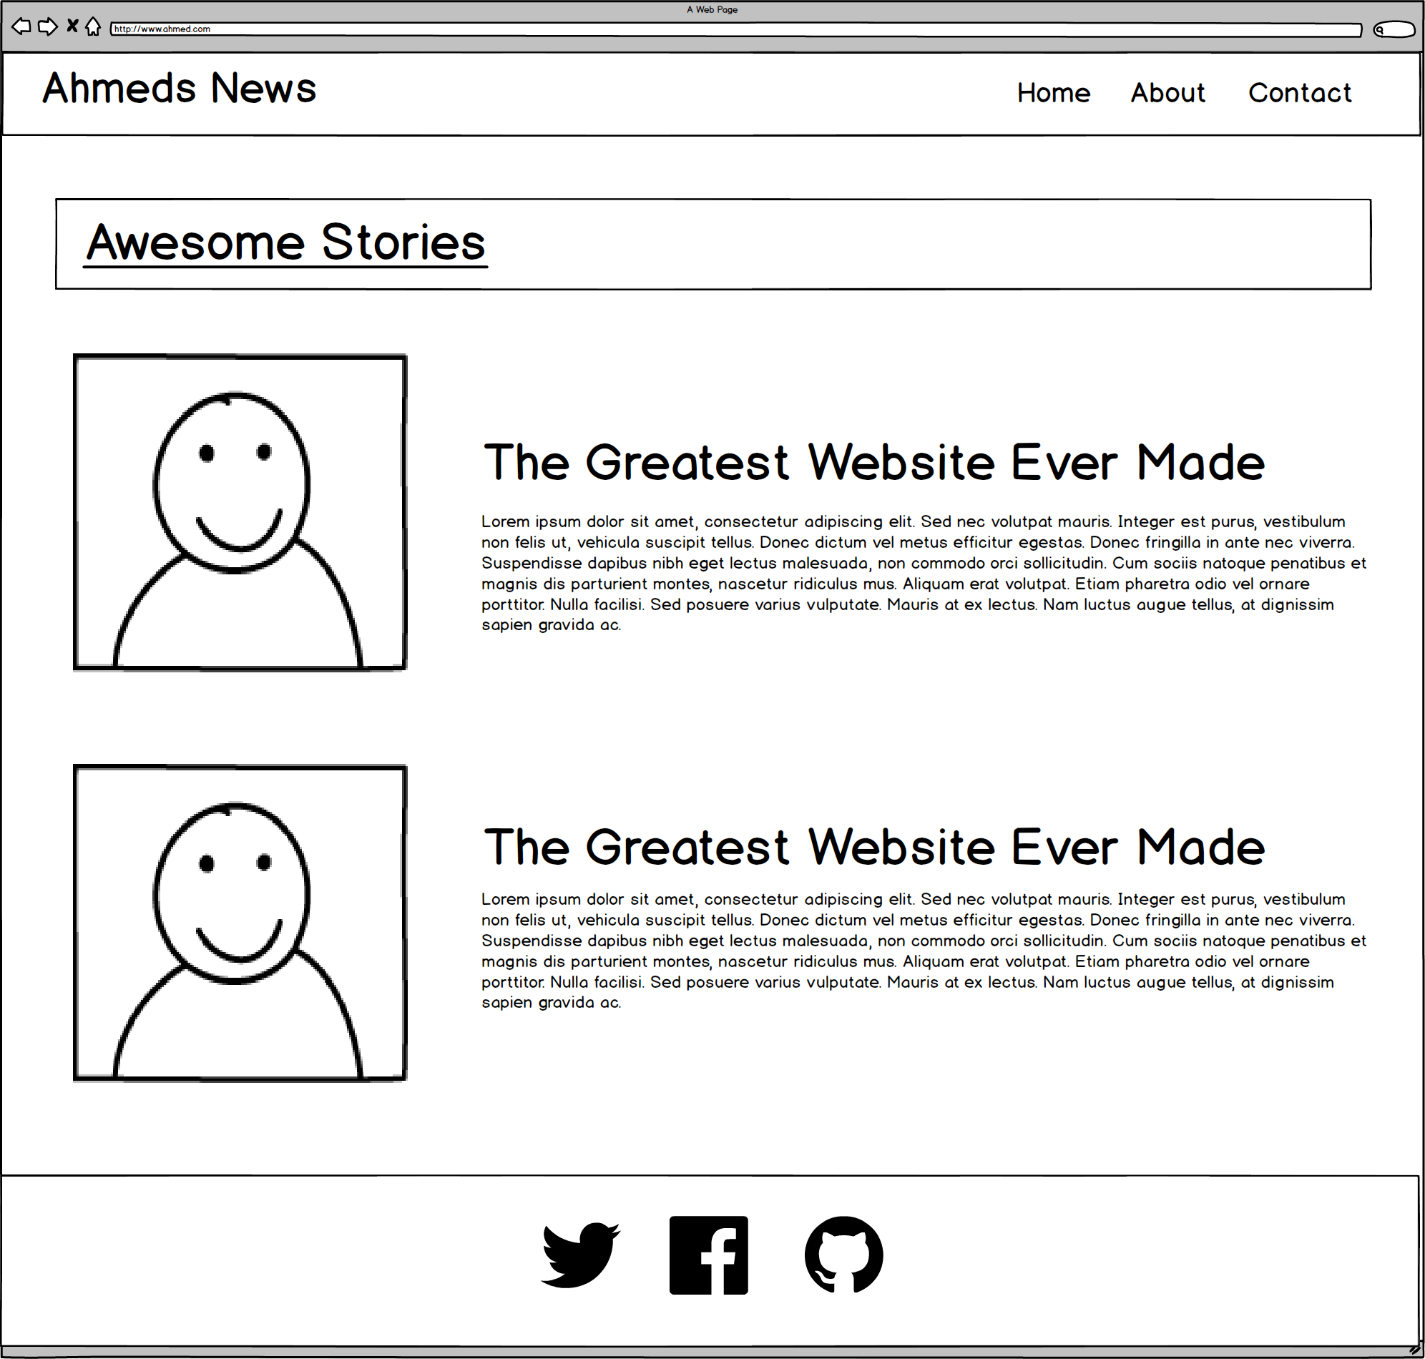
Notes:
7:00 – 7:05

Slide 38
ROWS
1
1
1
4
Total
1
Notes:
7:00 – 7:05

Slide 39
COLUMNS
1
2
2
1
Total Not relevant
Notes:
7:00 – 7:05

Slide 40
Level Up!
Now for another…

Slide 41
Notes:
7:00 – 7:05

Slide 42
ROWS
1
1***
1
4
Total
1
Notes:
7:00 – 7:05

Slide 43
COLUMNS
1
3
1
1
Total Not relevant
Notes:
7:00 – 7:05

Slide 44
You Try!
Notes:
7:00 – 7:05

Slide 45
Level Up!
This final one is tricky…

Slide 46
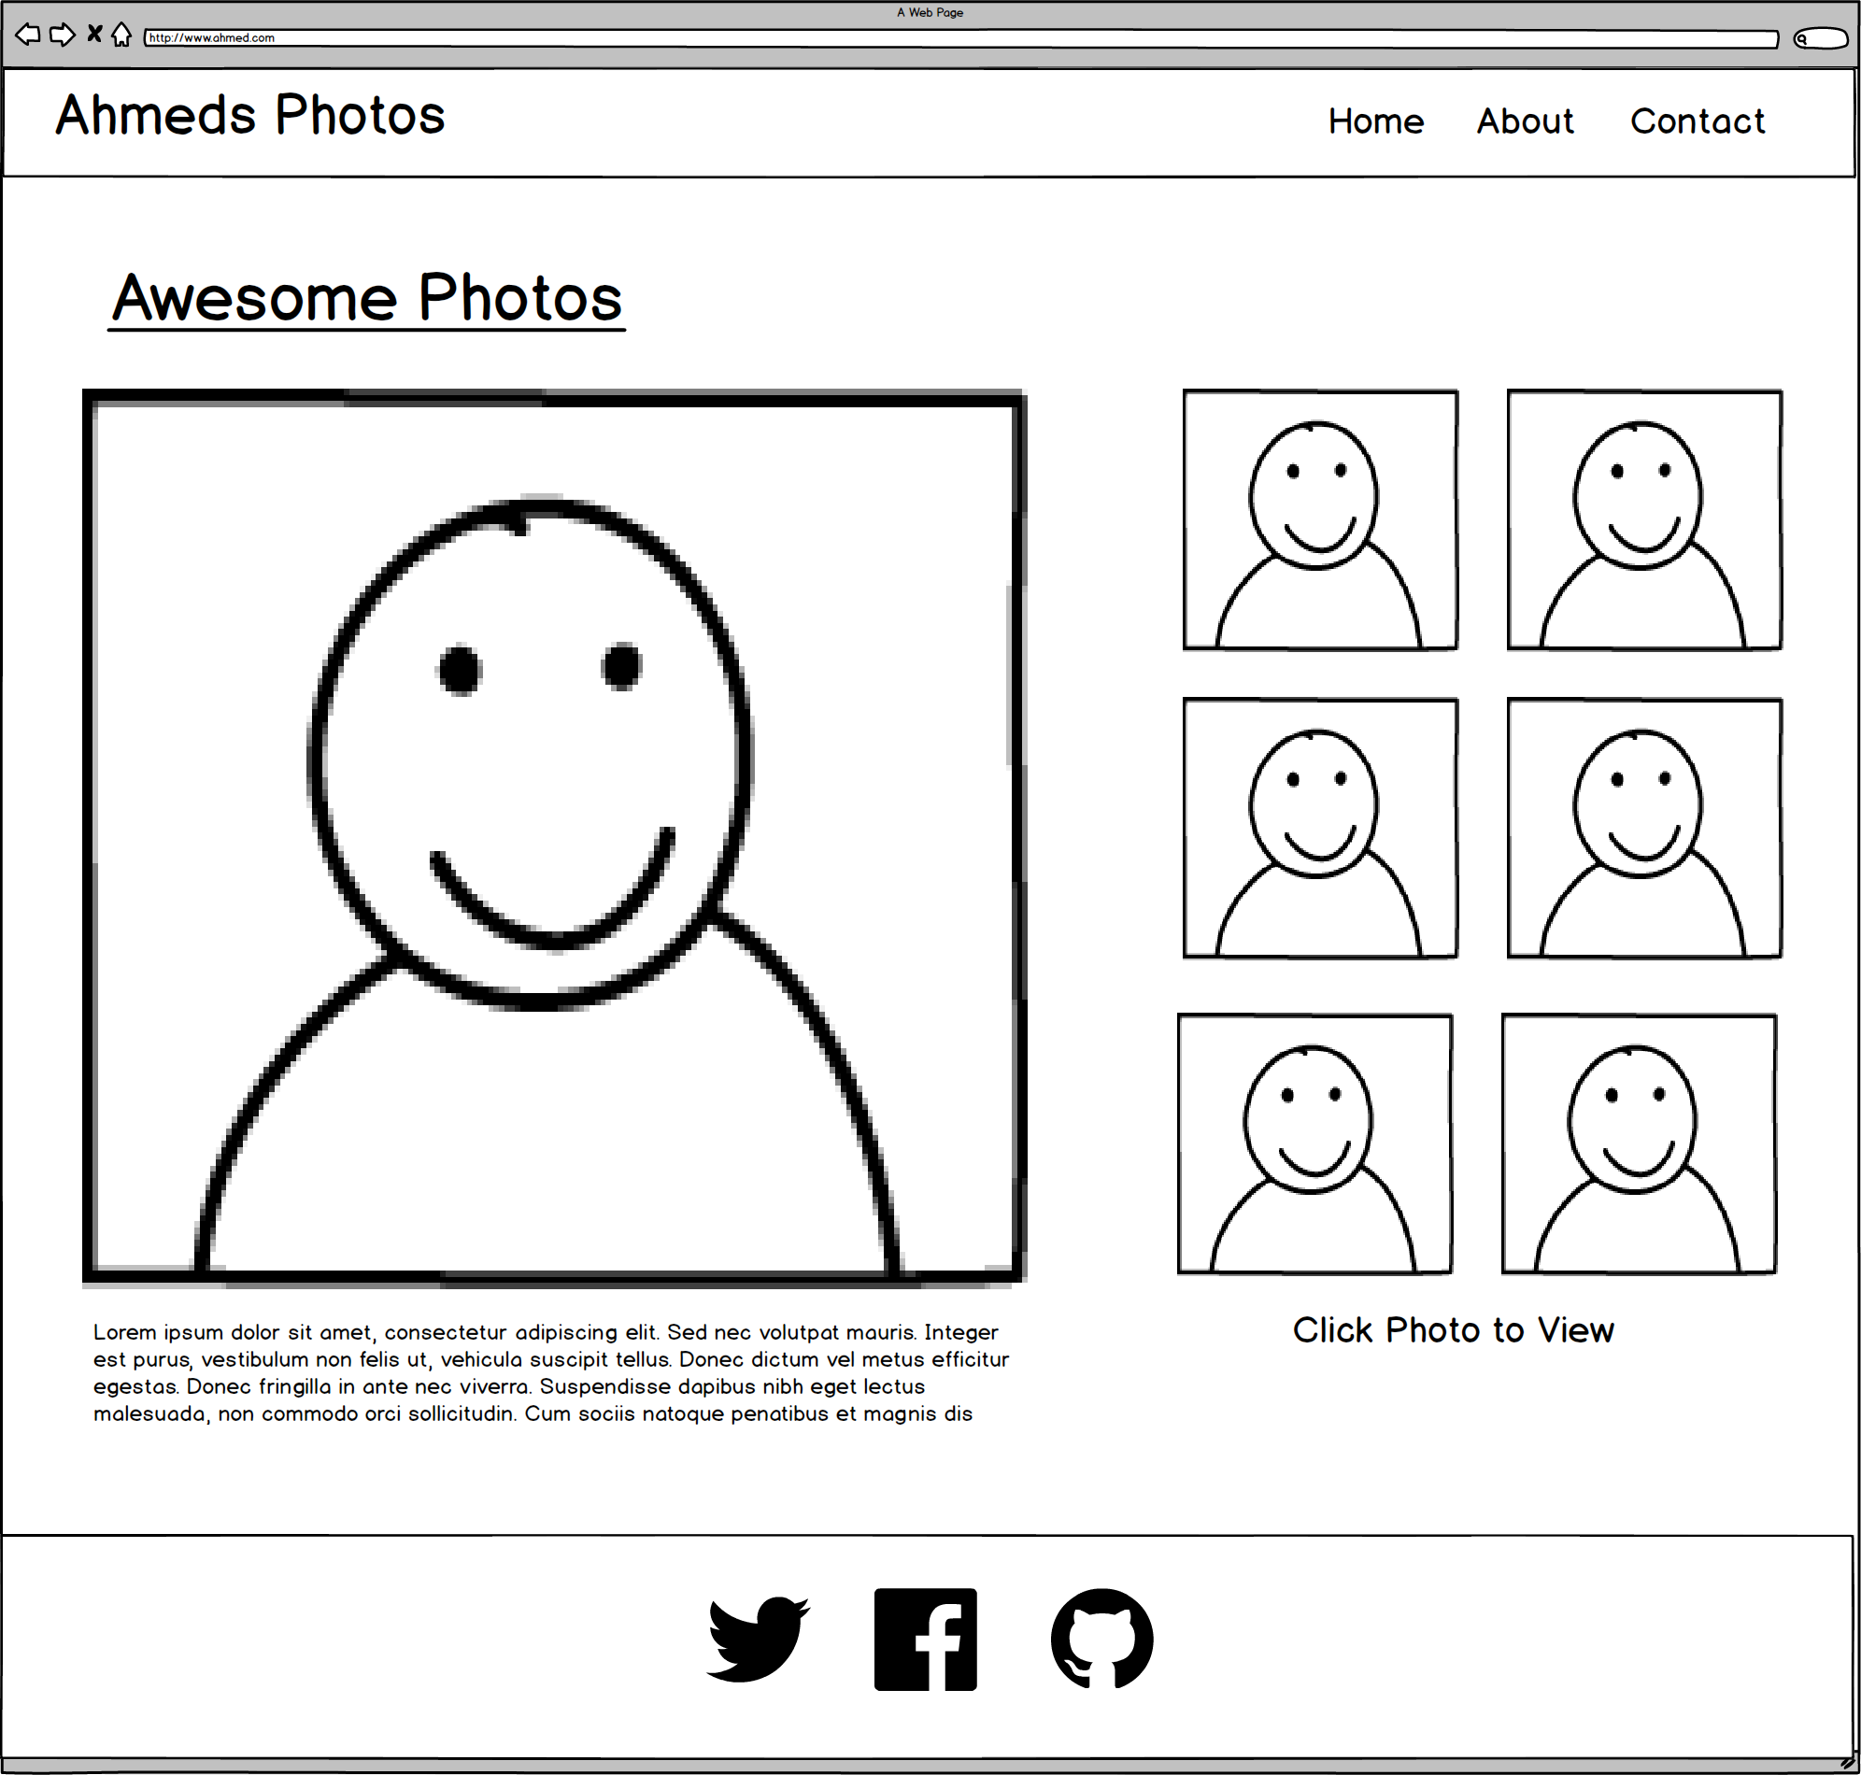
Notes:
7:00 – 7:05

Slide 47
Level Up!
Didn’t quite work right?
For this one we need sub-rows and sub-columns

Slide 48
ROWS
1
1***
1***
4
Total
1
Notes:
7:00 – 7:05

Slide 49
COLUMNS
1
2
1
Total Not relevant
Notes:
7:00 – 7:05

Slide 50
SUB-
ROWS
1
1
1
1
4
Total
Notes:
7:00 – 7:05

Slide 51
SUB-
COLUMNS
2
1
Notes:
7:00 – 7:05

Slide 52
You Try!
Notes:
7:00 – 7:05

Slide 53

Notes:
7:00 – 7:05

Slide 54
Grid Design with Bootstrap

Slide 55

More Genius Time!
Warning!
This is a fairly “tricky”… but VERY IMPORTANT topic.
Time to channel that inner genius.

Slide 57
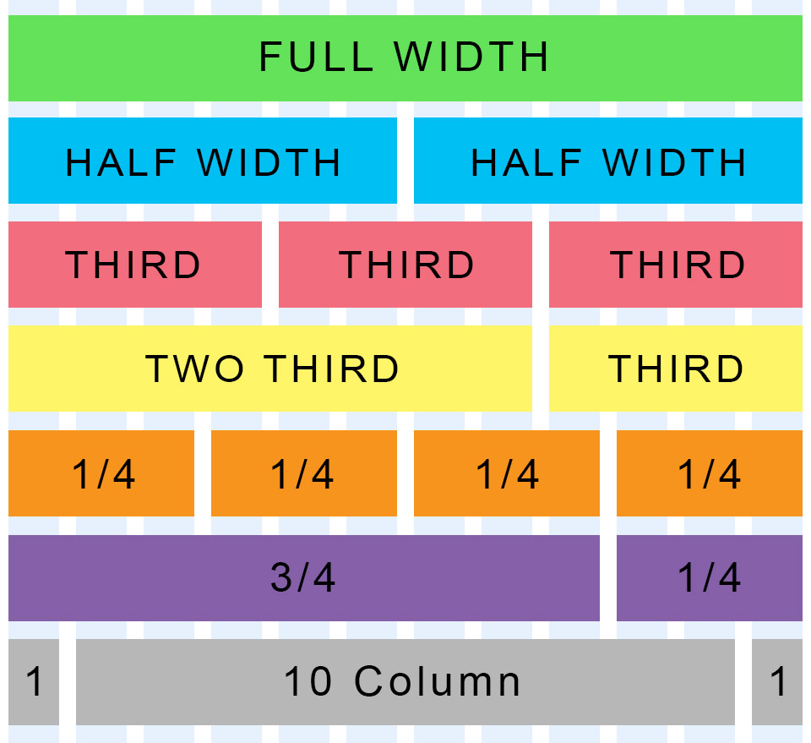
Bootstrap Grid
Bootstrap lets you organize content based on the “number of columns” a div spans – out of a total 12 columns.
Example:
<div class="col-md-12">
(Spans full width)
<div class="col-md-4">
(Spans 1/3 of full width)

Slide 58
Bootstrap Grids
Every Bootstrap Grid is made up of…
  containers - which wrap around the entire grid
  rows - which are defined first and are just rows
  columns - which are defined within rows and specify the columns. The sum total of all columns within a row must add up to 12.
Each of these elements is implemented by creating a div with a specific class name.

Slide 59
Defining Columns
Container
Row #1
Column#1
Column#2
Column#3
Column#4

Slide 60
> YOUR TURN!!
Quick Activity:
Turn to your neighbors and explain to one another:
The relationship between containers, rows, and columns. (Draw it on a piece of paper for them)
The syntax for each.
The specific syntax details for columns.

Slide 61
Coding Grids

Slide 62
INSTRUCTOR DEMO!
Instructor: Demo
(quickgrid.html | 13-InstructorGrids)

Slide 63
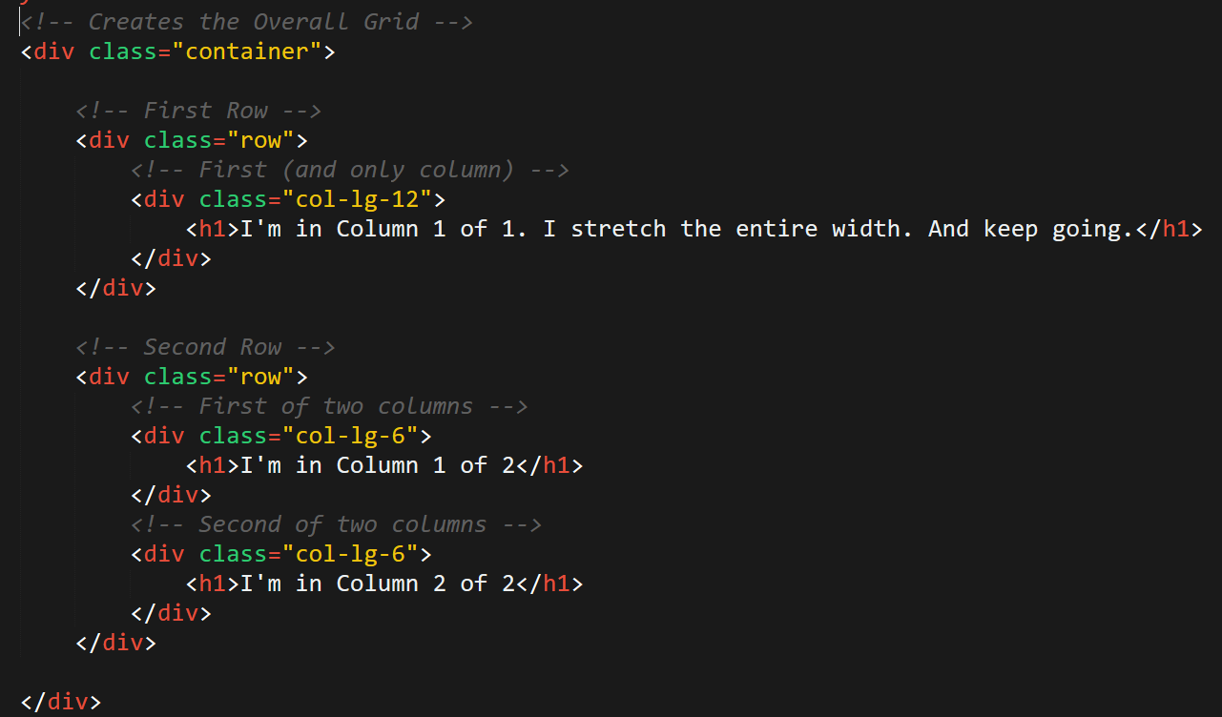
Bootstrap Grid
Note the rows, columns (col-lg-6), and containers

Slide 64
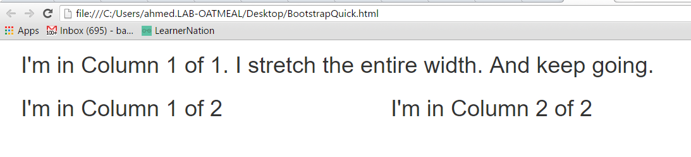
Bootstrap Grid
Note the rows, columns (col-lg-6), and containers

Slide 65
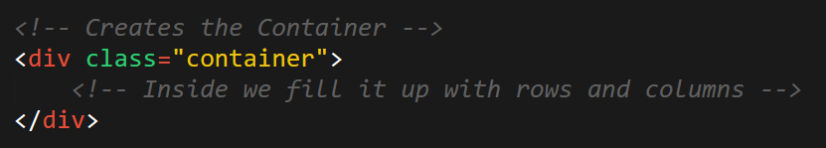
Defining Containers
“Containers” are like the box that the entire grid sits inside.

Slide 66
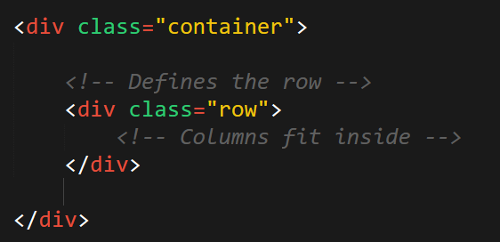
Defining Rows
“Rows” are like the rows we talked about earlier.

Slide 67
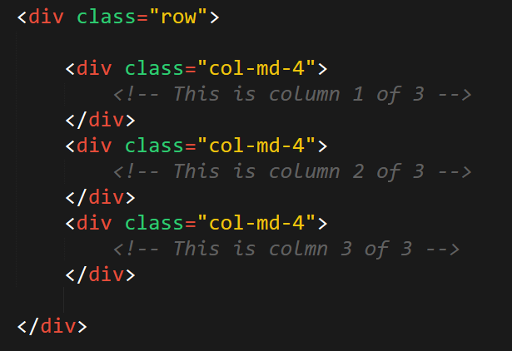
Defining Columns
“Columns” fit inside of rows. Note the syntax: col-sz-#
Col = column
sz = viewing size (in this case: medium)
# = number of “columns taken” out of 12. (in this case 4 of 12)

Slide 68
> YOUR TURN!!
Activity:
Using Bootstrap, create a layout that looks like the one shown on the next screen.
Spend some time prior to coding to draw out the grid layout
Count the number of rows and columns
Then use the bootstrap grid syntax to code it out.
Slack a screenshot of your page when you are done.
Ipsum Generator: http://www.lipsum.com/

Slide 69
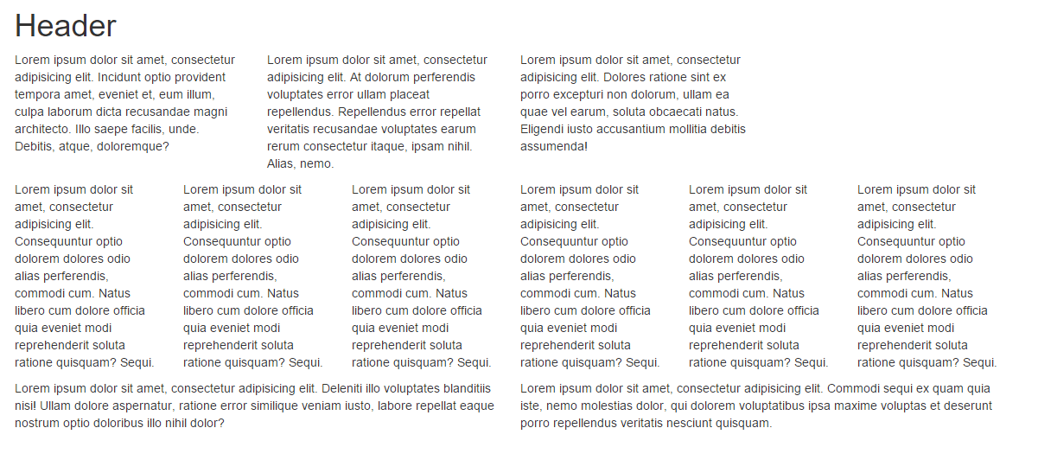
> YOUR TURN!!

Slide 70
Building Bootstrap Layouts

Slide 71
INSTRUCTOR DEMO!
Instructor: Demo
(InClass-DemoLayout.html | 15-InstructorLayout)

Slide 72
> YOUR TURN!!
Activity:
Working in pairs and using Bootstrap make the following design.
Be sure to note the:
Grid Layout
Navbar
Sidebar panel
Thumbnail
Additional details will be sent to you via slack.

Slide 73
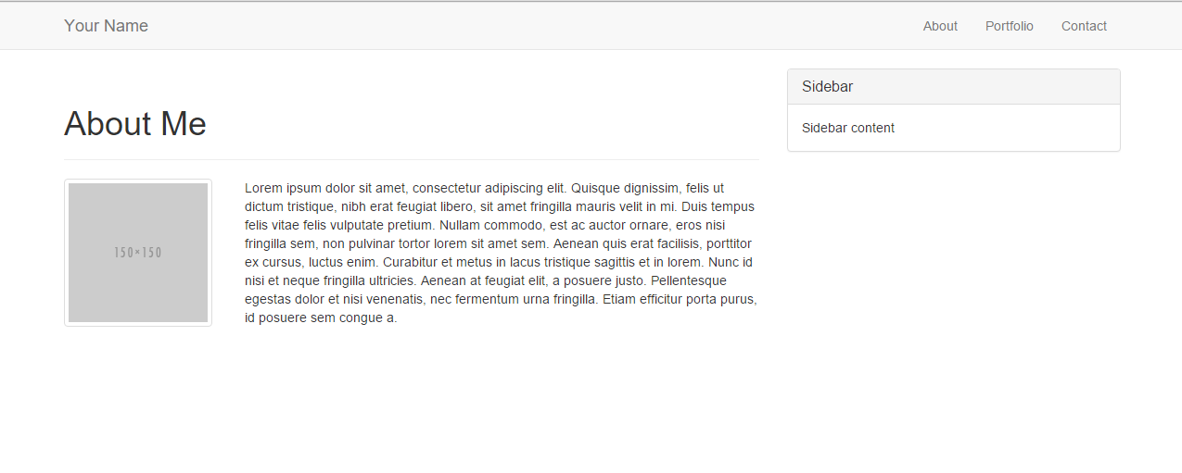
> YOUR TURN!!

Slide 74
Common Questions
Can I reverse the order (i.e. rows inside columns)?
Not usually. Columns should go inside of rows. Though, you can create sub-rows inside of columns. But those columns would still need to be inside of a row of their own.
Can I just avoid having a container?
You could… But it will mess things up. Just throw in a container.
What if I have columns that go past 12?
Then your bootstrap grid won’t behave as expected. Don’t go past 12.
What if I don’t add up to 12?
Nothing. You will have empty space at the end. But be careful, because the next column you add in this row will fill up the empty space (sometimes without your intention).

Slide 76
Mobile Responsive (HW)

Slide 77

Still No Facebook Time
Warning!
This next section matters a lot for your homework

Slide 78
Media Queries
Media Queries define how CSS styles are applied in relation to the characteristics of the device viewport.
Through media queries we can change the way a web page is displayed based on width, height, orientation, and even media type (screen, paper, braille, etc).
Bootstrap extensively uses media queries under the hood to help you create mobile responsive websites.
But remember! Media queries must be declared last.

Slide 79
INSTRUCTOR DEMO!
Instructor: Demo
(17-InstructorMedia)

Slide 80
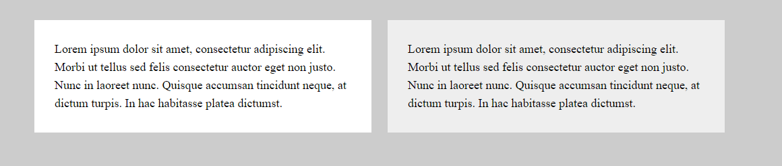
Quick Demo

Slide 81
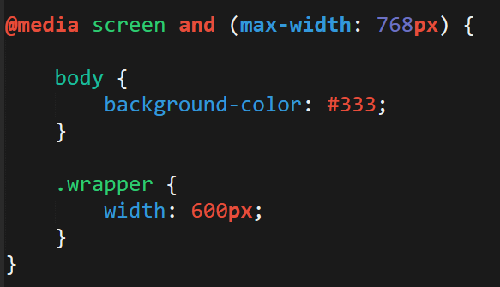
> YOUR TURN!!
Activity:
Explain to your partner what the following CSS code does:

Slide 82
> YOUR TURN!!
Activity:
Build your own mobile responsive HTML /CSS page using media queries.
Just follow the steps sent to you via Slack.

Slide 83
Viewport
Viewport refers to the display being used to view the website.
By default, mobile devices with small screen, high resolution viewports may render content at a typical desktop screen ratio (scaled down at the smaller screen size).
We can specify that a web page should scale its content to the width of its current viewport using a `meta` tag.

Slide 84
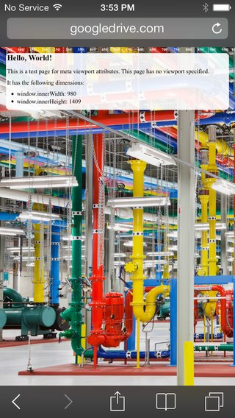
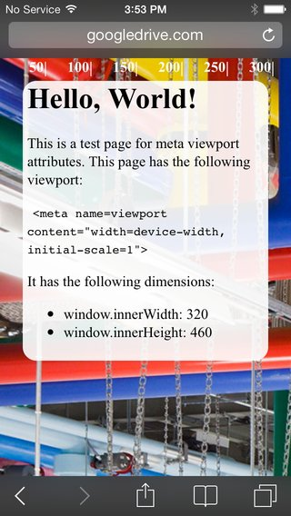
Viewport
No Viewport Content Scaling
Yes Viewport Content Scaling

Slide 85

Viewport Inclusion
Just include this line in the head
And then include a variety of @media queries for various sized screens.

Slide 86
> YOUR TURN!!
Activity:
Spend the next few moments on the site viewportemulator.com and visit your favorite websites using various viewports.
Notice how the sites change display wise.

Slide 87


Slide 88
Questions?

Slide 89
Extra Challenge
Time Permitting

Slide 90
> YOUR TURN!!
Activity:
With those around you (and using Bootstrap CSS), create a complex layout of your own.
You can use the layout provided to you as a guide, starting point, inspiration, or not at all.

Slide 91
