Slide 1
The Joys of JavaScript
Unit 3.1

Slide 2
Admin Items

Slide 3
Homework #2 – Questions?
Two parts to the assignment
Take existing Portfolio and apply Media Queries and Viewport to make mobile responsive.
Use Bootstrap CSS to recreate the portfolio you built in HW1. Your Bootstrap solution should minimize use of media queries.

Slide 4
Today’s Class!

Slide 5
Objectives
In today’s class we’ll be introducing:
JavaScript Definitions
JavaScript Basics:
  Variables
  Logging, Alerting, Prompting
  Arrays
  If/Else Statements

Slide 6
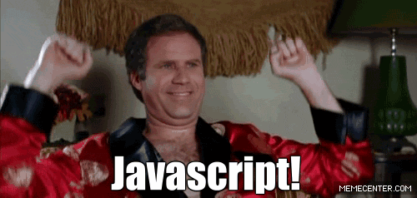
OMG JavaScript!
Prepare to become true coders.

Slide 7
How to Learn JavaScript

Slide 8
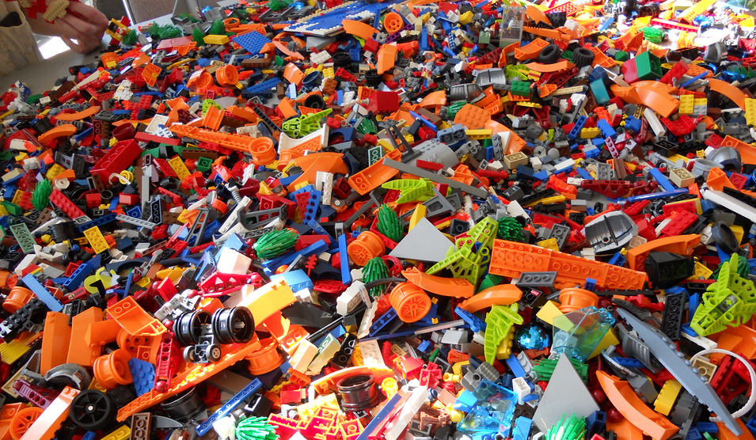
Your Brain on JavaScript…

Slide 9
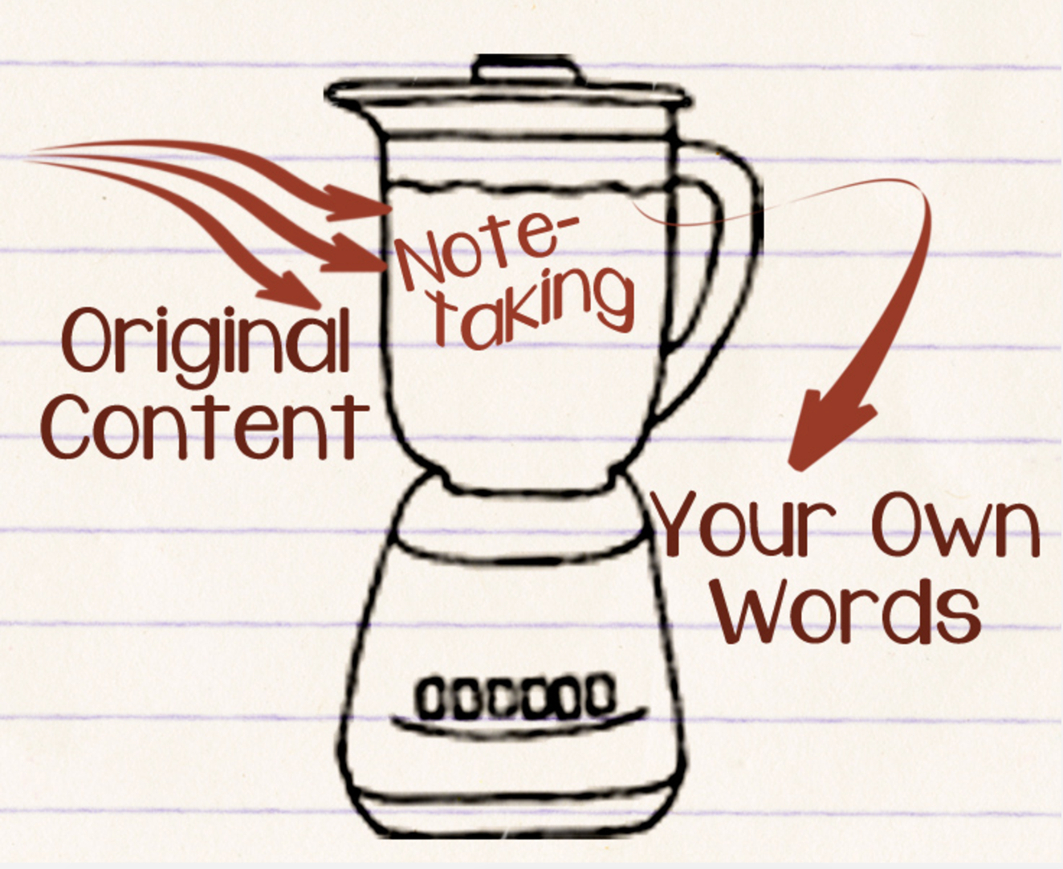
Time to Take Notes…

Slide 10
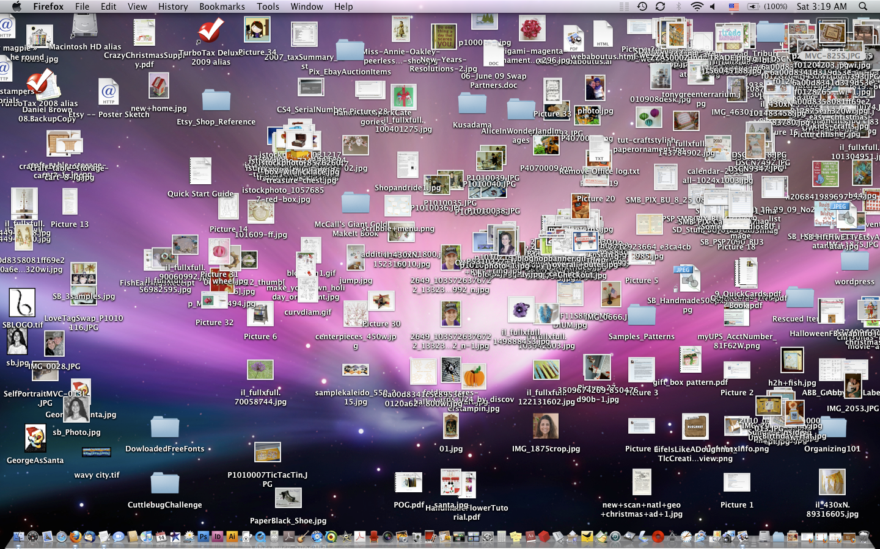
And Keep Organized!!!

Slide 11
Overall Tips
Review Immediately: We’ll be building upon these concepts quickly. The firmer your grasp now, the better off you’ll be.
Re-do the exercises in class: Don’t just re-read! Actually spend the time to re-do them from scratch on your own.
Get Help: Come to office hours. Ask conceptual questions. Ask specific questions. Just keep asking questions!
Don’t be Afraid: You will get this. It will take time, but you will get this. Just keep at it. Patience will pay off.

Slide 12
Warmup Activity

Slide 13
> YOUR TURN!!
Code Dissection:
Download the file sent to you via slack.
Open it in Chrome and observe what happens.
With a partner, try to explain how the code connects to the events that happen on the page.
p.s. We haven’t covered JavaScript before, but a big part of being a developer is learning on the fly!
MAJOR p.s. When downloading any code going forward, be sure to hit “Download”. If you copy and paste directly from Slack, your code will not work!

Slide 14
What is JavaScript?

Slide 15

JavaScript Definitions
JavaScript is the third of the three fundamental programming languages of the modern web (along with HTML, CSS).
JavaScript allows developers to create dynamic web applications capable of taking in user inputs, changing what’s displayed to users, animating elements, and much more.

Slide 16
Variables

Slide 17
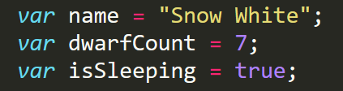
Basic Variables
Variables are the nouns of programming.
They are “things” (Numbers, Strings, Booleans, etc.).
They are composed of variable names and values.

Slide 18
INSTRUCTOR DEMO!
Variable Assignment

Slide 19
Demo Time
Instructor: Demo
(BasicVariablesDemo | 02-BasicVariablesDemo)

Slide 20
Basic Variables (Syntax)
Var Keyword
Variable name
Assignment
Value
Termination
var
name
=
“Snow White”
;

Slide 21
Basic Variables (Syntax)
Var Keyword
Variable name
Assignment
Value
Termination
var
name
=
“Snow White”
;
Be sure to notice the quotes (“”),
which convey that Snow White is a string.

Slide 22
> YOUR TURN!!
Code Creation:
Using the instructions in the file sent to you, fill in the missing JavaScript code to create variables.
When you are done, open the file in Chrome and check the output.
If you successfully completed the activity, you should see a series of pop-up windows with text inside.
Finally, look at the rest of the code and try to figure out why the text displayed the way it did.

Slide 23
Logs, Prints, Alerts

Slide 24
Demo Time
Instructor: Demo
(ConsoleDemoInstructor.html | 04-ConsoleLogDemo)

Slide 25
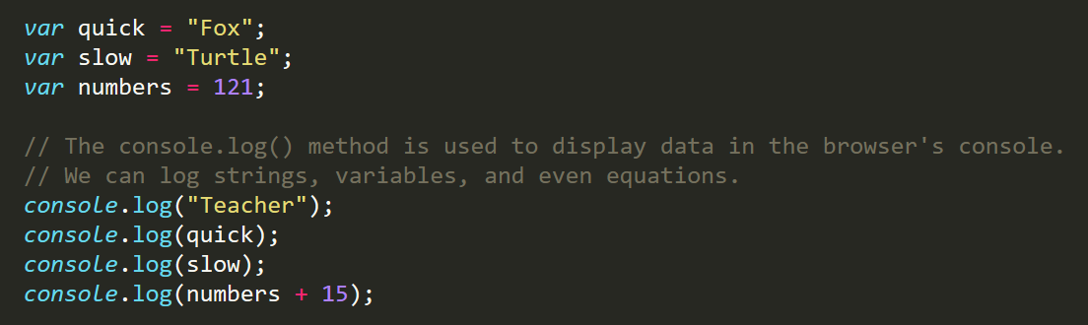
Console.log
console.log is a quick expression used to print content to the debugger.
It is a very useful tool to use during development and debugging.

Slide 26
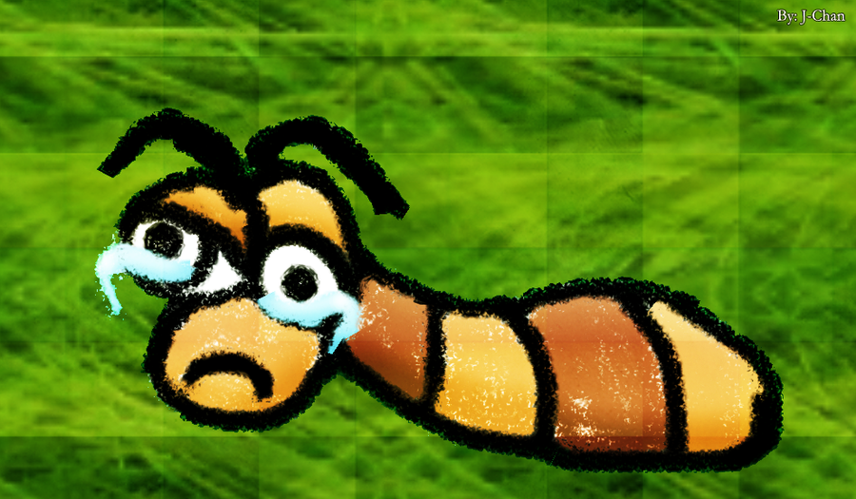
Sad Little Bug…
Hey Class!
How do you comfort a JavaScript bug?

Slide 27

Sad Little Bug…
Hey Class!
How do you comfort a JavaScript bug?
You “console” it.

Slide 28
Sad Little Bug…
Don’t worry!
It was a hilarious joke… that will make sense in a few weeks.

Slide 29
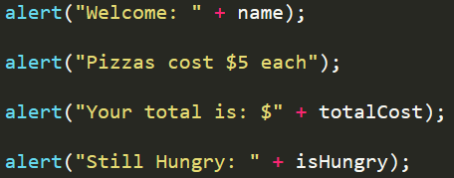
> YOUR TURN!!
Code Creation:
Using the file sent to you as a guide, modify the code so that is uses console.log instead of alerts to display messages.
Then open the file in the browser and open up chrome Developer tools -> Console to confirm the changes worked.
With a partner, discuss the different between using console.log and alert.

Slide 30
INSTRUCTOR DEMO!
Alerts, Prompts, Confirms

Slide 31
Demo Time
Instructor: Demo
(PromptDemo.html | 06-PromptDemo)

Slide 32
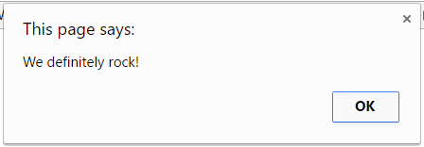
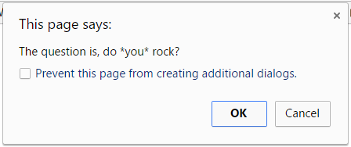
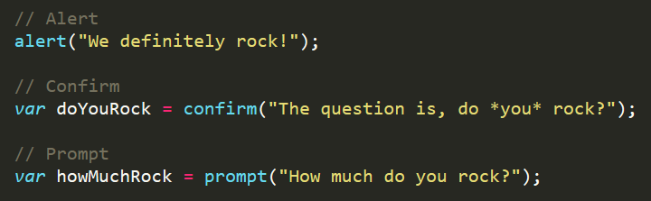
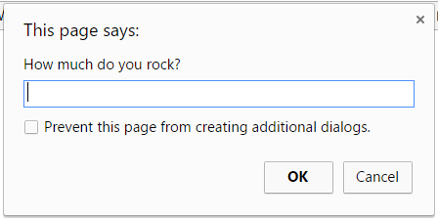
Alerts, Prompts, Confirms
Alerts, Confirms, and Prompts will create a popup box in the browser when run.
These are also useful for development and debugging.

Slide 33
> YOUR TURN!!
Code Creation:
Write JavaScript code that does the following:
Using a confirm, ask the user: “Do you like _____?” and store their response in a variable.
Using a prompt, ask the user: “What kind of _____? do you like?” and store their response in a variable.
Alert both variables to the screen.

Slide 34
Document Write

Slide 35
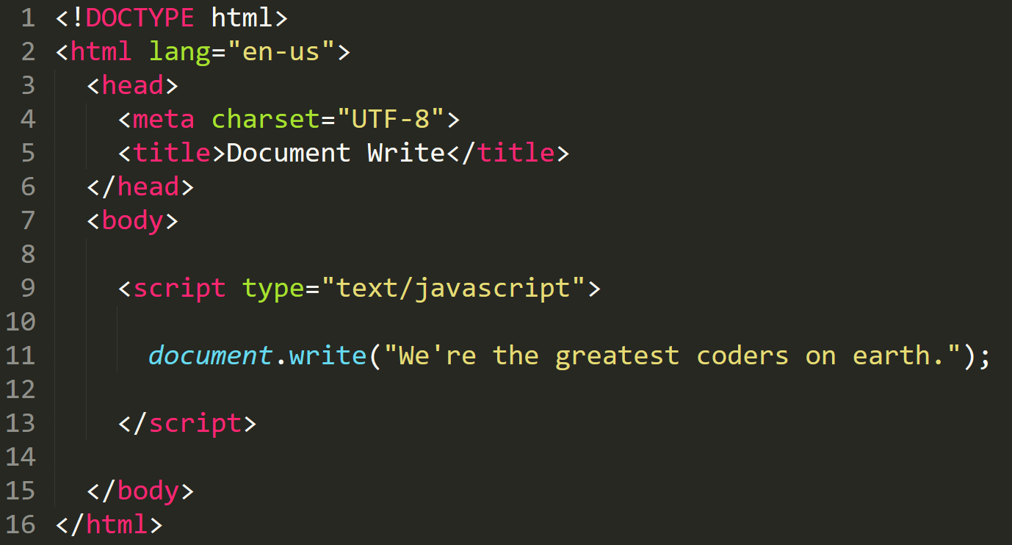

Writing to HTML
We can also use JavaScript to directly write to the HTML page itself using document.write( ).
Later we will go over much more advanced approaches for writing HTML using JavaScript and jQuery.
Test.html (chrome)
Test.html
(sublime)

Slide 36
If/Else Statements

Slide 37
Demo Time
Instructor: Demo
(conditionaldemo.html | 08-ConditionalDemo)

Slide 38
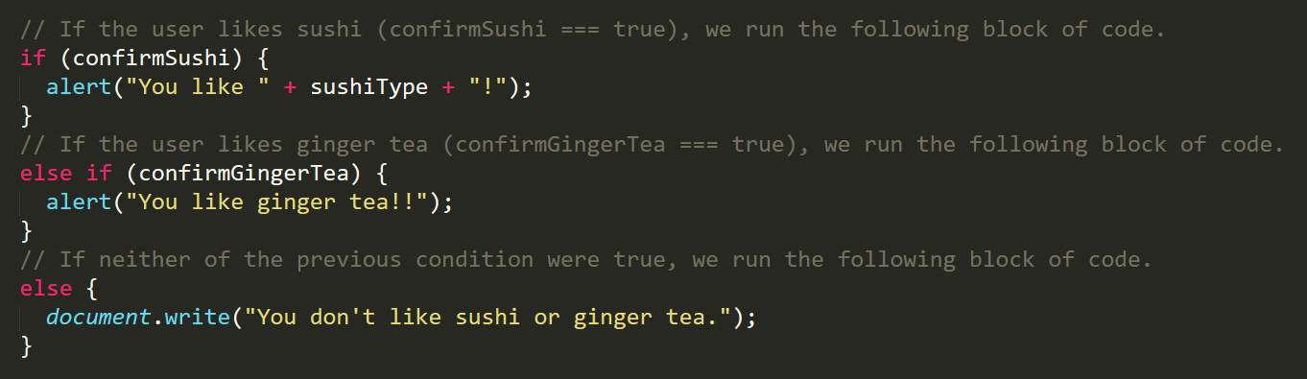
If/Else Statements
If/Else statements are critical.
Each statement is composed of an if, else-if, or else (keyword), a condition, and the resulting code in { } curly brackets.

Slide 39
> YOUR TURN!!
Code Creation:
Create a website (from scratch) that asks users if they eat steak.
If they respond with “yes”, write the following to the page: “Here’s a Steak Sandwich!”.
If they respond with “no”, write the following to the page: “Here’s a Tofu Stir-Fry!”.
Bonus: Ask what the user’s birth year is. If they are under 21, alert the following: “No Sake for you!”
Hint: You will need to use document.write( ) from the last activity.

Slide 40
> YOUR TURN!!
Code Dissection:
Open the file sent to you in Sublime.
With a partner, go through and predict what the result of each “conditional” statement will be (i.e. will the “if” or the “else” be triggered).
Then run the program to check if you are right. Note any that you got wrong and ask about it in class.

Slide 41
Arrays

Slide 42
The Zoo Pen
Array Name: zooAnimals
Zebra
Rhino
Giraffe
Owl
Index 0
Index 1
Index 2
Index 3

Slide 43
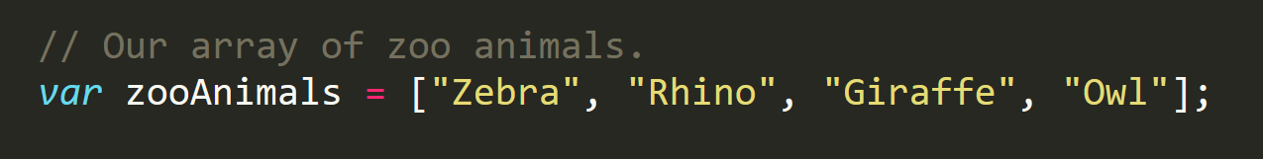
The Zoo Pen… Coded
Array Name: zooAnimals
Zebra
Rhino
Giraffe
Owl
Index 0
Index 1
Index 2
Index 3
Coded in JavaScript using an Array

Slide 44
INSTRUCTOR DEMO!
Arrays

Slide 45
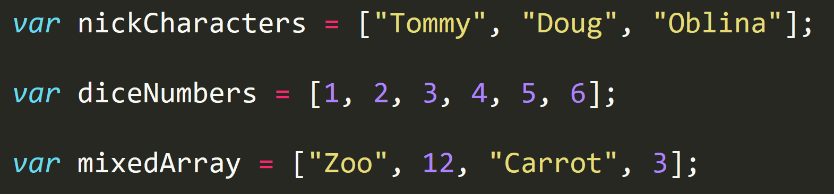
Basic Arrays
Arrays a type of variable that are collections.
These collections can be made up of strings, numbers, Booleans, other arrays, objects, anything.
Each element of the array is marked by an index. Indexes always start with 0.

Slide 46
Demo Time
Instructor: Demo
(ArraysDemo.html | 11-ArraysDemo)

Slide 47
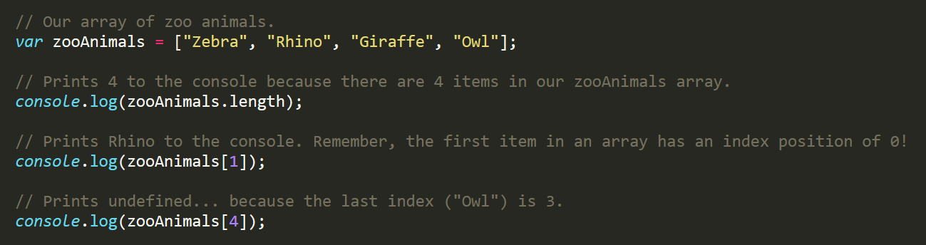
Basic Arrays Indices
To recover the value at any specific index you include the name of the array with a square bracket [ ] and inside the bracket is the element’s index.
You can easily grab the number of elements in the array using the method array.length.

Slide 48
> YOUR TURN!!
Class Code Dissection:
With a partner, take a few moments to look over the following code.
Above each console.log() write a comment “predicting” what you think the output will be.

Slide 49
Homework #3

Slide 50
Questions?

Slide 51
Challenge Activity?

Slide 52
> YOUR TURN!!
Code Creation (Challenge):
Create a website that accomplishes the following:
  Create an array of your favorite bands.
  With a prompt, ask the user’s favorite band.
  If it’s one of your favorites, alert: “YEAH I LOVE THEM!”.
  If it’s not, alert: “Nah. They’re pretty lame.”.
  Hint: You will need to research how to use .indexOf()
  Hint: You will need to research how to use .toLowerCase()

Slide 53
> YOUR TURN!!
Code Dissection (Re-examined, Time-permitting):
Re-examine the file sent to you at the start of class.
See if you can better understand how it works – after having gone through today’s class.

