Slide 1
Masters of MongoDB

Slide 2
Project Recap

Slide 3
Project Recap
Awesome Job
(Y’all don’t need memes anymore. You are professionals now.)

Slide 4

Just Kidding.

Slide 5
The Clear Positives
(++) You stayed ambitious
(++) You made smart decisions feature-wise
(++) You demonstrated technical mastery
(++) You learned a ton of learning on your own
(++) You closed-out
(++) You dominated
(++) You didn’t make excuses even when you had them.

Slide 6
Ahmed’s Advice For Next Time
Always Start with Guns Blazing
The first 30 seconds always count. Always come ready to impress. Show a demo. Say something interesting.
Practice, Practice, Practice
The difference between good speakers and weak ones is in the execution of minor details. Don’t get lost in transitions. Don’t get lost looking for your code.
Don’t be afraid to take charge
Learn to start being confident. Chime in when you can. Look for ways to lead in the groups you find yourself in.

Slide 7
Next Steps
Gif your GitHub Readme:
Back-end projects like the ones you completed are harder to “see” for a recruiter. Throw in a Gif that flips through all the screens of your project. There are plenty of ways to record a video and convert it to Gif. This will look really impressive.
Create a Guest Login:
Have a “dummy” Guest login to enter your application. Make it easily apparent on your readme.
Write a Tutorial:
Pitch a tutorial to scotch.io if you used any unusual libraries. You will get $$$ and you will build credibility.

Slide 8
Next Steps
List your Niche Skills on LinkedIn:
All of you should be listing out Node, Express, SQL, Data Visualization, etc. on your Linkedin Pages.
List your Project on LinkedIn:
If you don’t have a lot of tech experience on LinkedIn milk the project you created for all it’s worth – especially if it was really good.
Consider Writing each Other Recommendations:
I will remind you about this later as well… but consider writing recommendations for your group members and peers. Right now, you all are “students”, but you won’t be for long. Spread the credit!

Slide 9
Road Ahead…

Slide 10





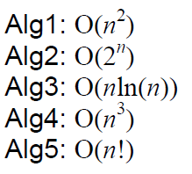
The Road Ahead…
Your Castle of Knowledge
Your Final Journey

Slide 11
Double Down
It’s time to double-down and make sure you have a strong foundation.
You have access to myself and the TAs for 2 months.
Look through the code base. Identify your weaknesses.
Schedule a help session during office hours.
And put in the hard hours!
This is the absolute best time to learn this material.

Slide 12
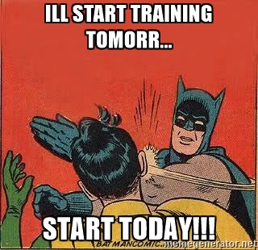
Start Now.
Because let’s be real.
You aren’t going to start when you graduate.

Slide 13
Your Goals – Beginning of the Year
“To land a solid career.. and be able to support a family.”
“Hope to make something of myself one day…”
“An opportunity to be more creative in my day-to-day work.”
“…to get a better paying job.”
“I want nothing more in the entire world than to be a game designer.”
“Change careers and become a web developer.”
“…to build mastery. To learn a skill that I haven’t yet explored.”
“[a chapter] better than the last.”

Slide 14

For Reference…
Students who tend to be doing well in our classes are putting in an average of 17 hours per week.

Slide 15
MongoDB

Slide 16

What’s MongoDB?
MongoDB is a very popular noSQL Database
It uses a document-oriented model as opposed to a table-based relational model (SQL)
MongoDB stores data in BSON Format (effectively compressed JSONs)
MongoDB has tons of drivers and packages for connecting to Node, C++, Java, etc.

Slide 17
Relational Databases (SQL)
ID | Title | Author | Published
1 | The History of Blah | Blah Matic | 2010
2 | The Chronicles of Blahrnia | Sir Blahston | 2011
3 | Love in the Time of Blah | Gabriel Garcia Blah | 2013
SQL relies on Joins to combine relevant data
Author | Email | Phone Number
Blah Matic | blahston@gmail.com | 911-546-5454
Sir Blahston | blahby@gmail.com | 911-544-5112
Gabriel Garcia Blah | blahby231@gmail.com | 125-215-5645

Slide 18
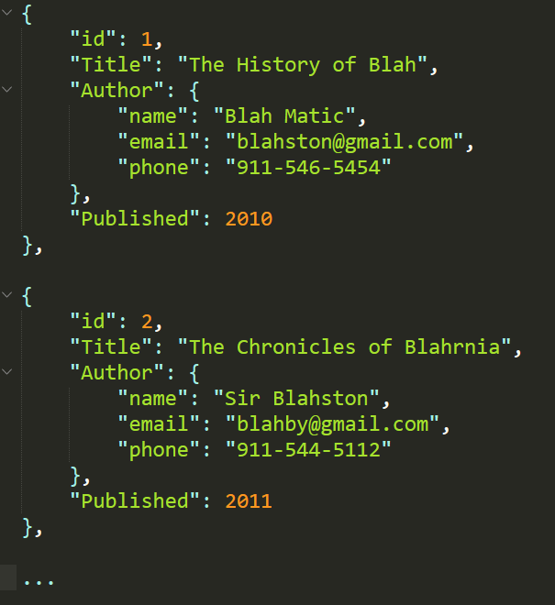
Document Database (noSQL)
noSQL Databases on the other hand are effectively JSONs.
They excel at heterogeneous data formats and are easy to implement.

Slide 19
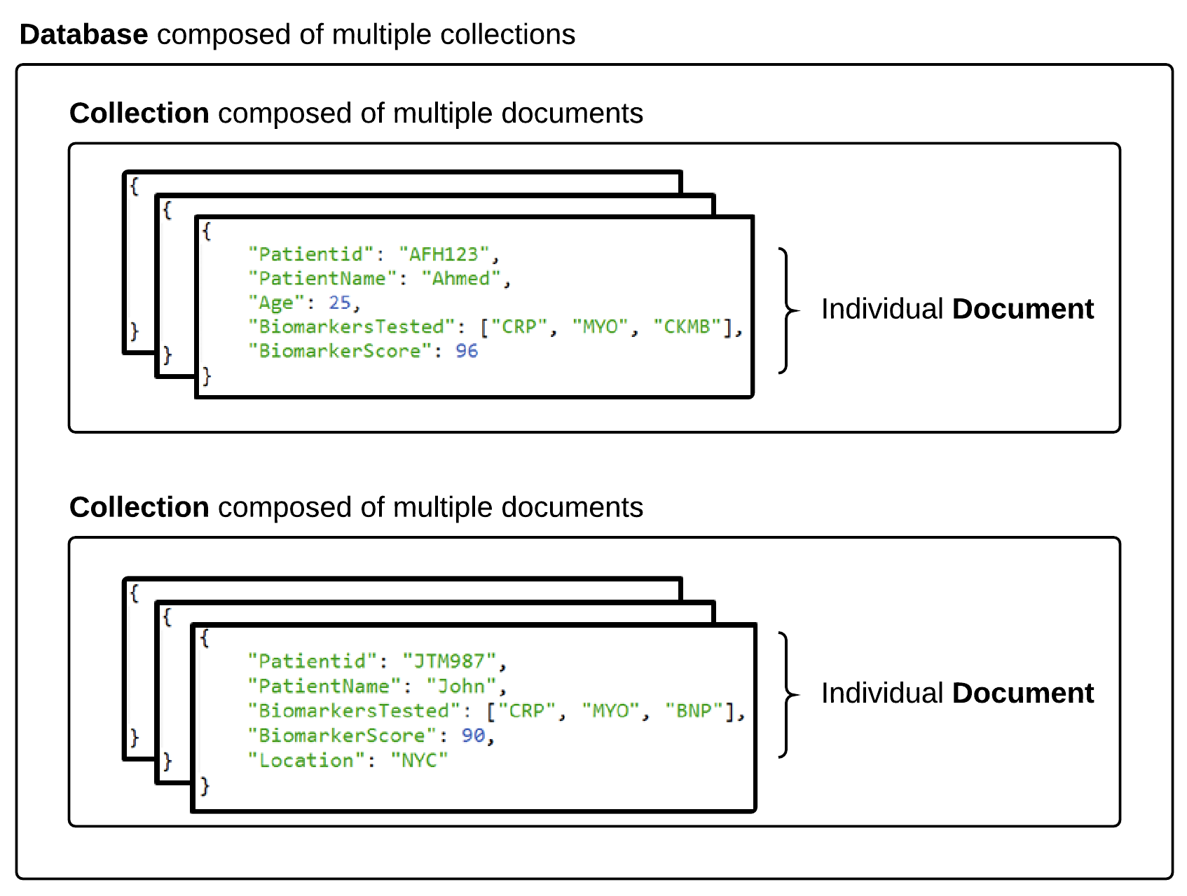

MongoDB Storage

Slide 20
MongoDB Storage
SQL Term | noSQL Term
Database | Database
Table | Collection
Row | Document
Column | Field
Terms are slightly different in the noSQL context.
Take note!

Slide 21
> YOUR TURN!!
Quick Activity:
Work with your neighbors to research the following
What are the advantages of using a noSQL database like MongoDB according to the MongoDB Website?
What are the advantages of using a noSQL database like MongoDB according to the web (places like Quora)?
What are the disadvantages of using a noSQL database like MongoDB according to the web (places like Quora)?

Slide 22

Learn to See Through the..
The tech world is filled with it.

Slide 23
Code Time!

