Slide 1
{Saturday}
ned
dot
Single Value Objects
where DDD and Functional Programming share forces
Saturday 28th May 2022

Slide 2




------------------------------ about me ----
Corniel Nobel
Energetic, optimistic, creative, out of the box thinking, front runner
20+ years experience
.NET, domain-driven design, code quality, static code analysis, machine learning
github.com/corniel
linkedin.com/in/corniel-nobel
corniel@gmail.com

Slide 3

Craftsmanship

Slide 4
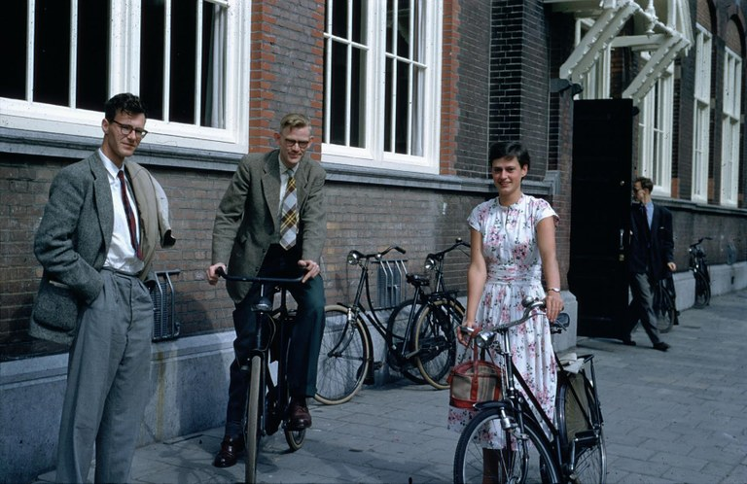
“
Simplicity is prerequisite for reliability.
~ Edsger W. Dijkstra ~

Slide 5

Telling a story

Slide 6
Telling a story
using
Single Value Objects

Slide 7

----- single value object -
Equal by value (by definition)

Slide 8
----- single value object -
Equal by value
Immutable (by consequence)

Slide 9
----- single value object -
Equal by value
Immutable
Valid (no rubbish)

Slide 10
----- single value object -
Equal by value
Immutable
Valid
It should be tiny (Scalar/primitive)*

Slide 11
----- single value object -
Equal by value
Immutable
Valid
It should be tiny
Encapsulated (don’t share internals)*

Slide 12

“
Encapsulation is important, but the reason why it is important is more important. Encapsulation helps us reason about our code. In well-encapsulated code, there are fewer paths to follow as you try to understand it. It isn’t an end in itself; it is a tool for understanding.
~ Michael C. Feathers ~

Slide 13
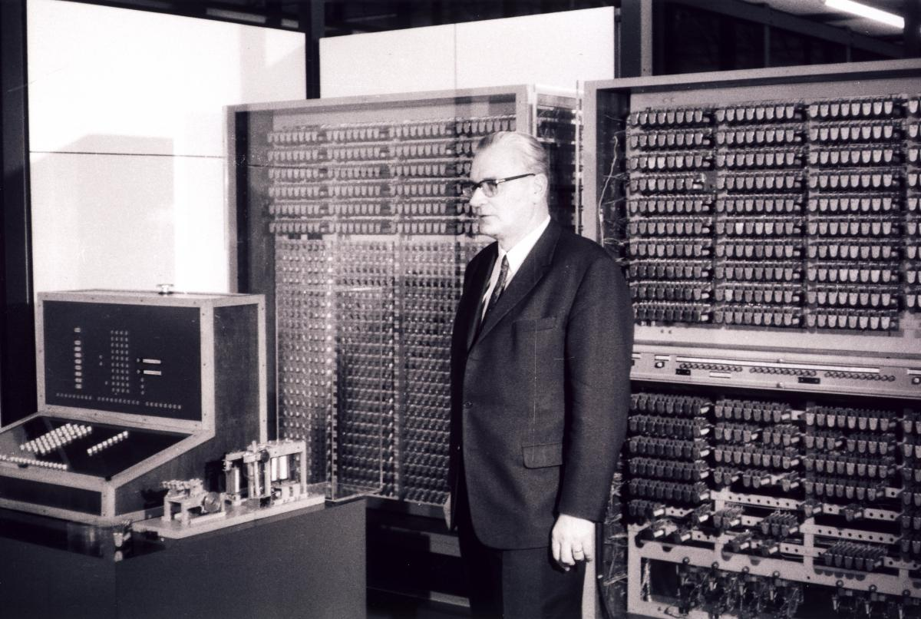
In1936, Konrad Ernst Otto Zuse produced the Z1, a motor-driven computer which could operate on booleans and floating-points.

Slide 14

---------------- contact clarity ------------------------------------------------------------------------

Slide 15
Contract clarity
interface Contract
{
string Email { get; }
DateTime DateOfBirth { get; }
decimal Price { get; }
string Currency { get; }
decimal BonusPercentage { get; }
}

Slide 16
Contract clarity
interface Contract
{
string EmailAddress Email { get; }
DateTime DateOfBirth { get; }
decimal Price { get; }
string Currency { get; }
decimal BonusPercentage { get; }
}

Slide 17
Contract clarity
interface Contract
{
EmailAddress Email { get; }
DateTime DateOnly DateOfBirth { get; }
decimal Price { get; }
string Currency { get; }
decimal BonusPercentage { get; }
}

Slide 18
Contract clarity
interface Contract
{
EmailAddress Email { get; }
DateOnly DateOfBirth { get; }
decimal Money Price { get; }
string Currency { get; }
decimal BonusPercentage { get; }
}

Slide 19
Contract clarity
interface Contract
{
EmailAddress Email { get; }
DateOnly DateOfBirth { get; }
Money Price { get; }
decimal Percentage BonusPercentage { get; }
}

Slide 20
Contract clarity
interface Contract
{
EmailAddress Email { get; }
DateOnly DateOfBirth { get; }
Money Price { get; }
Percentage Bonus { get; }
}

Slide 21

---------------- Units ---------------------------------------------------------------------------------------------------------------

Slide 22
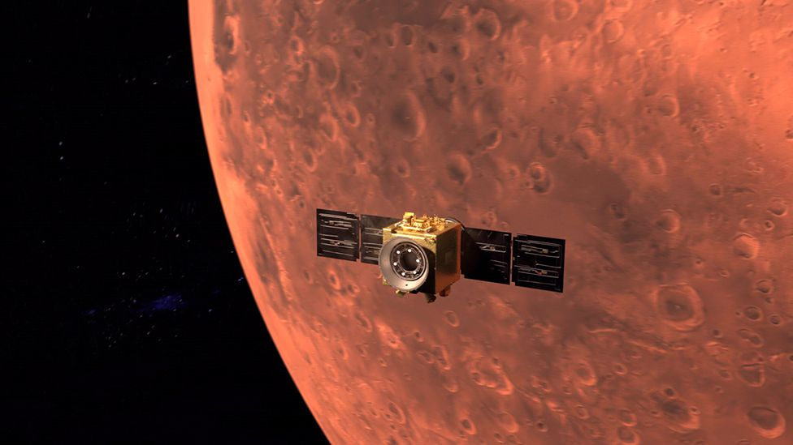
The Mars Climate Orbiter robotic space probe launched by NASA on December 11, 1998, to study the Martian climate and atmosphere.
However, on September 23, 1999, com-munication with the spacecraft was lost as the spacecraft went into orbital insertion, due to ground-based computer software which produced output in non-SI units of pound-force seconds (lbf·s) instead of the SI units of newton-seconds (N·s) specified in the contract between NASA and Lockheed.
$125 million was lost.

Slide 23
Units
double price = 520.50;
double discount = 20.00;
double total = price - discount; // 500.50

Slide 24
Units
Money price = 520.50 + Currency.EUR;
Money discount = 20.00 + Currency.EUR;
Money total = price - discount; // 500.50

Slide 25
Units
Money price = 520.50 + Currency.USD;
Money discount = 20.00 + Currency.EUR;
Money total = price - discount; // throws currency mismatch

Slide 26
Units
Area garden = 8.6.meter() * 2.3.meter(); // 27.52m²

Slide 27

---------------- Normalization ---------------------------------------------------------------------------

Slide 28
Normalization
[TestCase("grr")]
[TestCase("GRR")]
[TestCase("G. R. R.")]
public void Parsing_initials_normalizes_input(string input)
{
var initials = Initials.Parse(input);
initials.Should().Be(Initials.Parse("G.R.R."));
}

Slide 29
Normalization
var percentage_0 = double.Parse("12.5%");
var percentage_1 = double.Parse("12.5");
percentage_0.Should().Be(percentage_1); // throws

Slide 30
Normalization
var percentage_0 = Percentage.Parse("12.5%");
var percentage_1 = Percentage.Parse("12.5");
percentage_0.Should().Be(percentage_1);

Slide 31

---------------- Formatting ---------------------------------------------------------------------------------------

Slide 32
Formatting
// Summary:
// Provides functionality to format the value of an object into a string representation.
public interface IFormattable
{
// Summary:
// Formats the value of the current instance using the specified format.
string ToString(string format, IFormatProvider formatProvider);
}

Slide 33
Formatting
var size = StreamSize.FromMegabyte(12.5);
size.ToString("0.00 F"); // 12.50 Megabyte
size.ToString("#,##0 kB"); // 12,500 kB

Slide 34
Formatting
var size = StreamSize.FromMegabyte(12.5);
size.ToString("0.00 F"); // 12.50 Megabyte
size.ToString("#,##0 kB"); // 12,500 kB
Console.WriteLine($"The file has a size of {size:#,##0 kB}.");

Slide 35

---------------- Validation -----------------------------------------------------------------------------------------

Slide 36
Validation
struct Iban
{
static Iban Parse(string str)
{
var norm = Normalize(str);
if (string.IsNullOrEmpty(norm))
{
return Iban.Empty;
}
else return MatchPattern(norm) && ValidForCountry(norm) && Mod97(norm)
? new Iban(norm);
: throw new FormatException("Not a valid IBAN.");
}
}

Slide 37

---------------- Anti-corruption layer --------------------------------------------------

Slide 38
Anti-corruption layer
void Store(DateTime dateOfBirth)
{
var command = CreateCommand();
command.AddParameter("dateOfBirth", dateOfBirth.Date);
}

Slide 39
Anti-corruption layer
void Store(DateTime DateOnly dateOfBirth)
{
var command = CreateCommand();
command.AddParameter("dateOfBirth", dateOfBirth.Date);
}

Slide 40
Anti-corruption layer
void Store(DateOnly dateOfBirth)
{
var command = CreateCommand();
command.AddParameter("dateOfBirth", dateOfBirth);
}

Slide 41
Anti-corruption layer
async Task<Response> Balance(string iban, ...)
{
Guard.IsIban(iban);
var response = await Client.PostAsync(new Request
{
Iban = iban.Remove(" ", string.Empty).ToUpperInvariant(),
...
}
}

Slide 42
Anti-corruption layer
async Task<Response> Balance(string Iban iban, ...)
{
Guard.IsIban(iban);
var response = await Client.PostAsync(new Request
{
Iban = iban.Remove(" ", string.Empty).ToUpperInvariant(),
...
}
}

Slide 43
Anti-corruption layer
async Task<Response> Balance(Iban iban, ...)
{
var response = await Client.PostAsync(new Request
{
Iban = iban,
...
}
}

Slide 44

--------------------------------- Domain logic ------------------------------------------------------------

Slide 45
Domain logic
var factor = Percentage.Parse("13.6%");
var factor = (Percentage)0.136;
var factor = 13.6.Percent();

Slide 46
Domain logic
Money bruto = 50 + Currency.EUR;

Slide 47
Domain logic
Money bruto = 50 + Currency.EUR;
Money netto = bruto + 10.Percent(); // 55 EUR

Slide 48
Domain logic
21.Percent().ToJson(); // 0.21

Slide 49
Domain logic
21.Percent().ToJson(); // 21.0

Slide 50
Domain logic
21.Percent().ToJson(); // "21.0%"

Slide 51
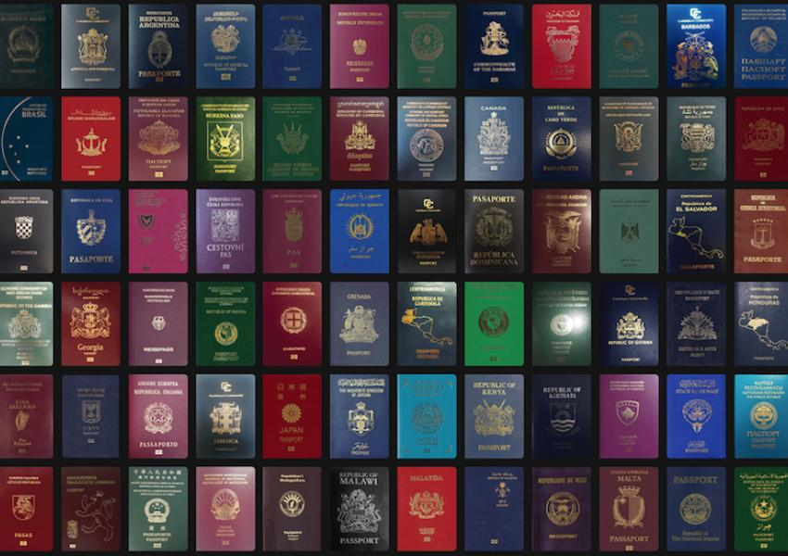
------------------------------------------------- Identifiers -----------------------------------------------------------

Slide 52
Identifiers
DocumentId id = DocumentId.Parse("8a1a8c42-d2ff-e254-e26e-b6abcbf19420");

Slide 53
Identifiers
pubic struct DocumentId
{
public int CompareTo(object? other);
public bool Equals(object? other);
public string ToString();
public static DocumentId Parse(string str);
public static DocumentId Next();
}

Slide 54
Identifiers
pubic struct Id<TIdentifier>
where TIdentifier : IIdentifierBehavior, new()
{
private static readonly TIdentifier behavior = new();
private readonly object val;
public int CompareTo(object? other) => behavior.Compare(val, other);
public bool Equals(object? other) => behavior.Equals(val, other);
public string ToString() => behavior.ToString(val);
public static Id<TIdentifier> Parse(string str) => new(behavior.Parse(str));
public static Id<TIdentifier> Next() => new(behavior.Next());
}

Slide 55
Identifiers
public sealed class ForDocument : GuidBehavior { }
Id<ForDocument> id = Id<ForDocument>.Parse("8a1a8c42-d2ff-e254-e26e-b6abcbf19420");

Slide 56
Identifiers
public sealed class ForDocument : GuidBehavior { }
using DocumentId = Id<ForDocument>;
DocumentId id = DocumentId.Parse("8a1a8c42-d2ff-e254-e26e-b6abcbf19420");

Slide 57
Identifiers
global using DocumentId = Id<ForDocument>;
public sealed class ForDocument : GuidBehavior { }
DocumentId id = DocumentId.Parse("8a1a8c42-d2ff-e254-e26e-b6abcbf19420");

Slide 58
Identifiers
global using DocumentId = Id<ForDocument>;
global using FileId = Id<ForFile>;
public sealed class ForDocument : GuidBehavior { }
public sealed class ForFile : StringBehavior
{
public override object Next() => $"{Clock.Today().Year}-File-{Math.Random()}";
}
DocumentId id = DocumentId.Parse("8a1a8c42-d2ff-e254-e26e-b6abcbf19420");
FileId fileId = FileId.Next();

Slide 59
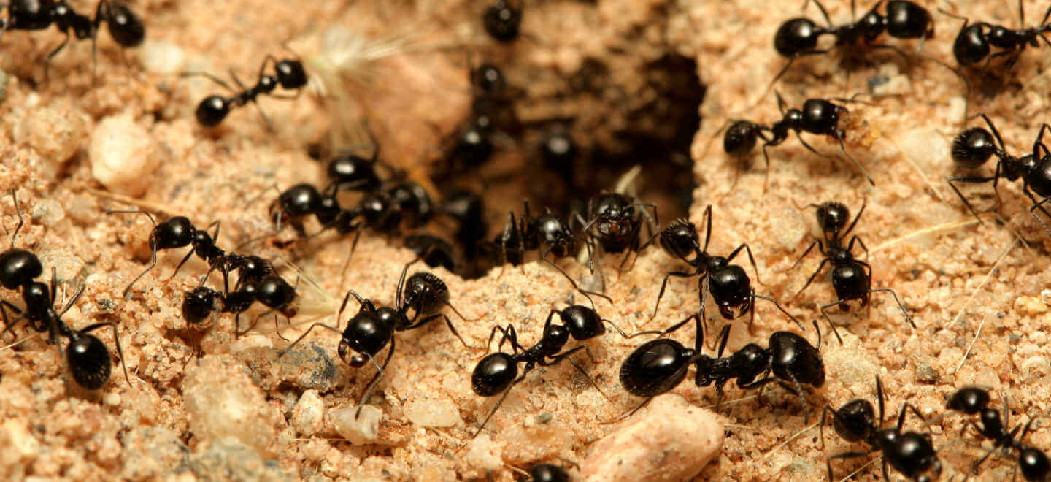
------------- Primitive Obsession -----------------------------------------------------------

Slide 60

Primitive Obsession is an anti-pattern that takes place when overusing primitive types, especially to model a domain. This anti-pattern is widely known in both DDD and functional programming communities.

Slide 61
----- primitive obsession------
No model-specific logic available
- logic is scattered through the code base
- logic might be duplicated
Existing logic might be undesirable
- operators
- properties
- methods
No type safety
- data may not longer represent concern
- similar types might be swapped

Slide 62

------------------ Challenges -----------------------------------------------------------------------------------

Slide 63

“
There ain't no such thing as a free lunch.

Slide 64
XML Serialization
struct MySvo : IXmlSerializable
{
public void ReadXml(XmlReader reader)
{
val = Parse(reader.ReadElementString()).val;
}
}

Slide 65
XML Serialization
struct MySvo : IXmlSerializable
{
void IXmlSerializable.ReadXml(XmlReader reader)
{
val = Parse(reader.ReadElementString()).val;
}
}

Slide 66
JSON Serialization
struct Percentage
{
object ToJson() => val.ToString("0,#%", CultureInfo.Invariant);
static Percentage FromJson(string json) => Parse(json, CultureInfo.Invariant);
static Percentage FromJson(double json) => new((decimal)json);
}

Slide 67
Equality (in JavaScript/TypeScript)
export class DateOnly
{
public equals(other: any): Boolean
{
...
}
}

Slide 68

Building SVO’s is challenging; if reusage is limited, if there are no limitations on the primitive, or it lacks domain-specific operations, it might not be worth the effort.

Slide 69


Slide 70
-------- qowaiv – svo’s ----------------
Open Source (github.org/Qowaiv, MIT)
NuGet Package (nuget.org/packages/Qowaiv)
Code Generation
Percentage, Money, Date, PostalCode, DateSpan, EmailAdress, …
JSON, TypeConversion, XML, IFormattable, IComparable, …
Reliable (years+, Exact Software, ABN-AMRO Bank, …)

Slide 71

Take away

Slide 72
Take away
SVO’s give meaning to your code

Slide 73
Take away
SVO’s give meaning to your code
SVO’s can be reused in most cases

Slide 74
Take away
SVO’s give meaning to your code
SVO’s can be reused in most cases
SVO's reduce primitive obsession

Slide 75
Take away
SVO’s give meaning to your code
SVO’s can be reused in most cases
SVO's reduce primitive obsession
Using SVO’s comes with a cost

Slide 76
Take away
SVO’s give meaning to your code
SVO’s can be reused in most cases
SVO's reduce primitive obsession
Using SVO’s comes with a cost
Sometimes it is not worth the effort

Slide 77
Take away
SVO’s give meaning to your code
SVO’s can be reused in most cases
SVO's reduce primitive obsession
Using SVO’s comes with a cost
Sometimes it is not worth the effort
global using statements are awesome

Slide 78

Questions?

Slide 79
42
Questions?

