Slide 1
{Saturday}
ned
dot
Project File Analysis with Roslyn
Beyond the basics
Saturday 18th May 2025

Slide 2




------------------------------ about me ----
Corniel Nobel
Energetic, optimistic, creative, outside the box thinking, front runner
20+ years experience
.NET, domain-driven design, code quality, static code analysis, machine learning
github.com/corniel
linkedin.com/in/corniel-nobel
corniel@gmail.com

Slide 3

Craftsmanship & tooling

Slide 4

----------------------------------- static code analysis ----------------------------------

Slide 5

- static code analysis ---
> Recognize (bad) patterns
> - Bugs
> - Optimizations
> - Vulnerabilities
> Enforce uniform style (opinionated)
> - Indenting
> - Whitespace
> - Naming

Slide 6

--------------------- opinionated ----
TREAT ALL WARNINGS AS ERRORS IS BAD

Slide 7
--------------------- opinionated ----
> We’re not developing in a perfect world
> Deprecated code
> New rules
> Warnings are not errors
> Conflicting IDE extensions
> False positives

Slide 8


----------------------------------- static code analysis ----------------------------------

Slide 9
My first Roslyn rule
[DiagnosticAnalyzer(LanguageNames.CSharp)]
public sealed class PreferConstants : DiagnosticAnalyzer
{
public override ImmutableArray<DiagnosticDescriptor> SupportedDiagnostics
=> [new("Rule01", "Prefer constants", "'{0}' can be a constant.")];
public override void Initialize(AnalysisContext c)
=> c.RegisterSyntaxNodeAction(AnalyzeNode, SyntaxKind.LocalDeclarationStatement);
private void AnalyzeNode(SyntaxNodeAnalysisContext c)
{
if (c.Node is LocalDeclarationStatementSyntax local
&& !local.Modifiers.Any(SyntaxKind.ConstKeyword)
&& c.SemanticModel.AnalyzeDataFlow(local) is { } flow
&& c.SemanticModel.GetDeclaredSymbol(local.Declaration.Variables.Single()) is { } symbol
&& !flow.WrittenOutside.Contains(symbol))
{
c.ReportDiagnostic(Diagnostic.Create(SupportedDiagnostics[0], c.Node.GetLocation(),
local.Declaration.Variables.First().Identifier.ValueText));
}
}}}

Slide 10

--- qowaiv analyzers-------
Qowaiv.Analyzers.CSharp
QW0001 - Use a testable Time Provider
QW0003 - Decorate pure functions
QW0005 - Seal concrete classes unless designed for inheritance
QW0006 - Only unsealed concrete classes should be decorated as inheritable
QW0007 - Use file-scoped namespace declarations
QW0008 - Define properties as not-nullable for types with a defined empty state
QW0009 - Define properties as not-nullable for enums with a defined none/empty value
QW0010 - Use System.DateOnly instead of Qowaiv.Date
QW0011 - Define properties as immutables
QW0012 - Use immutable types for properties
QW0016 - Prefer regular over positional properties
QW0017 - Apply arithmetic operations on non-nullables only
...

Slide 11
QW0016 - Prefer regular over positional properties
/// <summary>Represents a data structure.</summary>
/// <param name="Required">
/// Gets the required value.
/// </param>
/// <param name="Optional">
/// Gets the optional value.
/// </param>
/// <param name="WithDefault">
/// Gets the value provided by default.
/// </param>
public record DataStructure([Length(16)]string Required, object? Optional, int WithDefault = 42);

Slide 12
QW0016 - Prefer regular over positional properties
/// <summary>Represents a data structure.</summary>
public record DataStructure
{
/// <summary>Gets the required value.</summary>
[Length(16)]
public required string Required { get; init; }
/// <summary>Gets the optional value.</summary>
public object? Optional { get; init; }
/// <summary>Gets the value provided by default.</summary>
public int WithDefault { get; init; } = 42;
}

Slide 13
QW0003 - Decorate pure functions
public abstract class Compliant
{
[Pure]
public int PureFunction() => 42;
[Obsolete]
public int Obsolete() => 0; // Obsolete methods are ignored.
public void Void() { } // Void methods are impure per definition.
public abstract bool TryParse(string str, out object result);
[Impure]
public int ImpureMethod(int input) => 42;
[DoesNotReturn]
public int Throws() => throw new NotSupportedException();
}

Slide 14
.globalconfig vs .editorconfig
root = true
dotnet_diagnostic.CA1069.severity = warning # Enums values should not be duplicated
dotnet_diagnostic.CA1806.severity = warning # Do not ignore method results
dotnet_diagnostic.CA1847.severity = warning # Use char literal for a single character lookup
dotnet_diagnostic.FAA0004.severity = error # Replace NUnit assertion with FA equivalent
dotnet_diagnostic.NUnit2021.severity = warning # Incompatible types for EqualTo constraint
dotnet_diagnostic.NUnit2005.severity = error # Consider using Assert.That instead of AreEqual
dotnet_diagnostic.NUnit2033.severity = error # Consider using Assert.That instead of NotZero
dotnet_diagnostic.QW0001.severity = none # Use a testable Time Provider
dotnet_diagnostic.QW0003.severity = warning # Decorate Pure functions
dotnet_diagnostic.S100.severity = none # Properties should be named in PascalCase
dotnet_diagnostic.S101.severity = none # Types should be named in PascalCase
dotnet_diagnostic.S1133.severity = suggestion # Deprecated code should be removed
dotnet_diagnostic.S107.severity = warning # Methods should not have too many parameters
dotnet_diagnostic.SYSLIB1044.severity = none # Regex gen couldn't generate completely

Slide 15
--- analysis platforms -
> SonarQube Cloud/IDE
> JetBrains Codana

Slide 16

------------------------------------------------------------------ build engine ------------------------------

Slide 17
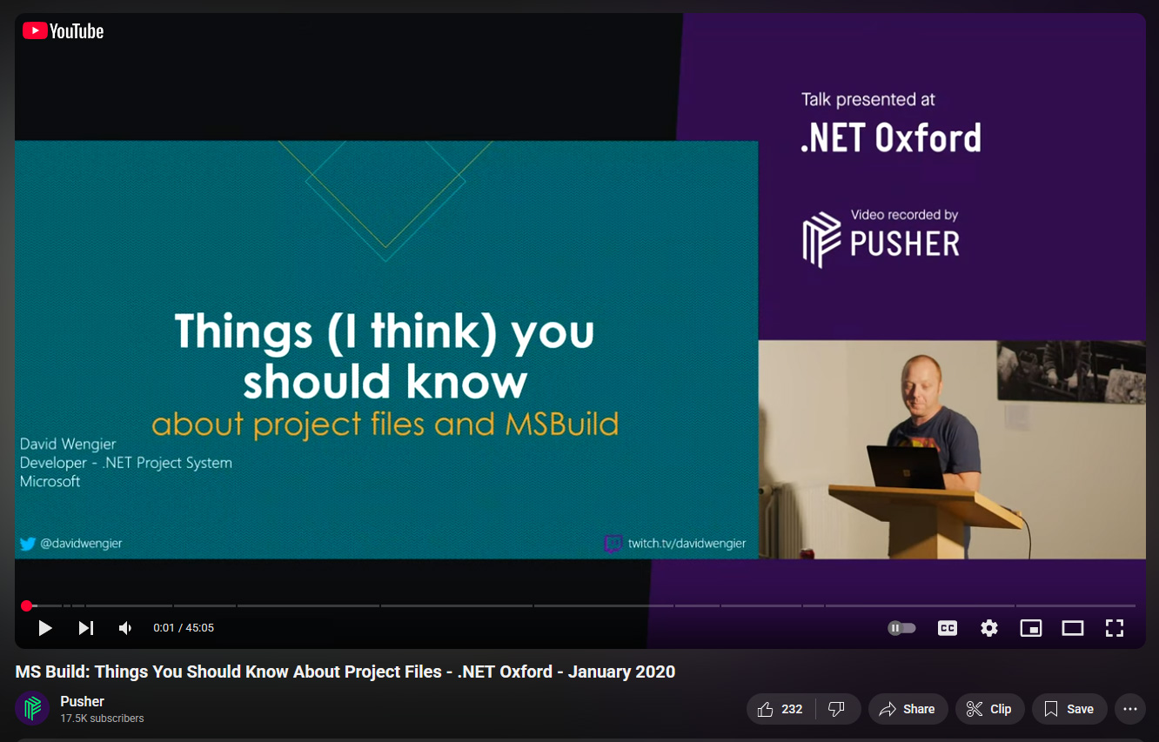
- MSBuild deep dive -
> https://youtu.be/5HEbsyU5E1g

Slide 18
MSBuild file
<Project Sdk="Microsoft.NET.Sdk">
<Import Project="../../props/common.props" />
<PropertyGroup>
<TargetFramework>net9.0</TargetFramework>
</PropertyGroup>
<PropertyGroup Condition="'$(Configuration)'=='Release'">
<GeneratePackageOnBuild>true</GeneratePackageOnBuild>
</PropertyGroup>
<ItemGroup Label="Test dependencies">
<PackageReference Include="NUnit" Version="4.3.2" />
</ItemGroup>
</Project>

Slide 19
- analyze msbuild files -
> Avoid likely bugs
> Avoid deprecated features
> Avoid known malicious libraries
> Recommend available analyzers
> Enforce uniform style
> Avoid implicit default settings
> Recommend lesser-known useful settings

Slide 20
Extending on Roslyn
public abstract class ProjectFileAnalyzer : DiagnosticAnalyzer
{
public void override Initialize(AnalysisContext context)
{
context.RegisterAdditionalFileAction(c =>
{
if (ProjectFiles.Global.UpdateMsBuildProject(c) is { } msbuild)
{
..
}
}
}
}

Slide 21
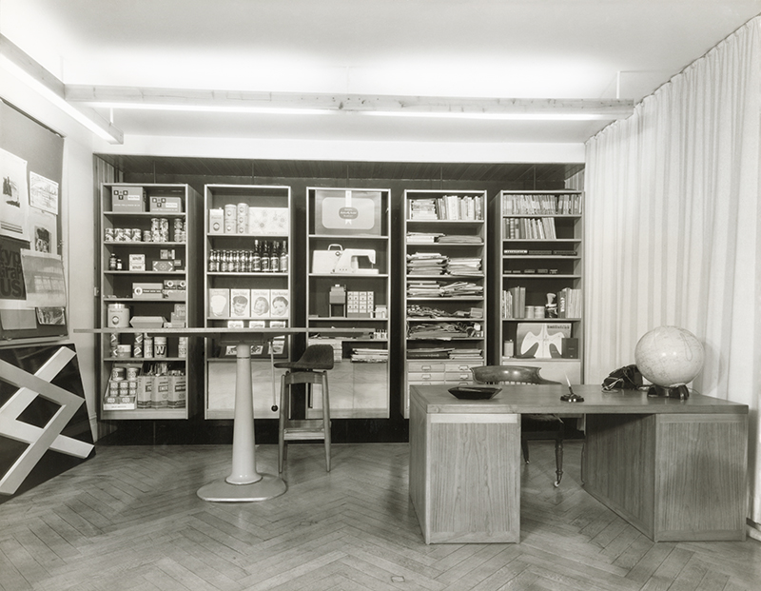

.NET project file analyzers
> https://dotnet-project-file-analyzers.github.io
> DotNetProjectFile.Analyzers

Slide 22
--- qowaiv analyzers-------
DotNetProjectFile.Analyzers
Proj0003: Define usings explicit
Proj0027: Override <TargetFrameworks> with <TargetFrameworks>
Proj0036: Remove None when redundant
Proj0022: Build action includes should exist
Proj0039: Treat all warnings as errors is considered a bad practice
+ 120 more …

Slide 23
.NET project file analyzers SDK
> https://dotnet-project-file-analyzers.github.io
> DotNetProjectFile.Analyzers.Sdk

Slide 24

Demo

Slide 25

Take away

Slide 26
Take away
Static code analysis should improve the readability of your code

Slide 27
Take away
Static code analysis should improve the readability of your code
Roslyn’s extensibility allows to analyze additional files too

Slide 28
Take away
Static code analysis should improve the readability of your code
Roslyn’s extensibility allows to analyze additional files too
Focus on newly introduced warnings only

Slide 29
Take away
Static code analysis should improve the readability of your code
Roslyn’s extensibility allows to analyze additional files too
Focus on newly introduced warnings only
MSBuild files should be considered code

Slide 30
Take away
Static code analysis should improve the readability of your code
Roslyn’s extensibility allows to analyze additional files too
Focus on newly introduced warnings only
MSBuild files should be considered code
.NET Project File Analyzers is big set of static code analysis rules

Slide 31
Take away
Static code analysis should improve the readability of your code
Roslyn’s extensibility allows to analyze additional files too
Focus on newly introduced warnings only
MSBuild files should be considered code
.NET Project File Analyzers is big set of static code analysis rules

Slide 32

Questions?

Slide 33
42
Questions?

