Slide 1
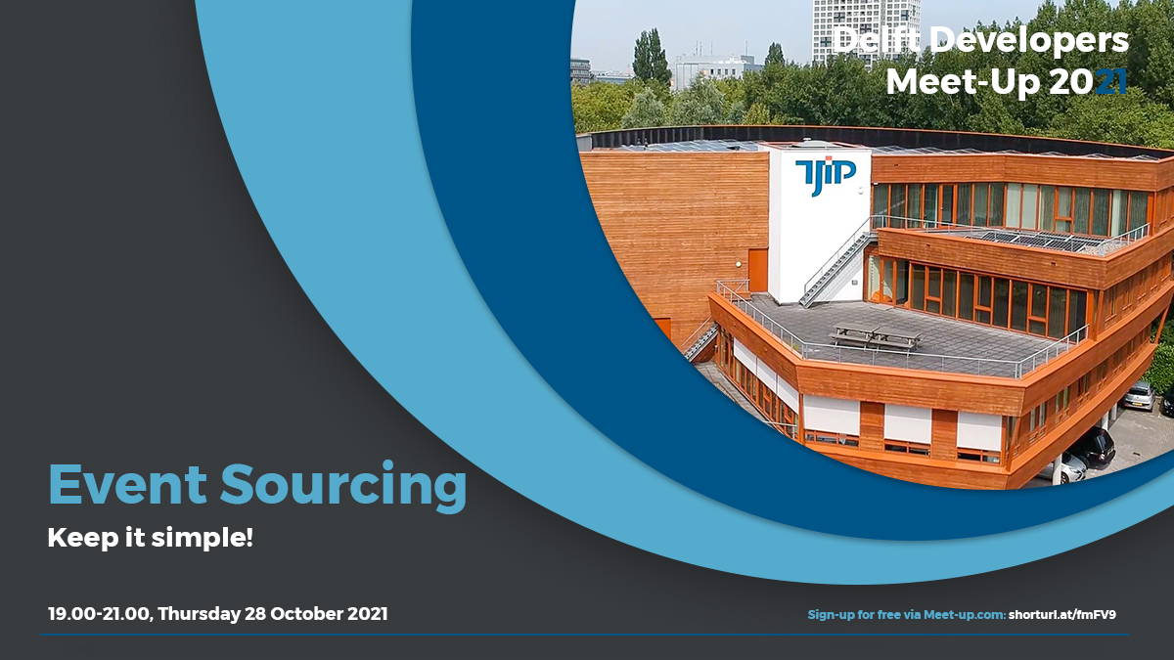

Slide 2

Craftsmanship

Slide 3
“
Code should be easy to reason about ~ Some genius ~

Slide 4

Event Sourcing

Slide 5
“
The fundamental idea of Event Sourcing is that of ensuring every change to the state of an application is captured in an event object. ~ Martin Fowler ~

Slide 6
»
Relation databases are history Storage can be append-only Trace of all changes Replay to any historical state of choice

Slide 7

The Challenge

Slide 8
Aggregate
Handler
Aggregate
Command
Message
Event
Event
Storage
Projection
Event
Event

Slide 9
Aggregate
ƒ(x)
Handler
Aggregate
Command
ƒ(x)
Event
When(e)
Event
Event
Event
Event
Message
Validate()
Event buffer
Event
Event
Storage
Projection
Event
Event

Slide 10
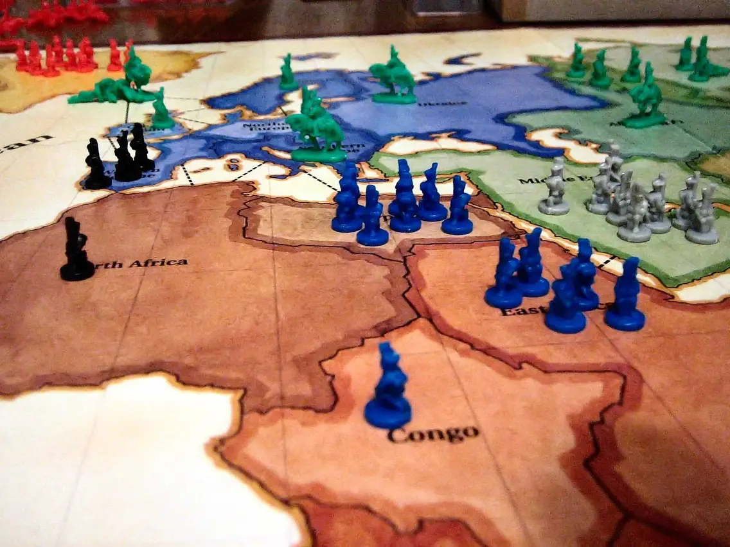
Case Study

Slide 11
}
Result<T> result = SomeResult(); if (result.IsValid) { result = SomeOtherResult(result.Value); } if (result.IsValid) { result = SomeNextResult(result.Value); } return result;

Slide 12
}
return SomeResult() .Act(val => SomeOtherResult(val)) .Act(val => SomeNextResult(val));

Slide 13
}
return SomeResult() | (val => SomeOtherResult(val)) | (val => SomeNextResult(val));

Slide 14
(Auto) Attack

Slide 15
Anti-corruption layer
(always valid)

Slide 16
Anti-corruption layer
(always valid)

Slide 17
(Re)play

Slide 18
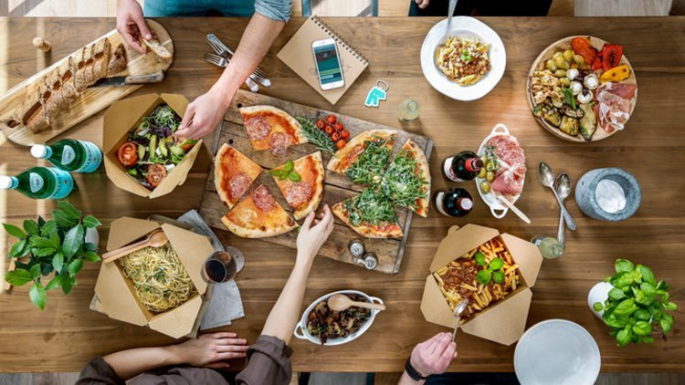
“There ain’t
no such thing as a
free lunch”

Slide 19
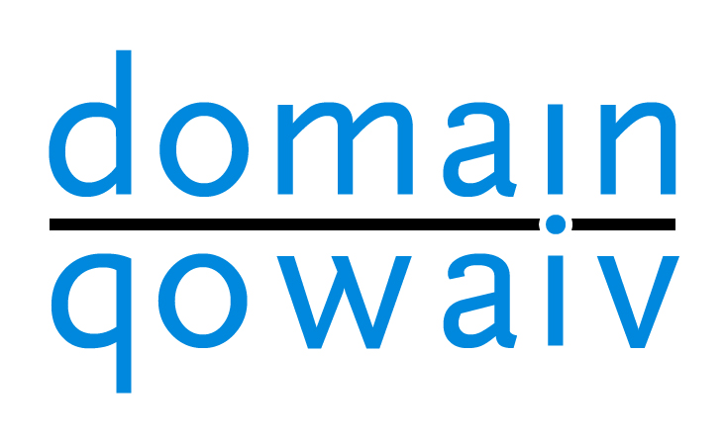

Slide 20
»
Open Source (github.com/Qowaiv/qowaiv-domainmodel, MIT) Package (nuget.org/packages/Qowaiv.DomainModel) Component library, not a framework No vendor lock-in (other than Qowaiv itself) Reliable (ABN-AMRO Bank, …)

Slide 21

Take-away

Slide 22
»
Event Sourcing is a natural way to persist DDD Focus on Domain Code, the Aggregate Storage, Messaging, DI, etc…, comes later

Slide 23



»
github.com/corniel linkedin.com/in/corniel-nobel/ corniel@gmail.com

Slide 24
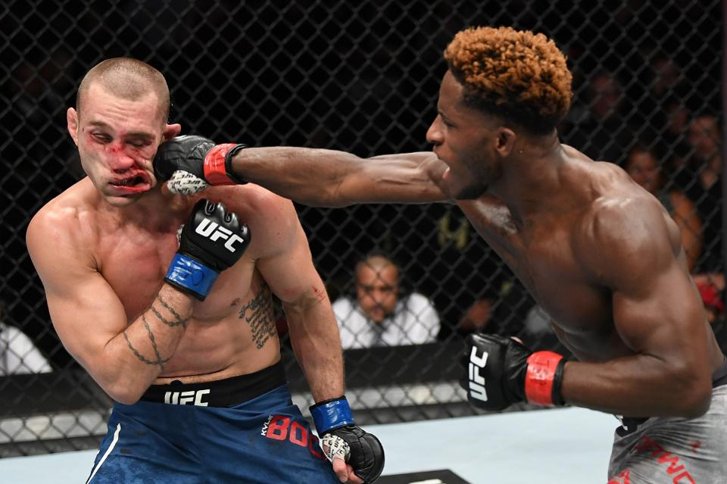
Questions

