Slide 1
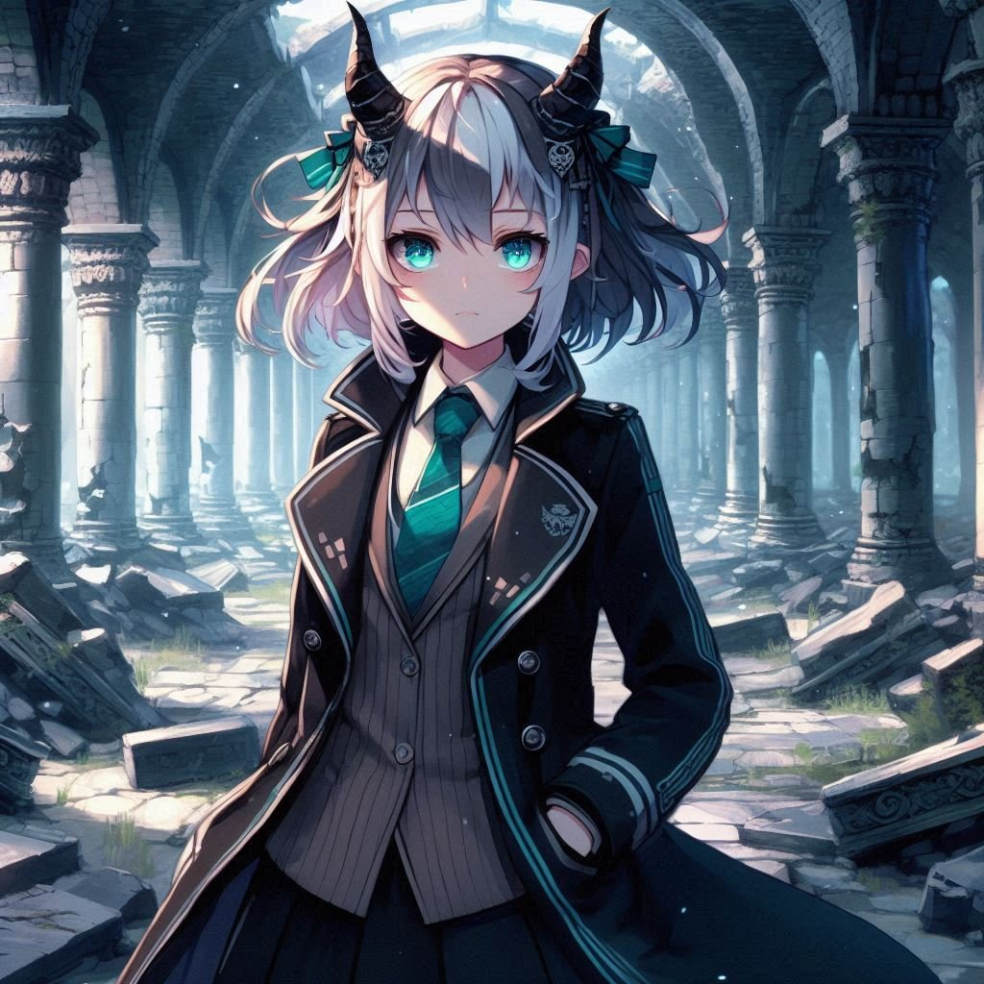
故事七步驟
冒險

Slide 2
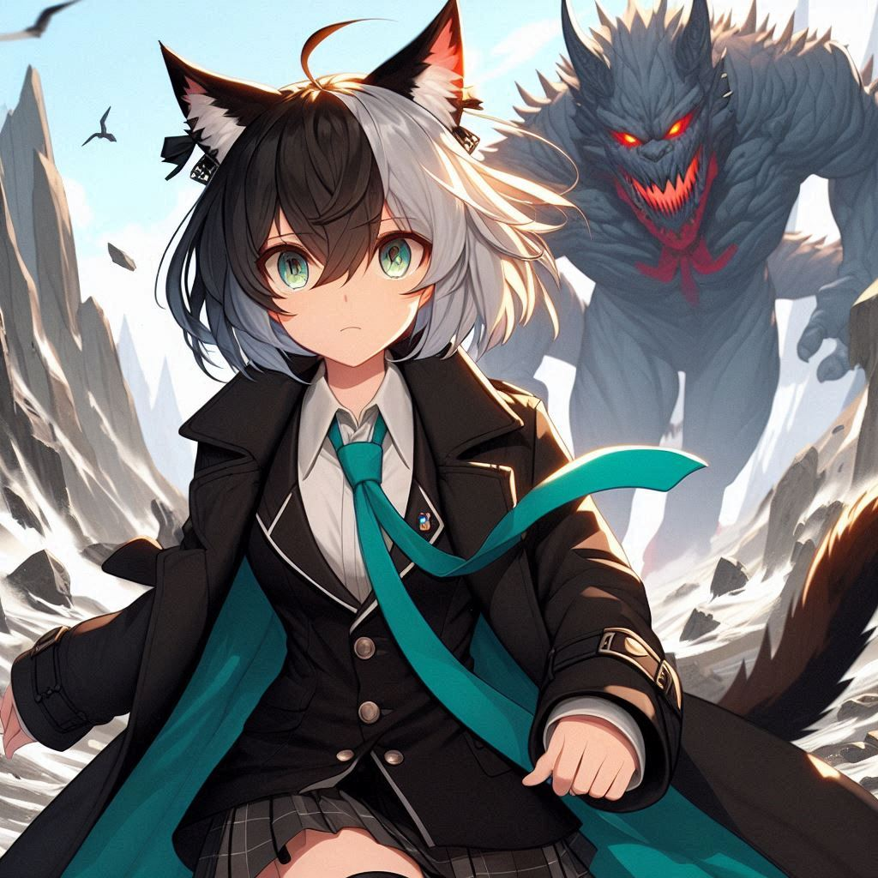
目標
作為一名虛擬空間構築師，我發現了一個關於被遺忘代碼的傳說。它隱藏在一个古老遺跡中，可能具有重塑虛擬空間的力量。我決定踏上這斷尋找代碼的旅程。
Notes:
[Prompt]
An anime-style female character with horns, cat ears, and black, white, and gray short hair, wearing black coat with teal tie.
Standing in ancient ruins.

Slide 3

阻礙
查閱了不少資料，我找到一張指向遺跡的地圖。遺迹位於一片危險的山谷。我收拾好工具，開始了艱難的旅程。(E2 驚訝)
旅途中我遇到了巨大的岩石怪物，憑藉靈活的身手，我成功地逃離。
Notes:
[Prompt]
An anime-style female character with horns, cat ears, and black, white, and gray short hair, wearing black coat with teal tie.
On the mountain, the rock monster is chasing behind, she dodges flexibly.

Slide 4
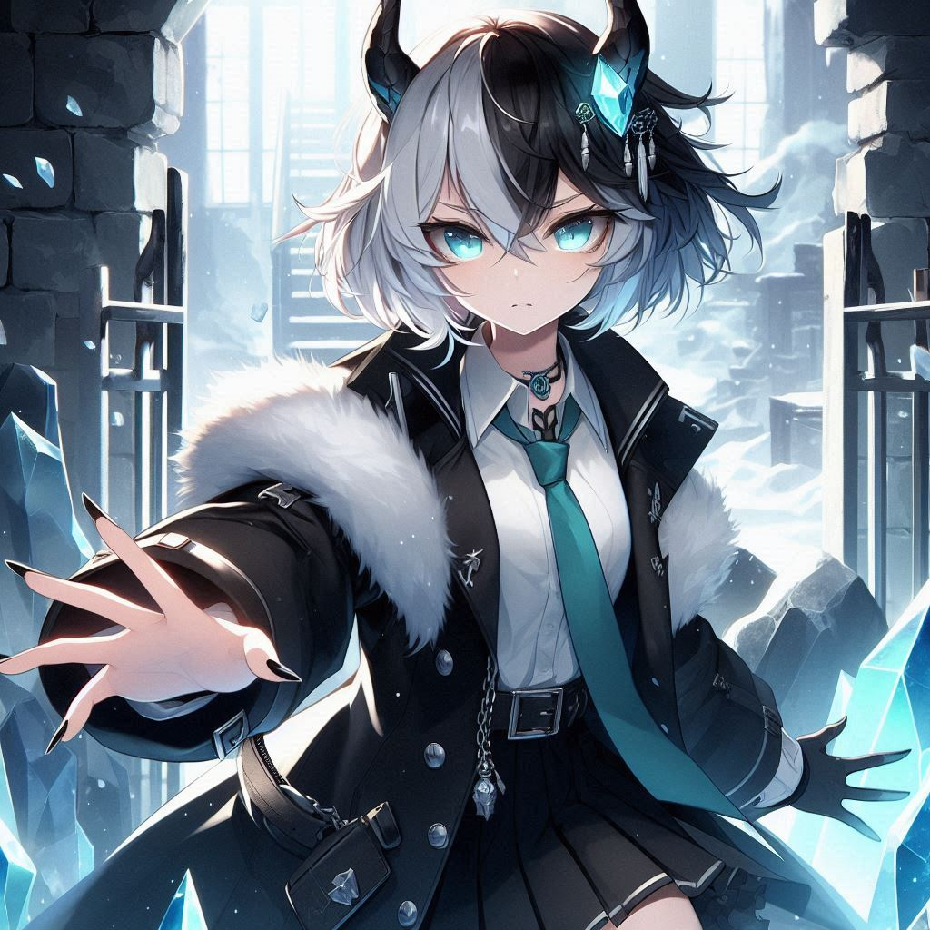
努力
幾天後，我抵達了山谷，發現遺跡的入口被古老的符文覆蓋。我解讀符文，成功打開了大門，寒冷的空氣撲面而來，遺跡內部充滿了未知的機關。
(E7星星眼)
Notes:
[Prompt]
An anime-style female character with horns, cat ears, and black, white, and gray short hair, wearing black coat with teal tie.
Standing at the entrance of the ruins, holding the ancient rune book in his hand, studying it carefully.

Slide 5

結果
在遺跡深處，我發現了一个閃爍著光芒的水晶，裡面封印著那段傳說中的代碼。觸碰水晶的瞬間，強大的能量流入我的身體，讓我感受到無語倫比的神清氣爽。
(Shift+7 十字星特效)
Notes:
[Prompt]
An anime-style female character with horns, cat ears, and black, white, and gray short hair, wearing black coat with teal tie.
In the mysterious room, reach out and touch the glowing crystal.

Slide 6
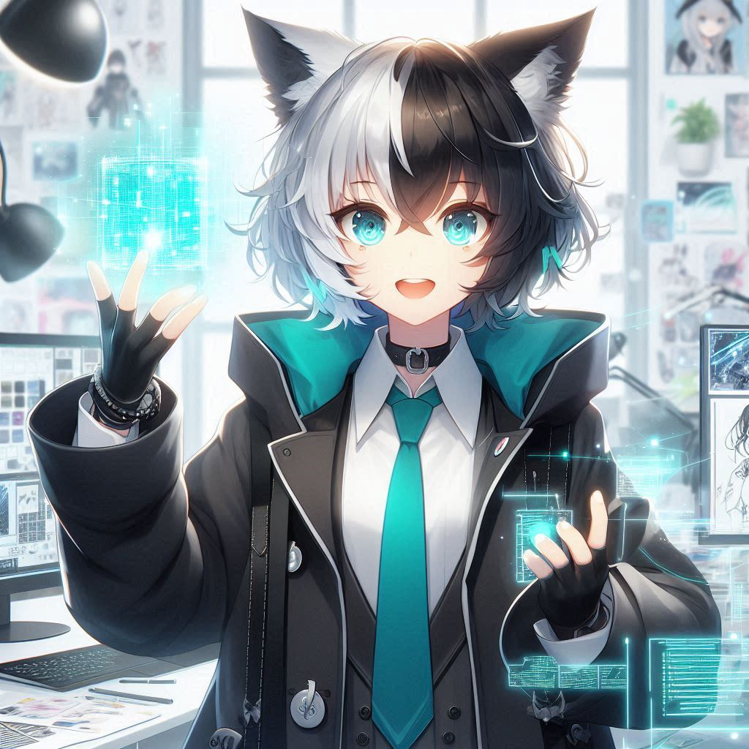
意外
帶著新獲得的知識，我回到了我的虛擬房間，開始將這段代碼融入到我的設計中。隨着創作的展開，我突然意識到這段代碼不僅僅屬於我，它是所有創作者渴望的存在，應當作為共享的財富。
Notes:
[Prompt]
An anime-style female character with horns, cat ears, and black, white, and gray short hair, wearing black coat with teal tie.
Busy in the virtual space, the surrounding designs shimmer with mysterious light.

Slide 7

轉折
我決定嘗試創造全新的虛擬體驗，结合這項新技術。這像是打開了一扇新大門，带我進入更寬廣的創作世界，讓我對未来的探索充滿期待，同時我將技術開源，讓所有的構築師可以持續拓展迭代這項技術。
Notes:
[Prompt]
An anime-style female character with horns, cat ears, and black, white, and gray short hair, wearing black coat with teal tie.
In the studio, surrounded by creative design sketches, holding a glowing piece of code in his hand with excitement in her eyes.

Slide 8
結局
經過這次冒險，我明白了創造的真正意義在於不斷探索與超越自我。現在，我不僅是一個虛擬空間的構築師，更是一個追尋夢想的探索者。我期待著未來的旅程，繼續創造出更加美好的可能性，迎接下一個冒險的到來！(E7)
Notes:
[Prompt]
An anime-style female character with horns, cat ears, and black, white, and gray short hair, wearing black coat with teal tie.
Smiling and facing forward, with a colorful virtual world behind him, symbolizing unlimited creativity.

