Slide 1
故事七步驟

Slide 2

目標
嗨，大家好！
我是 Cornu Dev.，你們可以叫我科弩。我來自另一个次元的世界，在那裡，我是一名虛擬空間的構築師。
我對人類的實體空間充滿好奇，想知道你們是如何用創造力塑造自己周圍的環境。
(E7星光眼表情)
嗨，大家好！我是 Cornu Dev.，你们可以叫我 Cornu。我来自一个虚拟次元的世界，在那里，我是一名虚拟空间的构筑师。我对人类的实体空间充满好奇，想知道你们是如何用创造力塑造自己周围的环境。
Notes:
[Prompt]
An anime-style female character with horns, cat ears, and black, white, and gray short hair, wearing black coat with teal tie.
Standing in the virtual world she designed, behind her are the complex buildings she designed

Slide 3

阻礙
因此，我使用傳送裝置来到你們的次元。然而，我發現自己與這個世界格格不入，語言和文化的差異讓我感到孤立。
Notes:
[Prompt]
An anime-style female character with horns, cat ears, and black, white, and gray short hair, wearing black coat with teal tie.
Facing the entrance to the real world, the expression is full of expectation and uneasiness.

Slide 4

努力
為了更好的融入與學習，我首先嘗試在人類社會中找了一份工作，但我身心俱疲。
(E0 哭泣表情)
Notes:
[Prompt]
An anime-style female character with horns, cat ears, and black, white, and gray short hair, wearing black coat with teal tie.
Working Sadly in the office.

Slide 5
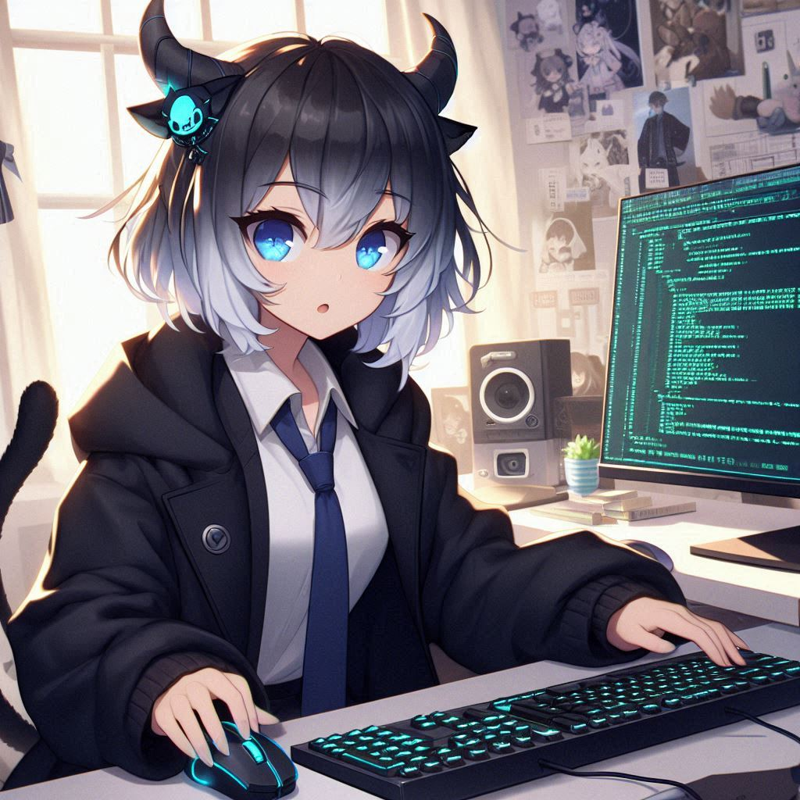
結果
辭去了工作，我開始直播，分享我的設計和想法。觀眾們的回饋讓我收穫豐富，他們對我的創作充滿好奇，幫助我理解更多可能性。
Notes:
[Prompt]
An anime-style female character with horns, cat ears, and black, white, and gray short hair, wearing black coat with teal tie.
Programing in her cute room.

Slide 6
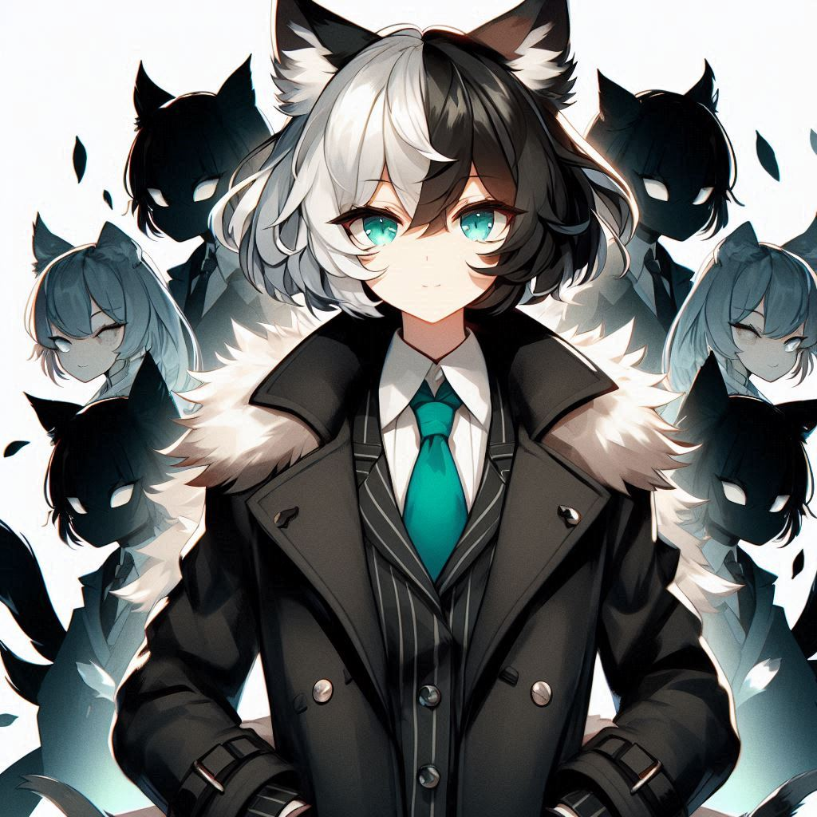
意外
我本想持續學習人類文化，但是我的族人希望我回到虛擬次元，我可能得道別。
(E8淚眼汪汪表情)
Notes:
[Prompt]
An anime-style female character with horns, cat ears, and black, white, and gray short hair, wearing black coat with teal tie.
Lots of shadow of the recall order appeared behind.

Slide 7

轉折
然而，我發現就算回到原本的次元(shift8 燈泡表情)，也能通過直播，將人類的創造力带回我的世界，讓兩個次元相互啟發，共同創造出新的可能性。
Notes:
[Prompt]
An anime-style female character with horns, cat ears, and black, white, and gray short hair, wearing black coat with teal tie.
Standing on the border between the real world and the virtual dimension, holding a puzzle symbolizing connection in his hands and smiling.

Slide 8

結局
現在，我不僅是一名虛擬空間構築師，也成為連接兩個世界的橋梁。每次直播都是新的冒險，我期待與大家一起探索無限的可能。歡迎你們隨時與我分享想法！
(瞇眼笑)
Notes:
An anime-style female character with horns, cat ears, and black, white, and gray short hair, wearing black coat with teal tie.
She invites everyone to join her on her creative journey with a smile, showing behind him a world where virtuality and reality blend.

Slide 9
總結（故事七步驟）：
目標（來自虛擬次元，渴望探索人類的實體空間）
阻礙（進入人類世界後發現文化差異）
努力（在人類社會中找了份工作）
结果（開始直播，與觀眾建立關係）
意外（面臨族人的意見）
轉折（结合虛擬和實體世界的創造力）
结局（作為橋梁繼續探索兩者的無限可能）

