Slide 1
Some random text game
By Brandon, that guy in the front of the room.

Slide 2
Style, because that matters for some reason…
File names are UpperCamelCase
Variable names are lowerCamelCase
Comments exist when necessary
{} on their own line
PLEASE FOR THE LOVE OF GOD HAVE A DAMN GOOD REASON FOR GLOBAL VARIABLES

Slide 3
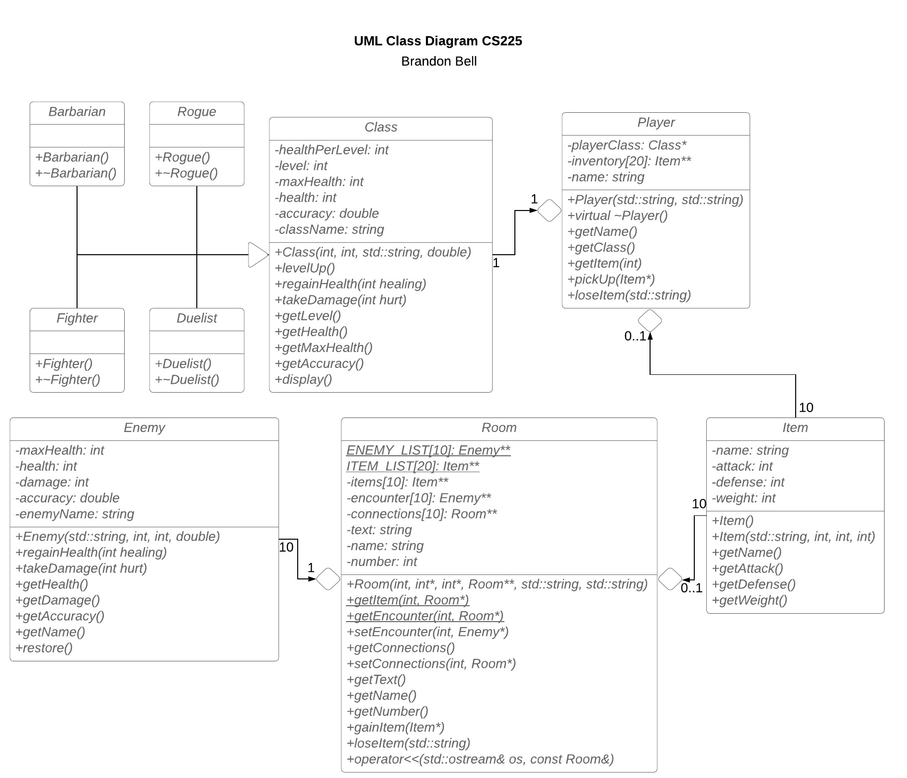

Slide 4
What is it?
A text-based adventure game.
If you know what Zork is, you need no explanation.
Type stuff to do stuff.

Slide 5
From here on out, there are pictures of code. If you’d like, just go ahead and ignore them. Or, you can try to read them despite me telling you what they do…

Slide 6
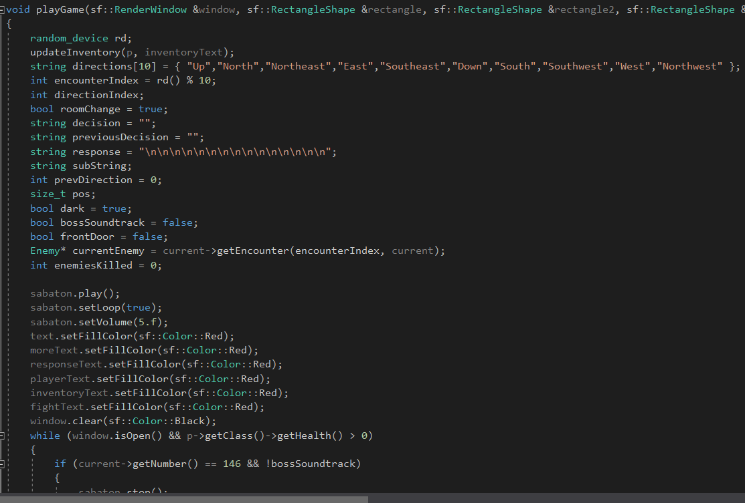

Slide 7
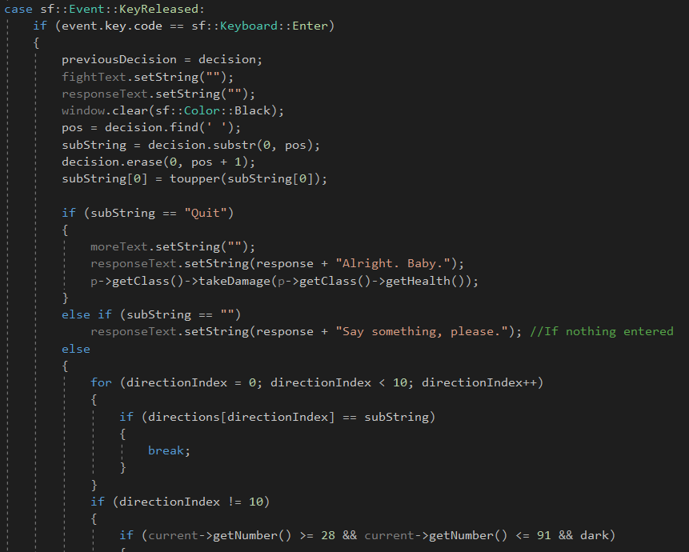

Slide 8
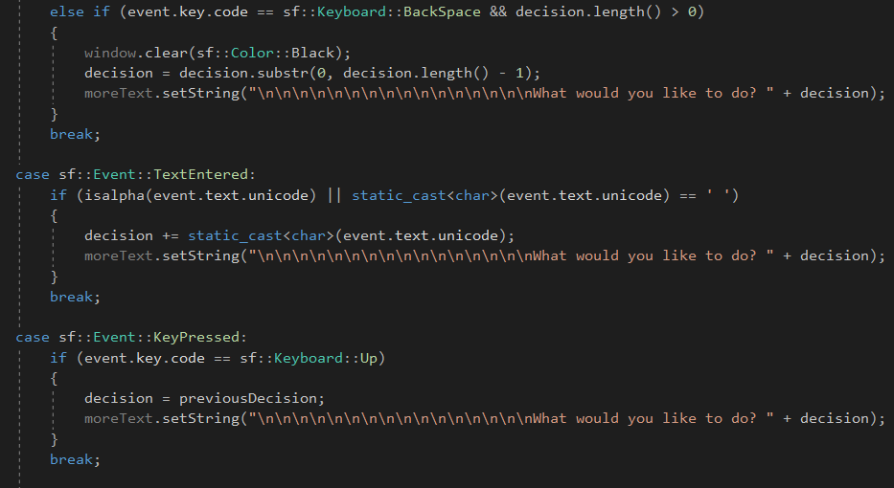

Slide 9
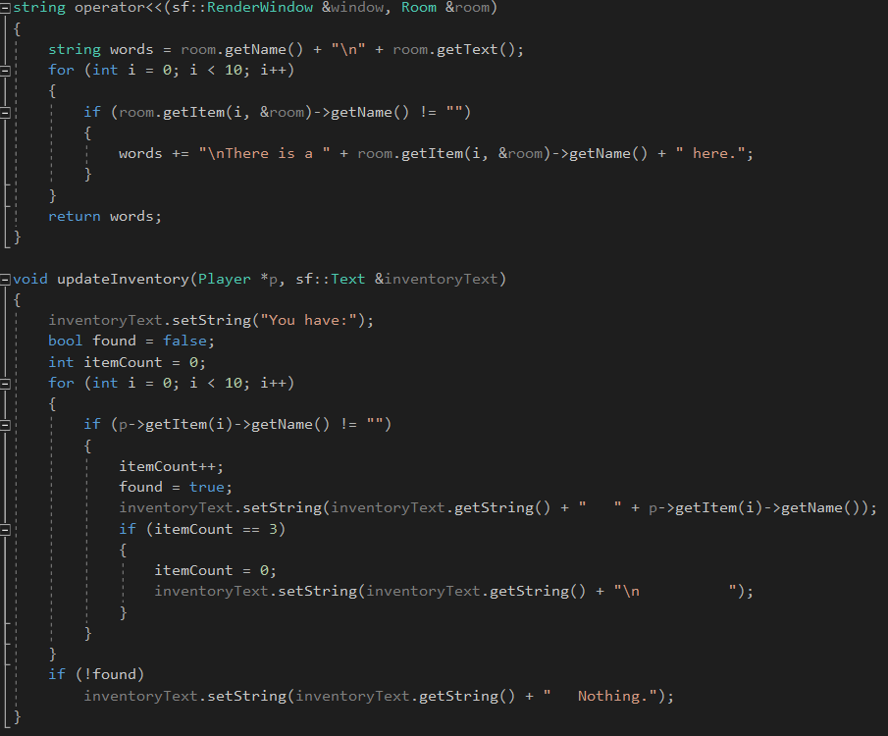

Slide 10
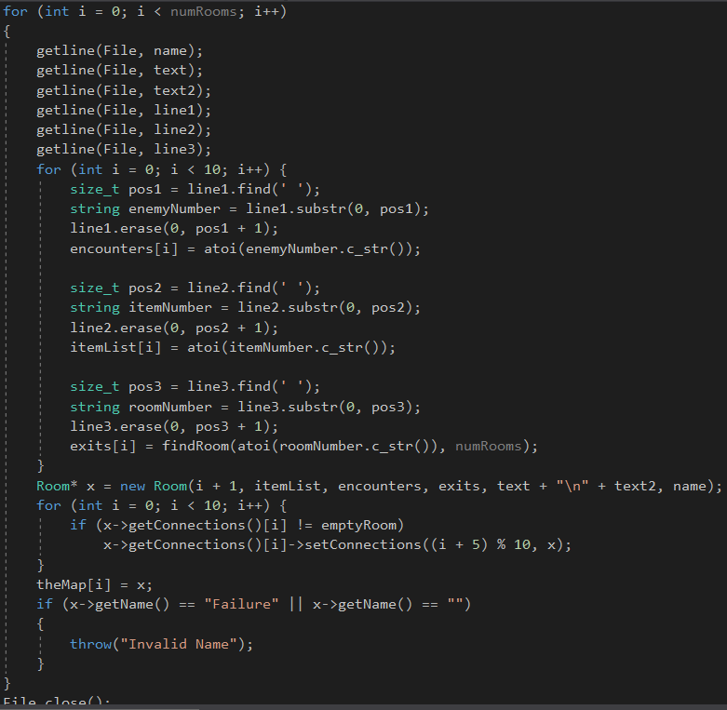

Slide 11
That’s all, Folks!
Are there any questions? (Note: Preferably don’t ask any questions)

