Slide 1
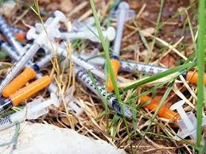
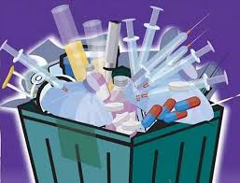
COMMON BIO-MEDICAL WASTE TREATMENT FACILITY
(CBMWTF)

Slide 2

BACKGROUND
‘Bio-medical waste’ means any solid and/or liquid waste including its container and any intermediate product, which is generated during the diagnosis, treatment or immunisation of human beings or animals or in research pertaining thereto or in the production or testing thereof.
Bio-medical Waste (Management & Handling) Rules, 1998 were notified by the Ministry of Environment & Forests (MoEF) under the Environment (Protection) Act, 1986. In exercise of the powers conferred by Section 6, 8 and 25 of the Environment (Protection) Act, 1986 (29 of 1986), and in supersession of the Bio-Medical Waste (Management and Handling) Rules, 1998 and further amendments made thereof, the Central Government vide G.S.R. 343(E) dated 28th March, 2016 published the Bio-medical Waste Management Rules, 2016.
These rules apply to all persons who generate, collect, receive, store, transport, treat, dispose, or handle bio medical waste in any form including hospitals, nursing homes, clinics, dispensaries, veterinary institutions, animal houses, pathological laboratories, blood banks, Ayush hospitals, clinical establishments, research or educational institutions, health camps, medical or surgical camps, vaccination camps, blood donation camps, first aid rooms of schools, forensic laboratories and research labs.

Slide 3
WHAT IS CBWTF ?
A Common Bio-medical Waste Treatment and Disposal Facility (CBWTF) is a set up where biomedical waste generated from member health care facilities is imparted necessary treatment to reduce adverse effects that this waste may pose on human health and environment. The treated recyclable waste may finally be sent for disposal in a secured landfill or for recycling.
According to the Bio-medical Waste Management Rules, 2016, "bio-medical waste treatment and disposal facility" means any facility wherein treatment, disposal of bio-medical waste or processes incidental to such treatment and disposal is carried out, and includes common bio-medical waste treatment facilities and "operator of a common bio-medical waste treatment facility" means a person who owns or controls a Common Bio-medical Waste Treatment and Disposal Facility (CBWTF) for the collection, reception, storage, transport, treatment, disposal or any other form of handling of bio-medical waste.

Slide 4
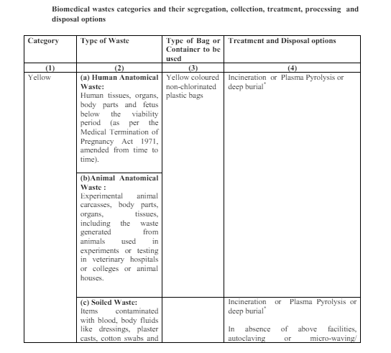
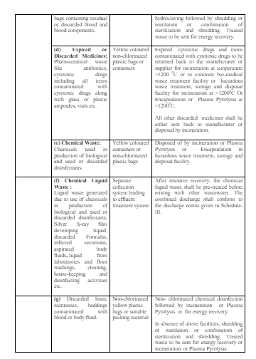

Slide 5
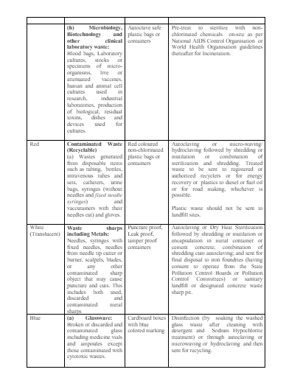
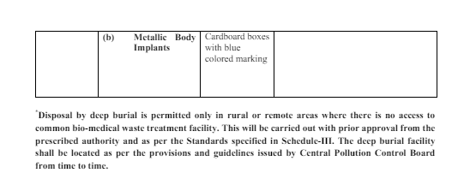

Slide 6
EIA CATEGORY FOR CBWTF
The project falls under Category B of project activity 7(da) as per the schedule of EIA Notification 2006.
For Bio-Medical Waste Treatment Facilities : 7 (da) Category as per the Schedule to the EIA Notification 2006 i.e. 1(d), 2(b), 5(f) etc.
Applicability of General Conditions of EIA Notification 2006: i.e. Ensure that:
(1) Protected areas notified under the Wildlife (Protection) Act, 1972;
(2) CEPI areas
(3) Eco-sensitive areas and
(4) Inter-state boundaries and international boundaries; are not located within 5 km or 10 km (as the case may be) area from the boundary of the proposed site.

Slide 7
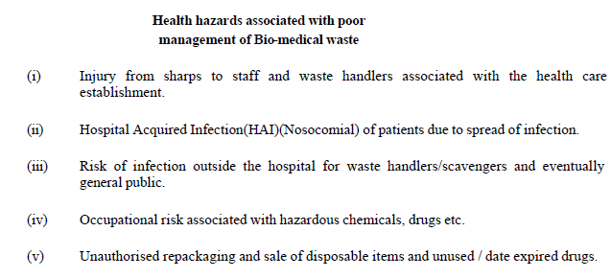
BMW RULES
The prescribed authority for enforcement of the provisions of these rules in respect of all the health care facilities located in any State/Union Territory is the respective State Pollution Control Board (SPCB)/ Pollution Control Committee (PCC) and in case of health care establishments of the Armed Forces under the Ministry of Defence shall be the Director General, Armed Forces Medical Services (DGAFMS).
These rules stipulate duties of the Occupier or Operator of a Common Bio-medical Waste Treatment Facility as well as the identified authorities. According to these rules, every occupier or operator handling bio-medical waste, irrespective of the quantity is required to obtain authorisation from the respective prescribed authority i.e. State Pollution Control Board and Pollution Control Committee, as the case may be. These rules consist of four schedules and five forms.

Slide 8
ADVANTAGES
The concept of CBWTF is not only addresses such problems but also prevents proliferation of treatment technologies in a particular town or city. In turn, it reduces the monitoring pressure on regulatory agencies.
By running the treatment equipment at CBWTF to its full capacity, the cost of treatment of per kilogram bio-medical waste gets significantly reduced.
Biomedical waste contains hazardous materials such as chemicals, pathogens, and pharmaceuticals. Adequate disposal prevents these substances from contaminating soil, water sources, and the air, thus safeguarding the environment.
By minimizing the improper disposal of biomedical waste, communities are shielded from potential health hazards associated with exposure to infectious agents and toxic substances.
Certain biomedical waste, like organic materials, can be processed to generate energy through methods such as incineration or anaerobic digestion, contributing to renewable energy production.

Slide 9
DISADVANTAGES
Failure to comply with biomedical waste management regulations can result in legal consequences, fines, and reputational damage for healthcare facilities and waste management entities. Non-compliance also undermines efforts to control disease outbreaks and environmental pollution.
Proper management of biomedical waste requires investment in infrastructure, equipment, training, and regulatory compliance measures. Healthcare facilities and waste management entities may face financial burdens associated with implementing and maintaining effective waste management systems.
Inadequate management of biomedical waste increases the risk of disease transmission within communities, as pathogens from improperly disposed waste can contaminate water sources, food supplies, and public spaces, posing a threat to public health.

Slide 10
REGULATORY FRAMEWORK
According to the Bio-Medical Waste Management Rules, 2016 the facility operators need to do the following for complying to rules :
It shall be the duty of every operator to -
Take all necessary steps to ensure that the bio-medical waste collected from the occupier is transported, handled, stored, treated and disposed of, without any adverse effect to the human health and the environment, in accordance with these rules and guidelines issued by the Central Government or, as the case may be, the central pollution control board from time to time;
Ensure timely collection of bio-medical waste from the occupier as prescribed under these rules;
Establish bar coding and global positioning system for handling of bio- medical waste within one year;
Inform the prescribed authority immediately regarding the occupiers which are not handing over the segregated bio-medical waste in accordance with these rules;

Slide 11
REGULATORY FRAMEWORK
Undertake appropriate medical examination at the time of induction and at least once in a year and immunise all its workers involved in handling of bio-medical waste for protection against diseases, including Hepatitis B and Tetanus, that are likely to be transmitted while handling bio-medical waste and maintain the records for the same;
Report major accidents including accidents caused by fire hazards, blasts during handling of biomedical waste and the remedial action taken and the records relevant thereto, (including nil report) in Form I to the prescribed authority and also along with the annual report;
Maintain a log book for each of its treatment equipment according to weight of batch; categories of waste treated; time, date and duration of treatment cycle and total hours of operation;
Shall display details of authorisation, treatment, annual report etc on its web-site;
After ensuring treatment by autoclaving or microwaving followed by mutilation or shredding, whichever is applicable, the recyclables from the treated bio-medical wastes such as plastics and glass, shall be given to recyclers having valid consent or authorisation or registration from the respective State Pollution Control Board or Pollution Control Committee;
Maintain all record for operation of incineration, hydroor autoclaving for a period of five years; and
Upgrade existing incinerators to achieve the standards for retention time in secondary chamber and Dioxin and Furans within two years from the date of this notification.

Slide 12
AUTHORISATION PROCESS
Every operator handling the bio medical waste must apply in form II to concerned SPCB along with the required fee .
Documents will be scrutinised by SPCB or PCC to assess the capabilities and capacity of CBMWTF.
A site inspection will be conducted and consequently report will be prepared .
The SPCB will grant the authorization in form III after successful inspection & redressal of all issues .
The authorization will be granted within 90 days of successful submission of the application .

Slide 13
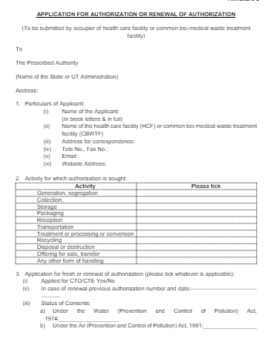
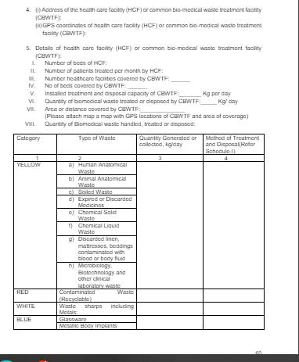

Slide 14
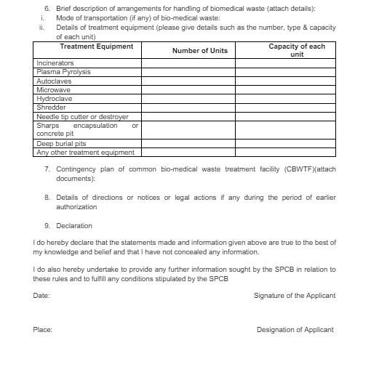

Slide 15
DOCUMENTS REQUIRED
LAYOUT PLAN
POLLUTION NOCs FROM SPCB
LETTER OF REQUISITION
TREATMENT, DISPOSAL & STORAGE FACILITY AGREEMENT COPY
MAP WITH GPS COORDINATES OF CBMWTF & AREA OF COVERAGE
APPLICATION FORM OF BIOMEDICAL WASTE MANAGEMENT RULES 2016
CONTINGENCY PLAN OF CBMWTF
COPY OF MANIFESTS OF LIFTING WASTE
AFFIDAVIT SELF DECLARATION FOR OWNERSHIP
SELF DECLARATION / AFFIDAVIT FOR LIQUID WASTE TREATMENT
ENVIRONMENTAL CLEARANCE
HAZARDOUR WASTE MANAGEMENT AUTHORIZATION

Slide 16
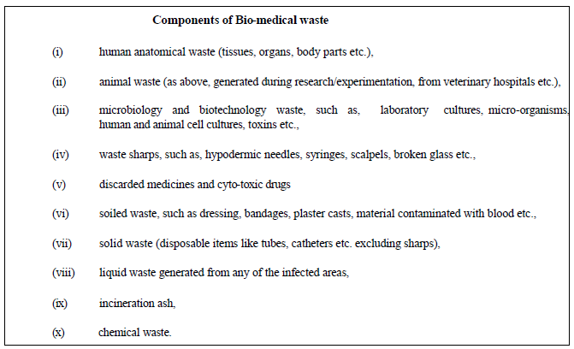
BMW COMPONENTS

Slide 17
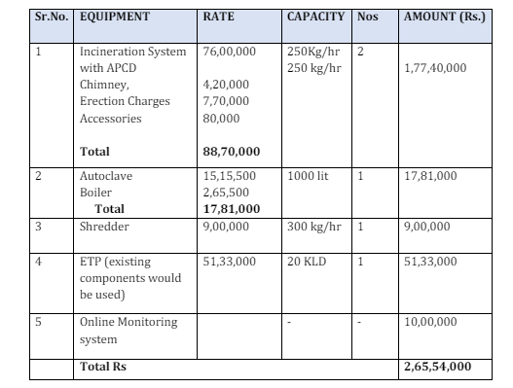
INVESTMENT DETAILS
EQUIPMENT COST ANALYSIS

Slide 18
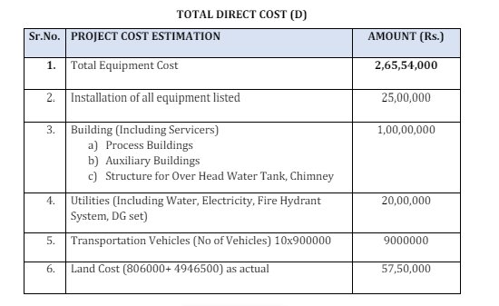
INVESTMENT DETAILS
This is the approximate cost estimate of CBMWT facility . The actual cost amount can vary depending on market scenario and capacity of the facility .

Slide 19
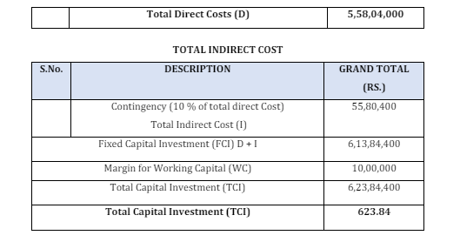
INVESTMENT DETAILS

Slide 20
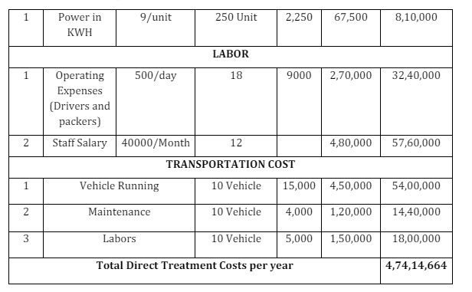
INVESTMENT DETAILS
This is the approximate cost estimate of CBMWT facility . The actual cost amount can vary depending on market scenario and capacity of the facility .

Slide 21
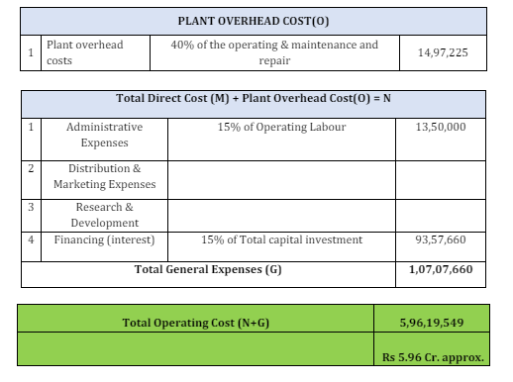
INVESTMENT DETAILS

Slide 22
RECYCLING BMW PROCESS STEPS
Segregation, Storage &Type of Treatment
Only segregated waste will be collected from the source point. Storage of the untreated and treated Bio Medical waste in a proper way as clearly labelled & in designated storage areas only as per the guideline. Waste shall be store in leak proof bags and properly sealed containers.
Cleanliness of roads and storage area is done regularly to prevent accumulation of dust and waste material. Treated waste will be stored at separate storage area.
Adequate storage will be provided for Treated, Untreated BMW and other Hazardous wastes.
Transportation System for Collection of BMW
The bio-medical waste collected will be transported to the CBWTF in a fully covered vehicle designed as per the CPCB guideline for CBMWTF. Such vehicle shall be dedicated for transportation of bio-medical waste only.
Depending upon the volume of the wastes to be transported, the vehicle may be a three-wheeler, light motor vehicle or heavy duty vehicle. The vehicle shall be labelled with the bio-medical waste symbol (as per the schedule IV of the BMWM rule) and shall display the name, address and telephone number of the CBWTF.
Reuse/ Recycle of BMW
Disinfected materials (Shredded plastic, glass etc.) will be sent to authorized recyclers

Slide 23
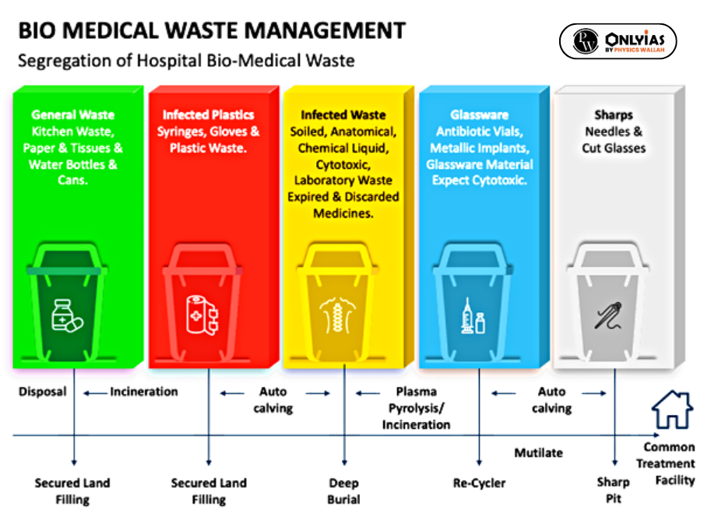

Slide 24
PROCESS & TECHNOLOGY
Total bio-medical waste treatment capacity of the facility (MT/day) is 14
Raw material for CBWTF is the hospital wastes, medical facilities waste, nursing homes etc.
Sr. No. | Facility | Capacity | Working hours per day and no. of days per year | Waste to be Handled (MT/day)
1 | Incinerator | 200 kg/hr x 2 Nos. 100 kg/hr x 1 Nos. | 20 hr and 365 days | 10
2 | Autoclave / Disinfection | 450 lit/hr x 2 Nos. | 12 hr and 365 days | 4
3 | Shredder | 100 kg/hr x 2 Nos. | 20 hr and 365 days | 4

Slide 25
WASTE TREATMENT AND DISPOSAL
Incineration
This is a high temperature thermal process employing combustion of the waste under controlled condition for converting them into inert material and gases. Incinerators can be oil fired or electrically powered or a combination thereof.
Broadly, three types of incinerators are used for hospital waste : multiple hearth type, rotary kiln and controlled air types. All the types can have primary and secondary combustion chambers to ensure optimal combustion. These are refractory lined.
In the Bio-medical Waste (Management and Handling) Rules, Incineration has been recommended for human anatomical waste, animal waste, cytotoxic drugs, discarded medicines and soiled waste.
Autoclave Treatment
This is a process of steam sterilisation under pressure. It is a low heat process in which steam is brought into direct contact with the waste material for duration sufficient to disinfect the material. These are also of three types : Gravity type, Pre-vacuum type and Retort type.

Slide 26
WASTE TREATMENT AND DISPOSAL
Hydroclave Treatment
Hydroclave is an innovative equipment for steam sterilisation process (like autoclave). It is a double walled container, in which the steam is injected into the outer jacket to heat the inner chamber containing the waste. Moisture contained in the waste evaporates as steam and builds up the requisite steam pressure (35-36 psi). Sturdy paddles slowly rotated by a strong shaft inside the chamber tumble the waste continuously against the hot wall thus mixing as well as fragmenting the same. In the absence of enough moisture, additional steam is injected. The system operates at 132 deg.C. and 36 psi steam pressure for sterilisation time of 20 minutes. The total time for a cycle is about 50 minutes, which includes start-up, heat-up, sterilisation, venting and depressurisation and dehydration. The treated
material can further be shredded before disposal. The expected volume and weight reductions are upto 85% and 70% respectively.
Microwave Treatment
This again is a wet thermal disinfection technology but unlike other thermal treatment systems, which heat the waste externally, microwave heats the targeted material from inside out, providing a high level of disinfection.

Slide 27
PLANT SPECIFICATIONS
Salient features of the project including Water, Air and Hazardous waste management
Sr. No. | Particulars | Details
1 | Total cost of Proposed Project (Rs. in Crores) | Rs. 6 Crore
2 | Total Plot area ( sq. meter) | 4,292 sq.m.
 | Green belt area,/Tree Plantation area ( sq. meter) | 1,417 sq.m. (33%)
3 | Employment generation | 40 Persons
4 | Water
i | Source of Water Supply (Bore well, Surface water, Tanker supply etc.) | Borewell
ii | Water consumption (KLD)
 | 1) Total water requirement for the project: 17 KLD 2) Quantity to be recycled: 8.2 KLD 3) Total fresh water requirement: 8.8 KLD
iii | Waste water generation (KLD): 6.5 KLD
iv | Treatment facility within premises with capacity [For existing and Proposed] [In-house ETP (Primary, Secondary, Tertiary), MEE, Stripper, Spray Dryer, STP etc.

Slide 28
PLANT SPECIFICATIONS
Sr. No. | Particulars | Details
v | In case of Common facility (CF) like CETP, Common Spray dryer, Common MEE, CHWIF etc. : Name of Common facility
5 | Air
i | Flue gas emission details No. of Boilers/TFH/Furnaces/DG sets etc. with capacities viz. TPH, Kcal/hr, MT/hr, KVA etc. | D.G. set (82.5 kVA)
ii | Process gas i.e. Type of pollutant gases (SO2, HCL, NH3, CL2, NOx etc.)
 | Incinerator (200 kg/hr): (Dry Technology) Collection Unit, Air Cooler, Gas neutralization unit, Filter unit Incinerator (100 kg/hr): (Wet Technology) Quencher, Venturi Scrubber, Droplet Separator
6 | Hazardous waste
 | Used oil (30 Lit/Year); Incineration Ash (300MT/A), ETP Sludge (60MT/A)

Slide 29
FAQs
How to dispose the Bio-Medical Waste?
Ans The Bio-Medical Waste shall be segregated as per the colour coding (Yellow, Red, White & Blue). The segregated waste shall be disposed to concerned Common Bio-Medical Waste Treatment Facility operating in the area, on daily basis.
Who will issued the BMW Authorisation?
Ans The Member Secretary / Zonal Officer / Regional Officer of the Board shall grant the BMW Authorisation as per the delegation of powers.
Who require authorisation under Bio-Medical Waste Management Rules, 2016 ?
Ans As per the Rule 10 of BMWM Rules, every Health Care Facility i.e., occupier or operator handling Bio Medical Waste irrespective of the quantity such as hospitals, nursing homes, clinics, dispensaries, veterinary institutions, animal houses, pathological laboratories, blood banks, ayush hospitals, clinical establishments, research or educational institutions, health camps, medical or surgical camps, vaccination camps, blood donation camps, first aid rooms of schools, forensic laboratories and research labs shall obtain authorisation of the Board.

Slide 30
THANKS!

