Slide 1
CORPUS
CDN Manager
End-user guide
Every screen in the console, with what to do on it.
Screenshots are the live preview, 8 October 2026.
For NOC, franchisee staff, support, and billing
CDN Manager · End-user guide
1

Slide 2
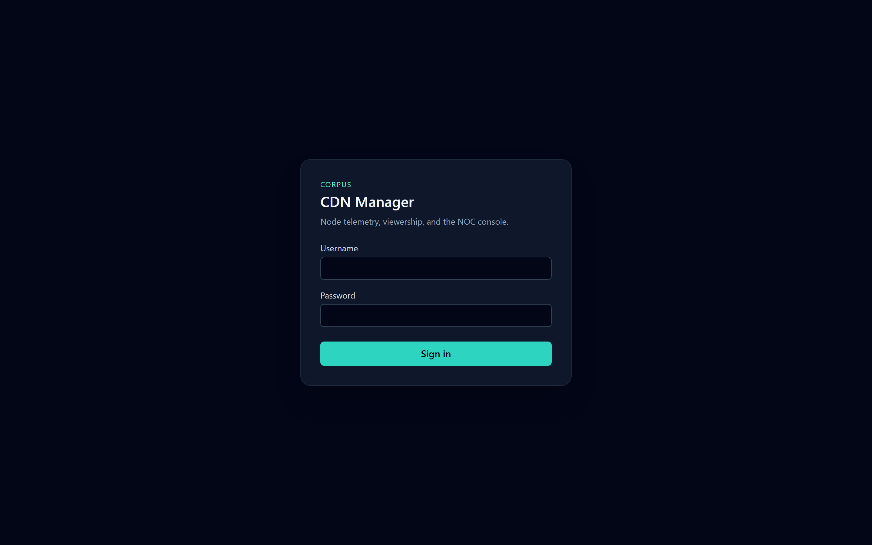
ENTER
Sign in, then use the left menu
• Open the address you were given and choose Sign in.
• Your role and name sit under CDN Manager. The menu shows only your pages.
• A wrong password says “Unknown username or password.”
• Choose Sign out at the bottom when you leave a shared desk. A session lasts 8 hours.
Live console · 8 October 2026
CDN Manager · End-user guide
2

Slide 3
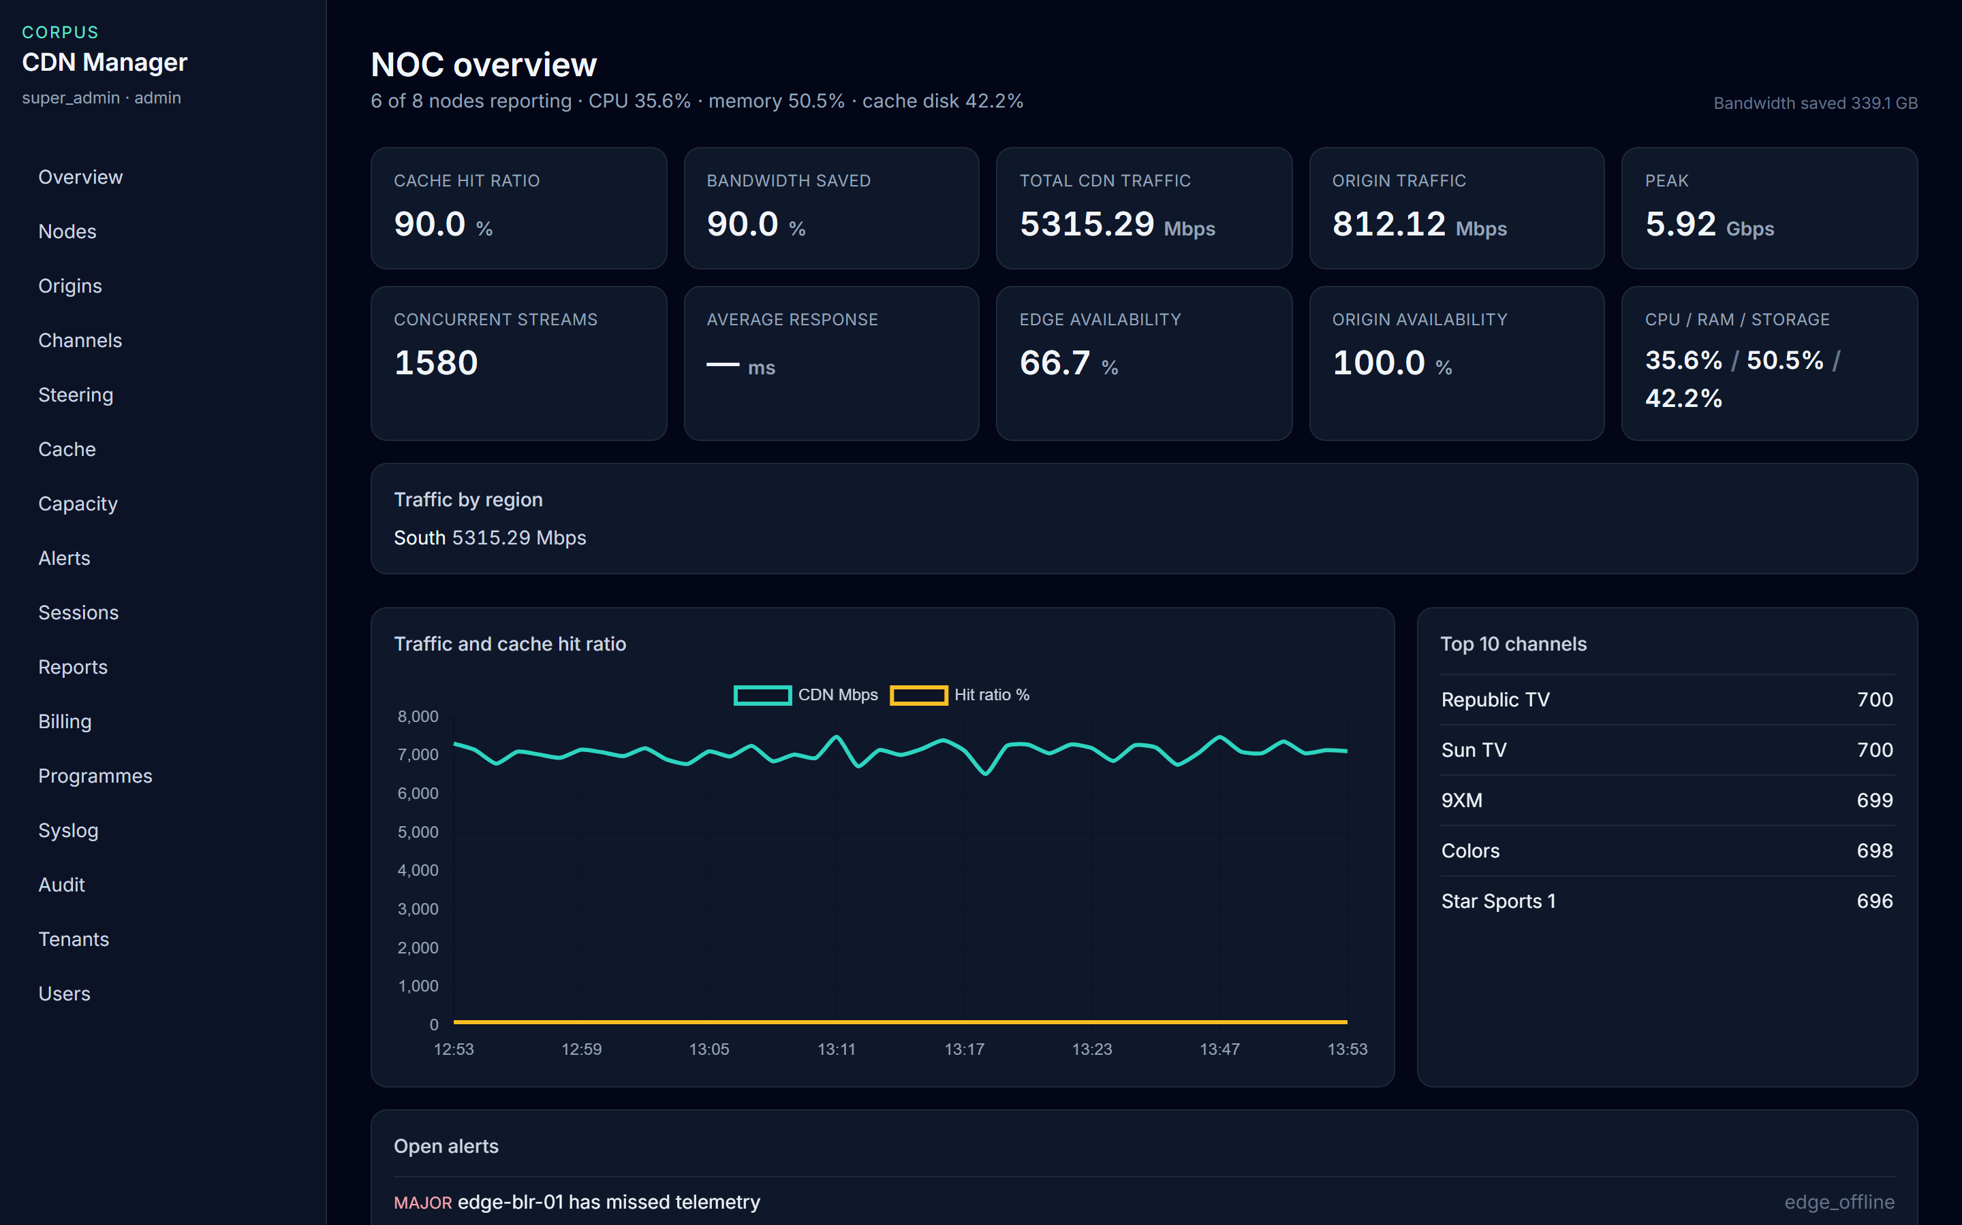
START OF SHIFT
Quote the tiles on Overview
• Cache hit 90%. Bandwidth saved 90%. CDN traffic 5,315.29 Mbps. Peak 5.92 Gbps.
• Origin traffic 812.12 Mbps. Origin availability 100%. Edge availability 66.7%.
• South is carrying 5,315.29 Mbps. Republic TV and Sun TV lead at 700.
• edge-blr-01 has missed telemetry. That is why six of eight nodes are reporting.
Live console · 8 October 2026
Read CPU from the tile, 35.6%. The chart scale is set by Mbps, so the hit-ratio line sits on the axis.
CDN Manager · End-user guide
3

Slide 4
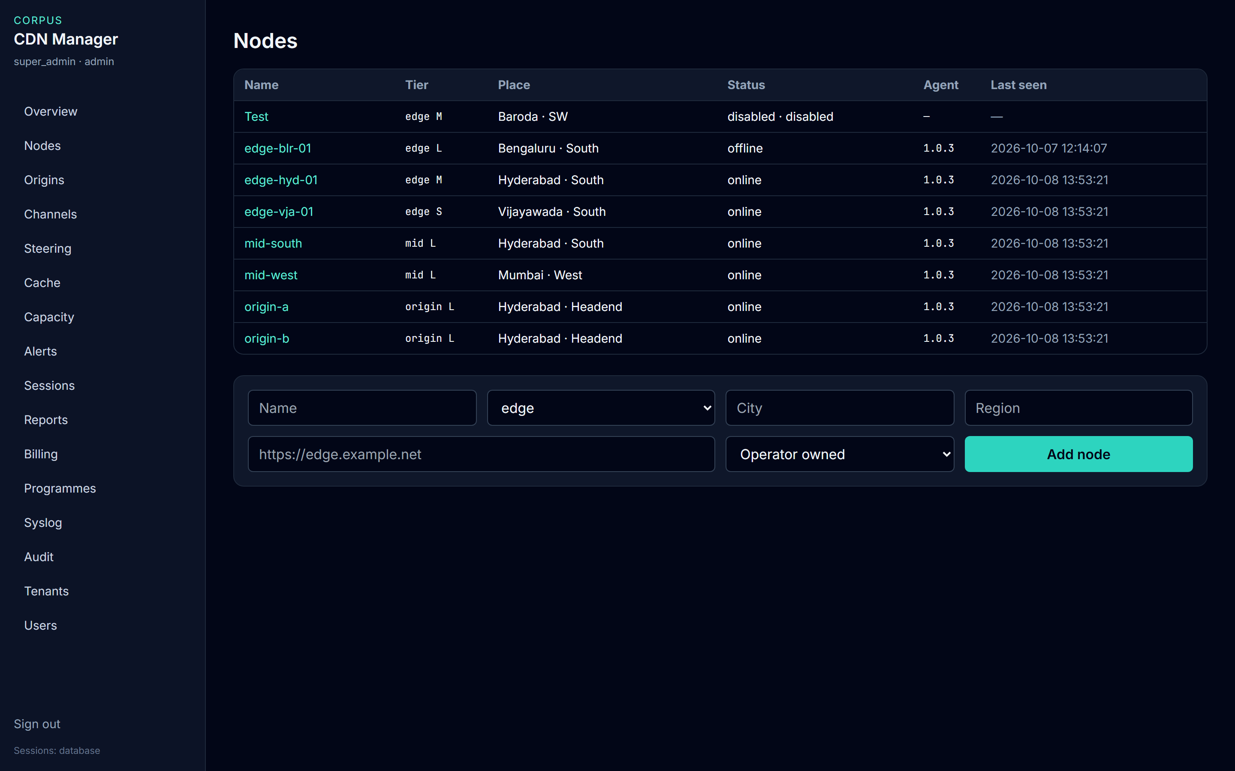
ESTATE
Find the node, then open its name
• Status online means telemetry just arrived. Offline means nothing for about 45 seconds.
• Disabled means the node is turned off and cannot report.
• edge-blr-01 is the offline edge. The Test node is disabled on purpose.
• NOC uses Add node. Enable and Disable are on the node page.
Live console · 8 October 2026
CDN Manager · End-user guide
4

Slide 5
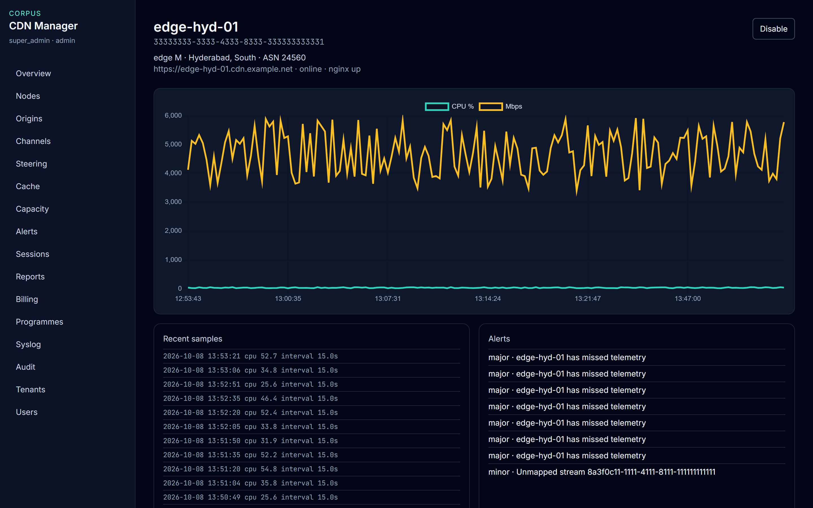
ONE EDGE
edge-hyd-01 is serving Hyderabad
• The page says online and nginx up.
• Recent samples show CPU moving through roughly 25–55%.
• Do not read CPU from the flat line on the chart. That line is flattened by the Mbps scale.
• Disable stops this node from accepting telemetry.
Live console · 8 October 2026
CDN Manager · End-user guide
5

Slide 6
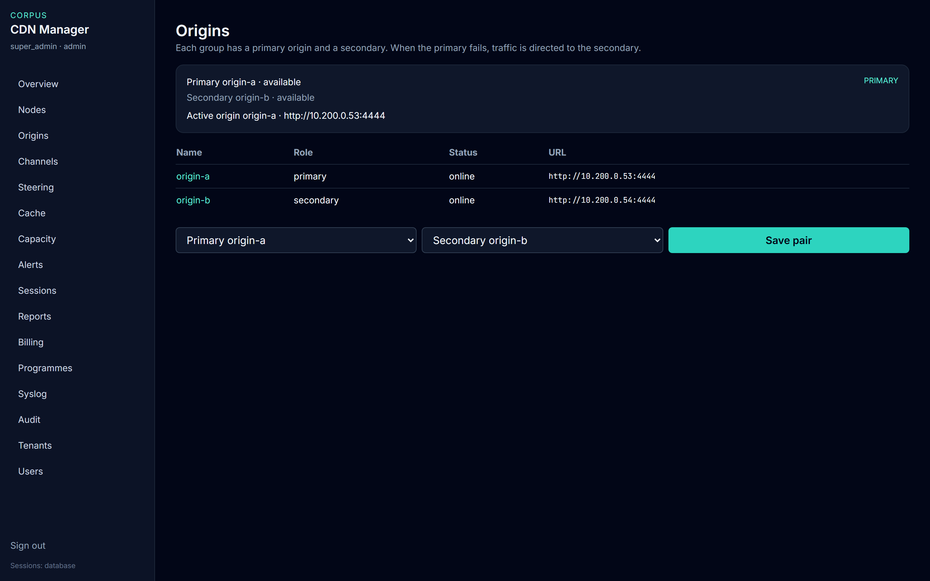
CONTINUITY
Keep a secondary origin ready
• origin-a is primary and available. origin-b is secondary and available.
• The active origin is origin-a, so traffic is not redirected.
• If the primary goes offline, this card names the secondary instead.
• NOC chooses the two origins and selects Save pair. The change is audited.
Live console · 8 October 2026
CDN Manager · End-user guide
6

Slide 7
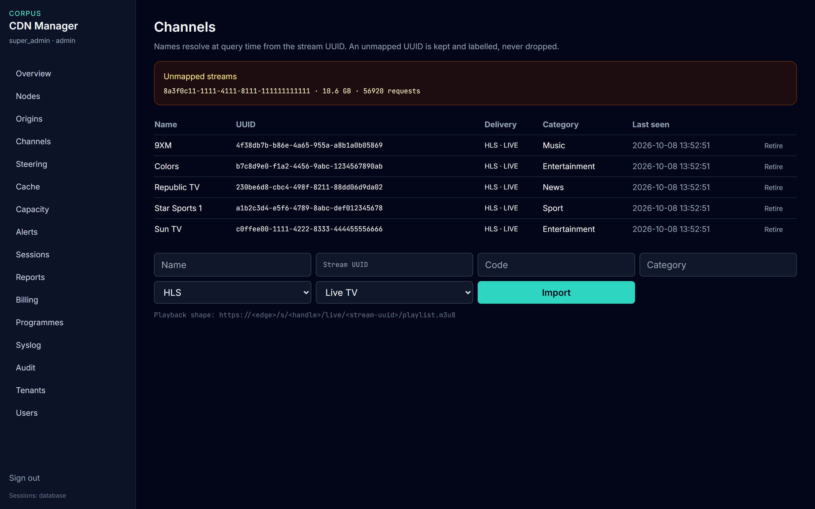
CATALOGUE
Name the stream, or it stays unmapped
• The amber box is 10.6 GB and 56,928 requests with no channel name. Those bytes are kept.
• Each row shows HLS and Live. Import can also be DASH, both, or VOD.
• Fill Name and Stream UUID, then choose Import.
• Retire only when the channel is finished. That UUID cannot be given a new name.
Live console · 8 October 2026
CDN Manager · End-user guide
7

Slide 8
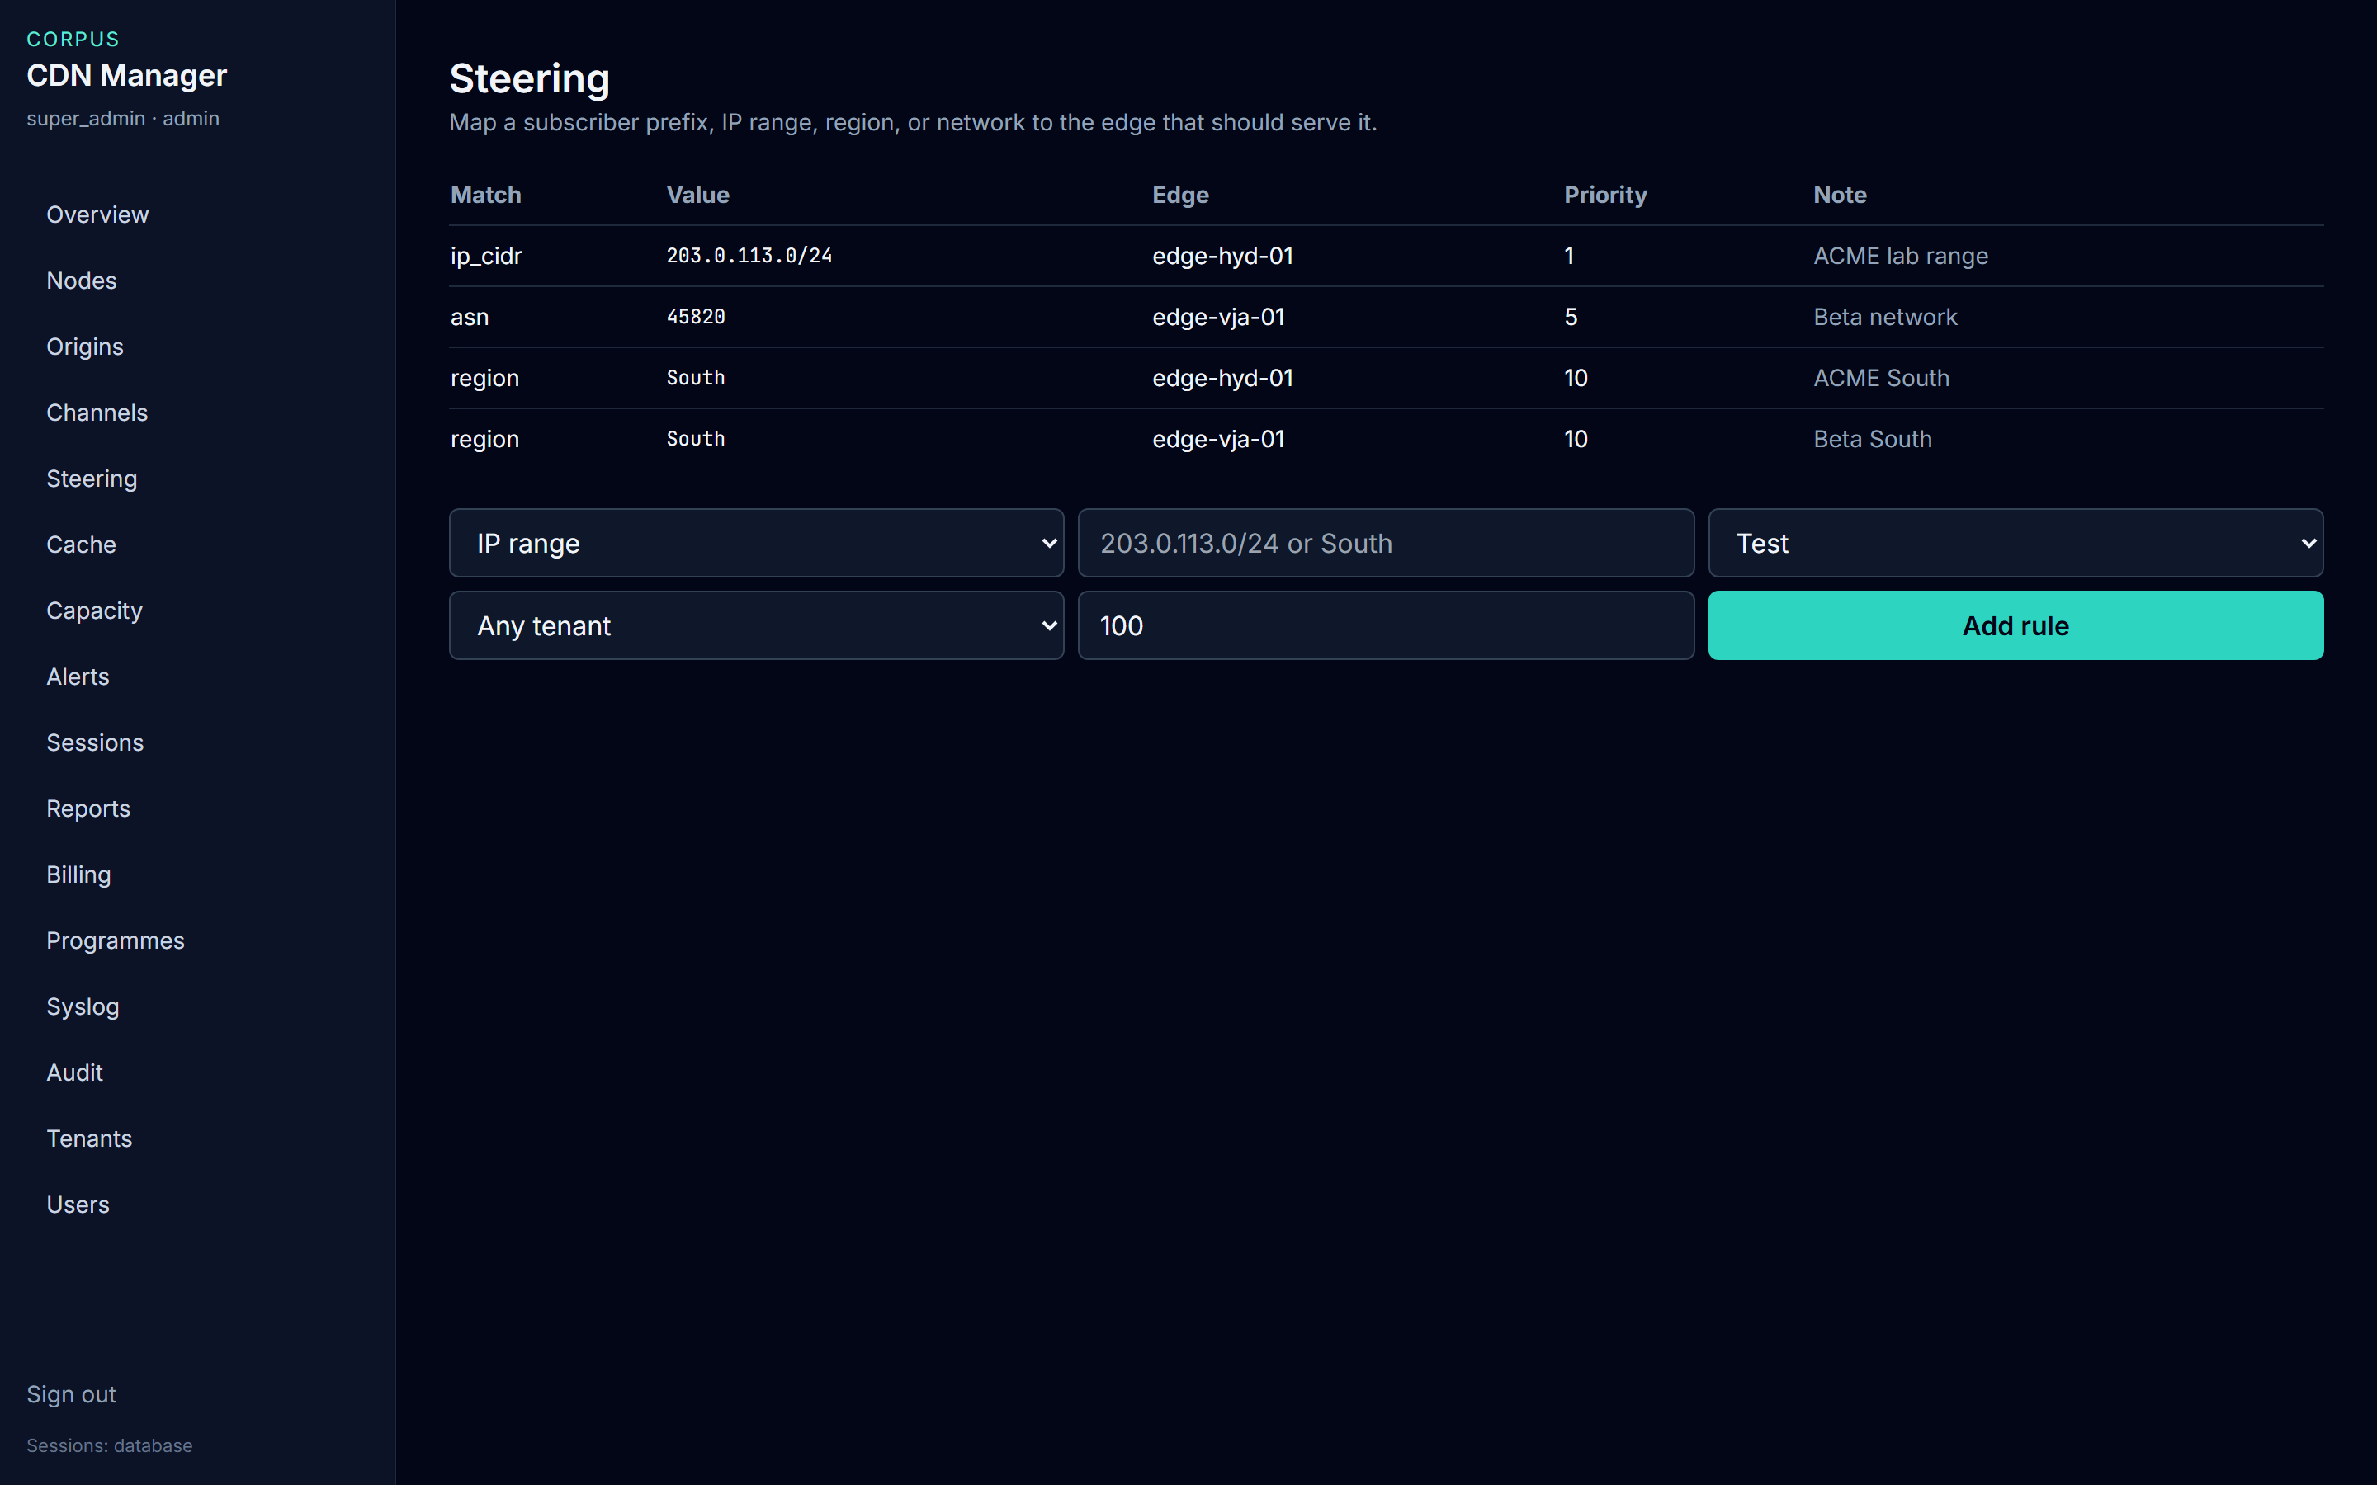
PLACEMENT
Send the viewer to the right edge
• The lab range 203.0.113.0/24 uses edge-hyd-01. Priority 1 wins over a broader rule.
• ACME South uses edge-hyd-01. Beta South and network 45820 use edge-vja-01.
• NOC picks the match, the value, the edge, and the franchisee, then Add rule.
• A franchisee account sees only its own rules.
Live console · 8 October 2026
CDN Manager · End-user guide
8

Slide 9
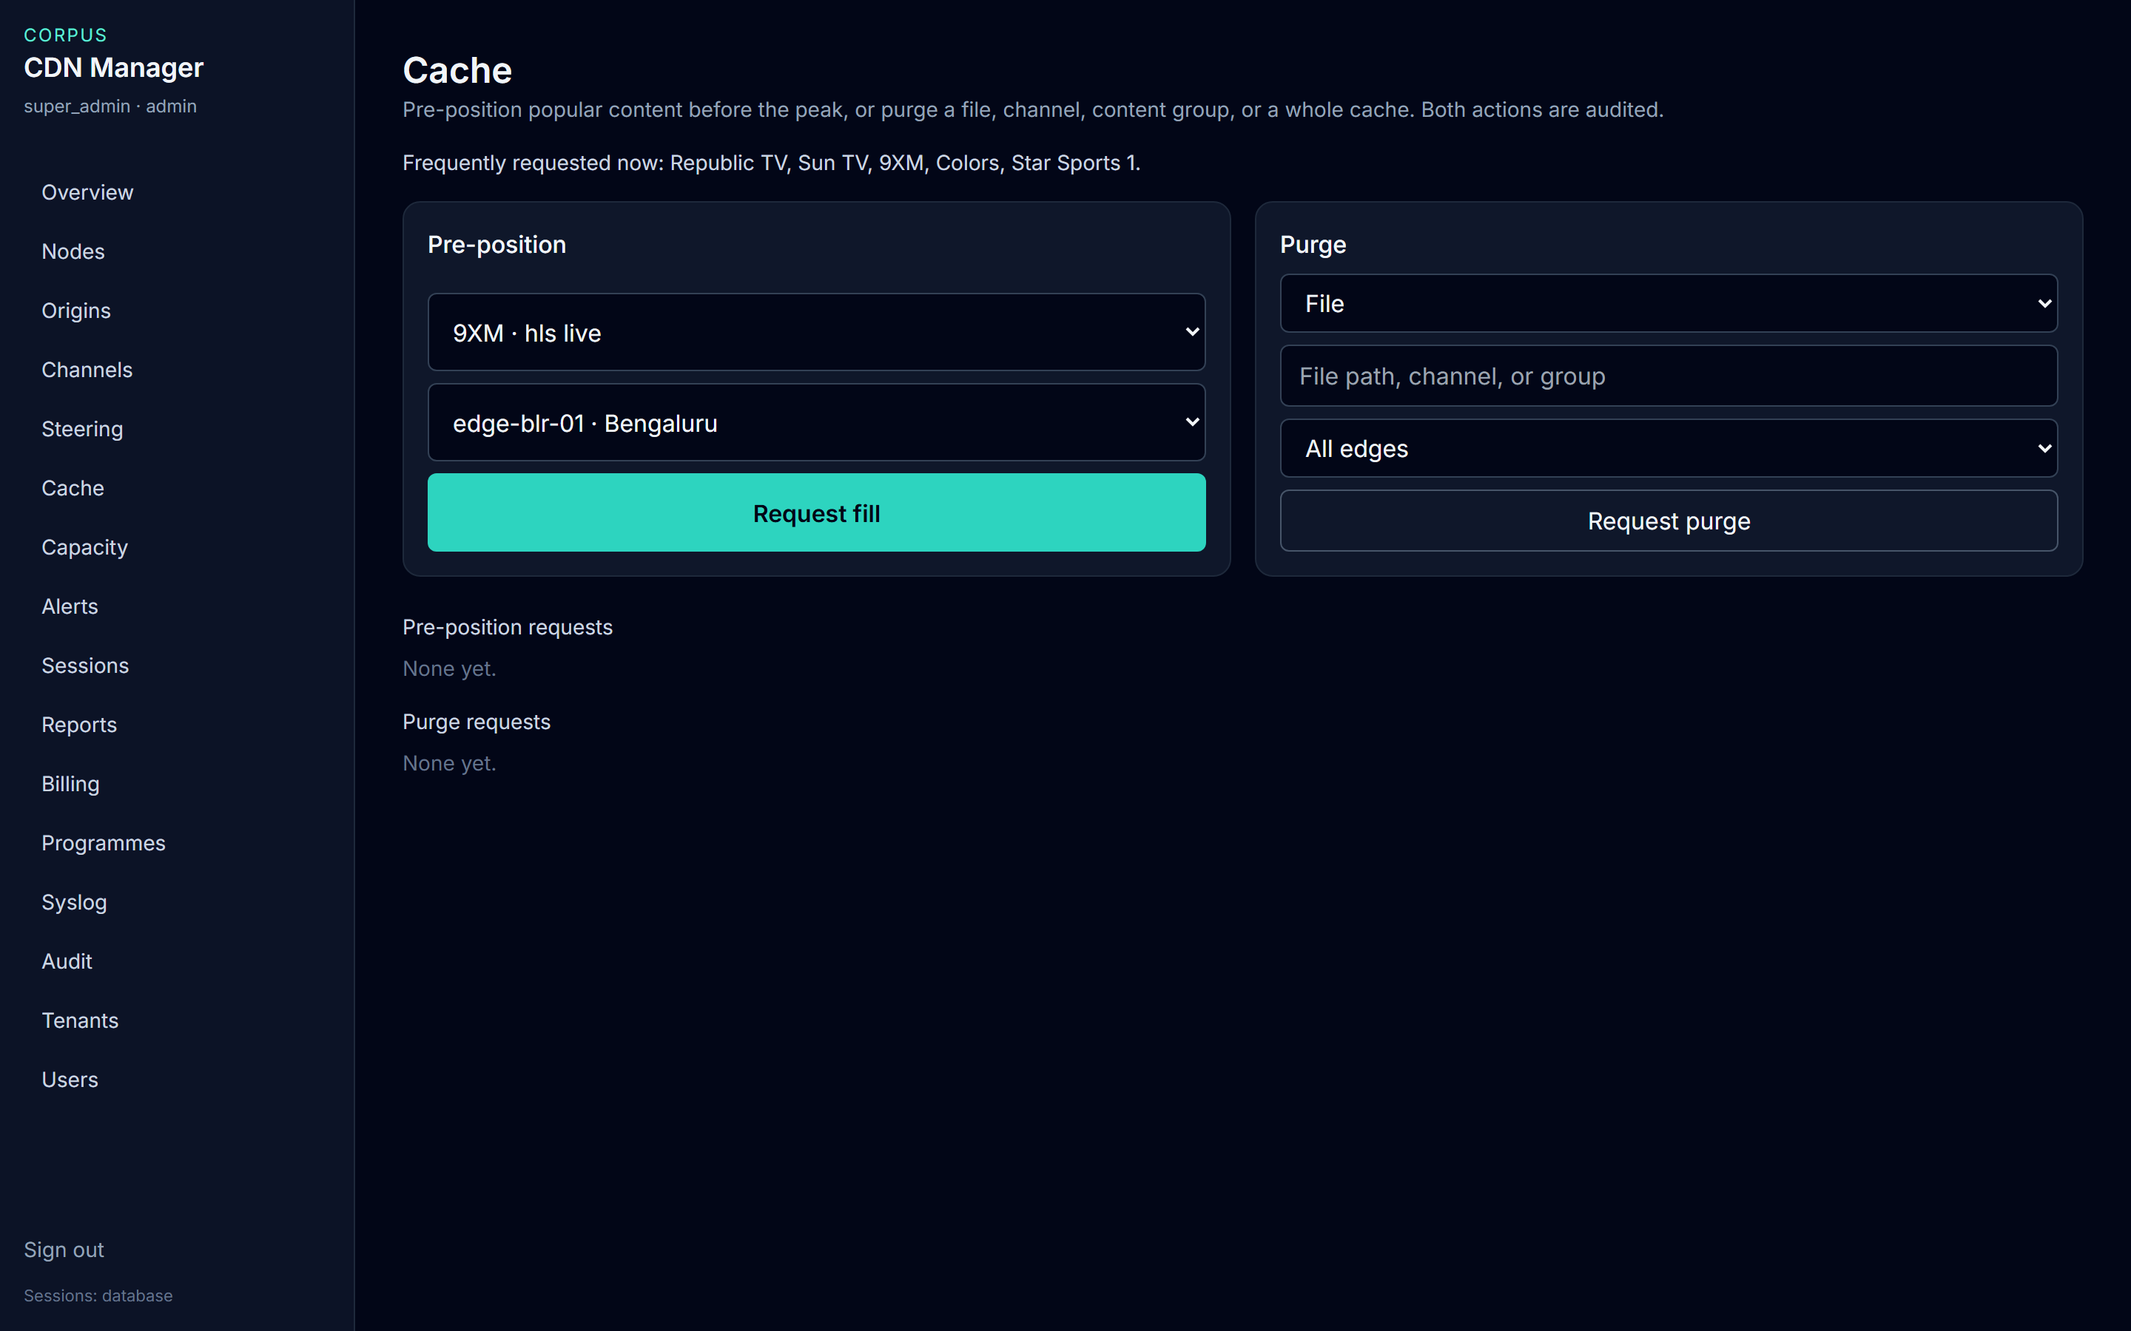
BEFORE THE PEAK
Fill a title, or purge what is stale
• Busy now: Republic TV, Sun TV, 9XM, Colors, Star Sports 1.
• Pre-position: pick the channel and the edge, then Request fill.
• Purge: file, channel, content group, or a complete cache, on one edge or all edges.
• Both requests are listed below the forms and written to Audit.
Live console · 8 October 2026
CDN Manager · End-user guide
9

Slide 10
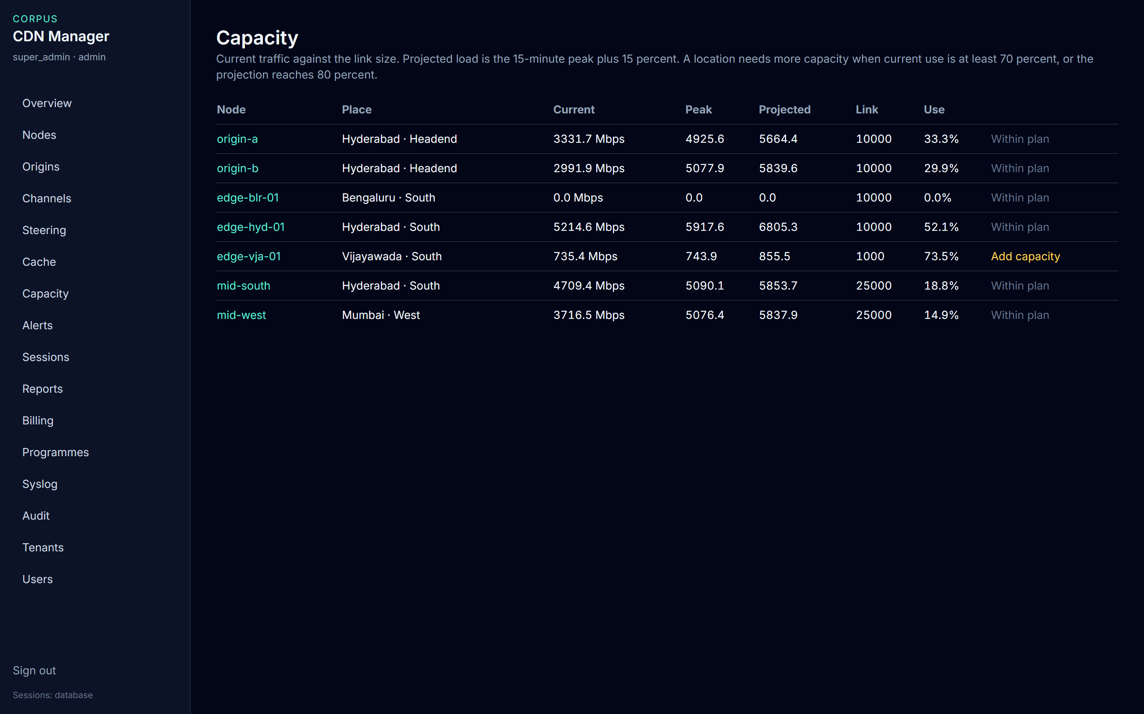
GROWTH
edge-vja-01 needs more capacity
• Current use there is 73.5% of a 1,000 Mbps link, so the row says Add capacity.
• edge-hyd-01 is at 52.1% and is within plan. edge-blr-01 is at zero because it is offline.
• Projected load is the 15-minute peak plus 15 percent.
• Add capacity is a planning mark. It does not change the node by itself.
Live console · 8 October 2026
CDN Manager · End-user guide
10

Slide 11
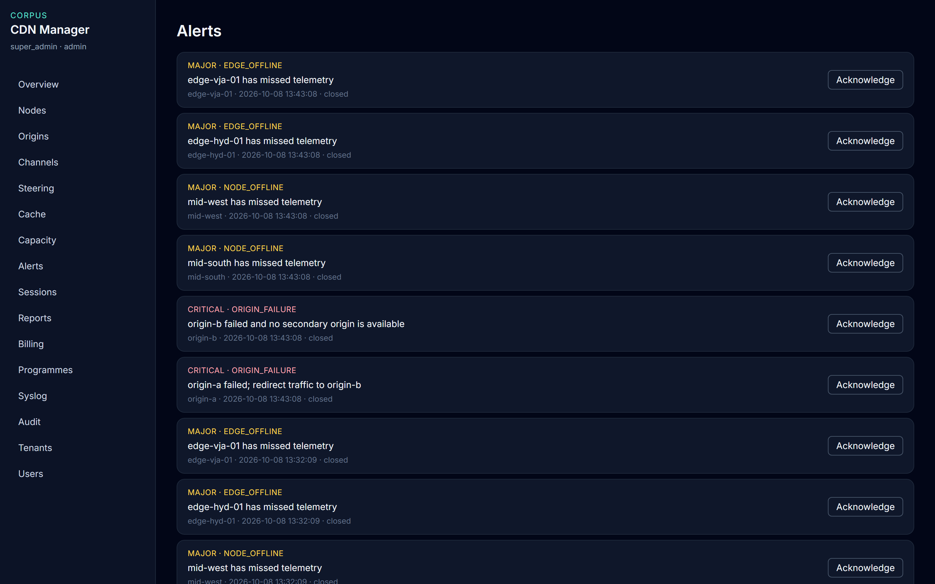
EXCEPTIONS
Acknowledge means you have seen it
• Open alerts on Overview are the ones still in force. This list also keeps closed ones.
• Major covers a missed node, disk pressure, and high bandwidth. Critical covers an origin failure or traffic above the link.
• Choose Acknowledge only after someone owns the condition.
• Billing accounts do not get this button.
Live console · 8 October 2026
CDN Manager · End-user guide
11

Slide 12
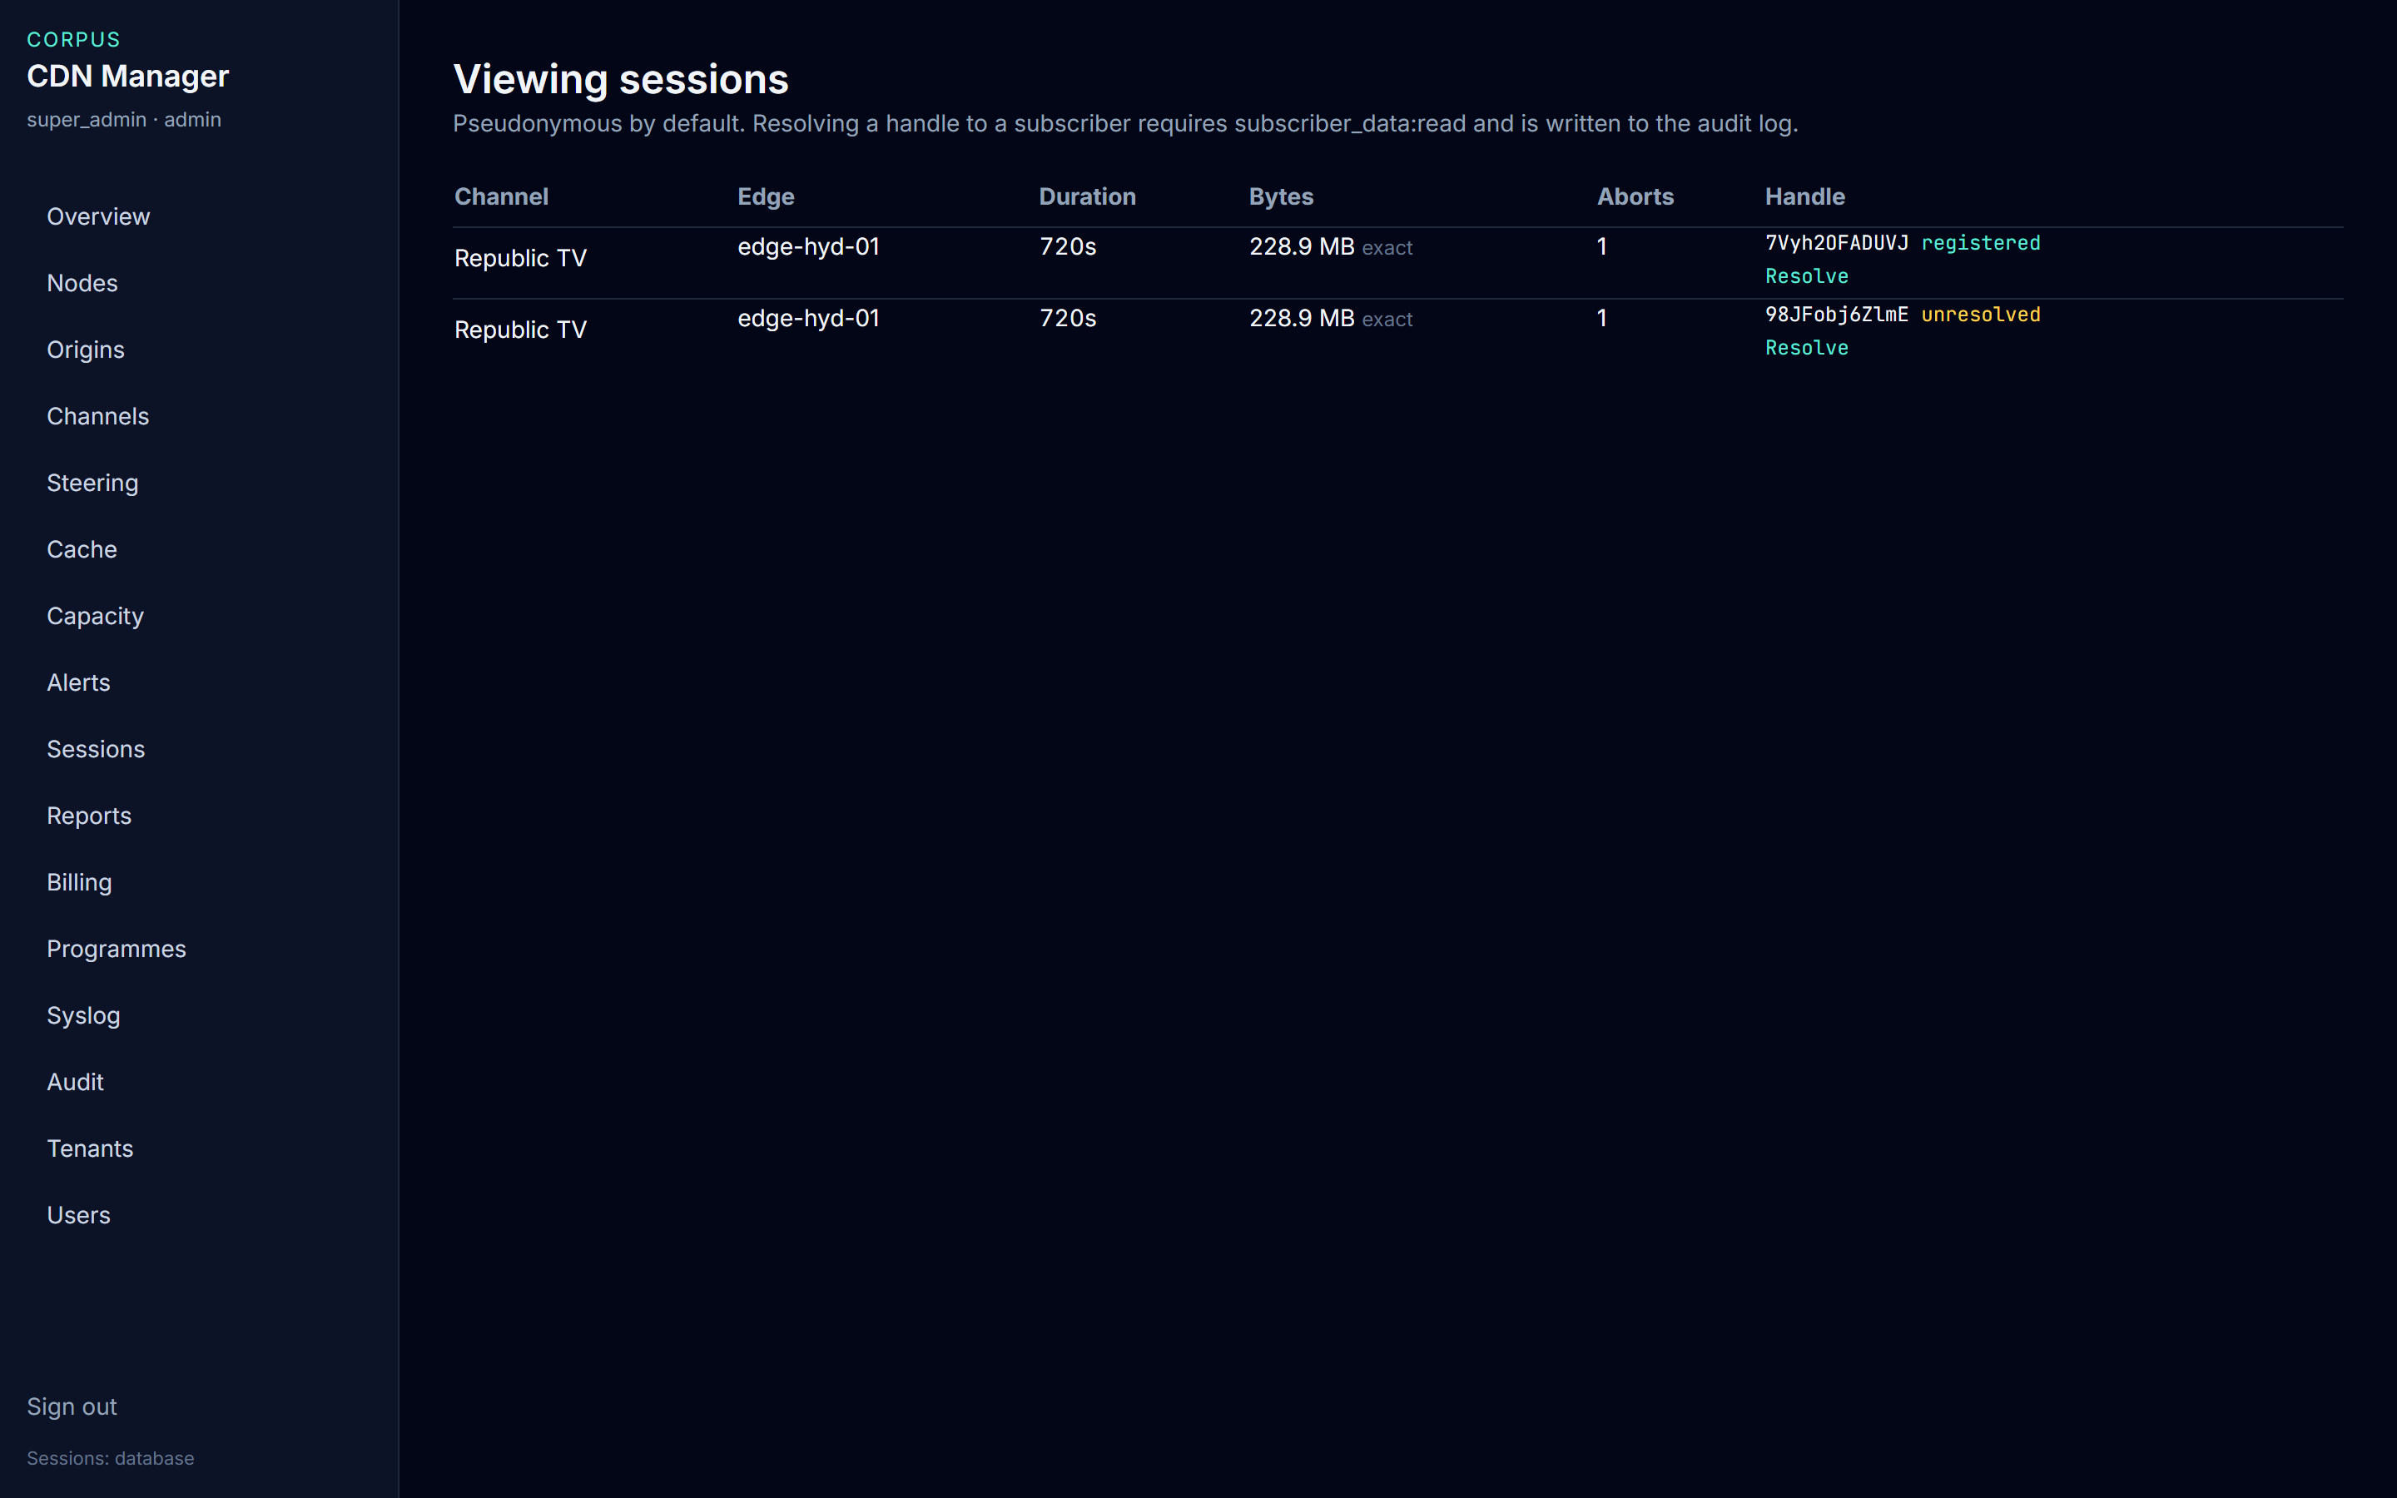
PRIVACY
Resolve one row, and your name is logged
• Both rows are Republic TV on edge-hyd-01, 720 seconds, 228.9 MB.
• registered can return a subscriber code. unresolved will not invent one.
• Resolve appears only when your account has subscriber data read.
• NOC does not have that permission. Support for another franchisee will not see the row.
Live console · 8 October 2026
CDN Manager · End-user guide
12

Slide 13
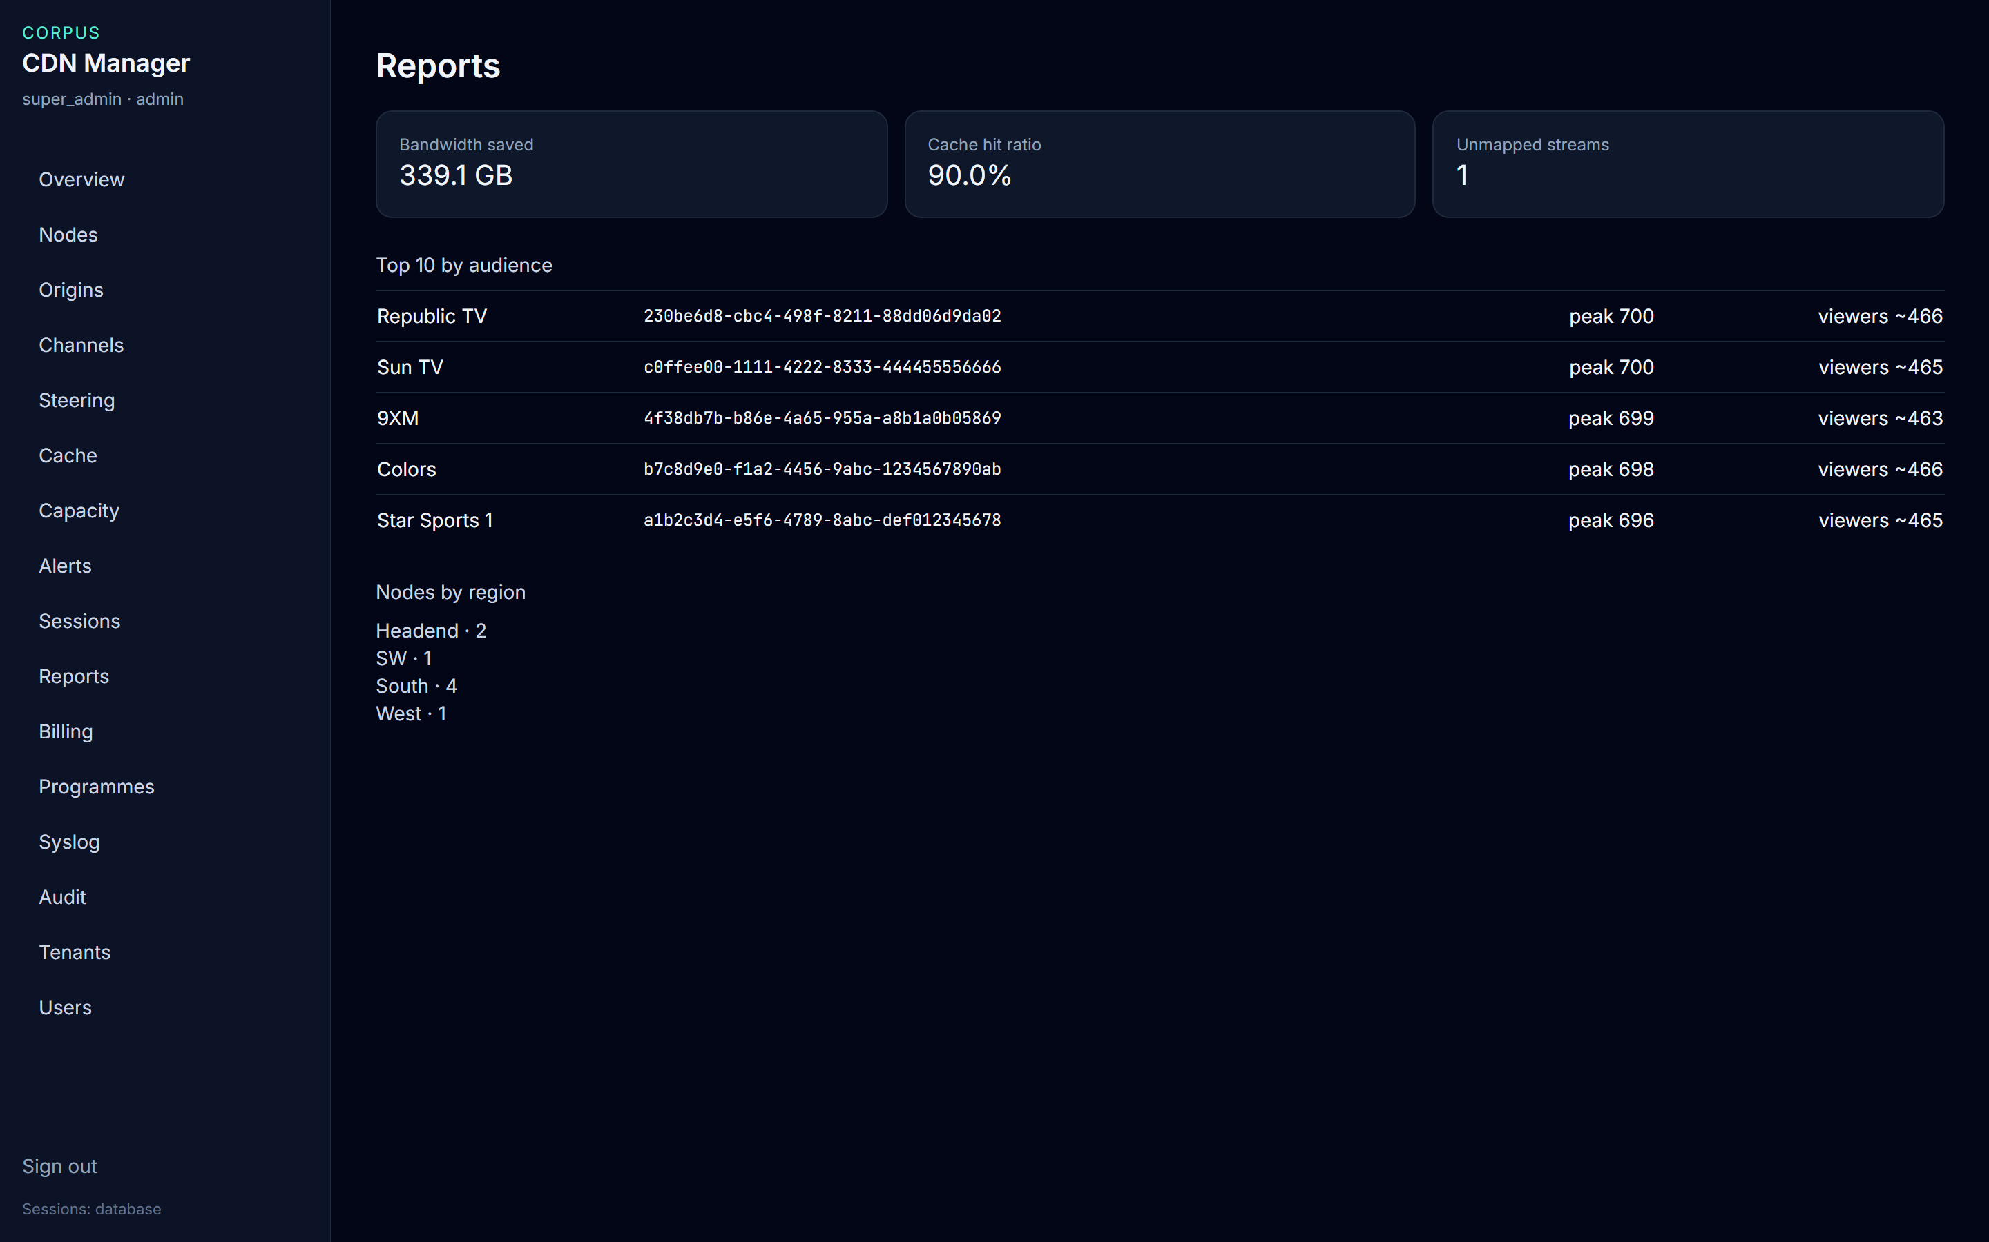
AUDIENCE
Reports is the figure to hand on
• Bandwidth saved 339.1 GB. Cache hit ratio 90%. One stream is still unmapped.
• Top 10 is the last six hours: peak concurrent and an estimated viewer count.
• Republic TV and Sun TV are both at peak 700.
• Nodes by region: Headend 2, SW 1, South 4, West 1.
Live console · 8 October 2026
CDN Manager · End-user guide
13

Slide 14
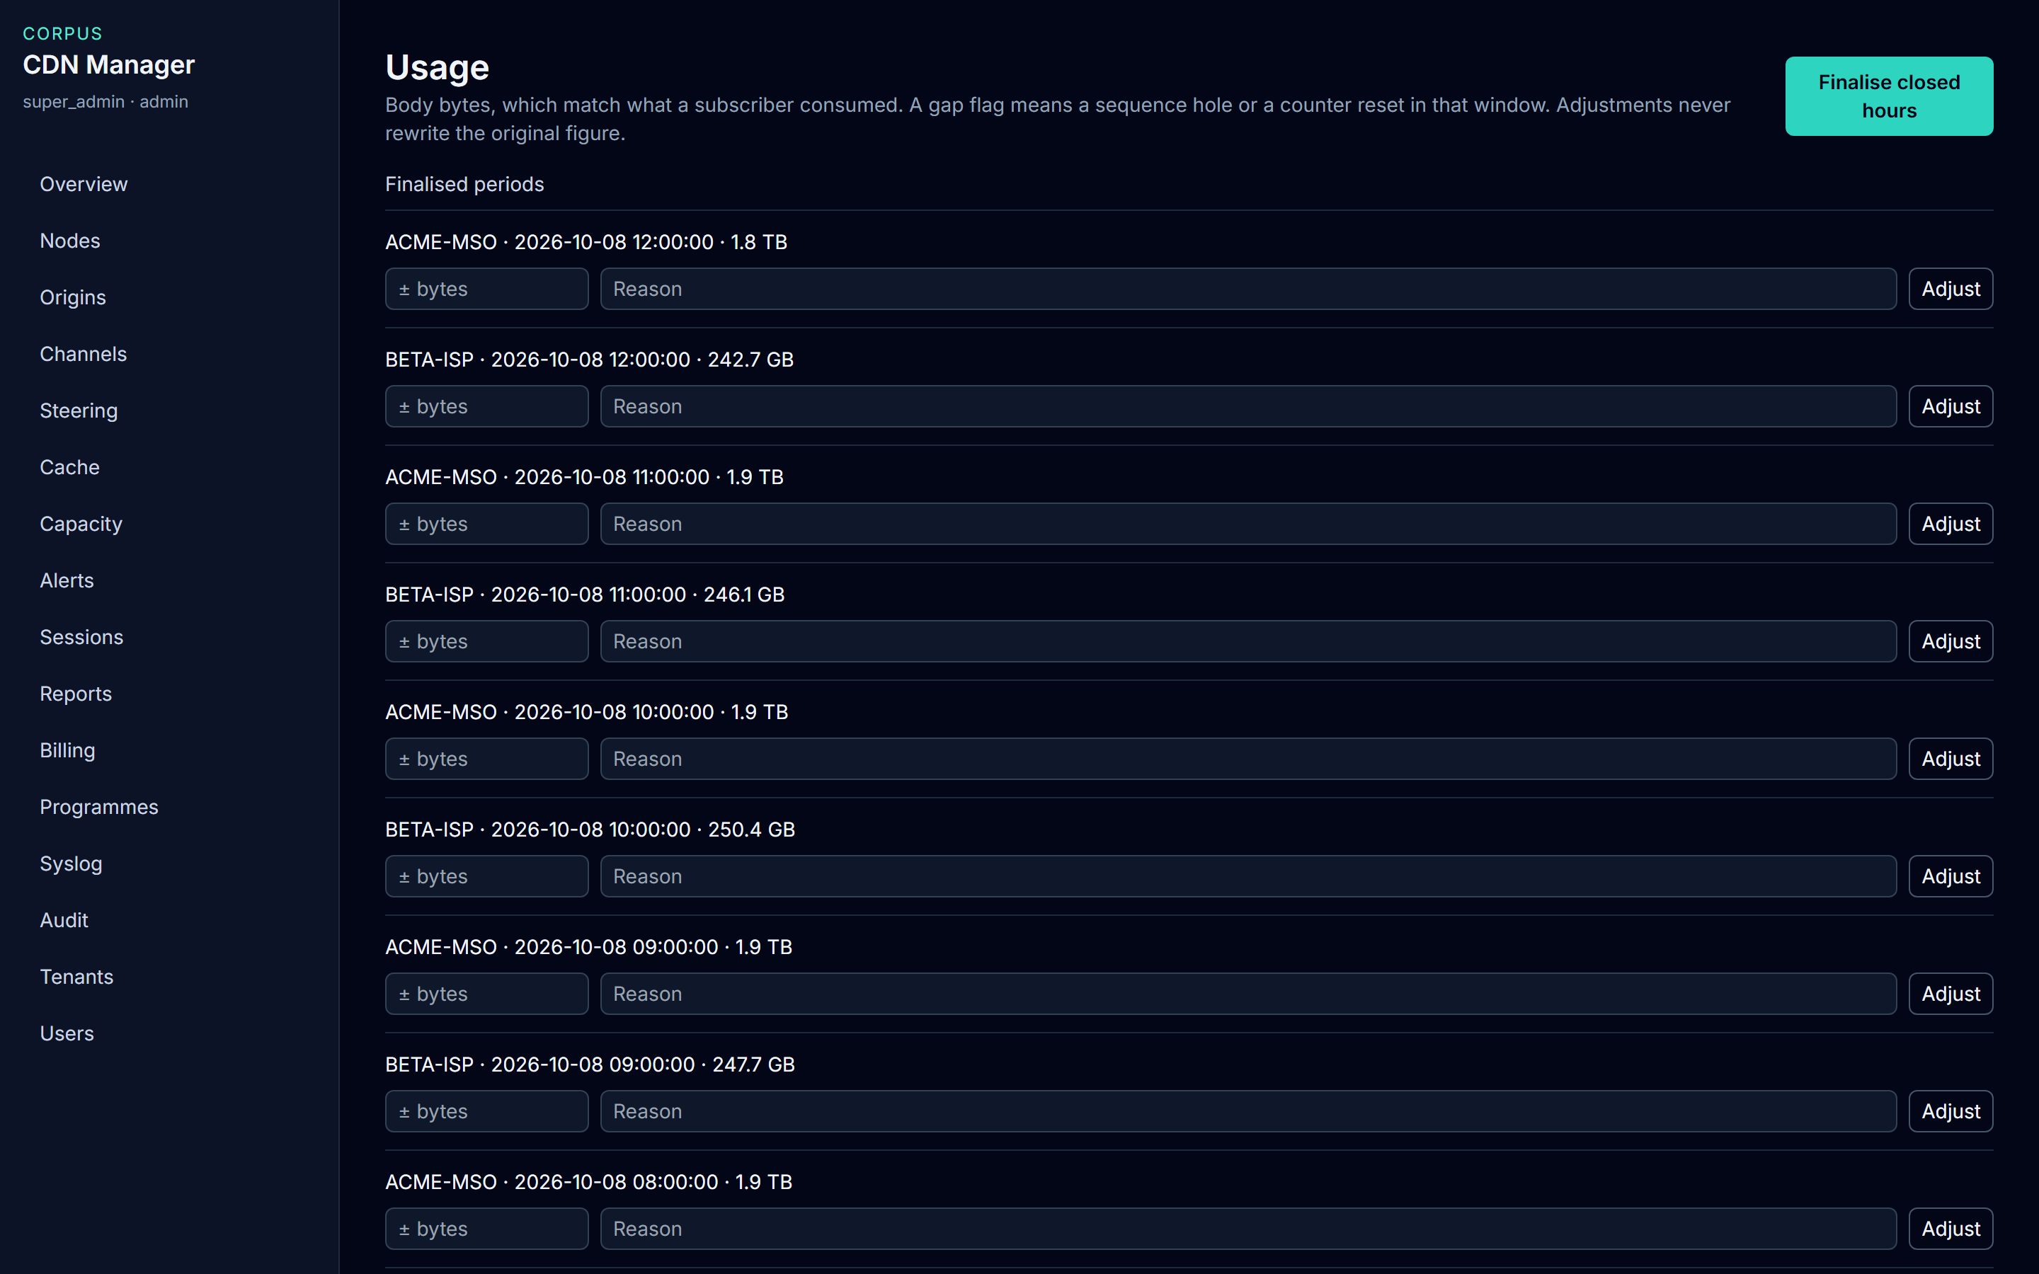
FINANCE
Close the hour. Do not rewrite it.
• The quantity is body bytes. On this preview, recent ACME hours are 1.8 to 1.9 TB.
• Beta hours in the same windows are 242.7 GB to 250.4 GB.
• Finalise closed hours locks the hour. Running it again does not double it.
• Adjust needs a byte change and a reason. The original hour stays. Your name is stored with the line.
Live console · 8 October 2026
A gap mark means a missing sequence or a counter reset. Do not treat that hour as a clean invoice.
CDN Manager · End-user guide
14

Slide 15
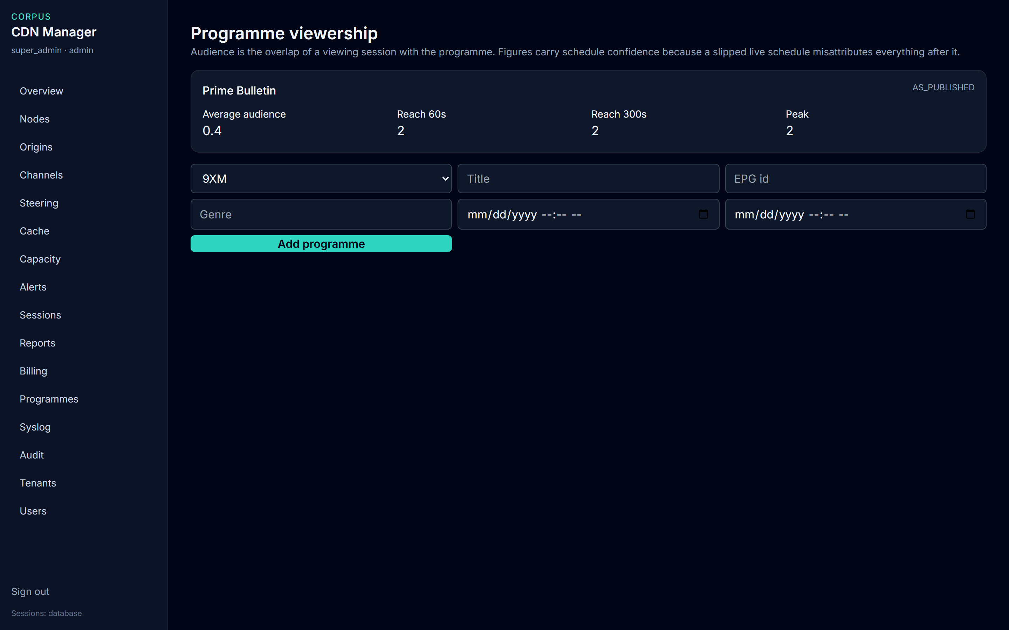
PROGRAMMES
Say as-published when the clock is the guide
• Prime Bulletin is labelled AS_PUBLISHED.
• Average audience 0.4. Reach at 60 seconds is 2. Peak is 2.
• Quote as-run only when both actual start and actual end are filled in.
• NOC adds a programme with Add programme. Billing does not have this page.
Live console · 8 October 2026
CDN Manager · End-user guide
15

Slide 16
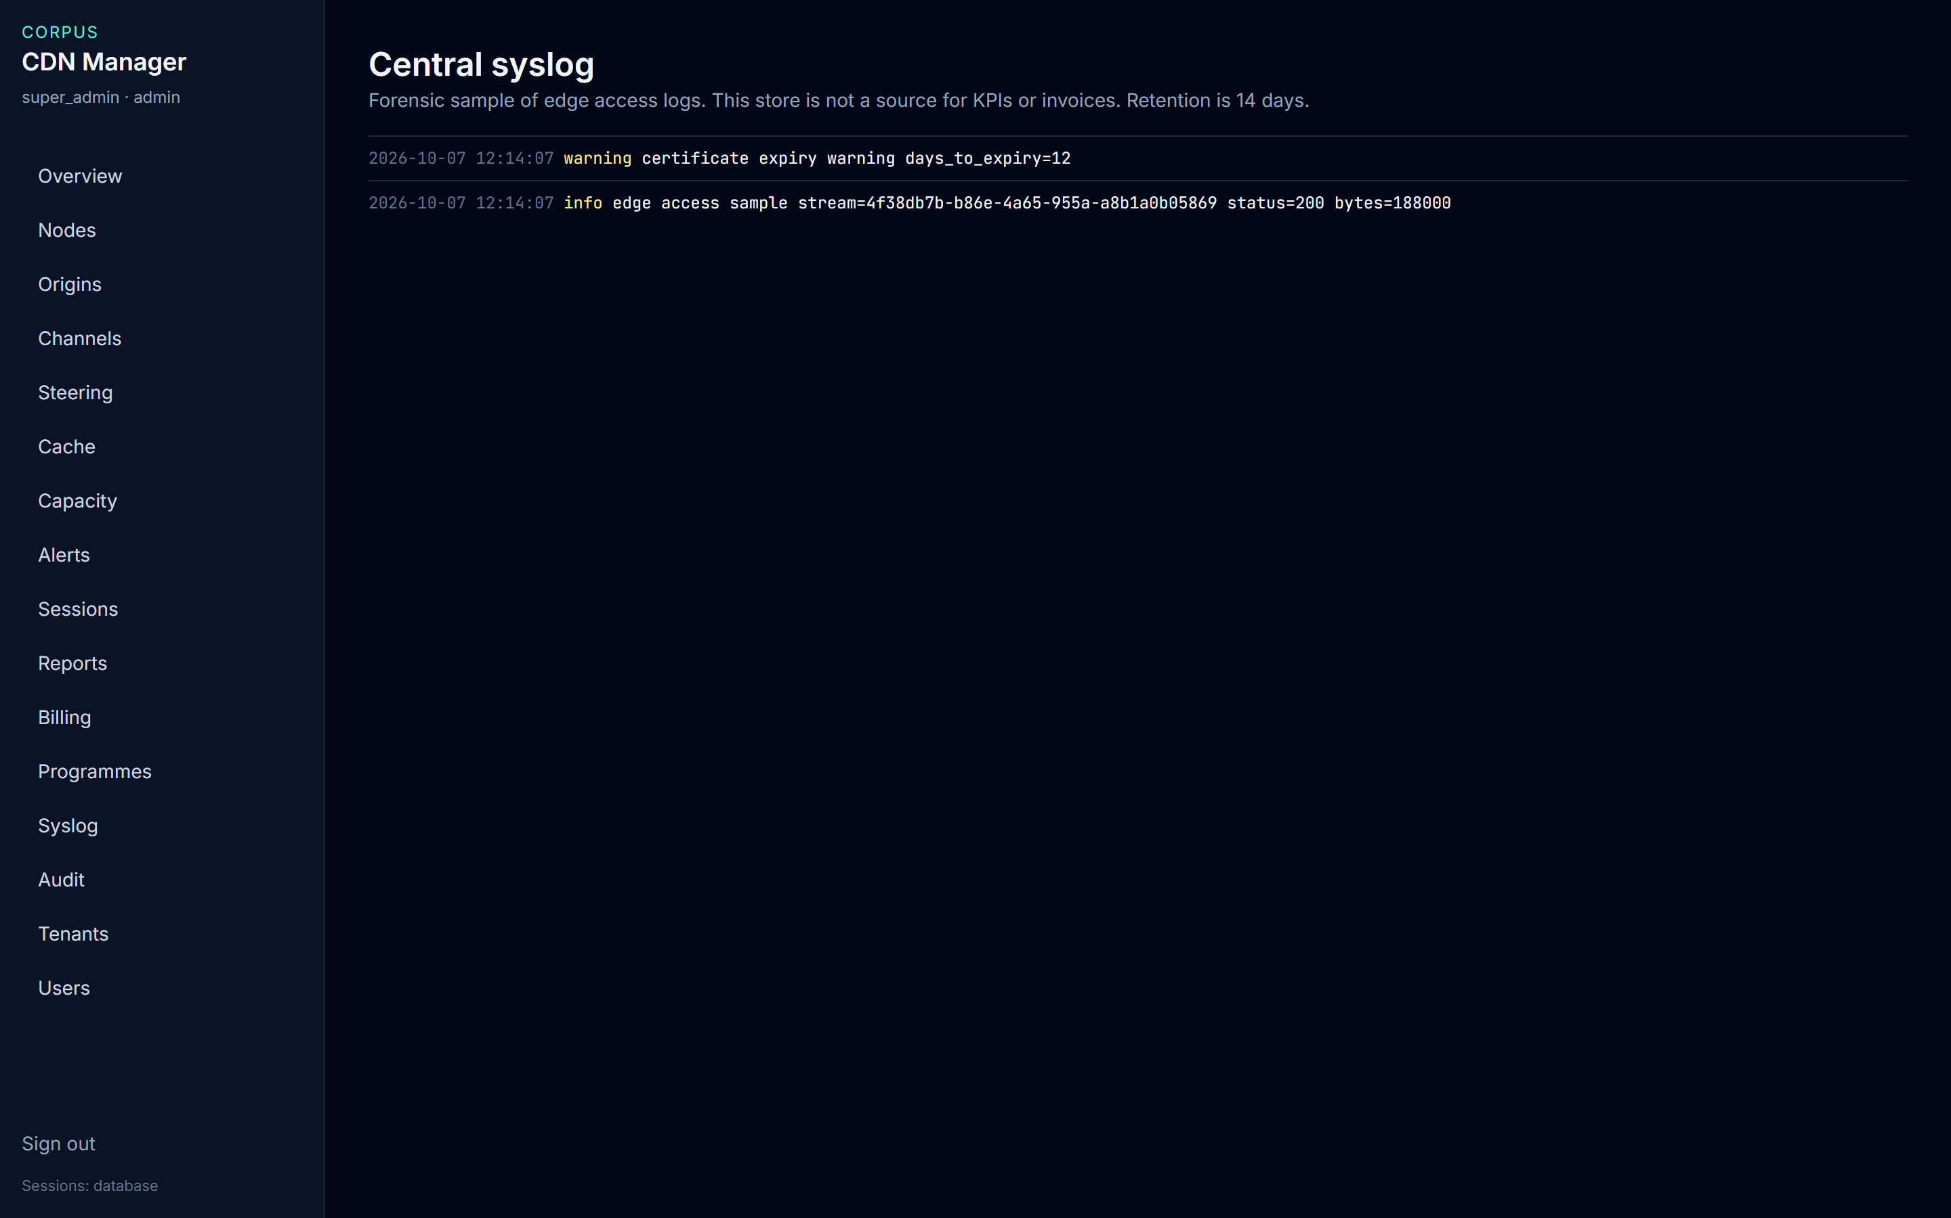
INCIDENTS
Syslog explains a fault. It does not bill one.
• The page says this store is not a source for KPIs or invoices.
• Use a line to see what an edge logged, such as a certificate warning.
• Lines older than 14 days are deleted.
• Do not reconstruct a subscriber from a log line. Use Sessions and Resolve.
Live console · 8 October 2026
CDN Manager · End-user guide
16

Slide 17
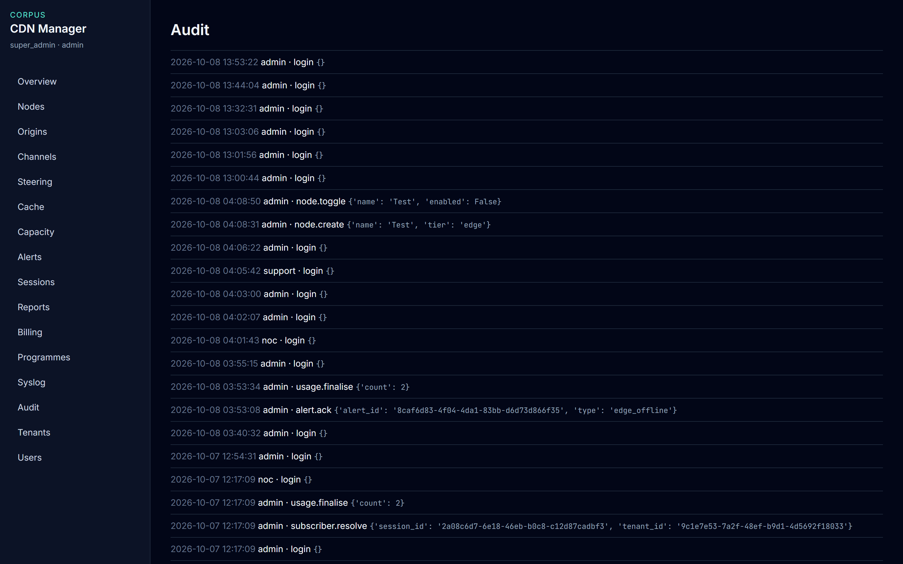
ACCOUNTABILITY
Audit shows who did it
• Sign-ins, channel imports, subscriber lookups, usage changes, and cache requests land here.
• A resolve line names the person, not a screenshot in chat.
• NOC and the super administrator can read this page.
• Add webhook is for a system that should hear about alerts and finalised hours. Only the super administrator should submit it.
Live console · 8 October 2026
CDN Manager · End-user guide
17

Slide 18
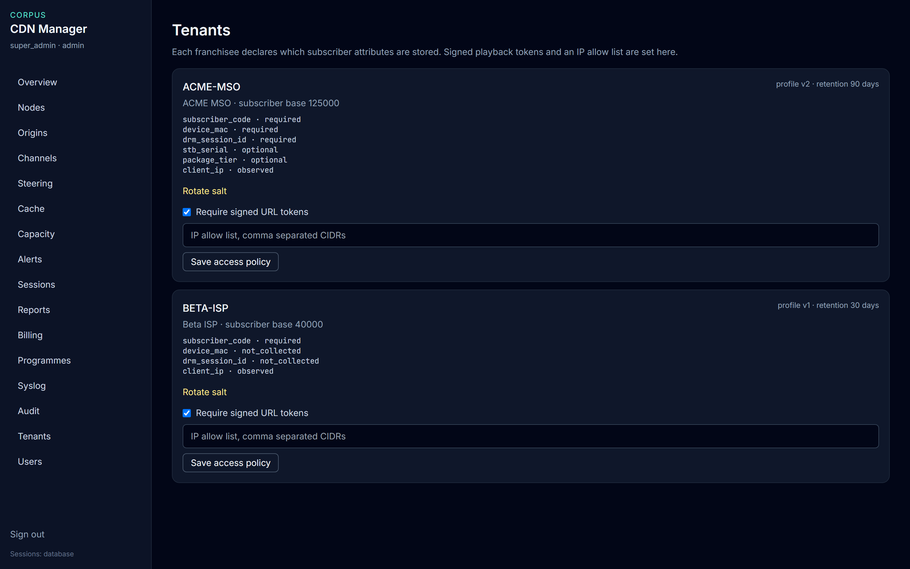
FRANCHISEES
Each tenant stores a different set of facts
• ACME may keep device and DRM fields. Retention is 90 days. Base is 125,000.
• Beta must not collect device or DRM fields. Retention is 30 days. Base is 40,000.
• Require signed URL tokens is on for both. An empty IP allow list means no address restriction yet.
• Rotate salt only when middleware is ready. New session handles will not match the old salt.
Live console · 8 October 2026
CDN Manager · End-user guide
18

Slide 19
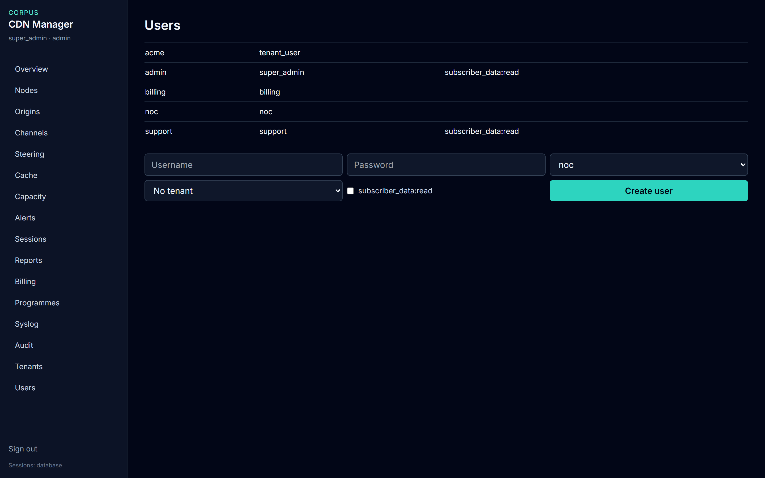
ACCOUNTS
Create a user for one role
• admin and support have subscriber data read. noc, acme, and billing do not.
• Attach tenant user, support, and billing to a franchisee. Leave NOC and super administrator unscoped.
• Tick subscriber data read only for people who handle subscriber cases.
• This page is only on the super administrator menu.
Live console · 8 October 2026
CDN Manager · End-user guide
19

Slide 20
QUICK REFERENCE
Where to click
I need to… | Open | Who
See health | Overview | Everyone, scoped to the franchisee
Inspect or disable a node | Nodes, then the name | Inspect: everyone. Enable or disable: NOC
See which origin is active | Origins | Everyone. Save pair: NOC
Name an unknown stream | Channels, then Import | NOC
Place a viewer on an edge | Steering, then Add rule | NOC. Franchisees can read their own rules
Fill or purge cache | Cache | NOC
See who needs capacity | Capacity | NOC, tenant user, support
Mark an alert as seen | Alerts, then Acknowledge | Everyone except billing
Find a subscriber code | Sessions, then Resolve | subscriber data read, inside that franchisee
Close or correct an hour | Billing | Finalise and Adjust: NOC and billing
Add a person or a policy | Users or Tenants | Super administrator
CDN Manager · End-user guide
20

Slide 21
BEFORE YOU LEAVE THE SCREEN
• Quote Overview tiles, not the chart line sitting on the axis.
• An unmapped stream is a catalogue gap. The bytes are still there.
• Resolve a subscriber only for a case. Your name is on the audit line.
• A gap stays on the usage hour. An adjustment never rewrites it.
• Syslog is for an incident. It is not an invoice.
CDN Manager · End-user guide
21

