Slide 1
CORPUS
CDN Manager
Executive briefing
Health, failover, placement, cache, capacity, and usage.
Every console screen is included. Figures are the live preview, 8 October 2026.
They are not a production invoice.
For leadership, NOC, franchisee operations, and finance
CDN Manager · Executive presentation
1

Slide 2
THE BRIEFING
Six decisions the console supports
Is the estate healthy?
Which origin is in use?
Which edge serves this viewer?
Overview quotes hit ratio, bandwidth saved, traffic, availability, and the open alert.
A primary and a secondary. The active origin changes when the primary fails.
An IP range, region, network, or subscriber prefix names one edge.
Is popular content close to them?
Where is capacity short?
What can finance close?
Channels name the streams. Cache can pre-position a title or purge a stale one.
Current, peak, and projected load against the link. One edge is already marked.
Body bytes by hour. A gap stays visible. An adjustment never rewrites the hour.
CDN Manager · Executive presentation
2

Slide 3
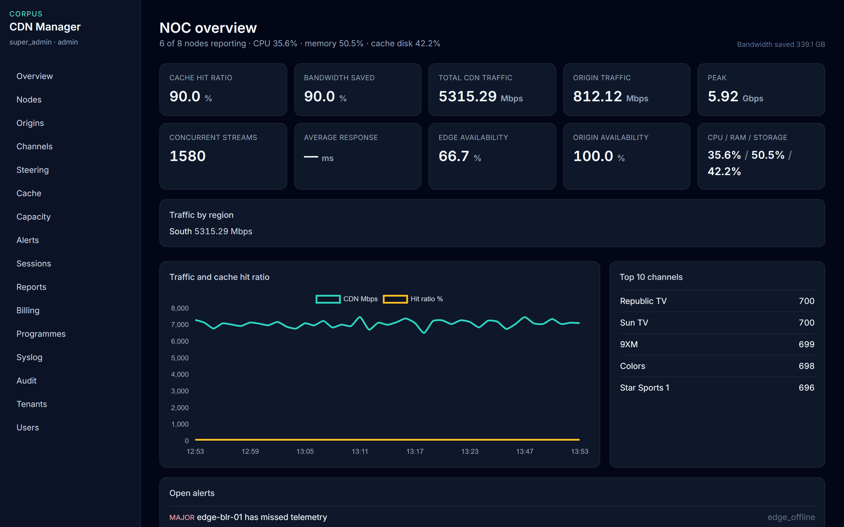
OPERATING PICTURE
Quote these tiles
• 90% cache hit and 90% bandwidth saved. 339.1 GB kept off the origin path.
• 5,315.29 Mbps on the CDN, peak 5.92 Gbps, origin fill 812.12 Mbps.
• Edges 66.7% available because edge-blr-01 is offline. Origins 100%.
• 1,580 concurrent streams. South carries the edge traffic. Republic TV and Sun TV lead.
Live console · 8 October 2026
CDN Manager · Executive presentation
3

Slide 4
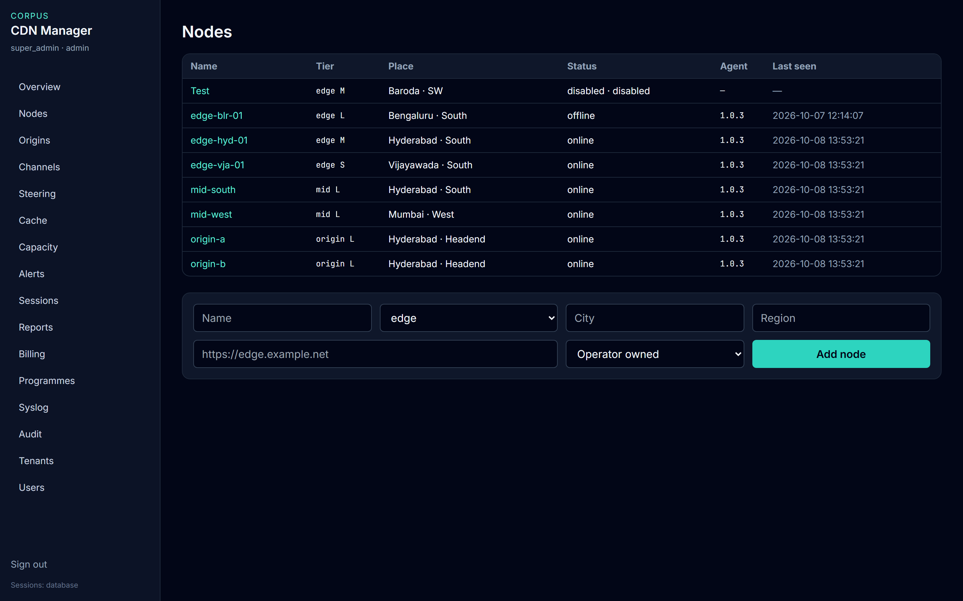
ESTATE
Six of eight nodes are reporting
• Online edges and origins are receiving telemetry now.
• edge-blr-01 is offline. That is the open major alert on Overview.
• A disabled node is refused on purpose.
• Partner-ISP edges appear in the same list as the operator’s own nodes.
Live console · 8 October 2026
CDN Manager · Executive presentation
4

Slide 5
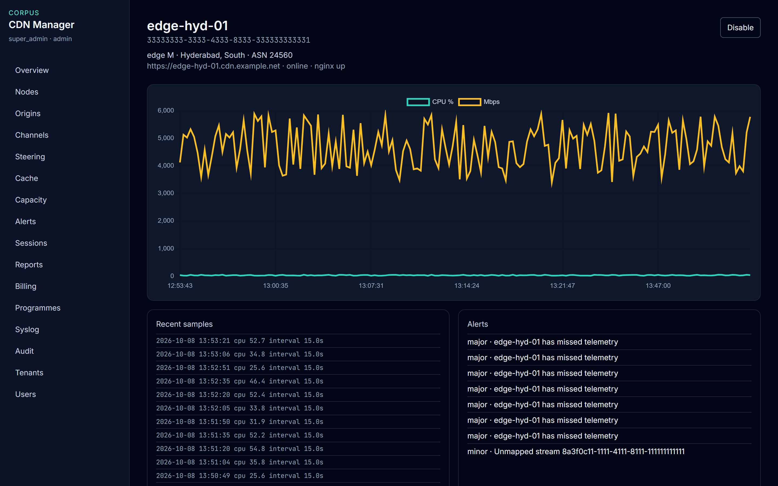
ONE EDGE
Hyderabad is online and serving
• edge-hyd-01 is online, nginx is up, and recent CPU is in a working range.
• This is the edge ACME South and the lab IP range are steered to.
• The yellow line is traffic. CPU is in Recent samples, about 25–55%.
• Disable is the control that stops the node reporting.
Live console · 8 October 2026
CDN Manager · Executive presentation
5

Slide 6
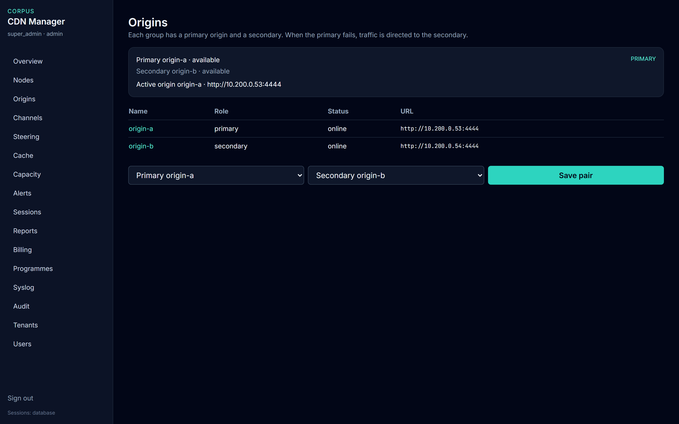
CONTINUITY
origin-a is active. origin-b is the spare.
• Both origins are available, so viewers stay on the primary.
• If origin-a fails, the same card names origin-b and says traffic was redirected.
• The origin map gives that answer to middleware for 30 seconds.
• Save pair is an audited configuration change.
Live console · 8 October 2026
CDN Manager · Executive presentation
6

Slide 7
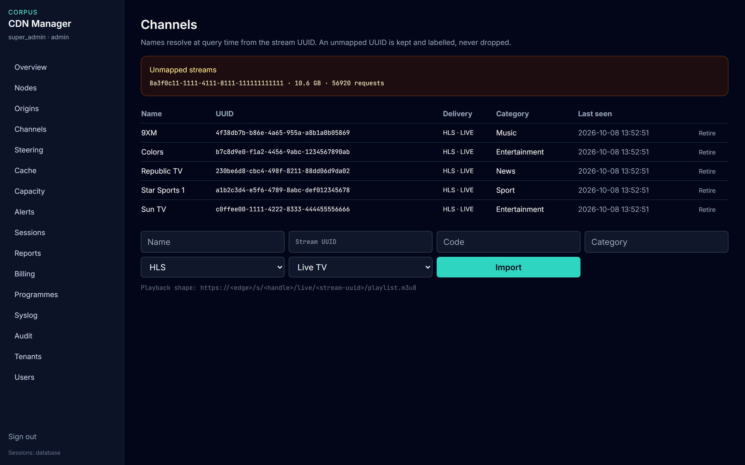
CATALOGUE
One stream is still unnamed
• Named channels are HLS live: 9XM, Colors, Republic TV, Star Sports 1, Sun TV.
• The amber box is 10.6 GB with no name. The traffic is kept, not dropped.
• Import records HLS or DASH, and live TV or VOD.
• Retire means that stream identity is finished and cannot be reused.
Live console · 8 October 2026
CDN Manager · Executive presentation
7

Slide 8
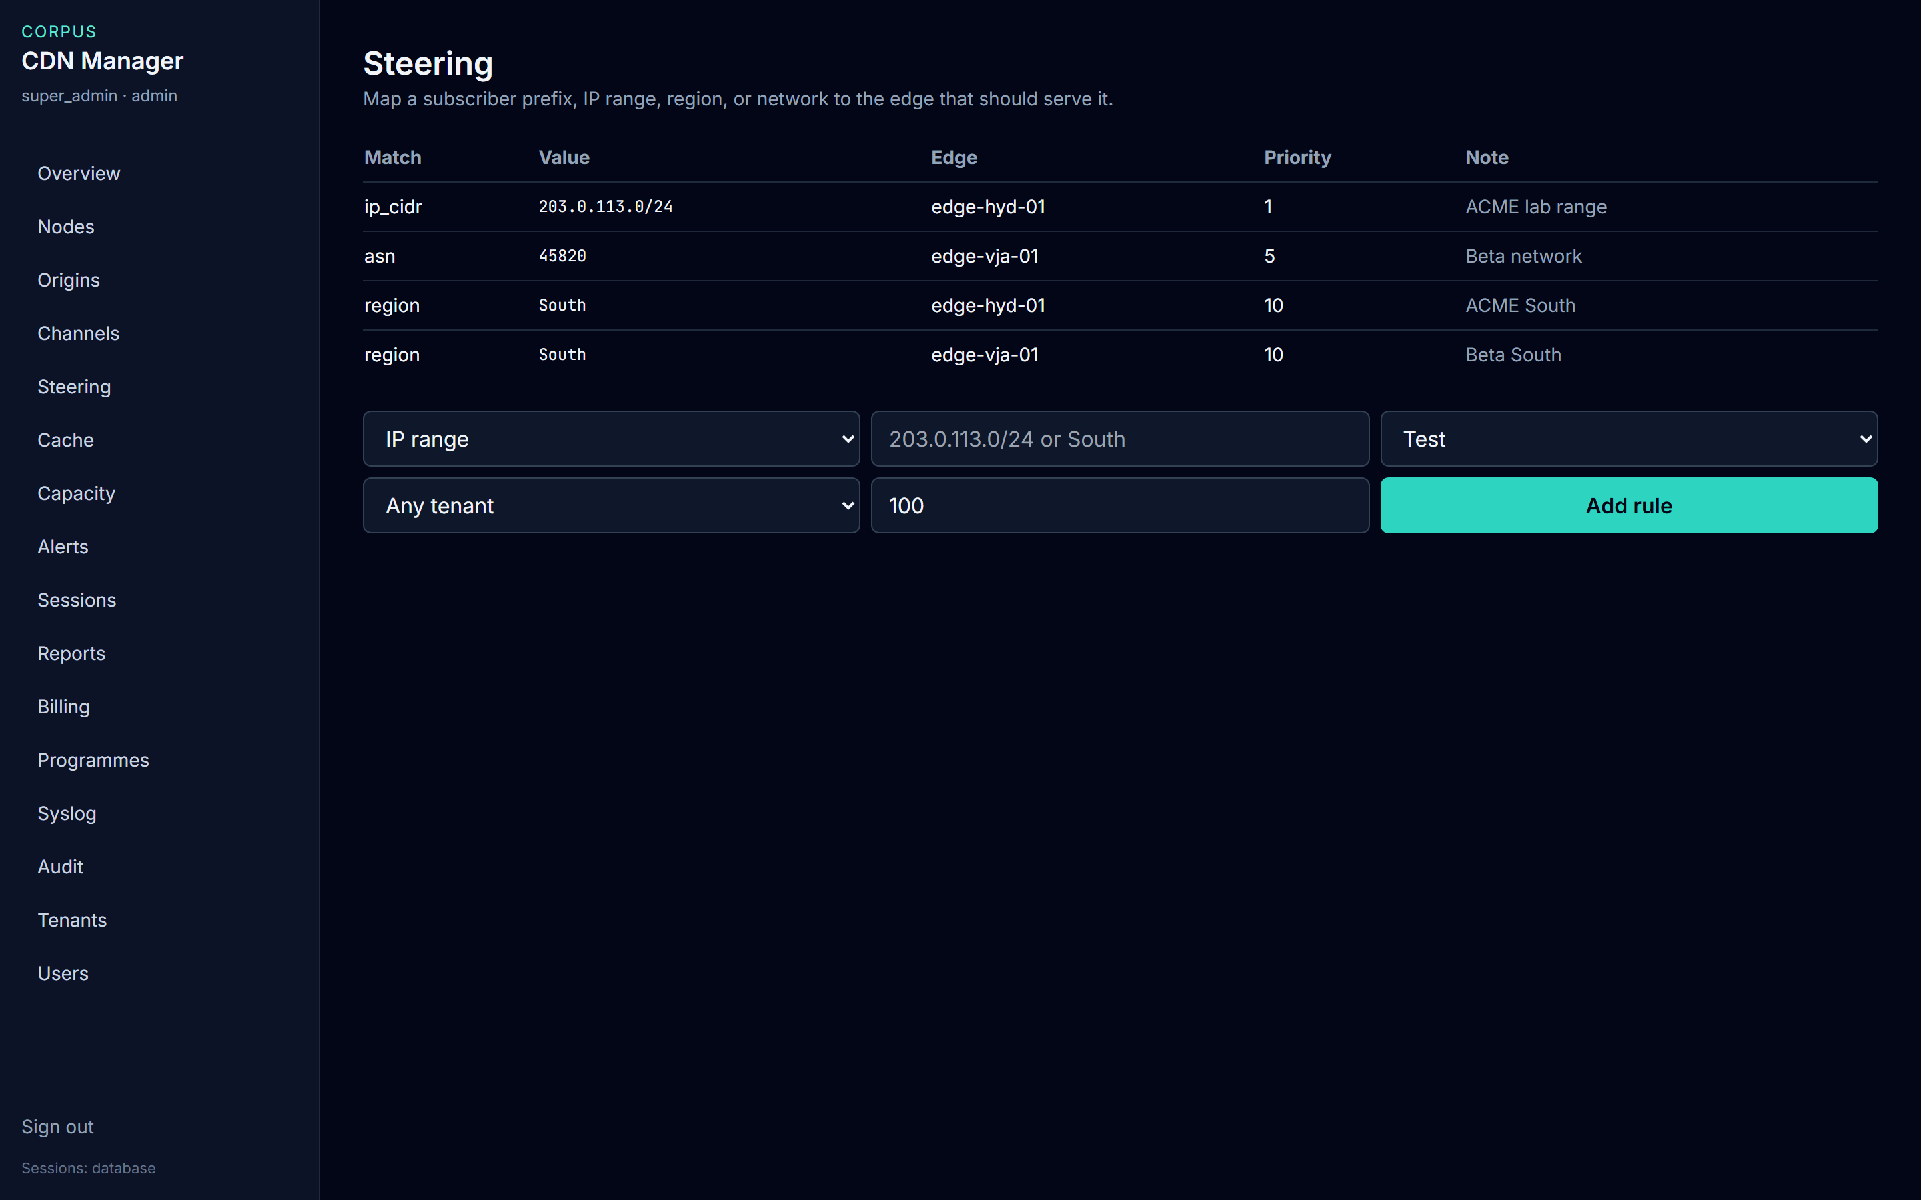
PLACEMENT
The lab range already has an edge
• 203.0.113.0/24 goes to edge-hyd-01 ahead of the broader South rule.
• ACME South uses Hyderabad. Beta South and network 45820 use Vijayawada.
• Lowest priority number wins when two rules match.
• A franchisee sees only its own rules.
Live console · 8 October 2026
CDN Manager · Executive presentation
8

Slide 9
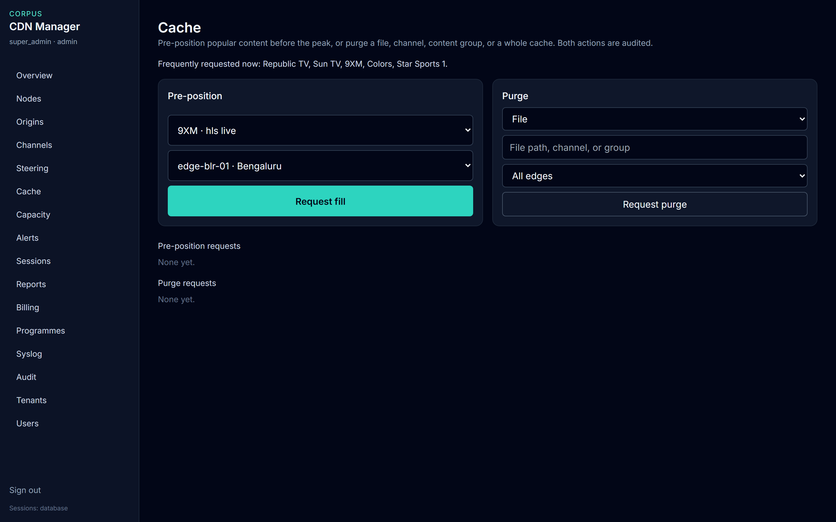
CACHE
Fill before the peak. Purge what is stale.
• The busy titles are Republic TV, Sun TV, 9XM, Colors, and Star Sports 1.
• Request fill places one of them on a chosen edge.
• Request purge covers a file, a channel, a group, or a whole cache.
• The console records the instruction. The node carries it out. Both are audited.
Live console · 8 October 2026
CDN Manager · Executive presentation
9

Slide 10
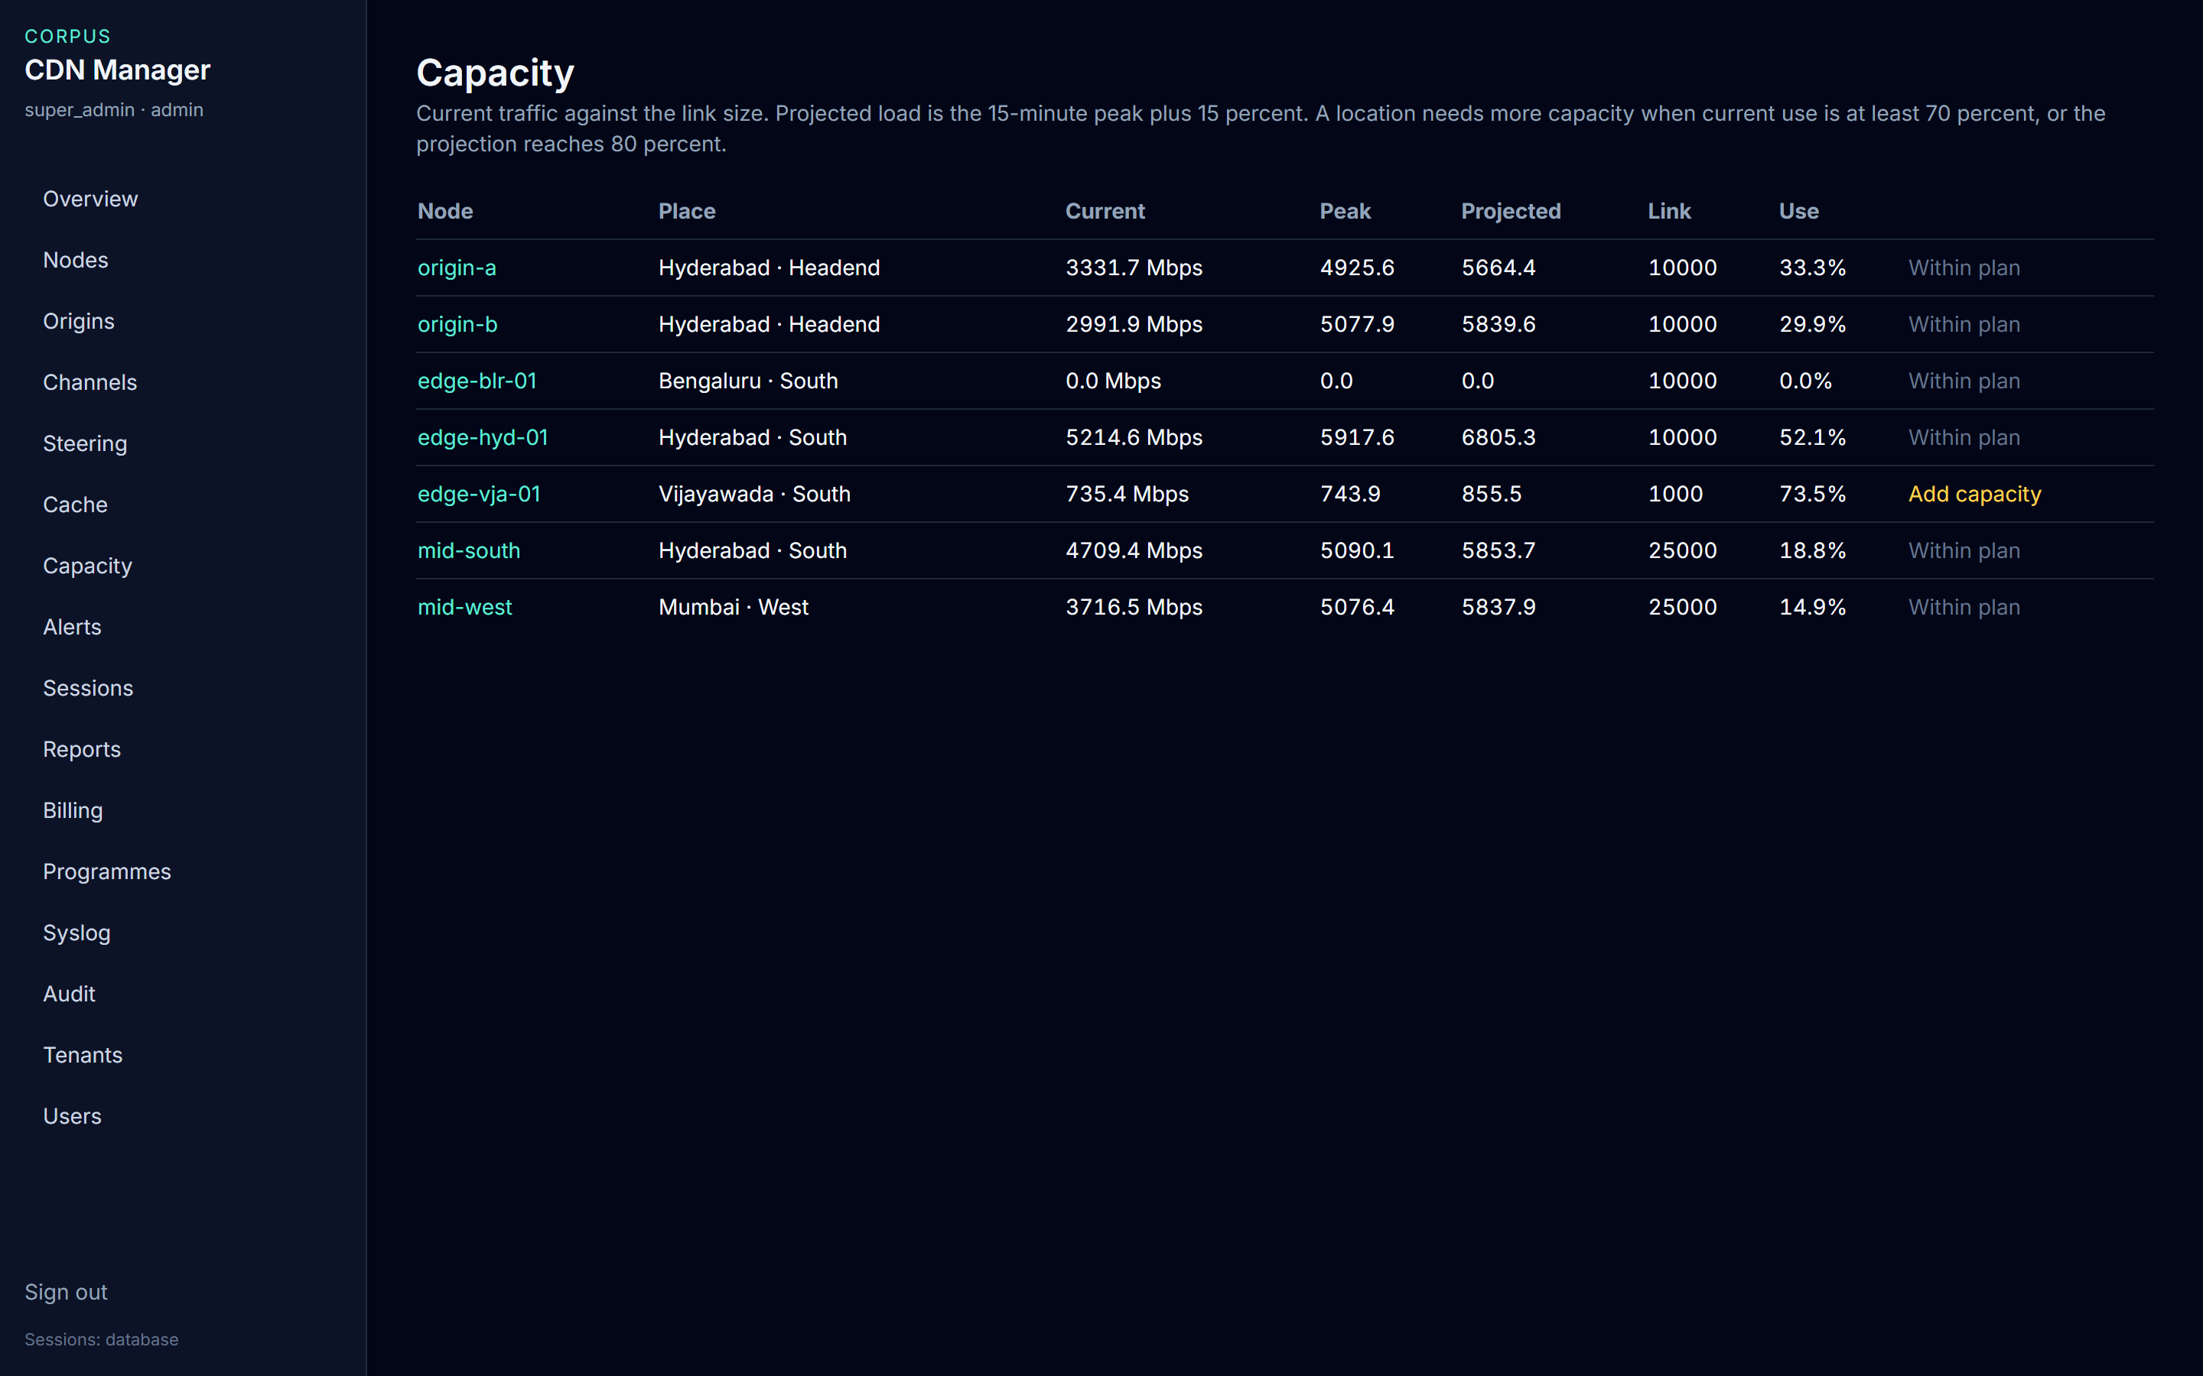
CAPACITY
Vijayawada is the location to grow
• edge-vja-01 is at 73.5% of a 1,000 Mbps link. The row says Add capacity.
• Hyderabad is at 52.1% of 10,000 Mbps and is within plan.
• Bengaluru shows zero because that edge is offline, not because demand is gone.
• Projected load is the recent peak plus 15 percent.
Live console · 8 October 2026
CDN Manager · Executive presentation
10

Slide 11
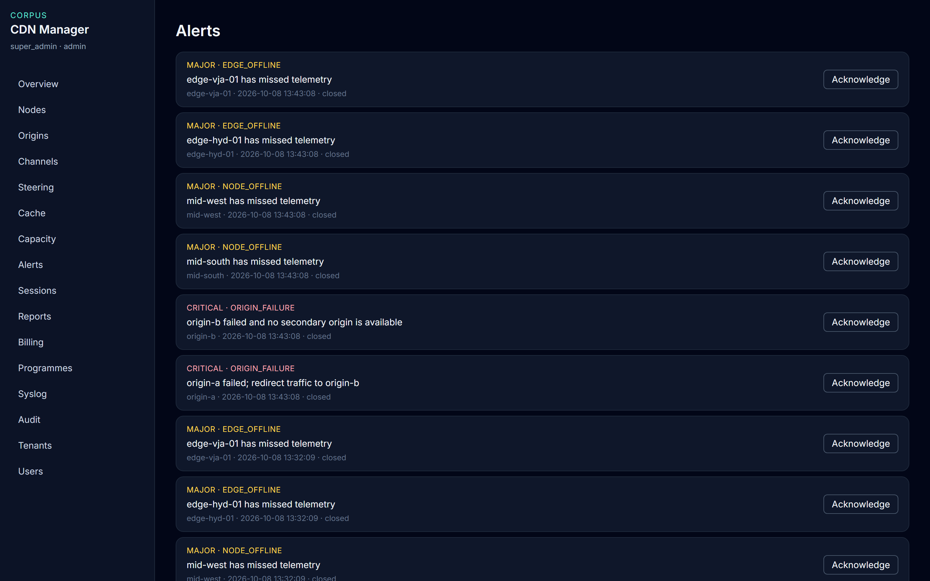
EXCEPTIONS
An alert is a condition, not a ticket
• The list keeps what is open and what has already closed.
• A missed node, a full cache, traffic at the link, and a failed origin are the conditions that matter.
• Acknowledge records who saw it. It does not repair the node.
• Billing staff do not acknowledge alerts.
Live console · 8 October 2026
CDN Manager · Executive presentation
11

Slide 12
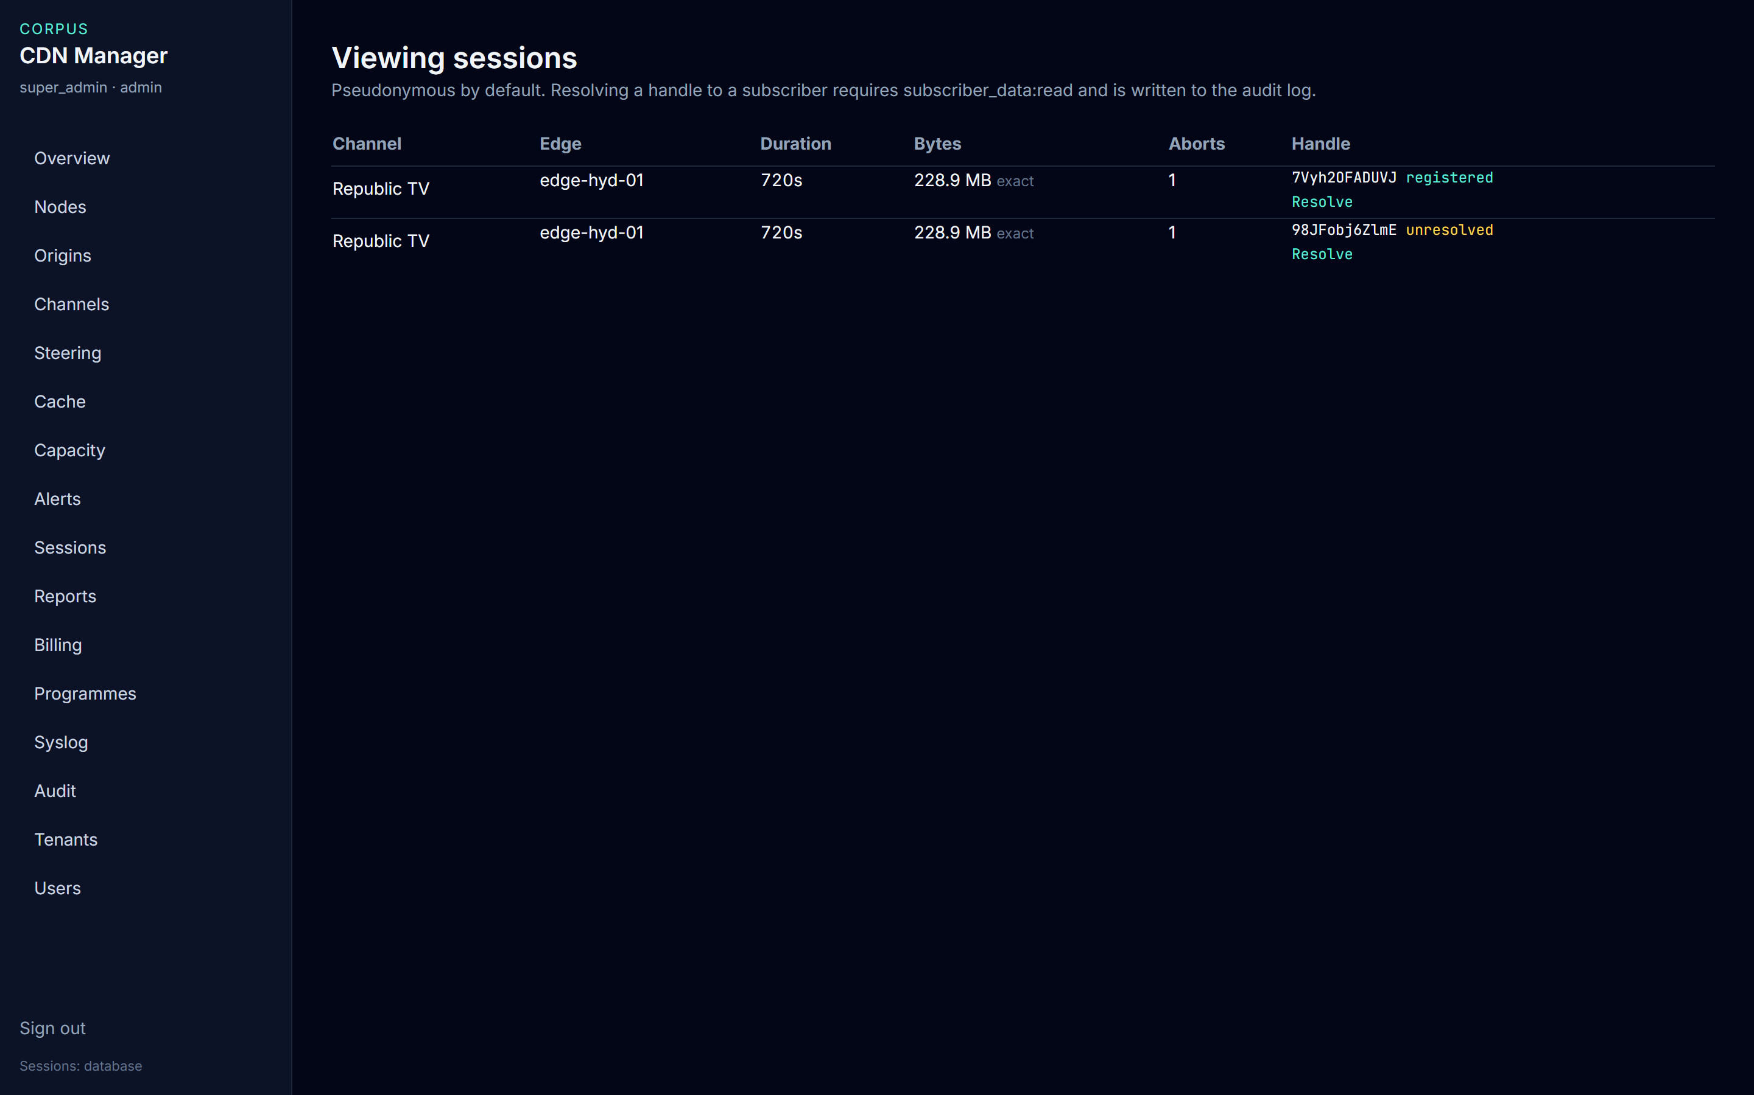
PRIVACY
Subscriber codes stay behind Resolve
• Sessions show a channel, an edge, and a pseudonym. Not a subscriber code.
• One Republic TV session is registered and can be resolved. The other cannot.
• Only an account with subscriber data read, inside that franchisee, can open it.
• Every lookup is an audit line under that person’s name.
Live console · 8 October 2026
CDN Manager · Executive presentation
12

Slide 13
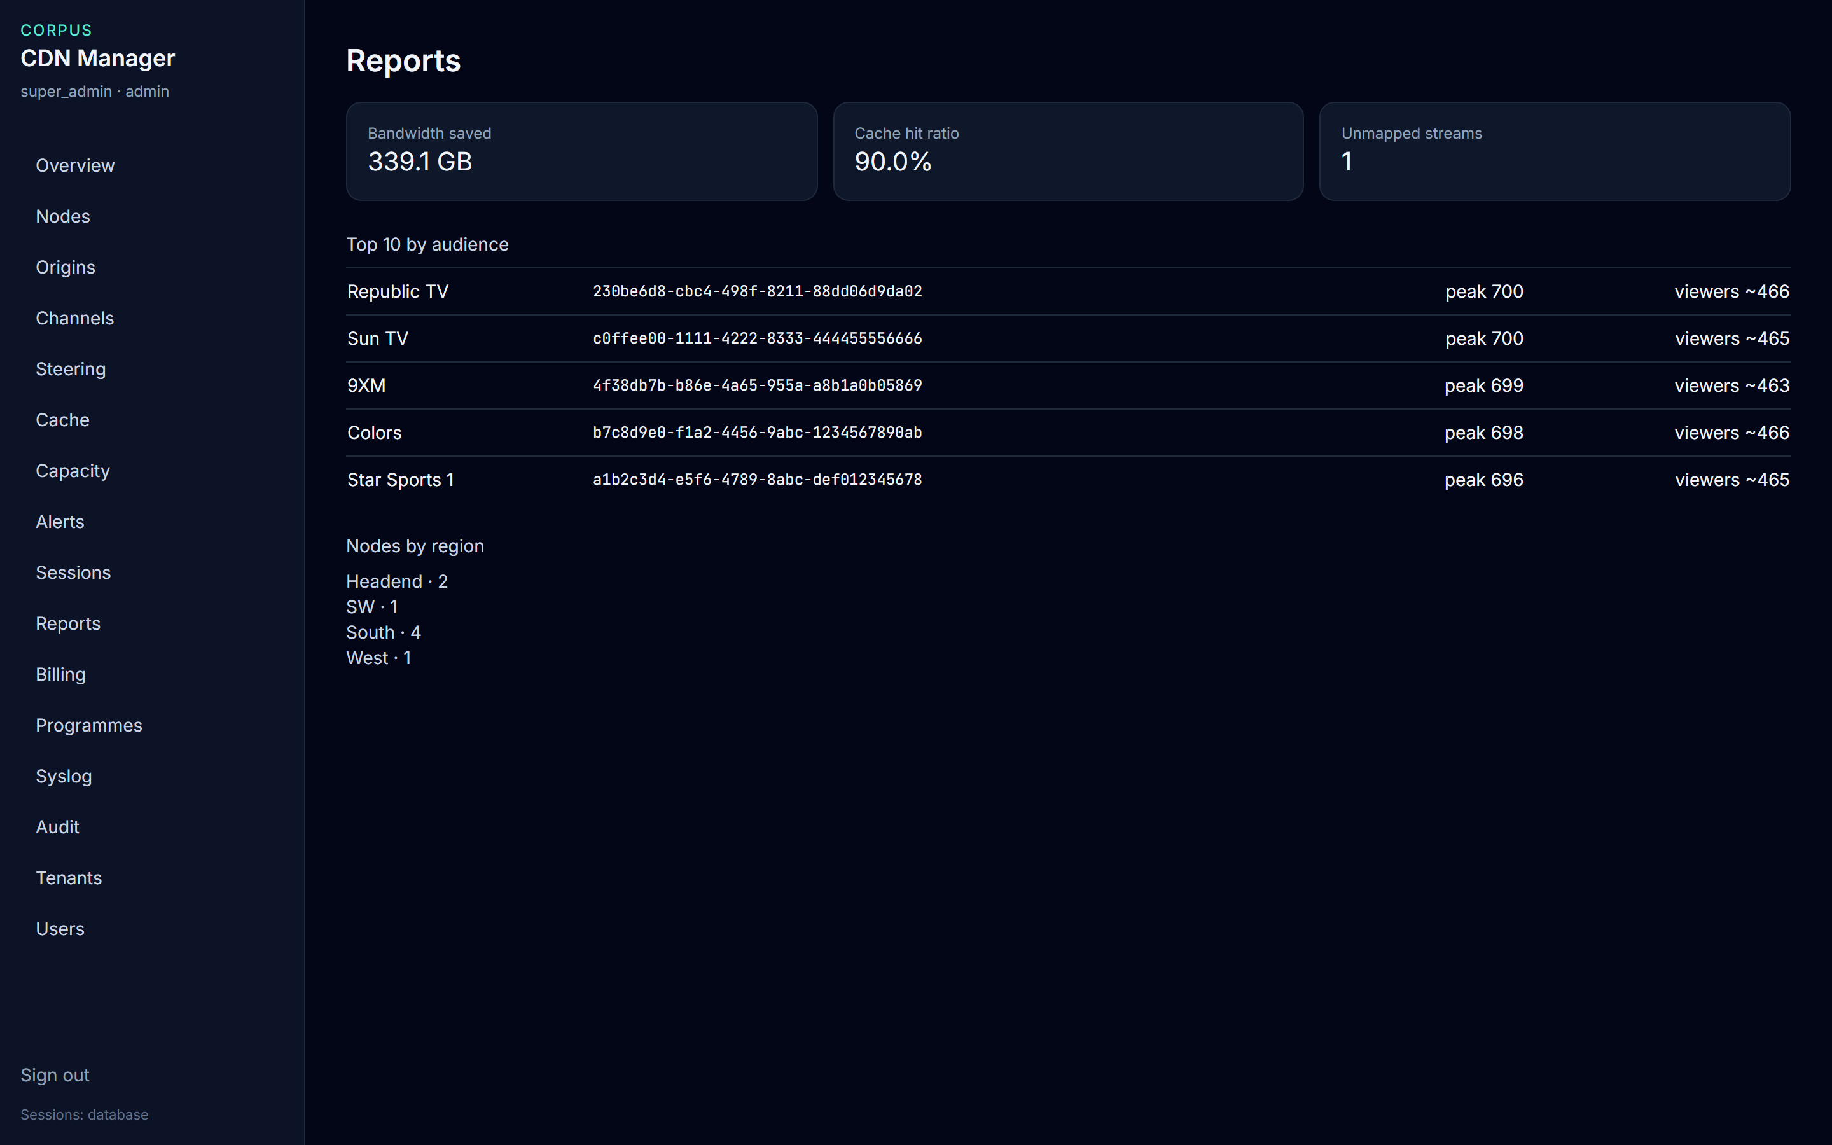
AUDIENCE
339.1 GB saved, at a 90% hit ratio
• That is the figure to quote from Reports for this capture.
• One stream is still unmapped.
• Republic TV and Sun TV share the top peak, 700.
• The estate count is Headend 2, SW 1, South 4, West 1.
Live console · 8 October 2026
CDN Manager · Executive presentation
13

Slide 14
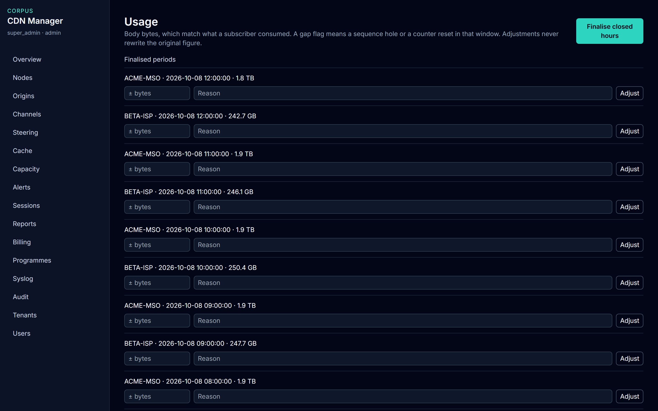
FINANCE
Hours close. They are not edited.
• Recent ACME hours are 1.8 to 1.9 TB of body bytes.
• Beta hours in the same windows are 242.7 GB to 250.4 GB.
• Finalise closed hours locks the hour once.
• Adjust is a separate signed line. A gap flag stays on the original hour.
Live console · 8 October 2026
CDN Manager · Executive presentation
14

Slide 15
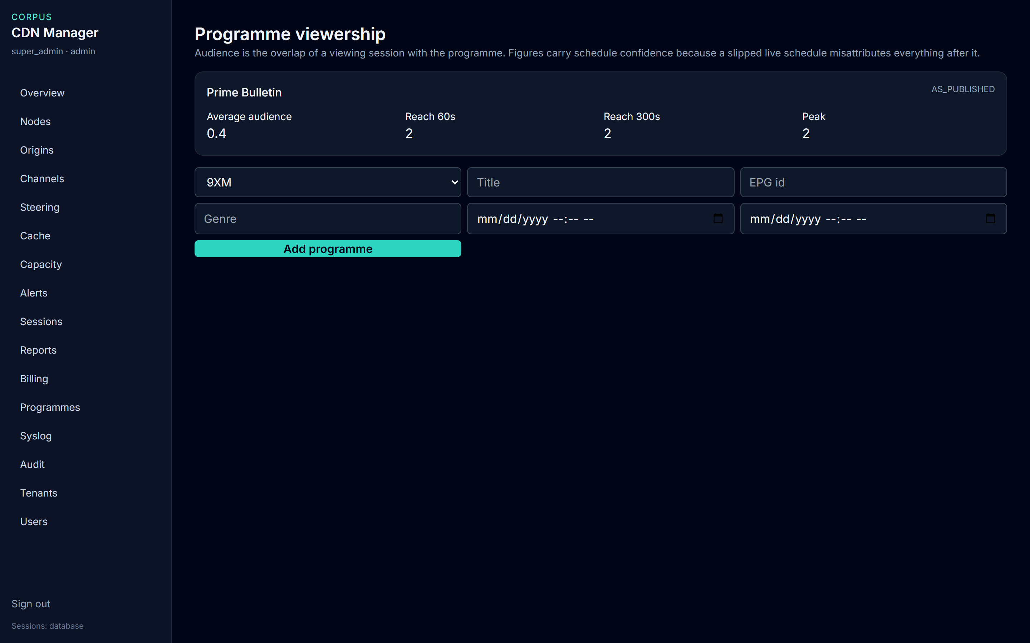
PROGRAMMES
Prime Bulletin is as-published
• The label means the schedule was used, not confirmed air time.
• Average audience 0.4. Reach at one minute is 2. Peak is 2.
• As-run is used only when both actual times exist.
• This page is hidden from billing.
Live console · 8 October 2026
CDN Manager · Executive presentation
15

Slide 16
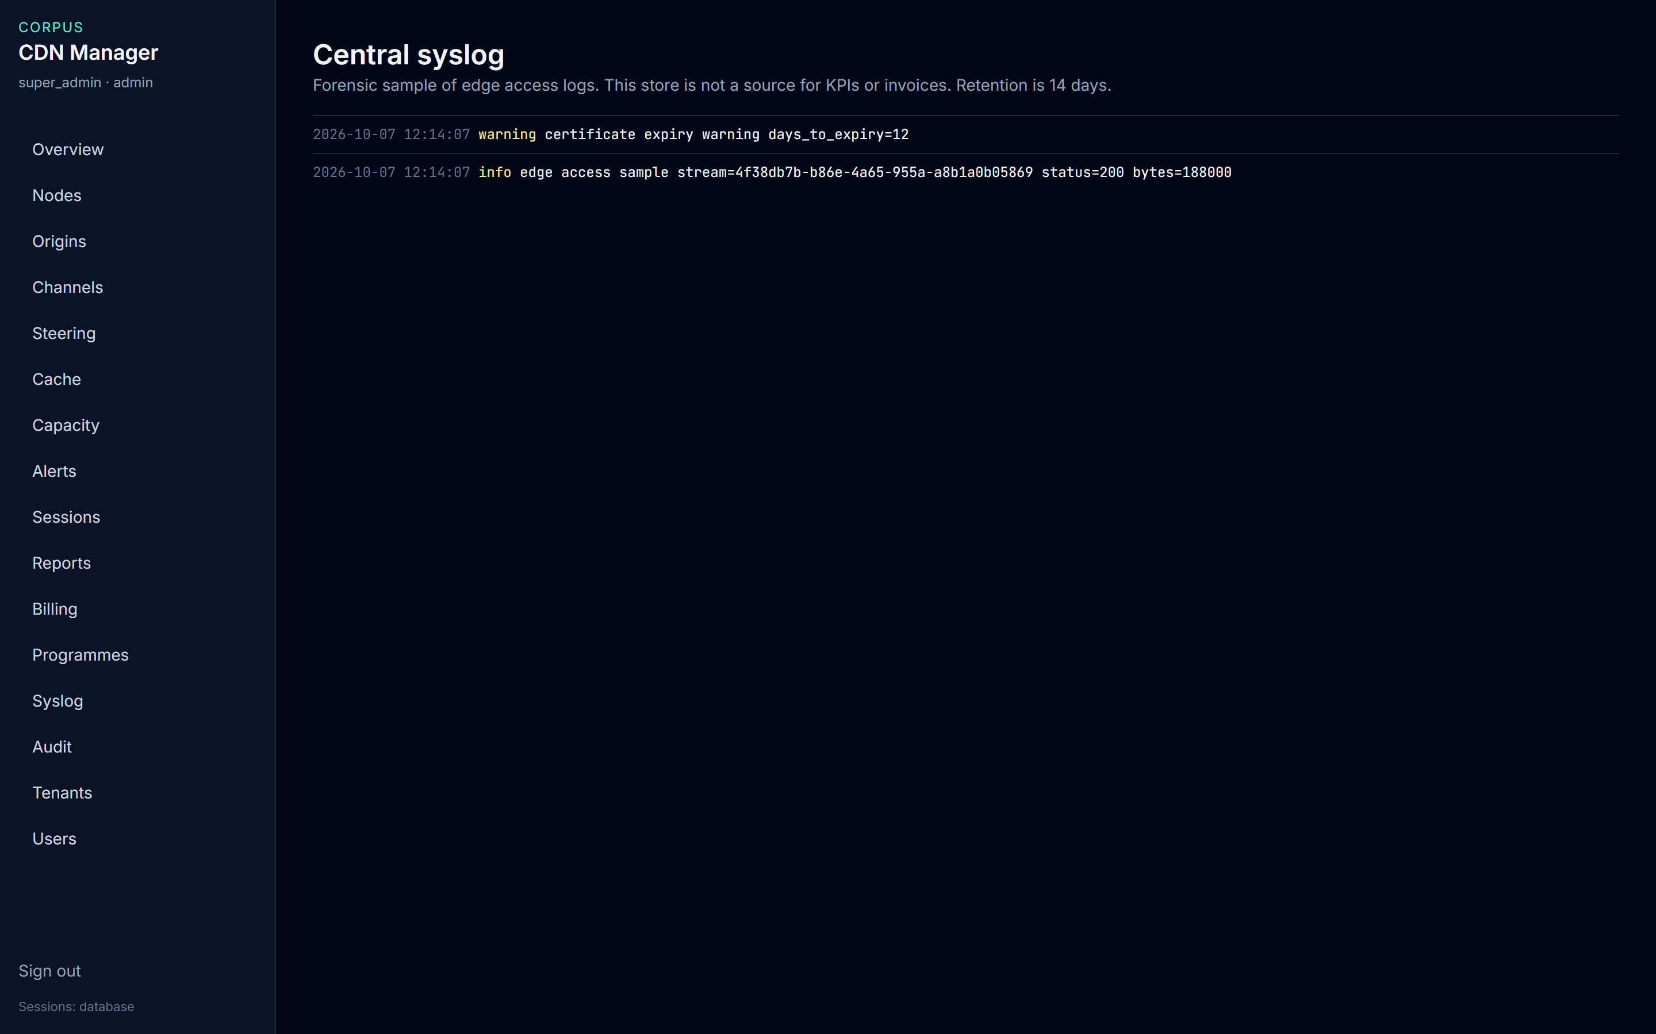
FORENSICS
Syslog is not a billing source
• The screen says so: not for KPIs, not for invoices.
• It is a 14-day sample of what an edge logged.
• A certificate warning is an incident clue, not a charge.
• Identity stays on Sessions, not in a log line.
Live console · 8 October 2026
CDN Manager · Executive presentation
16

Slide 17
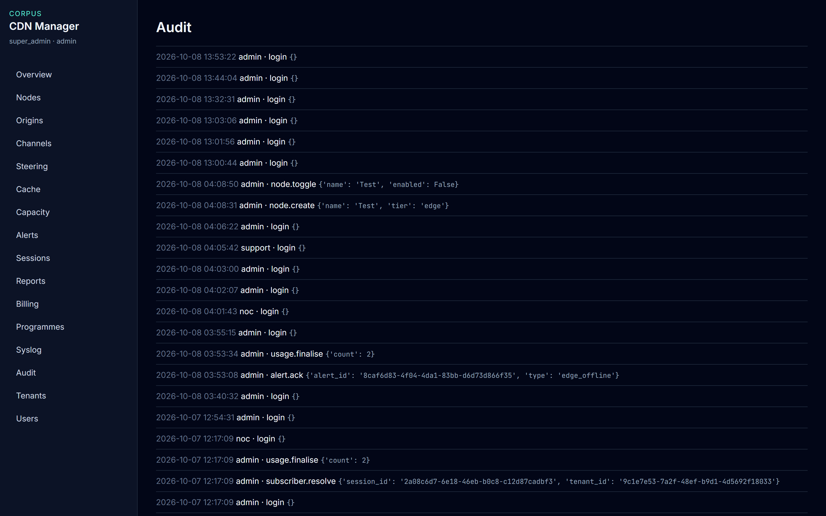
CONTROL
The audit log is the control record
• Sign-in, lookup, usage change, origin pairing, steering, and cache requests are recorded.
• NOC and the super administrator can read it.
• A webhook can tell another system that an alert opened or an hour was finalised.
• That notice does not change the hour.
Live console · 8 October 2026
CDN Manager · Executive presentation
17

Slide 18
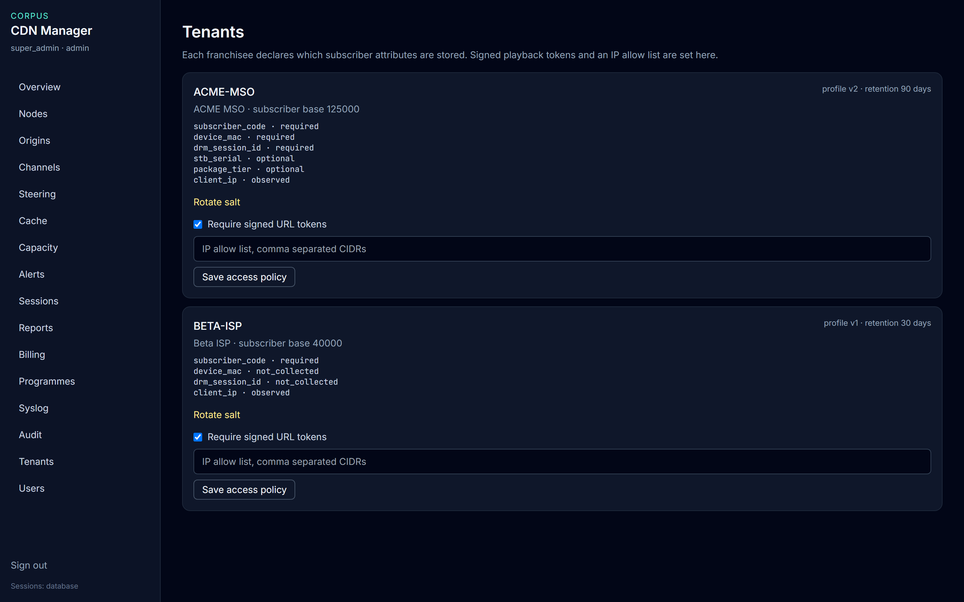
FRANCHISEES
ACME and Beta do not share a profile
• ACME stores device and DRM fields for 90 days. Base 125,000.
• Beta does not collect those fields. Retention is 30 days. Base 40,000.
• Both require a signed playback token. Neither has an IP allow list yet.
• Rotating the salt invalidates new session handles. Middleware must move with it.
Live console · 8 October 2026
CDN Manager · Executive presentation
18

Slide 19
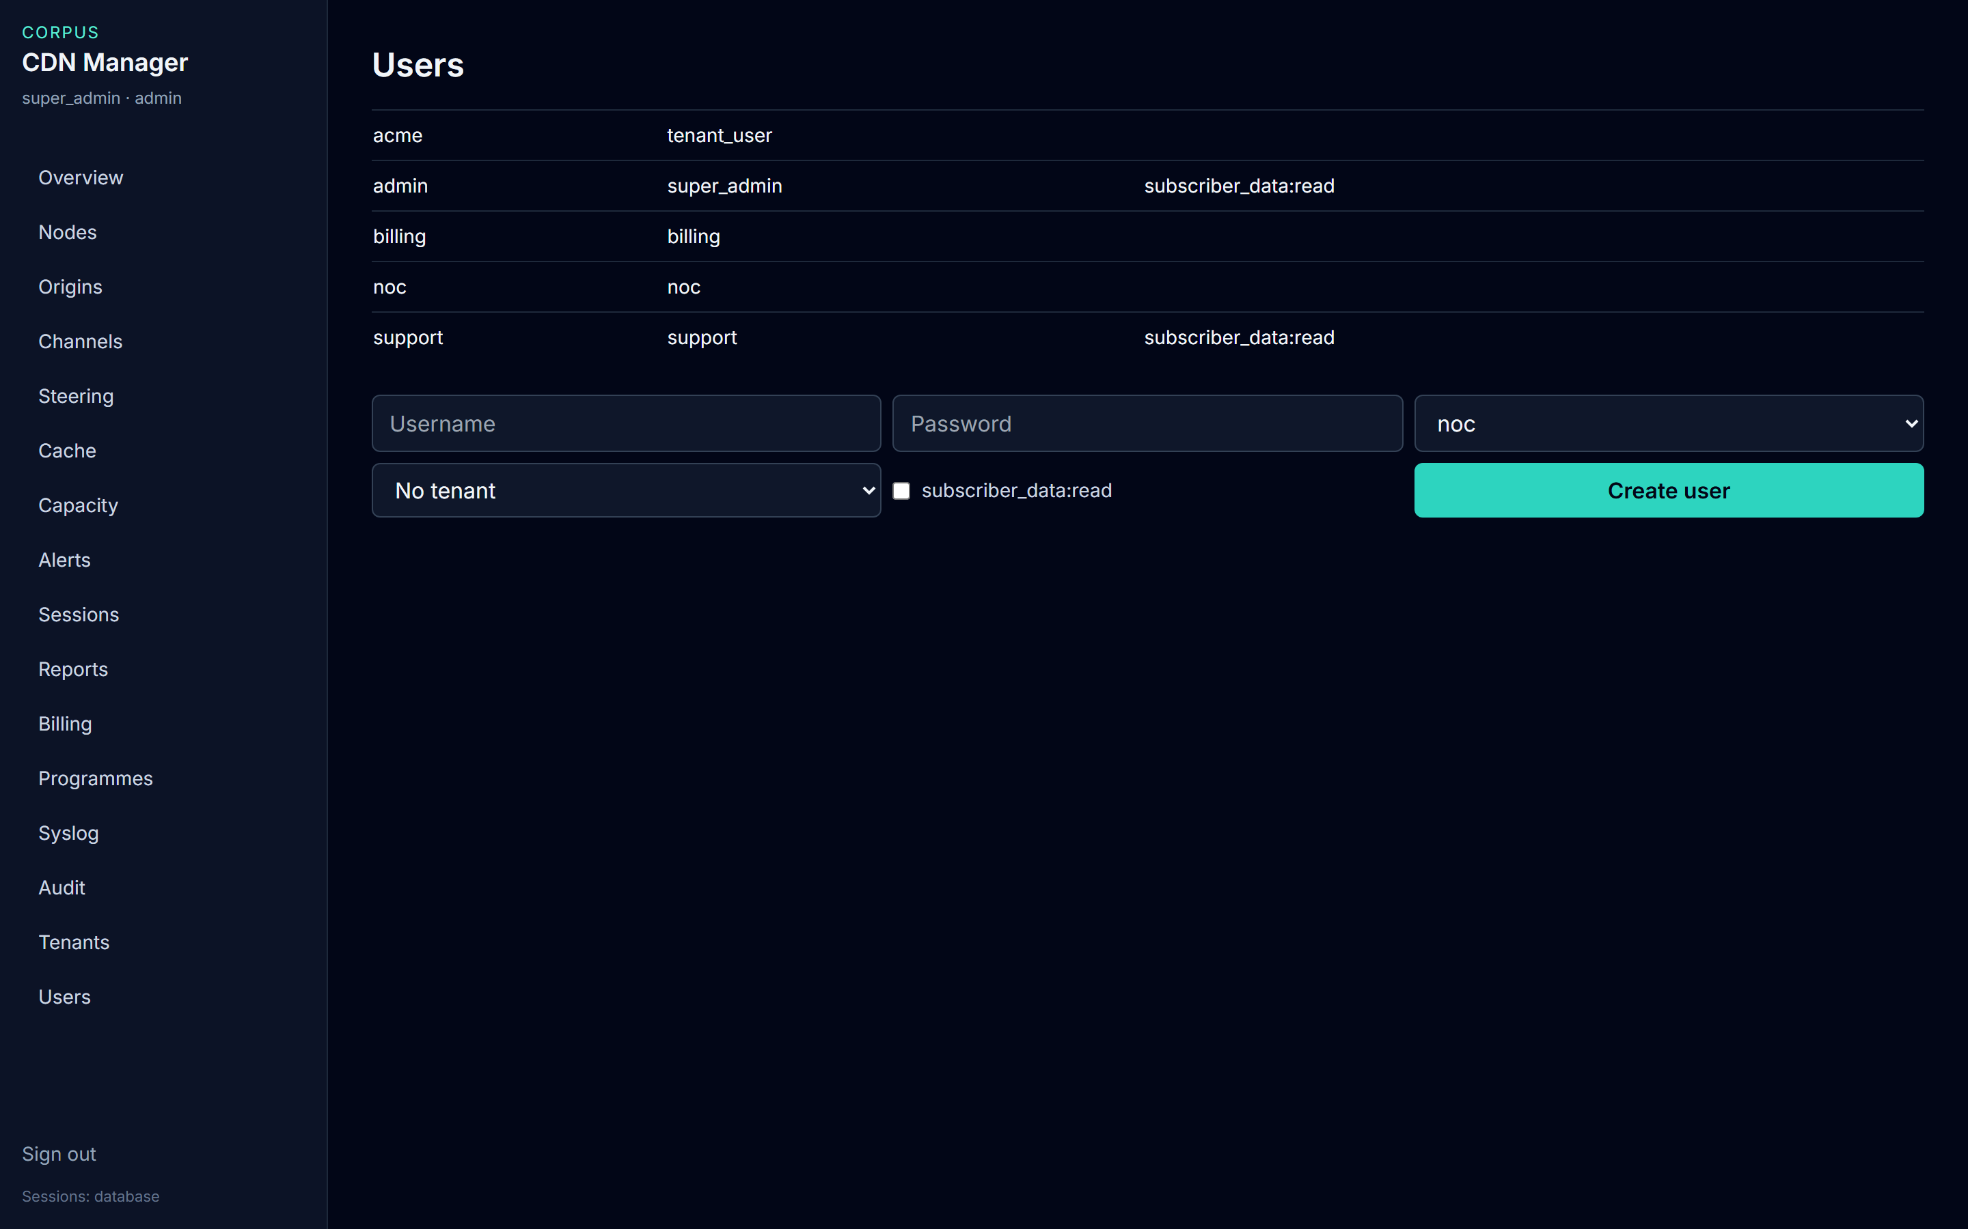
ACCESS
Two accounts may see a subscriber code
• admin and support have subscriber data read.
• noc, the ACME tenant user, and billing do not.
• Billing never sees sessions. Support never sees another franchisee.
• Only the super administrator creates accounts.
Live console · 8 October 2026
CDN Manager · Executive presentation
19

Slide 20
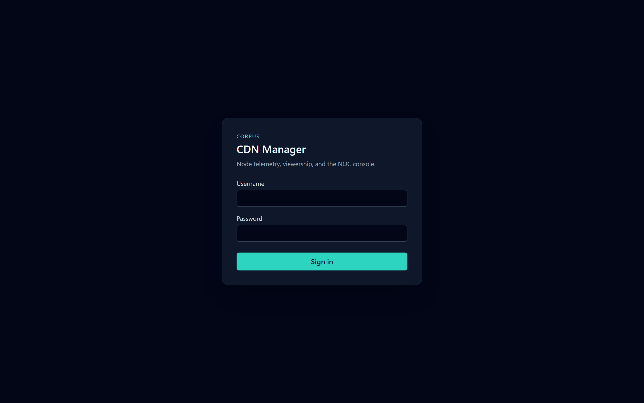
ENTRY
One sign-in for every role
• The menu hides pages the role cannot use.
• A failed password does not say whether the name exists.
• The session lasts eight hours unless the person signs out.
• Demo passwords are not part of this briefing.
Live console · 8 October 2026
CDN Manager · Executive presentation
20

Slide 21
TAKE INTO THE ROOM
• 90% hit, 90% bandwidth saved, 5.92 Gbps peak, origins fully available, edges at 66.7%.
• origin-a is active. origin-b is the spare.
• Vijayawada is the edge that needs capacity. Bengaluru is the edge that is down.
• A subscriber code appears only after Resolve, and the lookup is audited.
• Usage hours close. They are not rewritten. Syslog does not bill.
CDN Manager · Executive presentation
21

