Slide 1

Action4Diabetes
Monthly Update December

Slide 2
Today‘s Topics
Project overview
Data consistency
Database deep dive (& feedback)
Lessons learned for Laos data

Slide 3
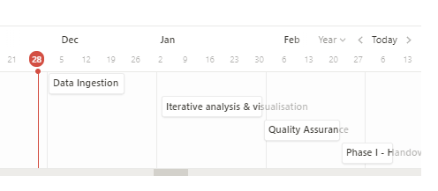
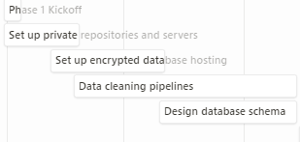
Project Overview
Done last month | Upcoming this month
Preparation for data ingestion Validation pseudonymized data | Data Ingestion
1. Setup project infrastructure | 2. Ensure encrypted database hosting | 3. Data cleaning pipelines | 4. Database schema | 5. Data ingestion | 6. Iterative Analysis & Visualisation | 7. Quality Assurance | 8. Handover
100% | 100% | 90% | 100% | 10% | 0% | 0% | 0%

Slide 4
Data consistency
Make sure that all tabs within a workbook are the same
Product section
Patient data existing
Sheets within a workbook have the same columns

Slide 5
Database Deep Dive
Overview
What are we doing?
Why?
Centralizing historical patient data in a database
Facilitate data handling & releases
Set up structure for future operationalization
Create basis for exploratory data analysis

Slide 6
Database Deep Dive
Data Dimensions
Static patient data
Date of birth
Benchmarks
…
Course of patient‘s treatment (visits)
When & where was last visit?
Latest HbA1c/Fbg values
…
Medication supply
Supply received in clinics
Supply handed out to patients
…

Slide 7
Database Deep Dive
Excel sheets
Collect & clean data
Raw, cleaned data
Aggregate information
Processed data
Align & upload to database
Data Processing
Structured data in database

Slide 8
Database Deep Dive
Simplified Database Structure - Tables
Patients
Who are our patients?
Visits
When do patients visit the clinic?
What has changed?
Clinics
Which clinics do we support?
Given products
Which products were given out?
Products
Which products are in use?

Slide 9
Database Deep Dive
Simplified Database Structure – Visit Relations
Patients
Who?
Visits
Where?
Clinics
Given products
Products

Slide 10
Database Deep Dive
Simplified Database Structure – Released Products Relation
Patients
Visits
Who?
Clinics
Where?
Given products
What?
Products

Slide 11
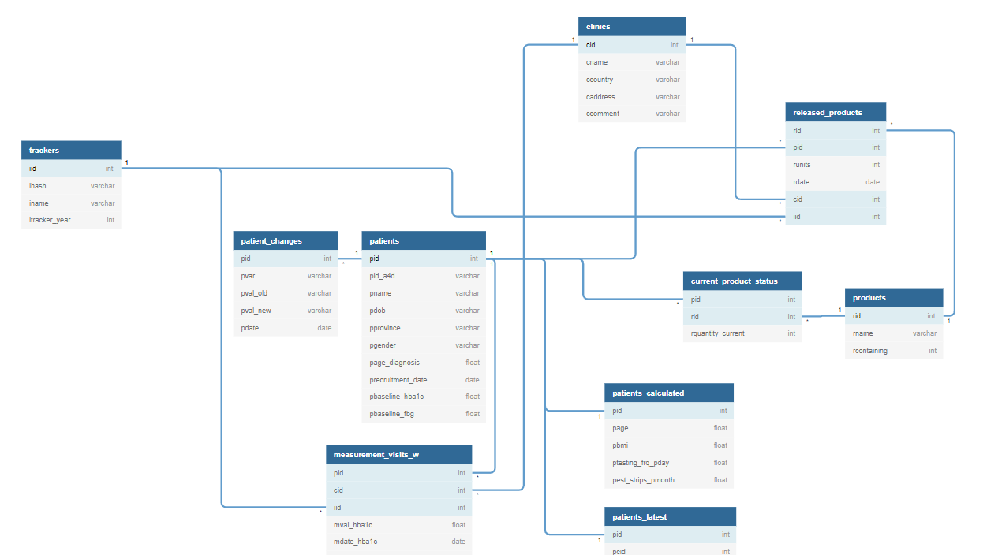

Slide 12
Database Deep Dive
Excel sheets
Collect & clean data
Raw, cleaned data
Aggregate information
Processed data
Align & upload to database
Current Status
Structure created (in SQL) – needs to be filled
Structured data in database
Applied existing pipelines to new data
Finalize data pipelines with new input
Map finalized information to database structure

Slide 13
Questions & Feedback
?…!

