Slide 1

Action4Diabetes
Monthly Update August

Slide 2
Open Topics
Outlining correct data within excel sheets
Data scoping document

Slide 3
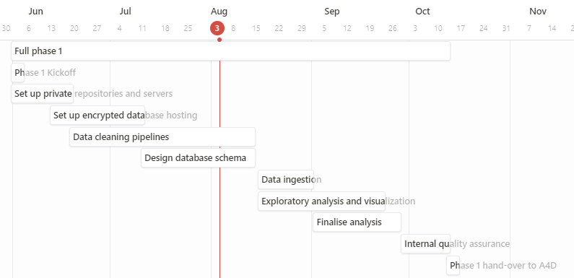
Project Overview
Done in July
Finishing basic infrastructure
Extract information from excels
Document data structure
Upcoming in August
Finalize sanity checks
Finalize database schema
Final data
1. Set up private repositories and servers | 2. Set up encrypted database hosting | 3. Data cleaning pipelines | 4. Design database schema | 5. Data ingestion | 6. Exploratory analysis and visualisation | 7. Final analysis | 8. Internal quality assurance
100% | 80% | 60% | 30% | 0% | 0% | 0% | 0%

